Slide 1
e-handout
To have these notes
without taking notes
Go to OrHaOlam.com
Click on Messages tab,
2022 Messages

Slide 2
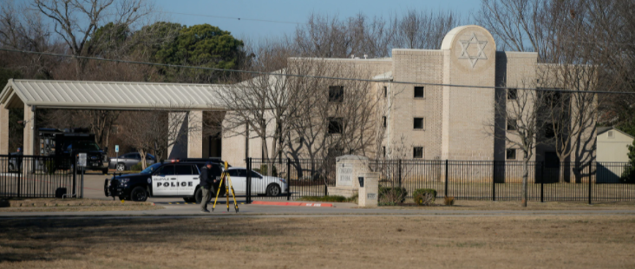
Cong. Beth Israel in Colleyville,TX
Notes:
https://nypost.com/2022/01/17/texas-rabbi-credits-security-training-for-hostage-survival/?utm_campaign=iphone_nyp&utm_source=mail_app
From Mike Boatright

Slide 3
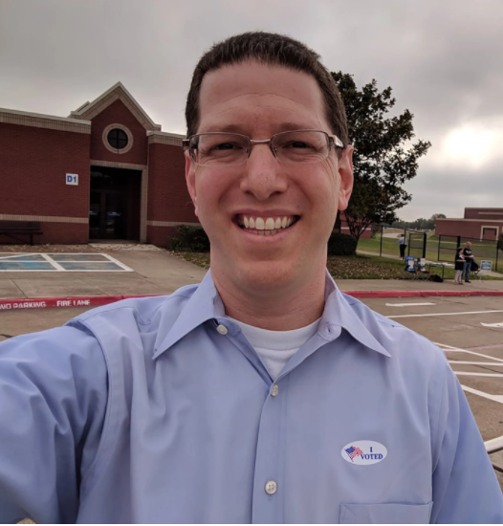
Rabbi Charlie Cytron-Walker
Notes:
https://nypost.com/2022/01/17/texas-rabbi-credits-security-training-for-hostage-survival/?utm_campaign=iphone_nyp&utm_source=mail_app
From Mike Boatright

Slide 4
The hero rabbi held hostage in his Texas synagogue has credited active-shooter training for helping him save his congregants — revealing Monday that he threw a chair at the terrorist so they could finally escape.
Notes:
https://nypost.com/2022/01/17/texas-rabbi-credits-security-training-for-hostage-survival/?utm_campaign=iphone_nyp&utm_source=mail_app
From Mike Boatright

Slide 5
The incident began when Akram entered the building as it was livestreaming a service, shouting that he had weapons and 'backpacks of explosives' on him. The hostage suspect wanted Aafia Siddiqui, a known terrorist who is incarcerated at Carswell Air Force Base near Fort Worth, freed
Notes:
https://vfinews.com/news/jan-21-2022/terrorists-brother-blames-shooters-actions-on-mental

Slide 6
In the last hour of our hostage crisis, the gunman became increasingly belligerent and threatening. When Akram “wasn’t in a good position” and Cytron-Walker and the two congregants with him were close to an exit, he told CBS, saying he made sure they “were ready to go.”
Notes:
https://nypost.com/2022/01/17/texas-rabbi-credits-security-training-for-hostage-survival/?utm_campaign=iphone_nyp&utm_source=mail_app
From Mike Boatright

Slide 7
Another man held hostage, Jeffrey R. Cohen, wrote on Facebook Monday that at one point during the siege, the gunman ordered the trio to their knees.
Instead, Cohen said, he reared up in his chair,
Notes:
https://nypost.com/2022/01/17/texas-rabbi-credits-security-training-for-hostage-survival/?utm_campaign=iphone_nyp&utm_source=mail_app
From Mike Boatright

Slide 8
slowly moving his head and mouthing “no” — with the group fleeing as Akram moved to return to his own chair.
“We escaped. We weren’t released or freed,” Cohen wrote.
Notes:
https://nypost.com/2022/01/17/texas-rabbi-credits-security-training-for-hostage-survival/?utm_campaign=iphone_nyp&utm_source=mail_app
From Mike Boatright

Slide 9
The terrorist was shot dead at around 9 pm local time (3 pm GMT) by the FBI's elite Hostage Rescue Team after holding four hostages, including the rabbi Charlie Cytron-Walker for ten hours.
Notes:
https://vfinews.com/news/jan-21-2022/terrorists-brother-blames-shooters-actions-on-mental

Slide 10
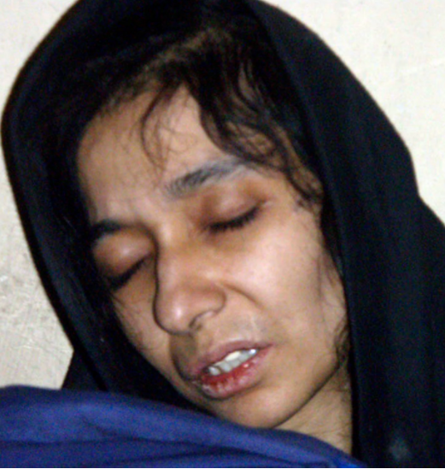
Aafia Siddiqui, 36, is a Pakistani mother of three, an alumna of MIT, and a Ph.D. in neuroscience from Brandeis University. 2008
Notes:
Siddiqui was arrested in Afghanistan in 2008 by forces who found her with cyanide and plans to attack the Brooklyn Bridge and Empire State Building and demanded jurors at her trial be DNA tested to see if they were Jewish.
https://www.dailymail.co.uk/news/article-10406483/Suspect-Texas-synagogue-hostage-situation-demanding-convicted-terrorist-sister-freed.html

Slide 11
She is also accused of working for Al-Qaeda and was charged last week in New York City with attempting to kill American soldiers.
2008 12,
Notes:
https://www.dailymail.co.uk/news/article-10406483/Suspect-Texas-synagogue-hostage-situation-demanding-convicted-terrorist-sister-freed.html

Slide 12
The Blackburn, UK, Muslim Community page announced that “Faisal Akram has sadly departed from this temporary world” and prayed that Allah “bless him with the highest ranks of Paradise.”
Notes:
http://www.danielgreenfield.org/2022/01/texas-synagogue-terrorist-came-out-of.html
Or HaOlam has had some active shooter training. We will have more. Run, hide, fight was the buzzword, but the “fight” part seems to be the one that works.

Slide 15
Outline
Meaning of covenant
History of covenant
Current active covenant
Application of covenant

Slide 16
Last time in this series Jan. 1, 2022, we talked about a greater ride than an SR-71

Slide 17
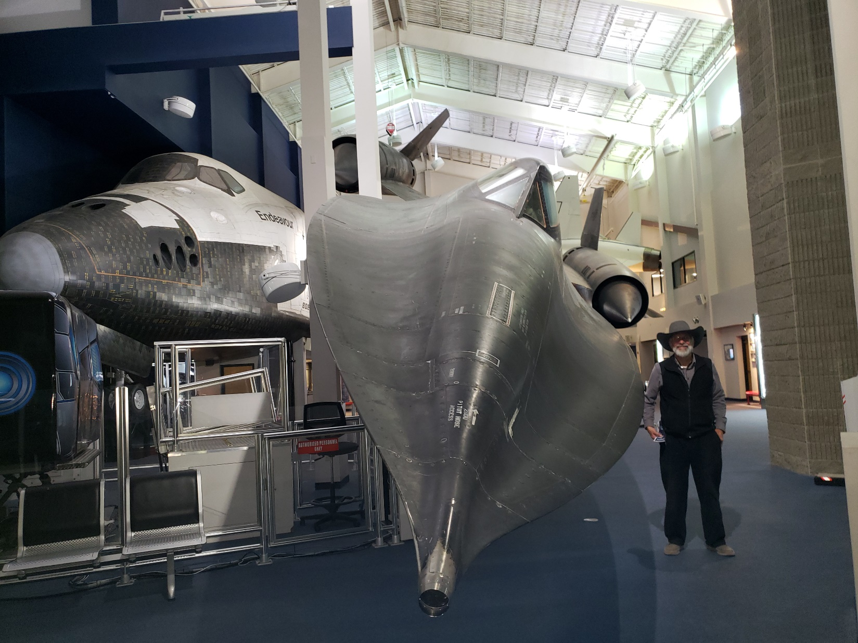
A real
SR-71
Blackbird
85,000 feet ceiling.
Mach 3+ = 2,300 mph+.
Notes:
85,000 ft = 17 miles up. Cf commercial aircraft at 7 miles. At the Hutchinson Kansas Cosmosphere.

Slide 18
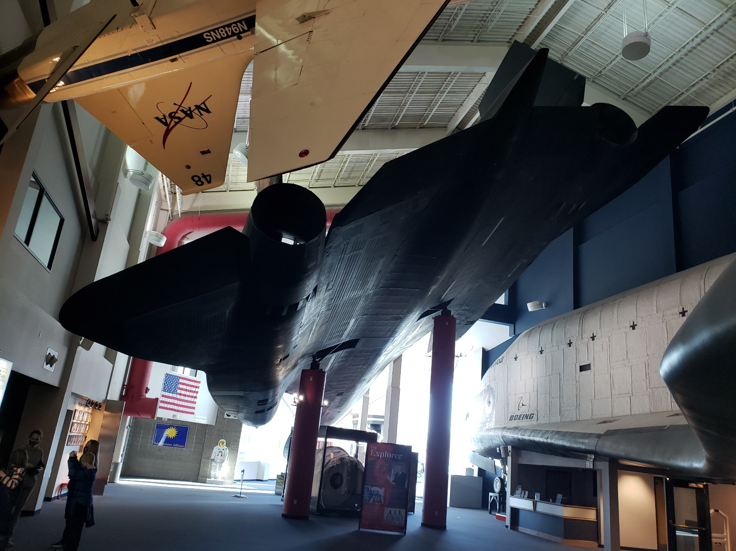

Slide 19
Last time in this series Jan. 1, 2022:
^{MJ/ Hebrews 10.12-13} After he had offered for all time a single sacrifice for sins, sat down at the right hand of God, from then on to wait until his enemies be made a footstool for his feet.
Notes:
So, Yeshua accomplished our redemption on the execution stake, then went to be seated at the right hand of the Father awaiting the Kingdom.
Next verses…

Slide 20
^{MJ 10.15-25} The Ruakh ha-Kodesh also testifies to us—[Yer. 31], “This is the covenant that I will cut with them: ‘After those days,’ says Adoni, ‘I will put My Torah upon their hearts, and upon their minds I will write it,’” then He says, “I will remember their sins and their lawless deeds no more.”…
Notes:
Might seem to be a disjointed transition in the scripture, but here is the connection:
Yeshua seated at the right hand of the Father, working priestly intercession to establish His covenant, His kingdom, in the world of people, of men and women like you and me!!
Covenant is a big concept in the mind of G-d.

Slide 21
Not just passively waiting. 2000 years Interceding, pouring out Ruakh/Spirit, appointing emissaries, prophets, proclaimers of the Good News, shepherds and teachers, ruling over the affairs of men to bring to salvation, We are invited to “seek those thing above, where Messiah is at the right hand of G-d, establishing His covenant…

Slide 22
Entering into His right hand warfare, I compared to the ravishing and ecstatic SR-71 which I saw at the Kansas Cosmosphere. Last Teerosh we prayed the Kaddish antiphonally. It’s a prayer of kingdom warfare. This Tues, the Shma שמע! Prayer is like a jet trip!!

Slide 23
Notes:
Goal of Yeshua’s work 2000 years seated at the right hand of the Father.

Slide 24
Outline
Meaning of covenant
History of covenant
Current active covenant
Application of covenant

Slide 25
Covenant is a central concept in the mind of G-d
relative to humanity.

Slide 26
בְּרִית Brit [breet]
treaty, alliance, pact, league:
constitution, ordinance, between monarch and subjects
Notes:
Two definitions correspond to two types of covenants in scripture…

Slide 27
There are two major types of covenants in the Hebrew Bible
The obligatory covenant deals with the relationship between two parties of equal standing. Example of alliance:
Notes:
https://en.wikipedia.org/wiki/Covenant_(biblical)

Slide 28
^{Beresheet/Gen.14.11-13} So they took all of Sodom and Gomorrah’s possessions and their food and left. They also took Lot, Abram’s nephew, and his possessions, and they left. Then a survivor came and told Abram the Hebrew,

Slide 29
^{Beresheet/Gen.14.11-13} who was dwelling by the large trees belonging to Mamre the Amorite, the brother of Eschol and the brother of Aner— they were Abram’s allies.
Notes:
Covenant among equals, allies.

Slide 30
Promissory covenants focus on the relationship between the suzerain and the vassal and are similar to the "royal grant" type of legal document, which include historical introduction, border delineations, stipulations, witnesses, blessings, and curses.
Notes:
https://en.wikipedia.org/wiki/Covenant_(biblical)
FFOZ: Suzerainty covenants

Slide 31
In royal grants, the master could reward a servant for being loyal. God rewarded Abraham, Noah, and David in his covenants with them. As part of his covenant with Abraham, God has the obligation to keep Abraham's descendants as God's chosen people and be their God.
Notes:
https://en.wikipedia.org/wiki/Covenant_(biblical)

Slide 32
God acts as the suzerain power and is the party of the covenant accompanied by the required action that comes with the oath whether it be fire or animals in the sacrificial oaths. In doing this, God is the party taking upon the curse if he does not uphold his obligation.
Notes:
https://en.wikipedia.org/wiki/Covenant_(biblical)

Slide 33
Covenant is a word of passion with the Father and Yeshua.
Modern Hebrew usage:

Slide 34
Notes:
Reuben Alcalay’s Complete Hebrew English Dictionary

Slide 35
Notes:
Reuben Alcalay’s Complete Hebrew English Dictionary
Review that verse in MJ/Hebrews…

Slide 36
^{MJ 10.15-25} The Ruakh ha-Kodesh also testifies to us—[Yer. 31], “This is the covenant that I will cut with them: ‘After those days,’ says Adoni, ‘I will put My Torah upon their hearts, and upon their minds I will write it,’” then He says, “I will remember their sins and their lawless deeds no more.”…
Notes:
He gives us some particular covenant establishing instructions.

Slide 37
^{MJ 10.23-25} … Let us hold fast the unwavering confession of hope, for He who promised is faithful. And let us consider how to stir up one another to love and good deeds. And do not neglect our own meetings, as is the habit of some, but encourage one another—and all the more so as you see the Day approaching.
Notes:
But first [as Ben Shapiro says] lets get a historical context for covenant…

Slide 39
Outline
Meaning of covenant
History of covenant
Current active covenant
Application of covenant

Slide 40
Consider G-d’s covenantal connection with humanity since the beginning.
Notes:
All been passionate expressions of G-d’s relational love for humanity, for us.

Slide 41
Name: | Edenic, before the Fall
Verses | Ber / Gen Ch 1-3
Provisions | Garden eternally
Type | Conditional
Response | Works / obedience
Sign | Tree of Life?
Participants | all humanity potentially
1.
Notes:
Salvation by works, eternal life there in the Garden. The only time humanity really could be saved by works.
G-d LOVES covenant relationships. ^{Ber 3.8-9} They heard the voice of Adoni God, אֶת-קוֹל יְי אֱלֹהִים walking in the garden at the time of the evening breeze,
This was Yeshua, visiting with them.

Slide 42
Targum Jonathan [Aramaic]:
וּשְׁמָעוּ יַת קַל מֵימְרָא דַיְיָ אֱלהִים מְטַיֵיל
^{Beresheet/ Gen 3.8} And they heard the voice of the Word of the Lord God walking
Notes:
https://www.sefaria.org/Targum_Jonathan_on_Genesis.3.8?lang=bi&with=all&lang2=en

Slide 43
Name: | Adamic, after the Fall
Verses | Ber / Gen 3.1-9
Provisions | Salvation
Type | Conditional
Response | Faith in future Descendent
Sign | Skins, childbirth issues
Participants | all humanity potentially
2.
Notes:
G-d LOVES covenant relationships.
^{Ber/Gen 3.9} Adoni God, called to the man, “Where are you?”
This was Yeshua, seeking them out.
Promise of eternal salvation
^{Ber 3.15,21} I will put animosity between you and the woman, and between your descendant and her descendant; he will bruise your head, and you will bruise his heel.”… Adonai, God, made garments of skin for Adam and his wife and clothed them.

Slide 44
Name: | Noakhic [Noah]
Verses | Ber / Gen 8.20-9.13
Provisions | Seasons, no flood
Type | Unconditional
Response | Capital punishment
Sign | rainbow
Participants | all humanity
3.
Notes:
Physical salvation
^{Ber. 6.5-6} Then Adoni saw that the wickedness of humankind was great on the earth, and that every inclination of the thoughts of their heart was only evil all the time. So Adoni regretted that He made humankind on the earth, and His heart was deeply pained. וַיִּתְעַצֵּב אֶל-לִבּוֹ. to be sad, to be sorry, [reflexive verb]
^{Gen 6.17-18} “Then I myself will bring the flood of water over the earth to destroy from under heaven every living thing that breathes; everything on earth will be destroyed. But I will establish my covenant with you; you will come into the ark, you, your sons, your wife and your sons’ wives with you.

Slide 45
^{Ber/Gen 9.12-16} God added, “Here is the sign of the covenant I am making between myself and you and every living creature with you, for all generations to come: I am putting my rainbow in the cloud — it will be there as a sign of the covenant between myself and the earth.

Slide 46
^{Ber/Gen 9.12-16} Whenever I bring clouds over the earth, and the rainbow is seen in the cloud; I will remember my covenant which is between myself and you and every living creature of any kind; and the water will never again become a flood to destroy all living beings.

Slide 47
^{Ber/Gen 9.12-16} The rainbow will be in the cloud; so that when I look at it, I will remember the everlasting covenant between God and every living creature of any kind on the earth.”

Slide 48
Name: | Avrahamic
Verses | Ber / Gen 12, 15, 17
Provisions | Blessings and curses, Land
Type | Unconditional
Response | Avraham’s obedience
Sign | Circumcision
Participants | Avraham’s descendents
4.
Notes:
Abrahamic covenant is NOT salvation. It’s blessings and the LAND. No one is eternally saved by virtue of being born Jewish.
Abe saved by faith in Gen 15.5-6, Then he brought him outside and said, “Look up at the sky, and count the stars — if you can count them! Your descendants will be that many!” He believed in Adonai, and he credited it to him as righteousness.
Abe covenant in Gen 12

Slide 49
Name: | Mosaic
Verses | Shmot/Ex 19-Dvarim/Dt
Provisions | Blessings, head of nations
Type | Conditional
Response | obedience
Sign | Shabbat Shmot/Ex 31.13
Participants | People of Israel
5.
Notes:
^{Shmot/Ex 19.5-6} Now if you will pay careful attention to what I say and keep my covenant, then you will be my own treasure from among all the peoples, for all the earth is mine; and you will be a kingdom of cohanim for me, a nation set apart.’ These are the words you are to speak to the people of Isra’el.”
This has a means of salvation, but we Jews failed it. Based around the beauty of the Torah
Actually two means of salvation: faith Dt. 30.11 quoted by Paul
Works in Lev 18.5 quoted by Paul.

Slide 50
^{Tehillim 1.1-3} Happy is the one who…his delight is in the Torah of Adoni, and on His Torah he meditates day and night. He will be like a planted tree over streams of water, producing its fruit during its season. Its leaf never droops— but in all he does, he succeeds.

Slide 51
Name: | Moavi / Moabite
Verses | Dvarim/Dt 29-30
Provisions | Regathering / Return to Land
Type | conditional
Response | repentance
Sign | May 14, 1948 Hatikvah
Participants | People of Israel
6.
Notes:
This one often gets overlooked. Marilyn Griffin’s insight^{. Dt 28.69/29.1} These are the words of the covenant which ADONI ordered Moshe to make with the people of Isra'el in the land of Mo'av, in addition to the covenant which he made with them in Horev 30.3 [after exile] At that point, ADONI your God will reverse your exile and show you mercy; he will return and gather you from all the peoples to which ADONI your God scattered you

Slide 52
Name: | Davidic
Verses | 2 Shmuel 7.8-17
Provisions | Everlasting Kingdom
Type | Conditional
Response | Kings keep Torah
Sign | Two comings of Messiah
Participants | Israel, and all nations
7.
Notes:
The covenant G-d made with David was for an everlasting dynasty. But David got saved by faith in G-d's redemption, as described at length in Ro 4.6-8 quoting Ps 32. The kingly covenant did not save David eternally.

Slide 53
Name: | Renewed
Verses | Yermiyahu/Jer 31.31-34
Provisions | Torah in our hearts
Type | Conditional
Response | Faith
Sign | Seder of Messiah [communion]
Participants | Israel & Judah, grafted
8.
Notes:
God made two UNCONDITIONAL choices: salvation information through Jews, salvation fact through Yeshua.

Slide 55
Outline
Meaning of covenant
History of covenant
Current active covenant
Application of covenant

Slide 56
^{Yeshayahu/Is 42.6} “I, Adoni, called You in righteousness, I will take hold of Your hand, I will keep You and give You as a covenant to the people, as a light to the nations,

Slide 57
^{Yeshayahu/Is 59.20-21} “Then a Redeemer will come to Tziyon, to those in Ya‘akov who turn from rebellion.” So says Adoni. “And as for me,” says Adoni, “this is my covenant with them: my Spirit, who rests on you,

Slide 58
^{Yeshayahu/Is 59.20-21} and my words which I put in your mouth will not depart from your mouth or from the mouth of your children, or from the mouth of your children’s children, now or ever,” says Adoni.

Slide 59
^{Yer /Jer 33.19-21} This word of Adonai came to Yirmeyahu: Here is what Adoni says: ‘If you can break my covenant with the day and my covenant with the night, so that daytime and nighttime no longer come when they are supposed to,

Slide 60
^{Yer /Jer 33.19-21} then my covenant with my servant David also can be broken, so that he will not have a descendant to reign from his throne or L’vi’im who are Cohanim to minister to me.

Slide 61
^{Yer/Jer 50.4-6} In those days, at that time,” says Adoni, “the people of Isra’el will come, together with the people of Y’hudah. They will weep as they go their way, seeking Adoni their God. They will ask the way to Tziyon;

Slide 62
^{Yer/Jer 50.4-6} and, turning their faces toward it, will say, ‘Come, join yourselves to Adoni by an everlasting covenant never to be forgotten.’ My people have been lost sheep.

Slide 63
^{Yekhez/Ezek 34.25-27} I will make a covenant of peace with them; I will rid the land of wild animals; and they will live securely in the desert and sleep in the forests. I will make them and the places around my hill a blessing,

Slide 64
^{Yekhez/Ezek 34.25-27} and I will cause the rain to fall when it should — there will be showers of blessing. The trees in the field will bear their fruit and the soil its produce, and they will be secure in their land. Then they will know that I am Adoni.

Slide 65
HaYovel young men, April 27, 2018 told us about Yaakov Berg. Lived in Tel Aviv and secular, but read Jer 31.5…
Once again, you will plant vineyards on the hills of Shomron, and those doing the planting will have the use of its fruit.
Notes:
Note: vineyards on the hills of Samaria/Shmron = West Bank

Slide 66
His Dad liberated Shomron area in the Six Day War.
1990s lab said soil was no good for grapevines. Planted anyway and lab said astonishing. Forgot dew...now wines winning Au Ag international competition.

Slide 67
^{Joel 2 21-24} Don’t fear, O soil; be glad! rejoice! for Adoni has done great things. Don’t be afraid, wild animals; for the desert pastures are green, the trees are putting out their fruit, the fig tree and vine are giving full yield. Be glad, people of Tziyon!
Notes:
https://www.google.com/amp/s/m.jpost.com/Israel-News/Rare-Byzantine-era-wine-seeds-found-in-Negev-390735/amp

Slide 68
^{Joel 2 21-24} Rejoice in Adoni your God! For he is giving you the right amount of rain in the fall, he makes the rain come down for you, the fall and spring rains — this is what he does first. Then the floors will be full of grain and the vats overflow with wine and olive oil.
Vats overflowed and stop picking.

Slide 69
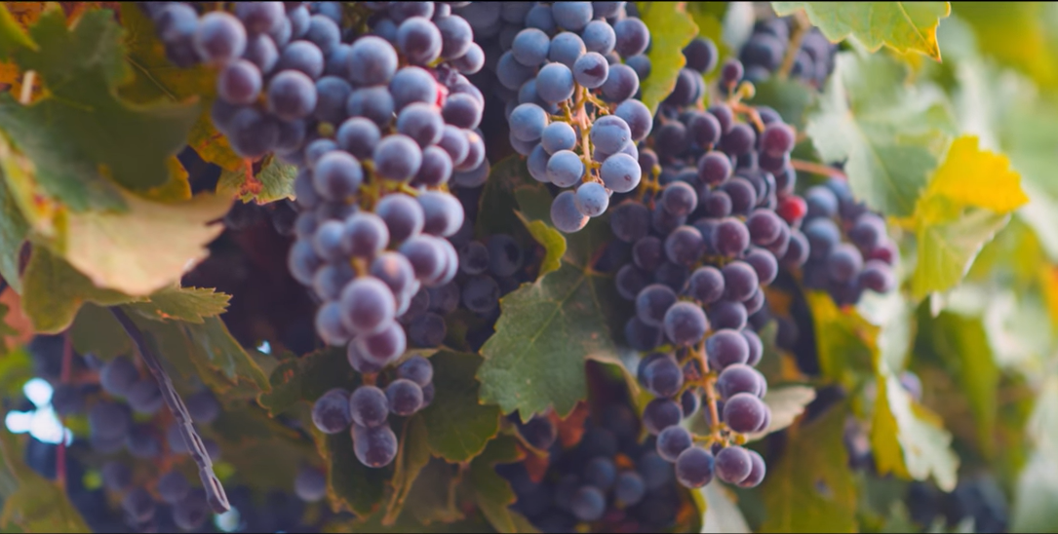
Vineyards of Israel
Notes:
https://youtu.be/9yBr2cLVi-s

Slide 71
Outline
Meaning of covenant
History of covenant
Current active covenant
Application of covenant

Slide 72
^{MJ 10.23-25} … Let us hold fast the unwavering confession of hope, for He who promised is faithful. And let us consider how to stir up one another to love and good deeds. And do not neglect our own meetings, as is the habit of some, but encourage one another—and all the more so as you see the Day approaching.
Notes:
But first [as Ben Shapiro says] lets get a context for covenant…

Slide 73
Hold fast, despite opposition.
When Israel was being re-populated by the Halutzim/pioneers, according to David ben Gurion, 9 of 10 left.
Marriage is a covenant
We are developing a Marriage Enrichment ministry
Notes:
Left in despair, despite all these promises. White knuckle

Slide 74
Consider one another!!
Assembly…livestream is great, but not ideal. If remote, Zoom groups.
Above all, look to Him, “He who promised is faithful.” He keeps covenant!
Notes:
Consider: not to criticize, but how can I help, bless, enrich, pray! Look left, right, front, back.

Slide 76
^{2 Chron. 36.21} He exiled to Babylon those who had escaped the sword and they became slaves to him and his sons until the reign of the kingdom of Persia— ²¹ in fulfillment of the word of Adonai by the mouth of Jeremiah, until the land had paid back her Shabbat rests—for as long as it lay desolate—the Shabbat rest was kept till 70 years were complete.

Slide 77
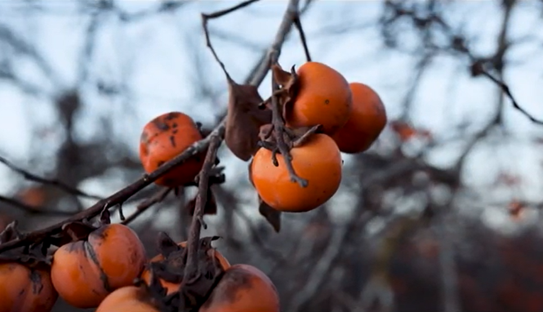
Shmittah שמיטה
Year of Release
Notes:
https://youtu.be/oapFzSmUo4k to 4.01 Shmittah Israel Pochtar

Slide 78
^{MJ 10.15-25} Therefore, brothers and sisters, we have boldness to enter into the Holies by the blood of Yeshua. He inaugurated a new and living way for us through the curtain—that is, His flesh. We also have a Kohen Gadol over God’s household. So let us draw near with a true heart in full assurance of faith, with hearts sprinkled clean from an evil conscience and body washed with pure water.

Slide 79
Do you KNOW Yeshua and the assurance of sins forgiven?
Are you hearing daily from His Word?
How are you applying what you heard?
Are you asking this of another?
Notes:
Who are you discipling, building up?4

Slide 80
Way Maker Miracle Worker
Promise Keeper
Light in the darkness
My God That is who You are
Hebrew understanding:

Slide 81
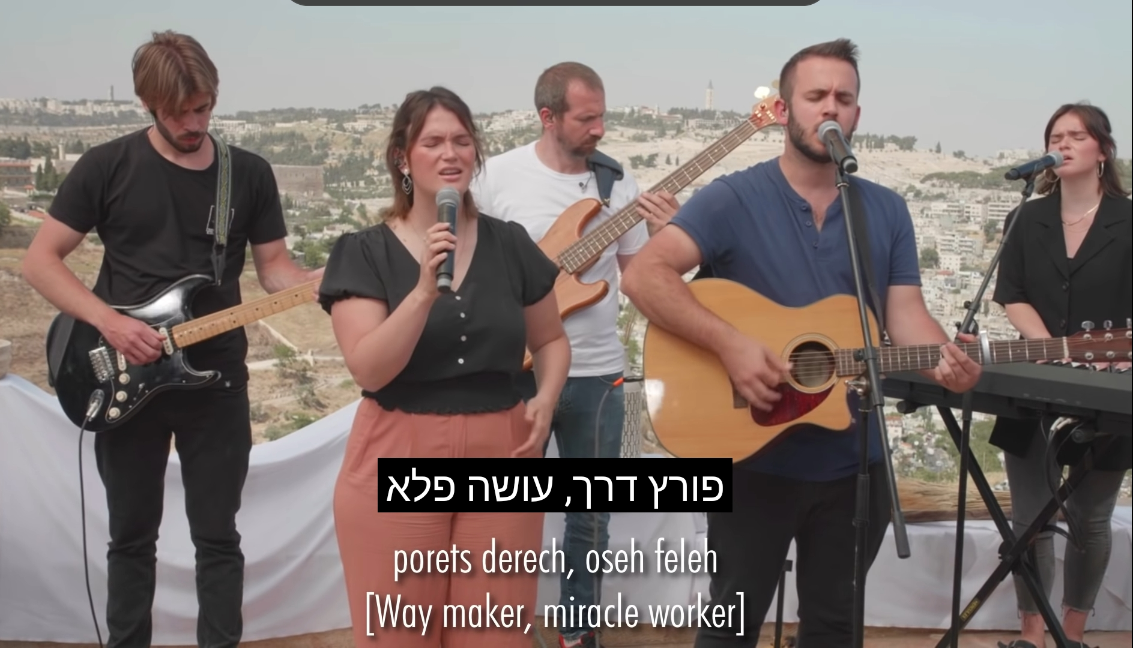
Waymaker Miracle Worker

Slide 82
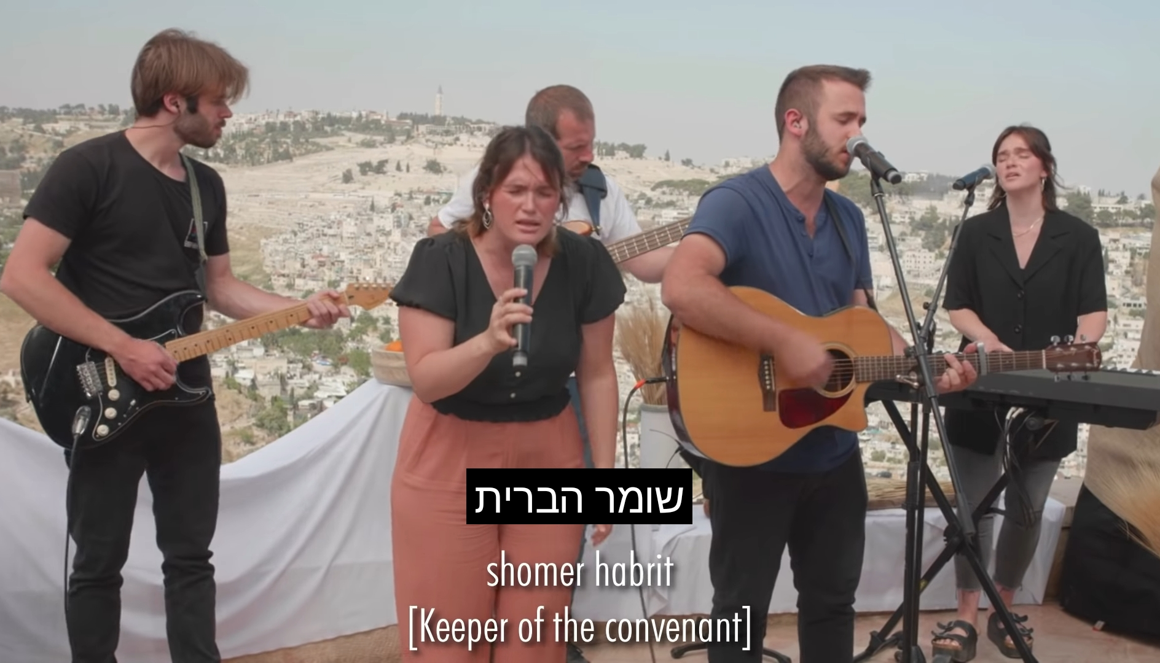
Promise Keeper

Slide 83
Light in the darkness

Slide 84
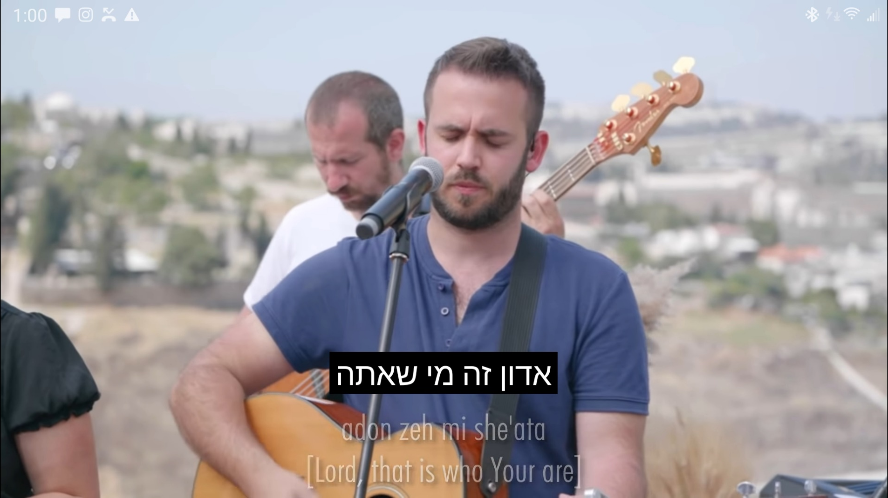
My God That is who You are
Notes:
He is the covenant keeper! Promises to you!
We need to be covenant keepers!

Slide 85
