Slide 1
e-handout
To have these notes
without taking notes
Go to OrHaOlam.com
Click on Messages tab,
2022 Messages

Slide 2
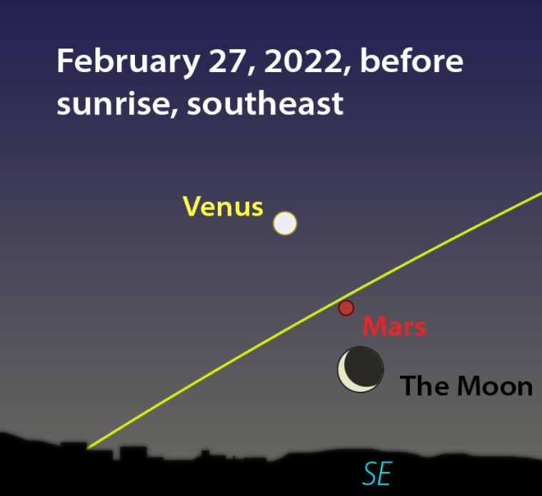
Notes:
https://www.theepochtimes.com/morning-star-venus-to-shine-its-brightest-tomorrow-morn-with-mars-mercury-moon-and-more-in-february_4263770.html?utm_source=newsnoe&utm_campaign=breaking-2022-02-09-1&utm_medium=email&est=ZIXeucrI42g3q0fbk67ygIS6OZ57DqRP051DdRxXw%2BL3j%2Bo7UcsJwdtmxSstreklpw%3D%3D
Happy Birthday candle stick to our 2nd born Daniel

Slide 3
Viewed from Earth, the moon, Venus, and Mars almost line up
Notes:
https://www.theplanetstoday.com/index.html

Slide 4
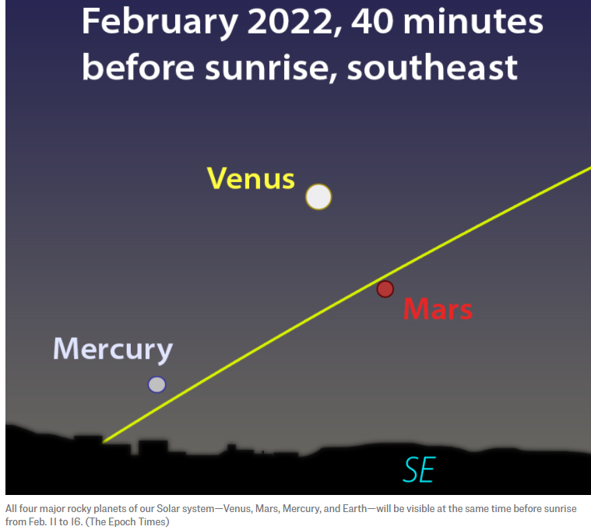
Notes:
https://www.theepochtimes.com/morning-star-venus-to-shine-its-brightest-tomorrow-morn-with-mars-mercury-moon-and-more-in-february_4263770.html?utm_source=newsnoe&utm_campaign=breaking-2022-02-09-1&utm_medium=email&est=ZIXeucrI42g3q0fbk67ygIS6OZ57DqRP051DdRxXw%2BL3j%2Bo7UcsJwdtmxSstreklpw%3D%3D

Slide 5
^{T’hillim /Ps 19. 2-4} The heavens declare the glory of God, the dome of the sky speaks the work of his hands. Every day it utters speech, every night it reveals knowledge.

Slide 6
^{T’hillim /Ps 19. 2-4} Without speech, without a word, without their voices being heard, their line goes out through all the earth and their words to the end of the world.

Slide 8
Last Shabbat: MJ 10:24-31 Covenant and Catastrophe
Vs 24-25 Covenant Community
Vs 26-31 Covenant Catastrophe
Notes:
After discussion of the 8th Covenant, the New Covenant, our great Cohen Gadol, High Priest, Yeshua the Messiah, and our access to the Holy of Holies, it discusses community and catastrophe.
Community is the positive application of the 8th, the new covenant.
Then it discusses catastrophe, judgement.
Catastrophe and Judgment is the negative application of the 8th, the new covenant.

Slide 9
We, as a culture, America and all the world, have rejected the Covenantal understanding of life.
So we face catastrophe.
Is there a remedy?
Notes:
Believers are punished or blessed with the judgment on the culture.

Slide 11
Reckless First Love
Vss 32-34 Current Culture of catastrophe
Vss 35-39 Confidence

Slide 12
^{Hebrews/MJ 10.32-35} But remember the earlier days, when, after you had received the light, you endured a hard struggle with sufferings. Sometimes you were publicly disgraced and persecuted, while at other times you stood loyally by those who were treated this way. For you shared the sufferings of those who had been put in prison.

Slide 13
^{MJ 10.32-34} Also when your possessions were seized, you accepted it gladly; since you knew that what you possessed was better and would last forever.

Slide 14
^{MJ 10.35} So don’t throw away that courage of yours, which carries with it such a great reward.

Slide 15
^{MJ 10.35-39} For you need to hold out; so that, by having done what God wills, you may receive what he has promised. For “There is so, so little time! The One coming will indeed come, he will not delay. But the person who is righteous

Slide 16
^{MJ 10.35-39} will live his life by trusting, and if he shrinks back, I will not be pleased with him.” However, we are not the kind who shrink back and are destroyed; on the contrary, we keep trusting and thus preserve our lives!

Slide 18
Reckless First Love
Vss 32-34 Current Cultural catastrophe
Vss 35-39 Confidence

Slide 20
from NextDoor.com
my neighborhood community news, Wed. Feb 9…
Notes:
Great place to promote Yeshua and the congregation.

Slide 21
I witnessed a woman walking out of Marshall’s at Antioch and Johnson Dr. today with an armload of clothing…. I was walking in, as she was walking out and noticed she had all these clothes in her arms with the hangers still on them and thought it was odd.
Notes:
https://nextdoor.com/p/CgW9FL3N9Kb9?post=216866303&utm_source=email&is=tpe&section=post&mar=true&ct=X4y2KvzeqRC1uCdkkQ58wX7irro42PEghyTdCif1hmHaE26WF9fBnrnWtiMRx7Di&ec=OWKiQRDj9vEHAYwTV6YMARldwuFdgGkeefhwfGYAE0s%3D&mobile_deeplink_data=eyJhY3Rpb24iOiAidmlld19wb3N0IiwgInBvc3QiOiAyMTY4NjYzMDN9&link_source_user_id=5998874

Slide 22
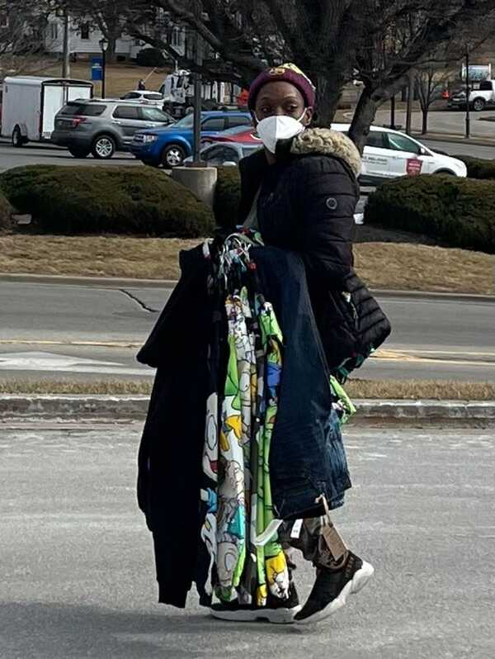
Notes:
https://nextdoor.com/p/CgW9FL3N9Kb9?post=216866303&utm_source=email&is=tpe&section=post&mar=true&ct=X4y2KvzeqRC1uCdkkQ58wX7irro42PEghyTdCif1hmHaE26WF9fBnrnWtiMRx7Di&ec=OWKiQRDj9vEHAYwTV6YMARldwuFdgGkeefhwfGYAE0s%3D&mobile_deeplink_data=eyJhY3Rpb24iOiAidmlld19wb3N0IiwgInBvc3QiOiAyMTY4NjYzMDN9&link_source_user_id=5998874

Slide 23
My brain wasn’t processing that she was stealing, till I was in the door and all these people were standing there with their mouths open watching…… Just standing there..
Notes:
https://nextdoor.com/p/CgW9FL3N9Kb9?post=216866303&utm_source=email&is=tpe&section=post&mar=true&ct=X4y2KvzeqRC1uCdkkQ58wX7irro42PEghyTdCif1hmHaE26WF9fBnrnWtiMRx7Di&ec=OWKiQRDj9vEHAYwTV6YMARldwuFdgGkeefhwfGYAE0s%3D&mobile_deeplink_data=eyJhY3Rpb24iOiAidmlld19wb3N0IiwgInBvc3QiOiAyMTY4NjYzMDN9&link_source_user_id=5998874

Slide 24
NO one was doing anything about it…. I was like “Oh Hell no” and ran after her. She just kept walking. A man stepped between us, obviously someone she knew. He was probably in his 60’s helping this woman.
Notes:
Was that right, to do nothing??
Cf 9/11 Hijackers…first three planes, till flight 93
Cf Rabbi in Colleyville, TX Jan 17, 2022
https://nextdoor.com/p/CgW9FL3N9Kb9?post=216866303&utm_source=email&is=tpe&section=post&mar=true&ct=X4y2KvzeqRC1uCdkkQ58wX7irro42PEghyTdCif1hmHaE26WF9fBnrnWtiMRx7Di&ec=OWKiQRDj9vEHAYwTV6YMARldwuFdgGkeefhwfGYAE0s%3D&mobile_deeplink_data=eyJhY3Rpb24iOiAidmlld19wb3N0IiwgInBvc3QiOiAyMTY4NjYzMDN9&link_source_user_id=5998874

Slide 25
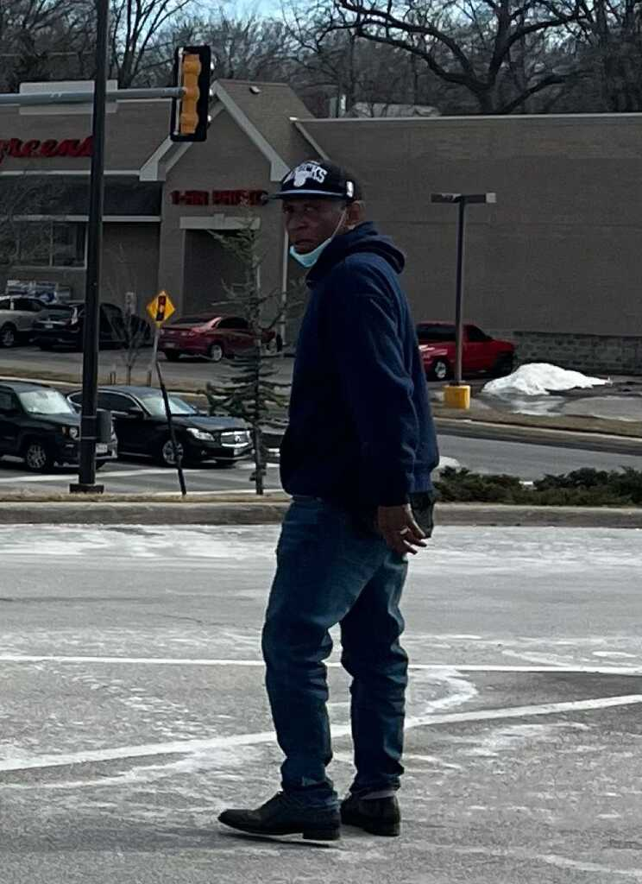
Notes:
https://nextdoor.com/p/CgW9FL3N9Kb9?post=216866303&utm_source=email&is=tpe&section=post&mar=true&ct=X4y2KvzeqRC1uCdkkQ58wX7irro42PEghyTdCif1hmHaE26WF9fBnrnWtiMRx7Di&ec=OWKiQRDj9vEHAYwTV6YMARldwuFdgGkeefhwfGYAE0s%3D&mobile_deeplink_data=eyJhY3Rpb24iOiAidmlld19wb3N0IiwgInBvc3QiOiAyMTY4NjYzMDN9&link_source_user_id=5998874

Slide 26
He left and another woman showed up. They wandered around the parking lot with me following taking their picture and finally jumped in their car and took off.
Notes:
https://nextdoor.com/p/CgW9FL3N9Kb9?post=216866303&utm_source=email&is=tpe&section=post&mar=true&ct=X4y2KvzeqRC1uCdkkQ58wX7irro42PEghyTdCif1hmHaE26WF9fBnrnWtiMRx7Di&ec=OWKiQRDj9vEHAYwTV6YMARldwuFdgGkeefhwfGYAE0s%3D&mobile_deeplink_data=eyJhY3Rpb24iOiAidmlld19wb3N0IiwgInBvc3QiOiAyMTY4NjYzMDN9&link_source_user_id=5998874

Slide 27
I have pictures of them and also have pictures of the car and plates. Women in Marshall’s says it’s been happening at least once a week and no one is doing anything… Police don’t seem very interested either. I guess it’s just becoming a way of life now. Even in the middle of the country…. This is not good…. What is going to have to happen before this type of behavior is punished.
Notes:
We’re NOT in San Francisco or Seattle. This is the calm, godly heartland.
https://nextdoor.com/p/CgW9FL3N9Kb9?post=216866303&utm_source=email&is=tpe&section=post&mar=true&ct=X4y2KvzeqRC1uCdkkQ58wX7irro42PEghyTdCif1hmHaE26WF9fBnrnWtiMRx7Di&ec=OWKiQRDj9vEHAYwTV6YMARldwuFdgGkeefhwfGYAE0s%3D&mobile_deeplink_data=eyJhY3Rpb24iOiAidmlld19wb3N0IiwgInBvc3QiOiAyMTY4NjYzMDN9&link_source_user_id=5998874

Slide 28
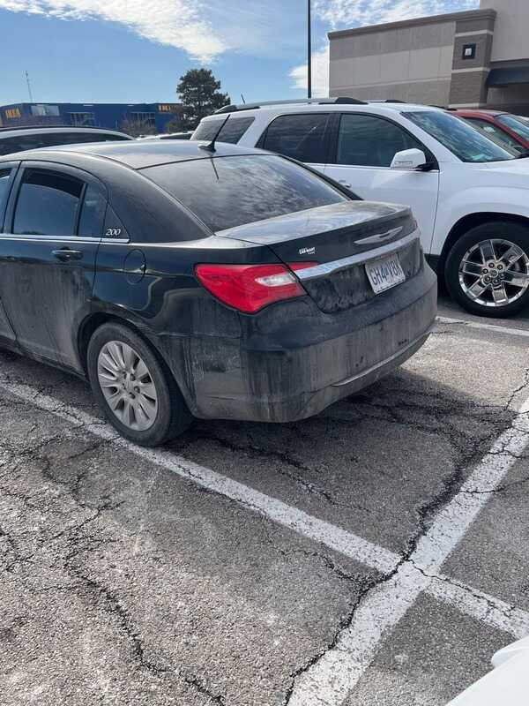

Slide 29
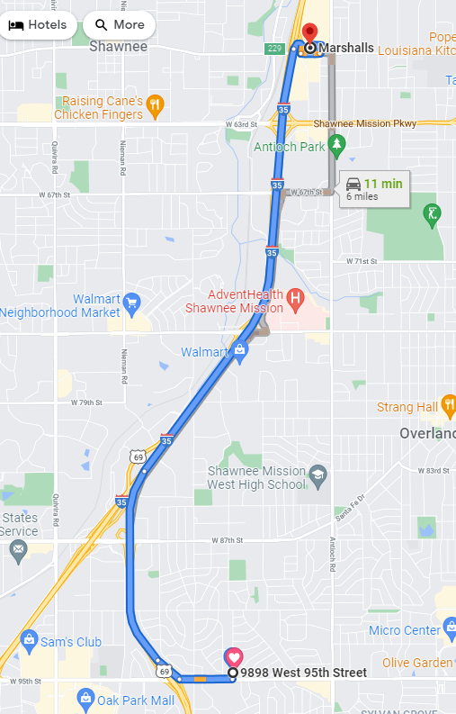
9 min (5.9 miles)

Slide 30
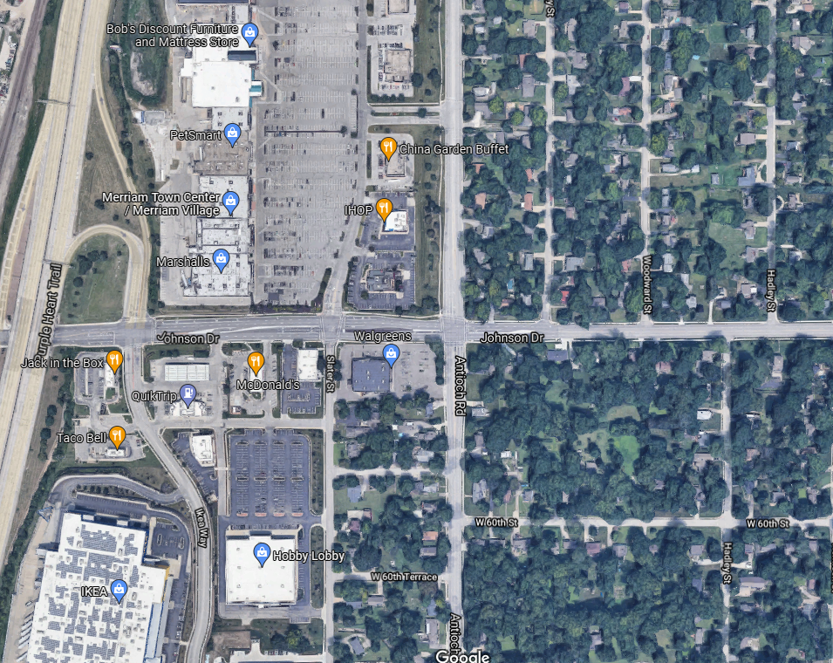
Notes:
Just north of the new Ikea store in Merriam off I-35.

Slide 31
Reckless First Love
Vss 32-34 Current Cultural catastrophe
Vss 35-39 Confidence

Slide 32
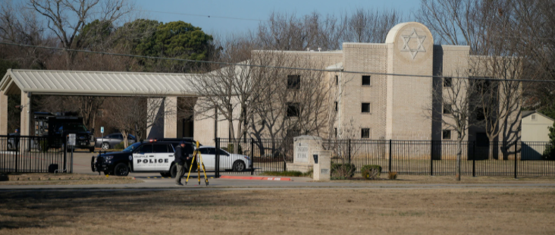
Cong. Beth Israel in Colleyville,TX
Notes:
https://nypost.com/2022/01/17/texas-rabbi-credits-security-training-for-hostage-survival/?utm_campaign=iphone_nyp&utm_source=mail_app
From Mike Boatright
We can fight

Slide 33
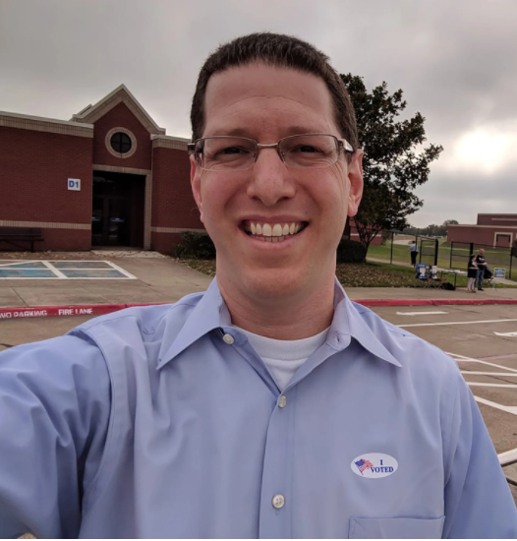
Rabbi Charlie Cytron-Walker
Notes:
https://nypost.com/2022/01/17/texas-rabbi-credits-security-training-for-hostage-survival/?utm_campaign=iphone_nyp&utm_source=mail_app

Slide 34
The hero rabbi held hostage in his Texas synagogue has credited active-shooter training for helping him save his congregants — revealing Monday that he threw a chair at the terrorist so they could finally escape.
Notes:
https://nypost.com/2022/01/17/texas-rabbi-credits-security-training-for-hostage-survival/?utm_campaign=iphone_nyp&utm_source=mail_app

Slide 35
But what about when we can’t adequately fight?
^{10.32} Hard struggle with sufferings
^{10.33a} Publicly disgraced and persecuted [canceled]
^{10.33b} Loyalty to those so treated

Slide 36
^{10.34a} For you shared the sufferings of those who had been put in prison.
^{10.34b} Possessions seized, you took it gladly…just stuff
^{10.34c} What you possessed was better and would last forever
Notes:
Imprisoned then relied on friends and family to bring them food and other provisions. Till 18th C England.
Lots of reports of loss of assets through inflation: store non-perishables, in case of collapse.

Slide 37
These possession aren’t being seized by our government, but also not always being protected.
Notes:
Proper respect to our safety officers
We may fight and win, or lose, but in a real sense, it doesn’t matter. We have joy.
“Doesn’t feel like it!”
Importance of worship. Choosing to worship.

Slide 38
^{Gal.4.13-15} I proclaimed the Good News to you the first time; and though my physical condition was a trial to you, you did not hate or reject me. No, you welcomed me as a messenger of God—or even as Messiah Yeshua. So where is your sense of joy? For I testify that you would have torn out your eyes and given them to me, if possible.
Notes:
Despite discouragement from Shaul/Paul’s disfiguring [?] ailment, they had JOY.

Slide 39
^{Phil. 4.6-7} Don’t worry about anything; on the contrary, make your requests known to God by prayer and petition, with thanksgiving. Then God’s shalom, passing all understanding, will keep your hearts and minds safe in union with the Messiah Yeshua
Notes:
Worry: family, marriage, children, siblings, Ukraine, Taiwan, Israel

Slide 40
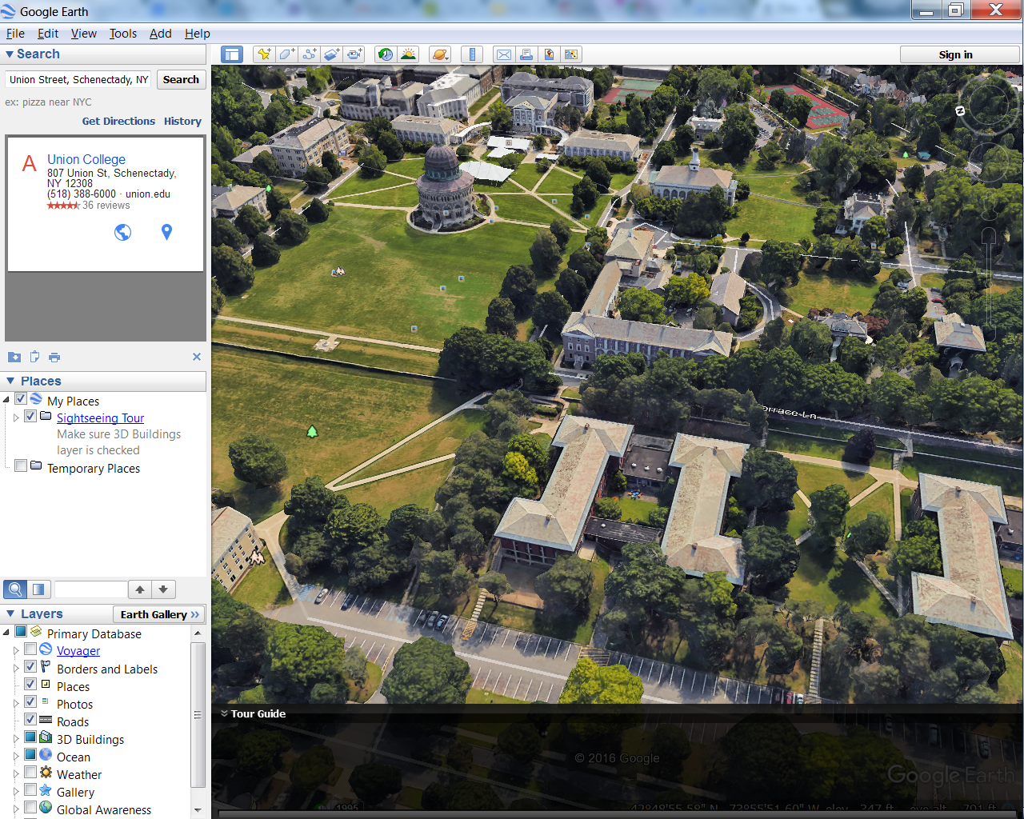
Union College, Schenectady NY
Notes:
I left semi-Ivy League Union for the unaccredited Bible College.

Slide 41
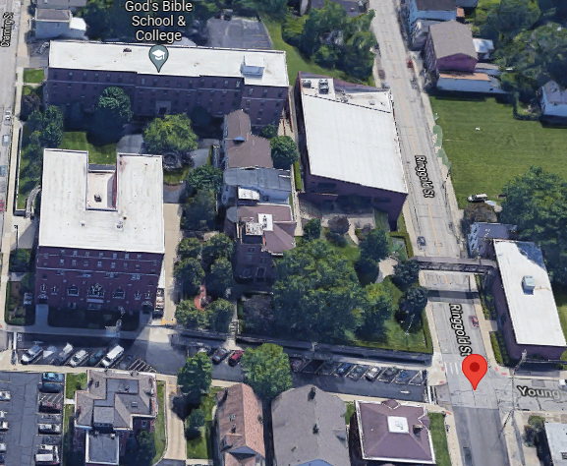
God’s Bible School & College
Notes:
A dear friend left Harvard for the same school. Why? Joy and glory. School then in disrepair. Recovered but didn’t matter much to us.
A bit toxic poverty mentality.

Slide 42
Suffering may be coming, but we rejoice despite it.

Slide 44
Reckless First Love
Vss 32-34 Cultural catastrophe
Vss 35-39 Reckless Confidence

Slide 45
Definition of reckless
marked by lack of proper caution, careless of consequences
2: Irresponsible
Notes:
We’ll go with #1

Slide 46
^{MJ 10.35} So don’t throw away that courage of yours, which carries with it such a great reward.

Slide 47
^{MJ 10.35-39} For you need to hold out; so that, by having done what God wills, you may receive what he has promised. For “There is so, so little time! The One coming will indeed come, he will not delay.

Slide 48
^{MJ 10.35-39} But the person who is righteous will live his life by trusting, and if he shrinks back, I will not be pleased with him.”
Context: paraphrastic quote from the prophet Habbakuk

Slide 49
Habakkuk was troubled by the coming Babylonian invasion of Judah.
^{Hab 1.13} Why are you silent when evil people swallow up those more righteous than they?

Slide 50
^{Hab. 2.2-4} Then Adoni answered me and said: “Write down the vision, make it plain on the tablets, so that the reader may run with it. For the vision is yet for an appointed time.

Slide 51
^{Hab. 2.2-4} It hastens to the end and will not fail. If it should be slow in coming, wait for it, For it will surely come—it will not delay.” Behold, the puffed up one— his soul is not right within him, But the righteous will live by his trust.
Notes:
Even in the Babylonian conquest and destruction of the Kingdom and the Temple.
This line is a MAJOR concept in the scriptural understanding of LIFE.

Slide 52
“the righteous shall live by Emunah אמונה Faith.”
צַדִּיק בֶּאֱמוּנָתוֹ יִחְיֶה.
Tsadeek beh-emunato yikhyeh
Notes:
Righteous: saved eternally, righteous in community
By his faith: not by himself, his strength, by his social and family support, but by faith in the atoning death and resurrection of the Messiah Yeshua
Live: strength, joy, dependence GIVE not from spouse, from kids, from community,

Slide 53
The tip of the Babylonian arrow. Archaeologists believe that the location can be confined to a specific event due to the unique combination of found artifacts and materials – pottery and lamps, along with coals, ash and tips.
But the righteous
will live by his trust.
Notes:
https://earth-chronicles.com/science/traces-of-babylonian-conquest-found-in-jerusalem.html

Slide 54
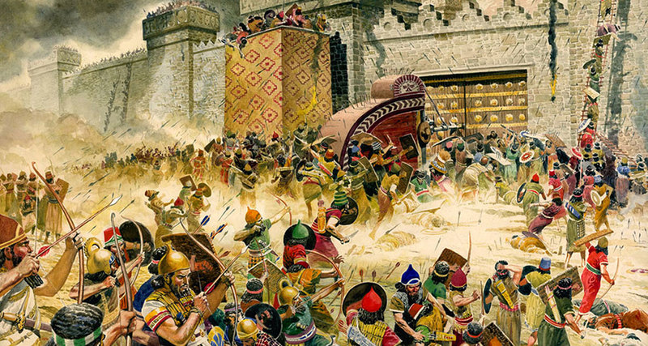
Notes:
https://earth-chronicles.com/science/traces-of-babylonian-conquest-found-in-jerusalem.html
https://earth-chronicles.com/wp-content/uploads/2019/08/bf2fdeb825180d8ac4cbc966f5434473_ce_1500x800x0x146_cropped_800x427.jpg
A group of archaeologists from the University of North Carolina at Charlotte, conducting excavations on Mount Zion in Jerusalem, announced the discovery of archaeological evidence of the capture of the city by the Babylonian army in 586 BC.

Slide 55
^{Ro.1.16-17} For I am not ashamed of the Good News, since it is God’s powerful means of bringing salvation to everyone who keeps on trusting, to the Jew especially, but equally to the Gentile.

Slide 56
^{Ro.1.16-17} For in it is revealed how God makes people righteous in his sight; and from beginning to end it is through trust — as the Tanakh puts it, “But the person who is righteous will live his life by trust.”
Notes:
Shaul quotes this as the foundational concept in presenting salvation to Israel and the Nations.

Slide 57
^{Gal 2.10-11} For all who rely on the deeds of Torah are under a curse—for the Scriptures say, “Cursed is everyone who does not keep doing everything written in the scroll of the Torah.” It is clear that no one is set right before God by Torah, for “the righteous shall live by Emunah אמונה Faith.”
Notes:
Here it is the decisive concept to keep us from legalism.

Slide 58
So the message from G-d to Havakkuk in the Babylonian destruction is the same message Shaul/Paul picked up on in understanding eternal salvation to all nations.

Slide 59
“the righteous shall live by Emunah אמונה Faith.”
צַדִּיק בֶּאֱמוּנָתוֹ יִחְיֶה.
Tsadeek beh-emunato yikhyeh
Notes:
Righteous: saved eternally, righteous in community
By his faith: not by himself, his strength, by his social and family support, but by faith in the atoning death and resurrection of the Messiah Yeshua
Live: strength, joy, dependence GIVE not from spouse, from kids, from community,

Slide 60
Faith, Emunah, believing G-d is working, is key to
Receiving forgiveness
Being filled with the Ruakh
Thriving in adversity

Slide 61
^{MJ 10.35-39} However, we are not the kind who shrink back and are destroyed; on the contrary, we keep trusting and thus preserve our lives!

Slide 62
So we trust G-d in the midst of danger, that G-d is working “Even when we don’t see Him, He’s working” bringing salvation.
Some radical examples.

Slide 63
How many remember the astonishing fall of the Soviet Union?

Slide 64
The dissolution of the Soviet Union[h] (1988–1991) was the…unintended result of General Secretary Mikhail Gorbachev's effort to reform the Soviet political and economic system. In late 1991, the leaders of three of the Union's founding and largest republics [Russia Ukraine, and Byelorussia]
Notes:
https://en.wikipedia.org/wiki/Dissolution_of_the_Soviet_Union
Pres. Reagan had called out, Mr. Gorbachev, Tear down this wall!

Slide 65
declared that the Soviet Union no longer existed, and 11 more republics joined them shortly thereafter. Gorbachev had to resign his office as president and what was left of the parliament to formally acknowledge the Union's collapse as a fait accompli.
Notes:
https://en.wikipedia.org/wiki/Dissolution_of_the_Soviet_Union

Slide 66
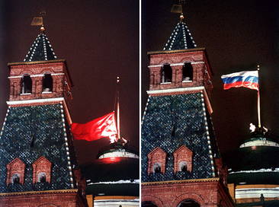
The Soviet flag [Hammer & Sickle] being lowered from the Kremlin; replaced with the flag of Russia
25 Dec. 1991
Notes:
https://en.wikipedia.org/wiki/Dissolution_of_the_Soviet_Union

Slide 67
G-d is working “Even when we don’t see Him #1

Slide 68
The Ayatollahs of Iran may fall

Slide 69
From the Jerusalem Post via Barry Segal: Iran ‘Society Set to Explode’
Notes:
https://vfinews.com/news/idf-drills-for-a-winter-war-with-hezbollah/iran-society-set-to-explode-while-biden-unfreezes?subscribed=true&mc_cid=443368d7ae&mc_eid=UNIQID

Slide 70
A hacktivist organization has revealed a highly sensitive Iran Islamic Revolutionary Guards Corps (IRGC) document that asserts Iranian “society is in a state of explosion”
Notes:
With roots in hacker culture and hacker ethics, its ends are often related to free speech, human rights, or freedom of information movements

Slide 71
“the document covers a meeting with IRGC’s intelligence wing and quotes an official named “Mohammadi” saying that Iran’s “society is in a state of explosion.”
Notes:
https://vfinews.com/news/idf-drills-for-a-winter-war-with-hezbollah/iran-society-set-to-explode-while-biden-unfreezes?subscribed=true&mc_cid=443368d7ae&mc_eid=UNIQID

Slide 72
The official noted that “several shocks” in recent months have “shaken public trust” in the regime of President Ebrahim Raisi, who is listed as a US-sanctioned person for his role in several mass murders, including the massacre of at least 5,000 Iranian political prisoners in 1988.
Notes:
https://vfinews.com/news/idf-drills-for-a-winter-war-with-hezbollah/iran-society-set-to-explode-while-biden-unfreezes?subscribed=true&mc_cid=443368d7ae&mc_eid=UNIQID

Slide 73
Rania Sayegh, is a Christian Arab ministry leader
HOPE - House Of Prayer & Exploits
Nazareth, Israel

Slide 74
Iranian New Year = Noroz
Wednesday preceding is called Char Chambi Sori” in Farsi which means “the Wednesday of fire” Mar. 16, 2022

Slide 75
The Lion of the Tribe of Judah is about to roar from Zion and bring vengeance over the Haman spirit that is moving in the land. Enough is enough, Aslan is on the move!
This is the decree to be released on Purim March 16, 2022!

Slide 76
G-d is working “Even when we don’t see Him #2
Hamas may fall

Slide 77
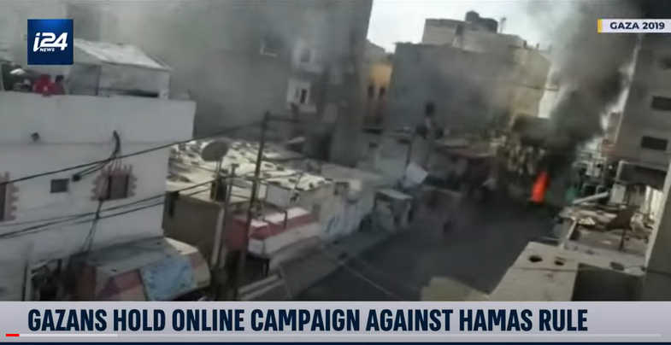
Notes:
https://youtu.be/jOV4F46QU40

Slide 78
G-d is working “Even when we don’t see Him #3
The Chinese Communist government may fall

Slide 79
Notes:
https://www.theepochtimes.com/ccp-is-terminally-ill-author-says-chinas-domestic-troubles-could-trigger-leadership-coup_4266908.html?utm_source=uschinanoe&utm_campaign=uschina-2022-02-10&utm_medium=email&est=OqYl6utzRM81rhvtQkI%2F%2Bl2XmFq59iUApdFPfq4gBs7EklBBz7e0ddF6%2BbJVo18xrg%3D%3D

Slide 80
CCP Is ‘Terminally Ill’: Author Says China’s Domestic Troubles Could Trigger Leadership Coup
Notes:
https://www.theepochtimes.com/ccp-is-terminally-ill-author-says-chinas-domestic-troubles-could-trigger-leadership-coup_4266908.html?utm_source=uschinanoe&utm_campaign=uschina-2022-02-10&utm_medium=email&est=OqYl6utzRM81rhvtQkI%2F%2Bl2XmFq59iUApdFPfq4gBs7EklBBz7e0ddF6%2BbJVo18xrg%3D%3D

Slide 81
A group of Chinese officials might stage an internal coup against Chinese leader Xi Jinping, and transition China to a democratic political system, according to Roger Garside, author of “China Coup.”
Notes:
https://www.theepochtimes.com/ccp-is-terminally-ill-author-says-chinas-domestic-troubles-could-trigger-leadership-coup_4266908.html?utm_source=uschinanoe&utm_campaign=uschina-2022-02-10&utm_medium=email&est=OqYl6utzRM81rhvtQkI%2F%2Bl2XmFq59iUApdFPfq4gBs7EklBBz7e0ddF6%2BbJVo18xrg%3D%3D

Slide 82
“The body politic of China is terminally ill. Only a transplant can save the body politic, and the only other system on offer is competitive democracy,” Garside, a former diplomat, told Epoch TV’s “China Insider” program on Jan. 31.
Notes:
https://www.theepochtimes.com/ccp-is-terminally-ill-author-says-chinas-domestic-troubles-could-trigger-leadership-coup_4266908.html?utm_source=uschinanoe&utm_campaign=uschina-2022-02-10&utm_medium=email&est=OqYl6utzRM81rhvtQkI%2F%2Bl2XmFq59iUApdFPfq4gBs7EklBBz7e0ddF6%2BbJVo18xrg%3D%3D

Slide 83
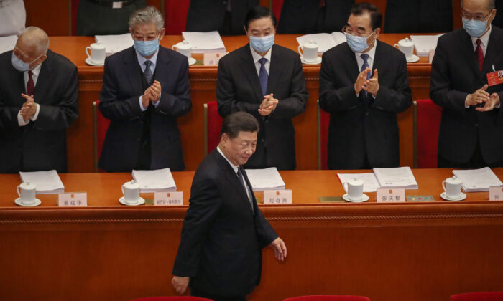
Notes:
Chinese Communist Party’s head Xi Jinping arrives at The Great Hall of the People for the opening of the National People's Congress on May 22, 2020 in Beijing, China. (Andrea Verdelli/Getty Images)
https://www.theepochtimes.com/ccp-is-terminally-ill-author-says-chinas-domestic-troubles-could-trigger-leadership-coup_4266908.html?utm_source=uschinanoe&utm_campaign=uschina-2022-02-10&utm_medium=email&est=OqYl6utzRM81rhvtQkI%2F%2Bl2XmFq59iUApdFPfq4gBs7EklBBz7e0ddF6%2BbJVo18xrg%3D%3D

Slide 84
China’s private sector has become powerful and autonomous, according to Garside. This has been putting pressure on the CCP, causing anxiety among the country’s leadership.

Slide 85
“Ever since 2011, the regime … has been spending more of its budget on internal security than it has on the military. It fears its internal enemies.”

Slide 86
The former diplomat argued that such a coup would probably transition China to democracy because officials are aware that the communist system is not functioning anymore, and that constitutional democracy is the better alternative.

Slide 87
Notes:
Olympic skater

Slide 88
The sheer malice shown toward Zhu appears to be symptomatic of a broader trend. In October 2011, a two-year-old Chinese girl by the name of Wang Yue was run over by two separate vehicles on a road in Foshan, Guangdong Province.
Notes:
https://www.theepochtimes.com/olympic-failure-and-the-cost-of-representing-china_4266257.html?utm_source=uschinanoe&utm_campaign=uschina-2022-02-10&utm_medium=email&est=uyPoCksXFrSOLB8ynNWaccQeHMh7ucgnIWy3RasVck%2F7hl1bJUCyTaAtQEkYBkiprQ%3D%3D

Slide 89
As the toddler lay bleeding on the road, crying out for more than seven minutes, at least 18 different drivers maneuvered around her body, opting to ignore rather than to help her. Eventually, a person had the decency to stop and take the little girl to the hospital for treatment.
Notes:
https://www.theepochtimes.com/olympic-failure-and-the-cost-of-representing-china_4266257.html?utm_source=uschinanoe&utm_campaign=uschina-2022-02-10&utm_medium=email&est=uyPoCksXFrSOLB8ynNWaccQeHMh7ucgnIWy3RasVck%2F7hl1bJUCyTaAtQEkYBkiprQ%3D%3D

Slide 90
Sadly, a week after the horrendous affair, Wang succumbed to her injuries and died. Again, what could explain such cruelty? How could close to 20 different drivers ignore a little girl, clearly injured, sprawled out in the middle of a road?
Notes:
https://www.theepochtimes.com/olympic-failure-and-the-cost-of-representing-china_4266257.html?utm_source=uschinanoe&utm_campaign=uschina-2022-02-10&utm_medium=email&est=uyPoCksXFrSOLB8ynNWaccQeHMh7ucgnIWy3RasVck%2F7hl1bJUCyTaAtQEkYBkiprQ%3D%3D

Slide 91
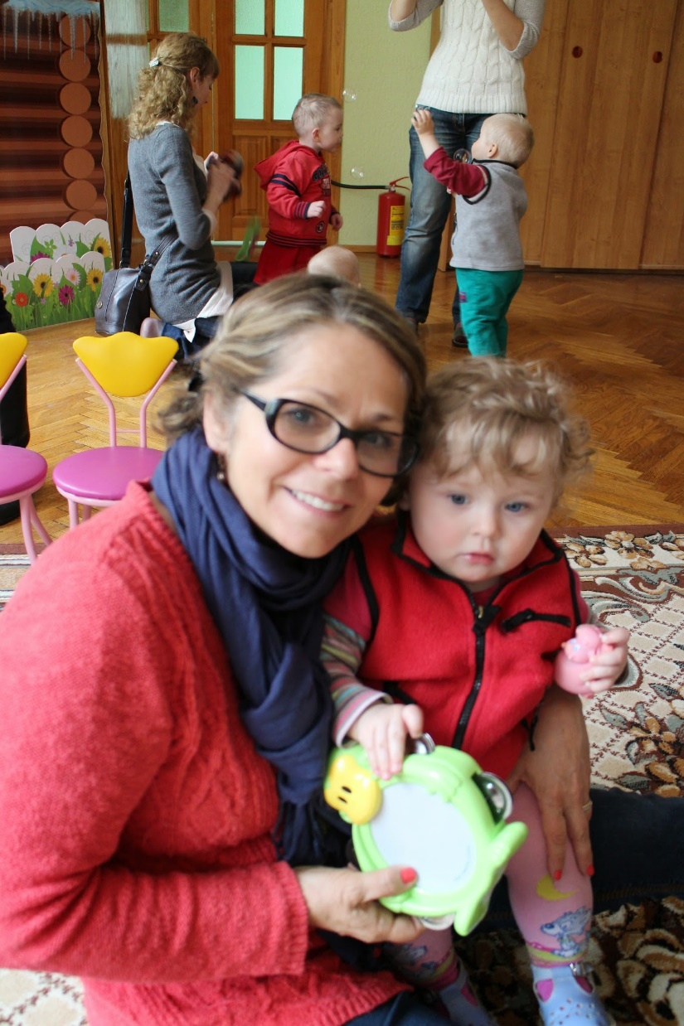
Notes:
Chantal Winograd saw a need and developed a ministry to parentally abandoned disabled and cancerous children.

Slide 92
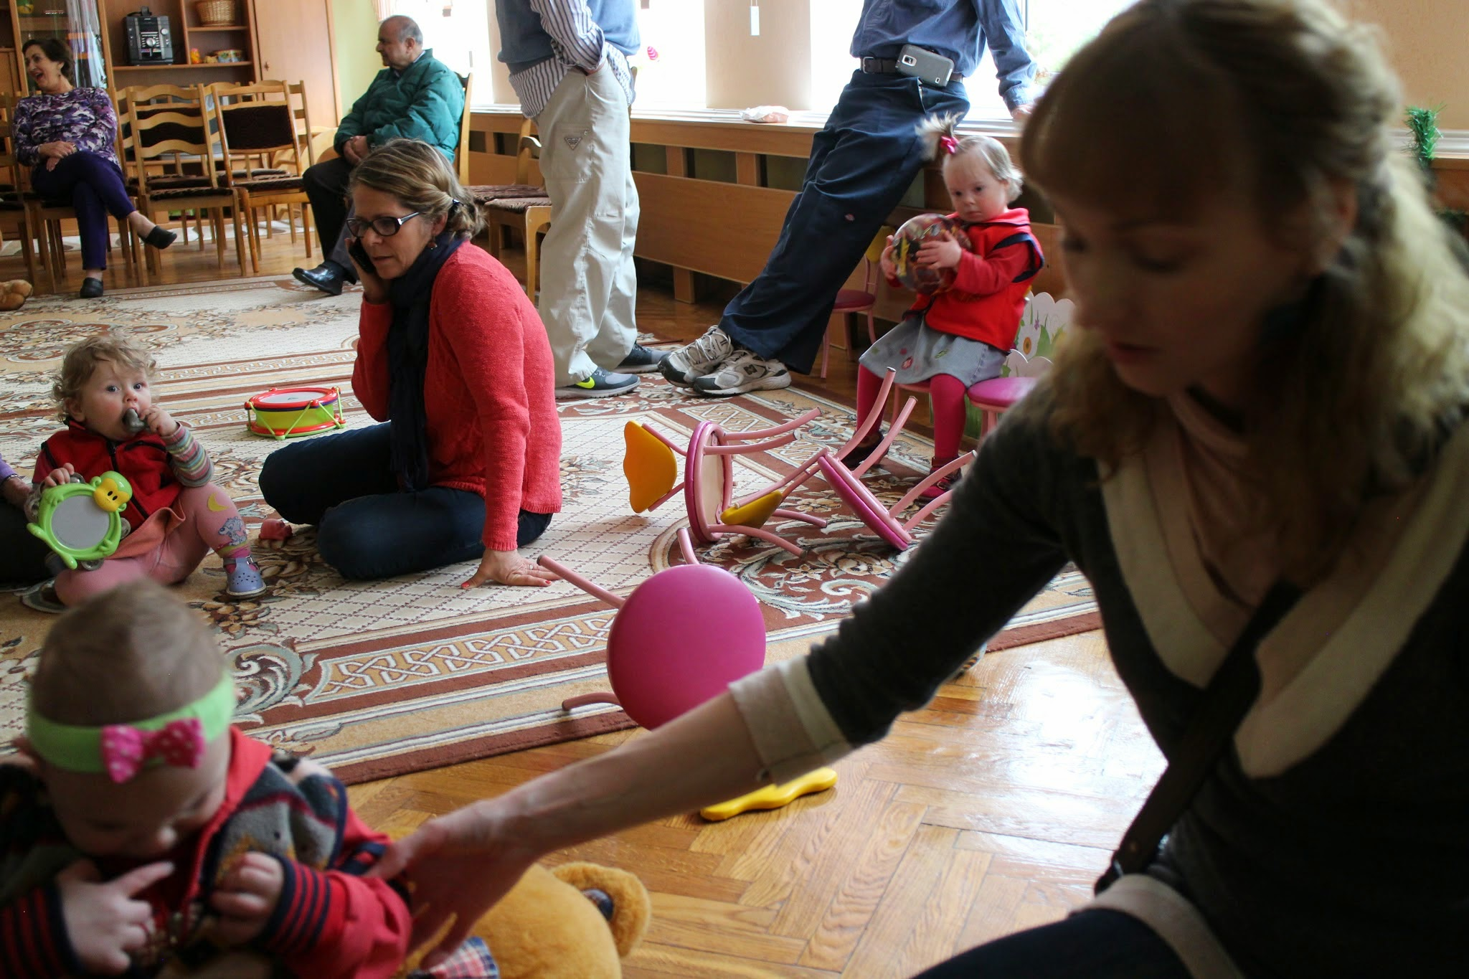
Notes:
We went to a children’s hospital to visit them on our trip.

Slide 93
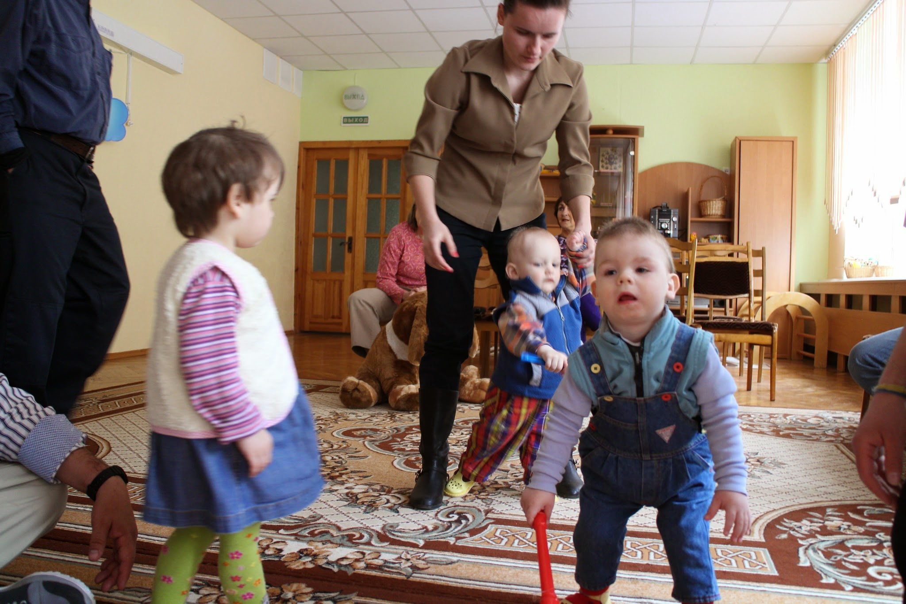

Slide 94
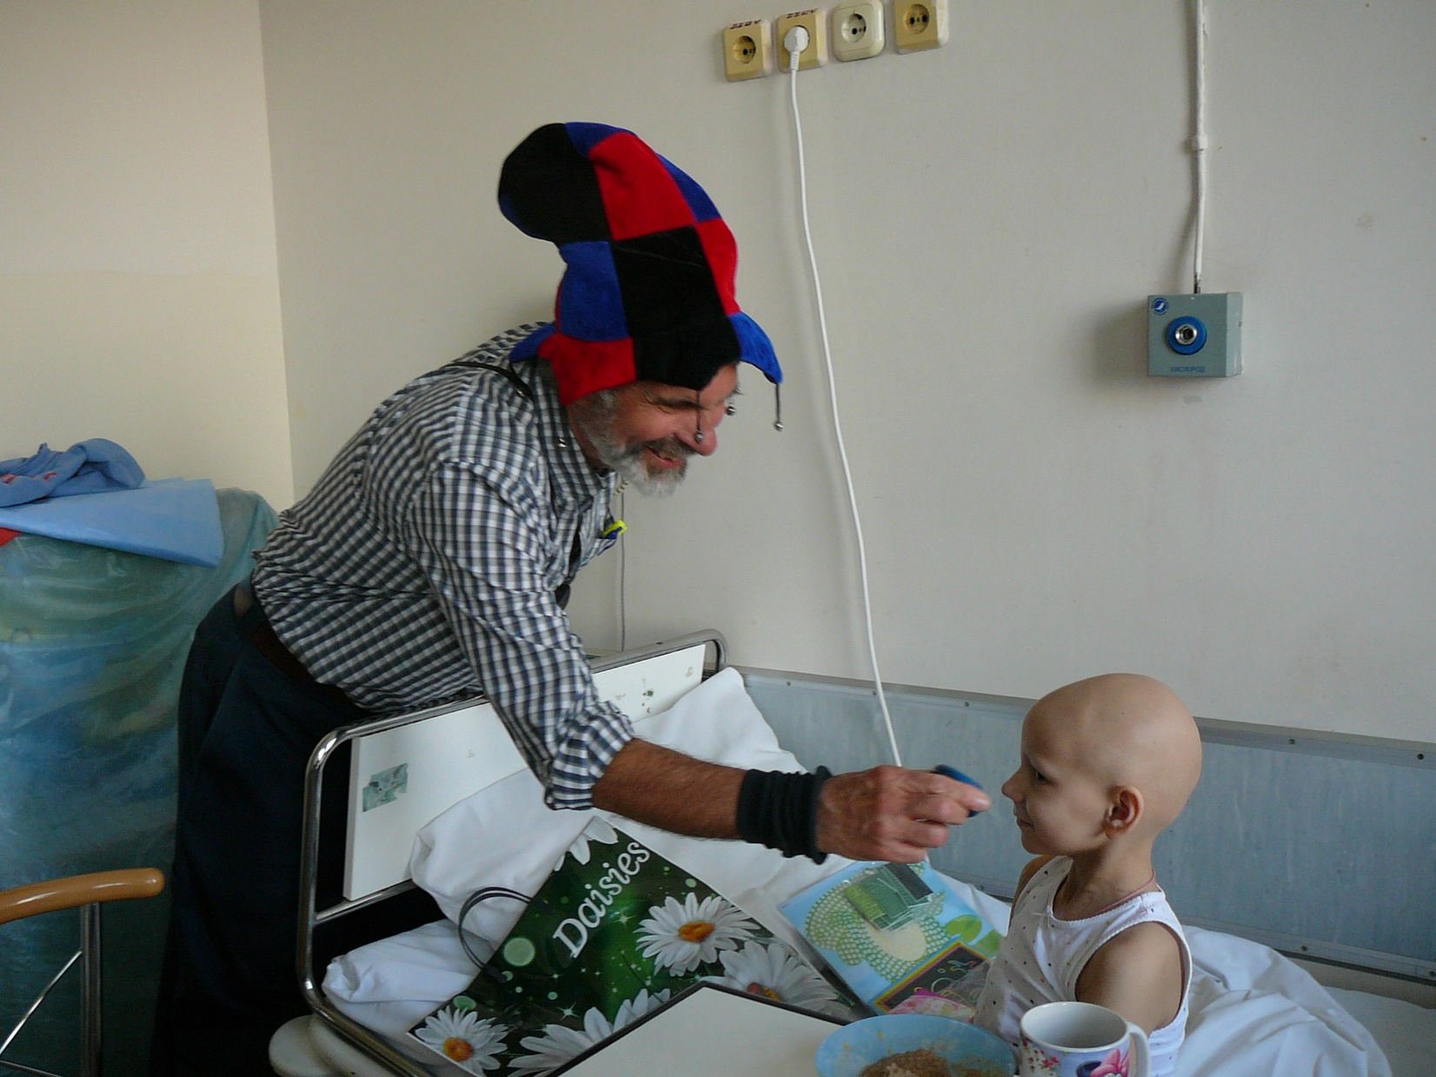

Slide 95
^{MJ 10.35-39} However, we are not the kind who shrink back and are destroyed; on the contrary, we keep trusting and thus preserve our lives!
Notes:
Reckless love Valentines
Phil prayer w faith

Slide 96
So we trust G-d recklessly, regardless of consequences, in the midst of danger, that G-d is working “Even when we don’t see Him, He’s working” bringing salvation.

Slide 98
Purim miracle coming!

Slide 99
^{Ester 9.22} These were to be days of feasting, celebration and sending presents of food מִשְׁלֹחַ מָנוֹת to one another and giving gifts to the poor."
Notes:
Sending gift baskets is a big deal in Jewish community. One time a GREAT abuse…

Slide 100
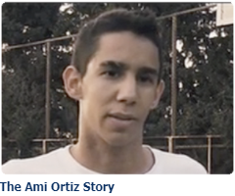

Slide 101
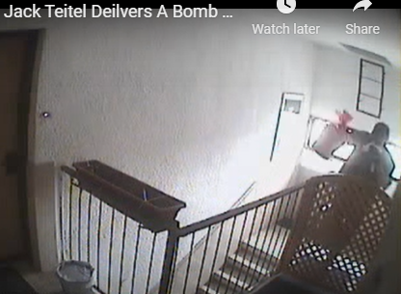

Slide 102
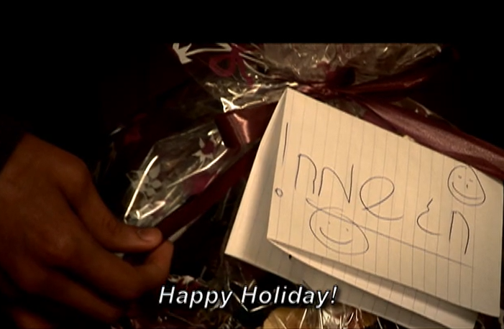
Notes:
https://vimeo.com/3800327?embedded=true&source=vimeo_logo&owner=1450969
1.30 to 2.01

Slide 103
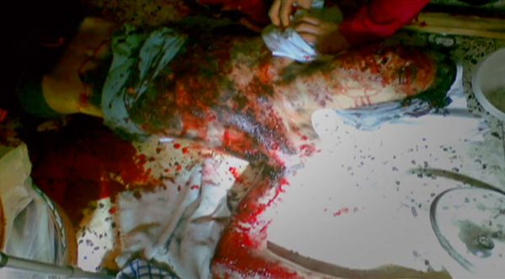

Slide 104
The Lord was moving mightily in Ami’s body as He was answering the prayers of His people. Healing began at such an alarming rate that it confounded the doctor’s and nurses. Every night, Ami was in excruciating pain from his wounds, but he felt deep itching over his entire body, and the sensations of his skin pulling.
Notes:
https://amiortiz.org/the-miracles

Slide 105
We knew that these were signs of healing, but healing hurts!! Every morning when the bandages were changed, the nurses would come out and tell us – he’s better today. One day, after a particularly hard night, they exclaimed, “He’s MUCH better today!” The plastic surgeons began running away from us, not knowing how to explain what they were seeing.
Notes:
https://amiortiz.org/the-miracles

Slide 106
David [Ami’s father] said, maybe they’re afraid that they’ll be put out of business! The skin grafts were done in the days following, but the surgeon was able to assess that his right thigh was healing by itself, and wouldn’t need a skin graft, and the skin did slowly grow back over the wounds on the right thigh, although with significant scarring.
Notes:
https://amiortiz.org/the-miracles

Slide 107
We will deliver Purim gift bags to our neighborhood. 50 to 80 or more.
We need bag packers, Mar. 5?
We need smiling distributors Mar 12?
We need welcomers and schmoozers. Mar 20!

Slide 108
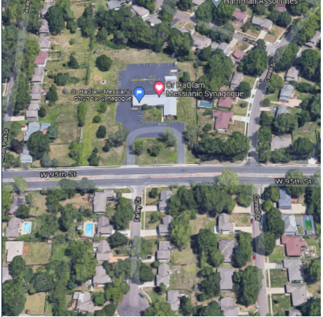
Perimeter home and south.

Slide 110
Reckless First Love
Vss 32-34 Cultural catastrophe
Vss 35-39 Confidence

Slide 111
“the righteous shall live by Emunah אמונה Faith.”
צַדִּיק בֶּאֱמוּנָתוֹ יִחְיֶה.
Tsadeek beh-emunato yikhyeh
Notes:
Righteous: saved eternally, righteous in community
By his faith: not by himself, his strength, by his social and family support, but by faith in the atoning death and resurrection of the Messiah Yeshua
Live: strength, joy, dependence GIVE not from spouse, from kids, from community,

Slide 113
Do you KNOW Yeshua and the assurance of sins forgiven?
Are you hearing daily from His Word?
How are you applying what you heard?
Are you asking this of another?
Notes:
Who are you discipling, building up?4

