Slide 1
e-handout
To have these notes
without taking notes
Go to OrHaOlam.com
Click on Messages tab,
2022 Messages
Notes:
You may notice that I’m slowing down in my rate of speech. This is because we may be getting language translation equipment for simultaneous translation.

Slide 2
Statistics:

Slide 3
Statistics: Means never having to say you're certain.
Notes:
50% chance of rain. When I was a child, they would say “Rain tomorrow.”

Slide 5
PILOTS

Slide 6
PILOTS - looking down upon people since 1903

Slide 7
Math illiteracy

Slide 8
Math illiteracy effects 7 out of every 5 people
Notes:
G-d thinks mathematically.

Slide 9
Yn 4.35-36
Harvest in Adversity

Slide 10
^{Yn 4.35-36} Don’t you have a saying, ‘Four more months and then the harvest’? Well, what I say to you is: open your eyes and look at the fields! They’re already ripe for harvest! The one who reaps receives his wages and gathers fruit for eternal life.
Context…

Slide 11
Timeline
^{Yn 2.23-24} Now while Yeshua was in Yerushalayim at the Pesakh festival, there were many people who believed in his name when they saw the miracles he performed. But he did not commit himself to them.
Notes:
Yn 2

Slide 12
Ch 3 Nakdimon/Nicodemus
^{Yn 3.22} After this, Yeshua and his talmidim went out into the countryside of Y’hudah, where he stayed awhile with them and immersed people.

Slide 13
^{Yn 4.1-4} When Yeshua learned that the P’rushim had heard he was making and immersing more talmidim than Yochanan (although it was not Yeshua himself who immersed but his talmidim), Yeshua left Y’hudah and set out again for the Galil. This meant that he had to pass through Shomron.

Slide 14
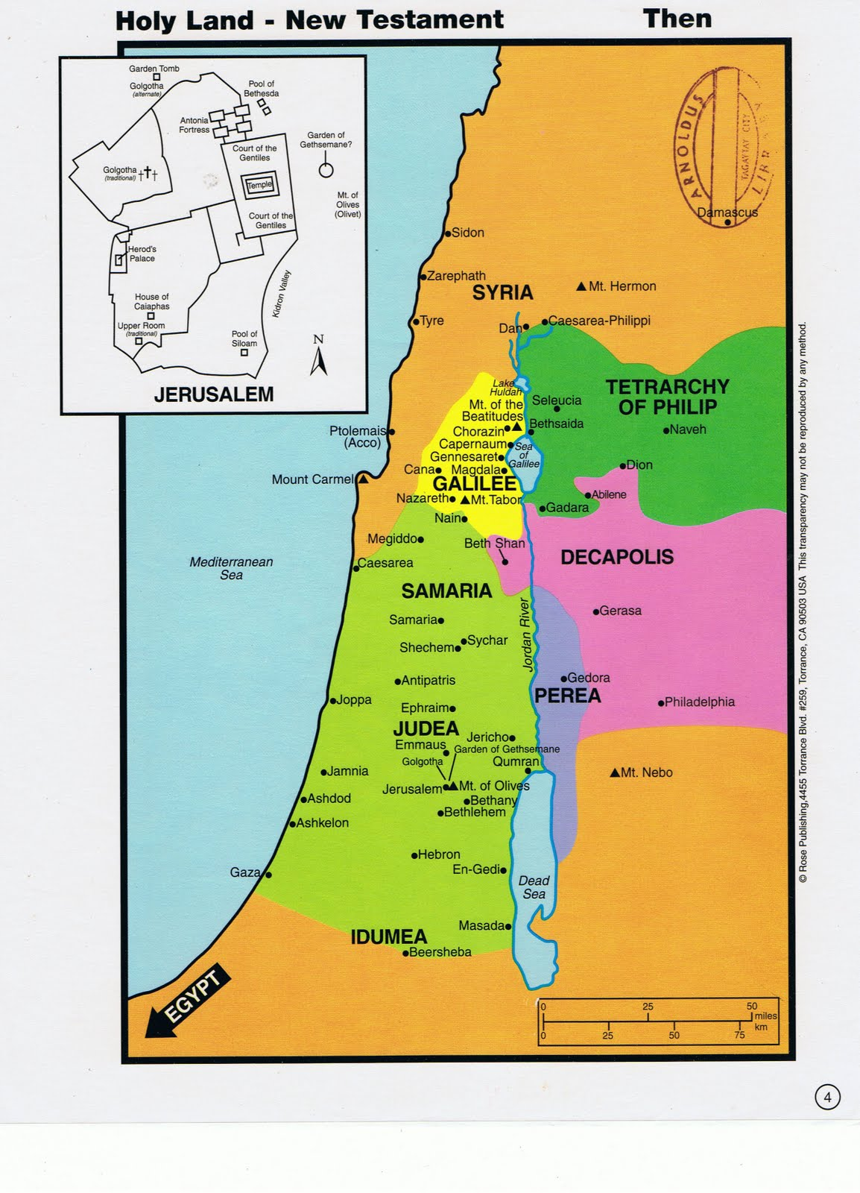
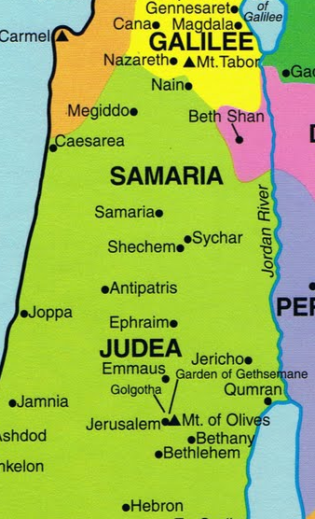
Immersion site
Qasr al-Yahud
The Tower
of the Jews
קאסר אל יהוד
Notes:
Two alternate routes. Jordan river, mountain top.
http://2.bp.blogspot.com/_7NVAYH5fhJU/TAtwTCewVsI/AAAAAAAACGQ/_jqC-RMxFHY/s1600/Map+of+Holy+Land+of+Jesus.jpg

Slide 15
Passover in Yerushalayim
Immersing in Yehudah.
Going north thru Shomron/Samaria
Conversation with the woman at the well.
Response to His talmidim…
Notes:
Key chronological context: not too long after Passover

Slide 16
^{Yn 4.35-36} Don’t you have a saying, ‘Four more months and then the harvest’? Well, what I say to you is: open your eyes and look at the fields! They’re already ripe for harvest! The one who reaps receives his wages and gathers fruit for eternal life.
Likely this dialogue was in May.
What happens in May?
Notes:
Likely this dialogue was in May [WB Godbey vol 6 p 150]
The wheat was sown before this time, and the barley a good while after. “Half Tisri, Marcheshvan, and half Kislev, were seed time.” T. Bab. Bava Metzia, fol. 106. 2.
Misn. Menachot, c. 8. sect. 2. sowing seventy days before the passover, which was within six weeks of the beginning of barley harvest.
https://www.biblestudytools.com/commentaries/gills-exposition-of-the-bible/john-4-35.html

Slide 17
^{Lev 23.15-16} From the day after the day of rest — that is, from the day you bring the sheaf for waving — you are to count seven full weeks, until the day after the seventh week; you are to count fifty days; and then you are to present a new grain offering to Adoni .' "
Notes:
Count = Sephira, from Passover to Shavuot Pentecost. Shavuot is the holiday that commemorates
The wheat harvest. Firstfruits
The giving of the Torah, Sinai revelation of the 10 Words/ 10 commandments
The giving of the Ruakh/Holy Spirit
June 4 evening celebration. No volunteers to teach the 3 one and a half hour sets.
G-d counts lots of things. Sometimes a Temple tax.
Context of Counting time, Sephira.

Slide 18
During the time encompassed by Sefirah/Counting, the grain of the field ripens and it is, therefore, a period of uncertainty -- of hope and prayer that our physical sustenance will be continued in abundance.
Notes:
Wheat called staff of life.

Slide 19
Therefore, this counting time is somewhat solemn, for the harvest is at risk. Historically, the omer period has been marked by several tragedies occurring to our people. The last great deportation to the gas chambers, that of the Jews of Hungary, took place during the Sefirah period.

Slide 20
Over time, this 49-day period became a time of mourning for many traditional Jewish people.
Thursday, May 19, 2022, was Lag b’Omer, a minor holiday on the Jewish calendar. לג Lag = 33 b’Omer is the 33rd day of the 49 days between Passover and Shavuot.
Notes:
From Stewart Winograd

Slide 21
There is a story that thousands of Jewish Torah scholars were killed (either by a plague or in war) during this season. As a result, Orthodox Jews have traditions to not play music, have weddings, or do other things that are joyful during these days.
Notes:
From Stewart Winograd

Slide 22
Lag =33rd day of the Omer marks the end of this terrible second-century plague that felled thousands of Rabbi Akiva’s students (who did not treat each other with respect), is also the date when his famous disciple, Rabbi Shimon bar Yochai, revealed the Torah’s deepest secrets, which were later aggregated into the Zohar.
Notes:
(Abudraham Hashalem, p. 241; B. R. H. 16a).

Slide 23
The day is traditionally celebrated outdoors, in nature, with parades, bonfires, (safely) shooting bows and arrows and studying Kabbalistic texts.
[That’s why we don’t do it, but it’s important history to know.}
Notes:
(Abudraham Hashalem, p. 241; B. R. H. 16a).
My parents wedding, first on military base before deployment, then back to NYC for Jewish wedding, was not allowed during the Omer count, except Lag B’Omer was an exception, and they could have their wedding before Dad was shipped off to Saipan. B-29 maintenance.

Slide 24
This Counting time/ Sephira sense of risk was due, in particular, to the fact that in Israel, the hot winds that are so harmful to the crops, blow between Pesakh and Shavu’ot’
Khamsin…

Slide 25
From the Arabic word for "fifty", these dry, sand-filled Khamsin khmishim חֲמִישִׁים windstorms blow sporadically over a fifty-day period in spring in the Egypt, Israel, Jordan. It carries great quantities of sand and dust from the deserts, with a speed up to 87 mph; and the humidity in that area drops below 5%.
Notes:
https://en.wikipedia.org/wiki/Khamsin

Slide 26
The sand storms are reported to have seriously impeded both Napoleon's military campaigns in Egypt as well as Allied-German fighting in North Africa in World War II. Some cultures excuse murders during the Khamsin.
Notes:
https://en.wikipedia.org/wiki/Khamsin

Slide 27
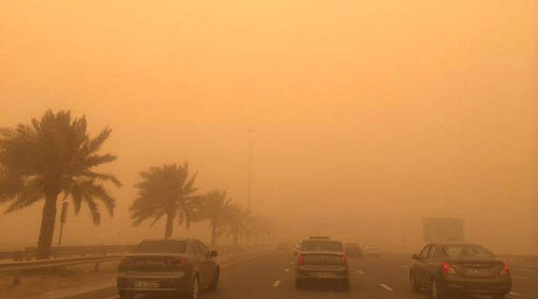
Notes:
https://external-content.duckduckgo.com/iu/?u=https%3A%2F%2Ftse1.mm.bing.net%2Fth%3Fid%3DOIP.ZX7R7Mwjlxj-SQUYBo3UxQHaEH%26pid%3DApi&f=1

Slide 28
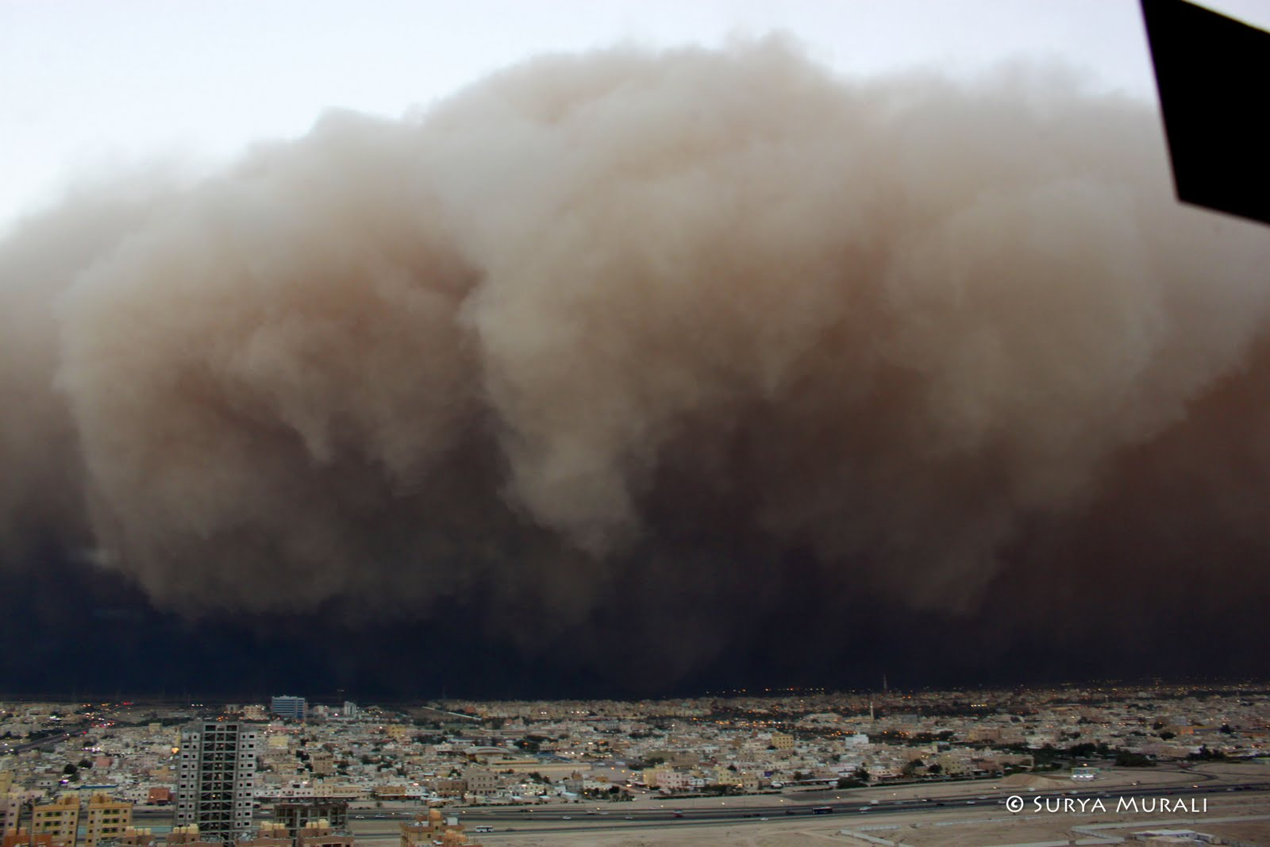
Notes:
During this Omer counting time, 50 days between Passover and Shavuot, is the reasonable time to do intercessory fasting. Many believers fast before Passover in the 40 day period that really has pagan associations. So, I never call for fasting during “Lent.” But Pesakh/Passover to Shavuot is the perfect time for extended fasts.
https://external-content.duckduckgo.com/iu/?u=http%3A%2F%2F1.bp.blogspot.com%2F-dvMma0Iuz6k%2FT6FGbEeTSaI%2FAAAAAAAABQQ%2FTzEjyK3hk5w%2Fs1600%2F005.jpg&f=1&nofb=1

Slide 29
Yeshua and his followers were in this uncertain counting time, yet His statement was…

Slide 30
^{Yn 4.35-36} Don’t you have a saying, ‘Four more months and then the harvest’? Well, what I say to you is: open your eyes and look at the fields! They’re already ripe for harvest! The one who reaps receives his wages and gathers fruit for eternal life.
Notes:
That is, harvest isn’t just for after Shavuot, when the count is done, wheat is ready. It is NOW! Even during this risky 50 days!

Slide 31
Yn 4.35-36
Harvest in Adversity

Slide 32
Example 1 of
the harvest in progress
NOW in adversity

Slide 33
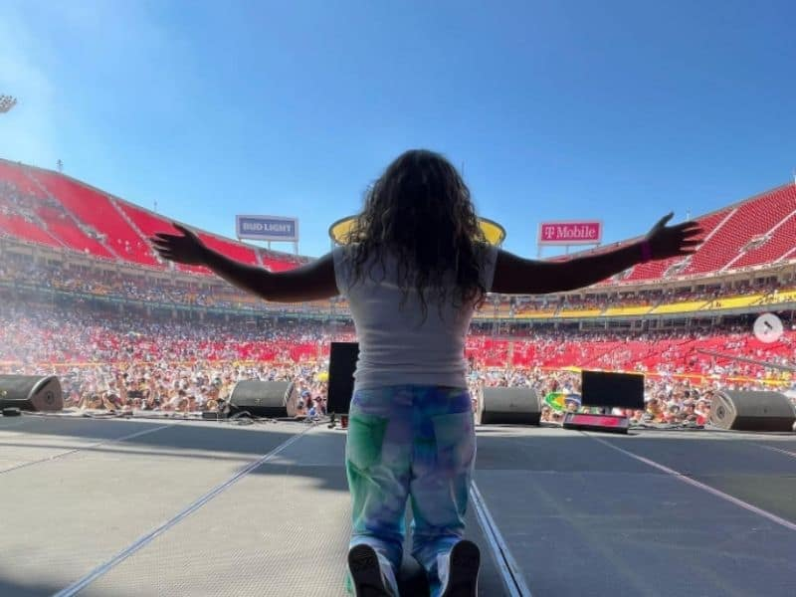
The Send, May 14, 2022

Slide 35
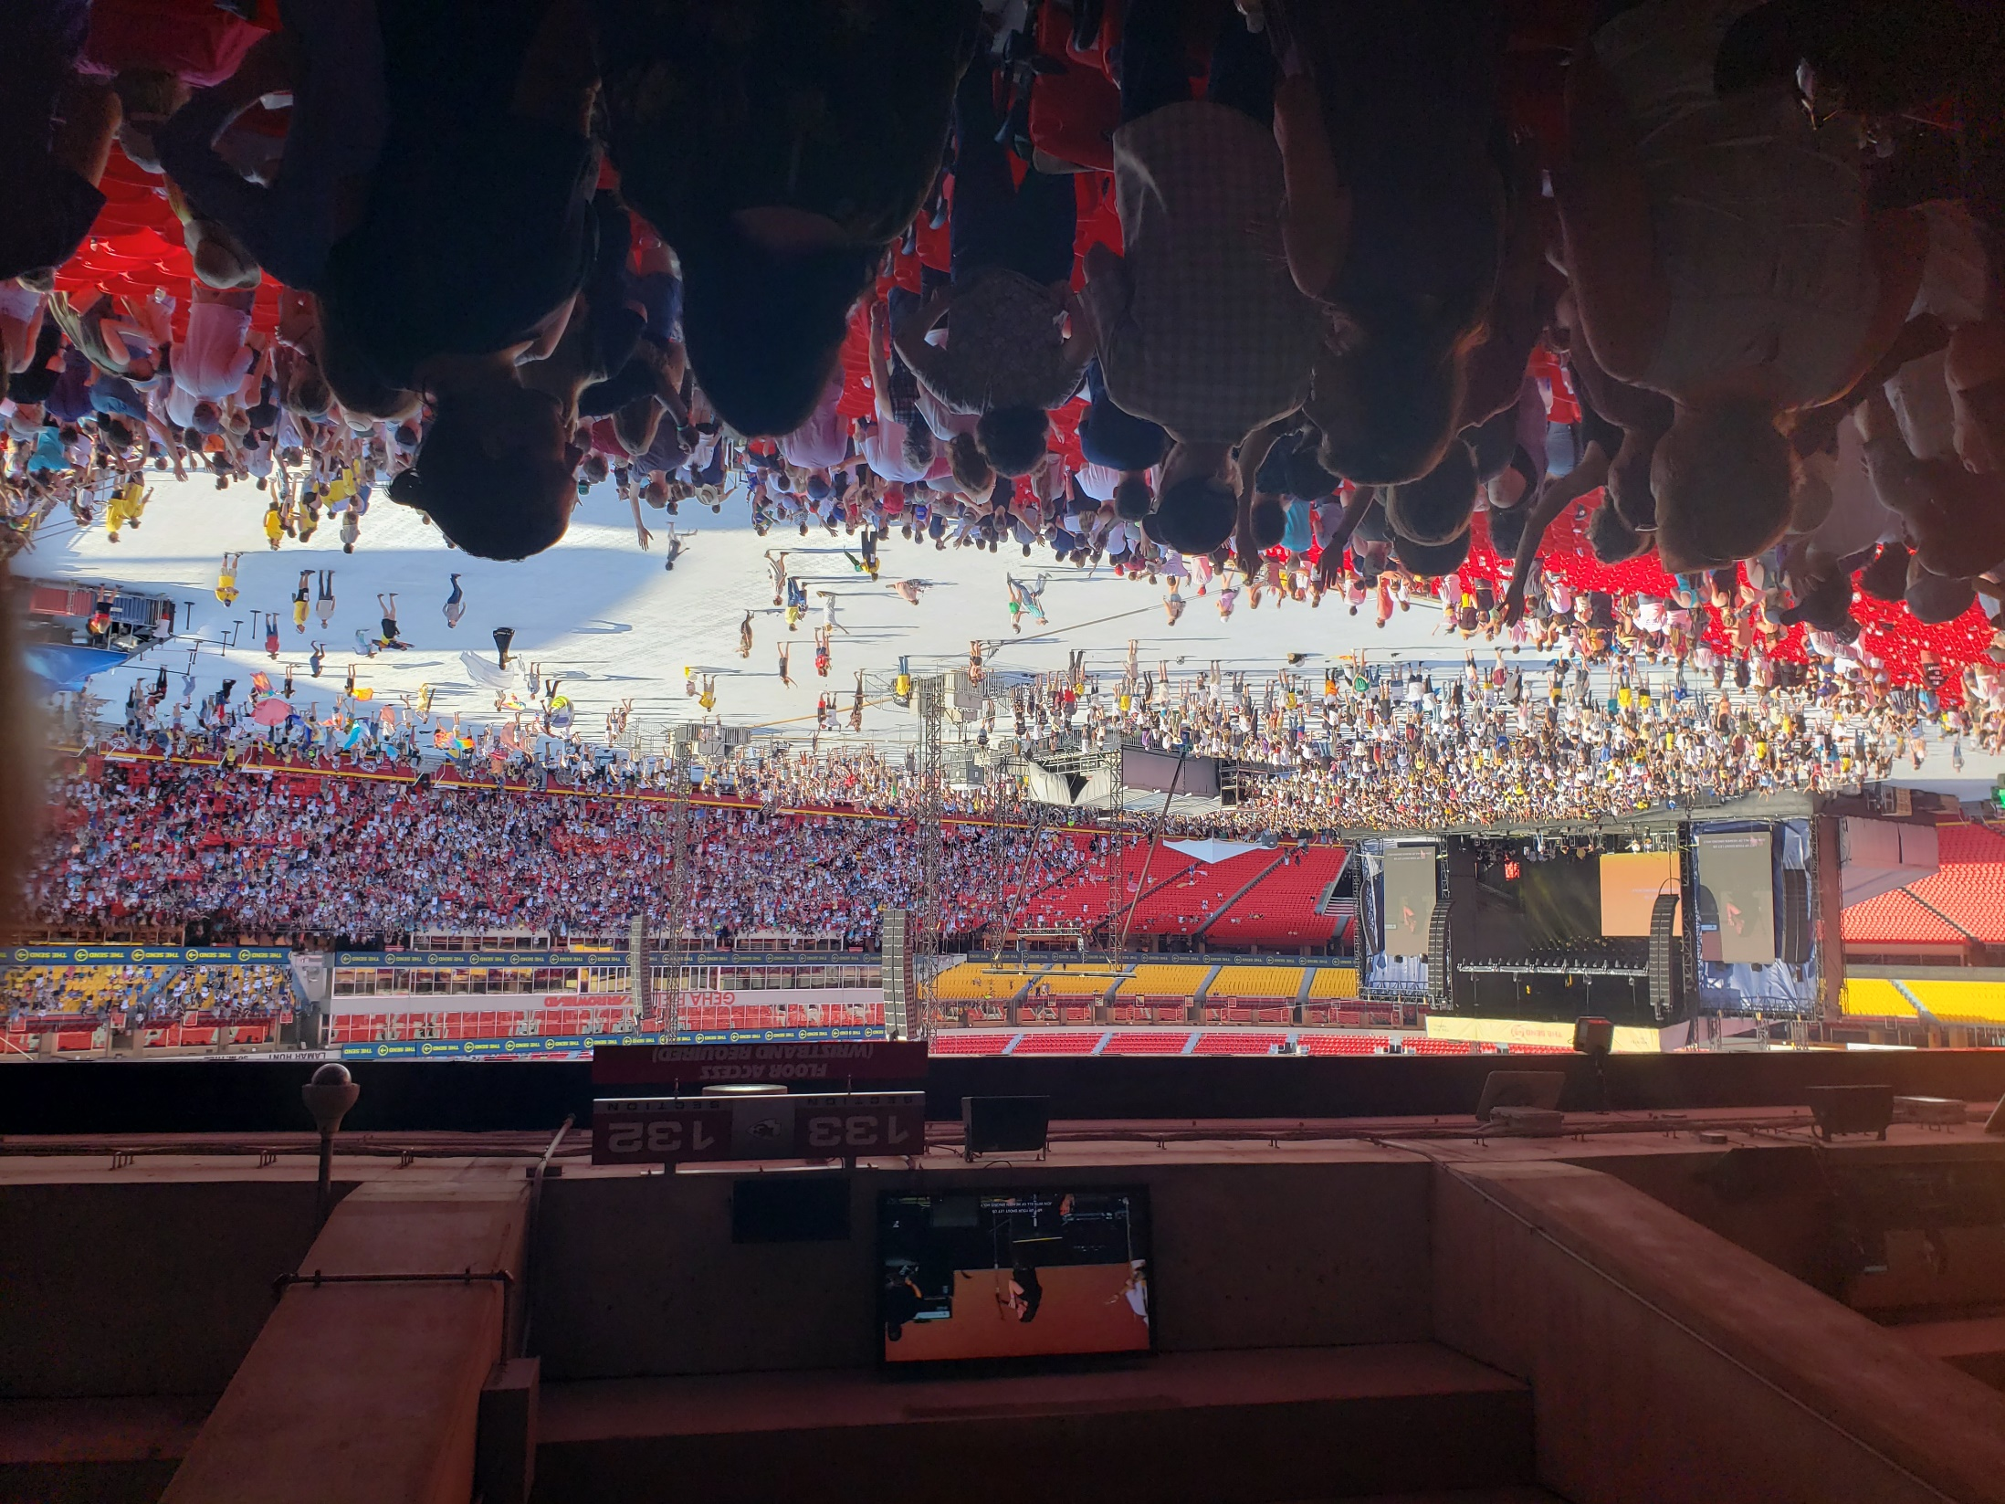

Slide 36
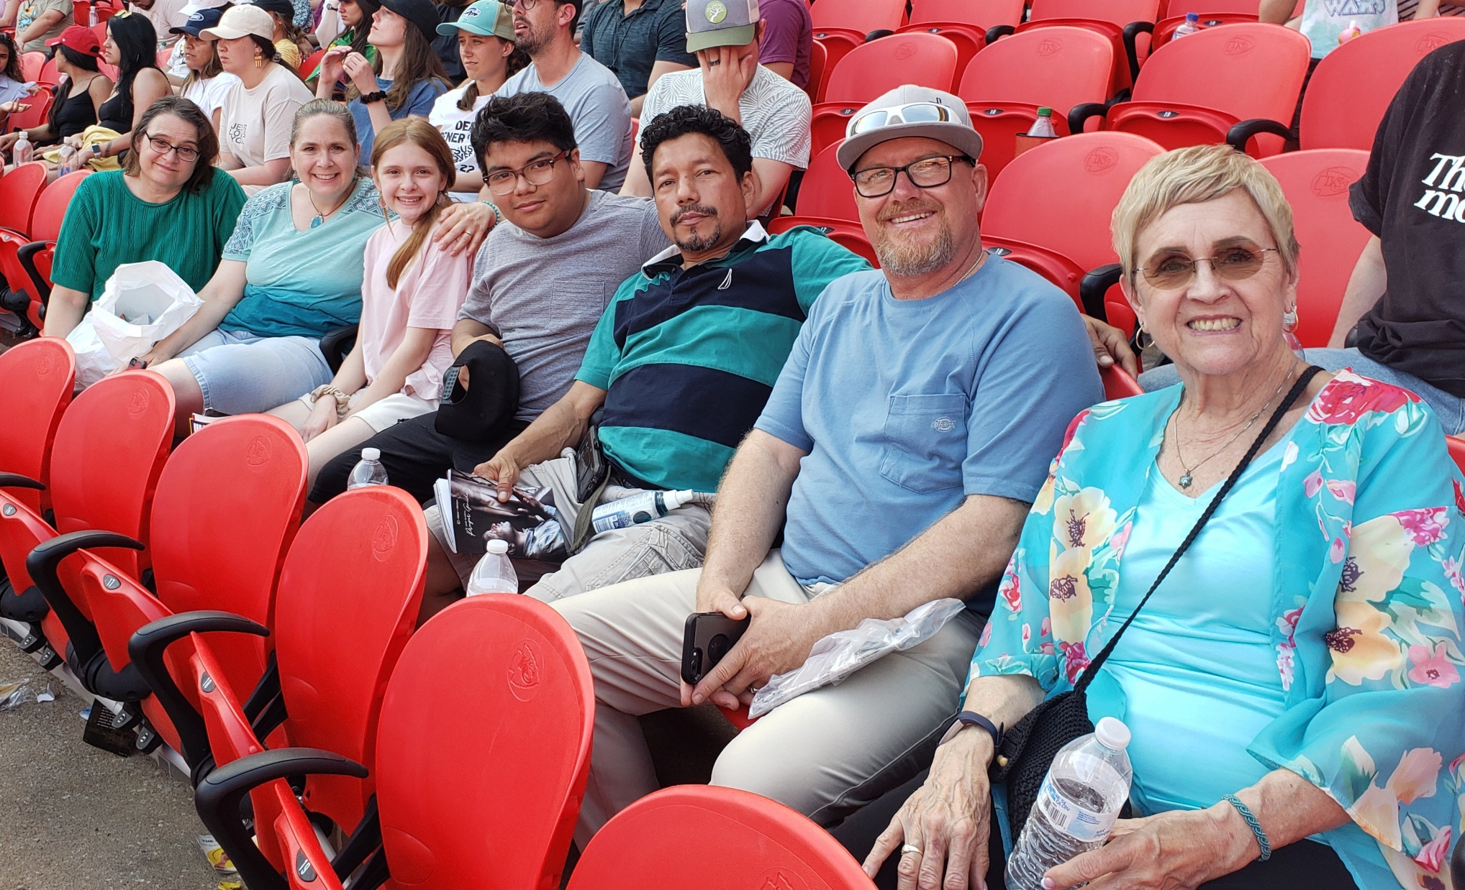

Slide 37
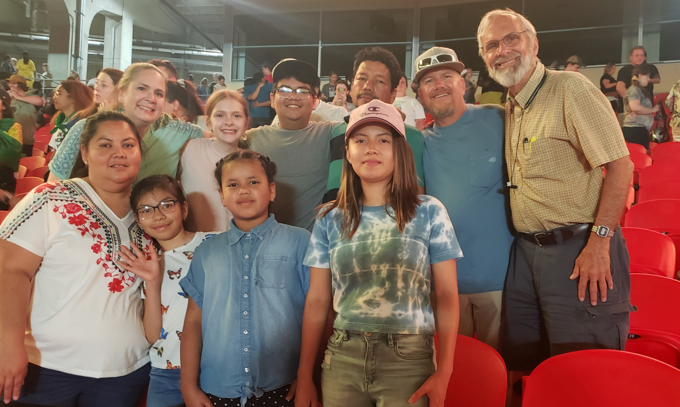

Slide 38
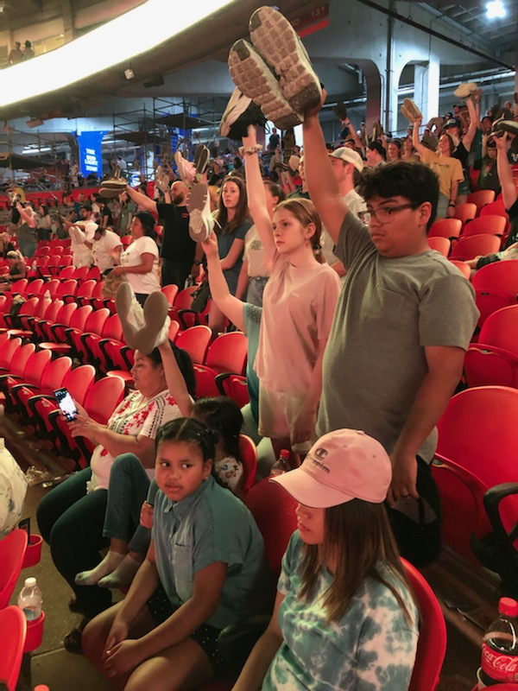
Holding up shoes as an expression of going where Yeshua calls!

Slide 39
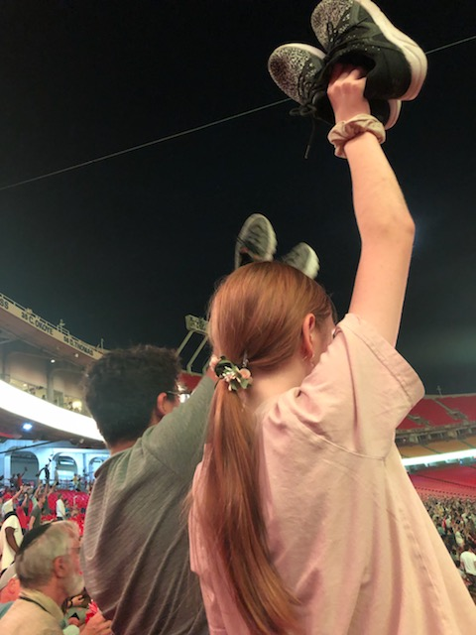
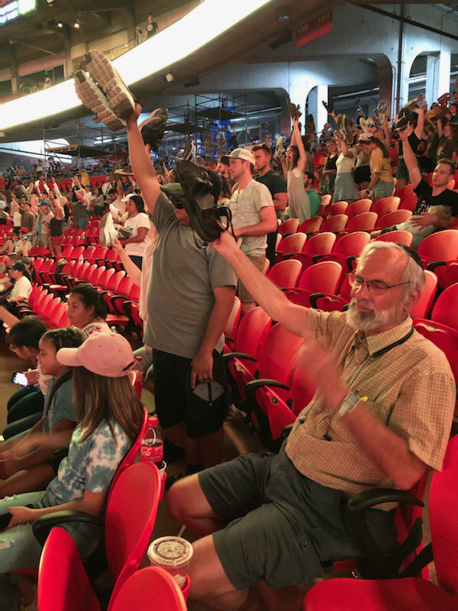

Slide 40
Youth testimonies

Slide 41
Notes:
The Send was different than One Thing. One Thing, Bartle Hall New Years 30k kids plus on line, huge and impact. Up to 120 youth from around the Messianic world, US, Europe, Israel. First met Chaim Malespin.

Slide 42
Notes:
https://thesend.org/take-action/
The largest percentage of young people come to faith by the end of their teenage years, yet thousands of high schools remain without any Yeshua presence. We want to see hundreds of high schools adopted and Yeshua clubs established.
On the average university in America 2% of students participate in a Bible group or organization. This can change. We are believing for a fresh wave of evangelists on universities who will win this generation of students to Messiah.

Slide 43
There are 107,918 foster children eligible for and waiting to be adopted. On any given day, there are nearly 428,000 children in foster care in the United States. In 2015, over 670,000 children spent time in U.S. foster care.
Notes:
https://adoptionnetwork.com/adoption-myths-facts/domestic-us-statistics/

Slide 44
Unfortunately, instead of being safely reunified with their families — or moved quickly into adoptive homes — many will languish for years in foster homes or institutions.
Notes:
https://adoptionnetwork.com/adoption-myths-facts/domestic-us-statistics/

Slide 45
Of the over 400,000 children in foster care in the U.S., 114,556 cannot be returned to their families and are waiting to be adopted. Among these children, males outnumber females, African American children are disproportionately represented, and over half are 6 years old or older.
Notes:
We don’t have the manpower…

Slide 46
^{Mt 9.37-38} Then He said to His talmidim / disciples, “The harvest is plentiful, but the workers are few. Therefore pray to the Lord of the harvest that He may send out workers into His harvest field.”

Slide 47
Example 2
of the harvest in progress
NOW, in adversity

Slide 48
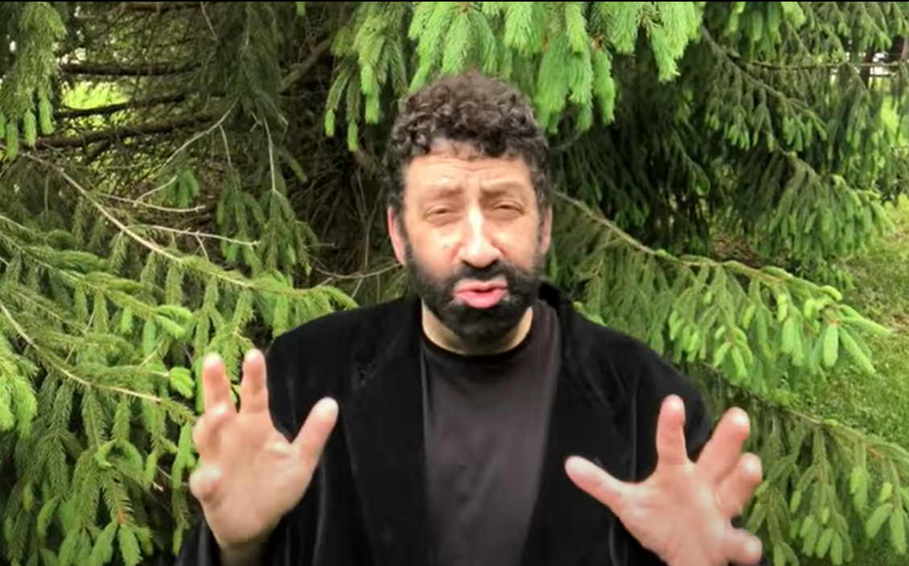

Slide 49
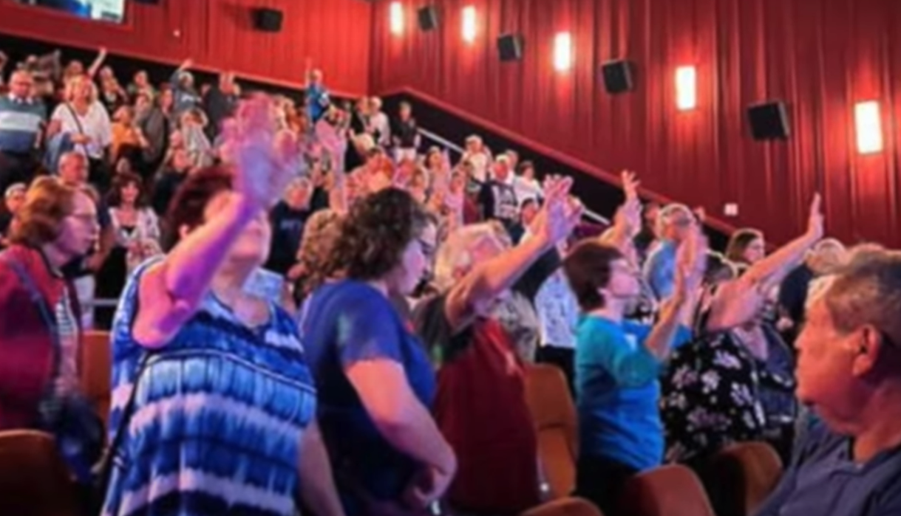
Notes:
https://www.youtube.com/watch?v=525ql0pPWiM

Slide 50
Example 3 of
the harvest in progress
in adversity

Slide 51
From Stewart Winograd
As the war in Ukraine continues, people try to find a bit of joy amid the suffering. We saw this firsthand during our recent visit to Western Ukraine.

Slide 52
Despite functioning as refugee centers, and serving the poor in their city, the congregations that we are partnering with continue to have services and prayer meetings. At these meetings many people who did not previously know the love of Yeshua are experiencing His Presence and finding a joy that goes beyond their very difficult circumstance.

Slide 53
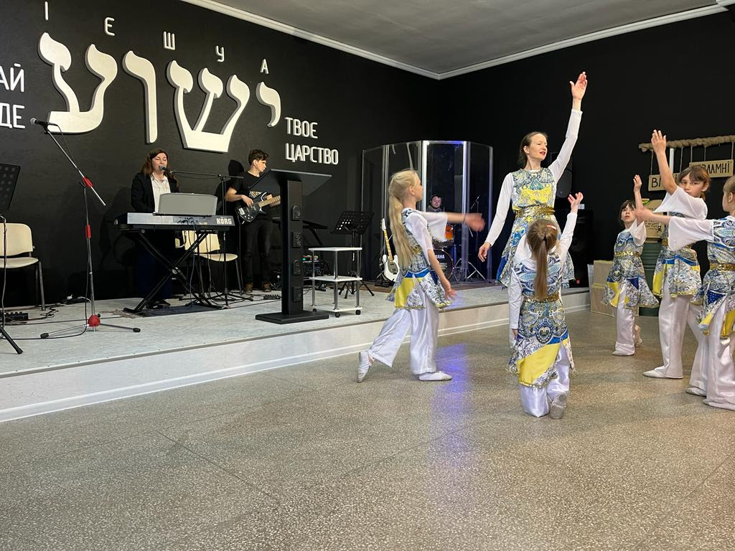

Slide 54
Today we also want to share with you how your support is enabling us to bring some joy to children. There is still no school being held in Ukraine, and the refugee children are very bored, trapped in close quarters with little to do. Because of your generosity we assisted one of our refugee center partners
Notes:
https://youtu.be/2ryNAGMOmUk

Slide 55
to set up a small playground area for the children including some trampolines.
The looks of joy on the children’s faces as they get to play and take their minds off the war around them was priceless! Check out this brief video here…
Notes:
https://youtu.be/2ryNAGMOmUk

Slide 56
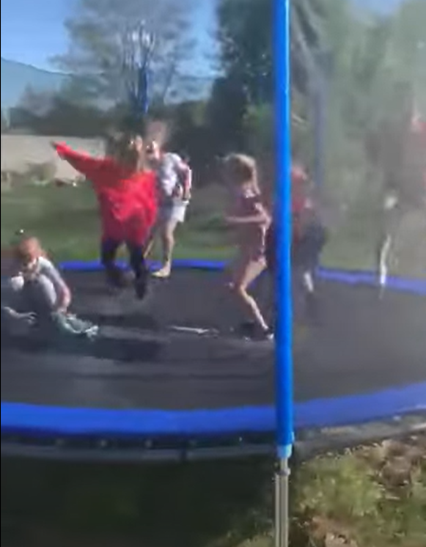
Notes:
https://youtu.be/2ryNAGMOmUk

Slide 57
Example 4
of the adversity

Slide 58
A Rolling Stone headline exclaimed, "The Buffalo Shooter Isn't a 'Lone Wolf.' He's a Mainstream Republican. “So, was the Buffalo mass murderer a conservative, a "mainstream Republican?“
Notes:
https://www.frc.org/get.cfm?i=WA22E42&f=WU22E13&utm_medium=email&utm_source=washingtonupdate&utm_campaign=wa22e42

Slide 59
Hardly. "Conservatism is corporatism in disguise, I want no part of it," he wrote. He describes himself as a "populist," an "eco-fascist," and "mild-moderate authoritarian Left."
New term: “Replacement theory.”
Notes:
https://www.frc.org/get.cfm?i=WA22E42&f=WU22E13&utm_medium=email&utm_source=washingtonupdate&utm_campaign=wa22e42

Slide 60
Example 5
of the adversity

Slide 61
Congresswoman Rashida Tlaib wants to officially commemorate the “Nakba”
The phrase “Nakba” means “catastrophe” in Arabic.
Notes:
https://www.israeltoday.co.il/read/the-nakba-myth-hijacks-congress/?utm_source=acfs&utm_medium=email&utm_term=all&utm_campaign=newsletter-en-2022-05-19

Slide 62
1948: “We will smash the country with our guns and obliterate every place the Jews seek shelter in,” said Iraqi Prime Minister Nuri Saif in 1948. “The Arabs should conduct their wives and children to safe areas until the fighting has died down.” The Jordanian newspaper Filastin admitted the same after the ceasefire that ended the war:
Notes:
https://www.israeltoday.co.il/read/the-nakba-myth-hijacks-congress/?utm_source=acfs&utm_medium=email&utm_term=all&utm_campaign=newsletter-en-2022-05-19

Slide 63
“The Arab States encouraged the Palestine Arabs to leave their homes temporarily in order to be out of the way of the Arab invasion armies.” It was the Arabs’ failure to slaughter the Jews that the Palestinians came to call their “catastrophe.”
Notes:
https://www.israeltoday.co.il/read/the-nakba-myth-hijacks-congress/?utm_source=acfs&utm_medium=email&utm_term=all&utm_campaign=newsletter-en-2022-05-19

Slide 64
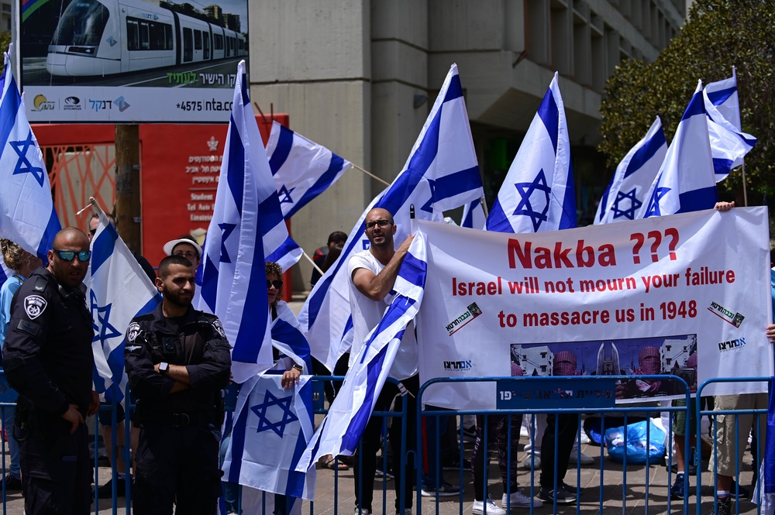
Notes:
https://www.israeltoday.co.il/read/the-nakba-myth-hijacks-congress/?utm_source=acfs&utm_medium=email&utm_term=all&utm_campaign=newsletter-en-2022-05-19

Slide 65
Yn 4.35-36
Harvest in Adversity

Slide 66
Example 6 of
the harvest in progress
in adversity

Slide 67
Yet more hazards of this time…
Stewart’s assessment is that Putin has the same demonic leadership that Hitler had.
70% of the Russian people believe Putin’s “war on Nazism” in Ukraine.
Notes:
Deception is enormous. Putin is the great defender of the Bible and tradition.
Belarussians, Minsk, every family lost someone to the Nazis. “Fascism” is a trip wire. Putin considers himself the representative of the Russian Orthodox Church and its destiny to save the world, according to Avner Boskey.
Stewart has seen the mass graves.

Slide 68
More harvest:
Sanctuaries are turned into refugee centers. Refuse to quit!
Many Ukrainian Messianic Rabbis and pastor believe that after this war there will be great turning to G-d out of the ashes.
Notes:
Reach Initiative has given $120 K to Ukrainians for food, other relief. Take zero admin fees. Committed to $30k/mo. Need for water.

Slide 69
Example 7 of
the adversity

Slide 70
WHO empowerment

Slide 71
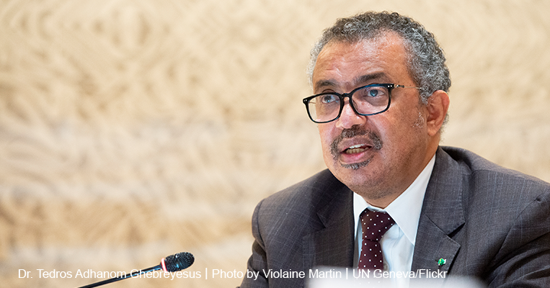
Dr. Tedros Adhanom
Ghebreyesus,
Director-General of
the World Health
Organization
since 2017.
Notes:
https://www.frc.org/get.cfm?i=WA22E48&f=WU22E15&utm_medium=email&utm_source=washingtonupdate&utm_campaign=wa22e48

Slide 72
On January 18, 2022, the Biden administration proposed a series of amendments to WHO’s International Health Regulations (IHR), which would give WHO authority to control global health care policies, including those of the United States. WHO will meet May 22-28 to vote on Biden's amendments.
Notes:
https://lc.org/newsroom/details/220516-urgent-stop-who-takeover-of-america

Slide 73
Go to https://lc.org/newsroom/details/220516-urgent-stop-who-takeover-of-america

Slide 74
The way to have harvest in adversity illustrated:

Slide 75
Dwight Widaman wrote:
On my way home from the oncologist today I noticed a little tree frog clinging to the windshield wiper. At 65 miles an hour and with swirling wind, that little frog continued to hold on until we were both safely home.

Slide 76
In our own life struggles we, too, need to hold on. Hold on to Yeshua.
Bad health diagnosis? Hold on.
Estranged child? Hold on.

Slide 77
Divorce? Hold on.
Exhausted caregiver? Hold on.
Military deployment? Hold on.
Death of a loved one? Hold on.
Job issues? Hold on.
Conflict with a friend? Hold on.
Thoughts of suicide? Hold on!

Slide 78
That frog didn't know the destination or how long the journey would be but it was determined to hold on with every ounce of energy.
You need to hold on. Hold on to Yeshua.

Slide 79
And if you've survived the journey and a friend is struggling, let them hold on to Yeshua by holding on to you.
Just hold on.
Dwight Widaman

Slide 80
Yn 4.35-36
Harvest in Adversity
Notes:
Worship team please

Slide 81
^{Yn 4.35-36} Don’t you have a saying, ‘Four more months and then the harvest’? Well, what I say to you is: open your eyes and look at the fields! They’re already ripe for harvest! The one who reaps receives his wages and gathers fruit for eternal life.
Notes:
That is, harvest isn’t just for after Shavuot, the count is done. It is NOW!

Slide 82
Take off and wave your shoes as expression of
Walking with Yeshua
Going where He SENDS

Slide 83
Do you KNOW Yeshua and the assurance of sins forgiven?
Are you hearing daily from His Word?
How are you applying what you heard?
Are you asking this of another?
Notes:
Who are you discipling, building up?4

Slide 84
Third hour Prayer Points

Slide 85
1. ^{Mt 9.37-38} Then He said to His talmidim / disciples, “The harvest is plentiful, but the workers are few. Therefore pray to the Lord of the harvest that He may send out workers into His harvest field.”
Servants, evangelists, givers.

Slide 86
2. That G-d will cause Putin to
have Nebuchadnezzar syndrome: eat grass like an ox, then repent before the Most High
Or be removed from power

Slide 87
3. That the Iranian leadership Ibrahim Raisi and Ayatola Khameini would have similar.
4. That the WHO upcoming decision would fail.

