Slide 1
e-handout
To have these notes
without taking notes
Go to OrHaOlam.com
Click on Messages tab,
2022 Messages

Slide 2
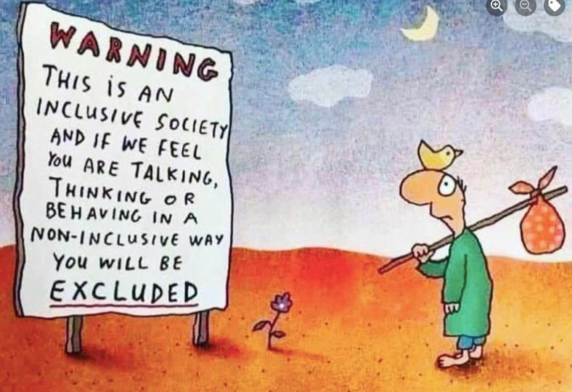
Notes:
From Bob Mendelsohn

Slide 3
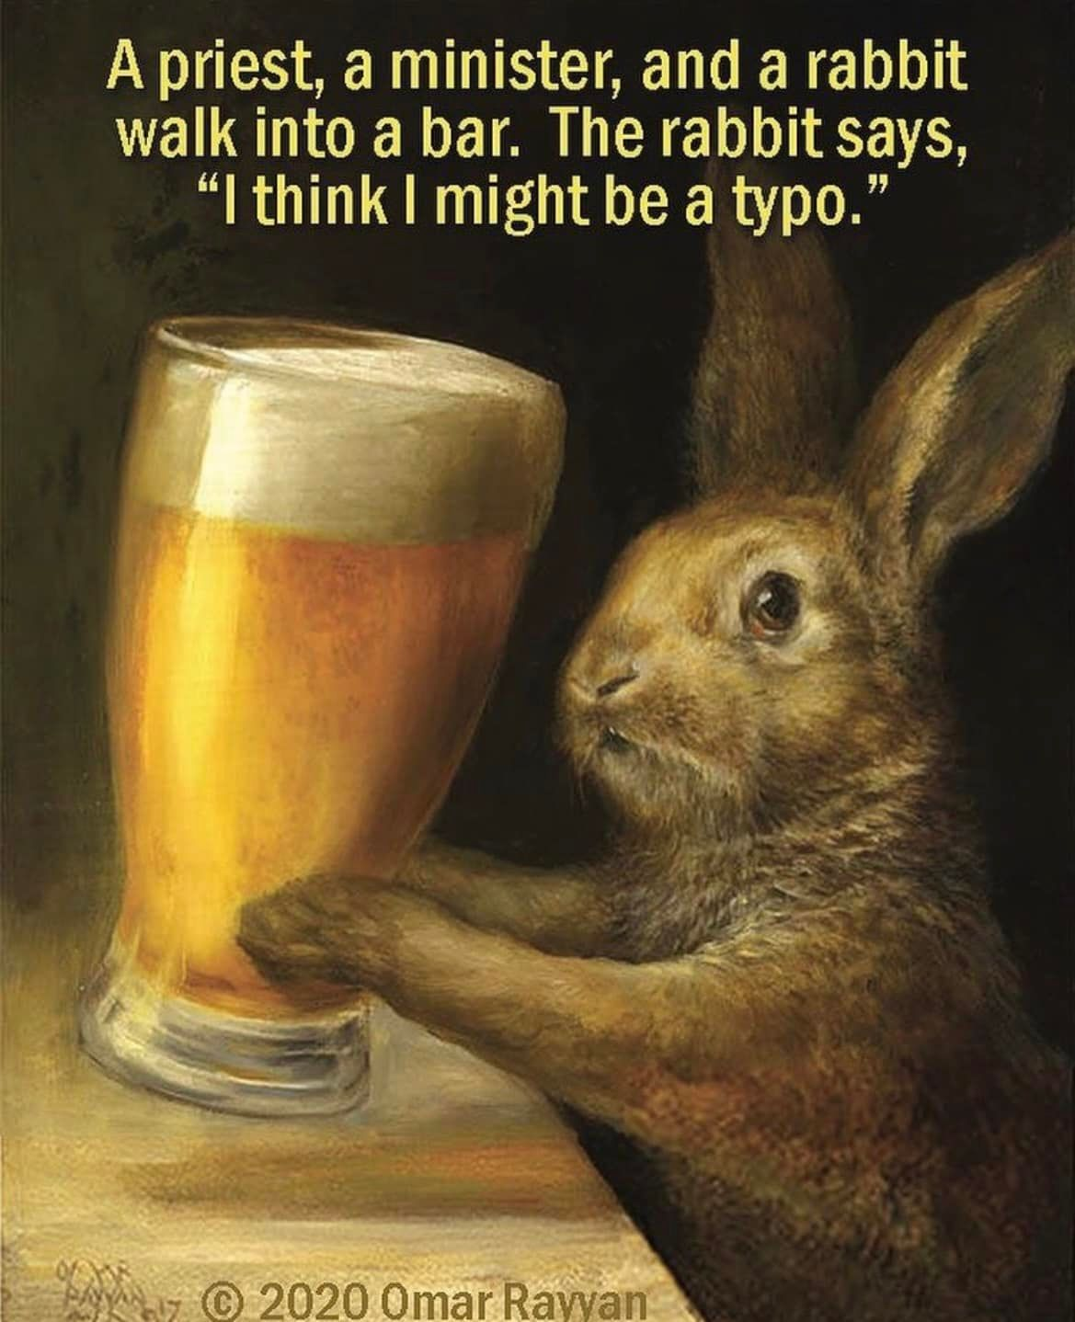

Slide 4
Notes:
From Rukhel Fields

Slide 6
Notes:
https://www.thejkc.org/jewish-experiences/day-of-discovery/

Slide 7
SESSION I - 9:30-10:45 a.m.
Modeh Ani Embodied: yoga
Notes:
I love the Modeh Ani prayer, Nefesh Mountain and other renditions.
OK. Not endorsing, but I know at least two people who do yoga and are VERY scrupulous to say no Hindu mantras, or even fact the image that is in the room. Just stretching, balance, etc.

Slide 8
SESSION II - 11 a.m.-12:15 p.m.
Spiritual Preparation for the High Holy Days
Rabbi Beryl Padorr, Associate Rabbi, Congregation Beth Shalom, Overland Park.
Rabbi Linda Steigman, Temple Adath Joseph, St. Joseph, MO.

Slide 9
“If I were to ask you, What are the three sounds of these Holy Days,” you would probably tell me?

Slide 10
“If I were to ask you, What are the three sounds of these Holy Days,” you would probably tell me?
“The blasts of the Shofar

Slide 11
“If I were to ask you, What are the three sounds of these Holy Days,” you would probably tell me?
“The blasts of the Shofar
The chanting of the Kol Nidre

Slide 12
“If I were to ask you, What are the three sounds of these Holy Days,” you would probably tell me?
“The blasts of the Shofar
The chanting of the Kol Nidre
The Avinu Malkeinu.” אָבִינוּ מַלְכֵּנוּ
Notes:
That resonated in my spirit as the Ruakh download for today.
Note transliteration varies.

Slide 13
אָבִינוּ מַלְכֵּנוּ

Slide 14
Avinu Malkenu, אָבִינוּ מַלְכֵּנוּ
Context and history
Praying it, selected verses
Applications and implications
Notes:
To Yeshua

Slide 15
Avinu Malkenu, אָבִינוּ מַלְכֵּנוּ
Context and history
Praying it, selected verses
Applications and implications
Notes:
To Yeshua

Slide 16
Avinu Malkenu אָבִינוּ מַלְכֵּנוּ
Our Father our King
Two opposite yet complementary attributes of G-d.
Loving Father, Just Ruler

Slide 17
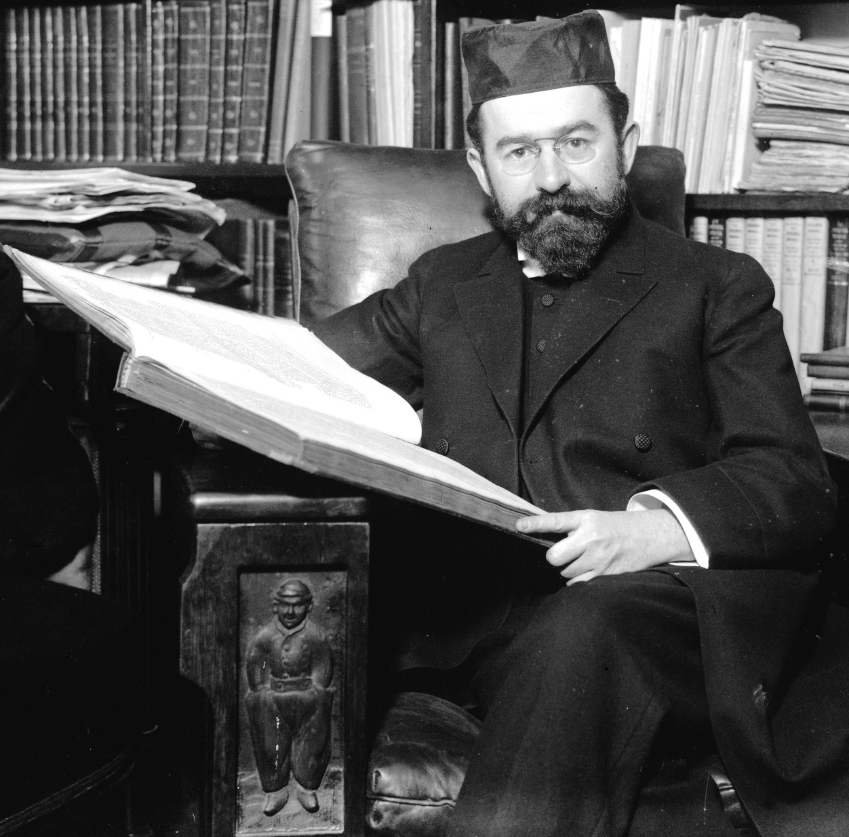
described Avinu Malkenu as “the oldest and most moving of all the litanies of the Jewish Year.”
R. J.H. Hertz,
chief rabbi of the British
Empire, 1913 until his death in 1946.
Notes:
Pulpit Humash / Bible: Torah and Haftorah and commentary of my youth
https://en.wikipedia.org/wiki/Avinu_Malkeinu

Slide 18
Last Shabbat on
The Father’s Love, and the epidemic of fatherlessness.
Notes:
https://actors.bible/about
https://www.youtube.com/watch?v=Ob-kLBNzVSY
https://youtu.be/Ob-kLBNzVSY

Slide 19
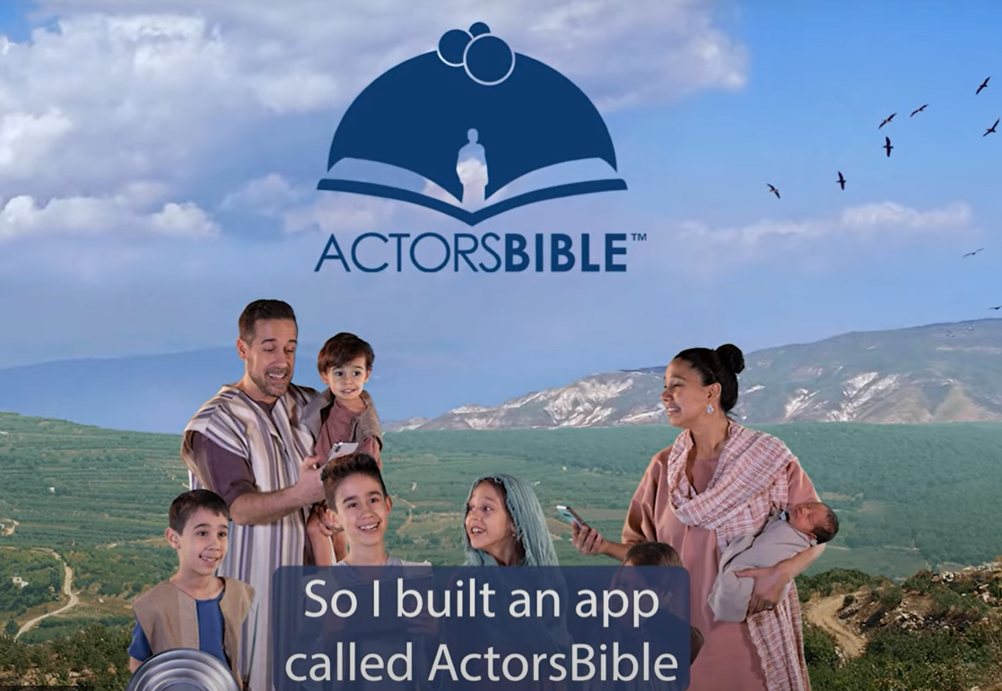
Notes:
https://actors.bible/about
https://www.youtube.com/watch?v=Ob-kLBNzVSY
https://youtu.be/Ob-kLBNzVSY
One couple already signed up!!
Build on that: G-d is our Father and our King, in Messiah!

Slide 20
Our Father
^{Yeshyahu /Is 63:16} You are our Father—even if Abraham would not know us or Israel not recognize us.
You, Adoni, are our Father, our Redeemer— from everlasting is Your Name.

Slide 21
Father
a male human parent
a person who establishes a whole new field of endeavor: Sir Isaac Newton is regarded by many as the father of modern science
Notes:
https://www.merriam-webster.com/thesaurus/father

Slide 22
Father
Synonyms for father: author, begetter, creator, establisher, founder, founding father, generator, inaugurator, initiator, instituter (or institutor), originator, sire, encourager, galvanizer, inspiration, inspirer
Notes:
https://www.merriam-webster.com/thesaurus/father
Many of us don’t have this in our kishkas. Trying to build.

Slide 23
“Our King”
^{Yeshayahu/ Is 33:22} For Adoni is our judge, Adoni is our lawgiver,
Adoni is our king. He will save us.

Slide 24
King מֶלֶךְ
A person who embodies the supreme power in a monarchical regime. He is usually crowned for life, and his rule is usually inherited.

Slide 25
אָבִֽינוּ מַלְכֵּֽנוּ A-vee-noo mal-kay-noo
There is a midrash that says that
the world is balanced
between absolute compassion and rigorous justice.
Notes:
Messiah Yeshua, in His coming, death, resurrection, and Aliyah/ascent brought BOTH

Slide 26
History:
began as a simple folk prayer
2nd century the Talmud records Rabbi Akiva (died 135 CE) reciting two verses each beginning “Our Father, Our King”
The prayer book of Amram Gaon (9th C) had 25 verses.
Notes:
https://en.wikipedia.org/wiki/Avinu_Malkeinu

Slide 27
Mahzor Vitry (early 12th C France) has more than 40 verses
High Holiday Prayer book = Makhzor chorus:
Notes:
https://en.wikipedia.org/wiki/Avinu_Malkeinu

Slide 28
Each line of the prayer begins with the words "Avinu Malkeinu" ["Our Father, Our King"] and is then followed by varying phrases, mostly supplicatory.
Notes:
https://en.wikipedia.org/wiki/Avinu_Malkeinu

Slide 29
אָבִֽינוּ מַלְכֵּֽנוּ A-vee-noo mal-kay-noo
אָבִֽינוּ מַלְכֵּֽנוּ! אָבִֽינוּ מַלְכֵּֽנוּ!
A-vee-noo mal-kay-noo!
Our Father and our King 2x

Slide 30
אָבִֽינוּ מַלְכֵּֽנוּ A-vee-noo mal-kay-noo
אָבִֽינוּ מַלְכֵּֽנוּ! חָנֵּֽנוּ וַעֲנֵֽנוּ, כִּי אֵין בָּֽנוּ מַעֲשִׂים,
A-vee-noo mal-kay-noo! Kha-nay-noo-va-ah-nay-noo,
kee ayn ba-noo ma-a-seem.
Our father, Our King,
be merciful to us, and answer us
For we have no deeds [to commend us.]
Notes:
Here is the opposite of salvation by works. We have no deeds. So essential to the thrust of G-dliness, focused in this season.
“I’m right, and violated”

Slide 31
עֲשֵׂה עִמָּנוּ צְדָקָה וָחֶסֶד
A-say ee-ma-noo
tz'da-ka va-khe-sed.
Make us righteous and loving,
Notes:
Make us…implies we need divine intervention. We can “white knuckle” our righteousness, a friend wrote, and sometimes have to. But ultimately it’s Ruakh intervention. That is where the Yeshua dimension of our faith is central, foundational.

Slide 32
עֲשֵׂה עִמָּנוּ צְדָקָה וָחֶסֶד וְהוֹשִׁיעֵֽנוּ.
A-say ee-ma-nu tz'da-ka
va-khe-sed, v'ho-shee-ay-nu.
Make us righteous and loving,
and save us!

Slide 33
Our Father and our King, be merciful to us,
and answer us,
for we have no deeds
to commend us.
Make us righteous and loving,
and save us!

Slide 34
Similar in concept to Shaul/Paul’s statement and prayer for continued growth, purification in Messiah.

Slide 35
^{Phil. 3.12-14} Not that I have already obtained this or been perfected, but I press on if only I might take hold of that for which Messiah Yeshua took hold of me. Brothers and sisters, I do not consider myself as having taken hold of this. But this one thing I do:

Slide 36
^{Phil. 3.12-14} forgetting what is behind and straining toward what is ahead, I press on toward the goal for the reward of the upward calling of God in Messiah Yeshua.

Slide 37
^{Phil 3.7-9} But whatever things were gain to me, these I have considered as loss for the sake of the Messiah. More than that, I consider all things to be loss in comparison to the surpassing value of the knowledge of Messiah Yeshua my Lord.

Slide 38
^{Phil 3.7-9} Because of Him I have suffered the loss of all things; and I consider them garbage in order that I might gain Messiah and be found in Him.

Slide 39
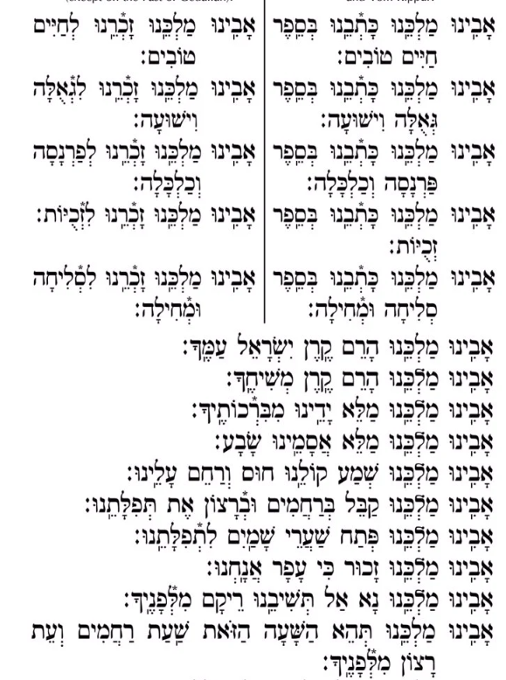
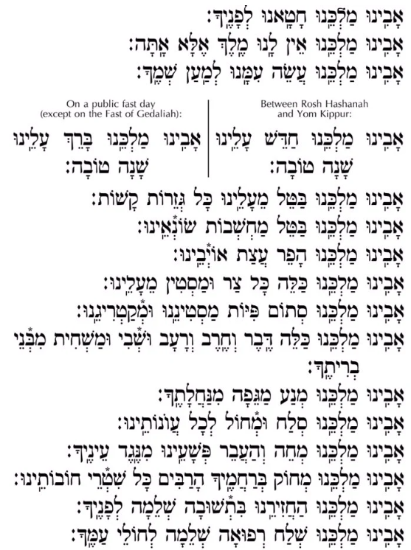
Notes:
https://www.chabad.org/library/article_cdo/aid/4491743/jewish/Avinu-Malkeinu-HebrewEnglish-Text.htm#AvinuMalkeinu

Slide 40
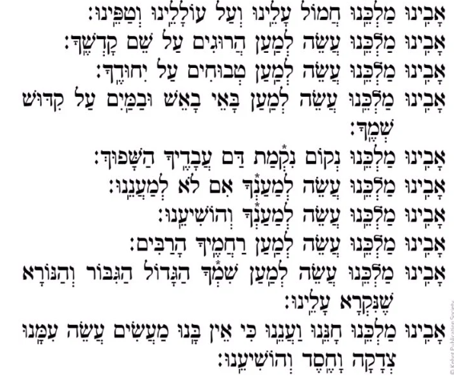
Notes:
https://www.chabad.org/library/article_cdo/aid/4491743/jewish/Avinu-Malkeinu-HebrewEnglish-Text.htm#AvinuMalkeinu

Slide 41
אָבִינוּ מַלְכֵּנוּ

Slide 42
Avinu Malkenu, אָבִינוּ מַלְכֵּנוּ
Context and history
Praying it, selected verses
Applications and implications
Notes:
To Yeshua

Slide 43
^{Yeshayahu/ Is. 9.6} For a child is born to us, a son is given to us; dominion will rest on his shoulders, and he will be given the name Pele-Yo‘etz El Gibbor Avi-‘Ad Sar-Shalom Wonder of a Counselor, Mighty God, Father of Eternity, Prince of Peace.
Notes:
To Yeshua

Slide 44
Our Father, our King, we have sinned before You.
Our Father, our King, we have no King but You.
Our Father, our King, act [benevolently] with us for the sake of Your Name.
Notes:
https://en.wikipedia.org/wiki/Avinu_Malkeinu
https://www.chabad.org/library/article_cdo/aid/4491743/jewish/Avinu-Malkeinu-HebrewEnglish-Text.htm#AvinuMalkeinu

Slide 45
Our Father, our King, remove from us all harsh decrees.
Our Father, our King, annul the intentions of our enemies.
Our Father, our King, foil the plans of our foes.
Notes:
https://en.wikipedia.org/wiki/Avinu_Malkeinu
https://www.chabad.org/library/article_cdo/aid/4491743/jewish/Avinu-Malkeinu-HebrewEnglish-Text.htm#AvinuMalkeinu

Slide 46
Our Father, our King, wipe out every oppressor and adversary from against us.
Our Father, our King, close the mouths of our adversaries and accusers.
Our Father, our King, remove pestilence, sword, famine, captivity, and destruction from the members of Your covenant.
Notes:
https://www.chabad.org/library/article_cdo/aid/4491743/jewish/Avinu-Malkeinu-HebrewEnglish-Text.htm#AvinuMalkeinu

Slide 47
Our Father, our King, erase in Your abounding mercies all the records of our debts [sins].
Our Father, our King, bring us back to You in wholehearted repentance.
Our Father, our King, send a complete healing to the sick of Your people.
Notes:
https://www.chabad.org/library/article_cdo/aid/4491743/jewish/Avinu-Malkeinu-HebrewEnglish-Text.htm#AvinuMalkeinu

Slide 48
Our Father, our King, remember us for redemption and deliverance.
Our Father, our King, remember us for livelihood and sustenance.
Notes:
https://www.chabad.org/library/article_cdo/aid/4491743/jewish/Avinu-Malkeinu-HebrewEnglish-Text.htm#AvinuMalkeinu

Slide 49
Our Father, our King, remember us for pardon and forgiveness
Our Father, our King, cause deliverance to flourish for us soon.
Our Father, our King, exalt the glory of Israel Your people.
Our Father, our King, exalt the glory of Your anointed one.
Notes:
https://www.chabad.org/library/article_cdo/aid/4491743/jewish/Avinu-Malkeinu-HebrewEnglish-Text.htm#AvinuMalkeinu

Slide 50
Our Father, our King, accept our prayer with mercy and with favor.
Our Father, our King, open the gates of heaven to our prayer.
Our Father, our King, let it be remembered that we are but dust.
Our Father, our King, we beseech You, do not turn us away from You empty-handed.
Notes:
https://www.chabad.org/library/article_cdo/aid/4491743/jewish/Avinu-Malkeinu-HebrewEnglish-Text.htm#AvinuMalkeinu

Slide 51
Our Father, our King, have compassion upon us, and upon our infants and children.
Our Father, our King, do it for Your sake, and deliver us.
Our Father, our King, do it for the sake of Your abounding mercies.
Our Father, our King, do it for the sake of Your great, mighty and awesome Name which is proclaimed over us.
Notes:
https://www.chabad.org/library/article_cdo/aid/4491743/jewish/Avinu-Malkeinu-HebrewEnglish-Text.htm#AvinuMalkeinu

Slide 52
Our Father, our King, withhold the plague from Your inheritance.
Our Father, our King, pardon and forgive all our iniquities.
Our Father, our King, blot out and remove our transgressions from before Your eyes.

Slide 53
אָבִינוּ מַלְכֵּנוּ

Slide 54
Avinu Malkenu, אָבִינוּ מַלְכֵּנוּ
Context and history
Praying it, selected verses
Applications and implications
Notes:
To Yeshua

Slide 55
^{2 Cor 12.14-15} Look, I am ready this third time to come and visit you; and I will not be a burden to you; for it is not what you own that I want, but you! Children are not supposed to save up for their parents, but parents for their children.

Slide 56
^{2 Cor 12.14-15} And as for me, I will most gladly spend everything I have and be spent myself too for your sakes. If I love you more, am I to be loved less?

Slide 57
^{1 Thes 211-12} For you know that we treated each one of you the way a father treats his children — we encouraged you and comforted you and appealed to you to lead lives worthy of God, who calls you into his Kingdom and glory.

Slide 58
^{Mk 13.12-13} Brother will betray brother to death, and a father his child. And children will rise up against parents and have them put to death. And you will be hated by all because of My name, but the one who endures to the end will be saved.

Slide 59
^{Mishlei/Prov 13.1} A son who heeds his father’s discipline is wise, but a scoffer doesn’t listen to rebuke.
^{Mishlei/Prov 13.24} He who fails to use a stick hates his son, but he who loves him is careful to discipline him.

Slide 61
אָבִינוּ מַלְכֵּנוּ Aveenu Malkaynu (Our Father, Our King) Holy Day Version
Max Janowski rendition of a prayer in the Makhzor
Used by permission, CCLI license #2412213

Slide 62
אָבִינוּ מַלְכֵּנוּ
שְׁמַע קוֹלֵנוּ
Ah-vee-nu Mal-kay-nu
Sh’ma Ko-lay-nu
[Our Father, Our King
Listen to our voice]

Slide 63
אָבִינוּ מַלְכֵּנוּ
חָטָאנוּ לְפָנֶיךָ
Ah-vee-nu Mal-kay-nu
Kha-ta-nu l'fa-ney-kha
[Our Father, Our King
We have sinned against You]

Slide 64
אָבִינוּ מַלְכֵּנוּ
Ah-vee-nu Mal-kay-nu
[Our Father, Our King]

Slide 65
חֲמוֹל עָלֵינוּ וְעַל עוֹלָלֵנוּ וְטַפֵּנוּ
Kha-mol a-lay-nu v’al
o-la-lay-nu v'ta-pay-nu
[Have compassion on us
and on our babies and our children]

Slide 66
אָבִינוּ מַלְכֵּנוּ
Ah-vee-nu Mal-kay-nu
[Our Father, Our King]

Slide 67
כַּלֵּה דֶּבֶר וְחֶרֶב וְרָעָב מֵעָלֵינוּ
Kah-lay deh-ver v'kheh-rev v'rah-av may-ah-lay-nu
[Make an end to sickness, and war (sword) and famine upon us]

Slide 68
אָבִינוּ מַלְכֵּנוּ
Ah-vee-nu Mal-kay-nu
[Our Father, Our King]

Slide 69
כַּלֵּה כָּל צַר וּמַשְׂטִין מֵעָלֵינוּ
Kah-lay kawl tsar
oo-mas-teen may-ah-lay-nu
[Make an end to all oppression and Satanic accusation from upon us]

Slide 70
[Selah] סֶלָה

Slide 71
אָבִינוּ מַלְכֵּנוּ
אָבִינוּ מַלְכֵּנוּ
Ah-vee-nu Mal-kay-nu
Ah-vee-nu Mal-kay-nu
[Our Father, Our King
Our Father, Our King]

Slide 72
כָּתְבֵנוּ בְּסֵפֶר חַיִּים טוֹבִים
Kaht-vay-nu b'say-fehr khi-yeem to-veem
[Inscribe us in the
Book of Life for good]
Notes:
Assurance of salvation

Slide 73
אָבִינוּ מַלְכֵּנוּ
Ah-vee-nu Mal-kay-nu
[Our Father, Our King]

Slide 74
חַדֵּשׁ עָלֵינוּ
חַדֵּשׁ עָלֵינוּ שָׁנָה טוֹבָה.
Kha-daysh a-lay-nu
Kha-daysh a-lay-nu
Sha-nah to-vah
[Renew us, renew us for a good year]

Slide 75
[Selah] סֶלָה

Slide 76
אָבִינוּ מַלְכֵּנוּ
Ah-vee-nu Mal-kay-nu
[Our Father, Our King]

Slide 77
חַדֵּשׁ עָלֵינוּ חַדֵּשׁ עָלֵינוּ
שָׁנָה טוֹבָה.
Kha-daysh a-lay-nu
Kha-daysh a-lay-nu
Sha-nah to-vah
[Renew us,
renew us for a good year]

Slide 78
אָבִינוּ מַלְכֵּנוּ
Ah-vee-nu Mal-kay-nu
[Our Father, Our King]

Slide 79
שְׁמַע קוֹלֵנוּ שְׁמַע קוֹלֵנוּ
שְׁמַע קוֹלֵנוּ
Sh'ma Ko-lay-nu, Sh'ma Ko-lay-nu,
Sh'ma Ko-lay-nu
[Hear our voice, Hear our voice
Hear our voice]

Slide 80
כָּתְבֵנוּ בְּסֵפֶר חַיִּים טוֹבִים
Kaht-vay-nu b'say-fehr khi-yeem to-veem
[Inscribe us in the
Book of Life for good]
Notes:
Assurance of salvation

Slide 81
In Rabbinic theology, The Book of Life, ספר החיים, Sefer HaKhaim; is the book in which God records the names of every person who is destined for Heaven and the World to Come. According to the Talmud it is open on Rosh Hashanah, as is its analog for the wicked, the Book of the Dead.
Notes:
https://en.wikipedia.org/wiki/Book_of_Life

Slide 82
Babylonian Talmud, Rosh Hashana 16b On Rosh Hashana, three books are opened [in Heaven] – one for the thoroughly wicked, one for the thoroughly righteous, and one for those in-between. The thoroughly righteous are immediately inscribed clearly in the Book of Life.
Notes:
https://en.wikipedia.org/wiki/Unetanneh_Tokef

Slide 83
Babylonian Talmud, Rosh Hashana 16b The thoroughly wicked are immediately inscribed clearly in the Book of Death. The fate of those in-between is postponed from Rosh Hashana until Yom Kippur, at which time those who are deserving are then inscribed in the Book of Life,
Notes:
https://en.wikipedia.org/wiki/Unetanneh_Tokef

Slide 84
Babylonian Talmud, Rosh Hashana 16b those who are undeserving are then inscribed in the Book of Death.
Notes:
This idea of special repentance and accountability between Rosh HaShannah and Yom Kippur is a good emphasis, but NOT a scriptural, Biblical mandate.
https://en.wikipedia.org/wiki/Unetanneh_Tokef

Slide 85
^{Eph.6.11-17} Put on the full armor of God, so that you are able to stand against the schemes of the devil. For our struggle is not against flesh and blood, but against the rulers, against the powers, against the worldly forces of this darkness, and against the spiritual forces of wickedness in the heavenly places.

Slide 86
^{Eph.6.11-17} Therefore, take up the full armor of God, so that you may be able to resist when the times are evil, and after you have done everything, to stand firm. Stand firm then! Buckle the belt of truth around your waist, and put on the breastplate of righteousness.

Slide 87
^{Eph.6.11-17} Strap up your feet in readiness with the Good News of shalom. Above all, take up the shield of faith with which you will be able to extinguish all the flaming arrows of the evil one. And take the helmet of salvation and the sword of the Spirit, which is the word of God.

Slide 88
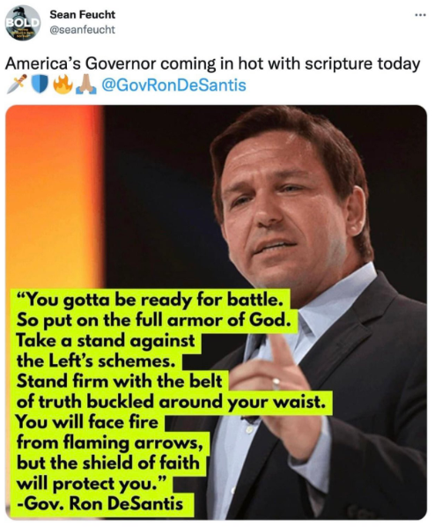
Put on the full armor of God, so that you are able to stand against the schemes of the devil… Stand firm then! Stand firm then! Buckle the belt of truth around your waist… take up the shield of faith with which you will be able to extinguish all the flaming arrows of the evil one

Slide 89
Notes:
https://www.patheos.com/blogs/askshaunti/

Slide 90
Shaunti Feldhan: Boarding the airplane back was very different. I rolled my heavy suitcase on and struggled to lift it up high enough to get it into the bin. I could see four men in nearby rows watching my efforts—yet none of them said anything. But here’s the thing: I could tell each of them wanted to.
Notes:
https://www.patheos.com/blogs/askshaunti/

Slide 91
Out of the corner of my eyes, I could see their reactions. Each individual guy was struggling to not jump up. To not say, “Can I help you?” I could feel their conflict. One in particular—a thirty-something guy dressed in business casual—looked very torn. He literally had his hands on his arm rests, as if he wanted to push himself to his feet. But he didn’t.
Notes:
https://www.patheos.com/blogs/askshaunti/

Slide 92
I gave up momentarily, put the suitcase down heavily, and rubbed my shoulder. I was saved by a young college guy coming down the aisle after me. He was wearing a Wake Forest University sweatshirt and was probably 18 years old—too young to have the concerns the other men did.
Notes:
https://www.patheos.com/blogs/askshaunti/

Slide 93
אָבִֽינוּ מַלְכֵּֽנוּ A-vee-noo mal-kay-noo
אָבִֽינוּ מַלְכֵּֽנוּ! אָבִֽינוּ מַלְכֵּֽנוּ!
A-vee-noo mal-kay-noo!
Our Father and our King 2x

Slide 94
אָבִֽינוּ מַלְכֵּֽנוּ A-vee-noo mal-kay-noo
אָבִֽינוּ מַלְכֵּֽנוּ! חָנֵּֽנוּ וַעֲנֵֽנוּ, כִּי אֵין בָּֽנוּ מַעֲשִׂים,
A-vee-noo mal-kay-noo! Kha-nay-noo-va-ah-nay-noo,
kee ayn ba-noo ma-a-seem.
Our father, Our King,
be merciful to us, and answer us
For we have no deeds [to commend us.]
Notes:
Here is the opposite of salvation by works. We have no deeds. So essential to the thrust of G-dliness, focused in this season.
“I’m right, and violated”

Slide 95
עֲשֵׂה עִמָּנוּ צְדָקָה וָחֶסֶד
A-say ee-ma-noo
tz'da-ka va-khe-sed.
Make us righteous and loving,
Notes:
Make us…implies we need divine intervention. We can “white knuckle” our righteousness, a friend wrote, and sometimes have to. But ultimately it’s Ruakh intervention. That is where the Yeshua dimension of our faith is central, foundational.

Slide 96
עֲשֵׂה עִמָּנוּ צְדָקָה וָחֶסֶד וְהוֹשִׁיעֵֽנוּ.
A-say ee-ma-nu tz'da-ka
va-khe-sed, v'ho-shee-ay-nu.
Make us righteous and loving,
and save us!

Slide 97
Our Father and our King, be merciful to us,
and answer us,
for we have no deeds
to commend us.
Make us righteous and loving,
and save us!

Slide 98
Do you KNOW Yeshua and the Father with assurance of sins forgiven?
Are you hearing daily from His Word?
How are you applying what you heard?
Are you asking this of another?
Notes:
Who are you discipling, building up?4

