Slide 1
e-handout
To have these notes
without taking notes
Go to OrHaOlam.com
Click on Messages tab,
2022 Messages
Notes:
You may notice that I’m slowing down in my rate of speech. This is because we may be getting language translation equipment for simultaneous translation.

Slide 2
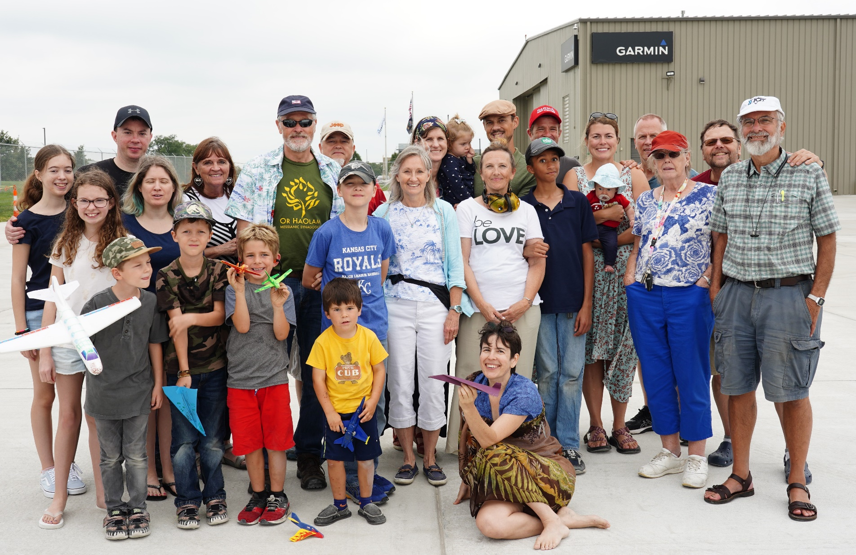

Slide 3
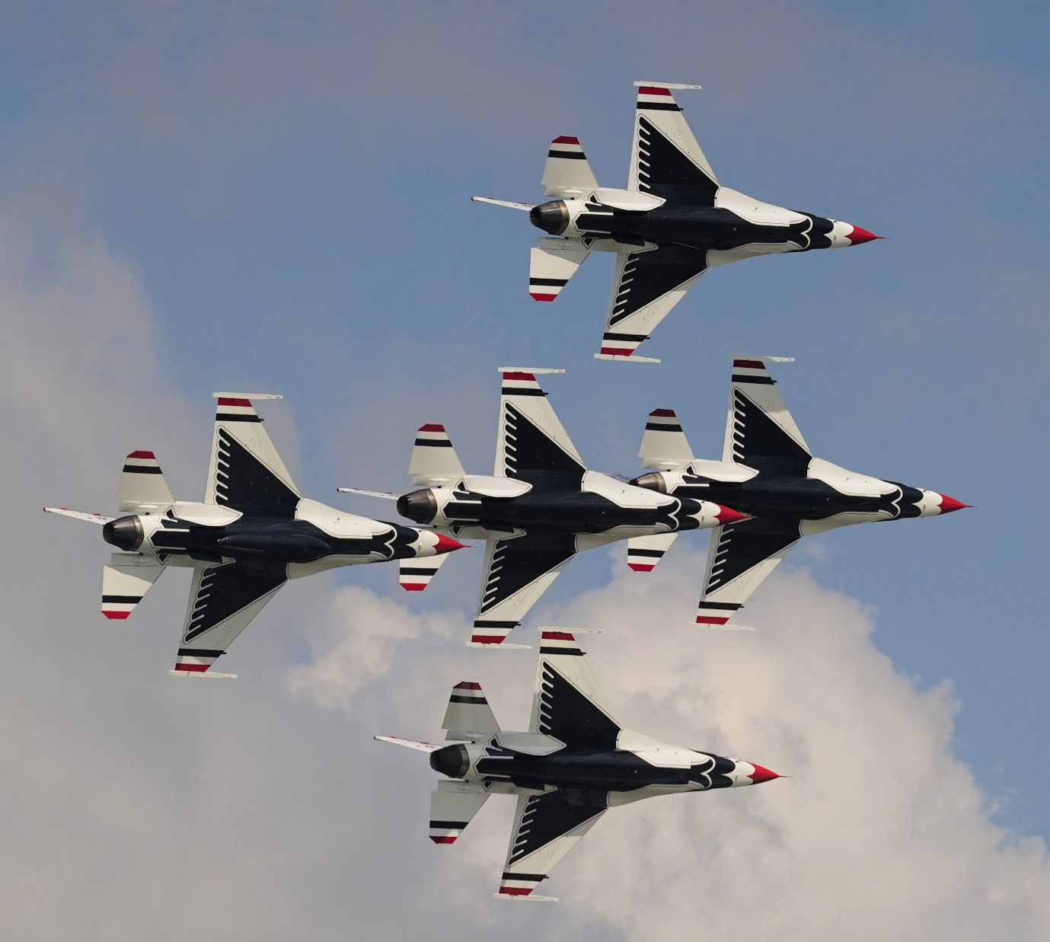

Slide 4
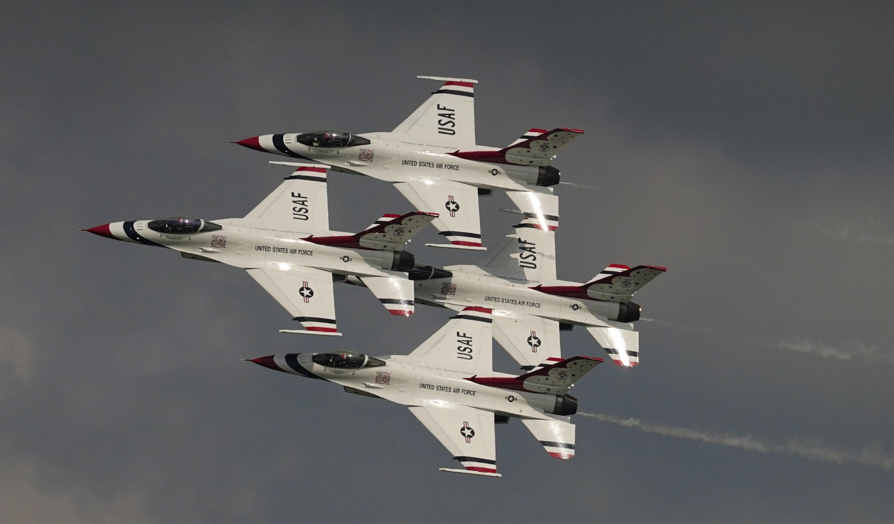

Slide 5
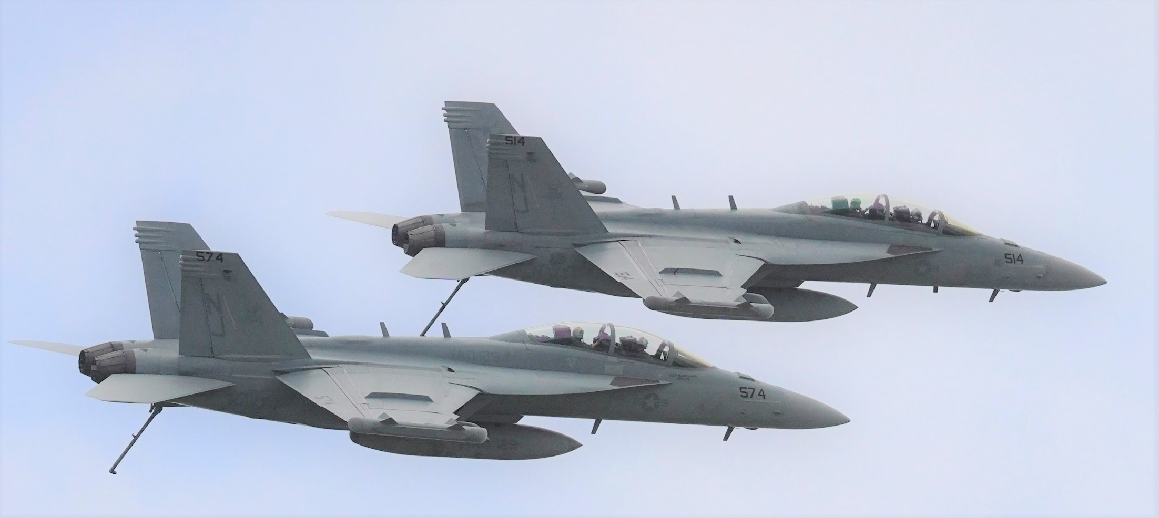
F-18 with tailhook down

Slide 6
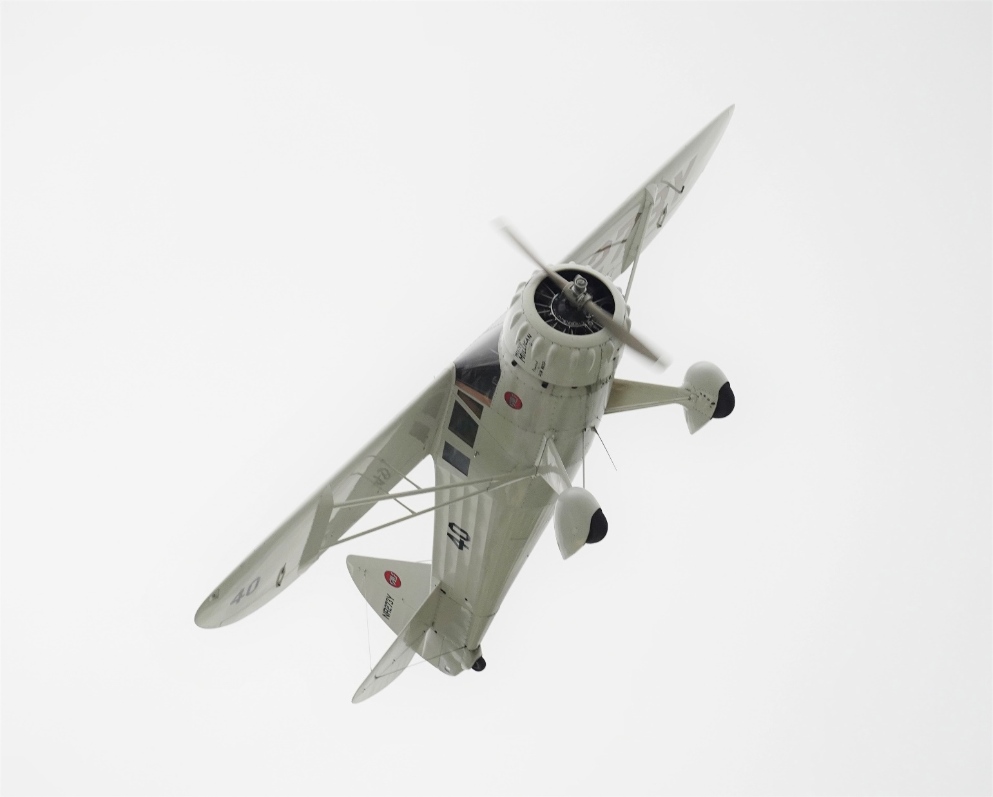

Slide 7
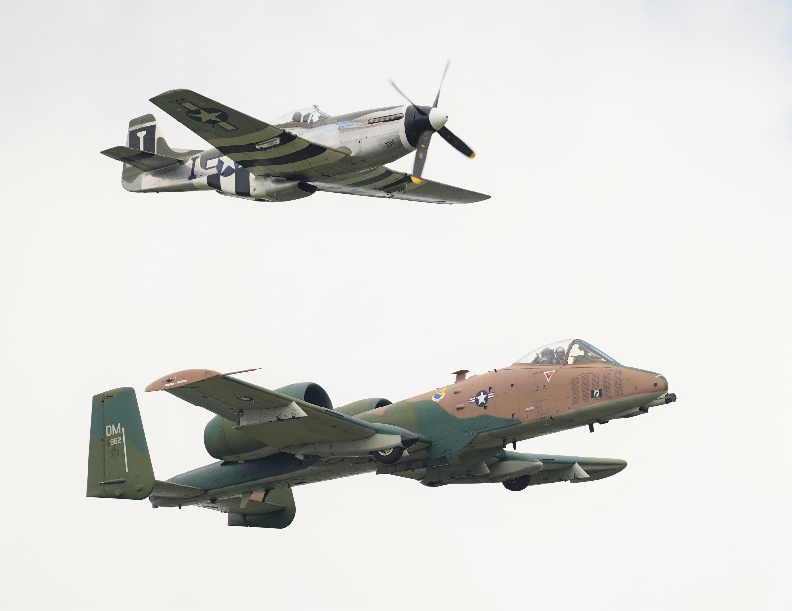

Slide 8
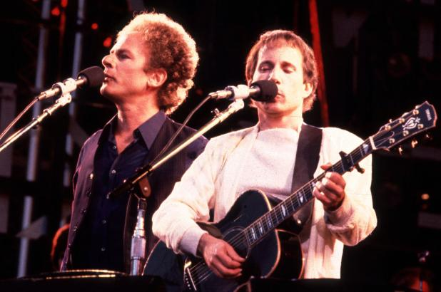
Iconic 1960’s
movie
The Graduate
Notes:
Https://pagesix.com/2014/03/07/paul-simon-clears-mystery-behind-joe-dimaggio-lyric/
https://www.youtube.com/watch?v=9C1BCAgu2I8 at 3:00

Slide 9
“Where have you gone, Joe DiMaggio?” — the line in Simon and Garfunkel’s 1968 No. 1 hit “Mrs. Robinson” — annoyed the Yankee legend until he understood it. Paul Simon, a Yankee superfan, writes, “I happened to be in a restaurant and there he was,” recalls Simon.
Notes:
https://pagesix.com/2014/03/07/paul-simon-clears-mystery-behind-joe-dimaggio-lyric/

Slide 10
“I gathered up my nerve to go over and introduce myself and say, ‘Hi, I’m the guy that wrote “Mrs. Robinson,” ’ and he said ‘Yeah, sit down . . . why’d you say that? I’m here, everyone knows I’m here.’ I said, ‘I don’t mean it that way — I mean, where are these great heroes now?’ He was flattered once he understood it.”
Notes:
https://pagesix.com/2014/03/07/paul-simon-clears-mystery-behind-joe-dimaggio-lyric/
When Paul Simon met Mickey Mantle on “The Dick Cavett Show,” the Mick asked him why he didn’t use his name instead of DiMaggio’s. “Wrong amount of syllables,” Simon told the Yankee star
Where are these great heroes now?’

Slide 12
Hero [n] גִּבּוֹר
גִּבּוֹר [adj]
brave, courageous;
strong, mighty
Notes:
Gavriel has Gibor in it

Slide 13
Summary of MJ/Heb ch 11
Eleven victorious mini-stories
Six names of victors
Nine unnamed successful events
Eight stories of brutal suffering.
Notes:
2. Names without stories.
3. Stories without names.
Read section of the chapter with #2 - #4

Slide 14
^{MJ/Heb 11.32-40} What more should I say? There isn’t time to tell about Gid‘on, Barak, Shimshon, Yiftach, David, Sh’mu’el and the prophets; who, through trusting, conquered kingdoms, worked righteousness, received what was promised, shut the mouths of lions, quenched the power of fire, escaped the edge of the sword,

Slide 15
^{MJ/Heb 11.32-40} had their weakness turned to strength, grew mighty in battle and routed foreign armies. Women received back their dead resurrected; other people were stretched on the rack and beaten to death, refusing to be ransomed, so that they would gain a better resurrection. Others underwent the trials of being mocked and whipped, then chained and imprisoned.

Slide 16
^{MJ/Heb 11.32-40} They were stoned, sawed in two, murdered by the sword; they went about clothed in sheepskins and goatskins, destitute, persecuted, mistreated, wandering about in deserts and mountains, living in caves and holes in the ground!

Slide 17
^{MJ/Heb 11.32-40} The world was not worthy of them! All of these had their merit attested because of their trusting. Nevertheless, they did not receive what had been promised, because God had planned something better that would involve us, so that only with us would they be brought to the goal.

Slide 18
Summary of MJ/Heb ch 11
Eleven victorious mini-stories
Six names of victors
Nine unnamed successful events
Eight stories of brutal suffering.

Slide 19
Eleven named heroes with stories Heb 11
Hevel/Abel,
Hanokh/Enoch,
Noah,
Avraham [11 vss],
Yitskhak/Isaac,
Yaakov/Jacob,
Yosef,
Moshe’s parents,
Moshe,
Yehoshua/Josh
Rahav

Slide 20
Summary of MJ/Heb ch 11
Eleven victorious mini-stories
Six names of victors
Nine unnamed successful events
Eight stories of brutal suffering.
Notes:
2. Without stories, but we should consider briefly.

Slide 21
^{MJ/Heb 11.32-40} What more should I say? There isn’t time to tell about ₁Gid‘on, ₂Barak, ₃Shimshon, ₄Yiftach, ₅David, ₆Sh’mu’el and the prophets;
Notes:
Gideon did?…destroyed Baal Altar [Jon Cahn], defeated Midianites w 300 men
Barak? with Devora defeat Sisera and Yavin
Shimshon/Samson?: fought the Philistine
Yiftach/Jepthah fought Ammonite oppressors
David: King and worship musician, G-d’s heart
Shmuel prophet anointed Shaul, David;

Slide 22
Summary of MJ/Heb ch 11
Eleven victorious mini-stories
Six names of victors
Nine unnamed successful events
Eight stories of brutal suffering.

Slide 23
^{MJ/Heb 11.32-40} who, through trusting, ₁conquered kingdoms, ₂worked righteousness, ₃received what was promised, ₄shut the mouths of lions, ₅quenched the power of fire, ₆escaped the edge of the sword,
Notes:
Who? Joshua, David, Hezekiah, Maccabees
Eliyahu and Baal
Joshua land
Daniel, also Shimshon/Samson
Shadrakh, Meishakh and ‘Aved-N’go
All warriors, David from Shaul

Slide 24
^{MJ/Heb 11.32-40} ₇had their weakness turned to strength, ₈grew mighty in battle and routed foreign armies. ₉Women received back their dead resurrected;
Notes:
Sarah conceived, Gideon “go in this your strength” “If Adoni is with us, then why is all this happening to us? And where are all his miracles our ancestors told us about when they said, ‘Didn’t Adoni bring us up from Egypt?’” Isaiah’s coal
^{Ps 144} By David: Blessed be Adoni, my rock, who trains my hands for war and my fingers for battle.
1K17 Eliyahu, Shunamite woman Elisha 2K4

Slide 25
Summary of MJ/Heb ch 11
Eleven victorious mini-stories
Six names of victors
Nine unnamed successful events
Eight stories of brutal suffering.
Notes:
The transition from heroes who won, and heroes who suffered, is seamless. Shockingly seamless. No difference in G sight if won or lost!! As long as walked with Him!

Slide 26
₁other people were stretched on the rack and beaten to death, refusing to be ransomed, so that they would gain a better resurrection.
Notes:
Most translations say “tortured”

Slide 27
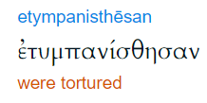
tumpanizó: to beat a drum, to torture by beating (the root of the English term "tympani-drum") – properly, to torture.

Slide 28
The tympanum seems to have been a wheel-shaped instrument of torture, over which criminals were stretched as though they were skins, and then horribly beaten with clubs or thongs
Notes:
https://biblehub.com/greek/5178.htm

Slide 29
^{2 Mac 6.18-31} Eleazar, one of the foremost scribes, a man advanced in age and of noble appearance, was being forced to open his mouth to eat pork. But preferring a glorious death to a life of defilement, he went forward of his own accord to the instrument of torture, spitting out the meat as they should do who have the courage to reject food unlawful to taste even for love of life.
Notes:
This refers to 2 Mac 6, according to Amy Jill Levine.
Sometimes it may be communicated that avoiding the prohibited meats is just minutiae, trivia, an optional spiritual luxury.
Maybe so BEFORE you get convicted on this. To Eleazar it was a matter of life or death. To us?

Slide 30
^{2 Mac 6.18-31}. Those in charge of that unlawful sacrifice took the man aside, because of their long acquaintance with him, and privately urged him to bring his own provisions that he could legitimately eat, and only to pretend to eat the sacrificial meat prescribed by the king.

Slide 31
^{2 Mac 6.18-31}. Thus he would escape death, and be treated kindly because of his old friendship with them. But he made up his mind in a noble manner, worthy of his years,

Slide 32
^{2 Mac 6.18-31} the dignity of his advanced age, the merited distinction of his gray hair, and of the admirable life he had lived from childhood. Above all loyal to the holy laws given by God, he swiftly declared, “If I dissemble to gain a brief moment of life, they would be led astray by me,

Slide 33
^{2 Mac 6.18-31} while I would bring defilement and dishonor on my old age… Therefore, by bravely giving up life now, I will prove myself worthy of my old age, and I will leave to the young a noble example of how to die willingly and nobly for the revered and holy laws.”

Slide 34
^{2 Mac 6.18-31}He spoke thus, and went immediately to the instrument of torture. Those who shortly before had been kindly disposed, now became hostile toward him because what he had said seemed to them utter madness. When he was about to die under the blows, he groaned, saying: “The Lord in his holy knowledge knows full well that, although I could have escaped death,

Slide 35
^{2 Mac 6.18-31} I am not only enduring terrible pain in my body from this scourging, but also suffering it with joy in my soul because of my devotion to Him.” This is how he died, leaving in his death a model of nobility and an unforgettable example of virtue not only for the young but for the whole nation.

Slide 36
₁other people were stretched on the rack and beaten to death, refusing to be ransomed, so that they would gain a better resurrection.
Notes:
Illustration was over eating pork

Slide 37
^{MJ/Heb 11.32-40} ₂Others underwent the trials of being mocked and whipped, then chained and imprisoned. ₃They were stoned, ₄sawed in two,
Notes:
2. Shimson/Samson, Jeremiah by Pashur,
3. Zekhariah ^{2 Chr 21.20-21} Then the spirit of God clothed Zechariah, son of Jehoiada the priest. He took his stand above the people and said to them: “Thus says God, Why are you transgressing the Lord’s commands, so that you cannot prosper? Because you have abandoned the Lord, he has abandoned you.” But they conspired against him, and at the king’s command they stoned him in the court of the house of the Lord.” Also legends about Yermiyahu/Jer.
4. Yeshayahu/Is according to Jewish, Christian and Islamic legend. AJL: died by being cut in two when he hid from Manasseh in a tree in Silwan. A tomb has been erected on a hill near where it was presumed he died, that he asked for water and it was sent, hence the name of the Shiloakh spring, sent https://www.christianity.com/wiki/people/how-did-isaiah-die.html

Slide 38
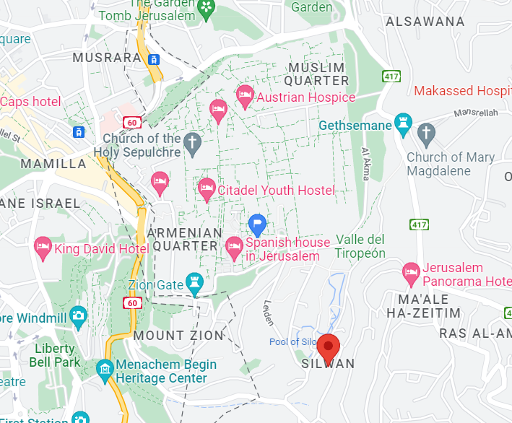
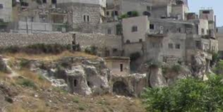
Notes:
T. Hieros. Sanhedrin, fol. 28. 3. “Manasseh sought to kill Isaiah, and he fled from him, and fled to a cedar, and the cedar swallowed him up, all but the fringe of his garment; they came and told him (Manasseh), he said unto them, go and saw the cedar, , "and they sawed the cedar", and blood was seen to come out.''

Slide 39
^{MJ/Heb 11.32-40} ₅murdered by the sword; ₆they went about clothed in sheepskins and goatskins, ₇destitute, persecuted, mistreated, ₈wandering about in deserts and mountains, living in caves and holes in the ground !
Notes:
5. The priests at Nob by King Shaul, prophets by Jezebel, Maccabees ~40K,
6. Eliyahu, Elisha
7. Eliyahu, fed by ravens
8. “And they kept the eight days with gladness, as in the feast of the tabernacles, remembering that not long afore they had held the feast of the tabernacles, when as they wandered in the mountains and dens like beasts.” ^{(2 Maccabees 10:6)}

Slide 40
^{MJ/Heb 11.32-40} The world was not worthy of them! All of these were commended for their faith. Nevertheless, they did not receive what had been promised, because God had planned something better that would involve us, so that only with us would they be brought to the goal.

Slide 41
Hero [n] גִּבּוֹר
גִּבּוֹר [adj]
brave, courageous;
strong, mighty
Notes:
Gavriel has Gibor in it

Slide 42
Summary of MJ/Heb ch 11
Eleven victorious mini-stories
Six names of victors
Nine unnamed successful events
Eight stories of brutal suffering.

Slide 43
The transition from heroes who succeeded and lived, and the heroes who suffered and died, is seamless.
We need heroes.
Notes:
Win or lose…faithful!!

Slide 44
Hero [n] גִּבּוֹר
גִּבּוֹר [adj]
brave, courageous;
strong, mighty
Notes:
Gavriel has Gibor in it

Slide 45
Notes:
We need heroes, who will STAND, live or die.

Slide 46
Rabbi Jonathan Cahn was guest speaker on James Dobson Family Talk Sept 1–2. The interview was about Rabbi Cahn’s new book, The Return of the gods.

Slide 47
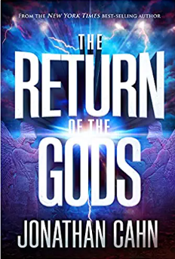
The Bible does speak of the gods. It says,
מי כמוך באלים יי?
Mi khamokיa b’elim Adoni?
Who is like You, Oh L-rd, among the gods?

Slide 48
When Israel turned away from God, they turned to other gods, and as they turned to other gods, there were three main, very iconic gods of all of them, and the first one I call the possessor.

Slide 49
The second one is called the enchantress, and the third is called the destroyer. Our culture is unique, this Western civilization, because it’s the only culture that was dispossessed, that was exorcised of the gods. And that's really where we have been, but now we're turning the other way.

Slide 50
Rabbi Cahn explains that America's turn from the one true God has opened the door for the return of the ancient little “g” gods, specifically three spirits that Rabbi Cahn calls the dark trinity made up of Baal, Ishtar, and Molech.

Slide 51
A parable that Yeshua said: Remember He said that if a spirit goes out of a man, He said, “It goes out, looks for a place to rest, finds no place to rest, and if it finds no place, it comes back and says, ‘I will return to my house,’” talking about the man. He comes back, finds it all clean and empty and says,

Slide 52
"I'm going to now bring my seven other friends, my seven other spirits," worse than itself, and now the man is repossessed, and Yeshua says that the latter state is worse than the beginning, but then He says, "So it will be with this generation."

Slide 53
He wasn't just talking about a man being possessed and turning back. He talks about an entire culture or civilization.

Slide 54
Germany that produced the reformation, Martin Luther, all that, when they turned away from the word, and they turned away from God, what came in? It wasn't neutral. It was demonic. The most demonic we've ever seen. So the warning is that in a pre-Christian culture, you might have a Nero and a Caligula, but in a post-Christian culture, you'll have a Hitler. You'll have something worse.

Slide 55
There's one spirit that goes in and then brings the rest. In Hebrew called Baal, which means the possessor. It means the possessor. It means the owner, means the master or Lord. And he was the spirit that Israel turned to at the beginning,

Slide 56
and when you look at the list of the gods, Baal, he's always first, and he was the god of the falling away. He's the alternate god, the substitute god. If you look back, when did America really start turning, start taking those steps? Well, if you look at the early sixties-

Slide 57
we actually have been striking down the 10 Commandments. pagan morality says, "Basically, you can create your own god. You can create your own idol. You're creating reality. You're creating truth." So everybody has their own god, everybody has their own truth. So now you hear a lot of, “Well, that's your own truth.”

Slide 58
When the Bible speaks about Baal, often right after Baal comes the next god or goddess, which is the goddess, the Bible calls Ashtoreth or Ashtora. In ancient Babylonia, Ashtoreth was called Ishtar. When she went to Greece, she became Aphrodite

Slide 59
The focal point of this one was sexuality, the sexual realm. And she was actually known as the prostitute goddess.

Slide 60
A prostitute takes sexuality out of marriage, out of the family, and puts it into the culture, puts it into the marketplace. It's very dark, she's actually a goddess of, she destroys. She has the sword. You see all the broken homes, that's the sword of this spirit. When you take sexuality out of God's sacred vessel, you get destruction.

Slide 61
In the ancient times, there are images of naked women in clay and in stone all over the culture and pornographic literature. what else do we see in the sixties? We see an explosion of drugs, drug culture. America has become more addicted in this period when it turned away from God,

Slide 62
became more addicted than any other time, so even drug use. And she's also the goddess of spells of the, occult. So also in the 1960s, what else do we see? A revival of the occult and new age and Eastern mysticism

Slide 63
And so this was the second of
the dark trinity. The third is called the destroyer. And this is what happens that it goes right in order. First, the turning away from God, then the sexual revolution, sexual immorality, that's always going to lead to the next one, which is the destroyer or Molech.

Slide 64
All around the pagan world, they had human sacrifice. What stopped the offering of children, the offering of human beings, only the message of the Messiah did.

Slide 65
children were treated horribly because the pagan world looks down on the weak and looks down on the elderly, looks down on women.

Slide 66
This goddess, Ishtar, there was something strange about her. And that is that she says in one of her ancient stones that have engraving says, "I am a woman." And then she says, "I am a man."

Slide 67
And it says she has the power to turn a man into a woman and a woman into a man. So this is the deeper work of Ishtar. she was called the androgynous goddess. She was a woman, but she had male attributes. She had priests in her temple that were men that dressed up as women. They were her priests.

Slide 68
This is a warning of the Bible, of God, that if a nation or a civilization turns away from God that has known God, the gods or the spirits of the ancient world are going to return and the same spirits that came to Israel have come to America.

Slide 69
The first one, the possessor, Baal, the second Ishtar, or the goddess who changes sexuality, alters gender. And the third, the destroyer is Molech that causes child sacrifice. It's all happening. Everything we're watching, this is what is behind what we are dealing with right now

Slide 70
A revival is the only answer.
A turning back to G-d in fervency and true worship in spirit and in truth. In ancient times, that is when those altars were broken, so we have to deal with it.

Slide 71
We need heroes.
Stand against the new threesome
Baal
Ishtar
Molokh

Slide 72
Notes:
We need heroes, who will STAND, live or die.

Slide 73
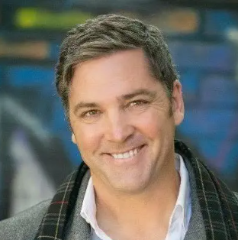
KEN HARRISON is the
president and chairman
of Promise Keepers
Notes:
KEN HARRISON is the president and chairman of Promise Keepers. Ken’s mission is to provide executive leadership and strategic direction to the ministry while inspiring men to be bold, humble and ambitious about their faith.
LAPD cop in Watts, successful realtor, retired at age 43.
https://www.amazon.com/Daring-Faith-Cowardly-World-Unfinished/dp/078529077X?asin=078529077X&revisionId=&format=4&depth=1

Slide 74
Courage seems to be the word of the day. It's the piece we're struggling I think most within the faith community. Let's be fair, there is a massive beat down on
social media,

Slide 75
If Yeshua gave the salvation
message in John 3:16, which He did, "If God so loved the world, He gave his only son, whoever believes in Him will not perish, but they return to life," then what are all the rest of His words about, the beatitudes?

Slide 76
And that's a message for us today. It's not about salvation. It's about becoming sanctified, about holiness of life, k’dusha קדושה.

Slide 77
Here's His message: when you've gone from poor in spirit and then mourning, and then hunger and thirst for righteousness, and then being meek, you're on this roadmap and you finally get to the end, congratulations, you'll have no friends. But rejoice because great is your reward in Heaven

Slide 78
Hebrews 11. That is the hall of faith. That's where God goes on and on about look at these people and be like them. You have this list of people who had two things in common. The first one was they were massively messed up, but repented.

Slide 79
The second thing they had in common is none of them ever backed down from a fight. We're often silenced because we're afraid or we're ashamed of who we are. He has unlimited grace for who you are. No matter how bad you mess up, no matter what you've done in the past, get up, repent, and be about your father’s business.

Slide 80
This saying you go to in the book, it’s called
“Hard times make strong men. Strong men make good times. Good times make weak men. Weak men make hard times.”

Slide 81
Yeshua is looking for first generation trailblazers, not third generation comfort seekers, people who are always worried about whether or not you're offending somebody or something.

Slide 82
People in America especially don't realize why Churchill was so amazing. People hear this statement that he saved the world and then they're like, "What?“ Churchill takes over and World War II is starting, and it's brutal.

Slide 83
And immediately after him taking over, we have Dunkirk, where they almost slaughtered pretty much the entire British Army, and were miraculously saved through prayer, which is an amazing story of its own.

Slide 84
And then the Germans now are sitting in Paris. They can now bomb London relentlessly because they have the ability to get their planes there. And everyone is begging Churchill to surrender, and every night London just get crushed. People are being killed. Over and over, sue Hitler for peace.

Slide 85
Churchill knew that if he gave Hitler peace, Hitler would turn around, take his entire army onto the Soviet Union, destroy the Soviet Union, because he would only have one more to go, then turn around with the entire army of Europe had come back against Britain. Well, finally, after a long time of these bombings,

Slide 86
London being destroyed, Hitler comes to Churchill for peace, because he knew that's what he wanted. Everybody tells Churchill, "You got to take peace. You got to take peace," and Churchill says no. It was unbelievable. It didn't look like Britain had a chance to win the war and he still stood and said no.

Slide 87
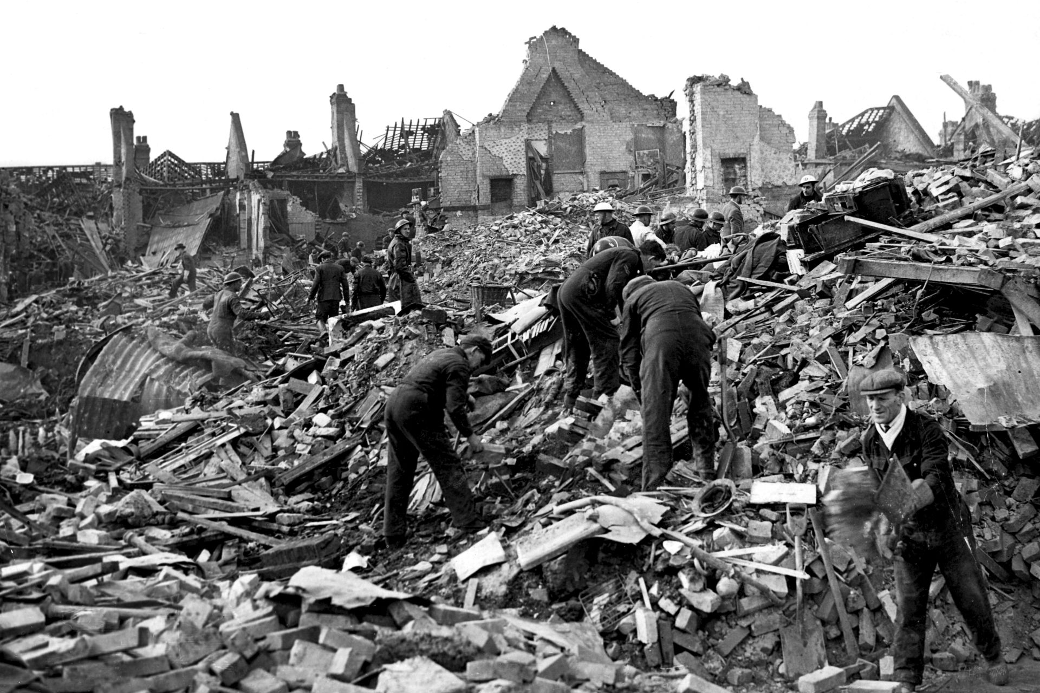
Notes:
https://external-content.duckduckgo.com/iu/?u=https%3A%2F%2Fres.cloudinary.com%2Fdk-find-out%2Fimage%2Fupload%2Fq_80%2Cw_1920%2Cf_auto%2FA-rexfeatures_1507055a_a4uqp0.jpg&f=1&nofb=1

Slide 88
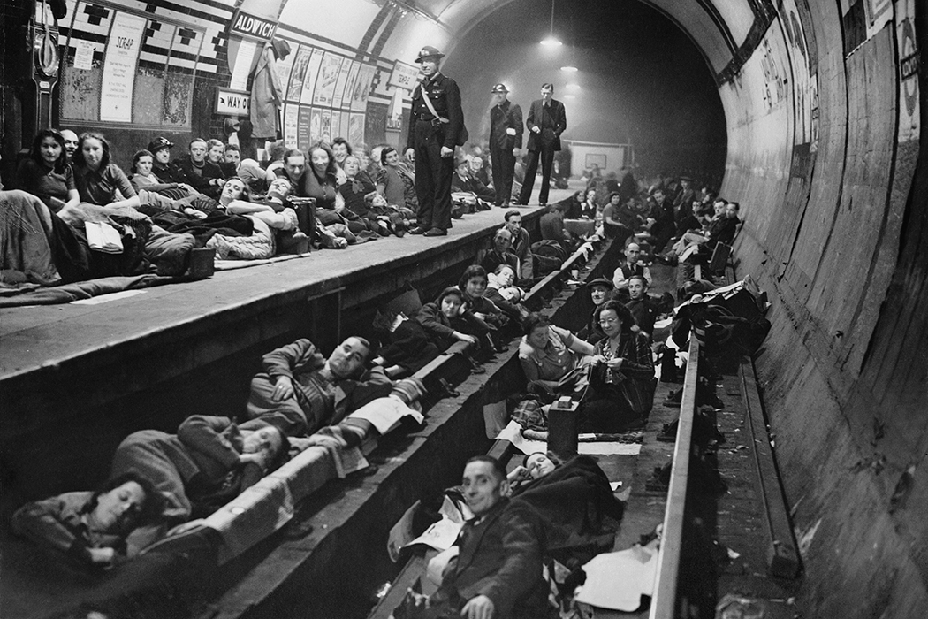
Notes:
https://external-content.duckduckgo.com/iu/?u=https%3A%2F%2Fdaily.jstor.org%2Fwp-content%2Fuploads%2F2018%2F08%2Ftube_london_blitz_1050x700.jpg&f=1&nofb=1

Slide 89
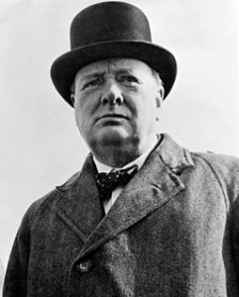
It was Winston Churchill’s first Speech as Prime Minister May 13, 1940 to the House of Commons.
Notes:
https://www.presentationmagazine.com/winston-churchill-speech-blood-toil-tears-and-sweat-7878.htm

Slide 90
I would say to the House, as I said to those who have joined this government: “I have nothing to offer but blood, toil, tears and sweat.”
Notes:
https://www.presentationmagazine.com/winston-churchill-speech-blood-toil-tears-and-sweat-7878.htm

Slide 91
We have before us an ordeal of the most grievous kind. We have before us many, many long months of struggle and of suffering. You ask, what is our policy? I can say: It is to wage war, by sea, land and air, with all our might and with all the strength that God can give us;
Notes:
https://www.presentationmagazine.com/winston-churchill-speech-blood-toil-tears-and-sweat-7878.htm

Slide 92
to wage war against a monstrous tyranny, never surpassed in the dark, lamentable catalogue of human crime. That is our policy. You ask, what is our aim?
Notes:
https://www.presentationmagazine.com/winston-churchill-speech-blood-toil-tears-and-sweat-7878.htm

Slide 93
I can answer in one word: It is victory, victory at all costs, victory in spite of all terror, victory, however long and hard the road may be; for without victory, there is no survival...But I take up my task with buoyancy and hope. I feel sure that our cause will not be suffered to fail among men.
Notes:
https://www.presentationmagazine.com/winston-churchill-speech-blood-toil-tears-and-sweat-7878.htm

Slide 94
4 June 1940
“Even though large tracts of Europe and many old and famous States have fallen or may fall into the grip of the Gestapo and all the odious apparatus of Nazi rule, we shall not flag or fail.
Notes:
https://www.presentationmagazine.com/winston-churchill-speech-we-shall-fight-them-on-the-beaches-8003.htm

Slide 95
We shall go on to the end, we shall fight in France, we shall fight on the seas and oceans, we shall fight with growing confidence and growing strength in the air, we shall defend our Island, whatever the cost may be,
we shall fight on the beaches,
we shall fight on the landing grounds,
Notes:
https://www.presentationmagazine.com/winston-churchill-speech-we-shall-fight-them-on-the-beaches-8003.htm

Slide 96
we shall fight in the fields and in the streets,
we shall fight in the hills;
we shall never surrender, and even if, which I do not for a moment believe, this Island or a large part of it were subjugated and starving,
Notes:
https://www.presentationmagazine.com/winston-churchill-speech-we-shall-fight-them-on-the-beaches-8003.htm

Slide 97
then our Empire beyond the seas, armed and guarded by the British Fleet, would carry on the struggle, until, in God’s good time, the New World, with all its power and might, steps forth to the rescue and the liberation of the old.”
Notes:
https://www.presentationmagazine.com/winston-churchill-speech-we-shall-fight-them-on-the-beaches-8003.htm

Slide 98
We shall fight
In the Presence of the Holy
In prayer and intercession
In fasting
In repentance → holiness
In outreach, proclamation
In political activism
We shall NEVER give up, go woke!
Notes:
We will be instruments to ADVANCE the Kingdom. Tavo malkhutekha תבוא מלכותך

Slide 99
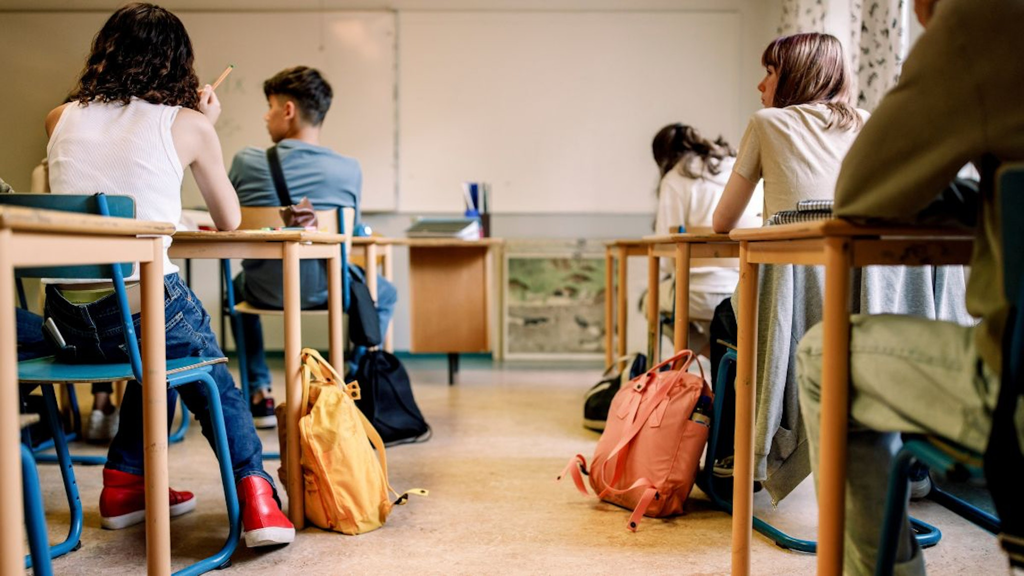
Notes:
https://www.dailywire.com/news/kansas-teacher-receives-95k-settlement-after-suspension-for-refusing-to-use-students-preferred-pronouns?utm_campaign=dw_newsletter&utm_medium=email&utm_source=housefile&utm_content=member

Slide 100
A Kansas teacher who sued the school district that suspended her for refusing to use a student's preferred pronouns reached a settlement with the district Wednesday and will be awarded $95,000, her lawyers said.
Notes:
https://www.nbcnews.com/nbc-out/out-news/kansas-teacher-was-suspended-refusing-use-students-preferred-pronouns-rcna45844

Slide 101
Pamela Ricard sued Geary County Schools in March, saying she was reprimanded and suspended for three days last year "for addressing a biologically female student by the student's legal and enrolled last name."
Notes:
https://www.nbcnews.com/nbc-out/out-news/kansas-teacher-was-suspended-refusing-use-students-preferred-pronouns-rcna45844

Slide 102
A school counselor at Fort Riley Middle School had told Ricard that the student preferred an alternative first name, and a classmate told Ricard that the student preferred he/him pronouns, the lawsuit said.
Notes:
https://www.nbcnews.com/nbc-out/out-news/kansas-teacher-was-suspended-refusing-use-students-preferred-pronouns-rcna45844

Slide 103
National test results released on Thursday from the National Assessment of Educational Progress (NAEP) revealed that the math and reading scores of elementary school students reached historic lows in 2022, with an unprecedented drop in math and the largest drop in 32 years in reading among nine-year-olds. Experts say that the drops can be attributed to a variety of factors, including repercussions from school shutdowns, discipline issues, open borders, classroom time spent on controversial ideologies, and other factors.
Notes:
https://washingtonstand.com/news/covid-shutdown-repercussions-teacher-vacancies-and-ideologies-among-problems-plaguing-education-experts-say

Slide 104
The transition from heroes who succeeded and lived, and the heroes who suffered and died, is seamless.
We need heroes.

Slide 105
Summary of MJ/Heb ch 11
Eleven victorious mini-stories
Six names of victors
Nine unnamed successful events
Eight stories of brutal suffering.

Slide 106
Hero [n] גִּבּוֹר
גִּבּוֹר [adj]
brave, courageous;
strong, mighty
Notes:
Gavriel has Gibor in it

Slide 107
Notes:
We need heroes, who will STAND, live or die.

