Slide 1
e-handout
To have these notes
without taking notes
Go to OrHaOlam.com
Click on Messages tab,
2023 Messages

Slide 2
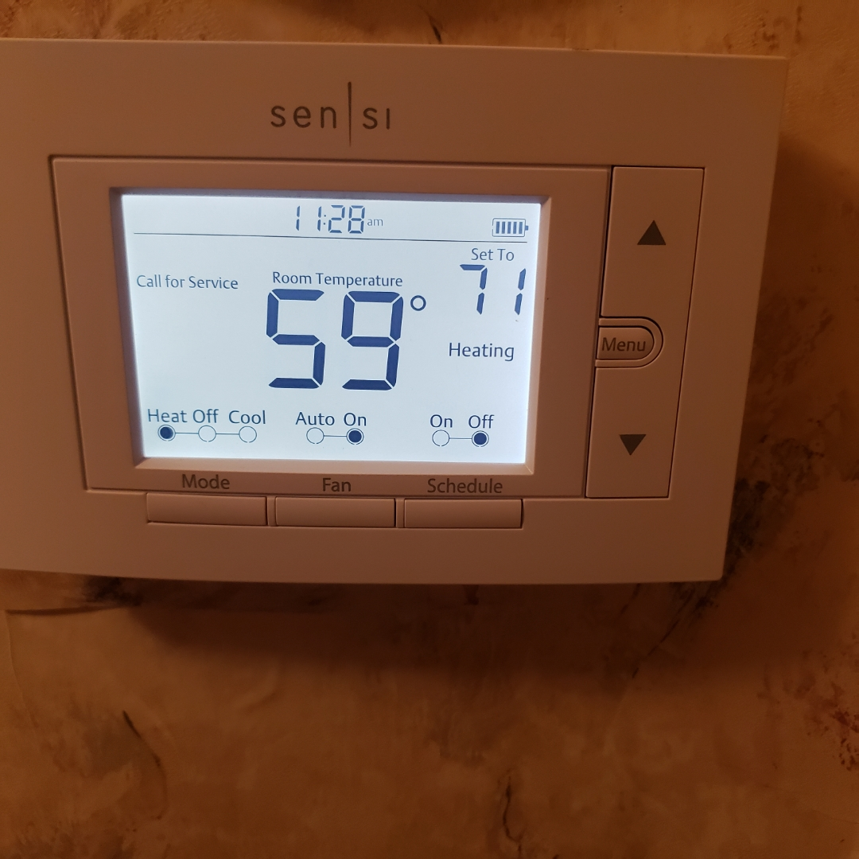
Notes:
when I got home at about 7:30 p.m. the house felt chilly, and the thermostat read 59 deg, as you see. So I tried the obvious, and nothing was amiss, so I called our furnace man, Alex Carson, the world's best. While I was on the phone with him and exploring options on the front inside of the furnace,

Slide 3
Notes:
my phone dropped the call because it was at 0% battery. So I went to charge it, but all the chargers were in the camper at the shul. I found a USB C wire in the car and a transformer for it, but it was slooooow, and took several minutes to get up to 1%, which wasn't enough to power a phone call. While I was waiting further I got out a flashlight, since my phone light wouldn't work, but it was out of battery, and had to be re-batteried. After several more minutes I was up to 3% phone battery, and called Alex the furnace guy, but couldn't unplug my phone to go back downstairs to the furnace until I realized I could unplug the freezer [risky] and talk through my bluetooth headset and look at the furnace.
After trying all the possible layman fixes, Alex determined that he would have to come over tomorrow. So I prepared this message without heat in the house. Cold and short!

Slide 4
This is the third special day:
Hoshana Rabbah [Ruakh] → Shemini Atzeret [Stop and Assemble] →
Messiah’s Birth and Power →
Simhat Torah שִׂמְחַת תּוֹרָה‎
Notes:
In Israel, Shemini Atzeret and Simchat Torah are celebrated on the same day.
In the 13th century, the reading of Genesis was added immediately upon the completion of Deuteronomy
https://en.wikipedia.org/wiki/Simchat_Torah

Slide 5
1st Day | Sukkot | holy convo-cation מִקְרָא-קֹדֶשׁ mikra kodesh 4 species
7th Day | Hoshannah Rabba Water drawing | Filling of the Ruakh
8th Day | Shemini Atseret | Mikra kodesh PLUS a solemn assembly= עֲצֶרֶת atseret The stop day | Combined in Israel, and by others in the diaspora, us.
9th Day | Simkhat Torah = Rejoicing in the Torah | Rewinding the scroll, dancing

Slide 6
So, why do
this extra Biblical holiday?
Why have a day to celebrate the joy of the Torah
[Torah in it’s widest sense = all scripture]

Slide 7
^{Ro.10.17 NKJV} So then faith comes by hearing, and hearing by the word of God.
^{Ro.10.17 TLV} So, faith comes from hearing, and hearing by the word of Messiah.
Notes:
or "of Messiah", as some copies read, and so do the Vulgate Latin and Ethiopic versions;
Bigger picture, what you already know.

Slide 8
^{Yn 1.1-3} In the beginning was the Word. The Word was with God, and the Word was God. He was with God in the beginning. All things were made through Him, and apart from Him nothing was made that has come into being.
The Word = Logos = Davar דבר

Slide 9
^{T’hillim/Ps 1.1-2} How blessed are those who reject the advice of the wicked, don’t stand on the way of sinners or sit where scoffers sit! Their delight is in Adoni’s Torah; on his Torah they meditate day and night.

Slide 10
^{T’hillim/Ps 1.3,6} They are like trees planted by streams — they bear their fruit in season, their leaves never wither, everything they do succeeds. For Adoni watches over the way of the righteous, but the way of the wicked is doomed.

Slide 12
What about the current
crisis in Israel?
Notes:
The nation of Israel is not universally righteous, but they are G-d’s covenant people. Well get to that in closing.

Slide 13
50 years ago, Israel came as close as it ever has to losing a war. While the Arab Islamic nations can repeatedly lose wars without paying much of a price, Israel can only lose one major war.
Notes:
https://www.israeltoday.co.il/read/50-years-ago-israel-was-nearly-destroyed/?mc_cid=0b026c0eac&mc_eid=9f06d9f262

Slide 14
The Yom Kippur War showed that the “safer bet” of relying on defenses like the Iron Dome isn’t really safe at all. When your enemies outnumber you and their ruthlessness is endless, playing defense is not a survival option. Israel thrived when it attacked brilliantly and unexpectedly.
Notes:
https://www.israeltoday.co.il/read/50-years-ago-israel-was-nearly-destroyed/?mc_cid=0b026c0eac&mc_eid=9f06d9f262

Slide 15
Under the “technological genius” of defenses like the Iron Dome, Israelis in Jerusalem and Tel Aviv are back to huddling in bomb shelters the way that they did during the old wars.
“Mow the grass mentality.”
Notes:
https://www.israeltoday.co.il/read/50-years-ago-israel-was-nearly-destroyed/?mc_cid=0b026c0eac&mc_eid=9f06d9f262

Slide 16
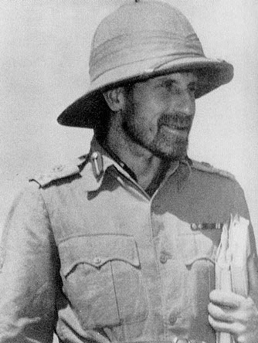
Orde Wingate 1903-1944 took the Israelis out of the “Stockade and Tower” mentality.
Moshe Dayan: All we know about war we learned from Orde Wingate.
Notes:
Wingate was an exponent of unconventional military thinking and the value of surprise tactics. Assigned to Mandatory Palestine, he became a supporter of Zionism, and set up a joint British-Jewish counter-insurgency unit. Wingate formed the Special Night Squads in which British infantry soldiers and Jewish paramilitary retaliated, often ruthlessly, against Arab insurgents. Wingate drilled his men in an ethos of utilizing offense over defense.
https://www.timesofisrael.com/75-years-after-his-death-why-orde-wingate-remains-a-hero-in-israel/

Slide 17
Today, [Shabbat, Oct. 7, 2023] Hamas went door to door, butchering women, men and children, dragging teenagers and children into captivity in Gaza.
For the past 20 years, there have been claims that Hamas is moderating, but their recent actions prove otherwise.

Slide 18
Hamas's aggression includes infiltrating IDF bases, taking civilians hostage, and launching rockets at civilian centers.
The bottom line: Most Gazans loathe Hamas, but they dare not rise up against their power-hungry oppressors, who enjoy support from Iran. Israel must destroy Hamas in order to prevent this tragedy from ever happening again.

Slide 19
Israel has arguably the most extensive and well-funded intelligence services in the Middle East. It has informants and agents inside Palestinian militant groups, as well as in Lebanon, Syria and elsewhere. It has, in the past, carried out precisely timed assassinations of militant leaders,
Notes:
https://www.bbc.com/news/world-middle-east-67040221

Slide 20
knowing all their movements intimately. Sometimes these have been done with drone strikes, after agents have placed a GPS tracker on an individual's car; sometimes in the past it has even used exploding mobile phones.
Notes:
https://www.bbc.com/news/world-middle-east-67040221

Slide 21
On the ground, along the tense border fence between Gaza and Israel there are cameras, ground-motion sensors and regular army patrols.
The barbed-wire topped fence is supposed to have been a "smart barrier" to prevent exactly the sort of infiltration that has taken place in this attack.
Notes:
https://www.bbc.com/news/world-middle-east-67040221

Slide 22
Yet the militants of Hamas simply bulldozed their way through it, cut holes in the wire or entered Israel from the sea and by paraglider.
Notes:
https://www.bbc.com/news/world-middle-east-67040221

Slide 23
To prepare for and carry out such a coordinated, complex attack involving the stockpiling and firing of thousands of rockets, right under the noses of the Israelis, must have taken extraordinary levels of operational security by Hamas.
Notes:
https://www.bbc.com/news/world-middle-east-67040221

Slide 24
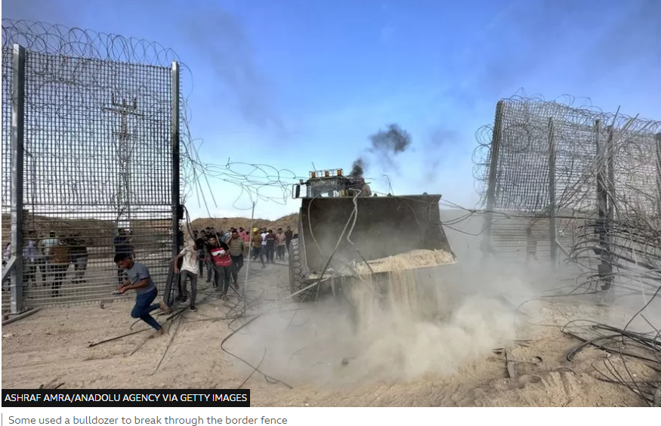
Notes:
https://www.bbc.com/news/world-middle-east-67038759

Slide 25
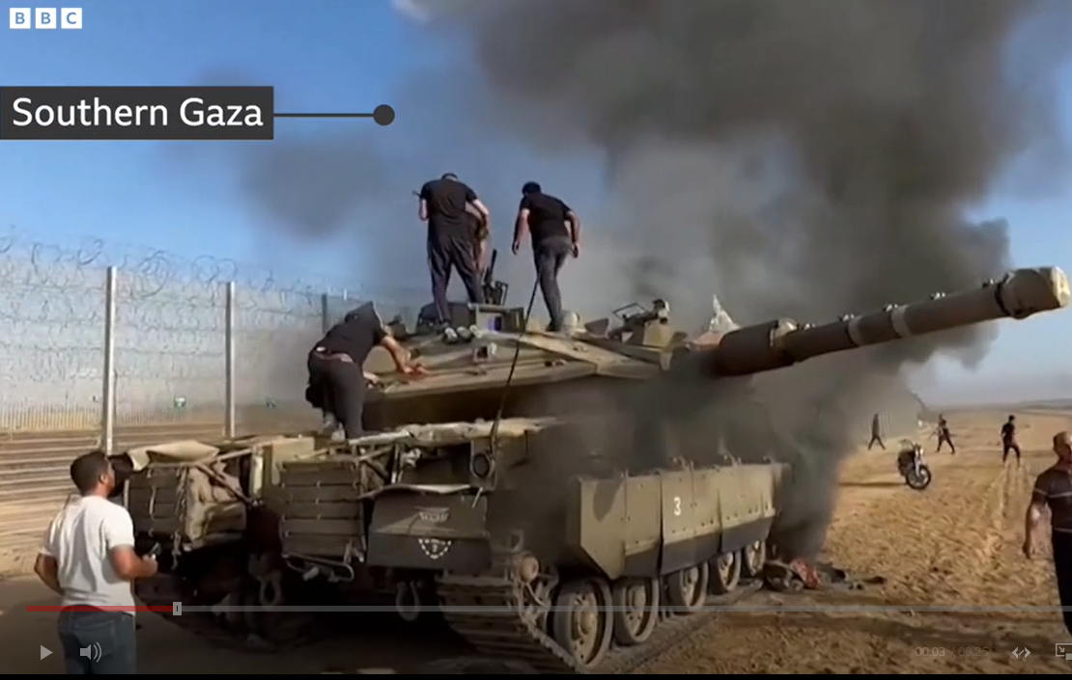

Slide 26
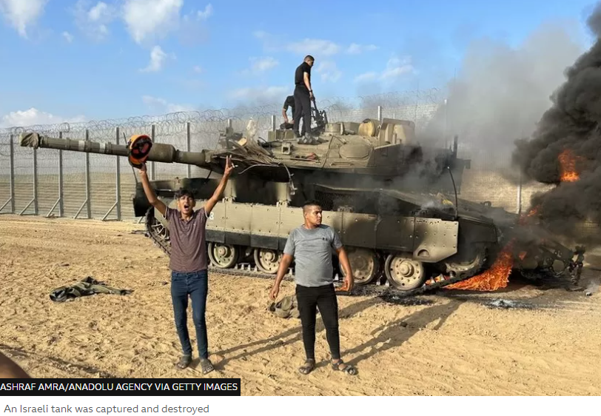
Notes:
https://ichef.bbci.co.uk/news/976/cpsprodpb/17D1D/production/_131356579_tank2.jpg.webp

Slide 27
In the border town of Sderot, the crisis assumes an unprecedented hue. Shoval Kahlon, a resident, details a harrowing narrative where Hamas terrorists tread with impunity, their boots echoing the terror that now haunts the streets.
Notes:
Jackie Santoro newsletter

Slide 28
They knock on doors, their sinister motives revealed when residents, expecting to find IDF troops, unwittingly open their doors to terrorists who take them hostage.

Slide 29
The child's silent cries for the missing parents, the silence of soldiers under siege, and the gunfire breaking out in front of kindergartens and supermarkets in Sderot,

Slide 30
echo the unspeakable horrors of a conflict that knows no boundaries, a vivid testament to the wanton brutality and ruthlessness of Hamas's aggression and unprecedented invasion against Israel.

Slide 31
Avner Boskey writes:
Our personal friends had their home broken into while they hid. The Hamas terrorists staked out the living room and were there for some hours before IDF special forces broke in and freed our friends.

Slide 32
Avner Boskey writes:
Our friends’ son had some of his best friends captured and dragged off to Gaza in a jihadi kidnapping. Many others on that kibbutz were also kidnapped.

Slide 33
Over 250 Israelis have been murdered by the jihadis and over 1,100 have been wounded, many severely. Hundreds are presumed kidnapped. Hamas is presently firing rockets into civilian areas in the Greater Tel Aviv area, and they are firing those rockets from civilian neighborhoods in Gaza. This is a double war-crime.
Notes:
Avner’s newsletter

Slide 34
Jerusalem Post Oct 08, 04:08 PM
Over 600 Israelis murdered in Hamas massacre
Israel's Embassy to the United States reported over 100 soldiers and civilians were kidnapped into Gaza • More than 2,000 wounded
Notes:
4 a.m. Central time

Slide 35
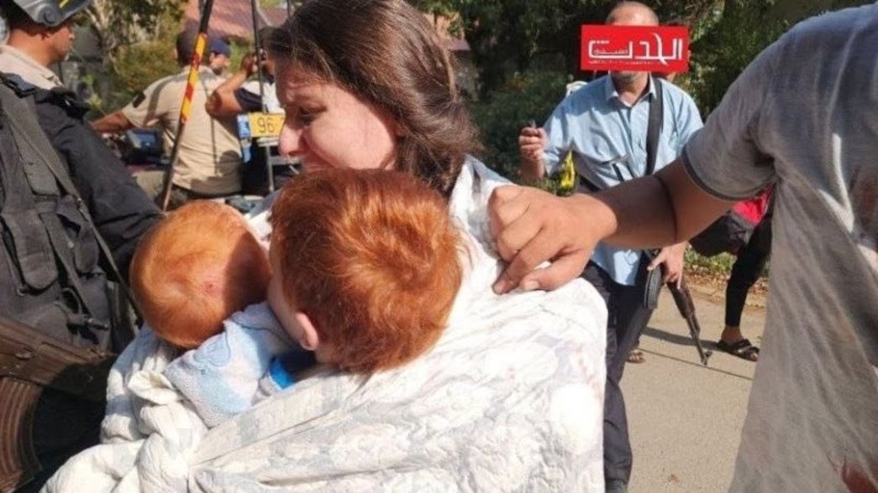
terrorists taking Israelis captive

Slide 36
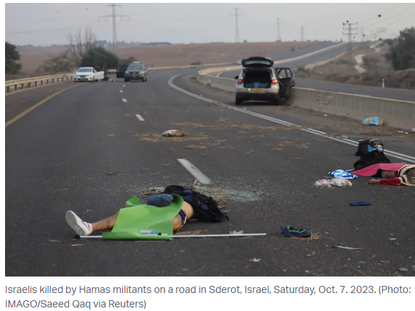
Notes:
https://allisrael.com/among-over-600-killed-israelis-civilians-idf-special-forces-officers-policemen-and-paramedics

Slide 37
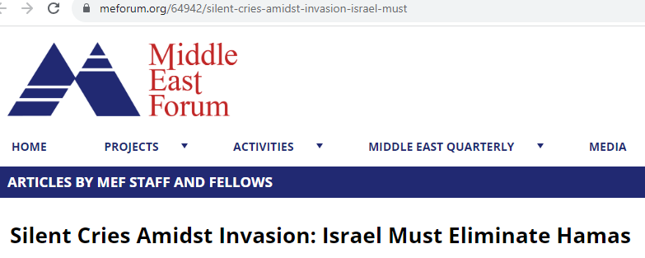
Notes:
Daniel Pipes Pres. Harvard and Columbia degreed. Speaks fluent Arabic, lived in Alexandria, Egypt for some years.

Slide 38
The adoption of a legislative package by Congress should call for:
Dismantle Hamas Resolution: This atrocity calls for more than just pressure on Hamas or rhetorical support for Israel; it demands the eradication of the Hamas threat.

Slide 39
Halt Qatari Funding: Coerce Qatar to cease Gaza funding; use strategic threats and financial restrictions.
Withhold USAID funding: Stop all aid to Gaza until Hamas’s power and manipulation are terminated.
Restrict "Frenemies": Halt military aid until countries expel Hamas leaders, forcing them to face justice.

Slide 40
Condition Egyptian Aid: Offer military aid to Egypt contingent on assisting in dismantling Hamas, aiding refugees.
Interdict Hamas Weapons: Redirect focus, intercept weapons bound for Gaza, similar to the Yemen-Iran-Ukraine precedent.

Slide 41
Bigger picture:

Slide 42
^{Yeshayahu/Is 54.17} No weapon formed against you will prosper and you will condemn every tongue that rises against you in judgment. This is the heritage of Adoni’s servants— their vindication is from Me.” It is a declaration of Adoni.

Slide 43
^{T’hillim/Ps 33.6} By the word of Adoni the heavens were made, and their whole hostצָבָא tsava [the military; army; multitude] by a breath from his mouth.
Notes:
So, every army is a reflection of the cosmic armies. G-d still has control.

Slide 44
^{Yn 1.1-3} In the beginning was the Word. The Word was with God, and the Word was God. He was with God in the beginning. All things were made through Him, and apart from Him nothing was made that has come into being.
The Word = Logos = Davar דבר

Slide 45
^{Ber/Gen 1.1-2} In the beginning God created the heavens and the earth. Now the earth was chaos and waste, darkness was on the surface of the deep, and the Ruach Elohim was hovering upon the surface of the water. Then God said, “Let there be light!” and there was light.

Slide 46
G-d existed before space-time. Then He caused the pulse of space time and light by the Word = Logos = Davar.
The Logos = the logic
But the logic is the math!
So G-d paused to get the equations of creation formulated.

Slide 47
All scientific laws are ultimately faith based. The heart of inductive logic is that the universe will do again what it just did.
Illustration of gravity.
You just believe the pen will drop.

Slide 48
.
General relativity
E = mc²
Gravitational field equation, bending of space time.
Notes:
Einstein (gravitational) field equations including the cosmological constant Lambda
https://commons.wikimedia.org/wiki/File:EinsteinLeiden4.jpg
https://www.physlink.com/education/askexperts/Images/ae329a.jpg

Slide 49
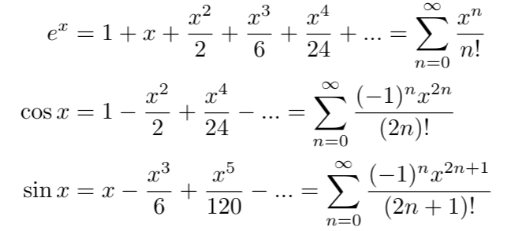
The Essence of Quantum Mechanics Part 2
Notes:
https://medium.com/@notaredpanda/the-essence-of-quantum-mechanics-part-2-complex-numbers-1b051478fc2d
I used to get intoxicated on this as divine, of sorts. Beauty, symmetry. That’s what the people at the Cern are doing. But it’s just an expression of the Logos, the Davar, the Memra!

Slide 50
^{Mishlei/ Prov 8.30-32} I was the craftsman beside Him, I was His daily delight, always rejoicing before Him, rejoicing in His whole world, and delighting in mankind. “So now, children, listen to me! Blessed are those who keep my ways.
Notes:
Keep the ways as foundational as relativity and quantum mechanics!

Slide 51
Applying the Word

Slide 52
^{T’hillim/Ps 19.8-12} The Torah of Adoni is perfect, restoring the inner person. The instruction of Adoni is sure, making wise the thoughtless. The precepts of Adoni are right, rejoicing the heart. The mitzvah of Adoni is pure, enlightening the eyes.
Notes:
Personal illustration: there is a certain inner weakness and fear, that two of my accountability partners are aware of, for which I got a word insight from the Ruakh, which breaks it’s power. Almost like an “off switch.” And…it works best when I quote it in Hebrew.

Slide 53
^{T’hillim/Ps 19.8-12} The fear of Adoni is clean, enduring forever. The rulings of Adoni are true, they are righteous altogether, more desirable than gold, than much fine gold, also sweeter than honey or drippings from the honeycomb. Through them your servant is warned; in obeying them there is great reward.

Slide 54
^{T’hillim/Ps 119.1-3} How happy are those whose way of life is blameless, who live by the Torah of Adoni! How happy are those who observe his instruction, who seek him wholeheartedly! They do nothing wrong but live by his ways.

Slide 55
^{T’hillim/Ps 119.9} How can a young man keep his way pure? By guarding it according to your word.
Notes:
Temptations of youth…hormones raging, sex, anger, ego and identity.

Slide 56
^{T’hiIlim/Ps 119.11-16} I will meditate on your precepts and keep my eyes on your ways. I will find my delight in your regulations. I will not forget your word.

Slide 57
^{T’hiIlim/Ps 119.11-16} I treasure your word in my heart, so that I won’t sin against you. Blessed are you, Adoni! Teach me your laws. I proclaim with my mouth all the rulings you have spoken. I rejoice in the way of your instruction more than in any kind of wealth.

Slide 58
^{T’hillim/Ps 119.18,38-40} Open my eyes, so that I will see wonders from your Torah. Fulfill your promise, which you made to your servant, which you made to those who fear you. Avert the disgrace which I dread, for your rulings are good. See how I long for your precepts; in your righteousness, give me life!

Slide 59
^{T’hillim/Ps 119.65-37} You have treated your servant well, Adoni, in keeping with your word. Teach me good judgment and knowledge, because I trust in your mitzvot. Before I was humbled, I used to go astray; but now I observe your word.
Notes:
There is something in my life that is irritating, regularly. Temptation to anger. But to that, I quote,
^{2 Corinthians 4:17 KJV} For our light affliction, which is but for a moment, works for us a far more exceeding and eternal weight of glory.

Slide 60
For wayward children, many scriptures. One of the strongest…

Slide 61
^{Yeshayahu / Is 60.4-5} Lift up your eyes and look all around: they all gather—they come to you— your sons will come from far away, your daughters carried on the hip. Then you will see and be radiant, and your heart will throb and swell with joy.
Notes:
Lift up your eyes? Praise and dwelling in the Word! Passive verbs…נקבצו = they will be gathered. Our work at this point, primarily to lift our eyes…to Him in praise and faith.

Slide 62
^{Yn 15.3-4} You are already clean because of the word I have spoken to you. Abide in Me, and I will abide in you. The branch cannot itself produce fruit, unless it abides on the vine. Likewise, you cannot produce fruit unless you abide in Me.

Slide 63
^{Yn 15.7-8} “If you abide in Me and My words abide in you, ask whatever you wish, and it shall be done for you. In this My Father is glorified, that you bear much fruit and so prove to be My disciples.”

Slide 64
^{Yn 15.10-12} If you keep My commandments, you will abide in My love, just as I have kept My Father’s commandments and abide in His love. These things I have spoken to you so that My joy may be in you, and your joy may be full. “This is My commandment, that you love one another just as I have loved you.

Slide 65
^{Yn 14.13-14} And whatever you ask in My name, that I will do, so that the Father may be glorified in the Son. If you ask Me anything in My name, I will do it.
Notes:
There are those who say you should only pray to the Father, albeit in Yeshua’s Name, and to pray to Him is idolatry. I was told by a Hasidic rabbi in Jerusalem that if I would commit to that, he would get me citizenship in Israel. However, here and other places, not so.

Slide 66
^{Dvarim 6.4-6} “Sh’ma, Yisra’el! Adoni Eloheinu, Adoni ekhad [Hear, Isra’el! Adoni our God, Adoni is one]; and you are to love Adoni your God with all your heart, all your being and all your resources. These words, which I am ordering you today, are to be on your heart.

Slide 67
^{Yer/Jer 31.34-36} This is what Adoni says, who gives the sun as light for the day, who ordained the laws for the moon and stars to provide light for the night, who stirs up the sea until its waves roar —Adoni -Tzva’ot is his name: “If these laws leave my presence,” says Adoni, “then the offspring of Isra’el will stop being a nation in my presence forever.”

Slide 68
^{Yer/Jer 31.34-36} This is what Adoni says: “If the sky above can be measured and the foundations of the earth be fathomed, then I will reject all the offspring of Isra’el for all that they have done,” says Adoni.

