Slide 1
e-handout
To have these notes
without taking notes
Go to OrHaOlam.com
Click on Messages tab,
2024 Messages

Slide 2
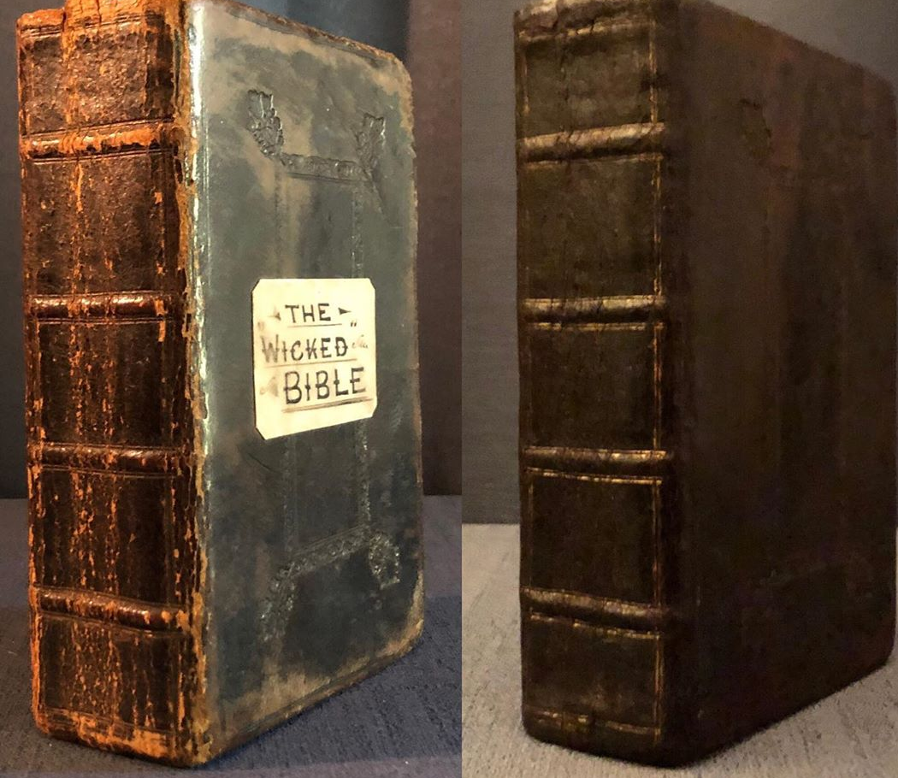
King James 1631
Notes:
https://upload.wikimedia.org/wikipedia/commons/d/db/Wicked_Bible.jpg
In files since 2019 Time Mag.

Slide 3
An edition of the Bible published in 1631 by the royal printers in London was meant to be a reprint of the 1611 King James Bible. In Exodus 20:14, the word "not" was omitted from the sentence, "Thou shalt not commit adultery," causing the verse to instead read, "Thou shalt commit adultery."
Notes:
https://en.wikipedia.org/wiki/Wicked_Bible

Slide 4
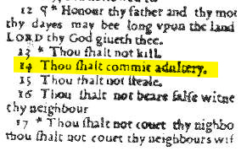
Notes:
https://upload.wikimedia.org/wikipedia/commons/d/d6/Marked_Wicked_bible.jpg

Slide 5
A thousand copies were printed of the much sought after “Wicked Bible.” There are fifteen known copies of the Wicked Bible today in the collections of museums and libraries in the British Isles, North America and Australasia:
Notes:
https://en.wikipedia.org/wiki/Wicked_Bible

Slide 6
New Great House for the play-ground
Notes:
March delivery. Therefore demolition this Sunday. Marcos heading rebuild of some scrap lumber into benches and tables. Modified: monkey bar on far side.

Slide 7
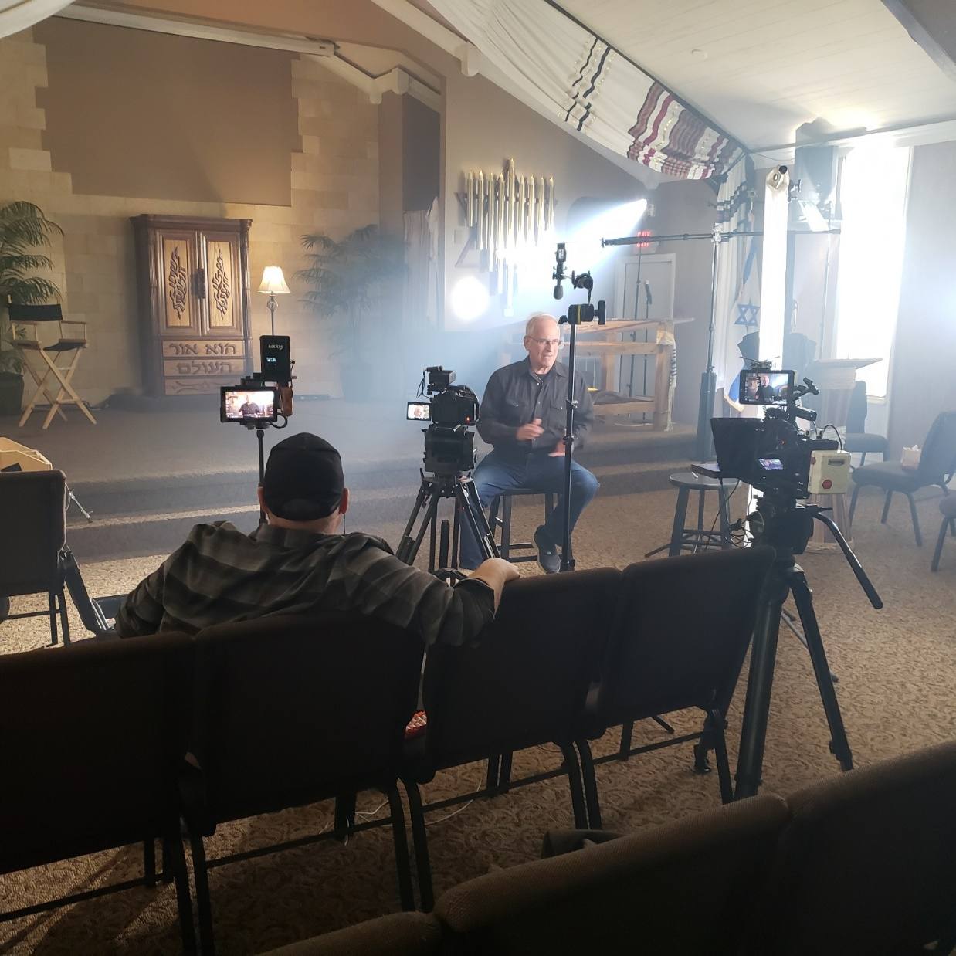
Photogs at work, Sunday, Jan. 11, 2024
Note fog machine effect!
Teleprompter.
Notes:
David Ledgin

Slide 8
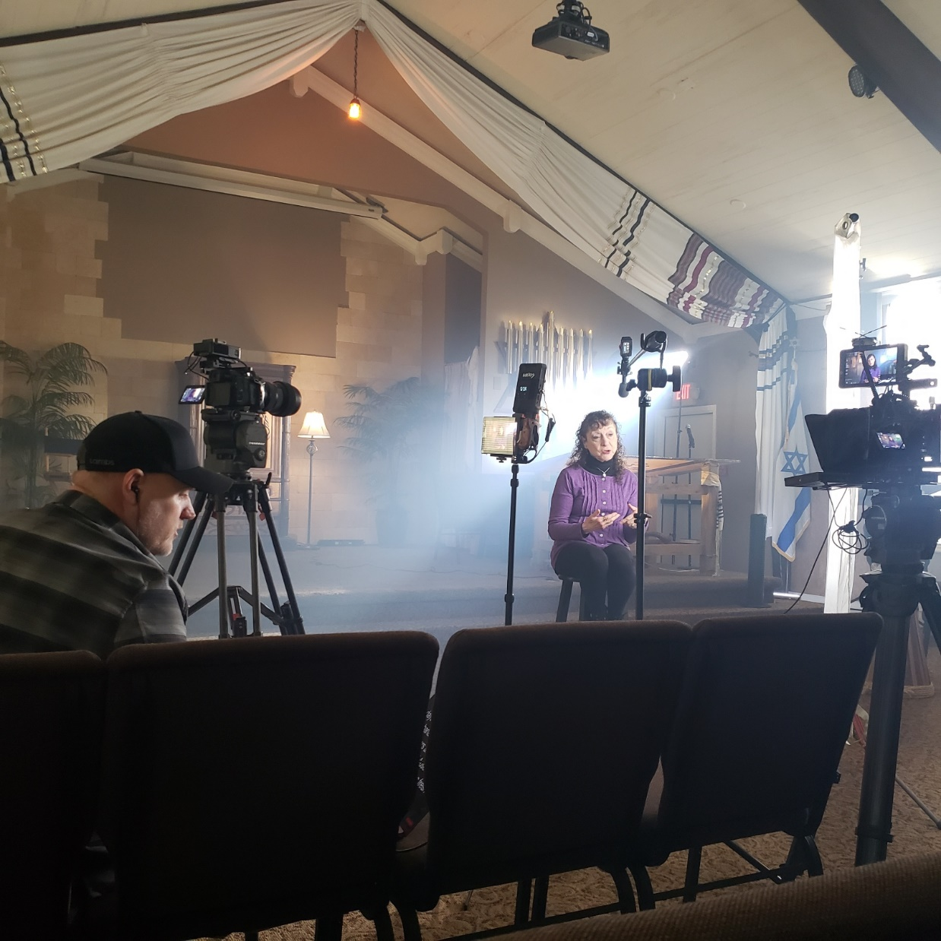
Notes:
Rukhel Fields

Slide 9
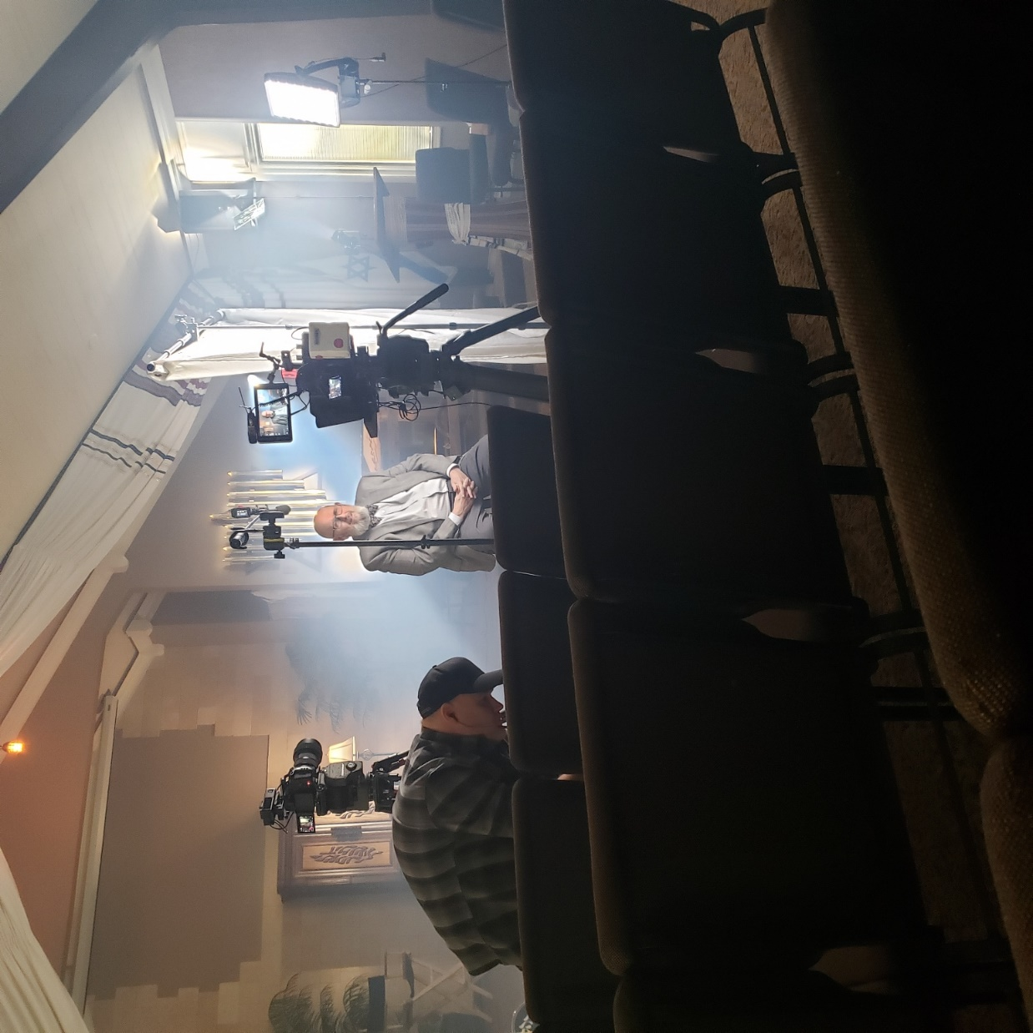
Notes:
Dr. Peter Greenspan
Also Sheila Schwartz Phillips and me.

Slide 10
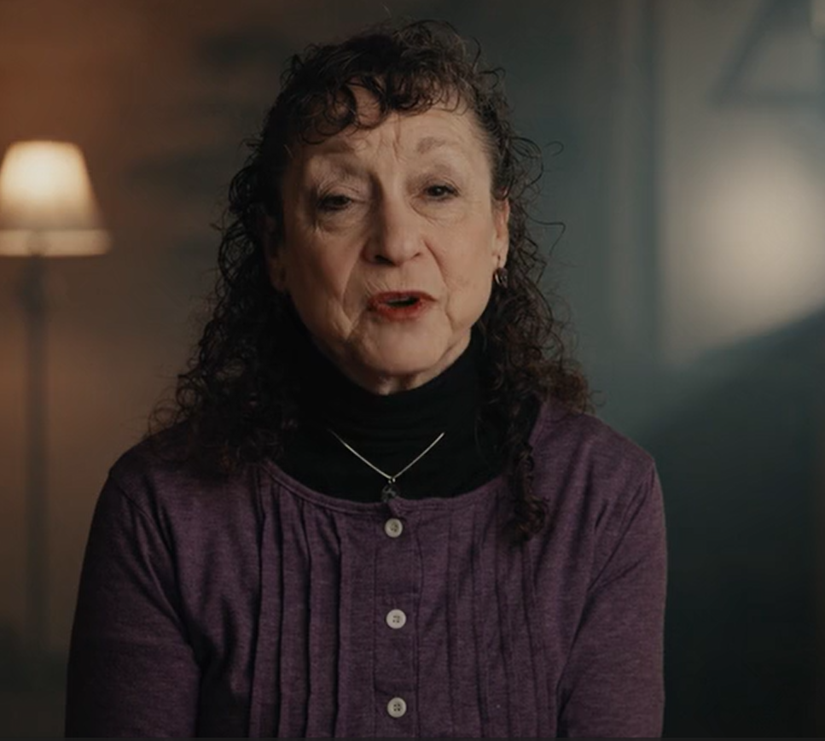
Trailer

Slide 12
^{Eph 4.1-2} Therefore I, the prisoner united with the Lord, beg you to lead a life worthy of the calling to which you have been called. Always be humble, gentle and patient, bearing with one another in love.

Slide 13
^{Eph 4.1-3} lead a life
worthy of the calling

Slide 14
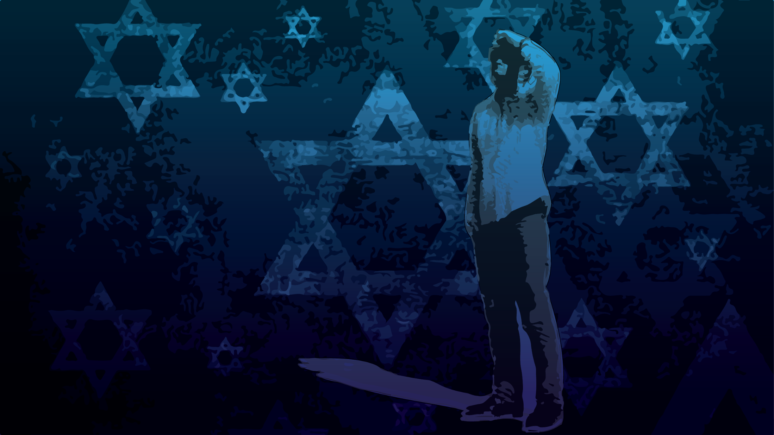
Worthy of the Calling Eph 4.1-2
Meaning of “worthy.”
Worthiness of G-d in Messiah
Unworthiness of people
Becoming worthy

Slide 15
Worthy of the Calling Eph 4.1-2
Meaning of “worthy.”
Worthiness of G-d in Messiah
Unworthiness of people
Becoming worthy

Slide 16
ἀξίως, suitably; worthily, in a manner worthy of, appropriately
Notes:
https://biblehub.com/greek/516.htm

Slide 17
worthily (viewed as "becoming"); suitable because recognized as fitting (having worth that "matches" actual value)
Sounds as if we earned it.

Slide 19
Worthy of the Calling Eph 4.1-2
Meaning of “worthy”
Worthiness of G-d in Messiah
Humankind unworthiness
Becoming worthy

Slide 20
^{T’hillim/Ps 18.4} I called upon Adoni, worthy of praise, and I was rescued from my enemies.
Notes:
1980s praise song

Slide 21
^{Rev 4.11} “You are worthy, Adoni Eloheinu, to have glory, honor and power, because you created all things — yes, because of your will they were created and came into being!”

Slide 22
^{Rev 5.2-3} I also saw a mighty angel proclaiming with a loud voice, “Who is worthy to open the scroll and to break its seals?” No one in heaven or on the earth or under the earth was able to open the scroll or to look into it.

Slide 23
^{Rev 5.9-12} “You are worthy to take the scroll and break its seals; because you were slaughtered; at the cost of blood you ransomed for God persons from every tribe, language, people and nation…

Slide 24
^{Rev 5.9-12} “Worthy is the Lamb who was slain, to receive power and riches and wisdom and might and honor and glory and blessing!”

Slide 25
Worthy of the Calling Eph 4.1-3
Meaning of “worthy”
Worthiness of G-d in Messiah
Unworthiness of people
Becoming worthy

Slide 26
^{Yeshuayahu/Is 64.5} All of us are like someone unclean, all our righteous deeds like very defiled rags.
Notes:
Even when we think we are doing right, our motives are corrupted.
How much we will be praised and appreciated for the good deed
What favors we might get in return
Our place of esteem as a reward.
Therefore Yeshua bids us do our giving in secret.
Our fasting
Our praying, at least some of it. Maybe most significant.

Slide 27
At the end of 1922 a loaf of bread in Berlin cost around 160 Marks
It cost 200,000,000,000 Marks by late 1923 200 billion!
Hyperinflation!
Notes:
https://en.wikipedia.org/wiki/Hyperinflation_in_the_Weimar_Republic

Slide 28
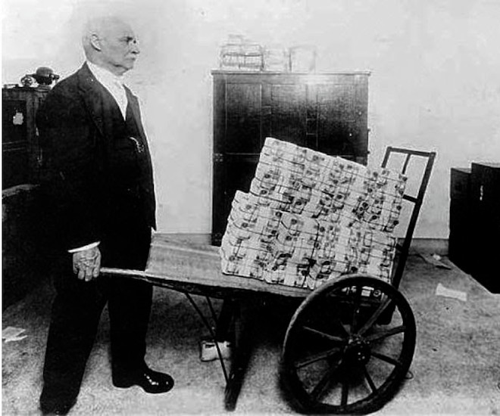
German hyper-inflation during the Weimar Republic
1923
Notes:
We are just not as big deal as we think, in fact, we are corrupt and in and of ourselves, not worth much. G-d affixes is love on us.
https://external-content.duckduckgo.com/iu/?u=https%3A%2F%2Fluxuo-com-production.s3.ap-southeast-1.amazonaws.com%2F2022%2F03%2FGermany-1923-Hyperinflation%2540660x550.jpg&f=1&nofb=1&ipt=6f853e8d2955840bf941afb26469fd2fdd8ce84878c0085210386950f0421980&ipo=images

Slide 29
^{Ephesians 2.8-10} For you have been saved, [delivered from eternal loss] by grace through trusting, and even this is not your accomplishment but God’s gift. You were not saved / delivered by your own actions;

Slide 30
^{Ephesians 2.8-10} therefore no one should boast. For we are of God’s making, created in union with the Messiah Yeshua for a life of good actions already prepared by God for us to do.
Notes:
So, we are not worthy.

Slide 31
^{Yn 1.26-27} “Among you stands One you do not know, coming after me, whose sandals I’m not worthy to untie.”

Slide 32
^{Yn 1.26-27} “Among you stands One you do not know, coming after me, whose sandals I’m not worthy to untie.”
Said by John the Jew.
Not John the Baptist

Slide 34
Worthy of the Calling Eph 4.1-2
Meaning of “worthy”
Worthiness of G-d in Messiah
Unworthiness of people
Becoming worthy

Slide 35
^{Eph 4.1-2} Therefore I, the prisoner united with the Lord, beg you to lead a life worthy of the calling to which you have been called. Always be humble, gentle and patient, bearing with one another in love.
Notes:
Let’s take it word by word.
First “therefore”

Slide 36
“Therefore”
ask, What is that there for?
Chapt 1-3
Life from the dead
Ascended with Him
Unfathomable riches of love
Notes:
BIG stuff!!

Slide 37
^{Eph 4.1-3} Therefore I, the prisoner united with the Lord,
Brutal reality of Roman prisons
Living this out in adversity gives Shaul/Paul authority of example.
Notes:
Wurmbrand Article

Slide 38
Kiddush HaShem קִדּוּשׁ הַשֵּׁם "sanctification of the Name")
You people are to be holy because I, Adoni your God, am holy.
קְדֹשִׁים תִּהְיוּ: כִּי קָדוֹשׁ אֲנִי יְיָ אֱלֹהֵיכֶם.
Notes:
https://en.wikipedia.org/wiki/Hadrian#Aftermath;_persecutions
What does that mean?
Be holy because I am holy. Doesn’t say
Be omnipotent because I am omnipotent.

Slide 39
Kiddush HaShem קִדּוּשׁ הַשֵּׁם "sanctification of the Name") is a precept of Judaism. It refers to private and communal conduct that reflects well, instead of poorly, on the G-d and His Jewish and Gentile people.
Notes:
https://en.wikipedia.org/wiki/Kiddush_Hashem

Slide 40
^{Lev 22.32-33} You must not profane My holy Name, for I will be made holy among the people of Yisrael. I am Adoni who makes you holy,
וְלֹא תְחַלְּלוּ, אֶת-שֵׁם קָדְשִׁי, וְנִקְדַּשְׁתִּי בְּתוֹךְ בְּנֵי יִשְׂרָאֵל: אֲנִי יְיָ מְקַדִּשְׁכֶם.
who brought you out of the land of Egypt, to be your God. I am Adoni.”
Notes:
Holiness of character based fundamentally on gratefulness. Even as Paul opens with “Therefore”

Slide 41
Any action by a Jew or Gentile follower of G-d that brings honor, respect, and glory to God is considered to be sanctification of His name.
Notes:
https://en.wikipedia.org/wiki/Kiddush_Hashem

Slide 42
khillul hashem חִלּוּל הַשֵּׁם
In contrast, any behavior or action that disgraces, harms or shames God's name and His Torah is regarded as a khillul Hashem (desecration of the Name).

Slide 43
The ultimate act of sanctification of the Name is a Jew or Gentile follower of G-d who is prepared to sacrifice his life rather than commit idolatry, sexually forbidden acts (such as incest or adultery), or murder.
Notes:
https://en.wikipedia.org/wiki/Kiddush_Hashem

Slide 44
Historical digression:
A massive anti-Hellenistic and anti-Roman Jewish uprising broke out, led by Simon bar Kokhba 135 CE
Notes:
https://en.wikipedia.org/wiki/Kiddush_Hashem
https://en.wikipedia.org/wiki/Hadrian#Aftermath;_persecutions

Slide 45
The Romans were overwhelmed at first by the organized ferocity of the uprising. Roman losses were heavy; an entire legion or its numeric equivalent of around 4,000.
Notes:
https://en.wikipedia.org/wiki/Hadrian#Aftermath;_persecutions

Slide 46
Roman war operations in Judea ultimately left some 580,000 Jews dead and 50 fortified towns and 985 villages razed. An unknown proportion of the population was enslaved.
Notes:
Roman scorched earth policy.
https://en.wikipedia.org/wiki/Hadrian#Aftermath;_persecutions
Some of you have been to Beitar, called the Masada of the North

Slide 47
The number of those who perished by famine, disease and fire was beyond finding out.
Kiddush HaShem,
Sanctifying the Name.
Love suffers.
Notes:
https://en.wikipedia.org/wiki/Hadrian#Aftermath;_persecutions

Slide 48
Martyrdom during the Hadrianic persecution is called sanctification of the Name Bavli Berachot 20a and Midrash Tehillim.
Notes:
https://en.wikipedia.org/wiki/Hadrian#Aftermath;_persecutions

Slide 49
^{2 Shmuel 12.14} [the prophet Natan to King David]
By this deed you have given great occasion to the enemies of the Lord to blaspheme.
אֶפֶס, כִּי-נִאֵץ נִאַצְתָּ אֶת-אֹיְבֵי יְיָ בַּדָּבָר הַזֶּה.
Notes:
נִאֵץ Harsh and blasphemed; hateful words, especially things that hurt sacred values

Slide 50
^{Eph 4.1-3} Therefore I, the prisoner united with the Lord, beg you to lead a life worthy of the calling to which you have been called.
Notes:
All people are called to worthiness, but there is a special calling to a Messianic cong.

Slide 51
Calling to Or HaOlam community?
Shabbat, Torah, Ruakh, Music, food, people, dance,.
Another deep purpose:
Gen 12.1-3 blessing Jews and be blessed.

Slide 52
^{Beresheet/Gen 12.1-3} Now Adoni said to Avram, “Get yourself out of your country…and go to the land that I will show you…₁I will bless you…₂and you are to be a blessing. I will bless ₃those who bless you.

Slide 53
G-d blesses Israel
Israel gives blessing
Nations receive
Nations bless Israel
Notes:
Calling to affiliate with Israel, blessings and sufferings. Glory and trauma.

Slide 54
^{Eph 4.1-3} Therefore I, the prisoner united with the Lord, beg you to lead a life worthy of the calling to which you have been called. Always be humble, gentle and patient.
This was a quality scorned by Greco-Roman culture.
Notes:
This is really the heart of the message. About time.

Slide 55
with all lowliness and meekness,
with complete lowliness of mind
with all humility and gentleness

Slide 56
tapeinophrosune: humility
"the having a humble opinion of oneself; a deep sense of one's (moral) littleness; modesty, humility, lowliness of mind";
Notes:
Thayer’s Greek lexicon
https://biblehub.com/greek/5012.htm
Read from McKee p 142-144

Slide 57
^{Iyov/Job 5.11} He raises the lowly on high and lifts mourners to safety.

Slide 58
^{Mtt. 11.29} Take my yoke upon you and learn from me, because I am gentle and humble in heart, and you will find rest for your souls.

Slide 59
^{Eph 4.1-2} ^{Eph 4.1-3} Therefore I, the prisoner united with the Lord, beg you to lead a life worthy of the calling to which you have been called. Always be humble, gentle and patient bearing with one another in love.
Notes:
More severe conflicts in 2024 2 months than ever

Slide 60
Patience is like good motor oil. It doesn’t remove all the irritants. It just puts them in suspension so they don’t get into your works and seize them up. Patient people have, so to speak, a large crankcase. They can put irritants into suspension.
Notes:
Cornelius Plantinga
Parallel in Colossians.

Slide 61
^{Col 3.12-15} Therefore, as God’s chosen people, holy and dearly loved, clothe yourselves with feelings of compassion and with kindness, humility, gentleness and patience. Bear with one another; if anyone has a complaint against someone else, forgive him.

Slide 62
^{Col 3.12-15} Indeed, just as the Lord has forgiven you, so you must forgive. Above all these, clothe yourselves with love, which binds everything together perfectly; and let the shalom which comes from the Messiah be your heart’s decision-maker,

Slide 63
^{Col 3.12-15} for this is why you were called to be part of a single Body. And be thankful

Slide 65
^{Eph 4.1-2} Therefore I, the prisoner united with the Lord, beg you to lead a life worthy of the calling to which you have been called. Always be humble, gentle and patient, bearing with one another in love.

Slide 66
Worthy of the Calling Eph 4.1-2
Meaning of “worthy.”
Worthiness of G-d in Messiah
Unworthiness of people
Becoming worthy

Slide 67
Do you KNOW Yeshua and drinking the water of LIFE?
Are you hearing daily from His Word?
How are you applying what you heard?
Are you offering that water of life to anyone?

