Slide 1
e-handout
To have these notes
without taking notes
Go to OrHaOlam.com
Click on Messages tab,
2024 Messages

Slide 2
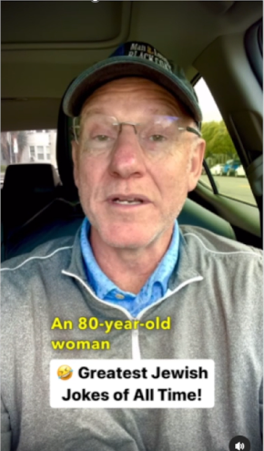
Greatest Jewish Jokes of All Time
Notes:
https://www.instagram.com/p/C4Eg7GDPSKd/

Slide 3
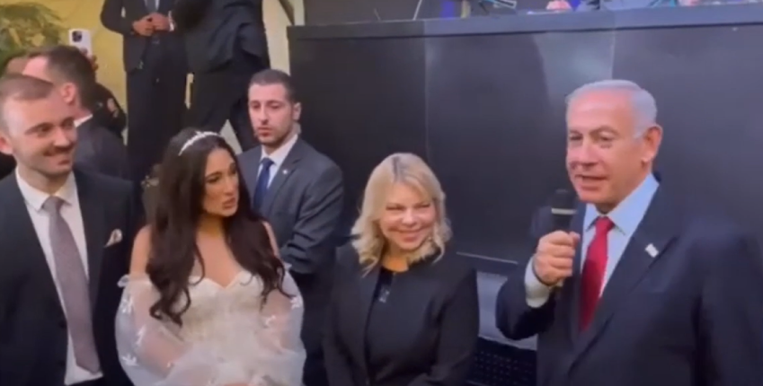
Hananya and India Naftali Wedding

Slide 4
LIBERATION

Slide 5
Last Shabbat: UNITY
^{Eph 4.2-6} You were called to one hope. And there is one Lord, one trust, one immersion, and one God, the Father of all, who rules over all, works through all and is in all. Unity of heart and spirit.
Notes:
So, to maintain unity…

Slide 6
^{Ephesians 4.7-10} But to each one of us grace was given in keeping with the measure of Messiah’s gift. Therefore it says, “When He went up on high, He led captive a troop of captives and gave gifts to his people.”
Notes:
Who are these captives?
Where were they in captivity?
How were they rescued?
What gifts?

Slide 7
^{Ephesians 4.7-10} Now what does “He went up” mean, except that He first went down to the lower regions of the earth? The One who came down is the same One who went up far above all the heavens, in order to fill all things.

Slide 8
LIBERATION
Notes:
Liberation of captives is a GREAT thing
Building on the last topic: It takes battle to keep unity.

Slide 9
Battlefield Liberation Gifts
Greatest Rescue in history
Greatest Rescue outside history
Greatest Rescue of our spirits
Are We Rescuers?

Slide 10
Battlefield Liberation Gifts
Greatest Rescue in history
Greatest Rescue outside history
Greatest Rescue of our spirits
Are We Rescuers?

Slide 11
On June 27, 1976 a routine commercial flight on Air France made its way from Tel Aviv to Paris. It was hijacked by the German Baader–Meinhof Gang and taken to Entebbe, Uganda, On July 4, a week after the plane was hijacked, Israeli forces landed in Entebbe during the dead of night.
Notes:
https://allthatsinteresting.com/operation-entebbe

Slide 12
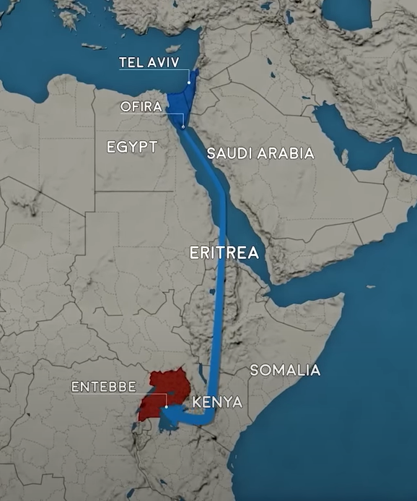
Notes:
https://youtu.be/4bnUn6A3EII
At 100 ft altitude to avoid Saudi and Egyptian radar. Permission from Kenya. Thank you Kenyans.

Slide 13
Notes:
https://youtu.be/GXkGNZEikPU
They had a car like Idi Amin’s. Interpol interviewed under hypnosis the French passengers released. Israeli contractor had built the terminal. They knew exactly where to go.
Key word DOWN or שכבו
Killed anyone standing.
A Holocaust survivor hearing orders given with a German accent…again was transported back 35 years.

Slide 14
Once the smoke cleared, every single one of the hijackers and 20 Ugandan soldiers supporting them were dead. The hostages were guided into the waiting C-130 aircraft. Liberated 102 hostages. Of the Israelis four were either dead or missing.
Notes:
https://allthatsinteresting.com/operation-entebbe

Slide 15
Among the dead was the commander of Operation Entebbe, Yonatan Netanyahu, older brother of Benjamin Netanyahu. He had been shot within minutes of the first aircraft landing.
Notes:
https://allthatsinteresting.com/operation-Entebbe

Slide 16
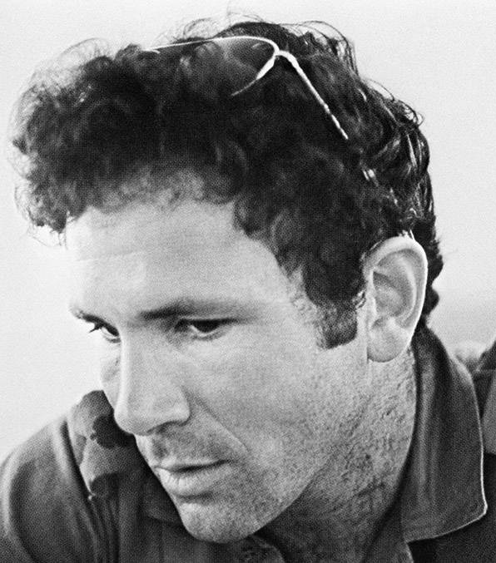
Yoni
Jonathan
Netanyahu
Notes:
https://allthatsinteresting.com/wordpress/wp-content/uploads/2018/03/yonatan-netanyahu.jpg
The family had thought that Yoni had the political leadership future. That all fell on younger brother Benjamin or Bibi.

Slide 17
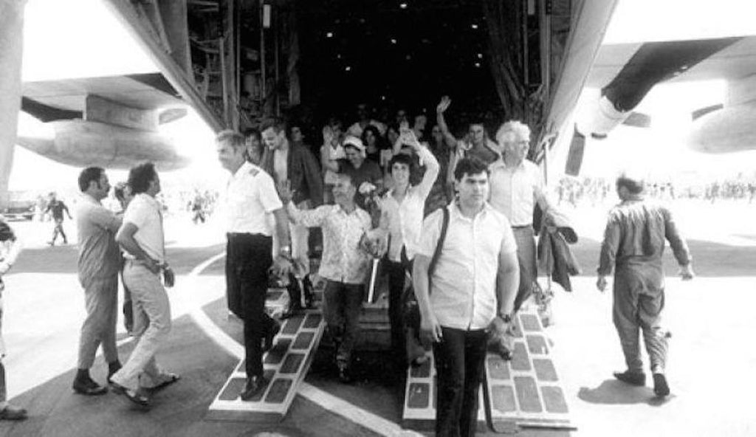
Arrival of Recued Hostages in
Israel
Notes:
https://cdn.shopify.com/s/files/1/2604/4866/files/11709608_946144722117310_3944984713459818311_n_1024x1024.jpg?v=1553715785

Slide 18
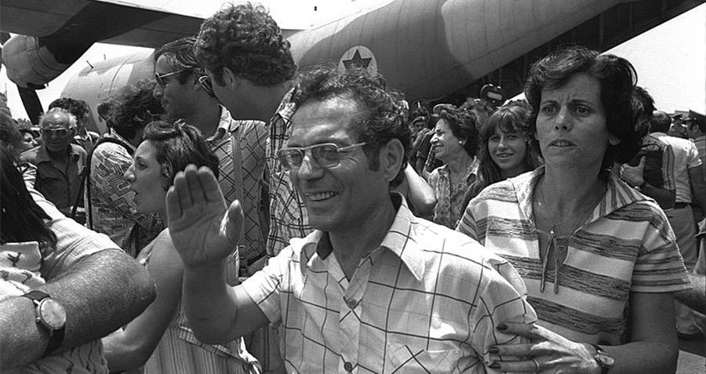
Notes:
https://allthatsinteresting.com/operation-Entebbe
Of 106 hostages, 102 were rescued and returned to Israel

Slide 19
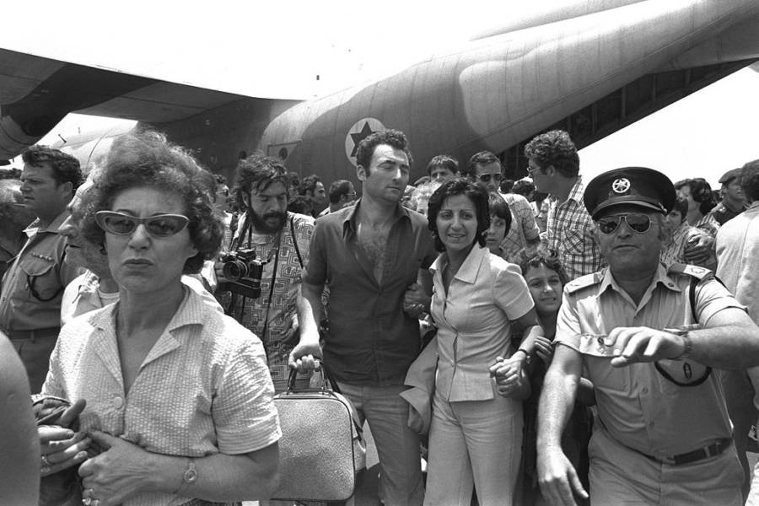
Arrival of Recued Hostages in
Israel

Slide 20
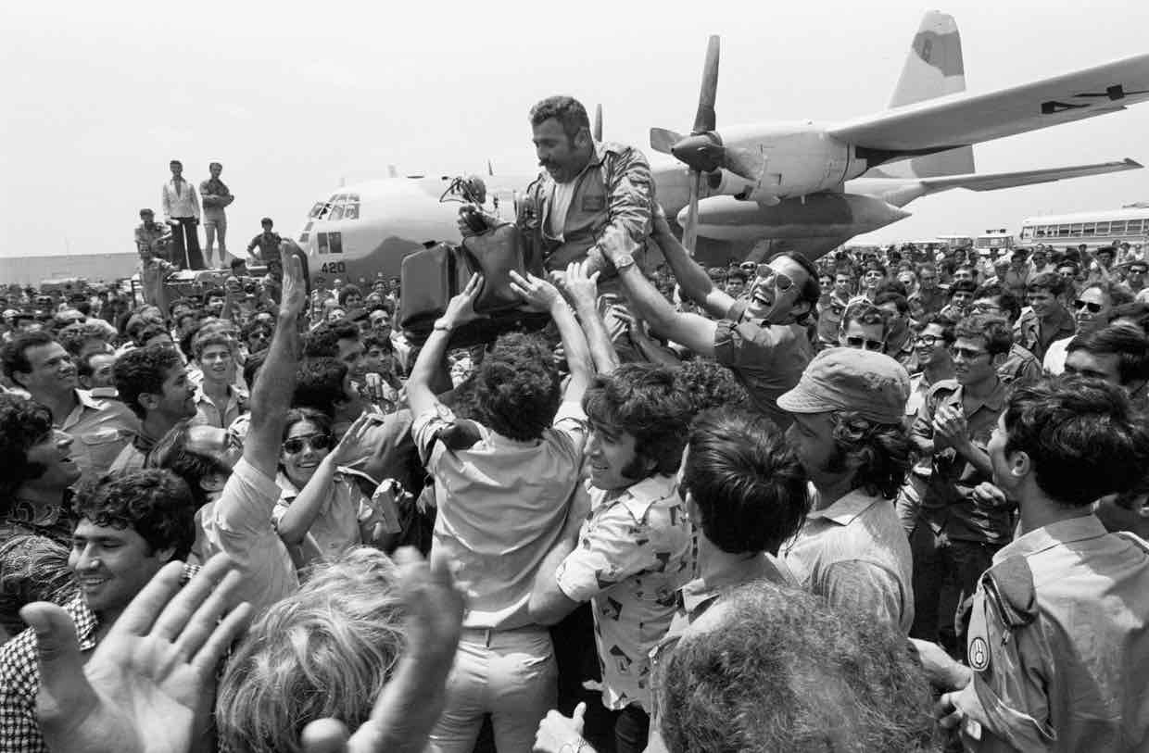
Arrival of Recued Hostages in
Israel
Notes:
https://spotterup.com/wp-content/uploads/2017/06/Entebbe.jpg

Slide 21
GREAT liberation of captives!!
Gift to them of survival, freedom, restoration to family and home.
Operation Entebbe was considered a stunning success and would be later taught and studied by armies around the globe.
Whole movie:
https://youtu.be/Qww8rwtWTO0
Notes:
https://allthatsinteresting.com/operation-entebbe
As great as that homecoming of these rescued captives is, there are greater homecoming celebrations coming.

Slide 22
LIBERATION
Notes:
We are rescued, and we are to be rescuers

Slide 23
Battlefield Liberation Gifts
Greatest Rescue in history
Greatest Rescue outside history
Greatest Rescue of our spirits
Are We Rescuers?

Slide 24
^{Ephesians 4.7-10} But to each one of us grace was given in keeping with the measure of Messiah’s gift. Therefore it says, “When He went up on high, He led captive a troop of captives and gave gifts to his people.”

Slide 25
^{Ephesians 4.7-10} Now what does “He went up” mean, except that He first went down to the lower regions of the earth? The One who came down is the same One who went up far above all the heavens, in order to fill all things.

Slide 26
Who are these captives?
Where were they in captivity?
How were they rescued?
What gifts?

Slide 27
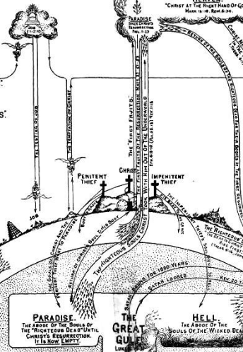
One meaning of who are the captives: The deceased in Paradise before Messiah’s death and resurrection.
Notes:
https://i.pinimg.com/originals/96/05/d2/9605d23c0af65c52372ce7d3cc6f915c.jpg
So this is a cosmic, eternal rescue by Messiah.

Slide 28
Before Messiah’s atoning death and resurrection the righteous deceased clearly went to Paradise, but NOT to G-d’s immediate presence.
After Yeshua’s death and resurrection, He brought them from Paradise, to G-d’s presence, captivity captive.

Slide 29
Notes:
From Clarence Larkin’s Dispensational Truth

Slide 30
^{T’hillim / Ps 68.18-22} The chariots of God are thousands and thousands —my Lord is among them as at Sinai, in holiness. You went up on high. You led captivity captive. You received gifts from humanity, even from the rebellious—

Slide 31
^{T’hillim / Ps 68.18-22} so that God might dwell there. Blessed be my Lord! Day by day He bears our burdens— the God of our salvation! Selah God is for us—a God of deliverance. Adoni my Lord has escape from death. Surely God crushes the head of His foes.
Notes:
Warfare and contention to bring the righteous deceased into G-d’s presence.

Slide 32
^{T’hillim/Ps 24 7-10} Lift up your heads, O gates, and be lifted up, you everlasting doors: that the King of glory may come in. “Who is this King of glory?” Adoni strong and mighty, Adoni mighty in battle! Lift up your heads,
Notes:
Warfare in eternal, unseen realms.

Slide 33
^{T’hillim/Ps 24 7-10} O gates, and lift them up, you everlasting doors: that the King of glory may come in. “Who is this King of glory?” Adoni -Tzva’ot—He is the King of glory!

Slide 34
^{Lk 16.20-26} “Now there was a rich man dressed in purple and fine linen, living it up in luxury every day. But a poor man named Lazarus had been laid at his gate, covered with sores and longing to be fed with what fell from the rich man’s table. Besides, even the dogs were coming to lick his sores.
Notes:
Doesn’t say, but implies that the man in luxury was corrupt, and sickly Lazarus was righteous. NOT implying that the riches were inherently evil. This rich guy apparently was defiled.

Slide 35
^{Lk 16.20-26} “It happened that the poor man died and was carried by the angels to Avraham’s side. [Doesn’t say “heaven” or “G-d’s presence.” But a place of bliss and comfort.]
Notes:
So Lazarus in Avraham’s side, honored guest at Avraham’s table.

Slide 36
^{Lk 16.20-26} Then the rich man also died and was buried. And from Sheol [Hell], as he was in torment, he raised his eyes. And he sees Abraham far off, and Lazarus at his side.
Notes:
Rich man in the place of punishment, died without G-d in his life and heart. Absence of G-d here implies absence of G-d in eternity!
G-d doesn’t have to send those separated from him to hell, they just continue to exist bereft of any comfort and blessings.

Slide 37
^{Lk 16.20-26} So he cried out and said, ‘Father Abraham, have mercy on me! And send Lazarus so he may dip the tip of his finger in water and cool off my tongue, because I am suffering torment in this flame.’ “But Abraham said, ‘Son, remember that in your life you received your good things,

Slide 38
^{Lk 16.20-26} even as Lazarus received the bad things. But now he is comforted here, and you are tormented. Besides all this, between us and you a great chasm is firmly set, so that those who want to cross over to you cannot, nor can those from there cross over to us.

Slide 39
Notes:
Another source of info about Paradise…

Slide 40
^{Lk 23.32} Two other men, both criminals, were led out to be executed with Him [Yeshua]. When they came to the place called The Skull, they nailed him to a stake; and they nailed the criminals to stakes, one on the right and one on the left.

Slide 41
^{Lk 23.34- 43} …One of the criminals hanging there was jeering at Him, saying, “Aren’t You the Messiah? Save Yourself—and us!”

Slide 42
^{Lk 23.34- 43} But the other one, rebuking him, replied, “Don’t you fear God, since you are under the same sentence? We’re getting what we deserve for our actions,

Slide 43
^{Lk 23.34- 43} and rightly so—but this One has done nothing wrong.” And he said, “Yeshua, remember me when You come into Your kingdom.” Yeshua said to him, “Amen, I tell you, today you shall be with Me in Paradise.”
Notes:
Couldn’t yet take him to G-d’s presence, to heaven.

Slide 44
Notes:
Another source of info about “captivity captive”

Slide 45
The Apostles’ Creed is used as an integral form of worship in many believing bodies. Good and bad:
[+]Clearly affirms deity and humanity of Messiah over some controversy.
[-] Makes NO reference to G-d’s covenants with Israel.
Notes:
https://www.ligonier.org/learn/teachers/rc-sproul
Dr. R.C. Sproul was founder of Ligonier Ministries, first minister of preaching and teaching at Saint Andrew’s Chapel in Sanford, Fla., first president of Reformation Bible College,

Slide 46
One of the more puzzling statements in that creed is:
“He [Messiah] descended into hell.” Most scholars that believe in an actual descent of Messiah into hell do not see him going to hell for further suffering because Yeshua declares
Notes:
https://www.ligonier.org/learn/teachers/rc-sproul

Slide 47
“It is finished.” Rather, he goes to hell to liberate those spirits who, from antiquity, have been held in prison. His task in hell then is one of triumph, liberating Old Testament saints.
Notes:
https://www.ligonier.org/learn/qas/what-does-apostles-creed-mean-when-it-says-jesus-d

Slide 48
I personally think that the Bible is less than clear on that point because the lost spirits in prison could very well refer to lost people in this world.
Notes:
https://www.ligonier.org/learn/qas/what-does-apostles-creed-mean-when-it-says-jesus-d

Slide 49
So now, “to be absent from the body is to be present with the L-rd. ^{2 Cor 5.8}
Notes:
Warfare and contention to bring the righteous deceased into G-d’s presence.

Slide 50
LIBERATION
Notes:
Liberation of captives is a GREAT thing

Slide 51
Battlefield Liberation Gifts
Greatest Rescue in history
Greatest Rescue outside history
Greatest Rescue of our spirits
Are We Rescuers?
Notes:
We are rescued, and we are to be rescuers.

Slide 52
An third meaning of who are the captives is:
All who are guilty of sin.

Slide 53
^{Yokhanan/Jn 8.34-36} Yeshua answered them, “Yes, indeed! I tell you that everyone who practices sin is a slave of sin. Now a slave does not remain with a family forever, but a son does remain with it forever. So if the Son frees you, you will really be free!
Notes:
Warfare and contention to bring the righteous deceased into G-d’s presence.
Kingdom of heaven suffers violence, and the violent take it by force.

Slide 54
^{Yeshuyahu/Isaiah 61.1-3} The Spirit of Adoni Elohim is upon me, because Adoni has anointed me to announce good news to the poor. He has sent me to heal the brokenhearted; to proclaim freedom to the captives,

Slide 55
^{Yeshuyahu/Isaiah 61.1-3} to let out into light those bound in the dark; to proclaim the year of the favor of Adoni and the day of vengeance of our God; to comfort all who mourn, yes, provide for those in Tziyon who mourn,

Slide 56
^{Yeshuyahu/Isaiah 61.1-3} giving them garlands instead of ashes, the oil of gladness instead of mourning, a cloak of praise instead of a heavy spirit, so that they will be called oaks of righteousness planted by Adoni, in which he takes pride.

Slide 57
Synagogue reading from the scroll was part of the life of Yeshua.

Slide 58
^{Lk. 4. 16-22} Now when he went to Natzeret, where he had been brought up, on Shabbat he went to the synagogue as usual. He stood up to read, and he was given the scroll of the prophet Yesha‘yahu Isaiah. Unrolling the scroll, he found the place where it was written,

Slide 59
^{Lk. 4. 16-22} “The Spirit of Adoni is upon me; therefore he has anointed me to announce Good News to the poor; he has sent me to proclaim freedom for the imprisoned and renewed sight for the blind, to release those who have been crushed, to proclaim a year of the favor of Adoni.”

Slide 60
^{Lk. 4. 16-22} After closing the scroll and returning it to the shammash, he sat down; and the eyes of everyone in the synagogue were fixed on him. He started to speak to them: “Today, as you heard it read,

Slide 61
^{Lk. 4. 16-22} this passage of the Tanakh was fulfilled!” Everyone was speaking well of him and marveling that such appealing words were coming from his mouth. They were even asking, “Can this be Yosef’s son?”

Slide 62
Are we rescuers?

Slide 63
^{Lk. 4. 16-22} “The Spirit of Adoni is upon me; therefore he has anointed me to announce Good News to the poor; he has sent me to proclaim freedom for the imprisoned and renewed sight for the blind, to release those who have been crushed, to proclaim a year of the favor of Adoni.”
Notes:
Do we sense the reality and presence of the Spirit upon us in our lives? Love, joy, peace. Evident?
Do we labor to bring the Good News of Messiah to the poor? Misloakh Manot 2 weeks.
Do we labor to loose those imprisoned?
Help those who are blinded to Truth, release the crushed? Pre-born?
Are we warriors to preserve Israel, sign petitions, go to demonstrations.
Do we fight against lies in the culture about gender, about Israel?
Do we sacrifice to have unity and blessing and growth.

Slide 64
Valiant for truth on the home front:

Slide 65
According to the 2024 Match Singles in America report, which released on Wednesday, while 31% of singles in America have explored consensual non-monogamy (also known as ethical non-monogamy), 49% of singles say that traditional sexual monogamy is still their "ideal sexual relationship.
Notes:
https://time.com/6568590/dating-non-monogamy-polyamory-match-singles-in-america/?et_rid=207180372&lctg=207180372

Slide 66
Of the one third of singles who had tried consensual non-monogamy, respondents reported participating in polyamory (where relationship partners agree that each may have a romantic relationship with other people), open relationships
Notes:
https://time.com/6568590/dating-non-monogamy-polyamory-match-singles-in-america/?et_rid=207180372&lctg=207180372

Slide 67
(a committed primary relationship that openly allows for romantic and/or sexual activity with others), swinging (expanding an exclusive romantic relationship to seek out other sexual partners together), and being monogamish (a committed relationship that allows for sexual variety with others, either together or individually).
Notes:
https://time.com/6568590/dating-non-monogamy-polyamory-match-singles-in-america/?et_rid=207180372&lctg=207180372
Sexual truth is simple: celibacy outside marriage.

Slide 68
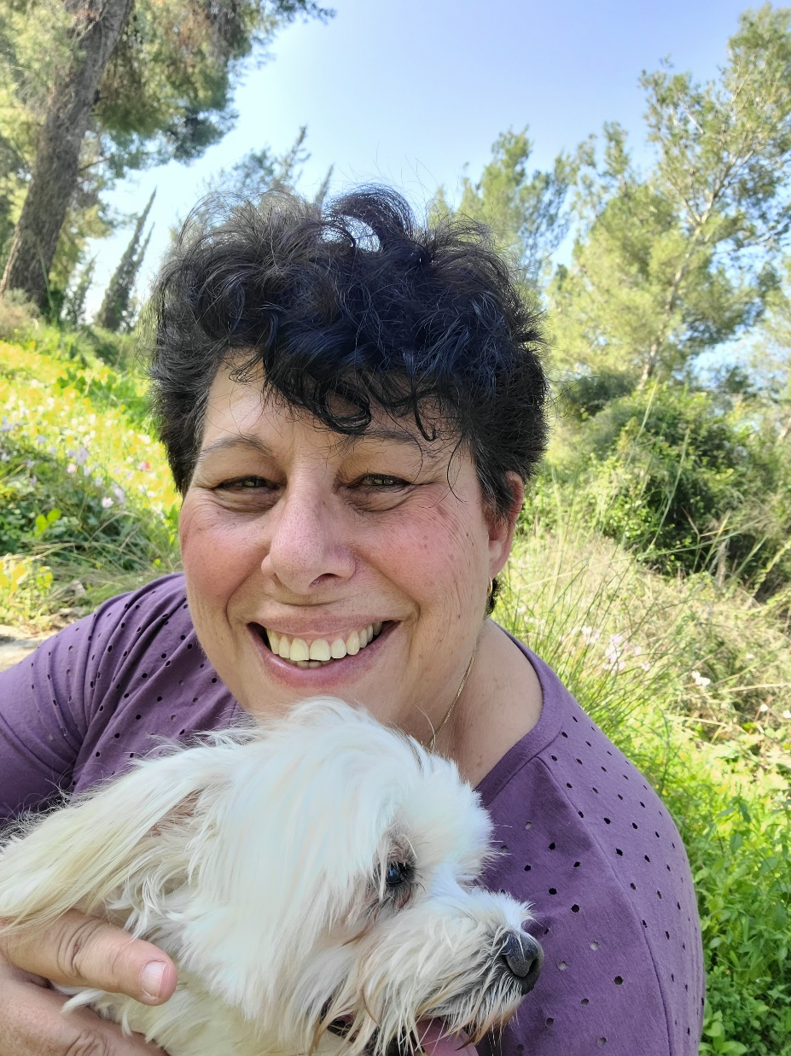
Contending for truth about Israel, from Sally Shiff, an Israeli guest speaker who has been here.

Slide 69
1 small note, this "not enough supplies" to Gaza? They are receiving 1.5 times the aid they did before Oct 7. Its a propaganda lie that is perpetrated by Hamas...
https://www.jpost.com/opinion/article-790880
Notes:
From Sally Shiff

Slide 70
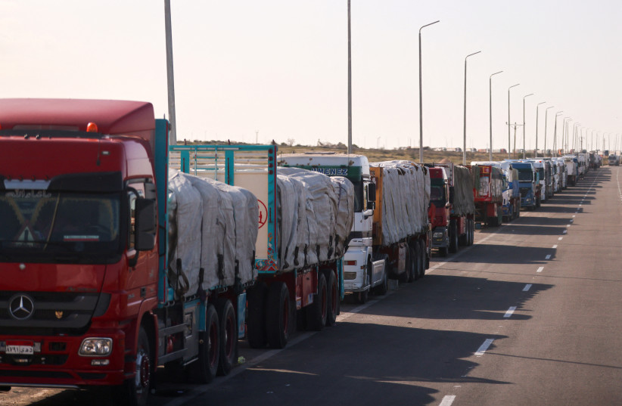
Trucks carrying aid line up near the Rafah border crossing
between Egypt and the Gaza Strip, amid the ongoing
Conflict between Israel and Palestinian Islamist group
Hamas, in Rafah, Egypt,
February 1, 2024. (credit:
MOHAMED ABD EL GHANY/REUTERS)
Notes:
Trucks carrying aid line up near the Rafah border crossing between Egypt and the Gaza Strip, amid the ongoing conflict between Israel and Palestinian Islamist group Hamas, in Rafah, Egypt, February 1, 2024. (credit: MOHAMED ABD EL GHANY/REUTERS)

Slide 71
The Negotiations are a stand still for good reasons. Hamas purposely kidnapped Israelis dead or alive to be used as a bargaining chip with Israel. Every terrorist who brought a hostage back received $10,000 from Hamas.
Notes:
From Sally Shiff

Slide 72
Hamas has stripped the people financially, leaving them in abject poverty. Standard of living is about $2 a day (for a family of 5). So when Hamas offers them $200 a month to build a tunnel under their home or kidnap Israelis...
Notes:
From Sally Shiff

Slide 73
Notes:
https://youtu.be/jNyrfO1d9Zk

Slide 74
Destroying Hamas in Rafah,
Moving Gazan citizens out of Rafah area
Defending the border with Lebanon,
Allowing Ramadan celebrations
Humanitarian aid in Gaza

Slide 75
Release/Rescue of the hostages,
Worldwide Anti-Zionism / AntiSemitism,
Enlistment of Orthodox Jews into the army,
Israel’s budget deficit during war,
Eurovision and “October Rain”.

Slide 76
To be a liberator takes:
Courage to be a liberator.
Sacrifice to be a liberator.
Humility to be a liberator.
Love to be a liberator.
Notes:
Speak the truth in love.
Elevate others.
First to confess.

Slide 77
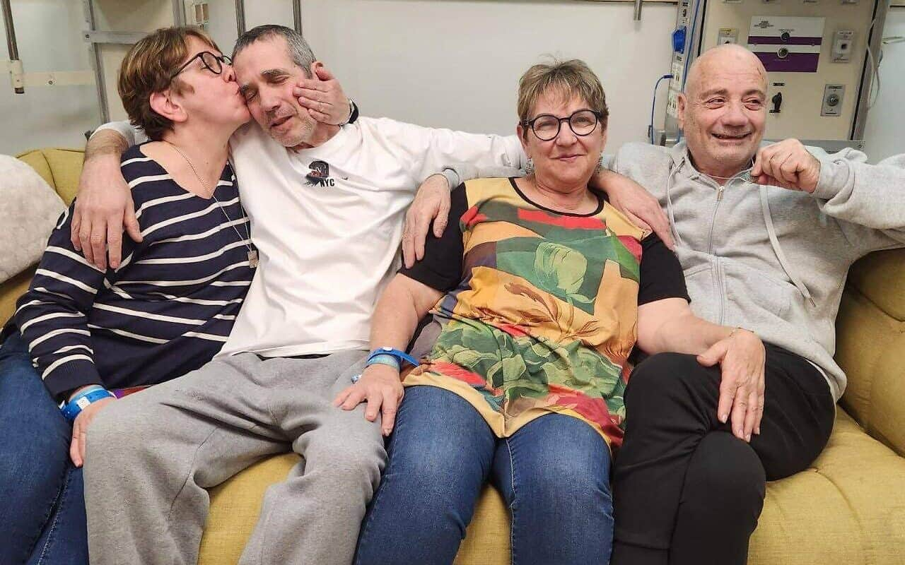
Freed Israeli hostages
Fernando Simon Marman (left)
and Louis Har
Notes:
Freed Israeli hostages Fernando Simon Marman (left) and Louis Har at Sheba Medical Center in Ramat Gan, Israel. Also pictured kissing Marman is his sister, Gabriela Leimberg, and his other sister and Har’s partner, Clara Marman, on Feb. 12, 2024. Source: X.
https://www.jns.org/rescue-op-a-vital-mini-success-on-the-way-to-overall-victory-in-gaza/

Slide 78
Every soldier who took part knew everything about Fernando Marman, 60, and Louis Har, 70, who were captured on Oct. 7 from their home in Kibbutz Nir Yitzhak near the Gaza Strip—their facial features, qualities and personalities.
Notes:
https://www.israeltoday.co.il/read/i-dragged-him-toward-me-and-said-weve-come-to-take-you-home/?mc_cid=980484d9e6&mc_eid=9f06d9f262

Slide 79
They also knew that the operation would be tough because it would take place in a Hamas stronghold that the IDF still hadn’t targeted, full of terrorists for whom Rafah is their last bastion.
Notes:
https://www.israeltoday.co.il/read/i-dragged-him-toward-me-and-said-weve-come-to-take-you-home/?mc_cid=980484d9e6&mc_eid=9f06d9f262

Slide 80
The unit trained non-stop during those weeks, with an emphasis on the fact that the difference between success and failure was measured in millimeters.
Notes:
https://www.israeltoday.co.il/read/i-dragged-him-toward-me-and-said-weve-come-to-take-you-home/?mc_cid=980484d9e6&mc_eid=9f06d9f262

Slide 81
Q: You weren’t afraid, when you killed the terrorists, that maybe you were mistakenly shooting at the hostages?
“The faces of Louis and Fernando have already been in my head for a long time. They were engraved in my mind, and I knew that if I wasn’t sure then I wouldn’t shoot.”

Slide 82
Q: Even at the price of the terrorists shooting at you?
“I think we’ve all already made our peace with that.”
Notes:
Physical rescue risky and costly. Spiritual rescue similar.

Slide 83
Notes:
https://youtu.be/AJLoO3jzxBA

Slide 84
Premiered Mar 7, 2024 A group of Israeli believers gathered from all over the Land, together with believers from the nations, for this song of prayer in the city of Sderot, located approximately one kilometer from the Gaza border.
Sign the "I pray #Isaiah61" petition at https://setthecaptivesfree.allisrael.com
Notes:
Tell believers by raising hands.

Slide 85
The believers gathered on the site of the former police station that was attacked by Hamas terrorists who took the lives of more than thirty policemen and civilians on October 7th.

Slide 86
Song: Ruach Adonai Alai - The Spirit of the Lord is Upon Me
Music: Tony Sperandeo and Noam Waxman ©1987 [Mes Cong leader]
Words: Isaiah 61:1-3
Recorded: 61 Herzl St, Sderot, Israel on Feb 26, 2024

Slide 87
Notes:
https://youtu.be/AJLoO3jzxBA

Slide 88
LIBERATION
Notes:
Liberation of captives is a GREAT thing

Slide 89
Battlefield Liberation Gifts
Greatest Rescue in history
Greatest Rescue outside history
Greatest rescue of our spirits
Are We Rescuers?

Slide 90
^{Ephesians 4.7-10} But to each one of us grace was given in keeping with the measure of Messiah’s gift. Therefore it says, “When He went up on high, He led captive a troop of captives and gave gifts to his people.”

Slide 91
^{Ephesians 4.7-10} Now what does “He went up” mean, except that He first went down to the lower regions of the earth? The One who came down is the same One who went up far above all the heavens, in order to fill all things.

Slide 92
Do you KNOW Yeshua and drinking the water of LIFE?
Are you hearing daily from His Word?
How are you applying what you heard?
Are you offering that water of life to anyone?

