Slide 1
e-handout
To have these notes
without taking notes
Go to OrHaOlam.com
Click on Messages tab,
2024 Messages

Slide 2
Notes:
https://imageio.forbes.com/specials-images/imageserve/65a7e7b7654fef0f33c5379d/2045/960x0.jpg?format=jpg&width=1440

Slide 3
Nov. 13-22, 2021
Notes:
https://imageio.forbes.com/specials-images/imageserve/65a7e7b7654fef0f33c5379d/2045/960x0.jpg?format=jpg&width=1440

Slide 4
Notes:
https://imageio.forbes.com/specials-images/imageserve/65a7e7b7654fef0f33c5379d/2045/960x0.jpg?format=jpg&width=1440

Slide 5
The “Great North American Eclipse” is over—now prepare for the “Greatest American Eclipse.”
Notes:
https://imageio.forbes.com/specials-images/imageserve/65a7e7b7654fef0f33c5379d/2045/960x0.jpg?format=jpg&width=1440
From Jim Templer

Slide 6
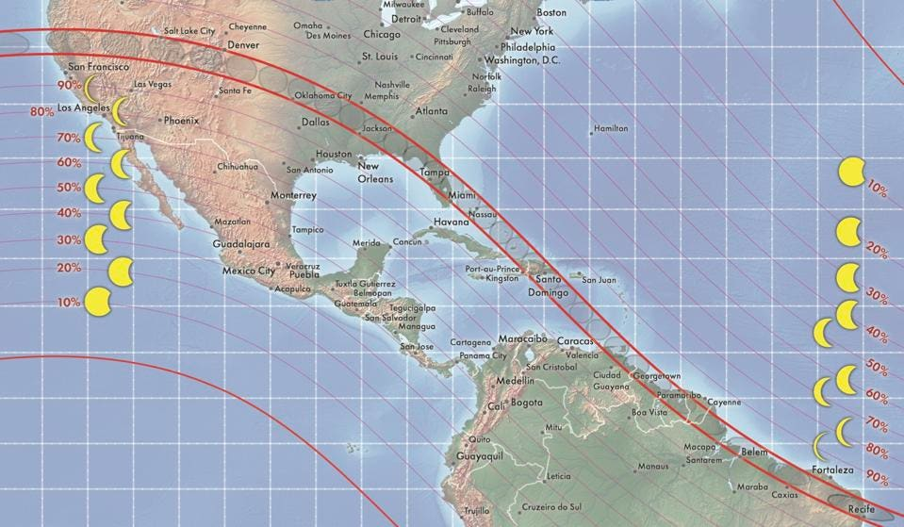
August 12, 2045
21 years 4 months
An eclipse from above, in the ISS

Slide 7
The 4 minutes 26 seconds of totality that was experienced during April 8’s total solar eclipse was the longest on land since 2010 anywhere in the world. Most totalities last about two minutes or so.
Notes:
https://imageio.forbes.com/specials-images/imageserve/65a7e7b7654fef0f33c5379d/2045/960x0.jpg?format=jpg&width=1440

Slide 8
That makes the next coast-to-coast total solar eclipse in the U.S. special.
On August 12, 2045, a whopping
6 minutes and 4 seconds of totality will be possible from Florida—the nation’s “Greatest American Eclipse.”
Notes:
https://imageio.forbes.com/specials-images/imageserve/65a7e7b7654fef0f33c5379d/2045/960x0.jpg?format=jpg&width=1440

Slide 9
It’s why you need to stay alive until 2045—and it’s the “best” eclipse on the celestial schedule for America’s “Generation Eclipse.”
Just 21 years 4 months from now!
Notes:
https://imageio.forbes.com/specials-images/imageserve/65a7e7b7654fef0f33c5379d/2045/960x0.jpg?format=jpg&width=1440
I’ll be 96, and still doing 80 push ups!

Slide 10
August 12, 2045
21 years 4 months
An eclipse from above, in the ISS
Notes:
Looks like OP, KS is right in the 100% band this time.

Slide 11
If anyone gets a message from me about canned meat, don't open it.
Notes:
From Scott Hahn

Slide 12
If anyone gets a message from me about canned meat, don't open it. It's Spam …

Slide 13
Fentanyl

Slide 14
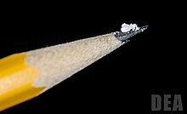
A two milligram dose of fentanyl
powder (on pencil tip) is a
lethal amount for most people
Notes:
https://en.wikipedia.org/wiki/Fentanyl

Slide 15
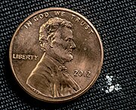
2 mg of fentanyl (white powder to the right) is a lethal dose in most people

Slide 16
According to Ben Shapiro, fentanyl poisonings have skyrocketed in recent years, rising from just 3,000 in 2013 to more than 73,000 in 2022. Death by fentanyl poisoning is, by many estimates, the leading cause of death for those ages 18 to 45.
Notes:
https://www.youtube.com/watch?v=sCJQHwHXCFk

Slide 17
Don’t take fentanyl
Don’t touch it
Don’t taste it
Don’t smell /snort it.

Slide 18
There is something similar to the deadliness of fentanyl in the Kingdom, from the days of Moshe.
Notes:
So, pay attention
Paga attencion!
שים לב

Slide 19
[Khametz]
Notes:
Most transliterations will have chametz with a ch.
Practice “Khametz”

Slide 20
Leaven = Khametz
and the old nature
1. Just the facts

Slide 21
^{Shmot Ex 12. 18-20} During the first month in the evening of the fourteenth day of the month, you are to eat matzot, [April 22, 2024] until the evening of the twenty-first day of the month [April 29, 2024]. For seven days no hametz is to be found in your houses,
Notes:
Khametz avoidance is just temporary, but it represents something VERY deadly

Slide 22
^{Shmot Ex 12. 18-20} for whoever eats hametz, that soul will be cut off from the congregation of Israel, whether he is an outsider or one who is born in the land. You are to eat no hametz; in all your houses you are to eat matzot.”
Notes:
Serious consequence.
Land based commandment. However, Jews everywhere practice it, from Brooklyn to Bangladesh. Non Jews as well.

Slide 23
^{Shmot Ex 12.15} For seven days you are to eat matzot, but on the first day you must remove hametz from your houses, for whoever eats hametz from the first day until the seventh day, that soul will be cut off from Israel.
Notes:
Serious consequences. Various interpretations.

Slide 24
What is all this, in plain English?

Slide 25
שְׂאֹר leavening agents s’or
חָמֵץ leavened food khametz
Khametz is a product that is both made from one of five types of grain and has been combined with water and left to stand raw for longer than eighteen minutes and becomes leavened.
Notes:
https://en.wikipedia.org/wiki/Chametz
Definitions of Hebrew a bit fluid.

Slide 26
Note: Hebrew is subject to various schemes of transliteration
חָמֵץ leavened food khametz
Could be hametz, chametz, hamets, chamets, Ḥametz, etc.

Slide 27
The five grains of Biblical Israel
חִטָּה Wheat Ḥittah
כֻּסְמִין Spelt Kusmin
שְׂעוֹרָה barley Se’orah
שִׁבֹּלֶת שׁוּעָל oats Shibbolet shual
שִׁיפוֹן rye sheefon
Notes:
https://en.wikipedia.org/wiki/Chametz
fox = שׁוּעָל
שִׁבֹּלֶת ear (of corn), stalk (of grain)=

Slide 28
Leavening agents, such as yeast or baking soda, are not themselves khametz. Rather, it is these five fermented grains. Thus yeast may be used in making wine, and kefir.
Notes:
https://en.wikipedia.org/wiki/Chametz

Slide 29
Jews from Europe, Ashkenazi Jews, have an additional restriction to the Biblical prohibitions of not eating anything that looks leavened, even if it doesn’t rise. Kitniyot…

Slide 30
Notes:
https://youtu.be/M-TjGJ9bgKQ
Rice is a key one. It looks fermented, but just water.
Or HaOlam follows the Biblical and Sephardic interpretation. Rice is OK. Horchata is OK.

Slide 31
So it’s a practice in observant Jewish homes to do a THOROUGH Spring cleaning! Get ALL the khametz out of every corner.
Burn the crumbs…bonfire.
And then a prayer of covering.
Notes:
Of course, the best is to eat it all before Passover!

Slide 32
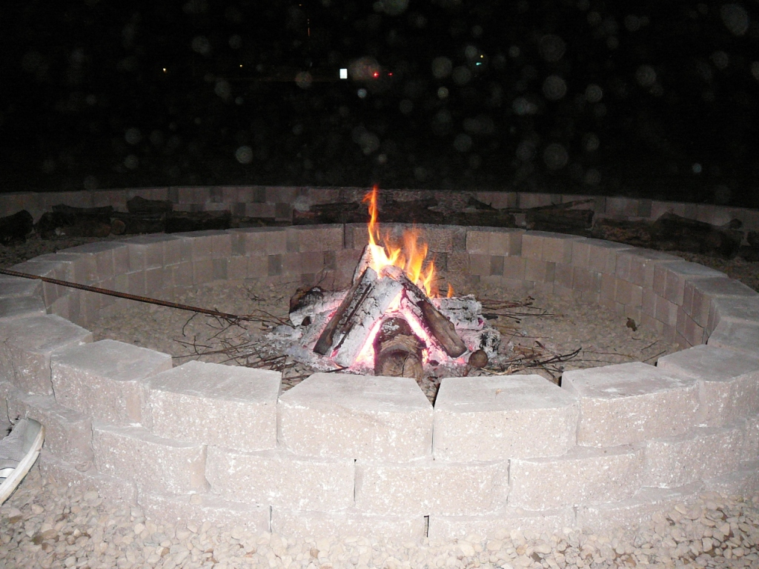
2 pm Sunday, April 21, 2024
Notes:
Evening photos.

Slide 33
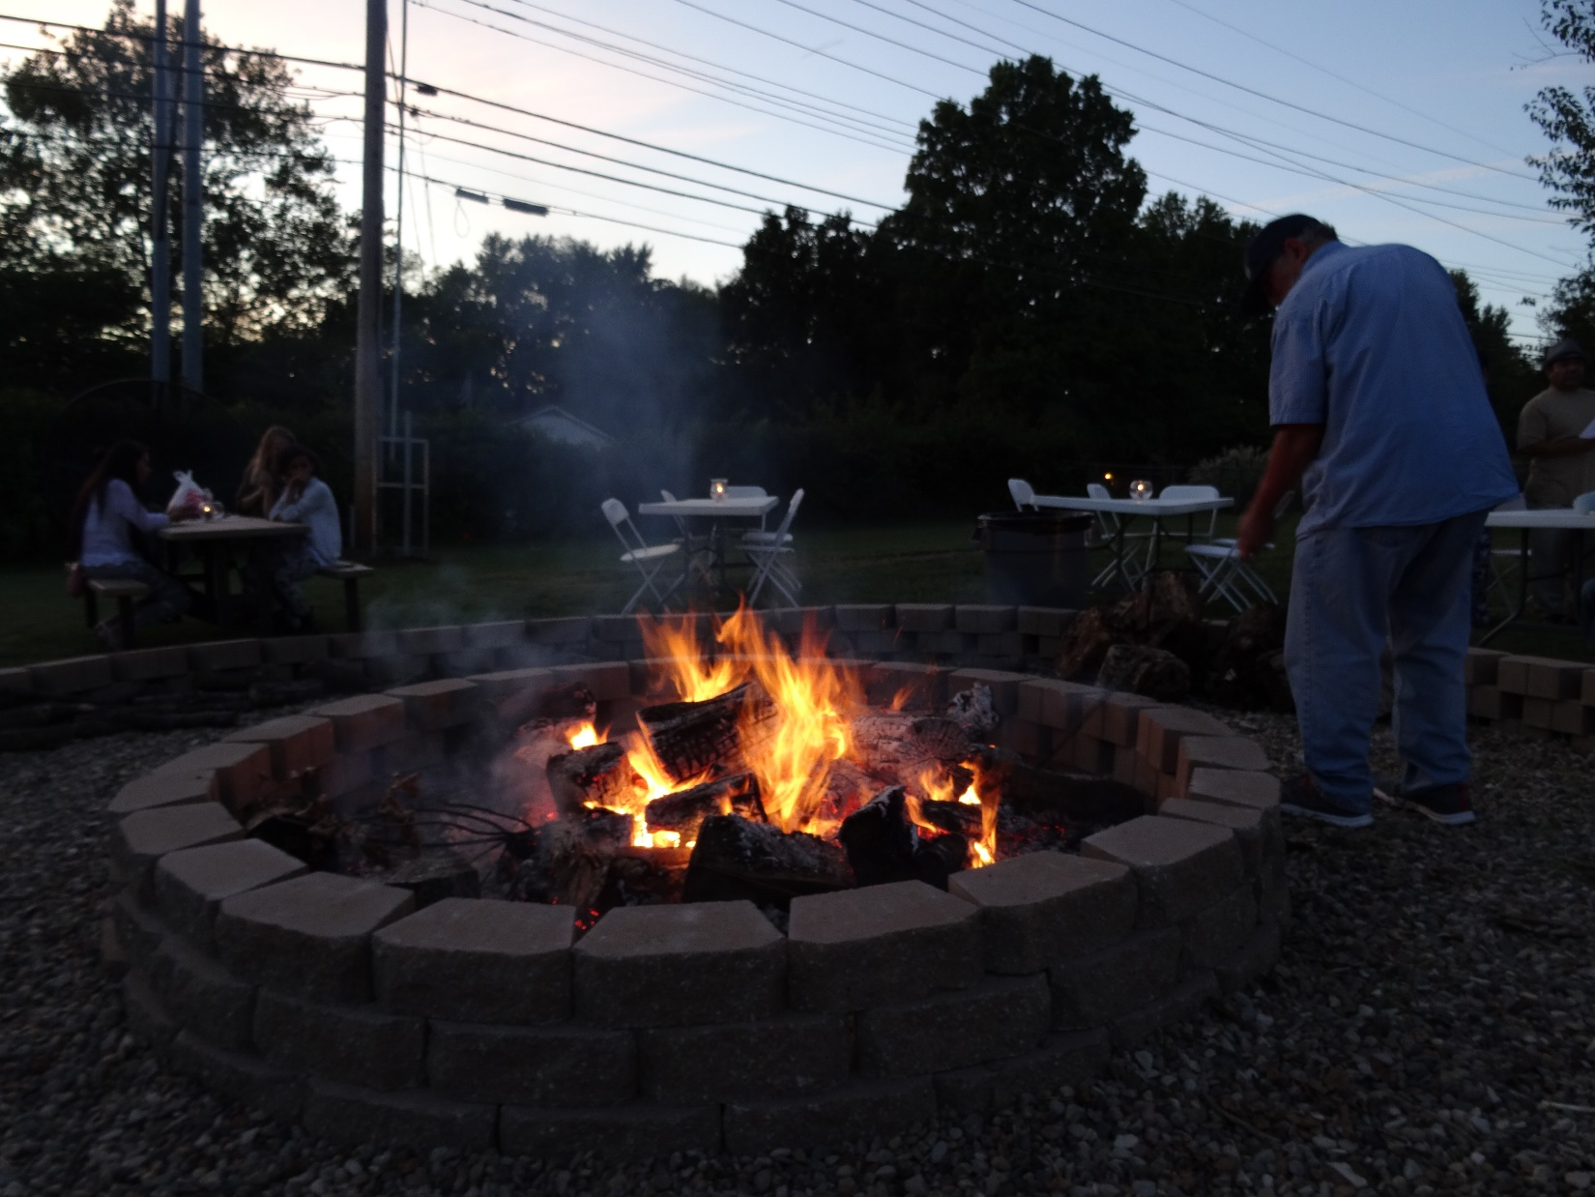

Slide 34
Jews from Europe, Ashkenazi Jews, have an additional day of unleavened bread…8 days.
Sephardic Jews, from Spain, Portugal, North Africa, have 7 days unleavened, then a bread fest on the eve of the 8th day.
Notes:
https://www.myjewishlearning.com/article/maimouna-a-post-passover-celebration/
I wondered about Memunah: Sephardic Jews have bread fest on the night of the 7th day. Ashkenaz still on matzah. How do they get the yeast so quickly?
A: they always had it.
Speaker of the Knesset MK Amir Ohana invites the public to a festive Mimouna event at the Knesset on Wednesday night, April 12, 2023, after the Passover holiday ends, to celebrate the Mimouna here for the first time.
https://main.knesset.gov.il/EN/About/Pages/Mimouna5783.aspx
European, Ashkenaz Jews have extra day and extra food prohibitions.

Slide 35
[Khametz]

Slide 36
Leaven = Khametz
and the old nature
Just the facts
Spiritual meaning to removing
khmetz?
Notes:
So intense that European Jews added a day and added leaven look alikes?

Slide 37
^{1 Cor 5.6-8} Don’t you know the saying, “It takes only a little hametz to leaven a whole batch of dough?” Get rid of the old hametz, so that you can be a new batch of dough, because in reality you are unleavened.
Notes:
Assumes that the hearers of the letter, Corinthian Greeks, knew about leaven / khametz

Slide 38
"Matzah was used in the sacrificial system of the Temple. Offerings had to be absolutely pure, and anything leavened (hametz) was considered impure because it had fermented, or soured.
Notes:
(Alfred J. Kolatch, The Jewish Book ofWhv, Middle Village, NY: Jonathan David Publishers, Inc., 1981, p. 187)

Slide 39
(The word hametz literally means 'sour’.) Matzah — unleavened bread — on the other hand, was a symbol of purity. The Talmud says, 'leaven represents the evil impulse of the heart'"
Notes:
(Alfred J. Kolatch, The Jewish Book ofWhv, Middle Village, NY: Jonathan David Publishers, Inc., 1981, p. 187)

Slide 40
"After reciting the Amidah Rabbi Alexandri used to add the following: 'Sovereign of the Universe, you are well aware that our will is to perform your will. What keeps us from doing it? The yeast in the dough^{....'"(B rakhot 17a)}
Notes:
https://kifakz.github.io/eng/bible/stern/stern_1-e_korinfyanam_05.html

Slide 41
In the Soncino translation a note explains that "the yeast in the dough" is "the evil impulse, which causes a ferment in the heart."
Notes:
https://kifakz.github.io/eng/bible/stern/stern_1-e_korinfyanam_05.html

Slide 42
"Some Jewish thinkers see khametz, that which rises and becomes leaven, as symbolically representing those tendencies in a man which arouse him to evil.
Notes:
https://kifakz.github.io/eng/bible/stern/stern_1-e_korinfyanam_05.html

Slide 43
They see the whole process of searching for the khametz and eliminating it as a reminder to man that he should search through his deeds and purify his actions. Mere renunciation of the imperfect past, one's own khametz is not sufficient; it must be destroyed.
Notes:
https://kifakz.github.io/eng/bible/stern/stern_1-e_korinfyanam_05.html

Slide 44
^{Gal 2.20} When the Messiah was executed on the stake as a criminal, I was too; so that my proud ego no longer lives. But the Messiah lives in me, and the life I now live in my body I live by the same trusting faithfulness that the Son of God had, who loved me and gave himself up for me.
Notes:
We get offended.
Pause for prayer, more later. Search our hearts.

Slide 45
Community application

Slide 46
"It takes only a little chametz to leaven a whole batch of dough," quoted in a similar context at Ga 5:9, here tells the Corinthians not only that each individual should guard against personal sin,
Notes:
https://kifakz.github.io/eng/bible/stern/stern_1-e_korinfyanam_05.html

Slide 47
but also that permitting a promiscuous sinner who professes to be a fellow-believer ^{(see vv. 9-10)} to remain in their midst is a sure way to infect the entire Messianic community with sin.
Notes:
https://kifakz.github.io/eng/bible/stern/stern_1-e_korinfyanam_05.html
So, if we have someone who is a pornographer, immoral but professing, is rife with denunciatory speech, or spreading negative information to those not involved, or problem solving NOT according to Mt 18
“Moreover, if your brother commits a sin against you, go and show him his fault — but privately, just between the two of you. If he listens to you, you have won back your brother. [Not, there are lot of people who agree with me.] And in humility, Gal 6.1 considering yourself. Winner is first to humble.

Slide 48
As King Solomon said in Proverbs 18:21:
Life and death are in the power of the tongue

Slide 49
Notes:
https://ci3.googleusercontent.com/meips/ADKq_NamDMSOjrM8Q15OsjUnxMwxQo7RgtyZHrtLdF8wv9HDrOdp1Lk5PzGD33xZCmC_vf_5Pb7m6ar2CCnIDEtaiuxkQBlD0Wsnj0MCLXWqSy8o7JL08THwDcl3f1YzAHqZ5xZsppMs7xtUc2ZE3SEWJbTPBg=s0-d-e1-ft#http://staticapp.icpsc.com/icp/resources/mogile/113437/7566846a55b333afdfa90b5869e07b4e.jpeg

Slide 50
Notes:
Jeffrey Seif

Slide 51
People who traffic in gossip about people they really don’t know, and about situations where they’re really not in authority to the relational context, say more about themselves than anything—and they hurt three people in the process. First, they injure their own humanity by trafficking in gossip;
Notes:
Jeff Seif

Slide 52
second, they take a piece out of the person they are talking about, and then, third, they injure the person they are talking to. In Proverbs 16:27, gossiping lips are likened to a “scorching fire,” and in v. 28, those with loose lips are referred to as “perverse” because they “separate close friends” (TLV).
Notes:
Jeff Seif

Slide 53
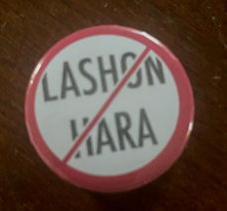
אזור חופשי לשון הרע
Azor khofshi
Lashon HaRa
Defamation free zone

Slide 54
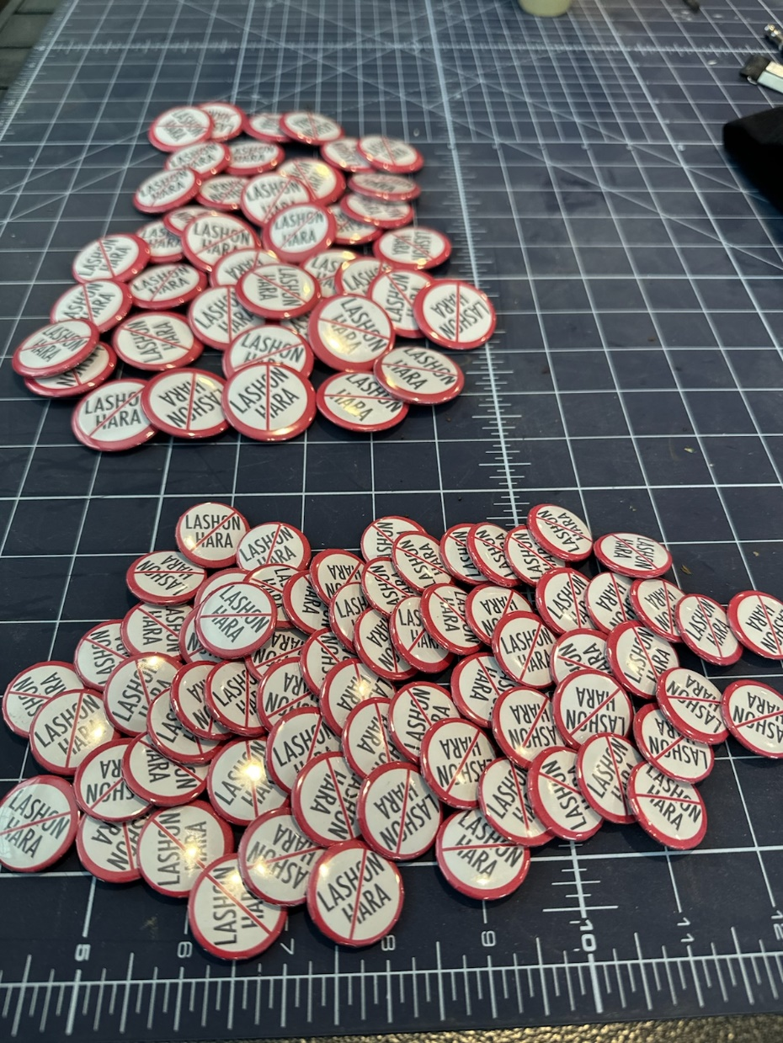
Rabbi Telushkin challenge.
Shaunti Feldhan kindness challenge.

Slide 55
[Khametz]
Notes:
Most transliterations will have chametz with a ch.
Practice “Khametz”

Slide 56
Leaven = Khametz
and the old nature
Just the facts
Spiritual meaning to removing
khametz?
3. Other spiritual applications?

Slide 57
^{1 Cor 8.1-3} Now about food sacrificed to idols: we know that, as you say, “We all have knowledge.” Yes, that is so, but “knowledge” puffs a person up with pride; whereas love builds up. The person who thinks he “knows” something doesn’t yet know in the way he ought to know. However, if someone loves God, God knows him.

Slide 58
How leaven/ khametz works:
Notes:
https://qph.cf2.quoracdn.net/main-qimg-b42b3a354126139ebfda91b68b3dc9e2-lq

Slide 60
Beer is produced by the brewing and fermentation of starches from cereal grains—most commonly malted barley, although wheat, maize, rice, and oats are also used.
Notes:
https://en.wikipedia.org/wiki/Beer

Slide 61
MOST relational problems are because someone’s inflated, puffed up, CO₂ infused ego is offended. Deflated. Hurt.
What to do?
Cleanse the leaven by humbling ourselves.
Notes:
Prayer pause

Slide 62
Leaven causes dough to rise, but the process takes time.
Sometimes, we need to FLEE.

Slide 63
Leaven causes dough to rise, but the process takes time.
^{Shmot/ Ex 12.37-39} Then the people of Yisrael journeyed from Rameses to Succoth, about 600,000 men on foot, as well as children. Also a mixed multitude went up with them,

Slide 64
^{Shmot/ Ex 12.37-39} along with the flocks, herds and heavy livestock. They had baked matzot cakes from the dough that they brought out of Egypt. It had no hametz, because they were thrust out of Egypt and could not delay, so they had not made provisions for themselves.

Slide 65
^{Shmot/ Ex 12 39} They baked matzah loaves from the dough they had brought out of Egypt, since it was unleavened; because they had been driven out of Egypt without time to prepare supplies for themselves.
Notes:
Usually there is NOT time to hesitate. When that image is on screen begging you to click.
Flee youthful lusts.

Slide 66
^{Rev 18.2-5} Bavel Babylon the Great! She has become a home for demons, a prison for every unclean spirit, a prison for every unclean, hated bird. “For all the nations have drunk of the wine of God’s fury caused by her prostitution

Slide 67
^{Rev 18.2-5} yes, the kings of the earth went whoring with her, and from her unrestrained love of luxury the world’s businessmen have grown rich.” Then I heard another voice out of heaven say: “My people, come out of her! so that you will not share in her sins,
Notes:
Scripture never says, “Resist temptation.” Says “Flee temptation.” “Resist the devil and he will flee.”

Slide 68
^{Rev 18.2-5} so that you will not be infected by her plagues, for her sins are a sticky mass piled up to heaven, and God has remembered her crimes.

Slide 69
^{Vayikra/Lev 2:11} Leaven represents sin or corruption. The Torah forbade grain offerings made with leaven. In fact, no yeast was allowed to be burned on the altar in any sacrifice.

Slide 70
Yeshua’s use of the term khametz.

Slide 71
^{Mtt 16.5-6} The talmidim, in crossing to the other side of the lake, had forgotten to bring any bread. So when Yeshua said to them, “Watch out! Guard yourselves against the hametz of the P’rushim and Tz’dukim,”

Slide 72
Say but not themselves doing.
Adding commandments: fence around the Torah
Earning salvation
No resurrection
Despising others less observant.

Slide 73
^{LK 12.1-4} Guard yourselves from the hametz of the P’rushim, by which I mean their hypocrisy. There is nothing covered up that will not be uncovered, or hidden that will not become known. What you have spoken in the dark will be heard in the light,
Notes:
So many leadership failures. Transparency. Accountability. Boundaries. Never alone with a person of the opposite gender.

Slide 74
^{LK 12.1-4} and what you have whispered behind closed doors will be proclaimed on the housetops. “My friends, I tell you: don’t fear those who kill the body but then have nothing more they can do.

Slide 75
Joshua 7:1-5 One man's sin! There were no accomplices. Nobody even saw him do it, yet Israel's army became paralyzed with fear. Joshua faltered and became confused. The whole nation was affected. Thirty-six men died. Thirty-six women became widows. And how many children no longer had a father?

Slide 76
^{Mk. 8.15} Yeshua said to them, “Watch out! Guard yourselves from the hametz of the P’rushim and the hametz of Herod.
Notes:
Political intrigue. Killed some of his own family for power.

Slide 77
[Khametz]
Notes:
Most transliterations will have chametz with a ch.
Practice “Khametz”

Slide 78
Leaven = Khametz
and the old nature
Just the facts
Spiritual meaning to removing
khametz?
3. Other spiritual applications?
4. Antidote to khametz?

Slide 79
Is there an antidote to fentanyl?
Narcan does work on fentanyl, but there are some things to keep in mind. While Narcan can work on fentanyl overdoses, these situations often happen extremely quickly, so it can be tough to act quickly enough to reverse a fentanyl overdose.
Notes:
https://www.therecoveryvillage.com/fentanyl-addiction/does-narcan-work-on-fentanyl/

Slide 80
^{1 Cor 5.6-8} For our Pesakh lamb, the Messiah, has been sacrificed. So let us celebrate the Seder not with leftover hametz, the hametz of wickedness and evil, but with the matzah of purity and truth.
Notes:
Written to Corinthians, Greeks
He is the antidote to the khametz within.

Slide 81
In the New Testament Yeshua the Messiah is portrayed frequently both as a lamb and as a sacrifice. At Yn 1:29, 36 he is called "the lamb of God, who takes away the sins of the world
Notes:
https://kifakz.github.io/eng/bible/stern/stern_1-e_korinfyanam_05.html

Slide 82
Romans 3:25 implicitly connects Yeshua's sacrificial death with a different Jewish holiday, Yom-Kippur, for there he is called the "kapparah," the covering, or atonement, "for sin."
Notes:
https://kifakz.github.io/eng/bible/stern/stern_1-e_korinfyanam_05.html

Slide 83
And this is not inconsistent with his also being the Passover lamb; in fact, he gives new meaning to all the Jewish holidays.
Notes:
https://kifakz.github.io/eng/bible/stern/stern_1-e_korinfyanam_05.html

Slide 84
But here Yeshua's death is understood as that of the Passover lamb, as at Yn 19:33, 36: "But when they got to Yeshua and saw that he was already dead, they didn't break his legs....
Notes:
https://kifakz.github.io/eng/bible/stern/stern_1-e_korinfyanam_05.html

Slide 85
For these things happened in order to fulfill this passage of the Tanakh: 'Not one bone of his will be broken" [Exodus 12:46, which refers to the Passover lamb]
Notes:
https://kifakz.github.io/eng/bible/stern/stern_1-e_korinfyanam_05.html

Slide 86
The Greek of our passage does not have in it the word for "lamb" but says, literally, "For the Messiah, our Pesach, has been sacrificed." This echoes Exodus 12:11 ("It is Adoni's Pesach") and 12:21 ("...and kill the Pesach"), where the absence of the word "lamb" from the Hebrew
Notes:
https://kifakz.github.io/eng/bible/stern/stern_1-e_korinfyanam_05.html

Slide 87
calls attention to the total identification between the Passover event and the Passover lamb — neither exists without the other. Likewise, there is no escape from the utter destruction of eternal death at the Last Judgment apart from trust in the Messiah, who is our Passover.
Notes:
https://kifakz.github.io/eng/bible/stern/stern_1-e_korinfyanam_05.html

Slide 88
^{Eph 4.17-24} Therefore I say this — indeed, in union with the Lord I insist on it: do not live any longer as the pagans live, with their sterile ways of thinking. Their intelligence has been shrouded in darkness, and they are estranged from the life of God, because of the ignorance in them, which in turn comes from resisting God’s will.

Slide 89
^{Eph 4.17-24} They have lost all feeling, so they have abandoned themselves to sensuality, practicing any kind of impurity and always greedy for more. But this is not the lesson you learned from the Messiah! If you really listened to him and were instructed about him, then you learned that since what is in Yeshua is truth, then,

Slide 90
^{Eph 4.17-24} so far as your former way of life is concerned, you must strip off your old nature, because your old nature is thoroughly rotted by its deceptive desires; and you must let your spirits and minds keep being renewed,
Notes:
Like cleaning out the leaven.
Time of prayer later for this.

Slide 91
^{Eph 4.17-24} and clothe yourselves with the new nature created to be godly, which expresses itself in the righteousness and holiness that flow from the truth.

Slide 92
The Old Testament animal sacrifice after it was slain, it was bound to the altar. The Bible says, "Bind the sacrifice to the altar." Do you know why it was bound to the altar? Because it would tend to slide off. Have you ever picked up a piece of freshly killed meat?
Notes:
https://familytalk.widen.net/view/pdf/9vtkrbwkco/11212023HOWTOTURNTHANKSGIVINGINTOTHANKSLIVING1.pdf?t.download=true&u=o5dst7

Slide 93
Is slippery. It’s slippery so there were two flesh hooks and those flesh hooks would bind that sacrifice to the altar. Have you ever made a commitment to the Lord and then tend to slide off the altar?
Notes:
https://familytalk.widen.net/view/pdf/9vtkrbwkco/11212023HOWTOTURNTHANKSGIVINGINTOTHANKSLIVING1.pdf?t.download=true&u=o5dst7

Slide 94
I mean I've told the Lord, I've vowed and declared Lord, "That's the last time I'll ever do that." Or I've said, "Lord, from now on I'm going to do this every day. God, you can count on me. And I just slide off the altar. Do you ever slide off the altar? Yeah.
Notes:
https://familytalk.widen.net/view/pdf/9vtkrbwkco/11212023HOWTOTURNTHANKSGIVINGINTOTHANKSLIVING1.pdf?t.download=true&u=o5dst7

Slide 95
You see, look, we need to be bound to the altar if we're going to have a living sacrifice. The priest had two flesh hooks. Let me mention two flesh hooks that'll keep you bound to the altar. Number one is devotion, your love for Yeshua. And number two is discipline
Notes:
https://familytalk.widen.net/view/pdf/9vtkrbwkco/11212023HOWTOTURNTHANKSGIVINGINTOTHANKSLIVING1.pdf?t.download=true&u=o5dst7

Slide 96
[Khametz]
Notes:
Most transliterations will have chametz with a ch.
Practice “Khametz”

Slide 97
Leaven = Khametz
and the old nature
Just the facts
Spiritual meaning to removing
khametz?
3. Other spiritual applications?
4. Antidote to khametz?

Slide 99
Daniel Greenfield is a Shillman Journalism Fellow, a columnist for the Gatestone Institute, and a brilliant and insightful writer. Here is a précis of his conclusions on this matter in his April 16, 2024 article titled ‘This Was Not the Actual Iranian Attack:’
Notes:
https://davidstent.org/shootout-at-the-orient-bazaar-part-two-of-three/

Slide 100
This was not the actual Iranian attack. This was the ‘attack’ prearranged for show between Iran and the Biden administration through backchannels. It’s an attack that allows Iran to show off that it can reach Israel . . . while not inflicting any real damage.
Notes:
https://davidstent.org/shootout-at-the-orient-bazaar-part-two-of-three/

Slide 101
Iran did burn up some resources doing this, but apart from the morale boost of doing it, it set out to test U.S. and Israeli defenses. And the defenses did what they were supposed to. However, had Iran actually been trying to launch a serious attack, it would have used its Hezbollah, Houthi, Iraqi and whatever is left of its Hamas proxies to saturate local air defenses.
Notes:
https://davidstent.org/shootout-at-the-orient-bazaar-part-two-of-three/

Slide 102
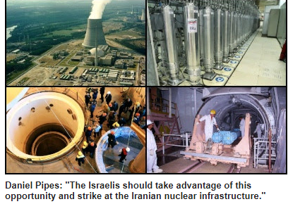
Notes:
https://www.danielpipes.org/22237/will-israel-respond-to-iran-attack?goal=0_086cfd423c-51755d0886-33765913&mc_cid=51755d0886&mc_eid=2515d15785

