Slide 1
e-handout
To have these notes
without taking notes
Go to OrHaOlam.com
Click on Messages tab,
2024 Messages

Slide 2
On Sunday 14 April, 1912. Californian encountered a large ice field. At 10:20 pm, and Captain Lord decided to stop the ship and wait until morning before proceeding further. Lord asked wireless operator Cyril Evans if he knew of any ships in the area, and Evans responded: “only the Titanic.”

Slide 3
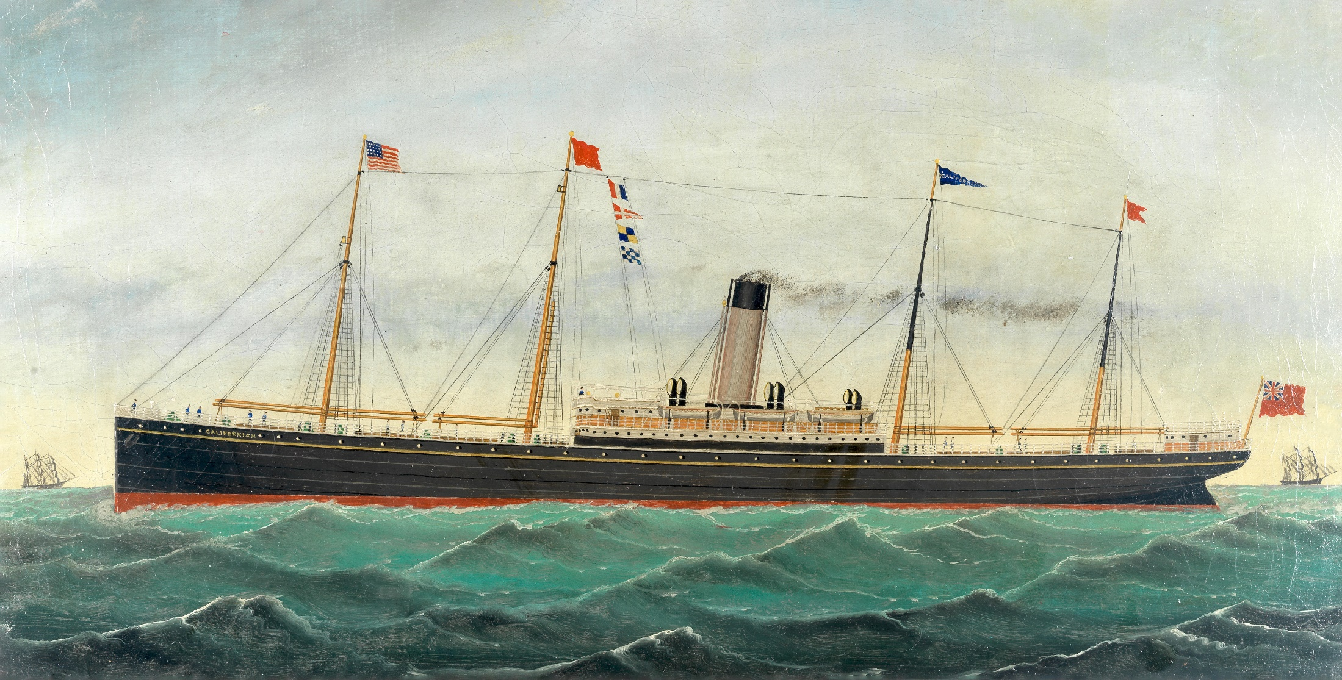
SS. Californian
Notes:
She is thought to have been the only ship to see the Titanic, or at least her rockets, during the sinking,[2][3] but despite being the closest ship in the area, the crew took no action to assist. the Californian could have saved many or all of the lives that were lost, had a prompt response been mounted to the Titanic's distress rockets
https://en.wikipedia.org/wiki/SS_Californian

Slide 4
A little bit later Evans, feeling that he had done his duty, switched off his wireless equipment and went to bed. One hour and 10 minutes later, at 11:40 pm, Titanic hit an iceberg. Shortly after midnight, she transmitted her first distress call.
Failed communication
Notes:
https://en.wikipedia.org/wiki/SS_Californian

Slide 5
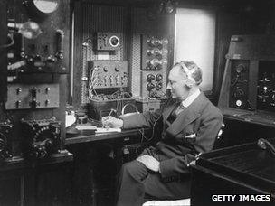
Italian electrical engineer Guglielmo Marconi's equipment was on board many prestigious ships
Notes:
The Titanic, as the showcase of an ambitious, optimistic era, had the biggest and best wireless equipment in the world.
https://www.bbc.com/news/magazine-17631595

Slide 6
Californian apprentice officer James Gibson, who had been doing the Morse light signaling, testified that at 12:55 am Stone told him he had observed five rockets in the sky above the nearby ship. [Titanic]
Failed communication
Notes:
https://en.wikipedia.org/wiki/SS_Californian

Slide 7
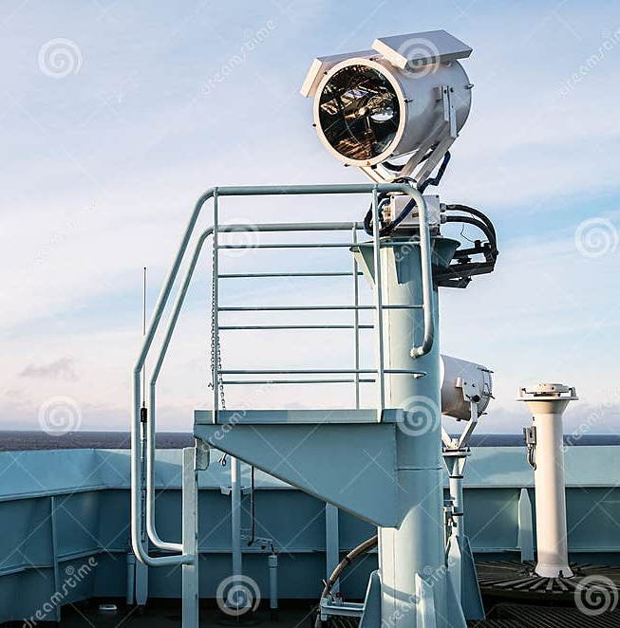
The signal lamp is designed to provide Morse code light signals
Notes:
https://www.dreamstime.com/ship-s-bell-signal-light-lamp-designed-to-provide-morse-code-signals-lighting-visual-communication-ships-image236210990

Slide 8
Californian Second Officer Herbert Stone, however…testified repeatedly that he did not think at the time that the rockets could have been distress signals.
Corrupted communication
Notes:
https://en.wikipedia.org/wiki/SS_Californian

Slide 9
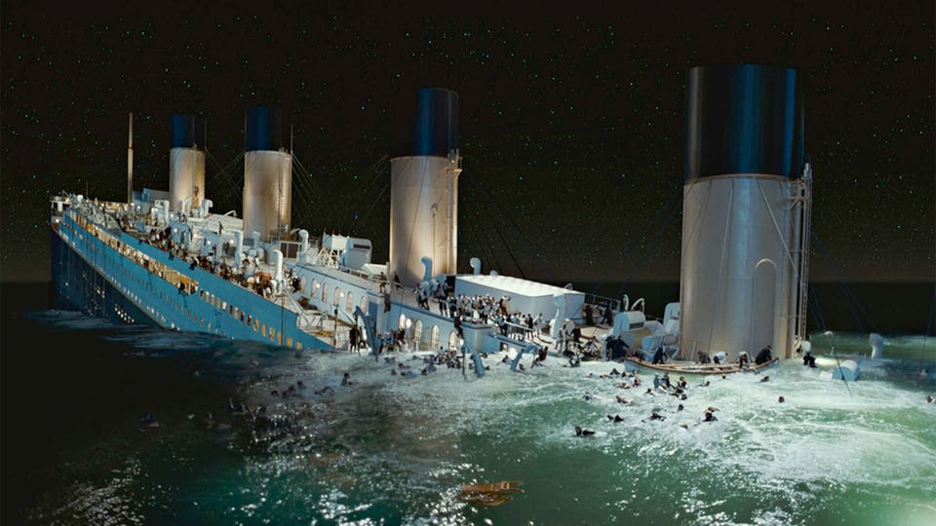
Notes:
https://external-content.duckduckgo.com/iu/?u=https%3A%2F%2Fassets.medpagetoday.net%2Fmedia%2Fimages%2F103xxx%2F103494.jpg%3Fwidth%3D0.6&f=1&nofb=1&ipt=c4cebd4610cf4c4699f8f38bb68e01145223272dc2965b710c618078c1fcb574&ipo=images

Slide 10
At 02:20 am, Titanic sank. 2,224 people were on board. More than 1500 were lost.
The British Inquiry concluded [that had] Californian responded to Titanic's rockets and gone to assist “…it might have saved many if not all of the lives that were lost.”
Notes:
https://en.wikipedia.org/wiki/SS_Californian

Slide 11
Three forms of failed communication:
wireless telegraph,
light signaling,
rockets.
The task of communication was totally corrupted by failed judgment.

Slide 12
The United States passed the Radio Act of 1912, which required 24-hour radio watch on all ships in case of an emergency. The first International Convention for the Safety of Life at Sea… required… standardized the use of distress rockets.
Corrupted communication
Notes:
https://en.wikipedia.org/wiki/SS_Californian

Slide 15
Corrupted Past Feeling
Description of Corruption
Original, before corruption
Strong evidence in the
generational communication
of the faith.
4. We have heirs and prodigals

Slide 16
Corrupted Past Feeling
Description of Corruption
Original, before corruption
Strong evidence in the
generational communication
of the faith.
4. We have heirs and prodigals

Slide 17
^{Ephesians 4.17-19} So I tell you this, indeed I insist on it in the Lord—walk no longer as the pagans do, stumbling around in the futility of their thinking. They are darkened in their understanding, alienated from the life of God

Slide 18
^{Ephesians 4.17-19} because of the ignorance in them due to the hardness of their heart. Since they are past feeling, they have turned themselves over to indecency for the practice of every kind of immorality, with greed for more.
Notes:
So, we misread each other, get angry and offended.
So, we are lonely, seduce each other with improper words or gestures.
We feel defrauded, and counterattack

Slide 19
^{Eph 4.20-24} However, you did not learn Messiah in this way— if indeed you have heard Him and were taught in Him, as the truth is in Yeshua. With respect to your former lifestyle,

Slide 20
^{Eph 4.20-24} you are to lay aside the old self corrupted by its deceitful desires, be renewed in the spirit of your mind, and put on the new self—created to be like God in true righteousness and holiness.
Notes:
We are naturally basically insane. Never totally stops.
Corrupted and deceitful…not my fault. I’m just defending myself. I’m just having fun. I’m just profiting.
Deceitful: Tony Perkins found on Facebook 2023 58 options of gender.
Immorality is never static. No one is born gay. Three main sources.
men abandoned natural relations with women and were burning with passion toward one another—men committing shameful acts with other men[Lev 18 holiness code] and receiving in themselves the due penalty for their error. Boring. Everyone is [potentially] gay.
Epigenetics
Family dysfunction, role models.

Slide 21
^{Yermiyahu/Jer 17.9-10} “The heart is deceitful above all things, and incurable — who can know it?
I Adoni search the heart, I try the mind, to give every man according to his ways, according to the fruit of his deeds.

Slide 22
^{Beresheet/Gen 6.5} Then Adoni saw that the wickedness of humankind was great on the earth, and that every inclination of the thoughts of their heart was only evil all the time.

Slide 23
Counting the Omer
S'fee-raht Ha-oh-mehr
סְפִירַת הַעֹמֶר

Slide 24
^{T’hillim/Ps 90.12} So teach us to number our days, so that we may get a heart of wisdom.

Slide 25
^{T’hillim / Ps 19.12-15} Who can discern unintentional sins? Cleanse me from hidden faults. Also keep your servant from presumptuous sins, so that they won’t control me.

Slide 26
^{T’hillim / Ps 19.12-15} Then I will be blameless and free of great offense. May the words of my mouth and the thoughts of my heart be acceptable in your presence, Adoni, my Rock and Redeemer.

Slide 27
^{T’hillim/Ps 139.23-24} Examine me, Search me, God, and know my heart; test me, and know my anxious thoughts. See if there is in me any hurtful offensive way, and lead me along the eternal way.

Slide 28
^{Isaiah 60.2} Darkness covers the earth and thick darkness the peoples; on you Adoni will rise; over you will be seen his glory.

Slide 29
^{Mt 19.3-8} Some P’rushim came and tried to trap him by asking, “Is it permitted for a man to divorce his wife on any ground whatever?” He replied, “Haven’t you read that at the beginning the Creator made them male and female, and that he said,

Slide 30
^{Mt 19.3-8} ‘For this reason a man should leave his father and mother and be united with his wife, and the two are to become one flesh’? Thus they are no longer two, but one. So then, no one should split apart what God has joined together.”

Slide 31
^{Mt 19.3-8} They said to him, “Then why did Moshe give the commandment that a man should hand his wife a get and divorce her?” He answered, “Moshe allowed you to divorce your wives because your hearts are so hardened. But this is not how it was at the beginning
Notes:
Keeps coming back, unless we work on it.

Slide 33
Corrupted Past Feeling
Description of Corruption
Original, before corruption
Strong evidence in the
generational communication
of the faith.
4. We have heirs and prodigals

Slide 34
^{Ber/Gen 1.26-28} Then God said, “Let us make humankind in our image, in the likeness of ourselves; and let them rule over the fish in the sea, the birds in the air, the animals, and over all the earth, and over every crawling creature that crawls on the earth.”

Slide 35
^{Ber/Gen 1.26-28} So God created humankind in his own image; in the image of God he created him: male and female he created them. God blessed them: God said to them, “Be fruitful, multiply, fill the earth and subdue it.
Notes:
There is a song here. Maybe the first song in the universe. G-d celebrating His beautiful creation of you and me, all humanity.
You and I were meant to communicate the image of G-d. How, in character, love, holiness, grace, servanthood, giving. Inner and out beauty.
Message of G-d’s image intended to be communicated to the universe, to angels, seraphs, cherubs, heavenly powers.

Slide 36
^{Eph 1.4} He chose us in the Messiah before the foundation of the world, to be holy and blameless before Him in love.
Notes:
Holy…in the image of G-d as at the beginning.

Slide 38
Corrupted Past Feeling
Description of Corruption
Original, before corruption
Strong evidence in the
generational communication
of the faith.
4. We have heirs and prodigals

Slide 39
Why was the original purpose of G-d in creation corrupted?
Why did Adam and Hava fail?

Slide 40
^{Ber/Gen 3.5-6} God knows that on the day you eat from it, your eyes will be opened, and you will be like God, knowing good and evil.”
Khava broke from trusting G-d.
Notes:
Trust. G is holding out on me.
This is the key thing. Why not trust G? There is no logic to it. Perfect environment. No deficiencies.
Totally unreasonable to distrust G-d. Perfect environment.
Our kids have our own parental toxicity to work through to survive and thrive. Adam vHava had none of that. This lack of trust is the beginning of all evil. Then the details.

Slide 41
^{Ber/Gen 3.5-6} When the woman saw that the tree was ₁good for food,
that it had a ₂pleasing appearance
and ₃that the tree was desirable for making one wise, she took some of its fruit and ate. She also gave some to her husband, who was with her; and he ate.
Notes:
1. Lust of the flesh, looks tasty, pleasurable, pleasure. As above. Once we give ourselves to pleasure, there is no end to how depraved and debauched we can become.
2. It LOOKS good. Accumulated pretty things. 1 Yn lust of the eyes: materialism.
3. Wisdom, in the sense of power to control. 1 Yn Pride of LIFE.
Three basic sins.
He was with her! the compliant husband. “Yes dear.”
“Yes dear” is GREAT most of the time. NOT when it comes to evil. “Sanctify and cleanse her.”

Slide 42
Result was spiritual death, as promised
“when you eat from it [the fruit of the Tree of the Knowledge of Good and Evil], you most assuredly will die!”

Slide 43
Distrust is the ultimate reason for prodigal children, starting with Adam and Hava. Then
^{Eph 4.18-19} Their intelligence has been shrouded in darkness, and they are estranged from the life of God, because of the ignorance in them,
Notes:
Still often unreasonable, for children to walk away in hostility to their parents.

Slide 44
^{Eph 4.18-19} which in turn comes from resisting God’s will. They have lost all feeling, so they have abandoned themselves to sensuality, practicing any kind of impurity and always greedy for more.

Slide 45
Scriptural pattern is Generation to Generation, but distrust breaks that.
^{Psalm 145:4,13} One generation will commend your works to another; they will tell of your mighty acts.

Slide 46
^{Psalm 145:13} Your kingdom is an everlasting kingdom, And Your dominion endures throughout all generations.

Slide 47
^{Psalm 100:5} For Adoni is good and his love endures forever; his faithfulness continues through all generations.
^{Genesis 22:18} Through your offspring all nations on earth will be blessed, because you have obeyed me.

Slide 48
^{Luke 1:50} His mercy extends to those who fear him, from generation to generation.

Slide 49
^{Exodus 34:6-7} And he passed in front of Moshe, proclaiming, “Adoni, Adoni, the compassionate and gracious God, slow to anger, abounding in love and faithfulness, maintaining love to thousands [generations],

Slide 50
^{Exodus 34:6-7} and forgiving wickedness, rebellion and sin. Yet he does not leave the guilty unpunished; he punishes the children and their children for the sin of the fathers to the third and fourth generation.”

Slide 51
^{Daniel 4:3} How great are his signs, how mighty his wonders! His kingdom is an eternal kingdom; his dominion endures from generation to generation.

Slide 52
^{Malachi 4:6} He will turn the hearts of the fathers to their children, and the hearts of the children to their fathers; or else I will come and strike the land with a curse.

Slide 53
^{Joel 2:28} "And afterward, I will pour out my Spirit on all people. Your sons and daughters will prophesy, your old men will dream dreams, your young men will see visions.

Slide 54
^{Psalm 112:2} His descendants will be mighty on earth; The generation of the upright will be blessed.
^{Lamentations 5:19} You, O Lord, rule forever; Your throne is from generation to generation.

Slide 55
^{Ephesians 3:20-21} Now to him who by his power working in us is able to do far beyond anything we can ask or imagine, to him be glory in the Messianic Community and in the Messiah Yeshua from generation to generation forever. Amen.

Slide 56
^{Exodus 3:15} God…said to Moses, “Thus you shall say to the sons of Israel, ‘Adoni, the God of your fathers, the God of Abraham, the God of Isaac, and the God of Jacob, has sent me to you.’ This is My name forever, and this is My memorial-name to all generations.

Slide 57
^{Genesis 9:12} God said, “This is the sign of the covenant which I am making between Me and you and every living creature that is with you, for all successive generations.

Slide 58
^{Exodus 12:17} You shall also observe the Feast of Unleavened Bread, for on this very day I brought your hosts out of the land of Egypt; therefore you shall observe this day throughout your generations as a permanent ordinance.

Slide 59
^{Psalm 105:8} He has remembered His covenant forever, The word which He commanded to a thousand generations.

Slide 61
Corrupted Past Feeling
Description of Corruption
Original, before corruption
Strong evidence in the
generational communication
of the faith.
4. We have heirs and prodigals
Notes:
Reflecting the original plan, kept or corrupted.
Our heirs, adult or teen children of parents in Or HaOlam who are worshipping here, or serving here
Josie, Marcos, Melanie, Duncan, Braden Blackburn, Wes Blackburn, Elana, Hedmon, Jaedyn, Miranda, Cassie, Kate Hershey, 12
Stand for appreciation
We also have prodigals, reflecting the corruption of the human race.

Slide 63
It was June 2nd several years ago.
Eighteen of us made a large circle in our Florida room. We each shared why we had come—a brief overview of our journey with a prodigal.

Slide 64
It was June 2nd several years ago.
Eighteen of us made a large circle in our Florida room. We each shared why we had come—a brief overview of our journey with a prodigal.

Slide 65
We had all come to the only place we thought offered any answers: on our knees. At first, our prayers were tentative—were these people safe? But then honesty, vulnerability, and tears opened our hearts. We connected at that throne of grace, petitioning our God for each other, for the many who requested prayer, for our own loved ones, and for ourselves.

Slide 66
In the end, we recognized that our prayers were as much for ourselves as for our loved wanderers. And we acknowledged that loving a prodigal was indeed a wilderness journey, but each beloved prodigal was a gift,

Slide 67
a true treasure to make us more and more like Yeshua. Gratitude filled us even as tears flowed.
And now, June 2nd is coming again: time for the Worldwide Prodigal Prayer Day.

Slide 68
For us, Shabbat, June 1 our afternoon study will be prayer for prodigals.

Slide 69
Scripture prayers for prodigals
^{Dvarim/Dt 6.4-6} “Sh’ma, Yisra’el! Adonai Eloheinu, Adonai echad [Hear, Isra’el! Adonai our God, Adonai is one]; and you are to love Adonai your God with all your heart,

Slide 70
Scripture prayers for prodigals
^{Dvarim/Dt 6.4-6} all your being and all your resources. These words, which I am ordering you today, are to be on your heart; 7 and you are to teach them carefully to your children.

Slide 71
^{Yeshayahu/Is 44.3-4} I will pour water on the thirsty land and streams on the dry ground; I will pour my Spirit on your descendants, my blessing on your offspring. They will spring up among the grass like willows on the riverbanks.

Slide 72
^{Yeshayahu/Is 44.3-4} One will say, ‘I belong to Adoni.’ Another will be called by the name of Ya‘akov. Yet another will write that he belongs to Adoni and adopt the surname Isra’el.”

Slide 73
^{Mishlei Prov 22.6} Train up a child in the way he should go, when he is old he will not turn from it.

Slide 74
^{2 Tim 2.25-26} Let him give guidance with humility to those who are in opposition—perhaps God may grant them a change of mind, leading to the knowledge of truth. Then they may regain their senses and escape the devil’s snare, in which they had been held captive by him to do his will.

Slide 75
^{Isaiah 60.4} Lift up your eyes and look all around: they all gather—they come to you— your sons will come from far away, your daughters carried on the hip.

Slide 76
T’hillim / Ps 133 A song of ascents. By David: Oh, how good, how pleasant it is
for brothers to live together in harmony. [as expanded by Shilo ben Hod]
Notes:
אשר כולנו מהללים שרים ביחד לאלהים כל אחד הוא חלק כל אחד בפנים
All singing together to G-d, all are one, taking part, buying in [to the family vision].

Slide 77
^{Ps 90.16-17} Let Your work appear to Your servants, and Your splendor on their children. Let the favor of the Lord our God be upon us. Establish the work of our hands for us— yes, establish the work of our hands.

Slide 78
^{Yn 16.7-11} For if I do not go away, the Helper will not come to you; but if I go, I will send Him to you. “When He comes, He will convict the world about sin, righteousness, and judgment: concerning sin, because they do not believe in Me;

Slide 79
^{Yn 16.7-11} concerning righteousness, because I am going to the Father and you will no longer see Me; and concerning judgment, because the ruler of this world has been judged.

Slide 80
^{Acts 16. 30-31} After he brought them out, he said, “Sirs, what must I do to be saved?” They said, “Put your trust in the Lord Yeshua the Messiah and you will be saved—you and your household!”

Slide 81
^{Yn 17.22-23} The glory that You have given to Me I have given to them, that they may be one just as We are one— I in them and You in Me—that they may be perfected in unity, so that the world may know that You sent Me and loved them as You loved Me.

Slide 83
Corrupted Past Feeling
Description of Corruption
Original, before corruption
Strong evidence in the
generational communication
of the faith.
4. We have heirs and prodigals

Slide 84
Do you KNOW Yeshua and drinking the water of LIFE?
Are you hearing daily from His Word?
How are you applying what you heard?
Are you offering that water of life to anyone?

Slide 85
Prayer points:
Our families
Some of the Israel concerns: 1. There is a group meeting over the next 3 days that are inviting all who want to learn. They are teaching how to use black magic and how to become witches among other things.

Slide 86
2. Many feel/know that the doors were being opened on Oct 7th at the Nova Festival and that the demonic spiritual realm has been unleashed in the Land by these types of activities. As you probably know these activities are not new in the Land.

Slide 87
3. That many are chasing after these other would be gods. A large number of them are absolutely ignorant of what they are doing and its consequences.

Slide 88
4. The attacks from the north are intensifying rapidly. Over 60 (and 1 day over 100) rockets, missiles, rpg, anti tank and UAVs have been fired each day for the last several. Reaching as far as Tiberas. They have made longer intrusions each day than has ever been achieved before.

Slide 89
4. Fortunately death and casualties have been 'minimal' but it is happening. And it is not minimal to those being affected for sure. Losses among soldiers have been higher than previous attacks.

Slide 90
5. Several have shared that they believe BB may be in danger.
6. Many are also concerned about the 'house divided' being a real issue.

