Slide 1
e-handout
To have these notes
without taking notes
Go to OrHaOlam.com
Click on Messages tab,
2024 Messages

Slide 2
Q) So what creature has more lives than the preverbal 9 lives of a cat
Notes:
Gavriel Rennels

Slide 3
Q) So what creature has more lives than the preverbal 9 lives of a cat
A) a frog, they croak every day.
Notes:
Gavriel Rennels

Slide 4
Moshe as a lifeguard…

Slide 5
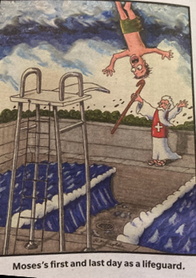
Notes:
David Lloyd

Slide 7
Holocaust Martyrs' and Heroes' Remembrance Day (Yom Hashoah in Hebrew) is a national day of commemoration in Israel and world Jewry, on which the six million Jews murdered in the Holocaust are memorialized.

Slide 8
It is a solemn day, beginning at sunset on the 27th of the month of Nisan [Monday, May 6]. On the eve of Yom HaShoah and the day itself, places of public entertainment are closed by law.
Monday evening and Tuesday in Israel.

Slide 9
Israeli television airs Holocaust documentaries and Holocaust-related talk shows, and low-key songs are played on the radio. Flags on public buildings are flown at half mast.

Slide 10
At 10:00 am Tuesday morning, an air raid siren sounds throughout the country and Israelis are expected to observe two minutes of solemn reflection. It is customary to pause what is being done and to reflect, including motorists who stop their cars in the middle of the road, standing beside their vehicles in silence as the siren is sounded.

Slide 11
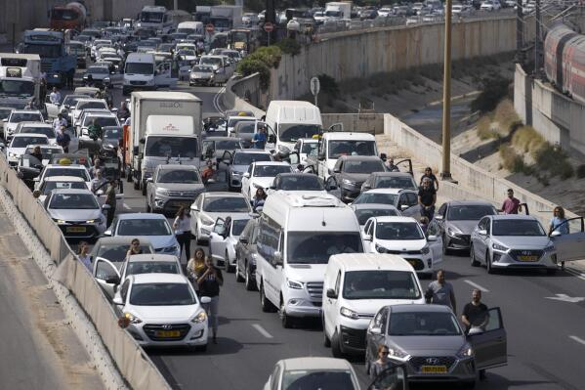
Yom HaShoah in Israel,
All traffic stops

Slide 12
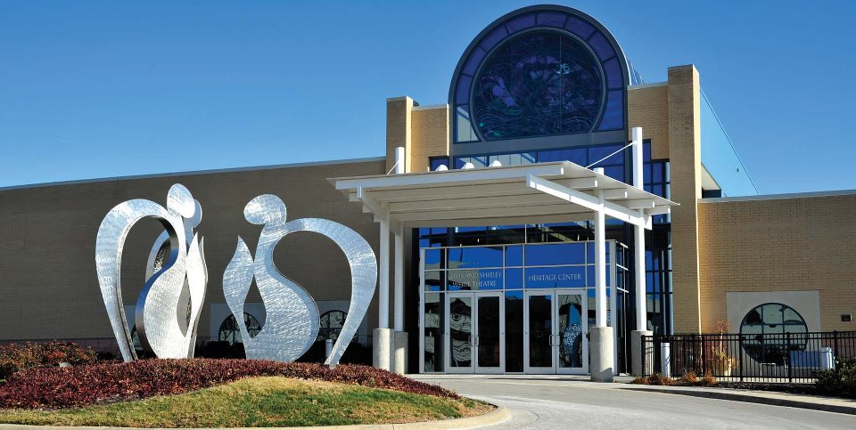
Yom HaShoah Service Overland
Park, Sun., May 5, 1:30pm – 3:00pm

Slide 13
Yom HaShoah v'Hagevurah Community Observance
When: Sun, May 5, 1:30pm – 3:00pm
Where: Lewis & Shirley White Theater, 5801 W 115th St, Leawood, KS 66211

Slide 15
Hostility and Holocaust
Internal dynamics of hostility
Pro-active with hostility
National wounds and hostility.
Response to national hostility
Our personal response to hostility

Slide 16
Hostility and Holocaust
Internal dynamics of hostility
Pro-active with hostility
National wounds and hostility.
Response to national hostility
Our personal response to hostility

Slide 17
^{Ephesians 4.25-27} Therefore, stripping off falsehood, let everyone speak truth with his neighbor, because we are intimately related to each other as parts of a body.

Slide 18
^{Ephesians 4.25-27} Be angry, but don’t sin — don’t let the sun go down before you have dealt with the cause of your anger; otherwise you leave room for the Adversary.
Notes:
Shaul Paul was always thinking in Tanakhic Biblical terms. So let’s break this down. Actually a quote from Psalm 4

Slide 19
^{Ephesians 4.25-27} Be angry, but don’t sin.
^{T’hillim / Ps 4.4 CJB} You can be angry, but do not sin!
רִגְזוּ וְאַל ־ תֶּחֱטָאוּ^{T’hillim / Ps 4.4 Sefaria}
So tremble, and sin no more.
Notes:
https://www.sefaria.org/Psalms.4.5?lang=bi

Slide 20
^{Ephesians 4.25-27} Be angry, but don’t sin — רִגְזוּ וְאַל ־ תֶּחֱטָאוּ
rigzu
to become agitated, stirred, excited, enraged, angry, to rage, quake, be livid, tremble, be sorry anguished, to be annoyed
Notes:
Modern Hebrew translation of Eph 4.25 USB
Some events make us agitated, some stirred…

Slide 21
^{Ephesians 4.25-27} Be angry, but don’t sin.
^{T’hillim / Ps 4.4 CJB} You can be angry, but do not sin! Think about this as you lie in bed, and calm down. (Selah) Offer sacrifices rightly, and put your trust in Adoni.
Notes:
The psalm goes on to say above.
Similarly

Slide 22
^{Ephesians 4.25-27} Be angry, but don’t sin — רִגְזוּ וְאַל ־ תֶּחֱטָאוּ
to become angry, to be annoyed
don’t let the sun go down before you have dealt with the cause of your anger; otherwise you leave room for the Adversary.
Notes:
Torah makes a point about quick resolution of debts and issues. Don’t put off paying. Don’t put off resolving conflicts.

Slide 23
^{Dvarim/Dt 24.14-15} “You are not to exploit a hired worker who is poor and needy, whether one of your brothers or a foreigner living in your land in your town. You are to pay him his wages the day he earns them, before sunset; for he is poor and looks forward to being paid. Otherwise he will cry out against you to Adoni, and it will be your sin.

Slide 24
^{Yaakov/Jas 1.19-20} Let every person be quick to listen but slow to speak, slow to get angry; for a person’s anger does not accomplish God’s righteousness!

Slide 25
If we don’t deal with anger, we’ll have a spirit of vengeance
^{Vayikra/Lev 19.18} You are not to take vengeance, תִקֹּם tikom from נקם nakam
Revenge, retaliation, reprisal, punishment

Slide 26
^{Vayikra/Lev 19.18} You are not to take vengeance nor bear any grudge
[נָטַר natar to guard, watch, keep]
against the children of your people, but love your neighbor as yourself. I am Adoni.
Notes:
It’s hard to love those you are upset with. Essence of love, according to Torah, is dealing with irritations and hurts.
Word study on ‘grudge’… Treasuring and nursing anger and hostility. Surprising use of the word ‘natar’ ‘grudge’

Slide 27
Neturei Kartaנָטוֹרֵי קַרְתָּא 'Guardians of the City') is a fringe religious group of Haredi Jews that was founded in Jerusalem in 1938. It is an active opponent of Zionism and advocates a "peaceful dismantling" of the State of Israel under the belief that the Jewish people are strictly forbidden
Notes:
https://en.wikipedia.org/wiki/Neturei_Karta#/media/File:Members_of_Neturei_Karta_Orthodox_Jewish_group_protest_against_Israel.jpg
Most ungentle group of Orthodox.

Slide 28
from re-establishing sovereignty in the Land of Israel until the arrival of the Messiah. To this end, the group's members believe that the existence of a Jewish state is a rebellion against God as it did not occur with divine intervention through the Messiah
Notes:
https://en.wikipedia.org/wiki/Neturei_Karta#/media/File:Members_of_Neturei_Karta_Orthodox_Jewish_group_protest_against_Israel.jpg

Slide 29
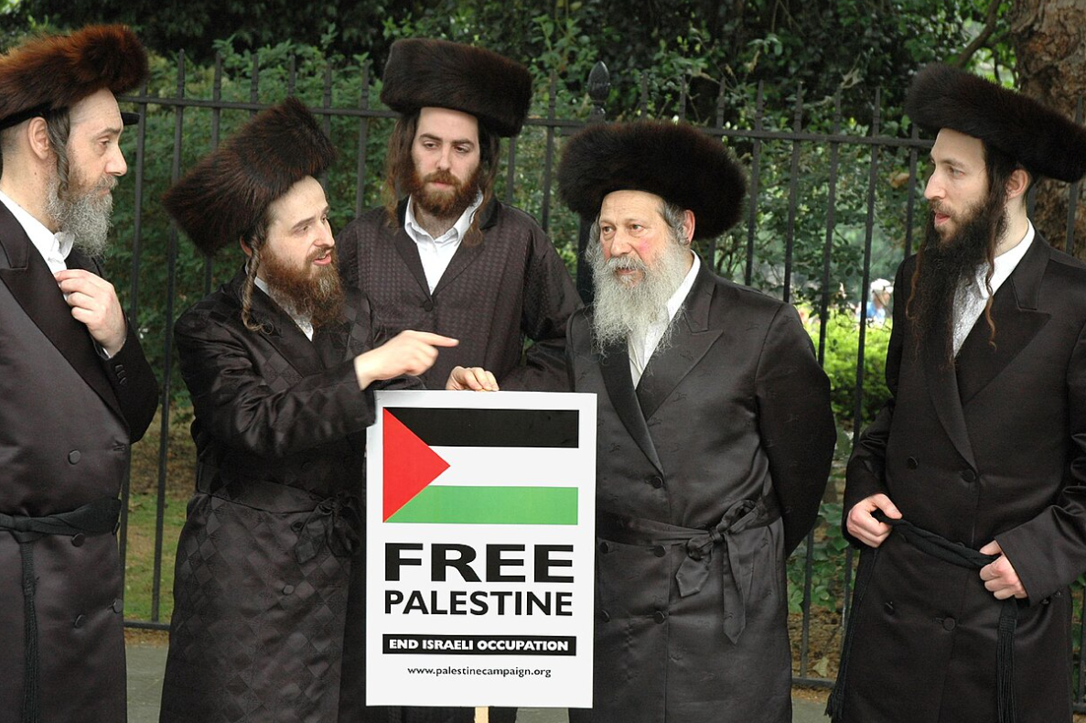
Notes:
https://en.wikipedia.org/wiki/Neturei_Karta#/media/File:Members_of_Neturei_Karta_Orthodox_Jewish_group_protest_against_Israel.jpg

Slide 30
רִגְזוּ וְאַל־תֶּחֱטָאוּ אִמְרוּ בִלְבַבְכֶם עַל־מִשְׁכַּבְכֶם וְדֹמּוּ סֶלָה׃
^{Ps 4.4} So tremble, and sin no more; ponder it on your bed, and sigh.
זִבְחוּ זִבְחֵי־צֶדֶק וּבִטְחוּ אֶל־יְיָ׃
Offer sacrifices in righteousness and trust in Adoni.
Notes:
https://www.sefaria.org/Psalms.4.5?lang=bi
How do we do that?

Slide 31
^{1 Yn 1.9} If we acknowledge our sins, then, since he is trustworthy and just, he will forgive them and purify us from all wrongdoing.

Slide 32
^{1 Yn 1.7} But if we are walking in the light, as he is in the light, then we have fellowship with each other, and the blood of his Son Yeshua purifies us from all sin.

Slide 33
^{Ephesians 4.25-27} Be angry, but don’t sin — don’t let the sun go down before you have dealt with the cause of your anger; otherwise you leave room for the Adversary.

Slide 34
Place to the adversary…Derek Prince exposition.
Notes:
Unforgiveness is an open door to Satan. Gives him territory in our spirit.

Slide 36
Hostility and Holocaust
Internal dynamics of hostility
Pro-active with hostility
National wounds and hostility.
Response to national hostility
Our personal response to hostility

Slide 37
Two types of forgiveness:

Slide 38
FIRST TYPE
Forgiveness based on the offender’s repentance is RECONCILATION.
Halleluyah and hugs.

Slide 39
^{Lk 17.3-4} Watch yourselves! If your brother sins, rebuke him; and if he repents, forgive him. Also, if seven times in one day he sins against you, and seven times he comes to you and says, ‘I repent,’ you are to forgive him.”
Notes:
If the perpetrator repents! We can likely all imagine some hurtful person begging our forgiveness.

Slide 40
SECOND TYPE: ABSOLUTE FORGIVENESS
^{Mtt 5.14-15} For if you forgive other people when they sin against you, your heavenly Father will also forgive you. But if you do not forgive others their sins, your Father will not forgive your sins.

Slide 41
^{Mtt 18.21-22} Then Kefa came up and said to him, “Rabbi, how often can my brother sin against me and I have to forgive him? As many as seven times?”
“No, not seven times,” answered Yeshua, “but seventy times seven!

Slide 42
Offense prevention vaccine
^{Mtt 20.20-28} But Yeshua called them over and said, “You know that the rulers of the nations lord it over them, and their great ones play the tyrant over them. It shall not be this way among you.
Notes:
What Yeshua was condemning, what He is against.

Slide 43
^{Mtt 20.20-28} But whoever wants to be great among you shall be your servant, and whoever wants to be first among you shall be your slave— just as the Son of Man did not come to be served, but to serve, and to give His life as a ransom for many.”

Slide 44
^{Yn 13.3-5} They were at supper, and the Adversary had already put the desire to betray him into the heart of Y’hudah Ben-Shim‘on from K’riot. Yeshua was aware that the Father had put everything in his power, and that he had come from God and was returning to God.

Slide 45
^{Yn 13.3-5} So he rose from the table, removed his outer garments and wrapped a towel around his waist. Then he poured some water into a basin and began to wash the feet of the talmidim and wipe them off with the towel wrapped around him.
Notes:
I mentioned more conflicts in 2024 than 27 years. Also, I have several situations personally in the category two forgiveness. I can’t figure how to get mutual repentance and reconciliation, so I just have to unilaterally, aggressively emotionally internally, FORGIVE.

Slide 46
Humility and forgiveness
are the prevention and cure of hostility and anger.
Notes:
[pause for prayer]

Slide 48
Hostility and Holocaust
Internal dynamics of hostility
Pro-active with hostility
National wounds and hostility.
Response to national hostility
Our personal response to hostility

Slide 49
The enemy has taken a real spiritual failure of the Jewish leaders, and turned it into a vendetta against our people.

Slide 50
^{Acts 2.36} Therefore, let the whole house of Isra’el know beyond doubt that God has made him both Lord and Messiah — this Yeshua, whom you executed on a stake!”
Notes:
Said to Jewish leaders and supporters in Jerusalem 33 CE. Not to all Jews everywhere and forever.

Slide 51
^{1 Thes 2.14-16} For, brothers, you came to be imitators of God’s congregations in Y’hudah that are united with the Messiah Yeshua — you suffered the same things from your countrymen as they did from the Judeans who both killed the Lord Yeshua and the prophets, and chased us out too.

Slide 52
^{1 Thes 2.14-16} They are displeasing God and opposing all mankind by trying to keep us from speaking to the Gentiles, so that they may be delivered. Their object seems to be always to make their sins as bad as possible! But God’s fury will catch up with them in the end.
Notes:
Said about Jewish leaders and supporters in Jerusalem 33 CE. Not about all Jews everywhere and forever.

Slide 53
The International Holocaust Remembrance Alliance (IHRA) definition of antisemitism states, “Antisemitism is a certain perception of Jews, which may be expressed as hatred toward Jews.
Notes:
https://holocaustremembrance.com/resources/working-definition-antisemitism

Slide 54
Rhetorical and physical manifestations of antisemitism are directed toward Jewish individuals and/or their property, toward Jewish community institutions and religious facilities.”
Notes:
https://holocaustremembrance.com/resources/working-definition-antisemitism
https://thelineoffire.org/article/did-the-house-of-representatives-just-outlaw-quoting-parts-of-the-new-testament?vcrmeid=JTQM1r2aA0C0T8loVqQbFQ&vcrmiid=n8-9Ls_siEGdG64--fUPAw

Slide 55
The IHRA then provides examples of Jew hatred, including, “Accusing Jews as a people of being responsible for real or imagined wrongdoing committed by a single Jewish person or group, or even for acts committed by non-Jews.”
Notes:
https://thelineoffire.org/article/did-the-house-of-representatives-just-outlaw-quoting-parts-of-the-new-testament?vcrmeid=JTQM1r2aA0C0T8loVqQbFQ&vcrmiid=n8-9Ls_siEGdG64--fUPAw

Slide 56
Or, “Accusing the Jews as a people, or Israel as a state, of inventing or exaggerating the Holocaust.” Or, “Using the symbols and images associated with classic antisemitism (e.g., claims of Jews killing Yeshua or blood libel) to characterize Israel or Israelis.”
Notes:
https://thelineoffire.org/article/did-the-house-of-representatives-just-outlaw-quoting-parts-of-the-new-testament?vcrmeid=JTQM1r2aA0C0T8loVqQbFQ&vcrmiid=n8-9Ls_siEGdG64--fUPAw
Our leaders then did so, and were supported by much of the population then, but NOT all.
1) large crowds of Jews followed Yeshua and it was mainly Jewish leaders who rejected Him (see, for example, Matthew 21:33-46);
2) all the first followers of Yeshua were Jews;
3) Peter and Paul are presented as observant, Torah-keeping Jews (see, e.g., Acts 10; 23:6); and
4) before the Temple was destroyed, there were tens of thousands of Jewish followers of Yeshua (Acts 21:20).

Slide 57
A new word, to me, Trope
Tropes encapsulate
these anti-Semitic views.

Slide 58
A literary trope is the use of figurative language, via word, phrase or an image, for artistic effect such as using a figure of speech. Also describes commonly recurring or overused literary and rhetorical devices,
Notes:
Wikipedia

Slide 59
or clichés in creative works. Literary tropes span almost every category of writing, such as poetry, film, plays, and video games.

Slide 60
Antisemitic tropes or antisemitic canards are "sensational reports, misrepresentations, or fabrications" that are defamatory towards Judaism as a religion or defamatory towards Jews as an ethnic or religious group.
Notes:
https://en.wikipedia.org/wiki/Antisemitic_trope

Slide 61
Tropes are the opposite to
dealing with wounds and hostility.
Tropes inflame the wounds.

Slide 62
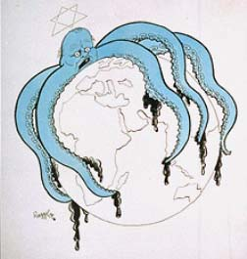
A Nazi German cartoon c. 1938 depicts Churchill as a Jewish-controlled octopus who is encircling the globe.
Notes:
https://en.wikipedia.org/wiki/Antisemitic_trope

Slide 63
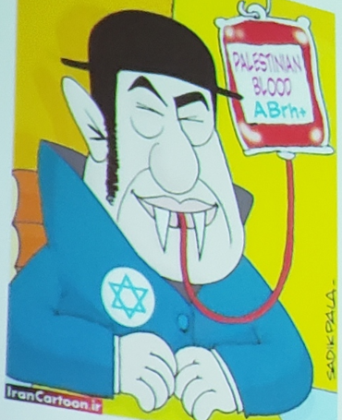

Slide 64
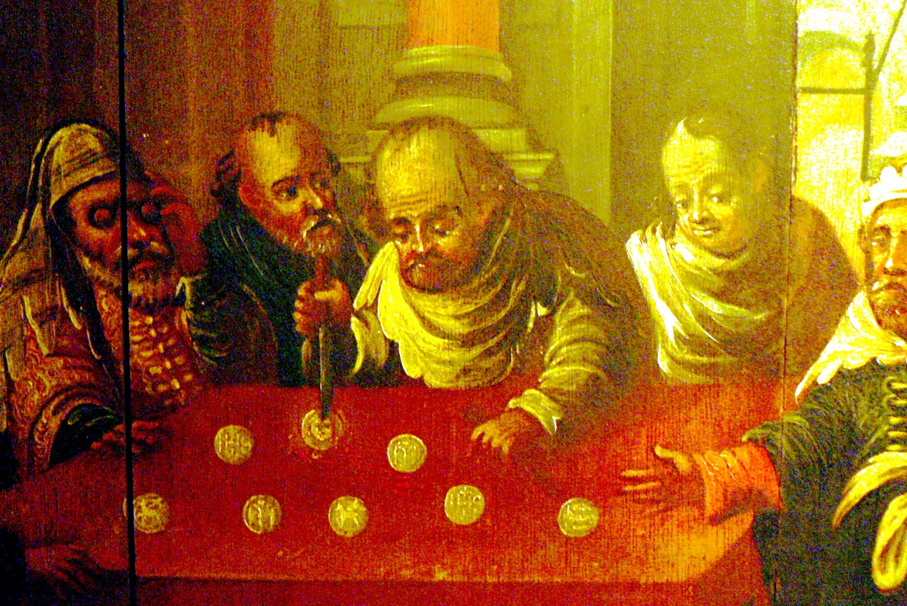
1500’s Host desecration by Jews
Notes:
16th-century painting showing alleged host desecration by Jews in Passau, Germany
https://en.wikipedia.org/wiki/Antisemitic_trope

Slide 65
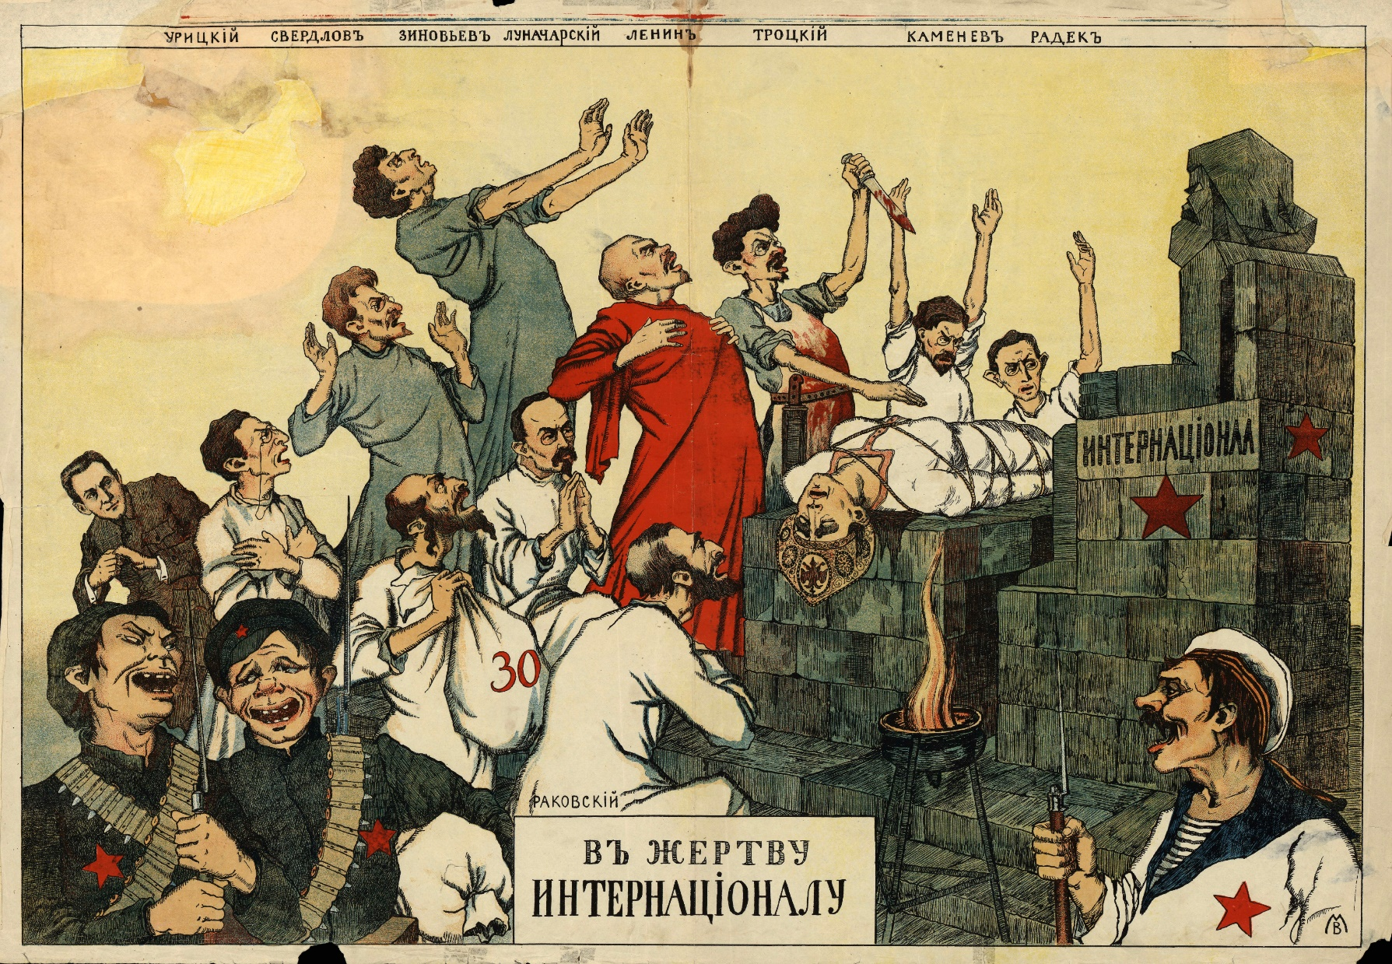
sacrifice of an allegorical
Russian character to a statue of Jewish Karl Marx.
Notes:
White Russian anti-Communist and antisemitic propaganda poster, c. 1919. Senior Bolsheviks – Sverdlov, Zinoviev, Lenin, Trotsky, Kamenev, Radek – sacrifice an allegorical character representing Russia to a statue of Karl Marx.
https://en.wikipedia.org/wiki/Antisemhttps://en.wikipedia.org/wiki/Antisemitic_trope
itic_trope

Slide 66
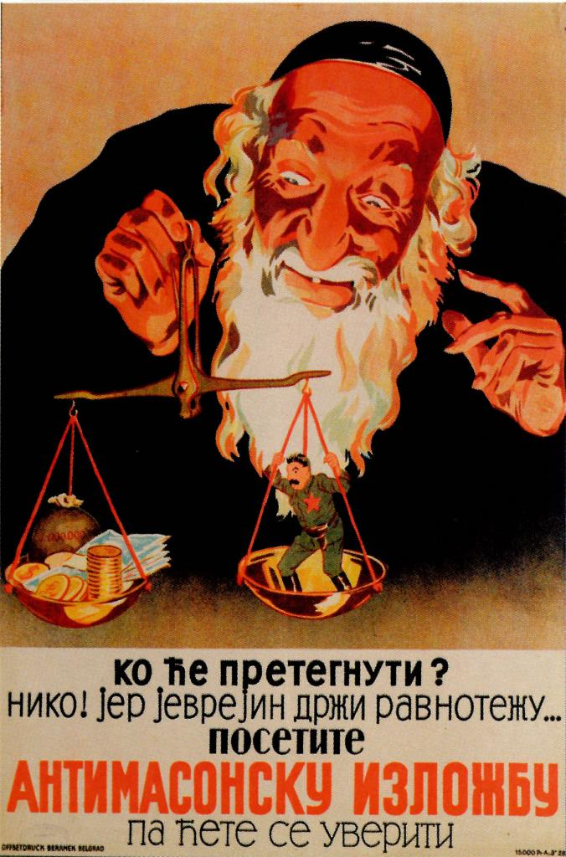
1941 antisemitic poster in German-occupied Serbia showing a Jew behind both capitalism and communism
Notes:
Jews are the capitalists AND the communists!
https://en.wikipedia.org/wiki/Antisemitic_trope

Slide 67
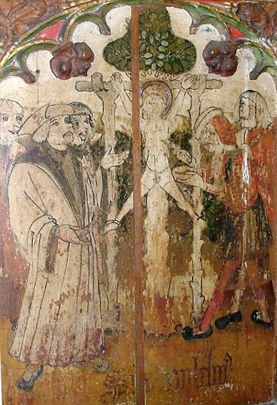
Jews were accused of the ritual murder of William of Norwich in 1144.
Killed Christian children to have blood to make matzah.
Notes:
https://en.wikipedia.org/wiki/Antisemitic_trope
Norwich is the town on the border of England and Scotland, seen in Braveheart.

Slide 68
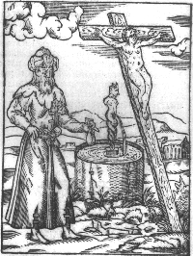
Medieval depiction of a Jew poisoning a well while performing a ritual murder.
1348 Black Death plague.
Notes:
https://en.wikipedia.org/wiki/Antisemitic_trope

Slide 69
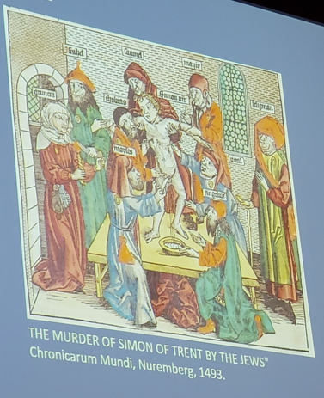
Notes:
Presentation by Shelly Cline local Holocaust historian and scholar

Slide 70
Notes:
https://www.youtube.com/watch?v=FTDiQnrSbes

Slide 71
Most Jewish people suspect there may be a latent Nazi in many non Jews. IF circumstances are ripe…
1890’s France [ after Napoleon’s Enlightenment, broke down the ghetto walls]
~1930’s Germany: Jews well accepted.
Passive anti-Semitism. Silence.

Slide 72
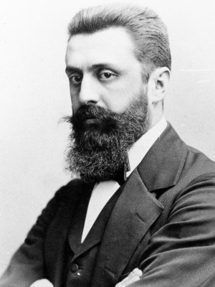
Theodore Herzl, “visionary
of the Nation”
Born: May 2, 1860
Budapest,
Kingdom of
Hungary
Died: July, 1904 (age 44)
Notes:
https://en.wikipedia.org/wiki/Theodor_Herzl

Slide 73
As a young man, Herzl was an ardent Germanophile who saw the Germans as the best Kulturvolk (cultured people) in Central Europe and embraced the German ideal of Bildung, where by reading great works of literature by Geothe and Shakespeare could allow one to appreciate the beautiful things in life, and thus become a morally better person.

Slide 74
Herzl believed that Hungarian Jews such as himself could shake off their "shameful Jewish characteristics" caused by long centuries of impoverishment and oppression, and become civilized Central Europeans, a true Kulturvolk along the German lines.

Slide 75
As the Paris correspondent for Neue Freie Presse, Herzl followed the Dreyfus affair, a notorious anti-Semitic incident in France in which a French Jewish army captain Alfred Dreyfus was falsely convicted of spying for Germany. Herzl was witness to mass rallies in Paris following the
Notes:
https://en.wikipedia.org/wiki/Theodor_Herzl

Slide 76
Dreyfus trial, where many chanted “Death to the Jews!” Shock to his view. He started writing pamphlets ‘A Jewish State.’ “I published a pamphlet which resulted in the establishment of the Zionist Movement.”
Notes:
Realized that Jews not really safe anywhere, unless own nation, own army. Radical. Not the first Zionist, but the catalyst.
https://en.wikipedia.org/wiki/Theodor_Herzl
Author Emile Zola later wrote a stinging newspaper article, “I Accuse” that expedited the judicial review and exoneration of Dreyfus.

Slide 77
At Basel I founded the Jewish state,” was the bold statement Theodor Herzl penned in his diary in the fall of 1897 after the first World Zionist Congress.

Slide 78
“Universal laughter,” he felt was a certainty if his words had been expressed aloud in 1897.
“Perhaps in five years,” he suggested, “and certainly in 50, everyone will know.”
Notes:
1897 + 50 = 1947 UN vote in November, 1947 to reestablish the Jewish Nation

Slide 79
Most Jewish people suspect there maybe a latent Nazi in many non Jews. IF circumstances are ripe…
1890s France [Napoleon’s Enlightenment]
~1930’s Germany.
Passive anti-Semitism. Silence.
Notes:
Therefore, when addressing difficult prophetic issues,
“All nations against Jerusalem”
2/3 die Zech 13.8 possibly already happened twice in history: fall of Jerusalem 70, 130 CE and then in Holocaust
Hitler and Holocaust seeds of prophetic restoration of Israel
Need GREAT spirit of grief, disclaimer that this is NOT good, but G-d uses it for good.

Slide 80
“Genocide!” is now the preferred weapon of defense used by those whose whole purpose is committing genocide. “War crimes!” is the accusation used by those who murder, burn, rape, decapitate, and kidnap innocent civilian Israelis- men, women and children.
Notes:
https://elhananbenavraham.substack.com/p/genocide

Slide 81
These insidious accusations by Hamas and its supporters are levelled at the nation they brutally attacked and which is now determined to defend its population by finally breaking the power of the evil terrorist Hamas organization, which has ignited now three unprovoked wars by regularly sending missiles into Israel’s civilian population.
Notes:
https://elhananbenavraham.substack.com/p/genocide

Slide 82
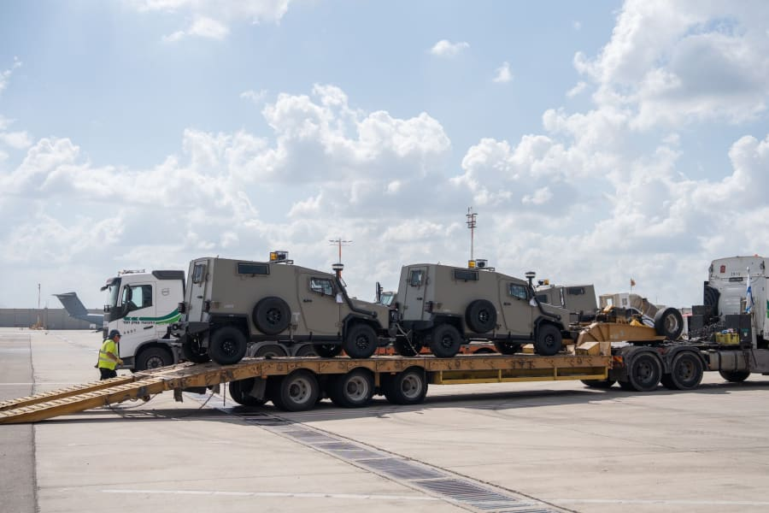
US cargo plane arrives in Israel with armored vehicles,
Oct. 19, 2023 (Photo: Ministry of Defense Spokesperson's Office)
Notes:
https://allisrael.com/coalition-of-90-lawyers-worldwide-call-to-reduce-us-military-aid-to-israel

Slide 83
A coalition of 90 lawyers worldwide, including 20 from the Biden administration, have signed a letter urging U.S. President Joe Biden to reduce the amount of military aid to Israel. The letter highlights concerns over Israel's pre-war actions in Gaza, asserting they violate both U.S. and international humanitarian law, according to a report by POLITICO.
Notes:
https://allisrael.com/coalition-of-90-lawyers-worldwide-call-to-reduce-us-military-aid-to-israel

Slide 85
Hostility and Holocaust
Internal dynamics of hostility
Pro-active with hostility
National wounds and hostility.
Response to national hostility
Our personal response to hostility

Slide 86
^{Mishlei/ Prov 3.1-5} My son, don’t forget my teaching, keep my commands in your heart; for they will add to you many days, years of life and peace. Do not let grace and truth leave you — bind them around your neck;

Slide 87
^{Mishlei/ Prov 3.1-5} write them on the tablet of your heart. Then you will win favor and esteem in the sight of God and of people. Trust in Adoni with all your heart; do not rely on your own understanding. In all your ways acknowledge him; then he will will make your paths straight.

Slide 88
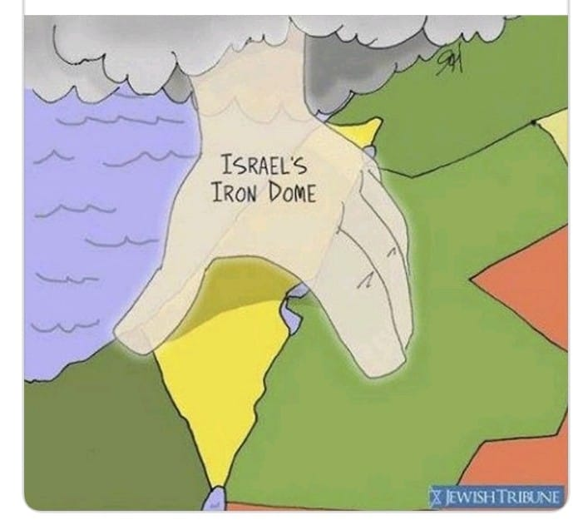
Notes:
From Jeanie Gelbart

Slide 89
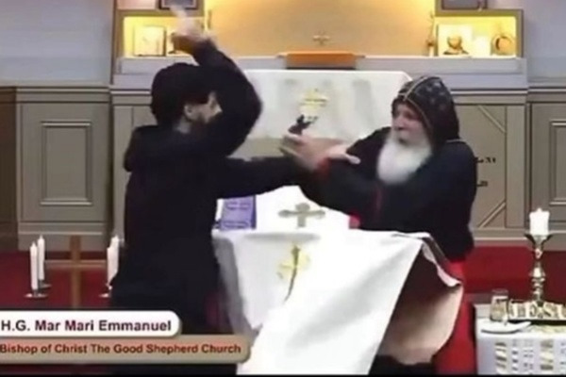
Notes:
https://www.meforum.org/65849/elon-musk-x-poses-ongoing-censorship-of-muslim?goal=0_086cfd423c-8016c0d4b6-33765913&mc_cid=8016c0d4b6&mc_eid=2515d15785

Slide 90
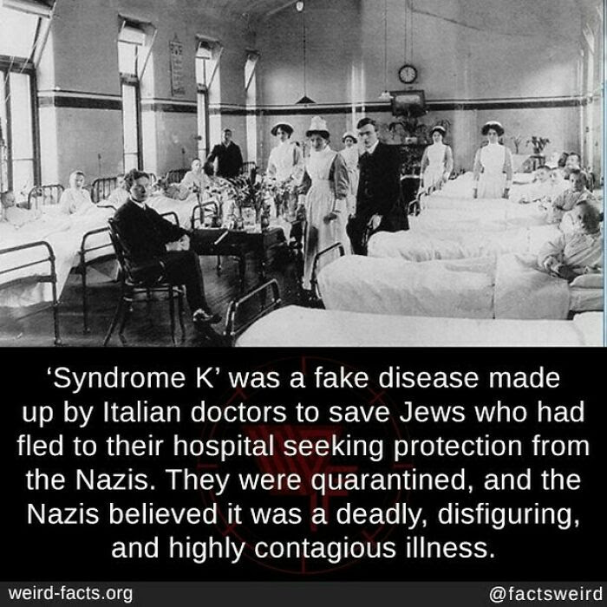

Slide 91
Notes:
https://youtu.be/kZU0H_4cH0k

Slide 93
Hostility and Holocaust
Internal dynamics of hostility
Pro-active with hostility
National wounds and hostility.
Response to national hostility
Our personal response to hostility

Slide 94
Forgive and bless whoever has hurt you, with Yeshua’s help.
Seek, with Yeshua’s help, to be reconciled with them.
Set boundaries to avoid further wounds, personal and national.
Comfort others wounded.

