Slide 1
e-handout
To have these notes
without taking notes
Go to OrHaOlam.com
Click on Messages tab,
2024 Messages

Slide 2
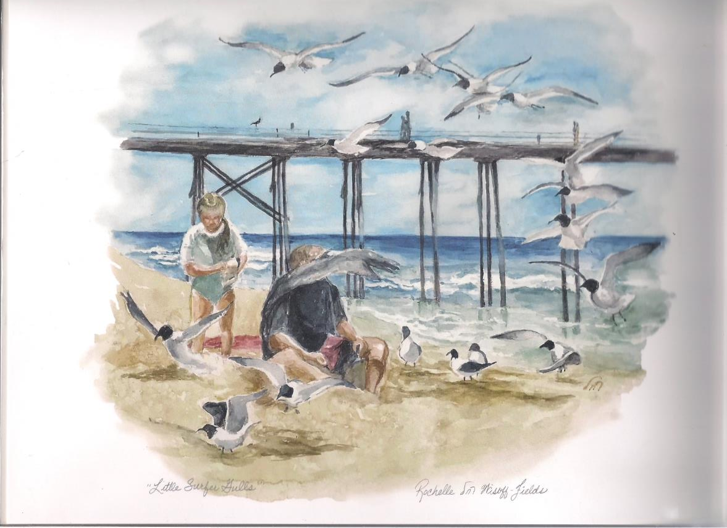
A husband a wife were examining
a beautiful ocean scape when suddenly he was hit with a pigeon dropping.
She said, “Don’t worry, I’ll get some toilet paper.”

Slide 3
He said, “Don’t worry. By the time you get back the pigeon will be long gone.
Notes:
Note the beautiful backdrop by our resident artist.

Slide 4
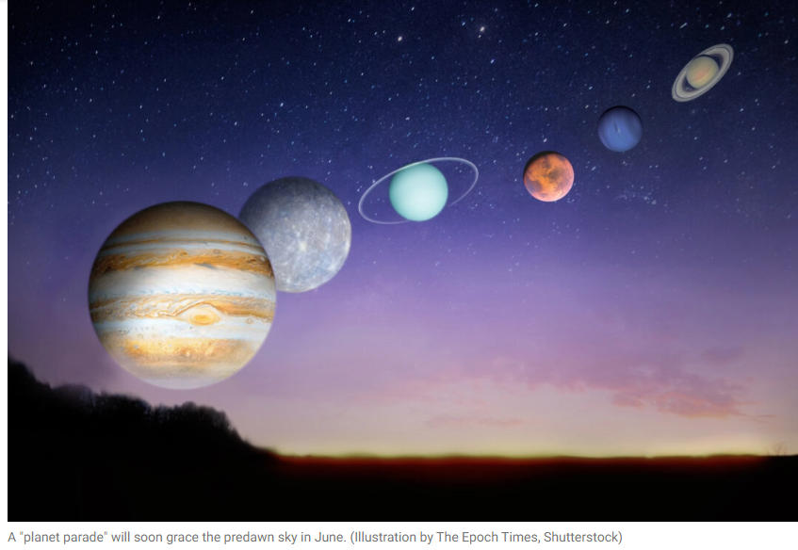
Monday June 3 just before
sunrise looking east
Jupiter, Mercury, Uranus, Mars,
Neptune, and Saturn, in that order
Notes:
On June 3, just 20 minutes before sunrise, your local time, the scene will have already risen above the horizon. For those in the Northern Hemisphere looking east, starting with Jupiter popping just over the horizon

Slide 5
Be there Monday, 5.34 am

Slide 6
In 2023 we took in $699 & paid $2k- supplement $1,301
This year we took in $317.50
Notes:
It was amazing that we got anything as it was about 12.30 and a bit chaotic. You folks are always so gracious. At the close of the message, we’d like to receive another offering for them

Slide 8
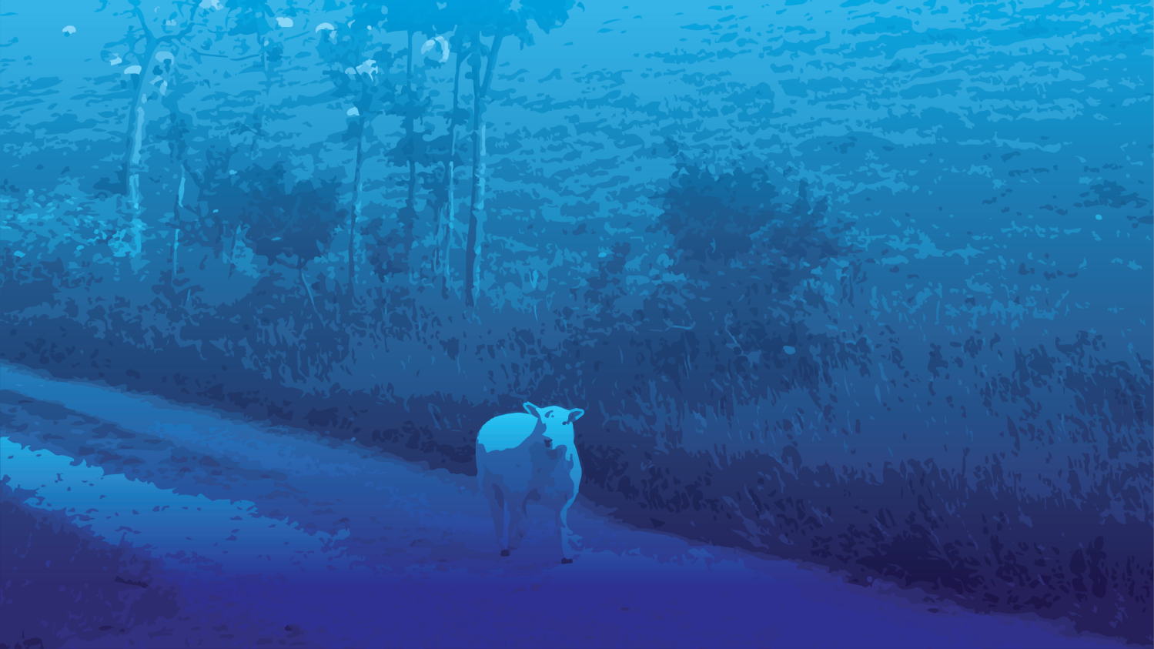
G-d of Avraham, Yitskhak, Yaakov
and the Errant
The model
The errant ones misdirected
The resources for mitigation

Slide 9
G-d of Avraham, Yitskhak, Yaakov
and the Errant
The model
The errant ones misdirected
The resources for mitigation

Slide 10
^{Acts 3.12-15} Kefa addressed the people: “Men of Isra’el! Why are you amazed at this? Or why do you stare at us as if we had made this man walk through some power or godliness of our own? The God of Avraham, Yitz’chak and Ya‘akov, the God of our fathers,
Notes:
G-d of families
As a new Jewish believer, brought up with this phrase in the synagogue, I saw and felt the power of it.

Slide 11
^{Acts 3.12-15} has glorified his servant Yeshua — the same Yeshua you handed over and disowned before Pilate, even after he had decided to release him. You denied the holy and innocent one, and instead asked for the reprieve of a murderer! You killed the author of life!

Slide 12
^{Shmot/Ex 3.5-6} He said, “Don’t come any closer! Take your sandals off your feet, because the place where you are standing is holy ground. I am the God of your father,” he continued, “the God of Avraham, the God of Yitz’chak and the God of Ya‘akov.”

Slide 13
^{Shmot/Ex 3.5-6} God also said to Moses: “You are to say to Bnei-Yisrael, Adoni, the God of your fathers, the God of Abraham, Isaac and Jacob, has sent me to you. This is My Name forever, and the Name by which I should be remembered from generation to generation.

Slide 14
^{T’hillim/Ps 78.1-7} Listen, my people, to my teaching; turn your ears to the words from my mouth. I will speak to you in parables and explain mysteries from days of old. The things which we have heard and known, and which our fathers told us we will not hide from their descendants; we will tell the

Slide 15
^{T’hillim/Ps 78.1-7} generation to come the praises of Adonai and his strength, the wonders that he has performed. He raised up a testimony in Ya‘akov and established a Torah in Isra’el. He commanded our ancestors to make this known to their children, so that the next

Slide 16
^{T’hillim/Ps 78.1-7} generation would know it, the children not yet born, who would themselves arise and tell their own children, who could then put their confidence in God, not forgetting God’s deeds, but obeying his mitzvot.

Slide 17
^{Shmot/Ex 12.24-27} You are to observe this as a law, you and your descendants forever. “When you come to the land which Adonai will give you, as he has promised, you are to observe this ceremony. When your children ask you, ‘What do you mean by this ceremony?’ say,

Slide 18
^{Shmot/Ex 12.24-27} ‘It is the sacrifice of Adoni’s Pesakh, because Adoni passed over the houses of the people of Isra’el in Egypt, when he killed the Egyptians but spared our houses.’”
Notes:
Passover has indeed carried the identity of the Jewish people, when all else is dropped, this is the last to go.

Slide 19
^{T’hillim / Ps 128} How happy is everyone who fears Adonai, who lives by his ways. You will eat what your hands have produced; you will be happy and prosperous. Your wife will be like a fruitful vine in the inner parts of your house. Your children around the table will be like shoots from an olive tree.

Slide 20
^{T’hillim / Ps 128} This is the kind of blessing that will fall on him who fears Adonai. May Adonai bless you from Tziyon! May you see Yerushalayim prosper all the days of your life, and may you live to see your children’s children! Shalom on Isra’el.

Slide 21
Effects of this family heritage focus even on
mostly secular Israel

Slide 22
Israel is the 5th happiest place on Earth, according to the World Happiness Report 2024, released on Wednesday.
The findings are powered by data from the Gallup World Poll and based on six factors—social support, income, health, freedom, generosity and absence of corruption.
Notes:
https://www.israeltoday.co.il/read/israel-ranked-5th-happiest-country-in-the-world/

Slide 23
The United States (23) dropped out of the top 20 for the first time since the World Happiness Report was first published in 2012, driven by a large drop in the wellbeing of Americans under 30.
Notes:
https://www.israeltoday.co.il/read/israel-ranked-5th-happiest-country-in-the-world/
Rugged individualism is great, but has limits.

Slide 24
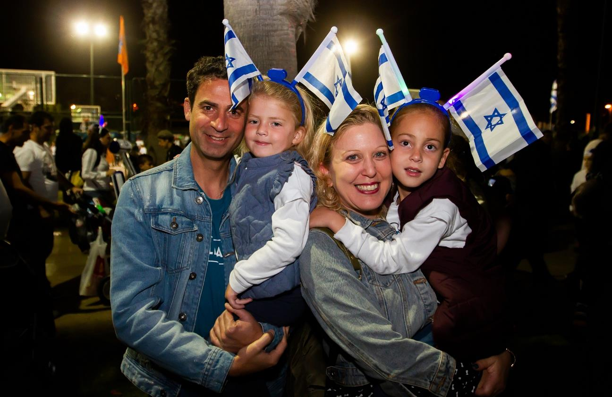
Notes:
https://external-content.duckduckgo.com/iu/?u=https%3A%2F%2Fstatic.timesofisrael.com%2Fwww%2Fuploads%2F2019%2F05%2FF190508FFFFF12.jpg&f=1&nofb=1&ipt=5d7322ca025344e90e44ee43ca27f45fd5976c253830bdcc511ffb7704d6f588&ipo=images

Slide 25
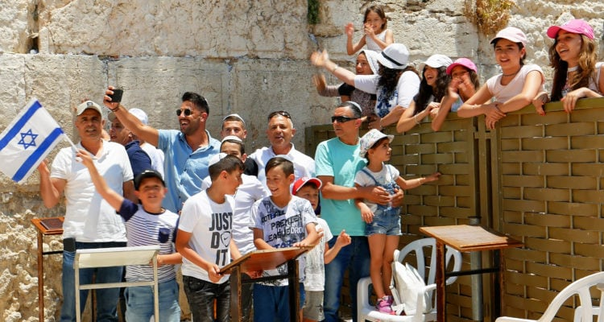

Slide 26
In Israel, if you were to look into most Jewish homes on an ordinary Friday night, you would see something similar to that American Thanksgiving scene.
Notes:
https://time.com/6334598/shabbat-brings-israel-together/

Slide 27
Shabbat is “brought in” with singing, blessings for children, prayers over wine and bread, and a set table. But even in secular homes it is the occasion for an unrushed sit-down dinner with not only the whole household but also grown children living outside the home, including those who have their own families.
Notes:
https://time.com/6334598/shabbat-brings-israel-together/
I hope and pray we have this culture here, among Jewish people and those from all Nations.

Slide 28
The early twentieth-century Hebrew essayist Ahad Ha’am was not exaggerating when he said, “More than the Jewish People have kept Shabbat, Shabbat has kept the Jews.” More than 70 percent of Jewish Israelis have a traditional Friday night dinner with family and friends each week.
Notes:
https://time.com/6334598/shabbat-brings-israel-together/
I had thought, in my early years as a believer, when there really was no Messianic Jewish movement, and I learned of church splits and fights, I had thought that when we have Jewish leadership in the Kingdom, there will be unity and shalom, no rancor.

Slide 29
Consistent with that ambience, we have MANY heirs and heroes, walking in the faith and in the legacy of their families.
Notes:
Our heirs, adult or teen children of parents in Or HaOlam who are worshipping here, or serving here
Josie, Marcos, Melanie, Duncan and Ilona, Braden Blackburn, Wes Blackburn, Elana, Hedmon, Jaedyn, Miranda, Cassie, Kate Hershey, German, Charlotte, Camron 16
Stand for appreciation
We also have prodigals, reflecting the corruption of the human race.

Slide 30
Zurieli Rojas
North Carolina testimony

Slide 31
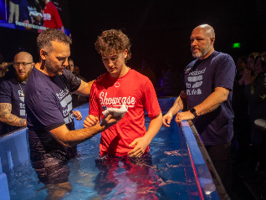
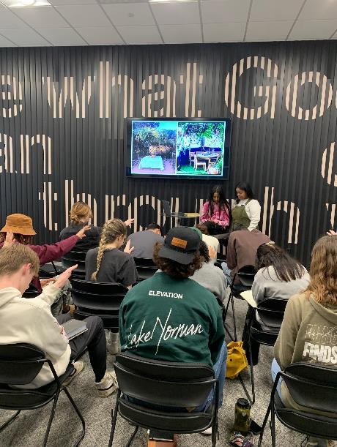
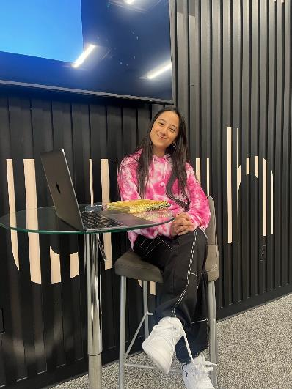
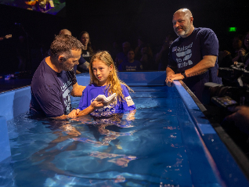
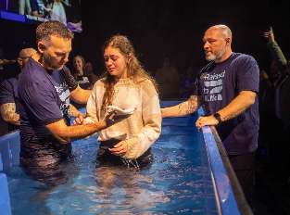

Slide 33
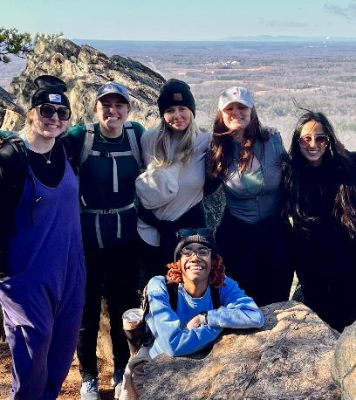
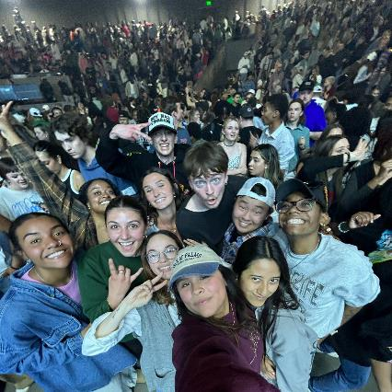
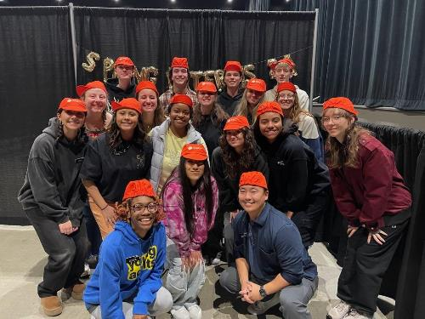
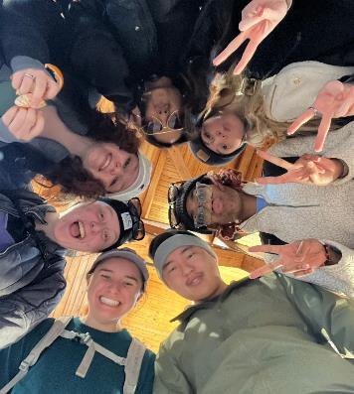
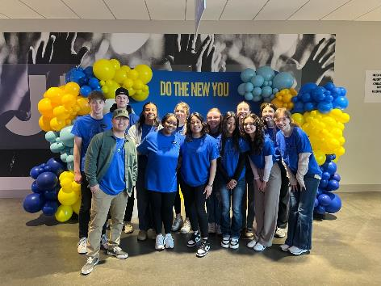

Slide 35
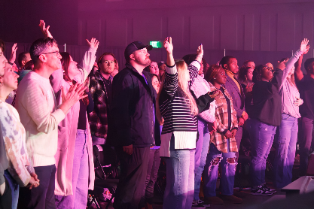
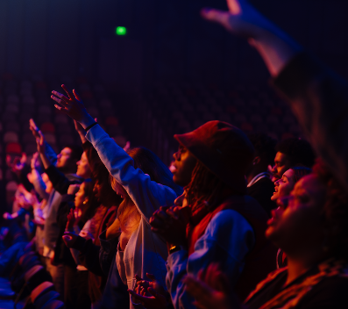
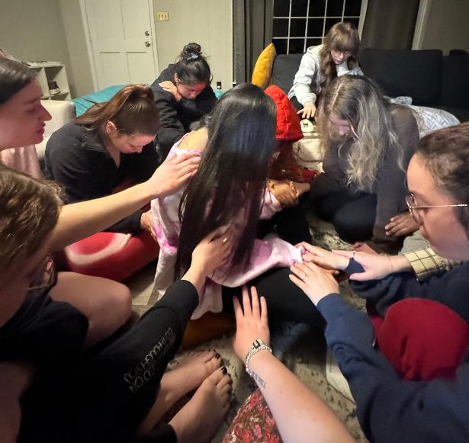
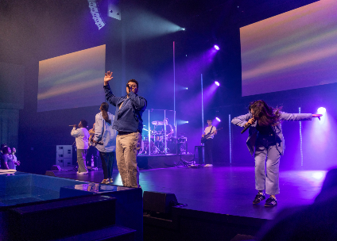
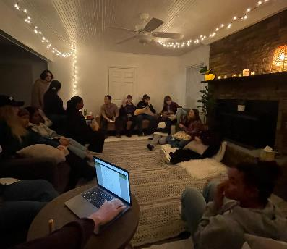
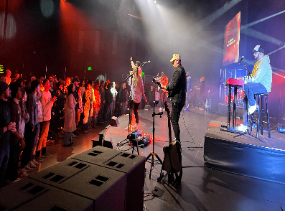

Slide 37
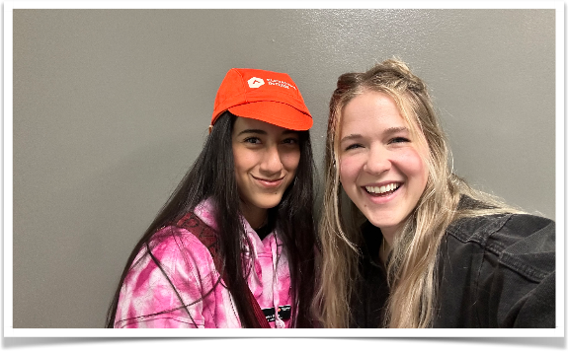
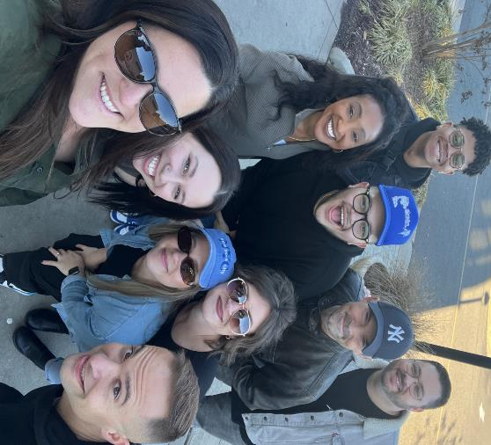
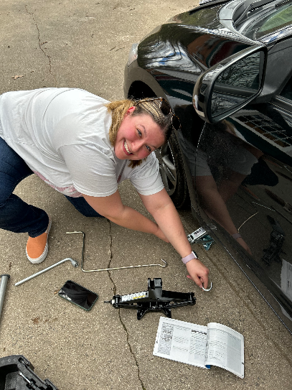
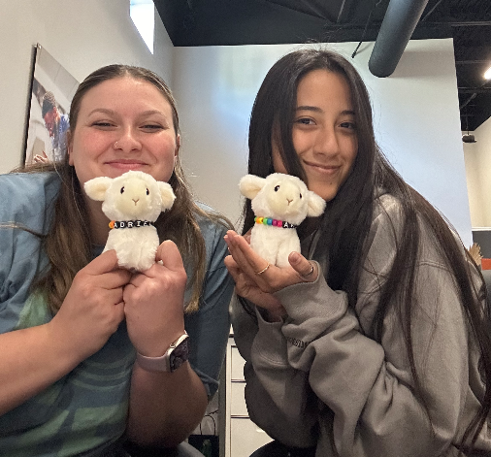

Slide 38
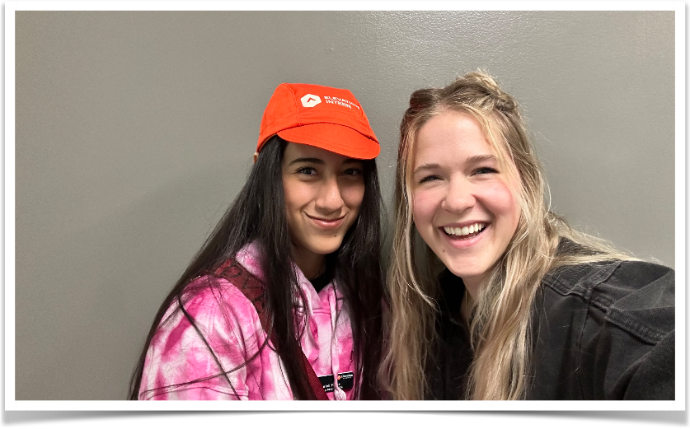

Slide 39
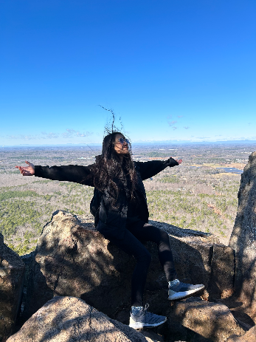
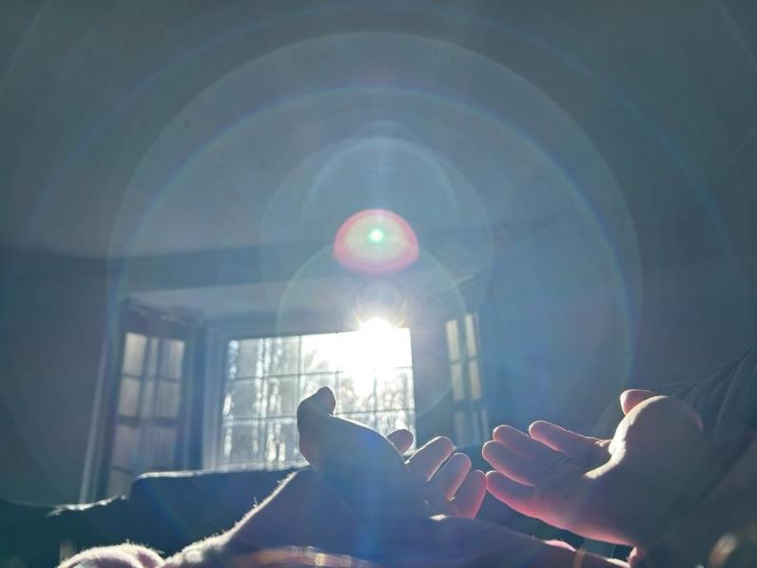

Slide 41
G-d of Avraham, Yitskhak, Yaakov
and the Errant
The model
The errant ones misdirected
The resources for mitigation

Slide 42
Errancy in either direction

Slide 43
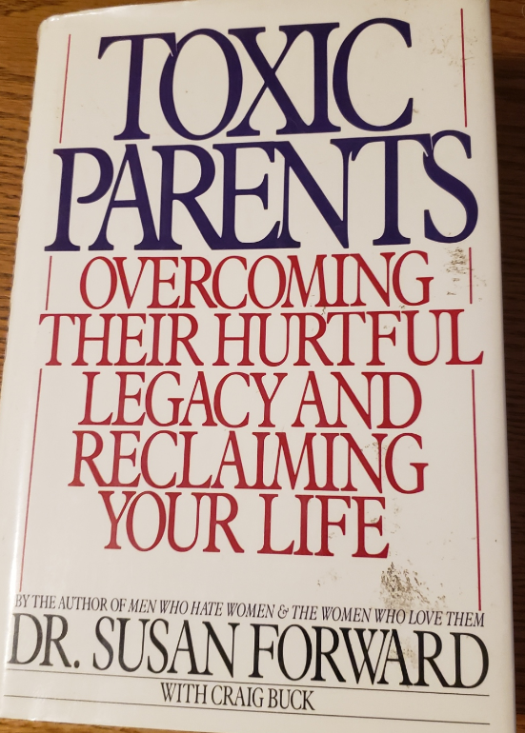

Slide 44
For people who are unable to discuss conflicts with their parents, resolution rarely happens. In this case, you need to be prepared to live with non-closure.

Slide 45
From the Adult Child’s perspective:
When and how to go “no contact” with your toxic parents is not a one-size-fits-all remedy to dealing with parental conflict, and it certainly doesn’t guarantee a resolution. However, there are times when estrangement is the only tool you have left to protect yourself, your spouse, and your children from harm or dysfunction.
Notes:
https://www.happierhuman.com/no-contact-parents/

Slide 46
On the other hand

Slide 47
Yvonne B., a 61-year-old health care provider from California, has had almost no contact with her 34-year-old daughter for over a year. “She began distancing maybe 2 years ago. Then she texted, saying her therapist advised her not to be in touch,” Yvonne said. “She called me ‘manipulative,’ and ‘narcissistic,’ and said she needed to ‘set boundaries.’”
Notes:
https://www.webmd.com/parenting/news/20230620/dealing-with-adult-child-estrangement

Slide 48
Kevin H., a computer technician from New York, hasn’t spoken to or heard from his younger son for 15 years. “Fortunately, I have a good relationship with my older son,” he said. “I’ll admit I’m not the most emotionally expressive person on the planet, but I haven’t done anything to deserve this. I think my ex-wife turned him against me.”
Notes:
https://www.webmd.com/parenting/news/20230620/dealing-with-adult-child-estrangement

Slide 49
“For centuries, society’s values included ‘respect your elders’ and ‘honor thy father and mother,’ and there were notions of loyalty and family ties. But today’s values focus more on identity, personal growth, individual happiness, and self-esteem,” Coleman said. Anyone perceived as standing in the way — including a parent — can be jettisoned.
Notes:
https://www.webmd.com/parenting/news/20230620/dealing-with-adult-child-estrangement

Slide 50
Reasons for Estrangement
Divorce: hostility, picking sides
Opposing religious or political views
A son- or daughter-in-law
Addiction and mental illness
Notes:
https://www.webmd.com/parenting/news/20230620/dealing-with-adult-child-estrangement

Slide 51
Therapists: Therapists typically explore their clients’ childhood memories to see how they might have contributed to present-day difficulties. A misguided therapist may “inadvertently encourage a victimized stance in relation to the parent, as opposed to a stance that sees the parent in a more three-dimensional way.”
Notes:
https://www.webmd.com/parenting/news/20230620/dealing-with-adult-child-estrangement

Slide 52
And some therapists use diagnostic terms, like “narcissist” or “borderline,” to describe parents they’ve never met. Mental health is regarded as a process of setting boundaries rather than finding compassion toward a parent’s human imperfections.
Notes:
https://www.webmd.com/parenting/news/20230620/dealing-with-adult-child-estrangement
These terms are real descriptors, but can be overused.

Slide 53
In my studies of the lives of older Americans, I learned that almost nothing is as painful to them as estrangement from an adult child. When we reach the later years, our dream is to be surrounded by loving children and grandchildren.
Notes:
https://www.huffpost.com/entry/parents-estranged-children_b_7297294
Risa S. Breckman, LCSW, Therapist and Director of NYC Elder Abuse Center

Slide 54
For some older people, however, a negative relationship with one of their offspring - or even worse, complete separation from him or her - is profoundly difficult.
Notes:
https://www.huffpost.com/entry/parents-estranged-children_b_7297294
Risa S. Breckman, LCSW, Therapist and Director of NYC Elder Abuse Center

Slide 55
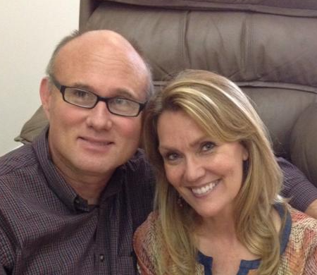
Barry & Cynthia Morehead
Notes:
Barry attends, from St. Joseph, from time to time, since about 2010. He and Cynthia have brought their children up in home school or Christian school. Best nurture in the L-rd they could. Barry came with us to Israel in ~2012 and we’ve had lunch together from time to time. I eat lunch for a living.

Slide 56
In 2012 we lost our oldest son to estrangement. He married a woman who by the looks of things seemed to be a good match. A believer well educated, attractive, athletic, from a solid family. All things true of him as well. They had much in common. However, she wanted him to herself and wanted nothing to do with our family.

Slide 57
The first thing she did after they returned from their honeymoon was to cut off all communication between him and the entire extended family and then begin the process of turning him against us. Six years later our son’s high school and college friends began contacting us. Apparently, she had not only cut off our family but also anyone who knew him prior to her entering his life. My grief was great those first three years. A sister in Messiah recommended a book to aid in my healing.
Notes:
We had dinner with Barry and Cynthia a few weeks ago, and the memory of her grief and trauma was palpable.

Slide 58
It’s called “In Sheep’s Clothing” subtitle “How to identify and deal with manipulative personalities”. It is not a faith based book. It is written by a psychologist regarding what he’s learned through the patients in his practice. I was to the acceptance stage of grief before reading the book, but the truths I discovered in this information gave me emotional freedom which was a deeper level of healing.

Slide 59
In April of 2021 our youngest daughter ghosted us. We had no idea why. She and her husband had only been married a few years and we didn’t know if maybe they needed some space to work through something. We can respect privacy as long as we know our daughter is okay. But in September of that year at a family wedding we were both attending it was clear that was not the case.
Notes:
Ghosted, new to me term, vanish like a ghost. No response to text, phone, email.

Slide 60
They would not come near us. After the reception they met us in the parking lot where she read a prepared statement off of her phone. In it she explained that she was going through “something”.

Slide 61
She was getting counseling. Until she gets her feet underneath her she would appreciate if we would respect her boundaries. And while we’re at it maybe we should get some counseling to figure out why none of our kids want to spend time with us (!!!). My husband asked if we had hurt or offended her in some way that we are unaware of.

Slide 62
Was there anything we should apologize for? She kept things vague and gave no answer. I listened, but before she left I hugged her, kissed her, told her that I loved her, and let her know that whenever she is ready I am here. That was the last time I spoke to her.

Slide 63
We had moved our youngest son to Columbia during the pandemic that he may begin his pursuit of his doctorate MU. He was single, lived alone, because of the pandemic he worked remotely and all his classes were being taught online. He would call us five times a week, sometimes alternating, calling his dad one day and me the next.

Slide 64
We were always in touch……until he went camping one time with his sister and her husband. Ever since then he has cut us out of his life as well. He communicated that officially in January of 2022. No explanation other than he is too busy right now to entertain phone calls, texts, or visits from us. That was the last time we heard from him.

Slide 65
We have since learned of a movement or therapy technique which targets gen x and millennials with their message. Their message is spread through counselors and through the psychology departments of universities that are training counselors. They have four main objectives:

Slide 66
1) tell their patients/ clients/ students to cut off all communication with their parents and don’t tell them why. That’s called “reclaiming your power”
2) talk a lot about boundaries “I would appreciate it if you would respect my boundaries”

Slide 67
3) gas light your parents. Let them know you have a problem (without saying what it is) and insinuate that they have some responsibility for your problem.
4) convince these young people that they are victims and they need to share their story with others as part of their healing.

Slide 68
Our daughter and son-in-law have spoken to folks in our family and church. Although we have no idea what is being said, some of those people have cut us out of their lives as well. Since then we have met over two dozen lovely believing families whose adult children are doing the same identical thing to them. Some of them go to counseling. Some of them are counselors.

Slide 69
Three of our four children no longer have contact with us but I have joy and I have peace because I know a few things:
1) I know that I am imperfect. I make mistakes and will probably continue to as it’s part of the human condition, however

Slide 70
2) I know that when it came to parenting I did my very best and our children were given a firm foundation from which to launch
3) I know that our children are adults and responsible for the consequences of their own choices

Slide 71
My husband and I are at a season of life where we don’t have time to waste feeling sorry for ourselves or chasing after relationships with people who have communicated clearly that they don’t currently want us in their lives. Although this is not how we pictured our story turning out,

Slide 72
God continues to redeem our story by continuing to bring people of all ages into our lives who want, need, and will accept our love. Our definition of family has changed, but that’s ok because God keeps extending our “family” to include those we might not have known otherwise. It’s not what we pictured, but it’s beautiful.

Slide 73
I continue to pray for our children and hope that one day they will turn back to the Father, but whatever they choose we are going to be fine because we’re moving forward with the one who loves us more than any other.

Slide 74
Contributing factors in the believing world
Escapist theology that says, “We’re going to be out of here any minute!”
Excessive individualism > community and accountability

Slide 76
G-d of Avraham, Yitskhak, Yaakov
and the Errant
The model
The errant ones misdirected
The resources for mitigation

Slide 77
Experience has taught me that when it comes to family life, nothing is simple or formulaic. Children who remain close to their parents didn't all grow up on Sunnybrook Farm. And those who distance themselves or choose to have zero contact haven't all done so because their parents failed them in some significant way.
Notes:
https://www.huffpost.com/entry/parents-estranged-children_b_7297294

Slide 78
(Though, of course, some have.) Many fine parents have children who pull away -- sometimes for reasons the parents cannot figure out. If your grown child has pulled away, ask yourself this: Is there an unresolved issue that needs to be addressed?
Notes:
https://www.huffpost.com/entry/parents-estranged-children_b_7297294

Slide 79
Is there something I might do to make that resolution possible? Is there something I need to apologize for or forgive? Difficult as it is, I've seen many parents remain openhearted to their estranged children, reaching out, inviting contact, expressing their love, with no expectation or insistence that it be reciprocated.
Notes:
https://www.huffpost.com/entry/parents-estranged-children_b_7297294

Slide 80
Dealing With Adult Child Estrangement, a ‘Modern-Day Epidemic’
Notes:
https://www.webmd.com/parenting/news/20230620/dealing-with-adult-child-estrangement

Slide 81
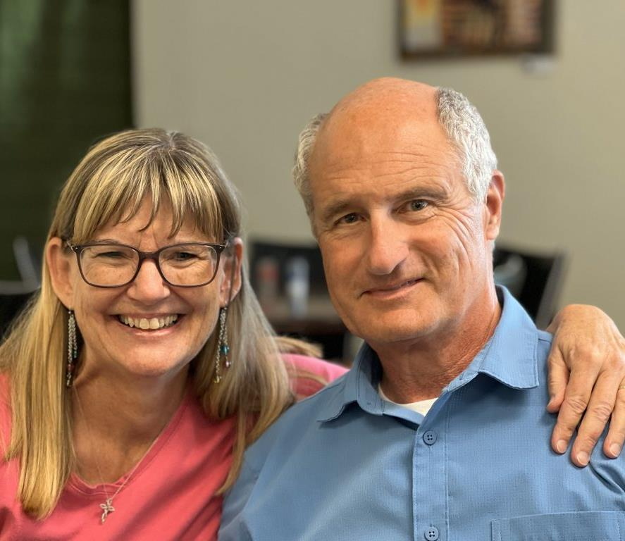
Mike and Becky McNamee, founders of Bold Destiny.

Slide 82
Notes:
https://bolddestiny.com/
Grandparenting camp.

Slide 83
LEGACY OF FAITH is an uplifting, one-of-a-kind retreat for Grandparent Couples desiring generational impact and a spiritual heritage that outlives them.
These retreats are being held at the beautiful Glen Eyrie Conference Center in Colorado Springs.
https://bolddestiny.com/
Notes:
https://bolddestiny.com/

Slide 84
We will address potential threats and barriers to building your Legacy of Faith, such as…prodigal children/grandchildren, resistance to God, long-distance grandparenting, complex family dynamics, past regrets, and cross-generational communication.
Notes:
https://bolddestiny.com/

Slide 89
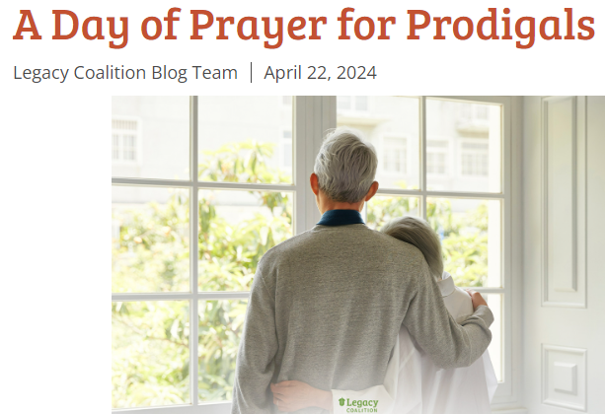

Slide 90
Rise up, shine forth,
For, your Light has come.
Shekhinah of Messiah in splendor has dawned.

Slide 91
See how darkness covers the earth
And the nations in depth of night
But Adoni in splendor will dawn on you.
And His glory, and His glory on you will appear.

Slide 92
No more will violence sound in your land
Blasts nor looting on your grounds
You will call your walls salvation
And your gates, and your gates
Praise will declare.

Slide 93
The smallest one will become like a thousand
And the least like a nation of might.
I’m Adoni, in its time I’ll accelerate.
In its time, in its time
I’ll accelerate.

Slide 94
Lift your eyes round about, and see them all
Gathered to you your sons come from very far away.

Slide 95
שְׂאִֽי־סָבִיב עֵינַיִךְ וּרְאִי כֻּלָּם
S’ee saviv e-ni-ikh ur’ee kulam
Lift your eyes round about, and see them all

Slide 96
נִקְבְּצוּ בָֽאוּ־לָךְ בָּנַיִךְ מֵֽרָחוֹק
Nikbitsu va-u lakh banayikh merakhok
Gathered to you, your sons come, from very far away.

Slide 97
In 2023 we took in $699 & paid $2k- supplement $1,301
This year we took in $317.50
Notes:
It was amazing that we got anything as it was about 12.30 and a bit chaotic. You folks are always so gracious. At the close of the message, we’d like to receive another offering for them

