Slide 1
e-handout
To have these notes
without taking notes
Go to OrHaOlam.com
Click on Messages tab,
2024 Messages

Slide 2
AI selected Dad Jokes
Notes:
https://www.dailymail.co.uk/sciencetech/article-13518163/ultimate-dad-jokes-Fathers-Day-AI.html?ito=rss-connatix

Slide 3
To celebrate Father's Day, we asked ChatGPT: 'What are the ultimate dad jokes?'
Within seconds, the AI bot came up with a list of 20 jokes, writing: 'Here are some of the best dad jokes that are sure to get a laugh (or a groan).'

Slide 4
Topping the list is 'Why don't skeletons fight each other?

Slide 5
Topping the list is 'Why don't skeletons fight each other?
They don't have the guts.'

Slide 6
Next is the classic 'What do you call cheese that isn't yours'

Slide 7
Next is the classic 'What do you call cheese that isn't yours?
Nacho cheese.'

Slide 8
What do you call fake spaghetti?

Slide 9
What do you call fake spaghetti? An impasta

Slide 10
Yesterday was June 21, the summer solstice.
Longest day of daylight of the year.

Slide 11
Notes:
City pays for park permits, or rather waives fees and expedites.

Slide 12
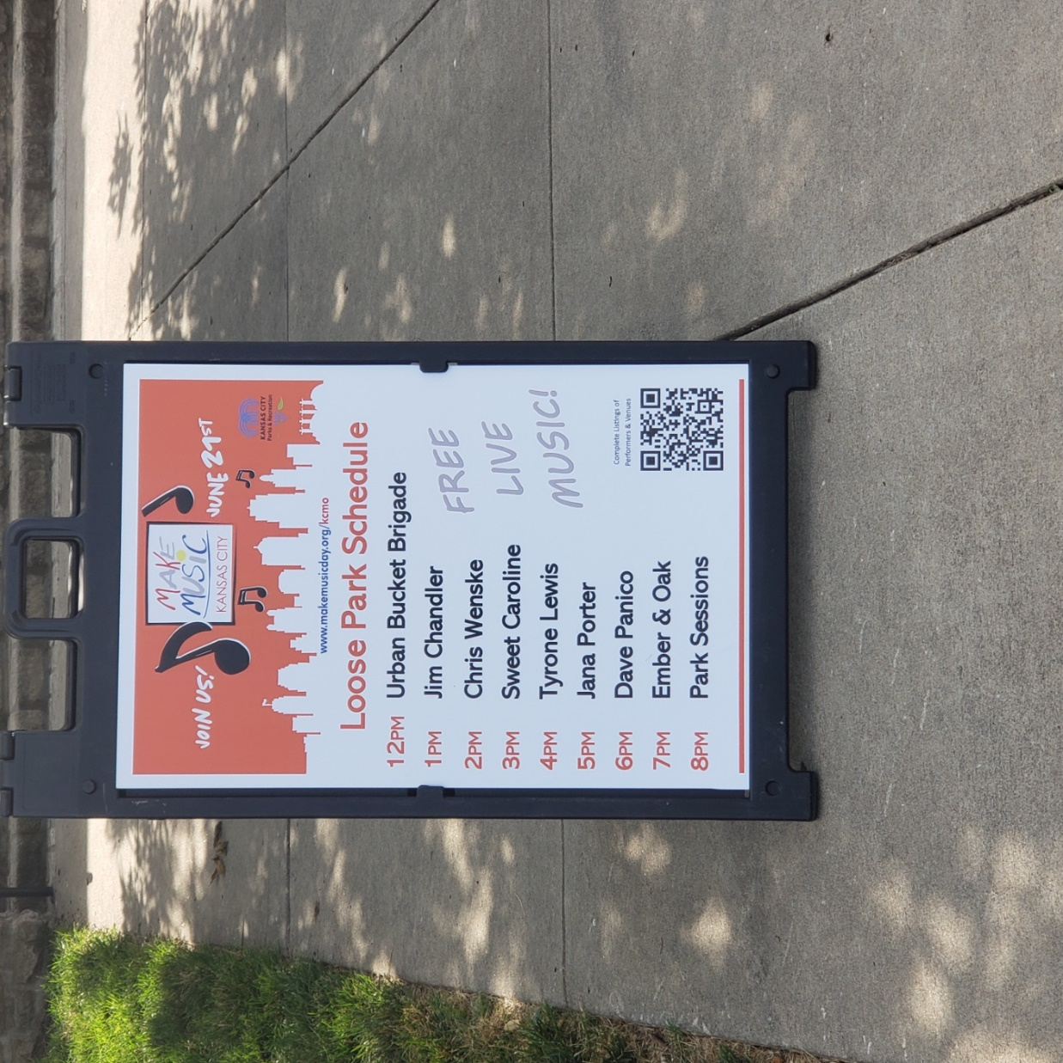

Slide 13
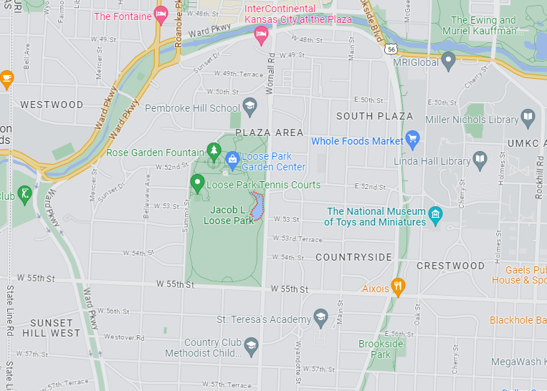
Make
Music Festival June 21
Loose Park

Slide 14
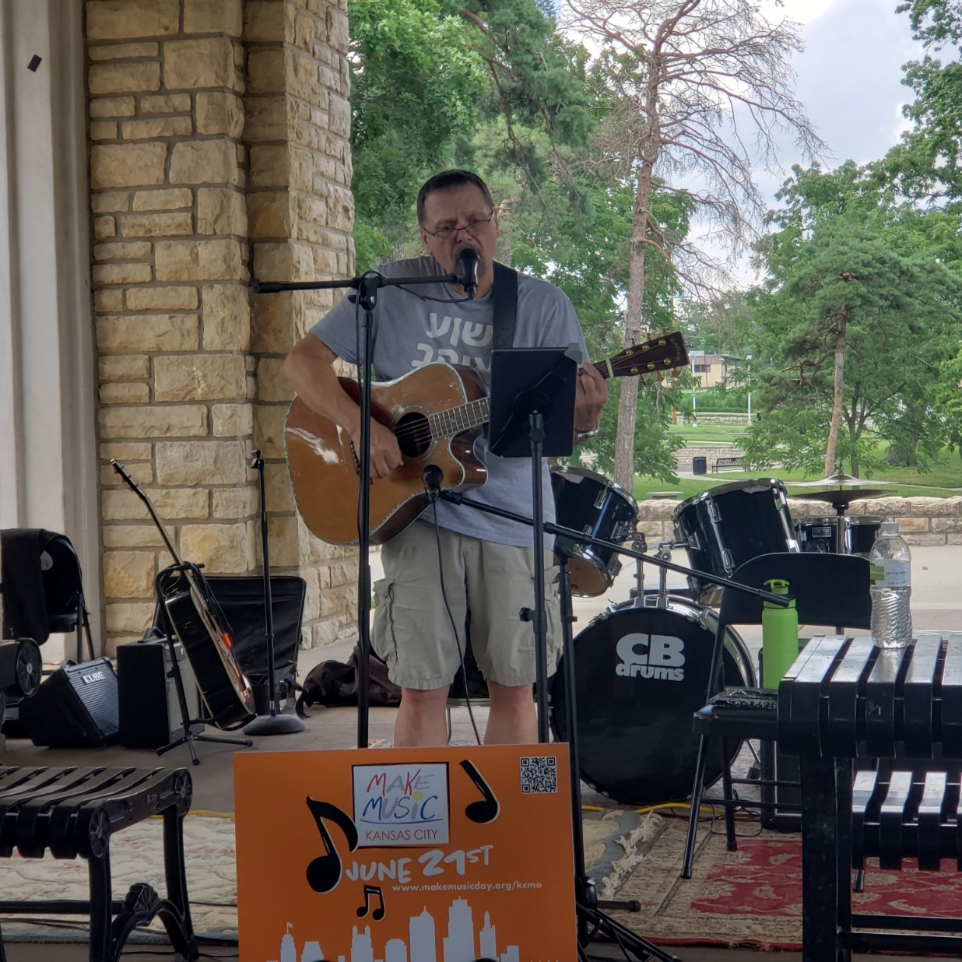
Notes:
Attempting to harvest. Sowing seed.

Slide 15
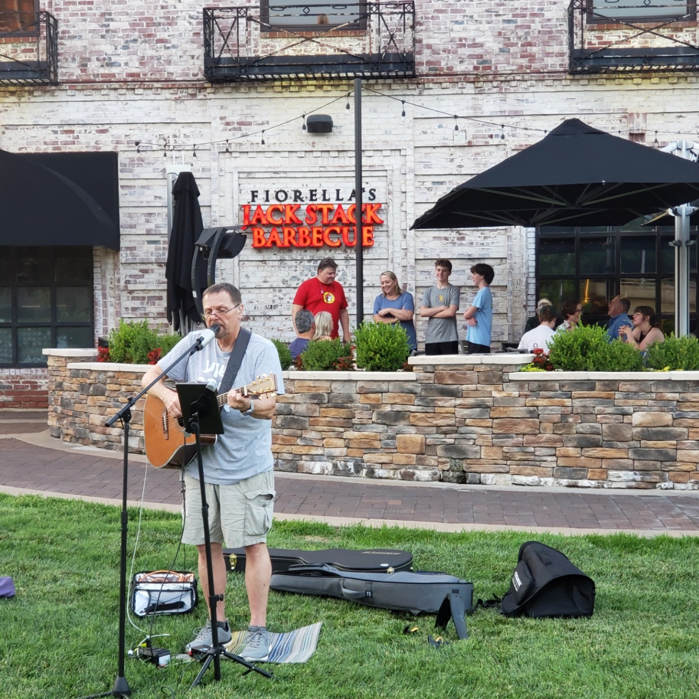
Later at 7:30 p.m.
Notes:
Attempting to harvest. Sowing seed.
Touches my heart. Kingdom is NOT in retreat.

Slide 17
Yet Four Months to the Harvest?
What four months?
Improbability of a harvest
Roaring to break the harvest
hindrance

Slide 18
Yet Four Months to the Harvest?
What four months?
Improbability of a harvest
Roaring to break the harvest
hindrance
Notes:
Context of the remark by Yeshua…

Slide 19
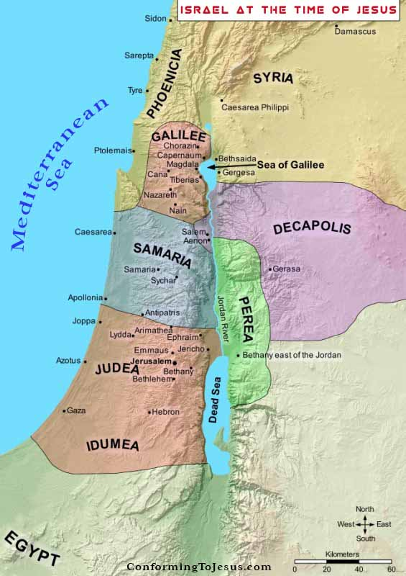
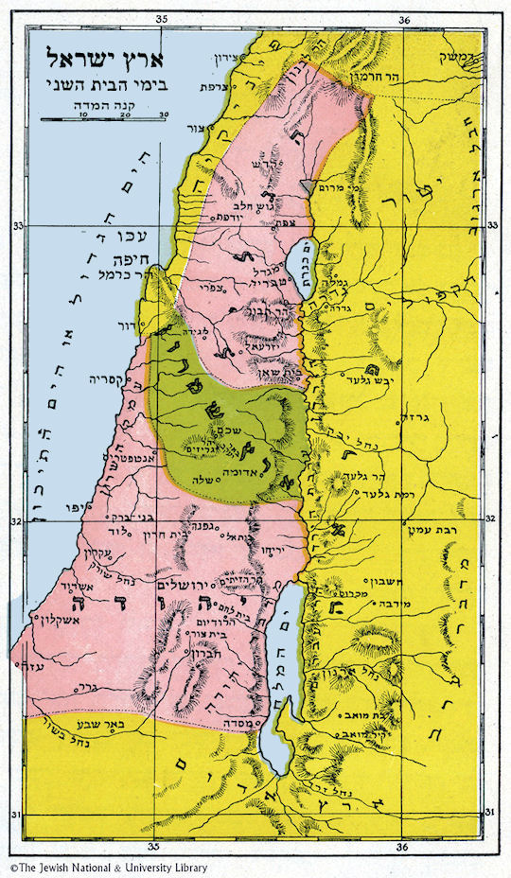
Notes:
Jews from Galil needed to go to Jerusalem 3x per year, and typically walked around Samaria, down Jordan valley, to avoid contact with the heretical people of the Samaritans. Yeshua and company went thru Samaria, and then stopped at Jacob’s well, city of Shomron = Nablus = Sychar. Yeshua sat by the well and visited with a local woman. The talmidim/followers went into the marketplace to get some falafel and hummus.
https://www.globalsecurity.org/military/world/israel/images/map-palestine-6.jpg
https://www.christiantoday.com.au/static/files/2019/02/05/5%20Feb%20-%20photo%20-%20Daniel%20Jang%20-%20israel_in_jesus_time_map.jpg

Slide 20
^{Yn 4.27-34} His talmidim arrived. They were amazed that he was talking with a woman; but none of them said, “What do you want?” or, “Why are you talking with her?” | So the woman left her water-jar, went back to the town and said to the people there,
Notes:
Yeshua followed the high ethical standards of the culture. Separation. This conversation didn’t break those ethics, but still surprising.
Billy Graham never got into a car with a woman other than his wife or sister or other family member.
Don’t go into a room or building alone with a member of the opposite gender.

Slide 21
^{Yn 4.27-34} “Come, see a man who told me everything I’ve ever done. Could it be that this is the Messiah?” They left the town and began coming toward him.

Slide 22
^{Yn 4.27-34} Meanwhile, the talmidim were urging Yeshua, “Rabbi, eat something.” But he answered, “I have food to eat that you don’t know about.” At this, the talmidim asked one another, “Could someone have brought him food?”
Notes:
Yeshua here does a bit of an enigmatic, surprising apparent change of subject, or maybe not.

Slide 23
^{Yn 4.35-38} Yeshua said to them, “My food is to do what the one who sent me wants and to bring his work to completion. Don’t you say, ‘Four more months, and then comes the harvest’?

Slide 24
Four months till Fall Holidays, harvest
Notes:
Other possible interpretations.

Slide 25
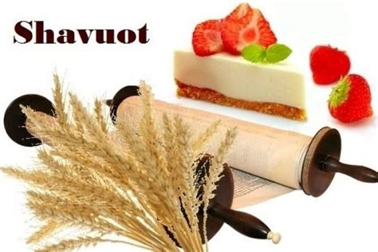
June 11-12, 2024
Notes:
https://external-content.duckduckgo.com/iu/?u=https%3A%2F%2Ftse1.mm.bing.net%2Fth%3Fid%3DOIP.5wrtmcHv2voBjFdAlo7kNQHaE8%26pid%3DApi&f=1&ipt=b7f4f93f34a9983579dfb3eb93368e13dc99b01ab8f3b94f46a1da6fc949994e&ipo=images

Slide 26
Rosh HaShannah, Yom Teruah
October 2-3, 2024
So, no Biblical, Levitical, ch 23 holiday June 12 to Oct 2 [Tisha B’Av]
Notes:
https://external-content.duckduckgo.com/iu/?u=https%3A%2F%2Ftse2.mm.bing.net%2Fth%3Fid%3DOIP.LCq72IkPfIbkYQlW2erx2gHaCy%26pid%3DApi&f=1&ipt=7f42dd97d9503a774f61decdbbe7c7072d517fb3abfad437b526772dfa73702b&ipo=images

Slide 27
Slack time at the beach?
Notes:
Get tanned and buff? Not a bad thing!
Yeshua had another idea for summertime.

Slide 28
^{Yn 4.35-38} Don’t you say, ‘Four more months, and then comes the harvest’? Look, I tell you, lift up your eyes and look at the fields! They are white and ready for harvest. “The reaper receives a reward and gathers fruit for eternal life, so that the sower and reaper may rejoice together.

Slide 29
^{Yn 4.35-38} They are white and ready for harvest. The reaper receives a reward and gathers fruit for eternal life.
Notes:
Colors change when the crop is ripe. Like cattle corn gets all brown before harvest. Dawn and me driving thru Ohio. Corn all brown. Thought major famine and drought.

Slide 30
Summer is supposed to be a joyful harvest time!
“The reaper receives a reward and gathers fruit for eternal life, so that the sower and reaper may rejoice together.

Slide 32
Yet Four Months to the Harvest?
What four months?
Improbability of a harvest
Roaring to break the harvest
hindrance

Slide 33
A. Internal improbability of harvest

Slide 34
^{Yn 11.20-25} Among those who went up to worship at the festival were some Greek-speaking Jews. They approached Philip, the one from Beit-Tzaidah in the Galil, with a request. “Sir,” they said, “we would like to see Yeshua.” Philip came and told Andrew; then Andrew and Philip went and told Yeshua.
Notes:
Greek speaking Jews likely wanted knowledge of Messiah, face of Messiah, fellowship of Messiah.
Yeshua had something else in mind for them.

Slide 35
^{Yn 11.20-25} Yeshua gave them this answer: “The time has come for the Son of Man to be glorified. Yes, indeed! I tell you that unless a grain of wheat that falls to the ground dies, it stays just a grain;

Slide 36
^{Yn 11.20-25} but if it dies, it produces a big harvest. He who loves his life loses it, but he who hates his life in this world will keep it safe right on into eternal life!

Slide 37
^{Phil 3.10-11} Yes, I gave it all up in order to know him, that is, to know the power of his resurrection and the fellowship of his sufferings as I am being conformed to his death, so that somehow I might arrive at being resurrected from the dead.

Slide 38
Fruitfulness by death to self.
Notes:
Jon Cahn p 267
Maybe these Jewish visitors from Greece were looking for a spiritual delight in the presence of the Messiah.

Slide 39
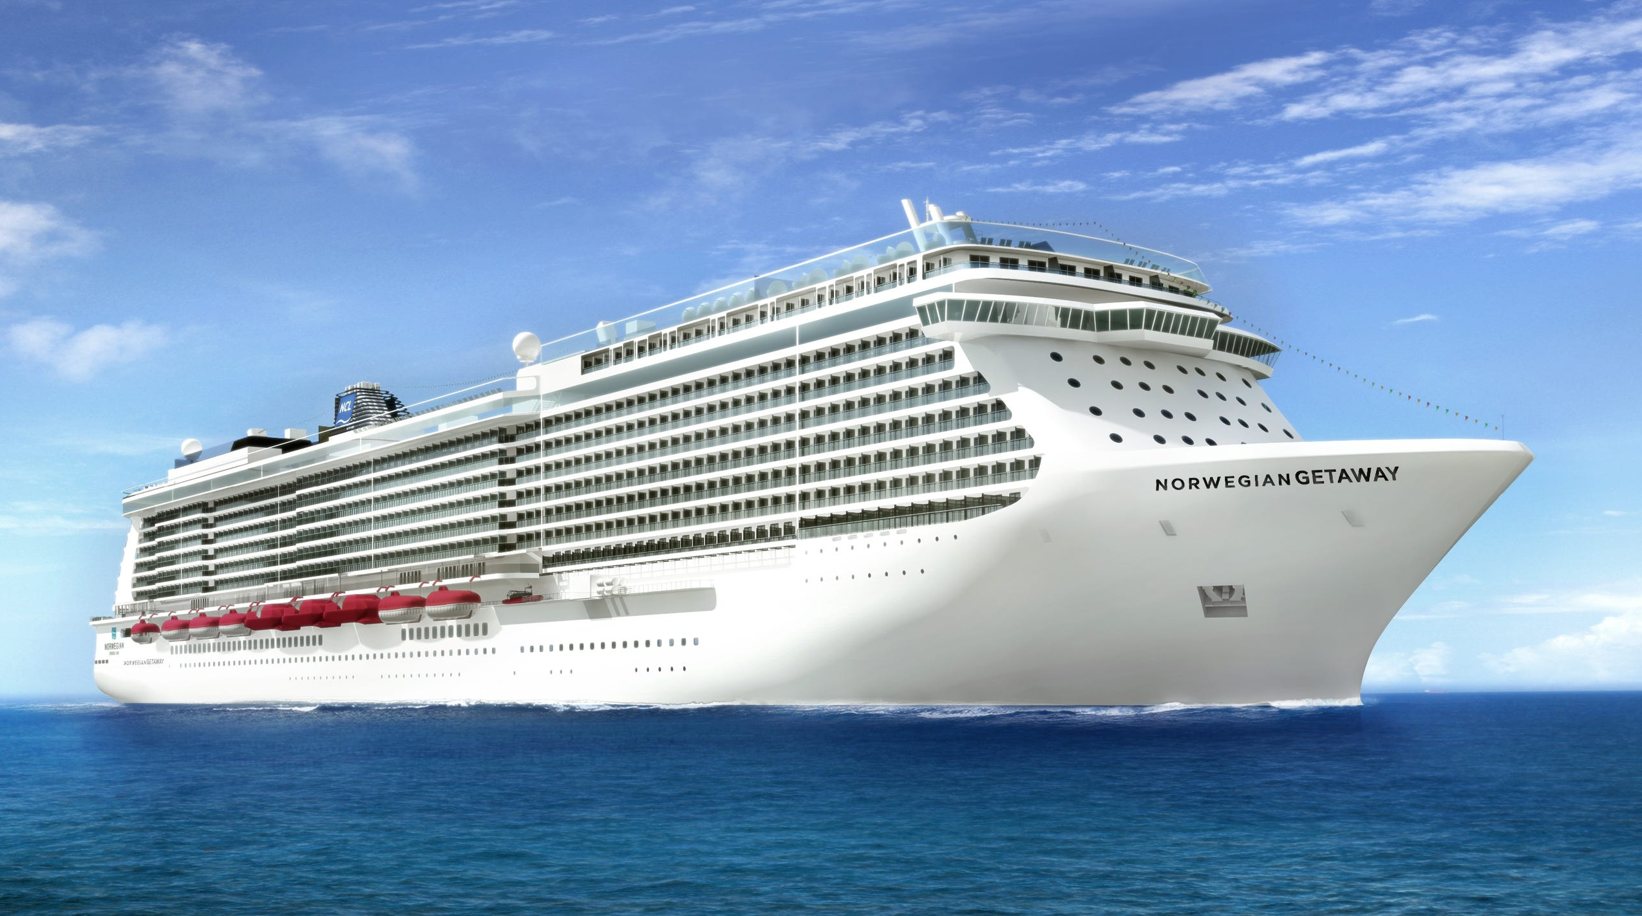
Notes:
A spiritual cruise ship.

Slide 40
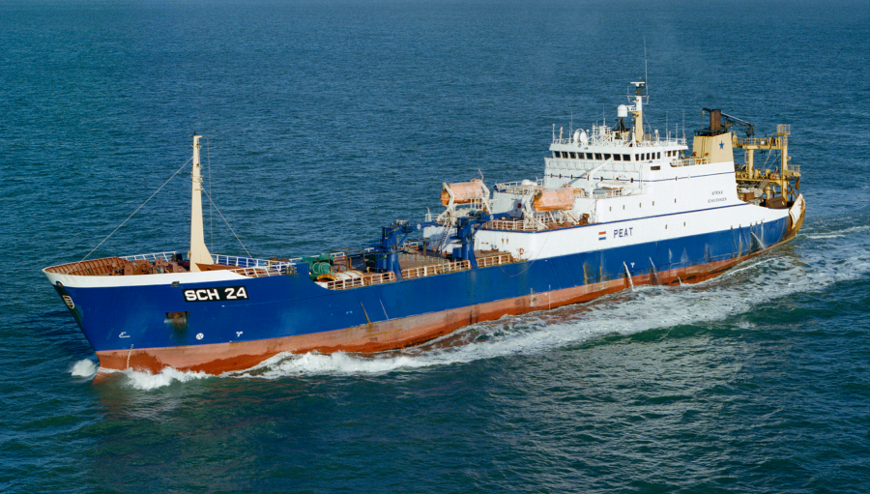
Willem van der Zwan supertrawler
Notes:
https://pembrokeshire-herald.com/56743/giant-factory-ships-emptying-the-fishing-grounds-off-milford-haven/
Yeshua had in mind more of a fishing ship, or possibly…

Slide 41
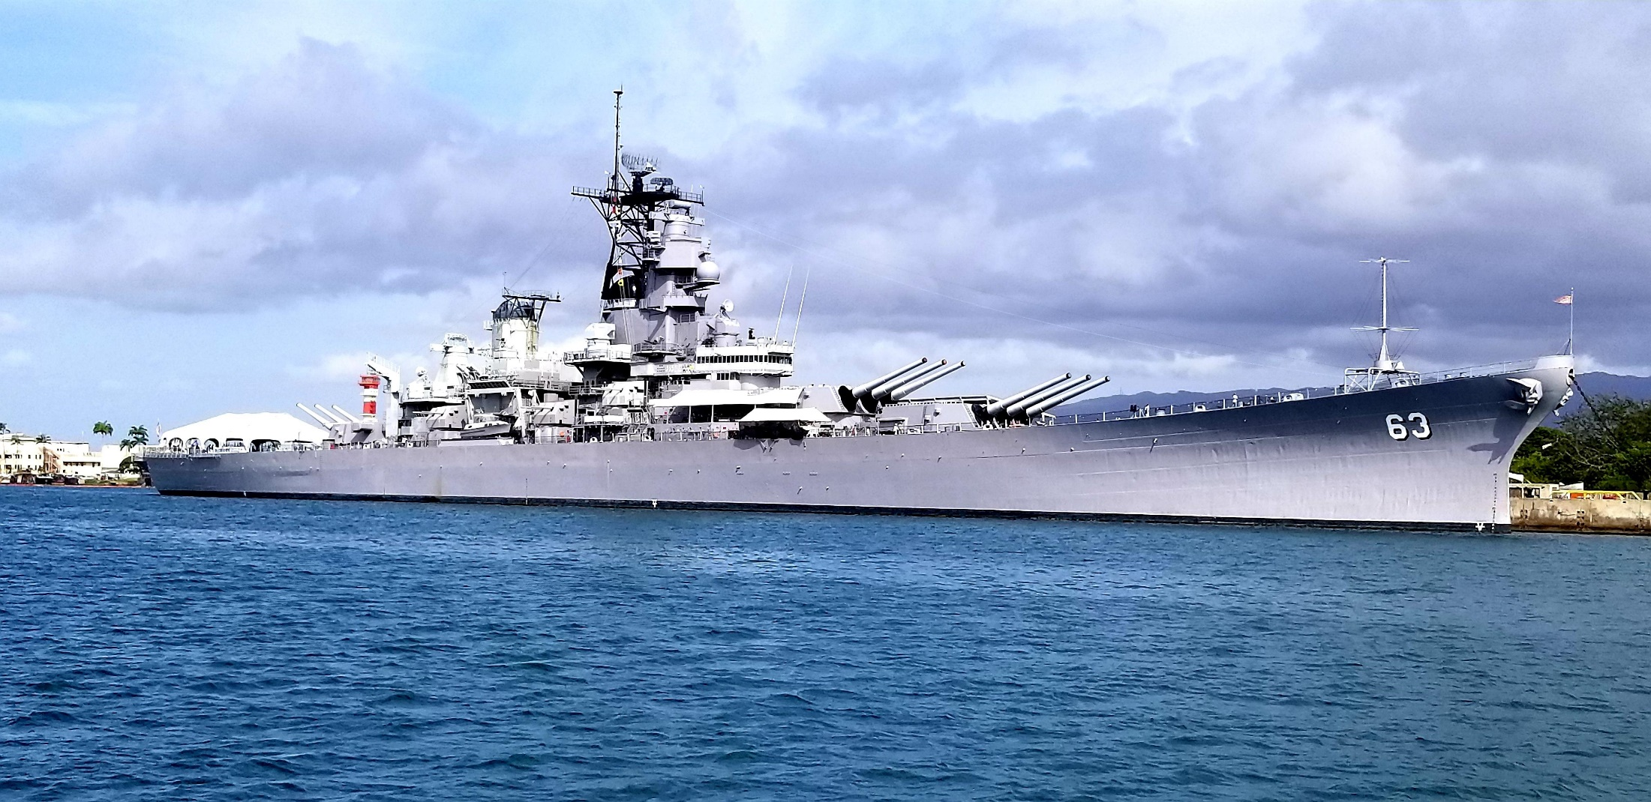
The USS Missouri was the most
dangerous battleship Ever built
Notes:
https://external-content.duckduckgo.com/iu/?u=https%3A%2F%2Fi.redd.it%2F61x21n2gi5a11.jpg&f=1&nofb=1&ipt=d403dee45813b22e7d18ab93024e7000f7eaf7e8048642b68b48c6c574bf525b&ipo=images
A battleship. We are at war.

Slide 42
^{Yn 15.1-2} “I am the real vine, and my Father is the gardener. Every branch which is part of me but fails to bear fruit, he cuts off; and every branch that does bear fruit, he prunes, so that it may bear more fruit.

Slide 43
Pruning?
Longsuffering love

Slide 44
Pruning?
Longsuffering love
Conflict resolution

Slide 45
Pruning?
Longsuffering love
Conflict resolution
Service

Slide 46
Pruning?
Longsuffering love
Conflict resolution
Service
Tithing firstfruits

Slide 47
Pruning?
Longsuffering love
Conflict resolution
Service
Tithing firstfruits
Outreach

Slide 49
Notes:
We have five

Slide 50
B. Recruitment improbability of harvest

Slide 51
^{Lk 10.2-3} He said to them, “To be sure, there is a large harvest. But there are few workers. Therefore, plead with the Lord of the Harvest that he speed workers out to gather in his harvest. Get going now, but pay attention! I am sending you out like lambs among wolves.
Notes:
Every department is a department of Outreach.

Slide 52
C. External improbability of harvest among Jewish people and the Nations harvest.

Slide 53
Jews and those that align with them are deeply hated:
Keeping in mind that Israel did not mount a major military offensive into Gaza for three weeks after the October 7 invasion, how is it that by October 8, Harvard University student organizations had already published their manifesto
Notes:
https://allisrael.com/blog/why-do-some-people-say-hamas-is-winning?

Slide 54
favoring the Palestinians and blaming Israel for the invasion, to be followed quickly thereafter by organizations on other major US universities?
Notes:
https://allisrael.com/blog/why-do-some-people-say-hamas-is-winning?

Slide 55
The volcano of anti-Semitism that has been lying dormant ever since the Holocaust in the West has now erupted, spewing its lava throughout the world. Though not exclusively the purview of Muslims, clearly the large amount of Islamic immigration to Europe and the West has served as a detonator for this explosion.
Notes:
https://allisrael.com/blog/why-do-some-people-say-hamas-is-winning?
We are in a bubble in Overland Park, for now.

Slide 56
Our nation is in or near financial ruin and unsustainability:

Slide 57
The U.S. Congressional Budget Office released new estimates this week that the federal deficit this year will be nearly $2 trillion, more than double the deficits just five years ago. “Over the past eight months of the fiscal year,
Notes:
https://www.worthynews.com/96304-shocking-federal-deficit-grows-by-27-percent-in-four-months

Slide 58
we’ve spent more on interest payments on the debt than we have on national defense. “We are already spending more on interest than we do on all federal spending for children, and we will see interest grow larger than Medicare spending this year.”
Notes:
https://www.worthynews.com/96304-shocking-federal-deficit-grows-by-27-percent-in-four-months
We are in a bubble in Overland Park, for now.

Slide 59
So many major spiritual leaders have failed morally, ethically. Does your heart ache for the honor of Yeshua and the kingdom?
That is why ethical considerations are SO important.

Slide 60
There is a culture of death.
Stonehenge defaced by “Activists” who hate civilization.

Slide 62
Yet Four Months to the Harvest?
What four months?
Improbability of a harvest
Roaring to break the harvest
hindrance

Slide 63
Where did that phrase
“Roar from Zion”
come from?

Slide 64
^{Amos 1.2} יְיָ מִצִּיּוֹן יִשְׁאָג, וּמִירוּשָׁלִַם יִתֵּן קוֹלוֹ
יְיָ מִצִּיּוֹן יִשְׁאָג, וּמִירוּשָׁלִַם יִתֵּן קוֹלוֹ ^{Yoel 4.16}
Adoni will roar from Tziyon, he will thunder from Yerushalayim
Notes:
Two places, and a slight variant in Hoshea, then a variant in Revelation

Slide 65
^{Yoel 4.1-2} They divided up My land.
^{Yoel 4. 14-18} Adoni will roar from Tziyon, he will thunder from Yerushalayim, the sky and the earth will shake.

Slide 66
^{Amos 1.2} Adoni is roaring from Tziyon, thundering from Yerushalayim…“For Dammesek’s three crimes, no, four — I will not reverse it.
Damascus, Azah עזה Gaza, Tzor/Tyre, Edom, Amon, Moav, Yehuda, Israel.

Slide 67
^{Hoshea 11.8-9} Efrayim, how can I give you up, or surrender you, Isra’el? How could I treat you like Admah or make you like Tzvoyim? My heart recoils at the idea, as compassion warms within me.
Notes:
Israel's own failures. Some say that reaching the Jewish people is impossible.

Slide 68
^{Hoshea 11.8-9} I will not give vent to the fierceness of my rage, I will not return to destroy Efrayim; for I am God, not a human being, the Holy One among you; so I will not come in fury.

Slide 69
^{Hoshea 11.10} They will walk after Adoni. He will roar like a lion.
Indeed, He will roar and the children will come trembling from the west.

Slide 70
How many remember Communism?
I lived daily with the threat of atomic war with the USSR
Fallout shelters
Viet Nam, Korea, Cuba
Space race
Olympics, Refusniks
Red October
“We will bury you,” Khrushchev

Slide 71
How many remember
"Perestroika" (restructuring) and "glasnost" (openness) were Mikhail Gorbachev's watchwords for the renovation of the Soviet body politic and society that he pursued as general secretary of the Communist Party from 1985 until 1991.
June 12, 1987 “Mr. Gorbachev tear down this wall!”
Notes:
We didn’t believe it. Until Jews started leaving former USSR

Slide 72
We didn’t expect these revolutions.
We didn’t expect the fall of communism.
We didn’t expect the liberation of Jerusalem 1967, and the Sinai, and the Golan, and Judea/Samaria.
You will probably be surprised by what happens.

Slide 73
Muslim convert urges congregations to evangelize their local Islamic communities
Notes:
https://metrovoicenews.com/muslim-convert-urges-churches-to-evangelize-their-local-islamic-communities/

Slide 74
“We take our personal discipleship and personal growth very seriously, but we are also commissioned to go make disciples of all the nations, and in that, we are called not just to study but to go,” Osman Jama says.

Slide 76
The remedy lies, I think, in the Israelis understanding their own mistake and adopting a new policy: not one of conciliation, appeasement, enrichment, placation, but of determining to cause the Palestinians to understand that they are weak and they are defeated.

Slide 77
In this case, that center of gravity lies not in the leadership, the militia, the economy, the land, or in religious sanctities, but in hope: the hope to destroy Israel and replace it with Palestine. Accordingly, Israel's goal must be to extinguish that hope and replace it with hopelessness

Slide 78
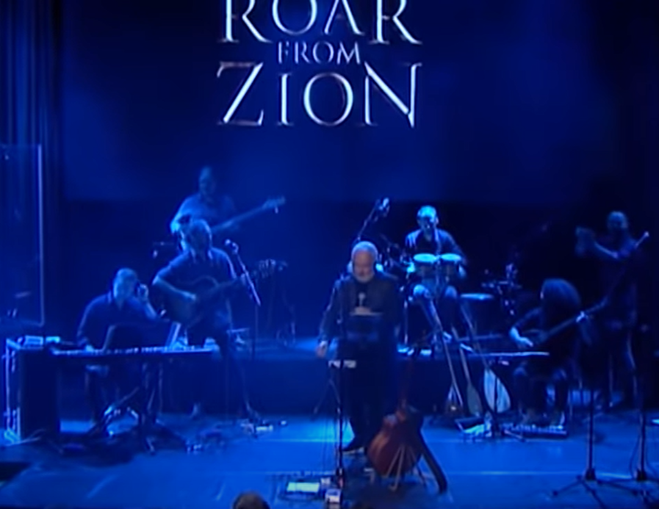
Notes:
https://youtu.be/SMjubP0nrG0 3.42 to the end

Slide 79
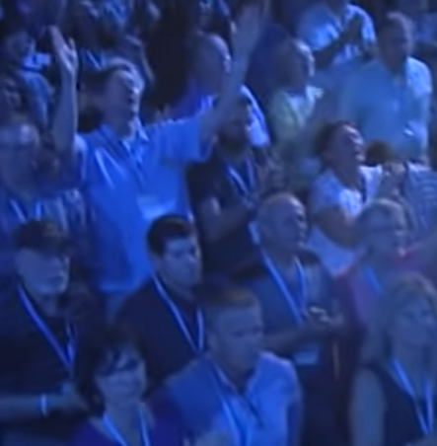
Eric and Joy Poling at 3:55 on the Roar from Zion live recording at King of Kings Auditorium

Slide 80
Roar from Zion One Nation One King People of God. From the East from The West To worship Your Holiness
Rejoice all you nations! Hear me oh Israel !
Yeshua has triumphed, His kingdom is over all. Prisoners of Hope, Be now restored he Lion of Judah, Is raising His sword! Shout!!!
Notes:
Derek Prince: Yeshua is, not was the Lion of the Tribe of Judah, and soon that Lion will roar.
https://www.azchristianlyrics.com/paul-wilbur/roar-from-zion/

Slide 81
Roar from Zion Mashiach Yeshua
Lion of Judah Roar from Zion The sound of Your Voice, Thunders from Jerusalem
The King is among us, The Shepard of righteousness. He’s gathered his people, called them to holiness
His presence returned, the veil has been torn, The glory departed has now been restored!
Notes:
https://www.azchristianlyrics.com/paul-wilbur/roar-from-zion/

Slide 82
Roar from Zion One Nation One King, People of God (sing) Roar from Zion From the East from The West , To worship Your Holiness. Roar from Zion Mashiach Yeshua
Lion of Judah Roar from ZionThe sound of Your Voice, Thunders from Jerusalem
Bridge:
Baruch Haba, B’shem Adonai
Blessed is He who comes in the Name of the Lord!
Notes:
https://www.azchristianlyrics.com/paul-wilbur/roar-from-zion/

Slide 83
Just remember we are a Kingdom of Priests. All of not just a team of Intercessors.
The situation is urgent. We are in a desperate position. Yet the weapons to defeat the enemy are in our hands.

