Slide 1
e-handout
To have these notes
without taking notes
Go to OrHaOlam.com
Click on Messages tab,
2024 Messages

Slide 2
The IDF rescued four Israeli hostages from Gaza on Saturday, extricating them from Hamas terrorists and evacuating them to the Tel Hashomer hospital in southern Israel. The four were named as Noa Argamani, 26; Shlomi Ziv, 40; Almog Meir Jan, 21; and Andrey Kozlov, 27.
Notes:
About 200 terrorists guarded the abductees. At the beginning of the operation, about 50 ran away. 55 were killed and the rest neutralized with various injuries. While the terrorists were busy fighting, another force emerged from another place and kidnapped the abductees.
Noa Argamani to Netanyahu: I haven't spoken Hebrew in a long time

Slide 3
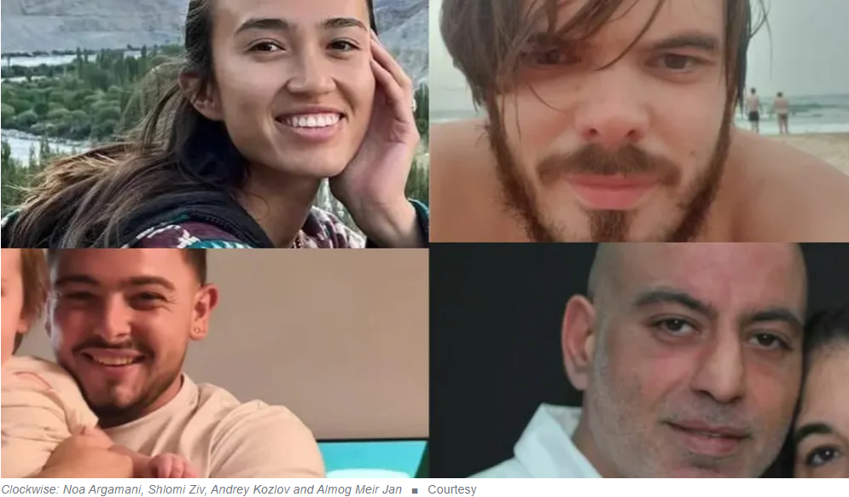

Slide 4
Class 10 a.m., June 2, 2024
Notes:
Sunday morning, 15 of us had a
קרב מגע Krav Maga Israeli self defense lesson.

Slide 5
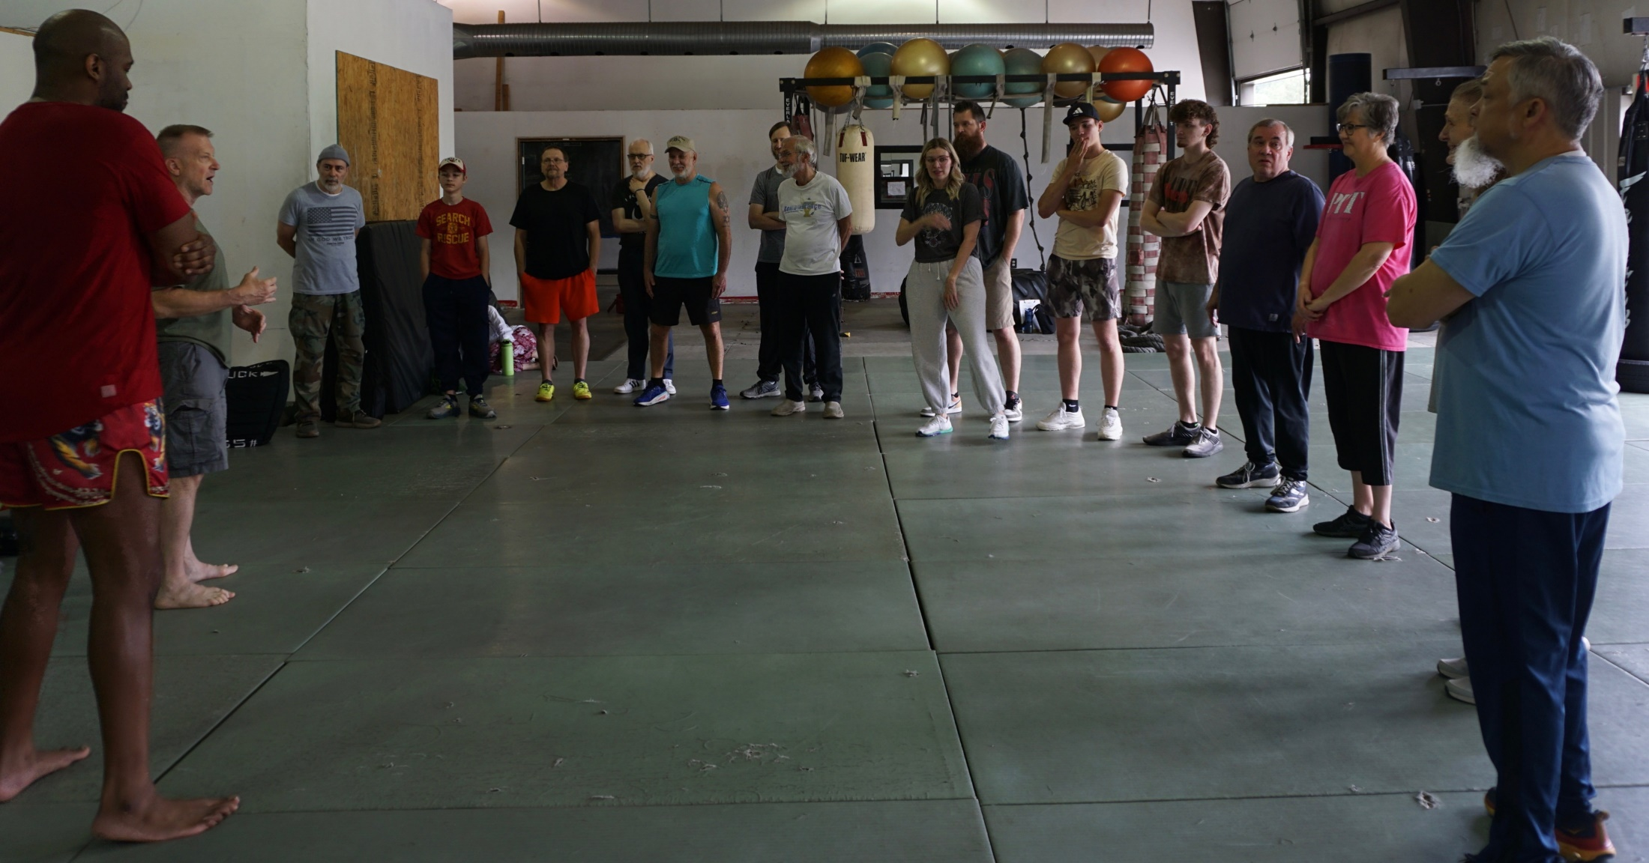
Class 10 a.m., June 2, 2024

Slide 6
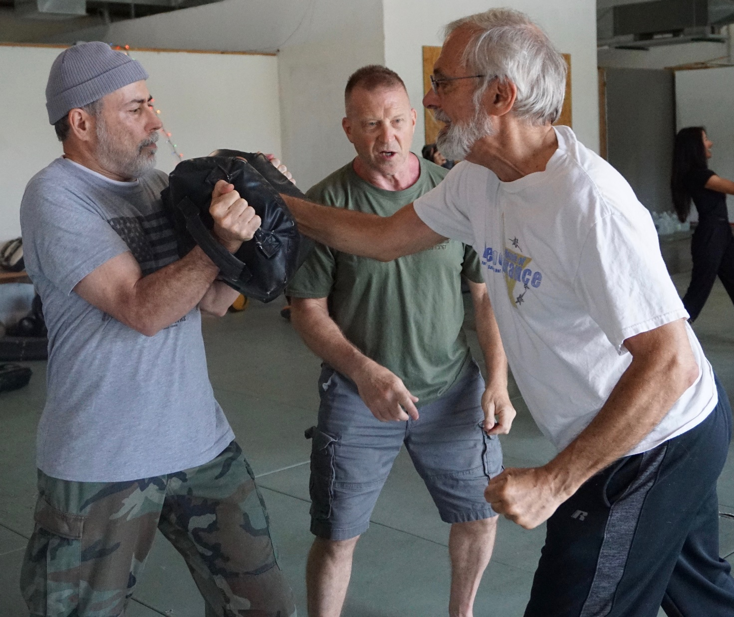

Slide 7
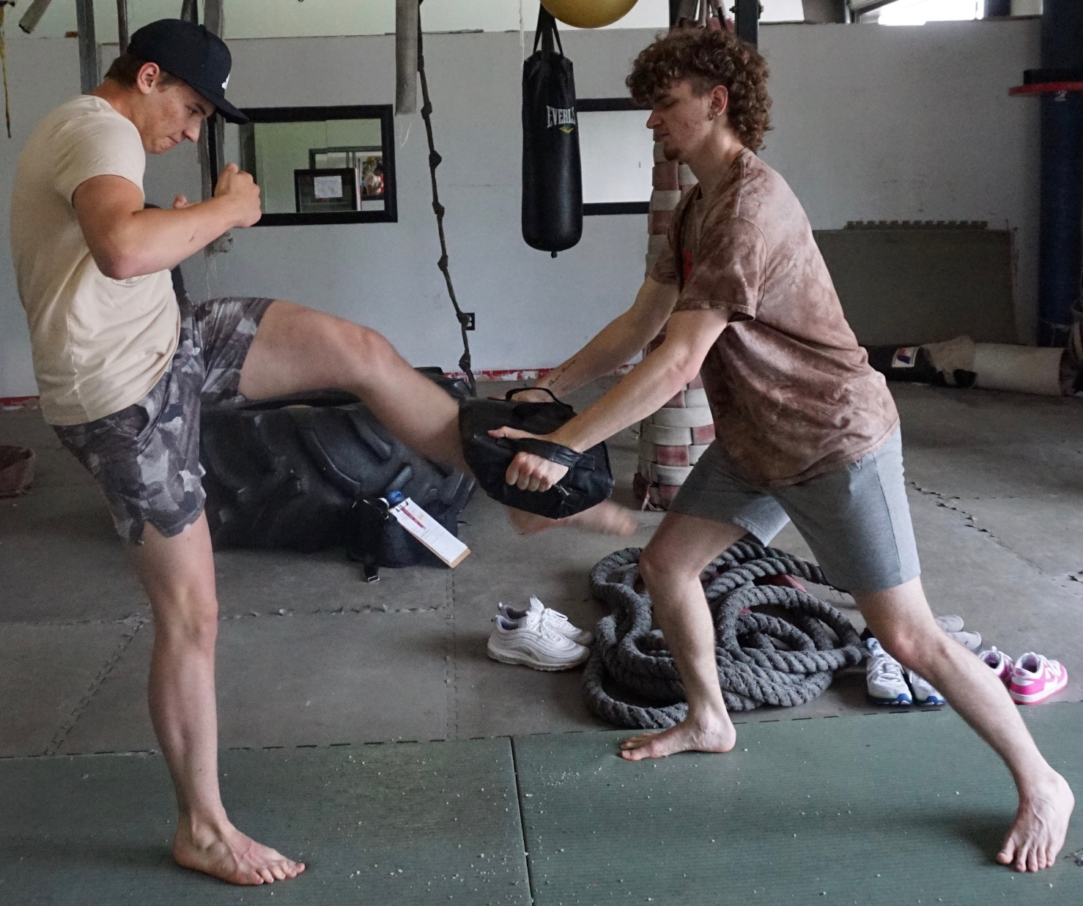

Slide 8
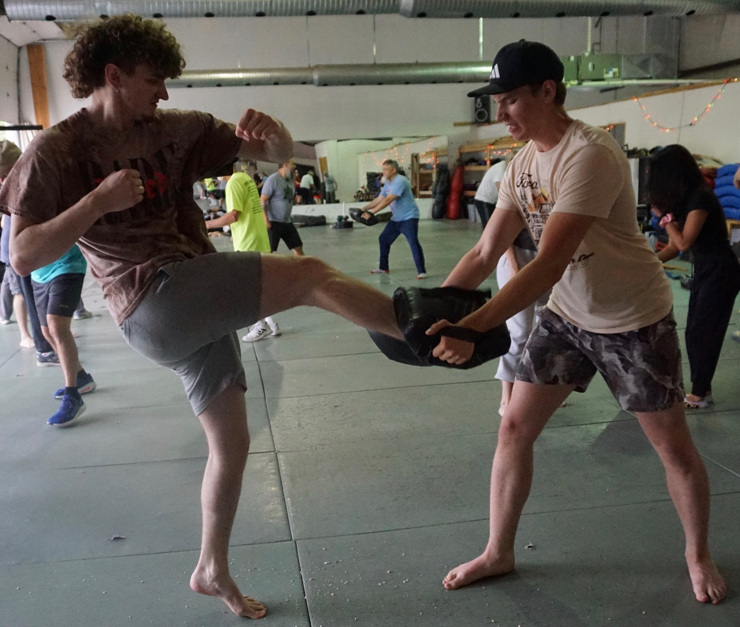

Slide 9
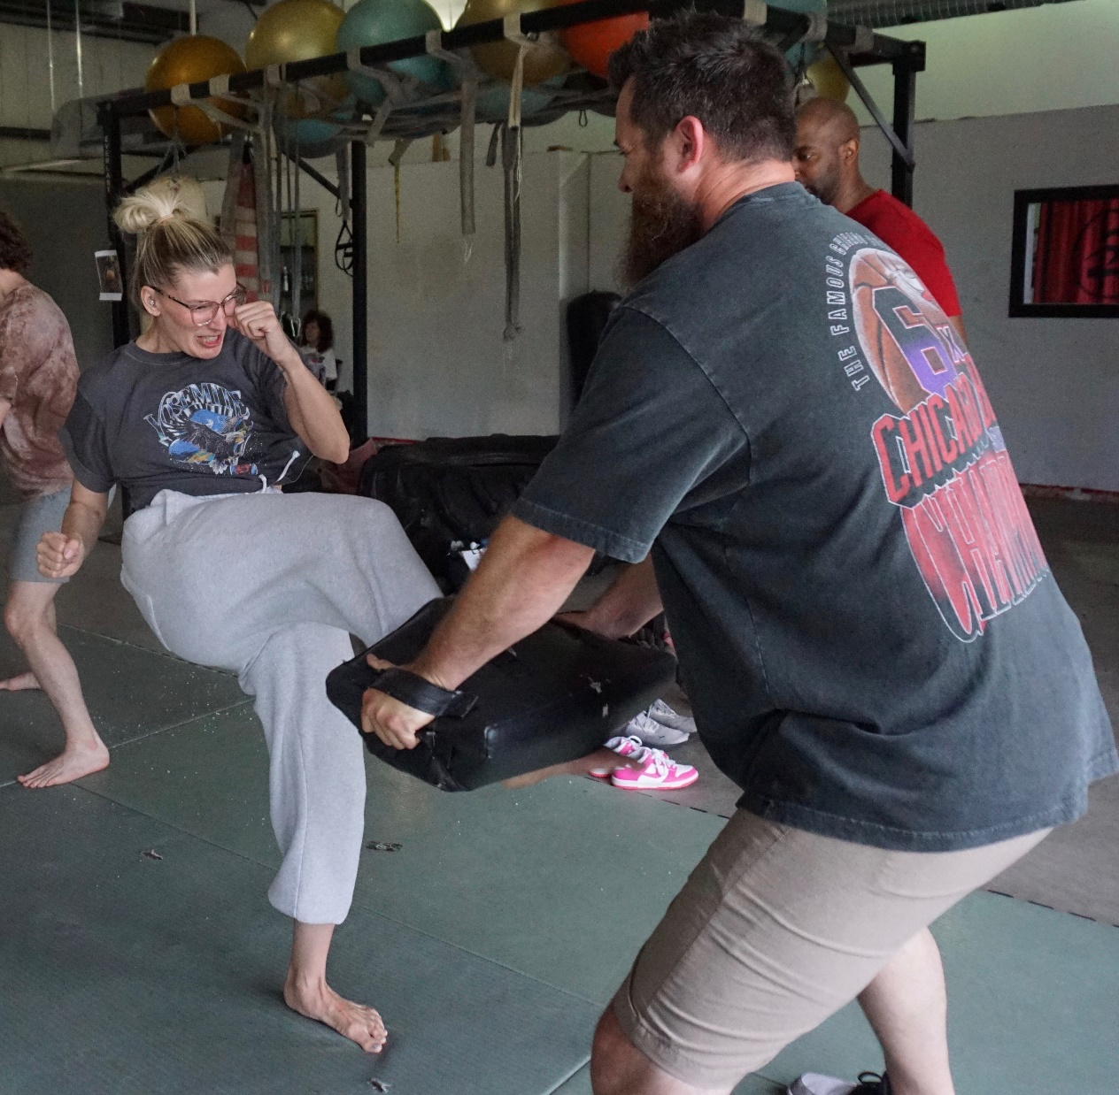

Slide 12
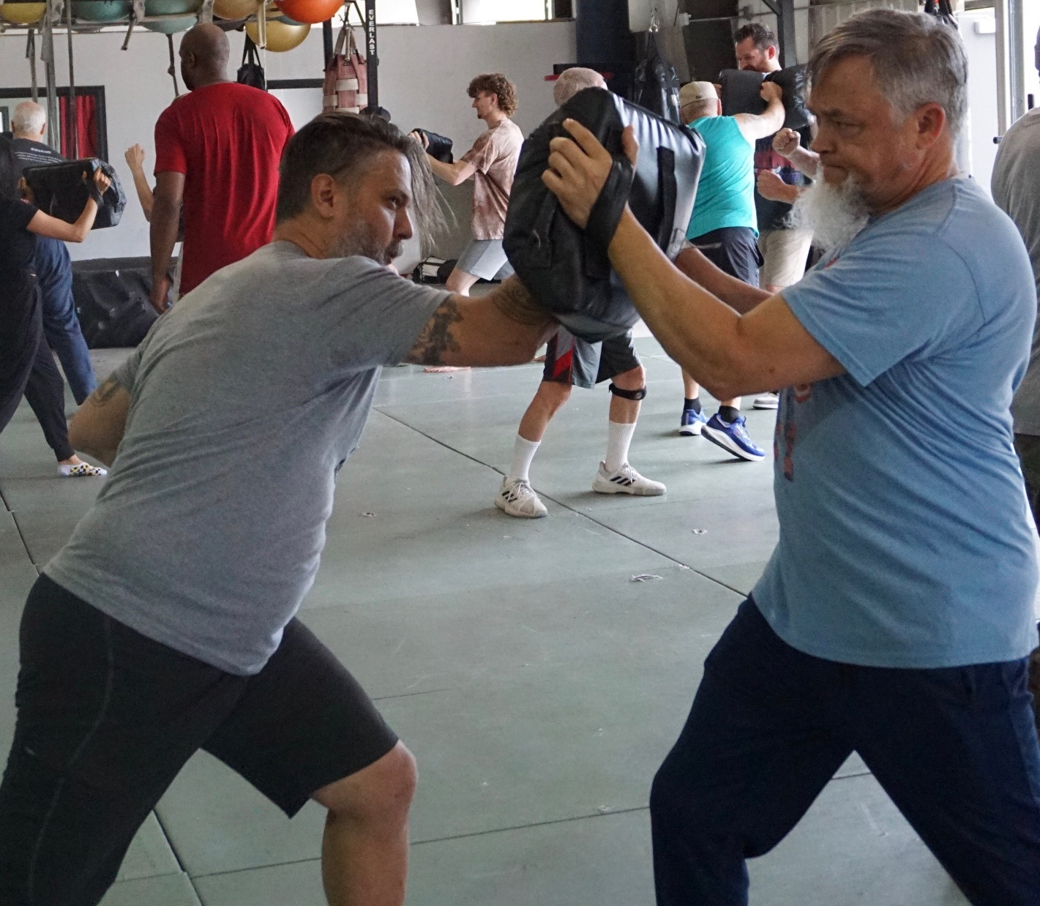
Notes:
Concerning fighting, June 6 was the 80th Commemoration of D-Day. Bless all the veterans.

Slide 13
A man goes into a psychologist and says “Doc I think I'm going crazy! Sometimes I think I'm a teepee and sometimes I think I'm a wigwam.”

Slide 14
The doctor says “Relax, You're too tents. That’s all!”
Notes:
From Amy Stewart

Slide 16
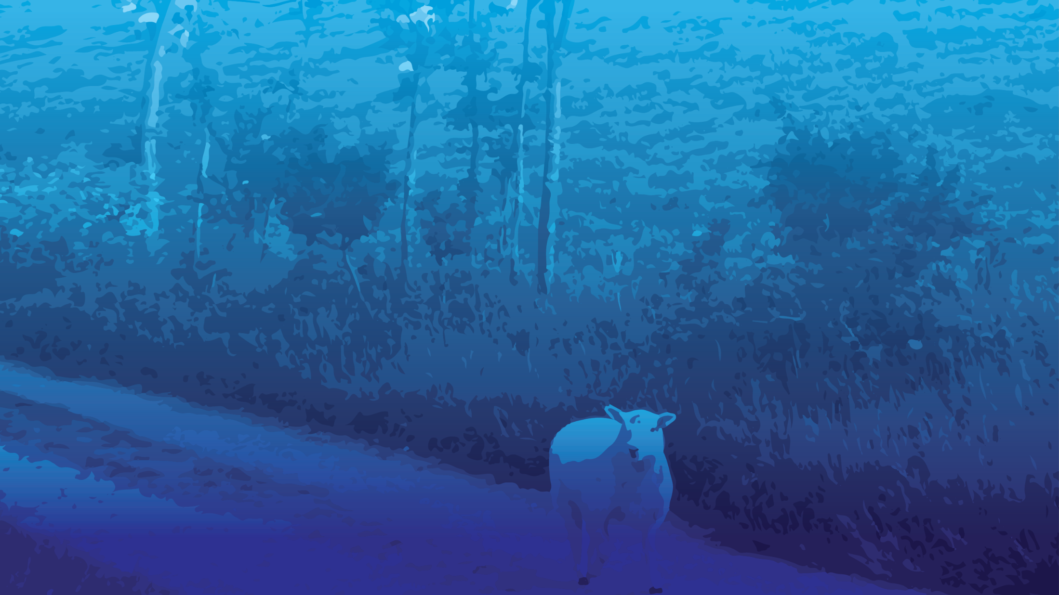
G-d of Avraham, Yitskhak, Yaakov
and the Errant, Part 2
The model
The errant ones misdirected
The resources for mitigation

Slide 17
G-d of Avraham, Yitskhak, Yaakov
and the Errant, Part 2
The model
The errant ones misdirected
The resources for mitigation

Slide 18
Blessed be ADONI our G-d
and the G-d of our forefathers
The G-d of Avraham
The G-d of Yits-khak
and the G-d of Ya-a-kov

Slide 19
בָּרוּךְ אַתָּה יְיָ
[בָּרוּךְ הוּא וּבָּרוּךְ שְּׁמוֹ]
Ba-rukh a-tah Ah-do-ni
[Ba-rukh hu u-ba-rukh sh'mo]

Slide 20
אֱלהֵינוּ וֵאלהֵי אֲבוֹתֵינוּ
E-lo-hay-nu
vay-lo-hay avo-tay-nu
אֱלהֵי אַבְרָהָם אֱלהֵי יִצְחָק
וֵאלהֵי יַעֲקב
Eh-lo-hay Av-rah-am
Eh-lo-hay Yits-khak
Vay-lo-hay Ya-a-kov

Slide 21
וְשִׁנַּנְתָּם לְבָנֶיךָ
V’shee-nahn-tahm l’va-neh-kha

Slide 22
You shall teach them
diligently to your children
Notes:
We have many adult and teenage children who are radiantly walking in the legacy of their parents.

Slide 23
Last Shabbat, a wonderful report from Zurieli Rojas:
North Carolina internship testimony with Elevation

Slide 25
G-d of Avraham, Yitskhak, Yaakov
and the Errant, Part 2
The model
The errant ones misdirected
The resources for mitigation

Slide 26
Errancy in either direction

Slide 27
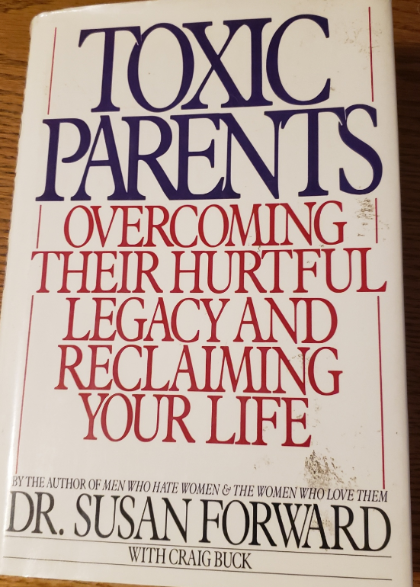

Slide 28
For people who are unable to discuss conflicts with their parents, resolution rarely happens. In this case, you need to be prepared to live with non-closure.

Slide 29
From the Adult Child’s perspective:
When and how to go “no contact” with your toxic parents is not a one-size-fits-all remedy to dealing with parental conflict, and it certainly doesn’t guarantee a resolution. However, there are times when estrangement is the only tool you have left to protect yourself, your spouse, and your children from harm or dysfunction.
Notes:
https://www.happierhuman.com/no-contact-parents/

Slide 30
On the other hand

Slide 31
Yvonne B., a 61-year-old health care provider from California, has had almost no contact with her 34-year-old daughter for over a year. “She began distancing maybe 2 years ago. Then she texted, saying her therapist advised her not to be in touch,” Yvonne said. “She called me ‘manipulative,’ and ‘narcissistic,’ and said she needed to ‘set boundaries.’”
Notes:
https://www.webmd.com/parenting/news/20230620/dealing-with-adult-child-estrangement

Slide 32
Kevin H., a computer technician from New York, hasn’t spoken to or heard from his younger son for 15 years. “Fortunately, I have a good relationship with my older son,” he said. “I’ll admit I’m not the most emotionally expressive person on the planet, but I haven’t done anything to deserve this. I think my ex-wife turned him against me.”
Notes:
https://www.webmd.com/parenting/news/20230620/dealing-with-adult-child-estrangement

Slide 33
“For centuries, society’s values included ‘respect your elders’ and ‘honor thy father and mother,’ and there were notions of loyalty and family ties. But today’s values focus more on identity, personal growth, individual happiness, and self-esteem,” Coleman said. Anyone perceived as standing in the way — including a parent — can be jettisoned.
Notes:
https://www.webmd.com/parenting/news/20230620/dealing-with-adult-child-estrangement

Slide 34
Reasons for Estrangement
Divorce: hostility, picking sides
Opposing religious or political views
A son- or daughter-in-law
Addiction and mental illness
Notes:
https://www.webmd.com/parenting/news/20230620/dealing-with-adult-child-estrangement

Slide 35
Therapists: Therapists typically explore their clients’ childhood memories to see how they might have contributed to present-day difficulties. A misguided therapist may “inadvertently encourage a victimized stance in relation to the parent, as opposed to a stance that sees the parent in a more three-dimensional way.”
Notes:
https://www.webmd.com/parenting/news/20230620/dealing-with-adult-child-estrangement

Slide 36
And some therapists use diagnostic terms, like “narcissist” or “borderline,” to describe parents they’ve never met. Mental health is regarded as a process of setting boundaries rather than finding compassion toward a parent’s human imperfections.
Notes:
https://www.webmd.com/parenting/news/20230620/dealing-with-adult-child-estrangement
These terms are real descriptors, but can be overused.

Slide 37
In my studies of the lives of older Americans, I learned that almost nothing is as painful to them as estrangement from an adult child. When we reach the later years, our dream is to be surrounded by loving children and grandchildren.
Notes:
https://www.huffpost.com/entry/parents-estranged-children_b_7297294
Risa S. Breckman, LCSW, Therapist and Director of NYC Elder Abuse Center

Slide 38
For some older people, however, a negative relationship with one of their offspring - or even worse, complete separation from him or her - is profoundly difficult.
Notes:
https://www.huffpost.com/entry/parents-estranged-children_b_7297294
Risa S. Breckman, LCSW, Therapist and Director of NYC Elder Abuse Center

Slide 39
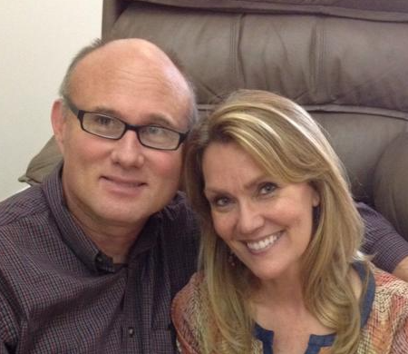
Barry & Cynthia Morehead
Notes:
Barry attends, from St. Joseph, from time to time, since about 2010. Came with me on the Israel trip when my son Ben was on. He and Cynthia have brought their children up in home school or Christian school. Best nurture in the L-rd they could. We’ve had lunch together from time to time. I eat lunch for a living.

Slide 40
In 2012 we lost our oldest son to estrangement. He married a woman who by the looks of things seemed to be a good match. A believer well educated, attractive, athletic, from a solid family. All things true of him as well. They had much in common. However, she wanted him to herself and wanted nothing to do with our family.

Slide 41
The first thing she did after they returned from their honeymoon was to cut off all communication between him and the entire extended family and then begin the process of turning him against us. Six years later our son’s high school and college friends began contacting us.

Slide 42
Apparently, she had not only cut off our family but also anyone who knew him prior to her entering his life. My grief was great those first three years. A sister in Messiah recommended a book to aid in my healing.
Notes:
We had dinner with Barry and Cynthia a few weeks ago, and the memory of her grief and trauma was palpable.

Slide 43
It’s called “In Sheep’s Clothing” subtitle “How to identify and deal with manipulative personalities”. It is not a faith based book. It is written by a psychologist regarding what he’s learned through the patients in his practice. I was to the acceptance stage of grief before reading the book, but the truths I discovered in this information gave me emotional freedom which was a deeper level of healing.

Slide 44
In April of 2021 our youngest daughter ghosted us. We had no idea why. She and her husband had only been married a few years and we didn’t know if maybe they needed some space to work through something. We can respect privacy as long as we know our daughter is okay. But in September of that year at a family wedding we were both attending it was clear that was not the case.
Notes:
Ghosted, new to me term, vanish like a ghost. No response to text, phone, email.

Slide 45
They would not come near us. After the reception they met us in the parking lot where she read a prepared statement off of her phone. In it she explained that she was going through “something”.

Slide 46
She was getting counseling. Until she gets her feet underneath her she would appreciate if we would respect her boundaries. And while we’re at it maybe we should get some counseling to figure out why none of our kids want to spend time with us (!!!). My husband asked if we had hurt or offended her in some way that we are unaware of.

Slide 47
Was there anything we should apologize for? She kept things vague and gave no answer. I listened, but before she left I hugged her, kissed her, told her that I loved her, and let her know that whenever she is ready I am here. That was the last time I spoke to her.

Slide 48
We had moved our youngest son to Columbia during the pandemic that he may begin his pursuit of his doctorate MU. He was single, lived alone, because of the pandemic he worked remotely and all his classes were being taught online. He would call us five times a week, sometimes alternating, calling his dad one day and me the next.

Slide 49
We were always in touch……until he went camping one time with his sister and her husband. Ever since then he has cut us out of his life as well. He communicated that officially in January of 2022. No explanation other than he is too busy right now to entertain phone calls, texts, or visits from us. That was the last time we heard from him.

Slide 50
We have since learned of a movement or therapy technique which targets gen x and millennials with their message. Their message is spread through counselors and through the psychology departments of universities that are training counselors. They have four main objectives:

Slide 51
1) tell their patients/ clients/ students to cut off all communication with their parents and don’t tell them why. That’s called “reclaiming your power”
2) talk a lot about boundaries “I would appreciate it if you would respect my boundaries”

Slide 52
3) gas light your parents. Let them know you have a problem (without saying what it is) and insinuate that they have some responsibility for your problem.
4) convince these young people that they are victims and they need to share their story with others as part of their healing.

Slide 53
Our daughter and son-in-law have spoken to folks in our family and church. Although we have no idea what is being said, some of those people have cut us out of their lives as well. Since then we have met over two dozen lovely believing families whose adult children are doing the same identical thing to them. Some of them go to counseling. Some of them are counselors.

Slide 54
Three of our four children no longer have contact with us but I have joy and I have peace because I know a few things:
1) I know that I am imperfect. I make mistakes and will probably continue to as it’s part of the human condition, however

Slide 55
2) I know that when it came to parenting I did my very best and our children were given a firm foundation from which to launch
3) I know that our children are adults and responsible for the consequences of their own choices

Slide 56
My husband and I are at a season of life where we don’t have time to waste feeling sorry for ourselves or chasing after relationships with people who have communicated clearly that they don’t currently want us in their lives. Although this is not how we pictured our story turning out,

Slide 57
God continues to redeem our story by continuing to bring people of all ages into our lives who want, need, and will accept our love. Our definition of family has changed, but that’s ok because God keeps extending our “family” to include those we might not have known otherwise. It’s not what we pictured, but it’s beautiful.

Slide 58
I continue to pray for our children and hope that one day they will turn back to the Father, but whatever they choose we are going to be fine because we’re moving forward with the one who loves us more than any other.

Slide 59
"Going No Contact". It's literally a scripted plan that they follow. It starts when they judge us as not just humans with whom they disagree, but "evil" because we don't see things their way.

Slide 60
Thanks to the self-esteem movement, any time they were uncomfortable for a moment equals abuse. Anytime they are not happy, they have been wronged, and the person who dared to 'make' them feel bad is a Narcissist.
Notes:
https://www.gransnet.com/forums/estrangement/1235012-The-Brainwashing-Behind-Going-No-Contact?

Slide 61
After justifying to themselves that they are RIGHT and their parents are EVIL NARCISSISTS, they begin plans to "Go No Contact".
Notes:
https://www.gransnet.com/forums/estrangement/1235012-The-Brainwashing-Behind-Going-No-Contact?

Slide 62
Estrangement is the last resort action to protect your well-being. If a resolution is not possible, severing the relationship may be the only choice you have.
Have you exhausted support groups, counseling, and everything else?
Notes:
https://www.happierhuman.com/no-contact-parents/

Slide 63
11 Steps for Going
No Contact with
Your Toxic Parents
Notes:
https://www.happierhuman.com/no-contact-parents/

Slide 64
Contributing factors in the believing world
Escapist theology that says, “We’re going to be out of here any minute!”
Excessive individualism > community and accountability
Notes:
Are you in an accountability relationship with some others?

Slide 66
G-d of Avraham, Yitskhak, Yaakov
and the Errant Part 2
The model
The errant ones misdirected
The resources for mitigation
Notes:
From Amy Stewart

Slide 67
How to Build Trust and Reconcile With Estranged Adult Children
Notes:
https://www.focusonthefamily.com/parenting/family-estrangement-6-ways-to-reconcile-with-adult-children/

Slide 68
Initiate Change
Walk in Humility
Find Common Ground
Choose Affirmation
Let Go of Control
Take the Time Needed
Notes:
https://www.focusonthefamily.com/parenting/family-estrangement-6-ways-to-reconcile-with-adult-children/

Slide 69
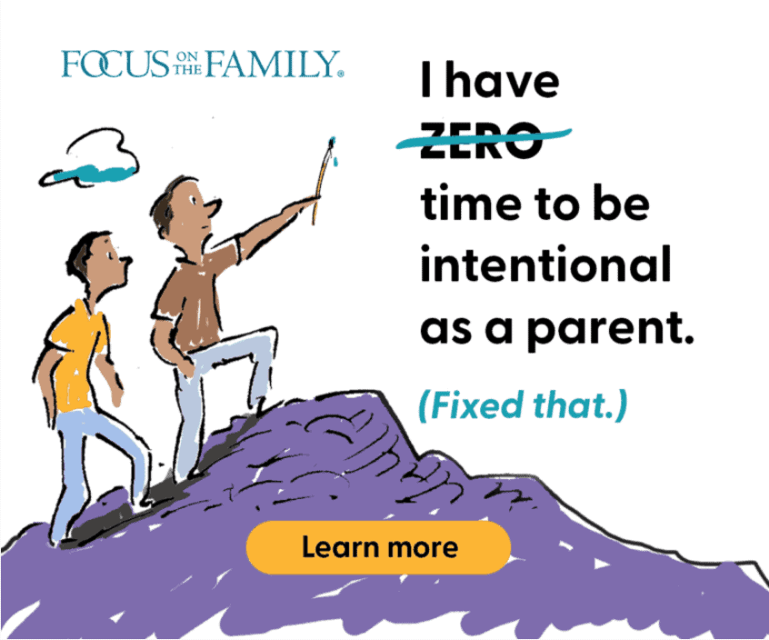
Notes:
https://www.focusonthefamily.com/parenting/family-estrangement-6-ways-to-reconcile-with-adult-children/

Slide 70
Josh Coleman, PhD, is author of the books, Rules of Estrangement and When Parents Hurt, call this a phenomenon “a modern-day epidemic and a modern-day tragedy.”
Notes:
https://www.webmd.com/parenting/news/20230620/dealing-with-adult-child-estrangement

Slide 71
Coleman recommends seeking the “kernel of truth” in your adult child’s complaints, even if they seem outrageous. “You might say, ‘I haven’t thought about myself in that way, but maybe there were narcissistic things I did. Is there a particular memory that gave you that feeling?’ That shows you’re receptive to their concerns.”
Notes:
https://www.webmd.com/parenting/news/20230620/dealing-with-adult-child-estrangement

Slide 72
Communicate empathetically and with willingness to take responsibility for any mistakes you might have made. “If you don’t understand why your child distanced, tell the child you don’t understand but you want to, that it’s clear you have blind spots.”
Notes:
https://www.webmd.com/parenting/news/20230620/dealing-with-adult-child-estrangement

Slide 73
In your letter, you can express willingness to go into family therapy together, even to meet his/her therapist. And if you’re sitting with the therapist, it’s better to listen than to challenge your child’s memories or perceptions.
When it comes to relationships, perception = reality.
Notes:
https://www.webmd.com/parenting/news/20230620/dealing-with-adult-child-estrangement

Slide 74
Experience has taught me that when it comes to family life, nothing is simple or formulaic. Children who remain close to their parents didn't all grow up on Sunnybrook Farm.
Notes:
https://www.huffpost.com/entry/parents-estranged-children_b_7297294

Slide 75
And those who distance themselves or choose to have zero contact haven't all done so because their parents failed them in some significant way.
Notes:
https://www.huffpost.com/entry/parents-estranged-children_b_7297294

Slide 76
(Though, of course, some have.) Many fine parents have children who pull away -- sometimes for reasons the parents cannot figure out. If your grown child has pulled away, ask yourself this: Is there an unresolved issue that needs to be addressed?
Notes:
https://www.huffpost.com/entry/parents-estranged-children_b_7297294

Slide 77
Is there something I might do to make that resolution possible? Is there something I need to apologize for or forgive? Difficult as it is, I've seen many parents remain openhearted to their estranged children, reaching out, inviting contact, expressing their love, with no expectation or insistence that it be reciprocated.
Notes:
https://www.huffpost.com/entry/parents-estranged-children_b_7297294

Slide 78
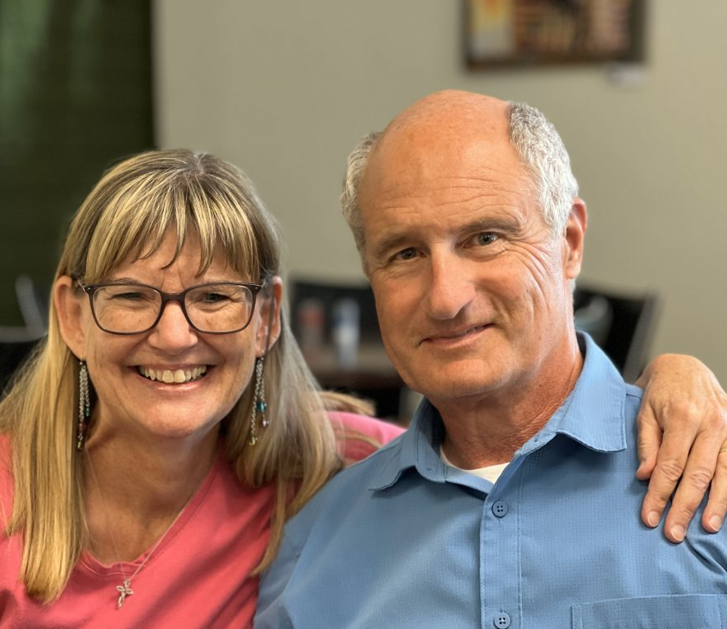
Mike and Becky McNamee, founders of Bold Destiny.

Slide 79
Notes:
https://bolddestiny.com/
Grandparenting camp.

Slide 80
LEGACY OF FAITH is an uplifting, one-of-a-kind retreat for Grandparent Couples desiring generational impact and a spiritual heritage that outlives them.
These retreats are being held at the beautiful Glen Eyrie Conference Center in Colorado Springs.
https://bolddestiny.com/
Notes:
https://bolddestiny.com/

Slide 81
We will address potential threats and barriers to building your Legacy of Faith, such as…prodigal children/grandchildren, resistance to God, long-distance grandparenting, complex family dynamics, past regrets, and cross-generational communication.
Notes:
https://bolddestiny.com/

Slide 85
Notes:
More at Legacy Coalition <LegacyCoalition@churchgrowth.org>

Slide 86
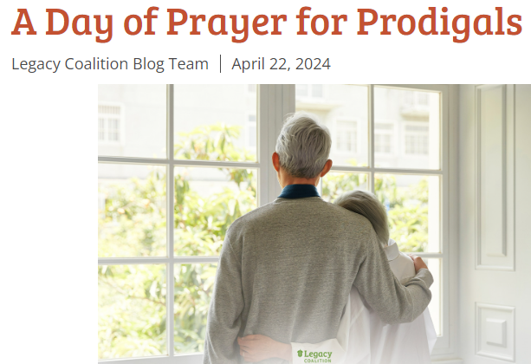
again June 29, 2024

Slide 87
G-d of Avraham, Yitskhak, Yaakov
and the Errant Part 2
The model
The errant ones misdirected
The resources for mighty Messianic mitigation
Notes:
From Amy Stewart

Slide 88
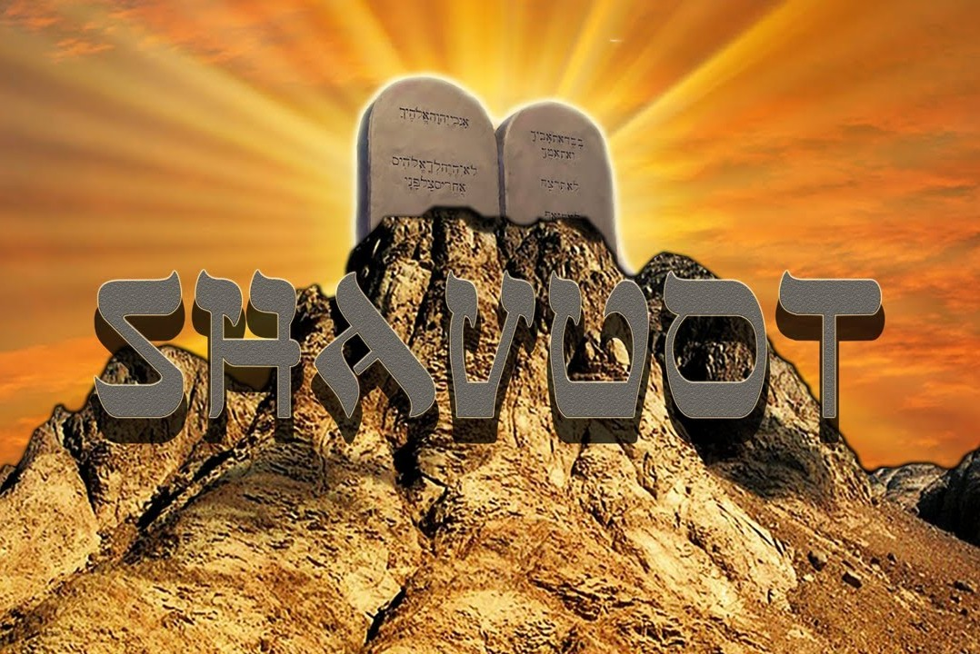
June 11 -12, 2024
Notes:
Shavuot is not today, but Tuesday evening – Wednesday. We are just acknowledging it today since we have our major attendance. Come back Tuesday evening for a study/worship/dairy fest.
The plethora of Biblical Levitical, and historic, extra Biblical holidays we observe as Messianic Jews and those from the Nations, SHOULD build a better family joy, celebration, unity.
https://www.ou.org/holidays/files/Shavuot-3-e1462448280402.jpg
We are commemorating the day. Come back Tuesday night!

Slide 89
Three themes to Shavuot [=Weeks, 50s, Pentecost]
First fruits of the wheat harvest

Slide 90
^{Vayikra/Lev 23.16-17} You are to count fifty days; and then you are to present a new grain offering to Adoni. You must bring bread from your homes for waving — two loaves.
Notes:
Wheat, staff of life

Slide 91
Three themes to Shavuot [=Weeks, 50s, Pentecost]
First fruits of the wheat harvest
Receiving of the Torah
Notes:
The Jewish nation was at Har Sinai, Mt. Sinai, on that day.

Slide 92
Notes:
https://www.bethshalomnb.org/wp-content/uploads/2020/01/shavuot.jpg
Wheat and the Word

Slide 93
Notes:
https://external-content.duckduckgo.com/iu/?u=http%3A%2F%2Fthejewishlady.com%2Fwp-content%2Fuploads%2F2017%2F05%2Fshavuot.jpg&f=1&nofb=1&ipt=9faaa98ccda436c9edbb8b2c71836acf6b0492d0f11ce4025bf36c6ab8ab05da&ipo=images
The Torah is likened to nourishing milk.
^{Yeshayahu/Is.55.1} “All you who are thirsty, come to the water! You without money, come, buy, and eat! Yes, come! Buy wine and milk without money — it’s free!
^{Song 4.11} Your lips [word], my bride, drip honey; honey and milk are under your tongue;
^{1 K 2.2-3} Like newborn babies, [be] thirsty for the pure milk of the Word; so that by it, you may grow up into deliverance. For you have tasted that Adonai is good.

Slide 94
Three themes to Shavuot [=Weeks, 50s, Pentecost]
First fruits of the wheat harvest
Receiving of the Torah
Receiving of the Ruakh / Spirit
Notes:
The followers of Messiah were in Jerusalem and just finished the count to Shavuot.

Slide 95
Tuesday, June 11-12, 7 p.m.

Slide 96
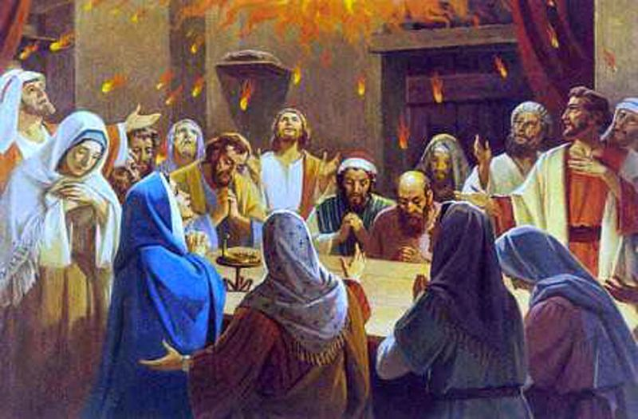
Notes:
https://1.bp.blogspot.com/-Ex2NM_oW4XY/XtIsp6UHO4I/AAAAAAAAFkY/d3Sl1tjcy5MLrTgH2WrGKwOPCJAXQWonACLcBGAsYHQ/s1600/Pentecost.jpg
^{Acts 2.1} The festival of Shavu‘ot arrived,
sumpléroó: to fill up completely, hence to fulfill

Slide 98
Tuesday, June 11, 7 p.m.

Slide 100
G-d of Avraham, Yitskhak, Yaakov
and the Errant Part 2
The model
The errant ones misdirected
The resources for mitigation
Notes:
From Amy Stewart

