Slide 1
A Sukkot treat coming.

Slide 2
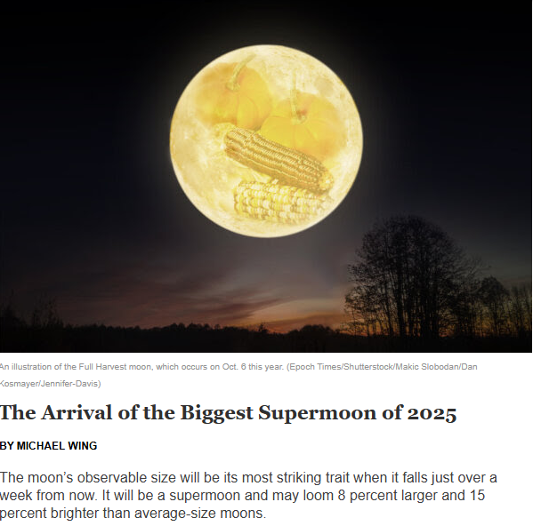
The moon’s observable size will be its most striking trait when it falls just over a week from now. It will be a supermoon and
may loom 8% larger and 15% brighter than average-size moons.
Notes:
On Sukkot!

Slide 3
What causes a supermoon?
Notes:
Is it a sign of anything?

Slide 4
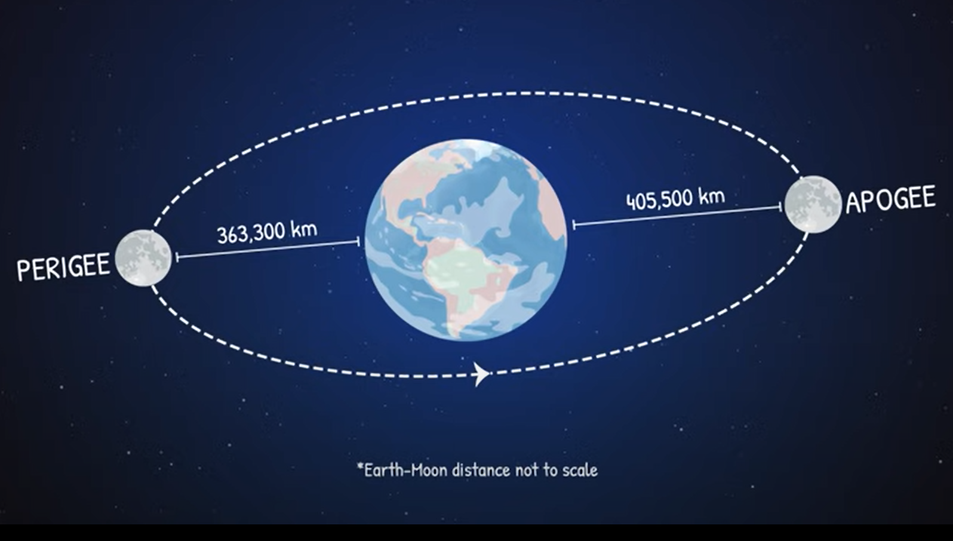
Note that the moons orbit is not
Circular, but elliptical
Notes:
https://www.instagram.com/p/DPPoRBRkmxW/
The orbit itself is precessing, or rotating, and the earth is rotating, so it’s complicated, but all mathematical. So what is the meaning?

Slide 5
^{T’hillim 8.4, 10} When I consider Your heavens, the work of Your fingers,
the moon and the stars, which You established— what is man, that You are mindful of him?...Adoni our Lord, how excellent is Your Name over all the earth!

Slide 6
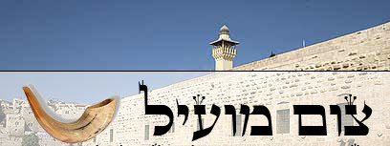
Tsom mo-eel ……..Profitable fast
Tsom Kal צום קל…Easy Fast
Notes:
מוֹעִיל effective, helpful, useful
I’ve spoken about the importance of admitting wrong, esp. re YK
Story of a rabbi visiting a sick, elderly person in nursing home. She had a bowl of peanuts, and he was munching on them as visiting. Ultimately realized he’d eaten them all. Apologized and confessed, “I’ve eaten all your peanuts.”
Lady responded, “That’ OK. I’m not able to eat them. I just suck off the chocolate.”

Slide 7
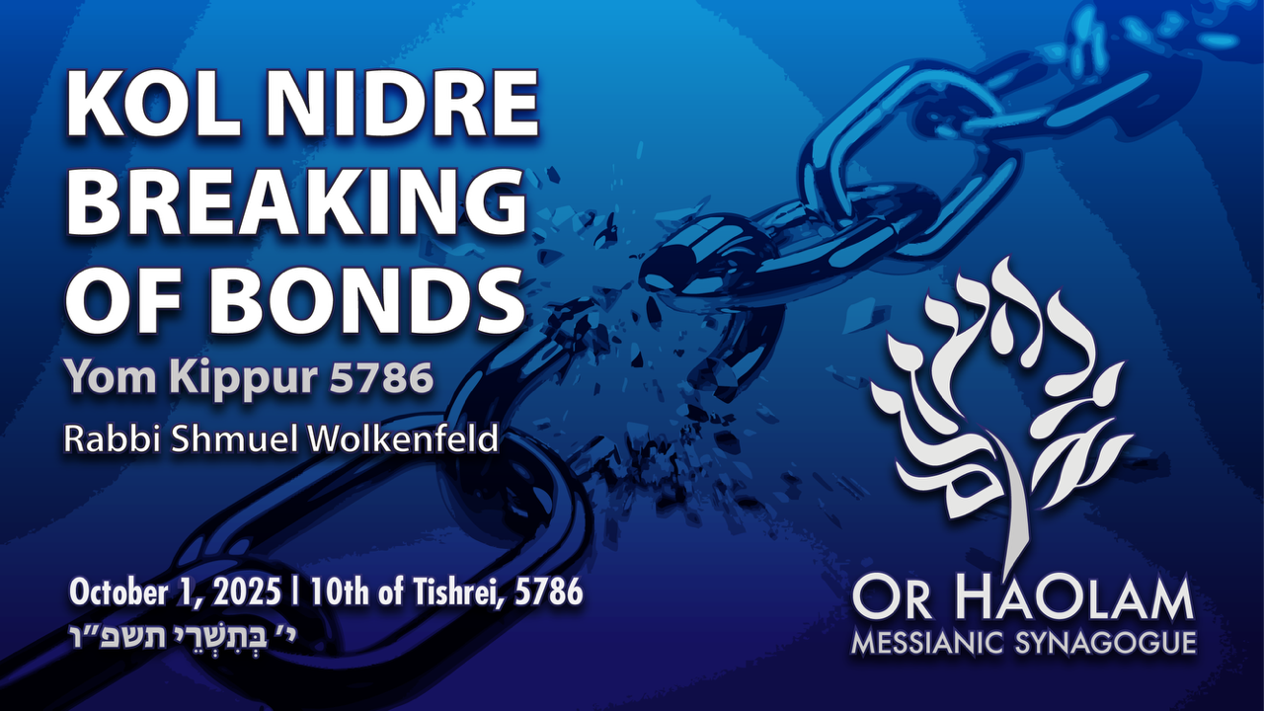

Slide 8
Every Yom Kippur we chant this hauntingly beautiful Kol Nidre prayer about the breaking of vows, and bonds, that deeply engages the soul. Why?
Notes:
It’s sort of a cultural icon. Theme of the Kol Nidre prayer was the first talkie movie ever made.

Slide 9
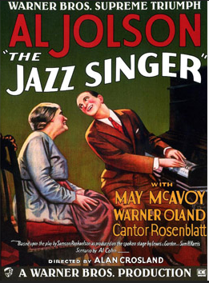

Notes:
1927 first talkie movie ever Al Jolson
1952 remake Danny Thomas, parents were Maronite Catholic immigrants from Lebanon
1959 remake Jerry Lewis born Joseph Levitch
Neil Diamond remake 1980

Slide 10
How does Yeshua
relate to this theme?

Slide 11
^{Yeshayahu / Is 6.1-2} Ruakh Elohim is upon me, because Adoni has anointed me to announce good news to the poor. He has sent me…to proclaim freedom to the captives, to let out into light those bound in the dark.

Slide 12
^{Luke 4.17-18} When the scroll of the prophet Isaiah was handed to Him, He unrolled the scroll and found the place where it was written,
Notes:
TLV + CJB

Slide 13
^{Luke 4.17-18} “The Ruakh Adoni is on me, because He has anointed me to proclaim Good News to the poor. He has sent me to proclaim release to the captives and recovery of sight to the blind, to set free the oppressed.
Notes:
TLV + CJB He began to tell them, “Today this Scripture has been fulfilled in your ears.”
So, Yeshua is the GREAT bond, enslavement breaker

Slide 15

Kol Nidre--Breaking of Bonds
Bond of sin
Bonds of fear
Bonds of sensuality, porn
Bond of bitterness
Release from Bonds

Slide 16
^{Yn 8.34-36} Yeshua answered them, “Yes, indeed! I tell you that everyone who practices sin is a slave of sin. Now a slave does not remain with a family forever, but a son does remain with it forever. So if the Son frees you, you will really be free!
Notes:
It’s not that we need a little improvement.
We need internal liberation and LIFE. And to nourish and shepherd that LIFE.

Slide 17
^{Mishlei/Prov 5.22} A wicked person’s own iniquities will trap him,
he will be held fast by the ropes of his sin.

Slide 18
^{Ro 6.16} Do you not know that to whatever you yield yourselves as slaves for obedience, you are slaves to what you obey—whether to sin resulting in death, or to obedience resulting in righteousness?
Notes:
Let’s look at this in particulars.

Slide 20
Kol Nidre--Breaking of Bonds
Bond of sin
Bonds of fear
Bonds of sensuality, porn
Bond of bitterness
Release from Bonds

Slide 21
^{Mishlei/Prov 29.25} Fearing human beings is a snare; but he who trusts in Adoni will be raised high [above danger].
Notes:
Are there fearful things today?

Slide 22
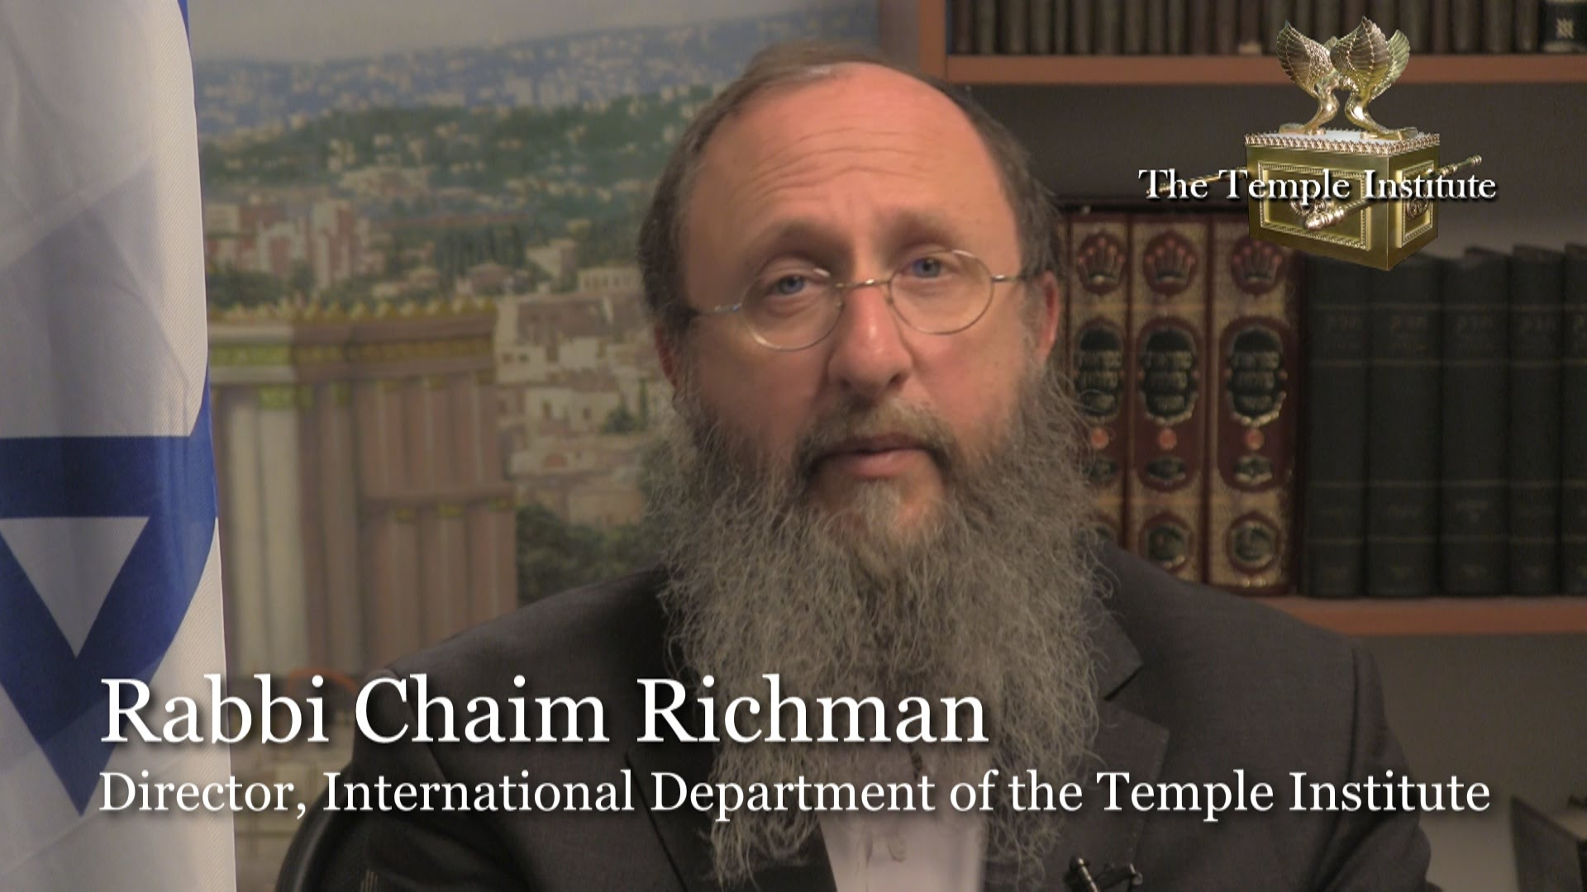
Notes:
You may remember this history that I’m about to share, but I need to add to it to relate how it reveals bondages.

Slide 23
The Temple Institute shares a key connection to the battle for Jerusalem. Its founder, Rabbi Yisrael Ariel, served with the 55th Paratroopers Brigade that captured the Temple Mount. After the victory, a Jordanian guide gave them a remarkable tour.
Notes:
http://metrovoicenews.com/kansas-city-archives/

Slide 24
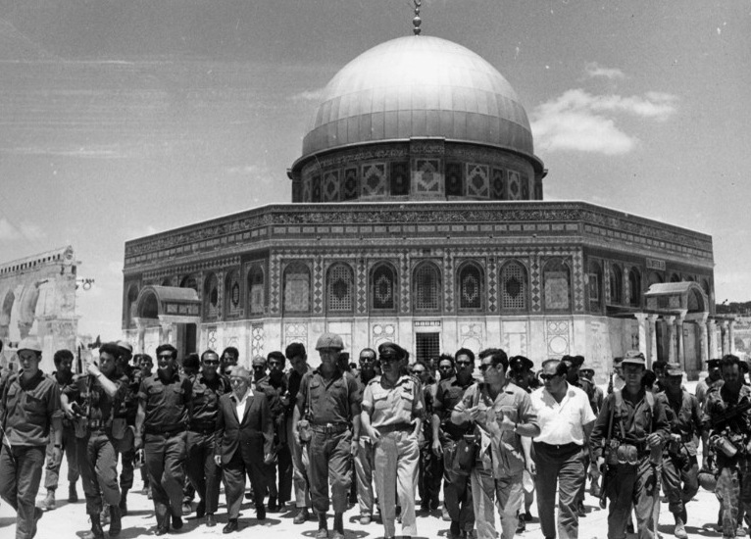
June, 1967, “The Temple Mount
Is in our hands.”
Notes:
https://www.google.com/search?q=the+temple+mount+is+in+our+hands&safe=active&tbm=isch&tbs=rimg:CSyQqPysuOnsIjifDf8H0wqRD4QuANhIO8npSnJQsutpzV5i1SDYFZywGEh8dlFkWbNxSn7ErxPn1dsMI_1PJHmrqKioSCZ8N_1wfTCpEPERg8rJSUbOu7KhIJhC4A2Eg7yekRJIPz0cr4wVkqEglKclCy62nNXhEW-tysy42IAioSCWLVINgVnLAYEemHr7lxPkInKhIJSHx2UWRZs3ER3-7RD3FQ1IsqEglKfsSvE-fV2xHSbBbFkXHQNCoSCQwj88keauoqETbFBbr_1wWsU&tbo=u&sa=X&ved=0ahUKEwilgLWF8crWAhXKy1QKHejbBogQ9C8IHw&biw=1164&bih=825&dpr=1.1#imgrc=LJCo_Ky46ezAOM:
הר הבית בידינו Har HaBayit b’yadenu

Slide 25
The soldiers were on the Temple Mount and it was just like the first hour or so. And they were approached by a Jordanian fellow in Western dress who explained that he was the official tour guide for the Jordanian parliament and he offered to take the soldiers and to show them the sites on the Temple Mount. [June 1967]
Notes:
http://metrovoicenews.com/kansas-city-archives/

Slide 26
"He takes the soldiers, you know, and the rabbi there, and he says, 'well this is exactly where the sanctuary stood. This is where the altar stood and then this is where the Menorah stood.‘ "He tells them all these things about the history of the Holy Temple …
Notes:
http://metrovoicenews.com/kansas-city-archives/
Israel Ariel, as told to me and a small tour group by Chaim Richman

Slide 27
Finally, the rabbi asked him, 'why are you telling us all this?‘
And he said, 'well, we have tradition from our fathers [and] they from their fathers that one day the Jews would wage a war and conquer this mountain

Slide 28
and rebuild the Holy Temple, and I assume that you're starting tomorrow. I want this to be my part, my part in helping you,'" he said, according to Rabbi Richman, according to Rabbi Ariel.
Notes:
http://metrovoicenews.com/kansas-city-archives/

Slide 29
Defense Minister Moshe Dayan’s first act on the Temple Mount, only a few hours after IDF Chief Rabbi Shlomo Goren blew the shofar and gave the Shehecheyanu blessing beside the Western Wall, was to immediately remove the Israeli flag that the
Notes:
http://jcpa.org/al-aksa-is-in-danger-libel-temple-mount/

Slide 30
paratroopers had raised on the mount.
Dayan’s second act was to clear out the paratroop company that was supposed to remain permanently stationed in the northern part of the mount.
Notes:
http://jcpa.org/al-aksa-is-in-danger-libel-temple-mount/
Narkiss reminded Dayan that Jordan, too, had stationed a military contingent on the mount to maintain order, and that long ago the Romans had done the same, deploying a garrison force in the Antonia Fortress that Herod had built near the mount.

Slide 31
June 1967. Defense Minister Moshe Dayan announced to the Waqf and the heads of the Supreme Muslim Council that they will be able to administer the Temple Mount compound themselves, while the Jews will be able to visit but not pray there!
Notes:
http://jcpa.org/al-aksa-is-in-danger-libel-temple-mount/
Dayan was a secular Jew who didn’t care about worship

Slide 32
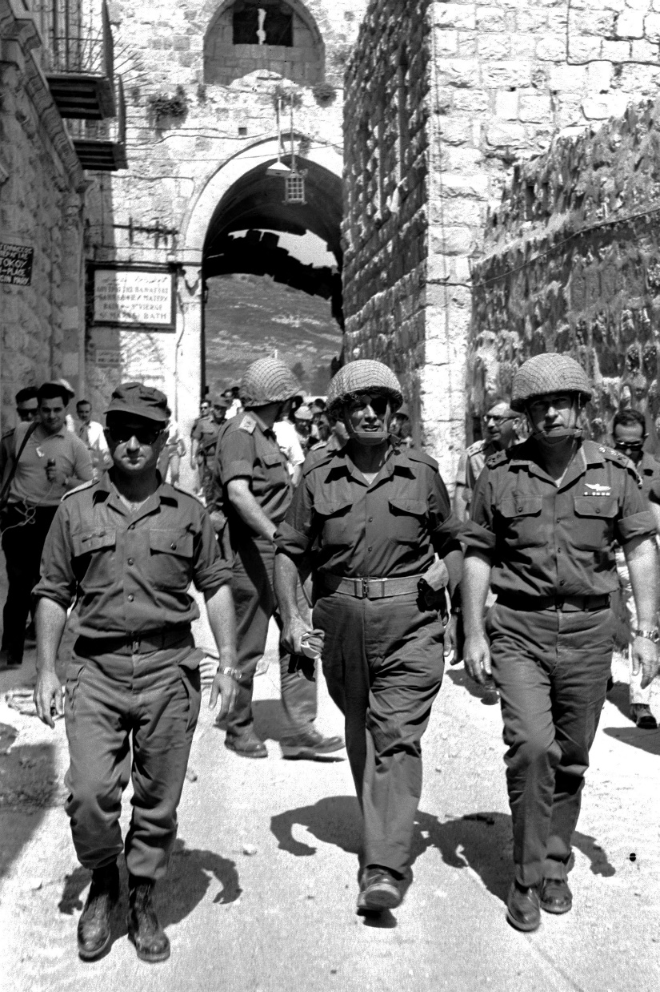
Gen. Uzi Narkiss, Defense Minister Moshe Dayan and Chief of staff Yitzhak Rabin in the Old City of Jerusalem during the Six-Day War

Slide 33
Israeli Prime Minister Levi Eshkol announced to the chief rabbis of Israel that they would be responsible for arrangements in the vicinity of the Western Wall, and promised the religious leaders of the
Notes:
http://jcpa.org/al-aksa-is-in-danger-libel-temple-mount/
Levi Eshkol also a secular. Temple Mount meant little.

Slide 34
Christian and Muslim communities that they would continue to determine the arrangements at the places holy to them: the Church of the Holy Sepulchre and the Temple Mount.
Notes:
http://jcpa.org/al-aksa-is-in-danger-libel-temple-mount/

Slide 35
The basic elements of the status quo that Dayan designed on the Temple Mount have remained the same up to the present.
Israel is in bondage to the words of unwise leaders in 1967.
Notes:
http://jcpa.org/al-aksa-is-in-danger-libel-temple-mount/

Slide 37
R. Chaim Richman said to us on tour, “We Jews are so desperate to get the approval of the world that we give away our soul.”
Bondage to fear.
Kol Nidre breaking of bondages
Notes:
Not exact quote.
Are you in bondage to, in fear of the approval of people? Pause to invite prayer…
However, despite all that, there are plans afoot in the Temple Institute and other places to build the Temple, but it will take another divine intervention. I’m counting on the muffed opportunity in June 1967 as a divine intervention.

Slide 38
^{Isaiah 51.12-16} “I, I am the One who comforts you. Who are you that you should fear man, who dies, or a son of man, who is given up like grass?” But you forgot Adoni your Maker, who stretched out the heavens and laid the foundations of the earth.

Slide 39
^{Dt 1.17} You must not show partiality in judgment—you must hear the small and the great alike. Fear no man, for the judgment is God’s.

Slide 40
^{Isaiah 51.12-16} Are you in constant dread all day because of the fury of the oppressor as he makes ready to destroy? But where is the fury of the oppressor? Soon one bowed down will be released. He will not die and go to the Pit, nor will his bread be lacking.

Slide 41
^{Isaiah 51.12-16} “For I am Adoni your God, who stirs up the sea so that its waves roar—Adoni-Tzva’ot is His Name. I have put My words in your mouth, and covered you with the shadow of My hand—I who set the heavens in place, who laid the foundations of the earth, and say to Zion, ‘You are My people.’”

Slide 42

Charlie Kirk debating pro-Palestinian activists at the University of Washington, Seattle, May 7, 2024. (photo credit: REUTERS/DAVID RYDER)

Slide 43
Charlie Kirk’s letter to Benjamin Netanyahu:
“Israel is getting CRUSHED on social media and you are losing younger generations of Americans, even among MAGA conservatives. In my opinion, you are losing the information war which will eventually translate

Slide 44
“into less political and military support from America. The Holy Land is so important to my life, and it pains me to see support for Israel slip away.

Slide 45
“The purpose of this letter is to lay out our concerns and outline potential remedies. Everything written here is from a place of deep love for Israel and the Jewish people,” Kirk added.

Slide 46
“I think it’s important to be brutally honest with those you love. In my opinion, Israel is losing the information war and needs a ‘communications intervention.’”

Slide 47
A recent Pew Research poll showed 53% of Americans now have an unfavorable view of Israel, up from 42% three years ago. U.S. support for Israel is precarious right now. A new media strategy is urgently needed.

Slide 48
From my vantage point, Israel has retreated from social media without a fight. How are you going to win over younger generations if you’re starting out in retreat on social media?
Notes:
Without a fight, too taxing, too frightening.

Slide 49
Feel free to contact me on my private number below if you would like to discuss this further.
Notes:
https://www.newsweek.com/charlie-kirks-letter-to-netanyahu-revealed-read-in-full-10804835

Slide 50
^{Dvarim/ Dt 20.8} “The officials will then add to what they have said to the soldiers: ‘Is there a man here who is afraid and fainthearted? He should go back home; otherwise, his fear may demoralize his comrades as well.’
Notes:
What are you afraid to confront??

Slide 51
There was once a young chassid who was asked by his Rebbe to take on a daunting mission in a distant village. The chassid trembled: “Rebbe, I don’t have the courage.”

Slide 52
The Rebbe smiled and answered: “Courage does not mean you feel no fear. Courage means you walk forward with faith even when you are afraid. That is when G-d Himself walks with you.”

Slide 53
This echoes Yehoshua’s charge: “Chazak Ve’Ematz” — be strong and courageous. Not because you are fearless, but because Hashem is with you.

Slide 54
As we begin this new year and read about courage, our hearts are broken by the ongoing plight of the hostages still held captive in Gaza by Hamas. Entire families are torn apart; mothers, fathers, children, and grandparents remain in darkness.

Slide 55
The words “חֲזַק וֶאֱמָץ – Khazak v’amatz Be strong and courageous” take on urgent meaning today. We must strengthen ourselves in faith, in unity, and in unrelenting demand for their release.
Notes:
Say altogether חֲזַק וֶאֱמָץ Khazak v’amatz
Ask Yeshua for courage. Dennis Prager says courage is the key virtue.

Slide 57
Kol Nidre--Breaking of Bonds
Bond of sin
Bonds of fear
Bond of bitterness
Bonds of sensuality, porn
Release from Bonds

Slide 58
^{Acts 8.23} For I see in you the poison of bitterness and the bondage of unrighteousness!”
Notes:
Said by Kefa/Peter to Shimon the sorcerer who tried to buy Kingdom Ruakh power.
I dealt with forgiveness last Shabbat somewhat extensively.
It’s sooo important to forgive.

Slide 60
Kol Nidre--Breaking of Bonds
Bond of sin
Bonds of fear
Bond of bitterness
Bonds of sensuality, porn
Release from Bonds

Slide 61
^{Ro 7.22-23} For I delight in the Torah of God with respect to the inner man, but I see a different law in my body parts, battling against the law of my mind and bringing me into bondage under the law of sin which is in my body parts.
Notes:
That is, hormonal, fallen nature.

Slide 62
^{2 Kefa/P 2.18-19} For by mouthing grandiosities that amount to nothing, they entice in sensual fleshly passions those who are barely escaping from those who live in error. They promise them freedom while they themselves are slaves of corruption—for a person is a slave to whatever has overcome him.

Slide 63
^{Mishlei Prov 5.1-5} My son, pay attention to my wisdom. Incline your ear to my insight, that you may maintain discretion and your lips may preserve knowledge. For a seducing woman’s lips drip honey and her mouth is smoother than oil.

Slide 64
^{Mishlei Prov 5.1-5} But in the end she is bitter as wormwood, sharp as a double-edged sword. Her feet go down to death, her steps lead straight to Sheol.

Slide 65
^{Mishlei Prov 5.22-23} The iniquities of a wicked man will ensnare him.
The cords of his sin will hold him down. He will die for lack of discipline, led astray by his own great folly.

Slide 66
^{2 Tim 2.25-26} Perhaps God may grant them a change of mind, leading to the knowledge of truth. Then they may regain their senses and escape the devil’s snare, in which they had been held captive by him to do his will.

Slide 67
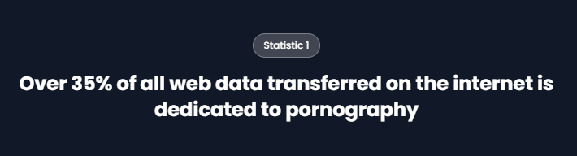
The average age at which Americans first view pornography is 11 years old
Notes:
https://wifitalents.com/porn-viewing-statistics/
Consider your children and grandchildren!!

Slide 68
Pornhub reports that they receive over 42 billion visits annually
The adult industry is estimated to employ over 10 million people worldwide
About 28,000 Americans visit pornographic websites every second
Notes:
https://wifitalents.com/porn-viewing-statistics/

Slide 69
The average adult spends about 75 minutes per week watching pornography
The percentage of teenage boys who view pornography monthly is over 70%, while for girls, it is around 30%
Notes:
https://wifitalents.com/porn-viewing-statistics/
Put computer on incognito mode. No tracking?

Slide 70
The content preferences on adult sites show that heterosexual content accounts for approximately 80% of all views, while LGBTQ+ content makes up about 20%
The average viewer of adult content visits a porn site approximately 4 times per week, with many having multiple sessions in a day.
Notes:
https://wifitalents.com/porn-viewing-statistics/

Slide 71
54% of practicing Christians watch pornography.
75% of Christian men watch pornography.
40% of Christian women consume pornography.
Notes:
https://www.covenanteyes.com/pornstats/
We are not Christian’s but Messianic Jews, so exempt.
Yeah right!

Slide 72
22% of Christians view pornography at least once a week, compared to 31% of non-Christians who view pornography at least weekly.
Notes:
https://www.covenanteyes.com/pornstats/

Slide 73
The answer if you have a problem, a bondage to porn?
Notes:
https://wifitalents.com/porn-viewing-statistics/

Slide 74
The answer if you have a problem, a bondage to porn?
Accountability.
Notes:
Talk to someone.

Slide 75
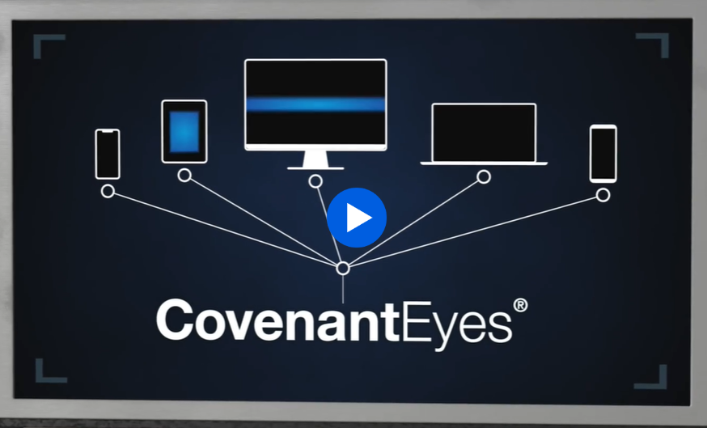
Notes:
Covenanteyes.com

Slide 76
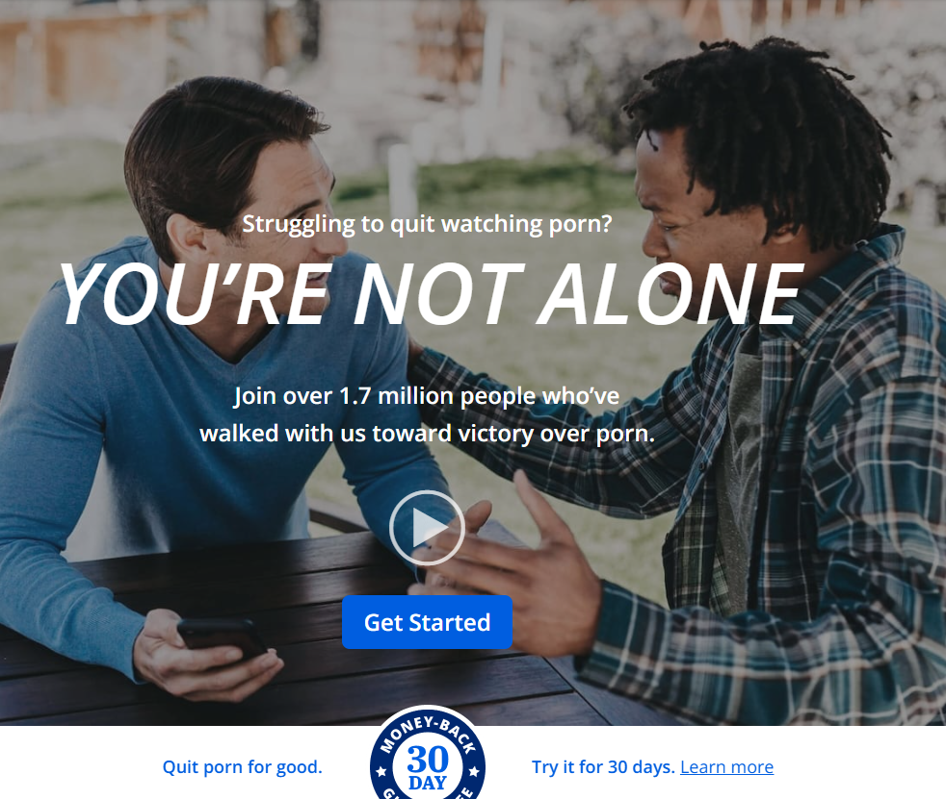
Notes:
Covenanteyes.com

Slide 77
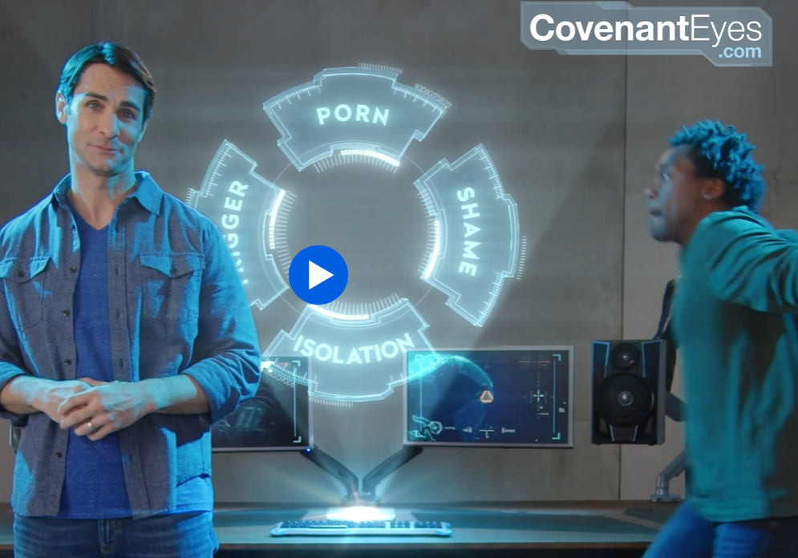
Notes:
Covenanteyes.com

Slide 78

canopy.us
Notes:
An alternative resource: https://canopy.us
Talk to someone, a trusted friend.

Slide 80
Kol Nidre--Breaking of Bonds
Bond of sin
Bonds of fear
Bond of bitterness
Bonds of sensuality, porn
Release from Bonds

Slide 81
^{1 Yn4.18} There is no fear in love. On the contrary, love that has achieved its goal gets rid of fear, because fear has to do with punishment; the person who keeps fearing has not been brought to maturity in regard to love.

Slide 82
^{Ro 8.1-2} Therefore, there is no longer any condemnation awaiting those who are in union with the Messiah Yeshua. Why? Because the Torah of the Spirit, which produces this life in union with Messiah Yeshua, has set me free from the “Torah” of sin and death.

Slide 83
^{Ro 6.12-14} Therefore, do not let sin rule in your mortal bodies, so that it makes you obey its desires; and do not offer any part of yourselves to sin as an instrument for wickedness. On the contrary, offer yourselves to God as people alive from the dead,

Slide 84
^{Ro 6.12-14} and your various parts to God as instruments for righteousness. For sin will not have authority over you; because you are not under legalism but under grace.

Slide 86
Kol Nidre--Breaking of Bonds
Bond of sin
Bonds of fear
Bond of bitterness
Bonds of sensuality, porn
Release from Bonds

