Slide 1


Slide 2
^{Eph. 3.19} That you will be filled with all the fullness of God.
Abundance

Slide 3

The fullness of G-d Eph 3.19
RH & YK seeking G-d
Sukkot: G-d loves abundance
Abundant love
Abundant love → unoffendable
Abundant love → forgive
Abundant love → reconcile
Notes:
2. Found G-d! ?

Slide 4
The fullness of G-d Eph 3.19
RH & YK seeking G-d
Sukkot: G-d loves abundance
Abundant love
Abundant love → unoffendable
Abundant love → forgive
Abundant love → reconcile

Slide 5
Rosh Hashanah’s complex calling
Remember, implying giving account!
Loud sounds, implying trumpet of judgment!
Gathering
No commercial transactions
Sweet foods →G-d’s mercy
Notes:
http://www.ulpanor.com/

Slide 6
Yom Kippur
Afflicting one’s soul: Fasting
Remembering the Temple atonement: visualizing Messiah!
Forgiveness: visualizing Messiah!
Confession
Intercession
Notes:
http://www.ulpanor.com/

Slide 8
The fullness of G-d Eph 3.19
RH & YK seeking G-d
Sukkot: G-d loves abundance
Abundant love
Abundant love → unoffendable
Abundant love → forgive
Abundant love → reconcile
Notes:
2. Found G-d

Slide 9
Sukkot ^{Vayikra/Lev 23.39} “‘But on the fifteenth day of the seventh month, when you have gathered the produce of the land.
Notes:
The implication is that you will gather in substantial crops.

Slide 10
^{Shmot/Exodus23:14-17} The festival of ingathering (Sukkot), at the end of the year, when you gather in from the fields the results of your efforts.
Notes:
The implication is that you will gather in substantial crops.

Slide 11
^{T’hillim 81.14-17} Oh that My people would listen to Me, that Israel would walk in My ways! I would soon subdue their enemies, and turn My hand against their foes. Those who hate Adoni would cringe before Him— their time of doom would be forever.
Notes:
We are seeing some measure of the subduing of enemies. Hezbollah, Iran, Houthis, now Hamas?

Slide 12
^{T’hillim 81.14-17} But you would be fed with the finest wheat, with honey out of a rock would I satisfy you.”

Slide 13
^{T’hillim / Ps 144.9-15} God, I will sing a new song to you; sing praises to you with a ten-stringed harp. You give kings their victories; you save your servant David from the cruel sword...Our sons in their youth will be like full-grown saplings,

Slide 14
^{T’hillim / Ps 144.9-15} our daughters will be like sculptured pillars fit for the corner of a palace. Our barns are full with crops of every kind; he sheep in our fields number thousands, tens of thousands, our oxen are well-fed, our city walls have no breach, our people are not taken captive,

Slide 15
^{T’hillim / Ps 144.9-15} and there are no cries of protest in our cities’ open places. How happy the people who live in such conditions! How happy the people whose God is Adonai!

Slide 16
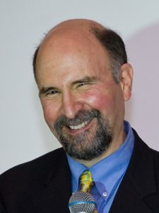
Rabbi Elias Lieberman, leader of the Falmouth Jewish Congregation in Massachusetts,
Notes:
https://www.jns.org/did-sukkot-help-shape-thanksgiving/

Slide 17
sees a strong biblical influence on Thanksgiving.
“While we cannot be certain about what motivated those Pilgrim settlers to initiate a feast of thanksgiving,
Notes:
https://www.jns.org/did-sukkot-help-shape-thanksgiving/

Slide 18
it is likely that they consciously drew on a model well-known to them from the Bible they cherished,” Lieberman told JNS.org. “Seeing themselves as new Israelites in a new ‘promised land,’ the Pilgrims surely found inspiration in the Bible,
Notes:
https://www.jns.org/did-sukkot-help-shape-thanksgiving/

Slide 19
and the Sephardic Jews in the Netherlands they lived among, in the Books of Leviticus and Deuteronomy, in which God commands the ancient Israelites to observe the Feast of Booths—in Hebrew, Sukkot, ‘To rejoice before Adoni your God’ at the time of the fall harvest.”
Notes:
https://www.jns.org/did-sukkot-help-shape-thanksgiving/

Slide 20
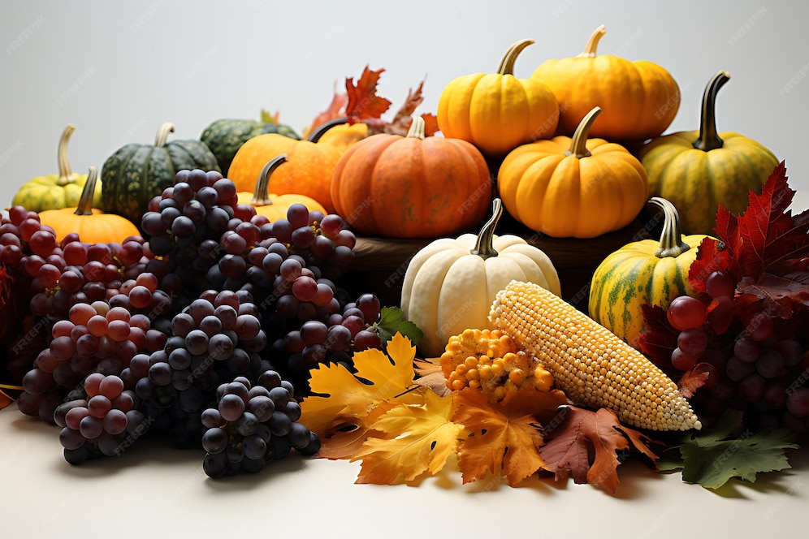
Thanksgiving Abundant food
Notes:
https://img.freepik.com/premium-photo/falls-bounty-thanksgiving-harvest-thanksgiving-background_753066-1555.jpg?w=996

Slide 21
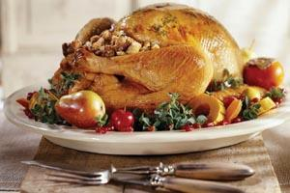
​
Notes:
So, keep in mind the celebratory nature of bringing lots of food for Oneg, for Sukkot, for Neilah. We appreciate all the help in setting up and cleaning up/tear down. Even if you are single and don’t cook, you can bring KFC or similar!
Not be parsimonious in our giving and sharing!
G-d loves abundance!!

Slide 23
The fullness of G-d Eph 3.19
RH & YK seeking G-d
Sukkot: G-d loves abundance
Abundant love
Abundant love → unoffendable
Abundant love → forgive
Abundant love → reconcile

Slide 24
^{Eph. 3.19} That you will be filled with all the fullness of God.
Abundance
Notes:
Context of this verse…

Slide 25
^{Eph. 3.14-21} For this reason, I fall on my knees before the Father, from whom every family in heaven and on earth receives its character.

Slide 26
For what reason?
The preceding chapters
Revelation of the secret of joint citizenship, Jews and Nations. ^{2.6}
Unfathomable riches ^{2.8}
Troubles Shaul is enduring ^{2.13}
Notes:
Ie Man, this is BIG

Slide 27
^{Eph. 3.14-21} For this reason, I fall on my knees
Unusual for modern Jewish prayer
Expression of utter amazement
King Solomon at dedication of the First Temple. Ps 95

Slide 28
^{Eph. 3.14-21} For this reason, I fall on my knees before the Father, from whom every family in heaven and on earth receives its character.
Notes:
Deep breath and cry, “Abba Father!!”
Verse is opaque, no father image for most of us, except for redemptive revelation following.
Men’s group building strong fatherhood.
Many of us don’t understand father allusion, since no experience in healthy families.
Father hunger
If you have a good father image, count yourself blessed. Among 4%

Slide 29

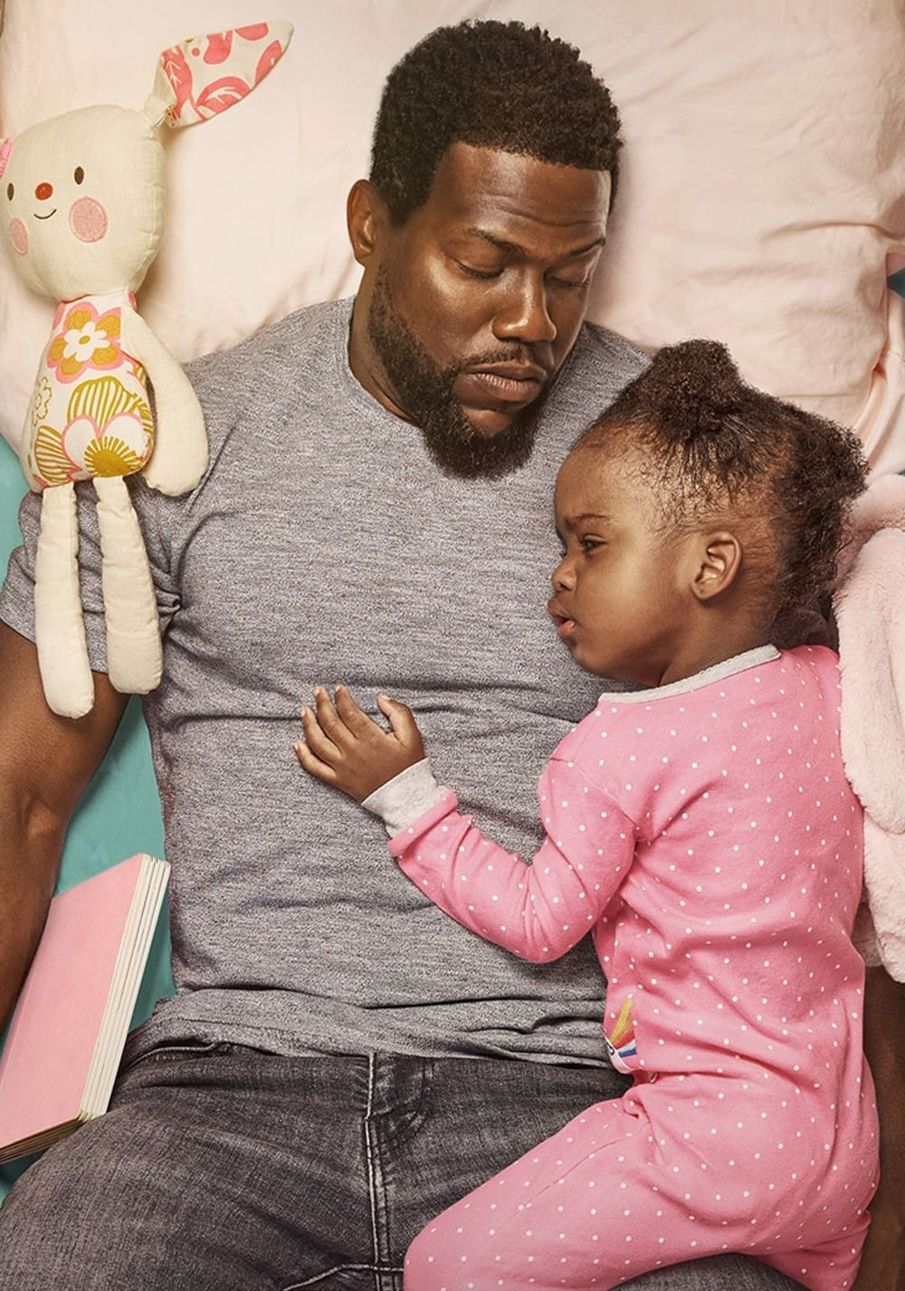
Healthy father figure
Notes:
https://www.focusonthefamily.com/wp-content/uploads/2021/06/fatherhood_1837455628.jpg
https://image.tmdb.org/t/p/original/BnvTMgTZrrgAKaPKNFYyZw3wZF.jpg

Slide 30
^{Eph. 3.14-21} For this reason, I fall on my knees before the Father, from whom every family in heaven and on earth receives its character.
Notes:
Introduces grid of family. Basis of emotional, pyschological health, spiritual understanding.

Slide 31

Classical nuclear family
Notes:
Smiling, eye contact, affirming, body language leaning in 6x/sec exchange of affirmation → oxytocin + dopamine
Healthy family is NOT a given. Takes work

Slide 32
Love doesn’t hurt, it feels good. Loving behavior nourishes your emotional well-being...Genuine love creates feelings of warmth, pleasure, safety, stability, and inner peace.” ― Susan Forward, Toxic Parents: Overcoming Their Hurtful Legacy and Reclaiming Your Life

Slide 33
John Bradshaw, a family-systems therapy advocate and family dynamics expert, cites research that found 96 percent of all families to be to some degree ‘dysfunctional’ — that is, distorted by addictions and compulsions... so, ignores the needs of each individual.
Notes:
http://www.thebiganswer.info/Family-Dysfunction.php

Slide 34
96 percent of all families are to some degree emotionally impaired.
Notes:
http://www.thebiganswer.info/Family-Dysfunction.php

Slide 35

Parents who cause us emotional or physical pain. Parents who ignored our needs or overburdened us with guilt.
Notes:
Given to me by my sister. Our parents.

Slide 36
“Most adult children of toxic parents grow up feeling tremendous confusion about what love means and how it’s supposed to feel. Their parents did extremely unloving things to them in the name of love― Susan Forward, Toxic Parents: Overcoming Their Hurtful Legacy and Reclaiming Your Life
Notes:
Remember topic: fullness of G-d in love

Slide 37
^{Eph. 3.14-21} For this reason, I fall on my knees before the Father, from whom every family in heaven and on earth receives its character.

Slide 38
^{Eph. 3.14-21} I pray that from the treasures of his glory he will empower you with inner strength by his Spirit,
Notes:
Treasures: most treasuries in the world are bankrupt. Word picture of emotional life.
Next slide too small to read, but if get notes, for comparison. Treasuries of the nations of the world. US is 13th wealthiest.

Slide 39
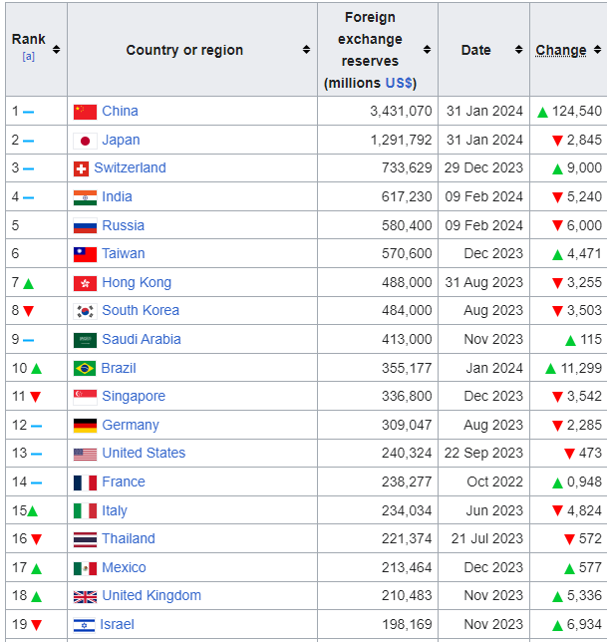
Reserves/
Treasures
Notes:
https://en.wikipedia.org/wiki/List_of_countries_by_foreign-exchange_reserves
Twenty countries with the most treasure = reserves
US 240 billion
Jan 17, 2024

Slide 40
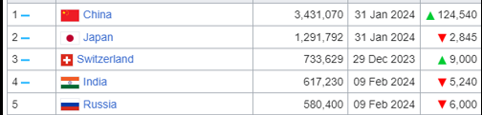
Reserves / Treasures, in
million dollars
Notes:
https://en.wikipedia.org/wiki/List_of_countries_by_foreign-exchange_reserves
China has $3.5 trillion treasure = reserves #1
Jan 17, 2024

Slide 41
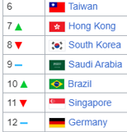
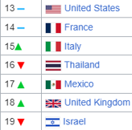
Reserves
Notes:
https://en.wikipedia.org/wiki/List_of_countries_by_foreign-exchange_reserves
United States #13
Israel #19

Slide 42
Consider debt

Slide 43
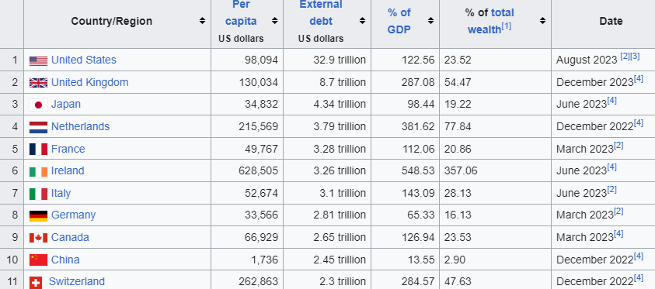
Debt: USA is first in the world
Notes:
https://en.wikipedia.org/wiki/List_of_countries_by_external_debt

Slide 44
Debt
Notes:
https://en.wikipedia.org/wiki/List_of_countries_by_external_debt
Israel #49 on debt chart. Much better debt to asset ratio. Evan Liberman WiseMoney Israel.

Slide 45
United States of America
$37 trillion debt, $240 billion reserves [hard to visualize, so proportionally:]
Like $37 thousand debt, $240 reserves
USA has no treasure, zero reserves in actuality
Notes:
https://en.wikipedia.org/wiki/List_of_countries_by_external_debt
Therefore, we didn’t accept CARES money during COVID China virus lockdown

Slide 46
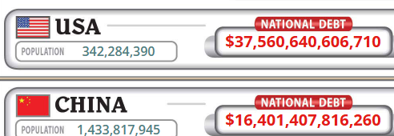
Notes:
As of Oct 3, 2025
https://www.usdebtclock.org/

Slide 47

The average American credit card debt:
Notes:
https://www.usdebtclock.org/#
Plus student loan plus mortgage
We are used to DEBT.
Jan 17, 2024
This building is debt free, NO MORTGAGE.

Slide 48
^{Eph. 3.14-21} I pray that from the treasures of his glory
Notes:
G-d HAS abundance, without debt.

Slide 49
Many of us may have zero love reserves.
Maybe a great love deficit.
Wounds
Unresolved conflicts
Settled anger

Slide 50
^{Eph. 3.14-21} I pray that from the treasures of his glory he will empower you with inner strength by his Spirit,

Slide 51
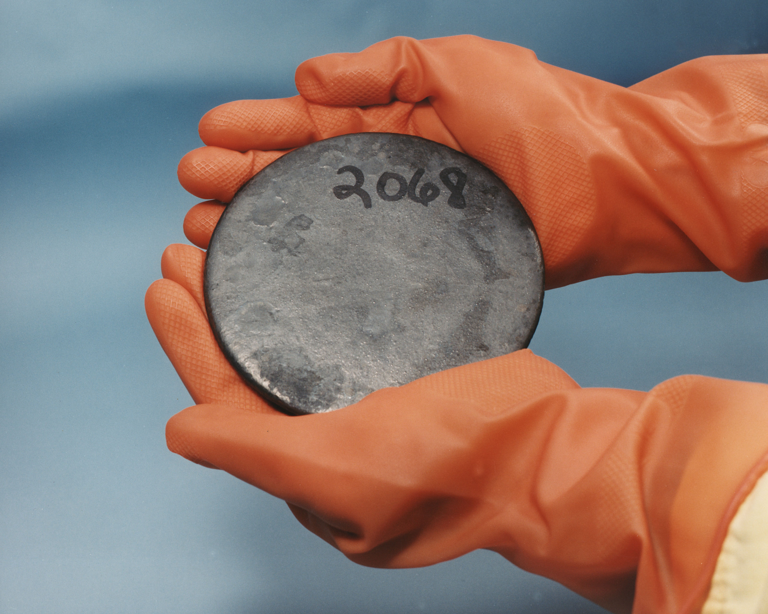
Uranium metal highly
enriched in ²³⁵U
2.5 million
times more
than the
energy
released
from
burning
coal
Notes:
https://en.wikipedia.org/wiki/Uranium-235
Heavy gloves
Treasurse of His glory >> valuable, more valuable and energizing than U-235
This is what we’ve been worried the Iranians would manufacture.
There is ENERGY of love from Messiah to forgive, live pure, love enemies, tell truth, control your tongue.

Slide 52
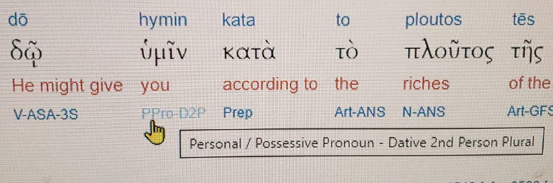
plural
Notes:
‘You’ is plural!! Give you, NOT individually, but in community.

Slide 53
^{Yer. 31.12} “Then the virgin will dance for joy, young men and old men together; for I will turn their mourning into joy, comfort and gladden them after their sorrow.
Notes:
Community joy and dance. Together. Different from charismatic two step, even elegant choreography much or most individual, even if group in unison. Ours in circles, lines. Handholds.

Slide 54
^{Yn 17.20-21} “I pray not only for these, but also for those who will trust in me because of their word, that they may all be one. Just as you, Father, are united with me and I with you, I pray that they may be united with us, so that the world may believe that you sent me.

Slide 55
^{Eph. 3.14-21} I pray that from the treasures of his glory he will empower you with inner strength by his Spirit,
^{NIV} I pray that out of his glorious riches he may strengthen you with power through his Spirit in your inner being,
Notes:
Summarize so far:
1. Treasures: most treasuries in the world are bankrupt. US $37 trillion debt, $240 billion reserves
$37 thousand debt, $240 reserves
2. Of His glory: made of??, no lien: pearls, Au, Ag, ²³⁵U fissile, and it’s empowering!!

Slide 56
^{Eph. 3.14-21} I pray that from the treasures of his glory he will empower you with inner strength by his Spirit,
^{NIV} I pray that out of his glorious riches he may strengthen you with power through his Spirit in your inner being,
Notes:
3. Empower you: give, grant, bestow
4. You in the plural, in community
5. Inner strength: dunamis: (miraculous) power, might, strength, physical power, force, might, ability, efficacy, energy, meaning
Why strength: wealth like that easy to waste.
6. By the Spirit of Him: not impersonal
Yn 16.15 Everything that the Father has is Mine. For this reason I said the Ruach will take from what is Mine and declare it to you.”
Accumulation of descriptions: treasure, glory, empower, you, inner strength, Spirit
This is the righteousness >> our own ability.

Slide 57
^{Eph. 3.14-21} so that the Messiah may live in your hearts through your trusting.
Notes:
Again, not impersonal strength, but Messiah, whom we love, whom we know, who bore our sins, rose from the dead, has no malice, ‘Meek and lowly in heart’ He dwell with/in us, so as to direct His love, humilty, patience to those we deal with.
Yeshua said, ‘You of little faith.’
In our hearts Conscious partnership
Thru trusting: decision of our mind, will, emotions, continuous
Continuous treasured empowering of inner strength by the Ruakh/Spirit
Next illustration some may think irreverent, but hang on...

Slide 58
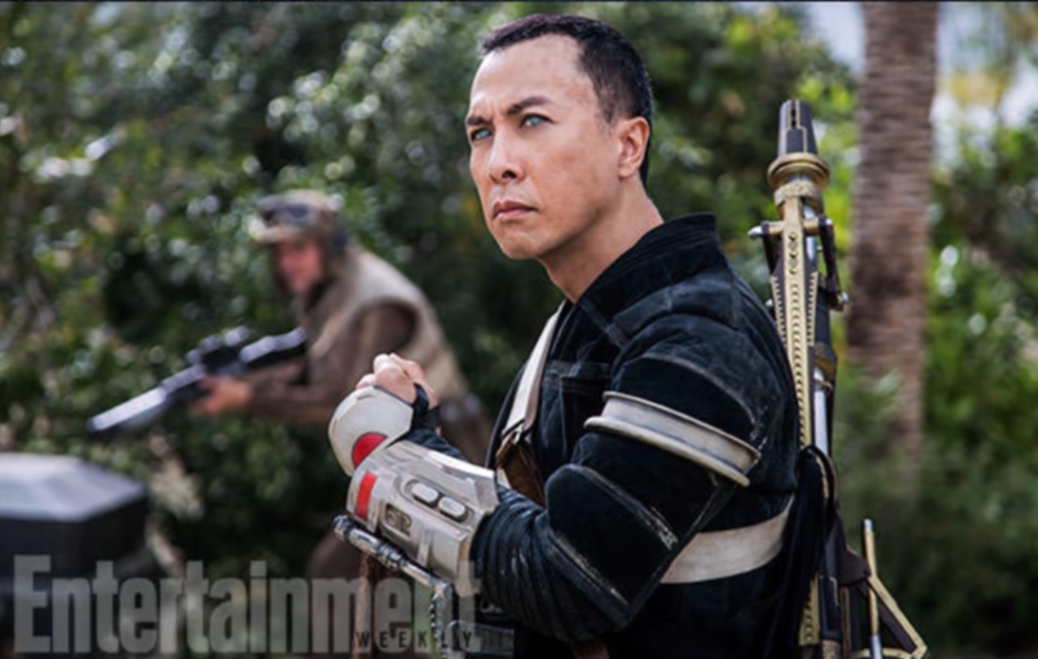
Rogue One
Notes:
Chirrut Inwe. Blind warrior: ‘I am with the force, and the force is with me.’ Great skill in battle.
We can say:
‘I am with Yeshua, and Yeshua is with/in me.’
All say, ‘I am with Yeshua, and Yeshua is with/in me.’

Slide 59
^{Eph. 3.14-21} so that the Messiah may live in your hearts through your trusting. Also I pray that you will be rooted and founded in love,
Notes:
Not just some mystical presence, but LOVE
Examine words:
Rooted: cause to take root; plant, fix firmly, establish

Slide 60
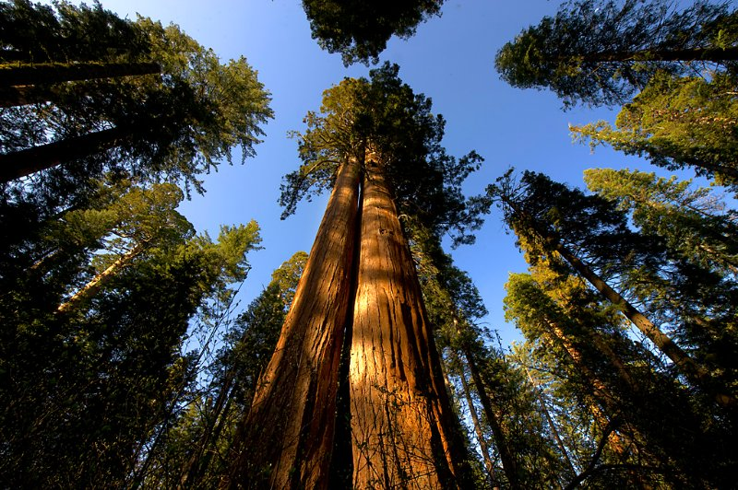

Slide 61
The sequoias have a matting, shallow, and wide spreading root system. There is no taproot. They only root to 12 to 14 feet deep even at maturity. A mature sequoia's roots can occupy over 1 acre of earth and contain over 90,000 cubic feet of soil
Notes:
https://www.giant-sequoia.com/faqs/giant-sequoia-questions/
Word picture: rooted in love

Slide 62
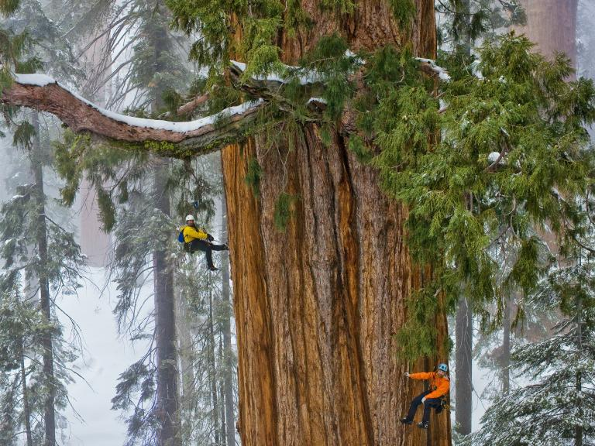
Wide root system: interdependent
with other trees
Notes:
https://www.linkedin.com/pulse/sequoia-tree-dr-tohid-nooralvandi

Slide 63
That mass of matted roots and soil has to maintain the equilibrium of a tree that is nearly 300 feet tall and weighs nearly 2 million pounds
Notes:
https://www.giant-sequoia.com/faqs/giant-sequoia-questions/

Slide 64
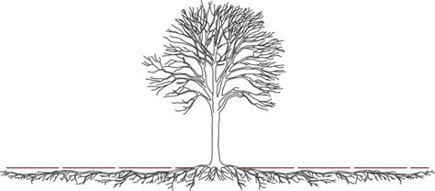
Wide root system
Notes:
https://external-content.duckduckgo.com/iu/?u=https%3A%2F%2Ftse2.mm.bing.net%2Fth%3Fid%3DOIP.0BTrVT2ZS9RpLmZ7TyL-2gHaDQ%26pid%3DApi&f=1&ipt=c0f3f12137b6f6d1a2797bfe039a852cdb5618c835ef67c97f56902ca0015add&ipo=images

Slide 65

Tap root system
Can stand alone
Notes:
https://www.taproot.com/wp-content/uploads/2019/07/RootCauseTreeDictionary-645x1024.png
Taproot trees can stand alone. Wide root trees need community.

Slide 66
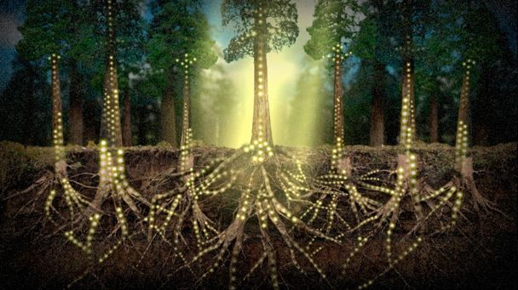
Intertwined roots
Notes:
https://external-content.duckduckgo.com/iu/?u=https%3A%2F%2Fi.pinimg.com%2Foriginals%2Fec%2F8c%2F52%2Fec8c525b4cbd434a4e918dabfff4ac03.jpg&f=1&nofb=1&ipt=0be114f23f60ef1b4bf99bf87120a7a68467722491c1494a57027b669eb6c341&ipo=images

Slide 67
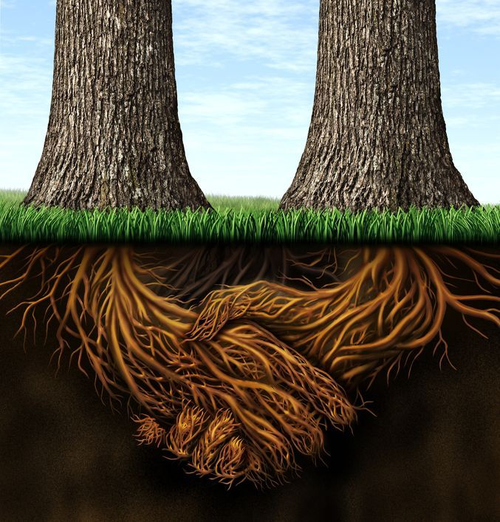
Spirit of Sequoia roots

Slide 68
^{Eph. 3.14-21} so that the Messiah may live in your hearts through your trusting. Also I pray that you will be rooted and founded in love,
[wide root sytem]
Notes:
Rooted: cause to take root; met: I plant, fix firmly, establish
Founded: found, lay the foundation building, structure, World Trade Center.

Slide 69
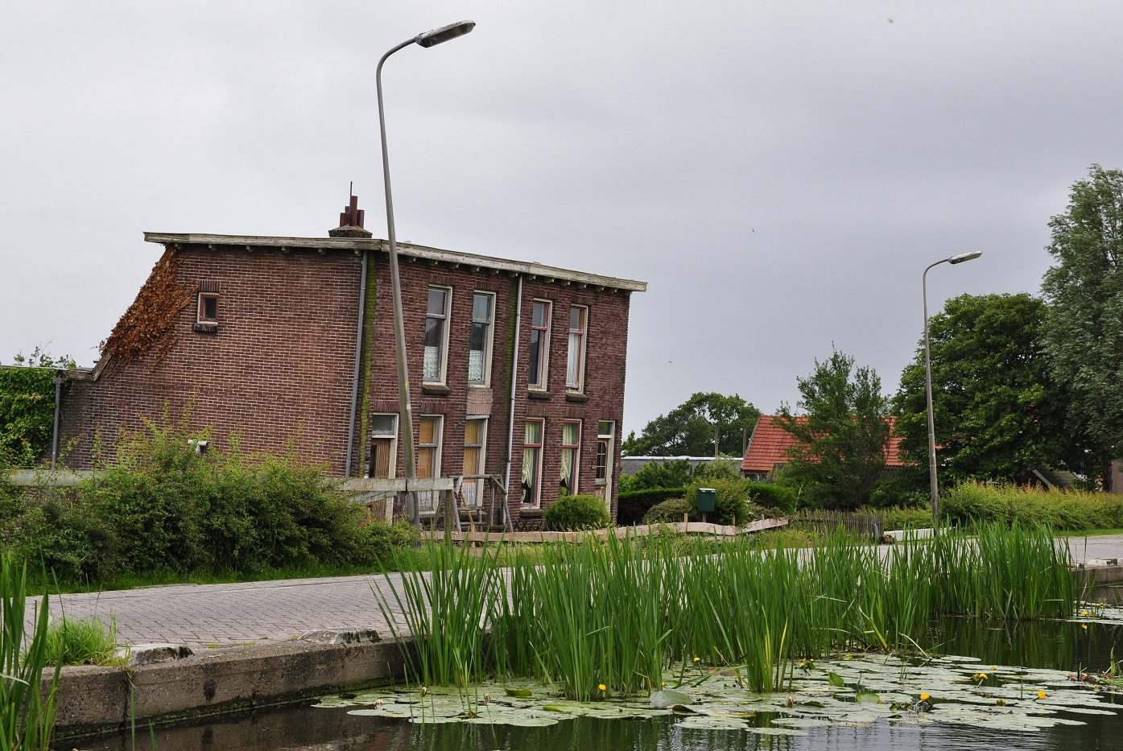
Notes:
Inadequate foundations in muddy soils below sea level caused these houses in the Netherlands to subside
https://en.wikipedia.org/wiki/Foundation_(engineering)#/media/File:Stompwijkseweg_68-70,_Stompwijk,_Netherlands.JPG

Slide 70
The foundation of the Twin Towers rested directly on the rock at a depth of more than 70' below the ground surface. A slurry wall 3' thick and about 80' deep, was constructed to support the soils surrounding the basements.
Notes:
http://www.columbia.edu/cu/civileng/ling/wtc/

Slide 71
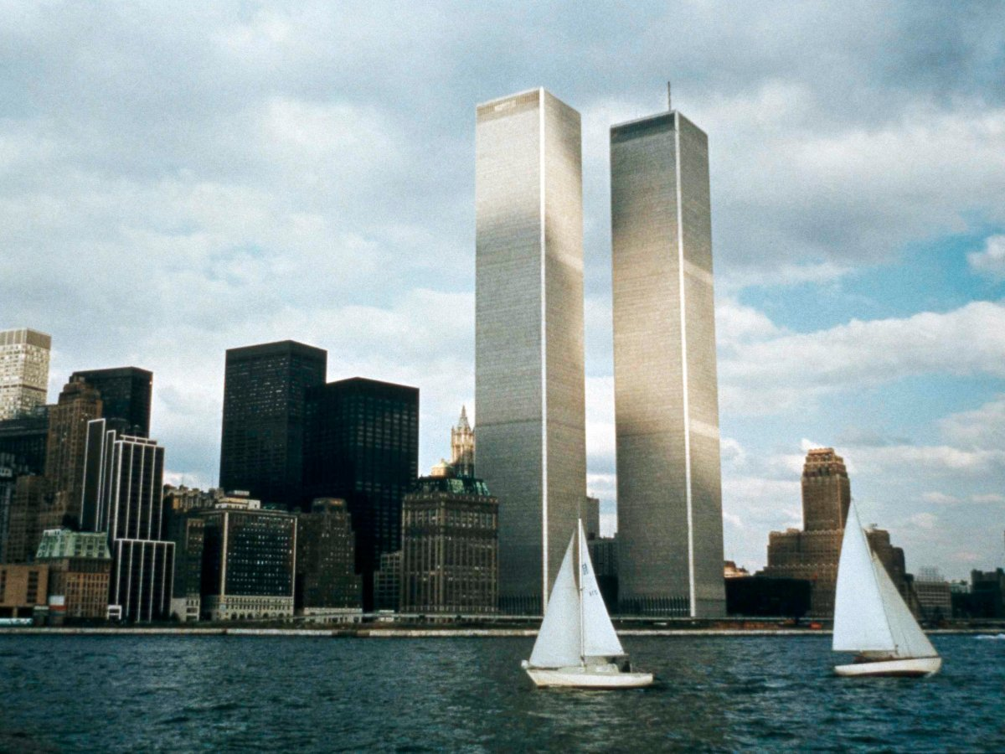

Slide 72
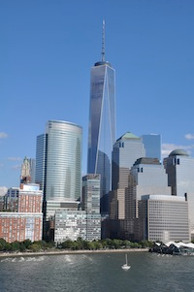
Notes:
On the Rock

Slide 73
^{Eph. 3.14-21} so that you, with all God's people, will be given strength to grasp the breadth, length, height and depth of the Messiah's love, yes, to know it,
[not only private knowledge, community knowledge, ~wide, mat root system of sequoias]
Notes:
Love in community: dance together, eat together, home groups, social intimacy ‘with all G-d’s people’
Strength: ‘have strength for (a difficult task), to be perfectly able.’ Why need strength? Easier to NOT dwell in love. Grumble, complain, see my needs, unfulfilled aspirations, social deficits, family, fanancial, career disappointments. I’m not honored enough. I’m criticized. Love is selfless, outward!
Breadth: inclusive ^{T’hillim/Ps 10312} As far as the east is from the west, so far has He removed our transgressions from us. [north/south 12k miles. E/W unlimited.] All races, all origins Length: ∞ Height: to the very presence of G
Depth: No matter how perverted, debauched, vile, His blood atonement covers!! “Unfathomable”

Slide 74
^{Eph. 3.14-21} even though it is beyond all knowing, so that you will be filled with all the fullness of God.
Now to him who by his power working in us is able to do far beyond anything we can ask
Notes:
^{2 Cor 12.3} And I know that such a man — whether in the body or apart from the body I don’t know, God knows — was snatched into Gan-‘Eden and heard things that cannot be put into words, things unlawful for a human being to utter. Bit like quasars, black holes, pulsars, worm holes: unimaginable. Love of King Messiah Yeshua
^{Yn 14.23} Yeshua answered him, “If someone loves me, he will keep my word; and my Father will love him, and we will come to him and make our home with him.
~jar filled with all the fullness of the ocean: salts, bacteria, seaweed, but only a bit

Slide 75
^{Eph. 3.14-21} or imagine, to him be glory in the Messianic Community and in the Messiah Yeshua from generation to generation forever. Amen.
Notes:
In the community: you and me
In the Messiah: KING
Generation to Generation: Lador vador.
Is this the same G-d who can send people to eternal loss, Gehenna, hell?
We separate ourselves from His love, there is only the opposite. We don’t go out of existence.

Slide 76
^{Ro. 10.3} They are unaware of God’s way of making people righteous and instead seek to set up their own.
So, we need to receive His righteousness, His fullness!
Notes:
I just can’t love everyone: Their ways annoy me. They are irresponsible. They are irritating. I don’t like...
^{1 Kefa/Peter 1.22} Now that you have purified yourselves by obeying the truth, so that you have a sincere love for your brothers, love each other deeply, with all your heart.
Love covers all sins.
[jump to last slide if time short]

Slide 77
Some people do righteousness VERY well.
Some people are nicer by nature than others are by grace.
GREATEST mystery to me is the deep flaws in some of G-d’s best people.

Slide 78
Dr. Tal Ben Shahar, nicknamed “Professor Happiness,” taught a course at Harvard on positive psychology - known as the most popular course on campus. (He has since returned to Israel where, perhaps, he is happier.)
Notes:
http://www.maozisrael.org/site/News2?abbr=maoz_&page=NewsArticle&id=11171&news_iv_ctrl=-1#top

Slide 79
Dr. Shahar believes the top predictor of happiness is spending time with people we care about and who care about us. In Israel, Friday night Shabbat dinners with extended family are a matter of course,
Notes:
http://www.maozisrael.org/site/News2?abbr=maoz_&page=NewsArticle&id=11171&news_iv_ctrl=-1#top
[RTF the key to all dysfunction and pain is abandonment/isolation, physical or emotional.]

Slide 80
even for the young and hip. After all, isolation is known to be a leading cause of unhappiness. “Loneliness epidemic”
Notes:
http://www.maozisrael.org/site/News2?abbr=maoz_&page=NewsArticle&id=11171&news_iv_ctrl=-1#top
[RTF the key to all dysfunction and pain is abandonment/isolation, physical or emotional.]

Slide 81
“It’s because of our focus on relationships,” the professor notes. “Friends and family are very high up on our value scale, and quality time with them is given a priority. Time we spend with people we care about and who care about us is the number one predictor of happiness.” (www.israel21c.org)
Notes:
http://www.maozisrael.org/site/News2?abbr=maoz_&page=NewsArticle&id=11171&news_iv_ctrl=-1#top

Slide 82
Let’s open our lives, hearts, will power/choice, purpose to RECEIVE:
from the treasures of his glory he will empower you with inner strength by his Spirit, so that the Messiah may live in your hearts through your trusting, that you will be rooted and founded in love.
Notes:
Treasures
Glory
Empower
You
Inner strength
Spirit
Messiah
Your trusting
Roots and foundation in love
Receive it and walk in it with others:

Slide 83
^{Eph. 3.19} That you will be filled with all the fullness of God.
Abundance

Slide 85
The fullness of G-d Eph 3.19
RH & YK seeking G-d
Sukkot: G-d loves abundance
Abundant love
Abundant love → unoffendable
Abundant love → forgive
Abundant love → reconcile

Slide 86
^{1 Cor 13 4-7} Love suffers long and kind, not jealous, not boastful, not proud, rude or selfish, not [easily] angered, and it keeps no record of wrongs. Love does not gloat over other people’s sins but takes its delight in the truth. Love always bears up, always trusts, always hopes, always endures.
Notes:
Offenses NOT unexpected.
Double negative: Offenses are to be expected.
Not touchy. Approachable. Not easily hurt.

Slide 88
The fullness of G-d Eph 3.19
RH & YK seeking G-d
Sukkot: G-d loves abundance
Abundant love
Abundant love → unoffendable
Abundant love → forgive
Abundant love → reconcile

Slide 89
^{Eph 4.32} Instead, be kind to one another, compassionate, forgiving each other just as God in Messiah also forgave you.
Filled with the fullness of G-d, so not keeping track of debts.

Slide 91
The fullness of G-d Eph 3.19
RH & YK seeking G-d
Sukkot: G-d loves abundance
Abundant love
Abundant love → unoffendable
Abundant love → forgive
Abundant love → reconcile

Slide 92
^{1 Thes 2.19-20} For when our Lord Yeshua returns, what will be our hope, our joy, our crown to boast about? Won’t it be you? Yes, you are our glory and our joy!
Notes:
Even with the fullness of G-d, it still may take work to reconcile. Counselors, books, etc. But the foundation is the fullness.

Slide 93
^{1 Thes 3. 12-13} And as for you, may the Lord make you increase and overflow in love toward each other, indeed, toward everyone, just as we do toward you; so that he may give you the inner strength to be blameless,

Slide 94
^{1 Thes 3. 12-13} by reason of your holiness, when you stand before God our Father at the coming of our Lord Yeshua with all his angels.

Slide 96
The fullness of G-d Eph 3.19
RH & YK seeking G-d
Sukkot: G-d loves abundance
Abundant love
Abundant love → unoffendable
Abundant love → forgive
Abundant love → reconcile

Slide 97
Do you have Messiah Yeshua’s abundant love?
Do you have love filling to not be easily offended?​
Do you have love filling to forgive?
Do you have love filling to reconcile, not hold the grudge?

Slide 98
​

