Slide 1

Notes:
Mordekhi Hiatt Facebook, I think

Slide 2
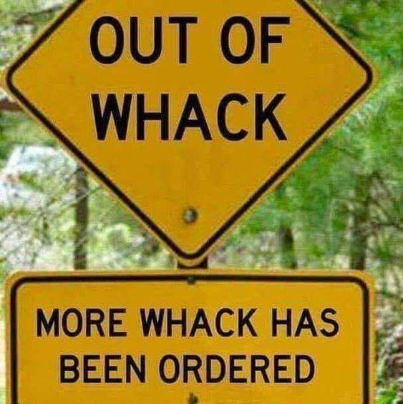
Notes:
Mordekhi Hiatt Facebook, I think

Slide 3
Notes:
Mordekhi Hiatt Facebook, I think

Slide 4

Notes:
We are at war, spiritually.
An illustration etched into the national consciousness…

Slide 5
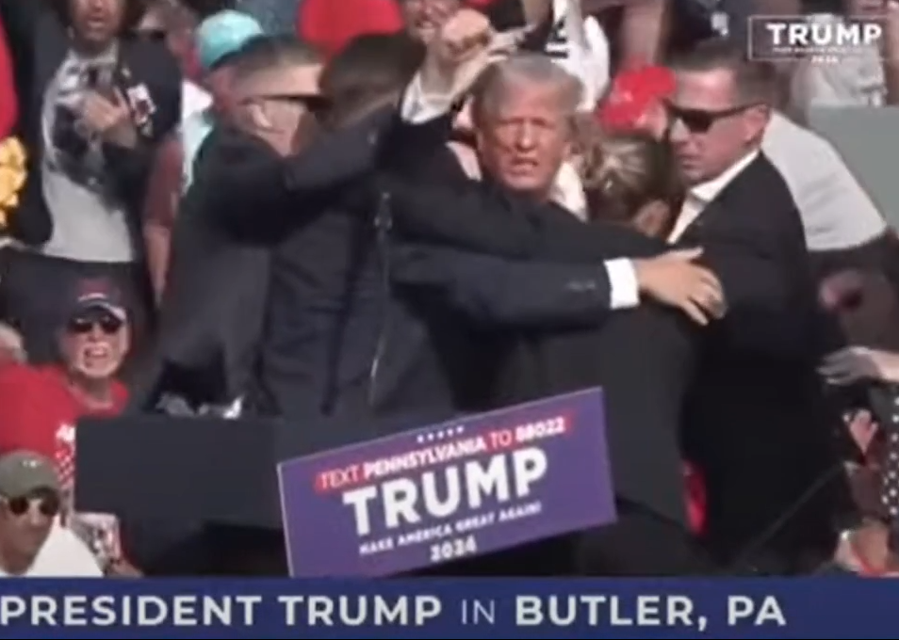
Notes:
https://youtu.be/LAk6dXEzIUo

Slide 6

Fight the good fight of the faith
The scripturality of the fight
What are the fights, the attacks?

Slide 7
Fight the good fight of the faith
The scripturality of the fight
What are the fights, the attacks?

Slide 8
^{1 Tim 6.12} Fight the good fight of the faith, take hold of the eternal life to which you were called when you testified so well to your faith before many witnesses.

Slide 9
^{Mtt 10 34-36} Yeshua: “Don’t suppose that I have come to bring peace to the Land. It is not peace I have come to bring, but a sword! For I have come to set a man against his father,

Slide 10
^{Mtt 10 34-36}“ a daughter against her mother, a daughter-in-law against her mother-in-law, so that a man’s enemies will be the members of his own household.

Slide 11
^{T’hillim / Ps 144.1} Blessed be Adoni, my rock, who trains my hands for war and my fingers for battle.
Notes:
It’s not pie in the sky in the sweet bye and bye.

Slide 12

Class 10 a.m., June 2, 2024
Notes:
Sunday morning, 15 of us had a
קרב מגע Krav Maga Israeli self defense lesson.

Slide 13
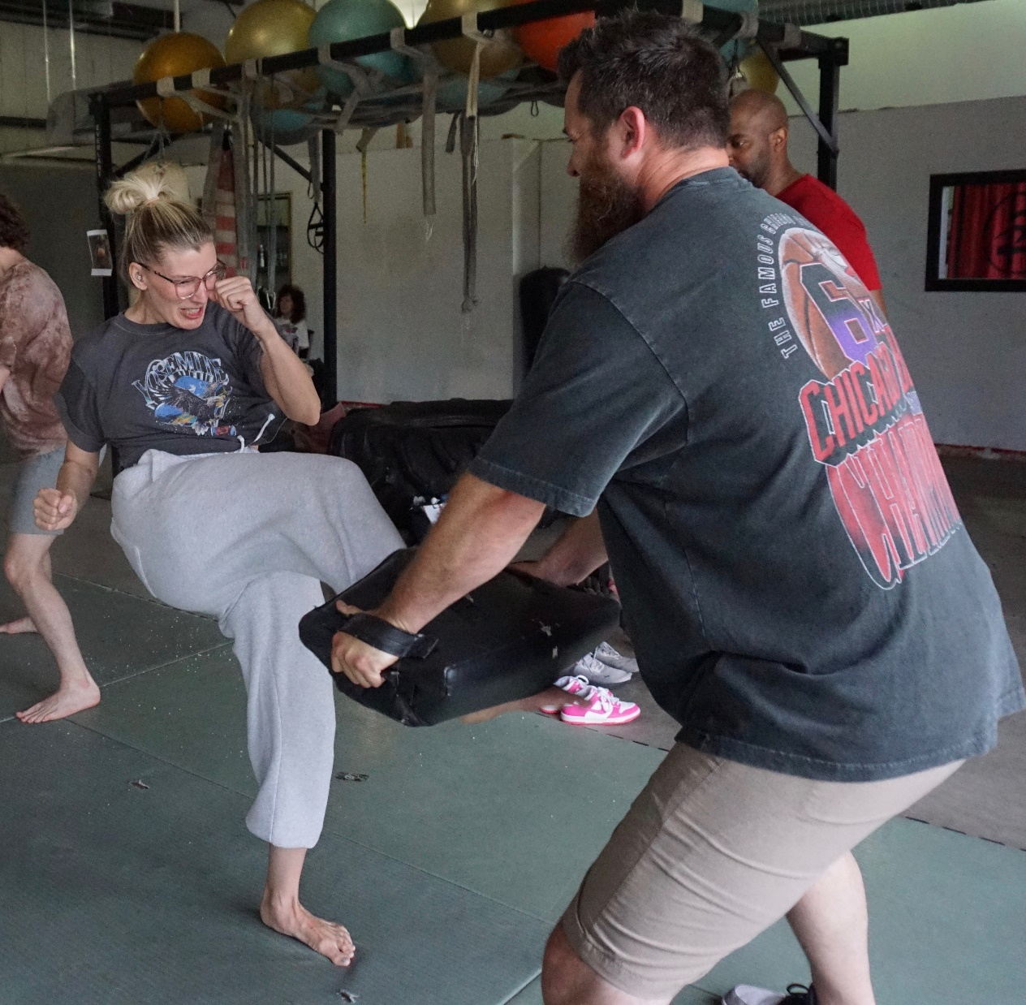
Notes:
Husband and wife

Slide 14
Notes:
Husband and wife, affectionate expression

Slide 15
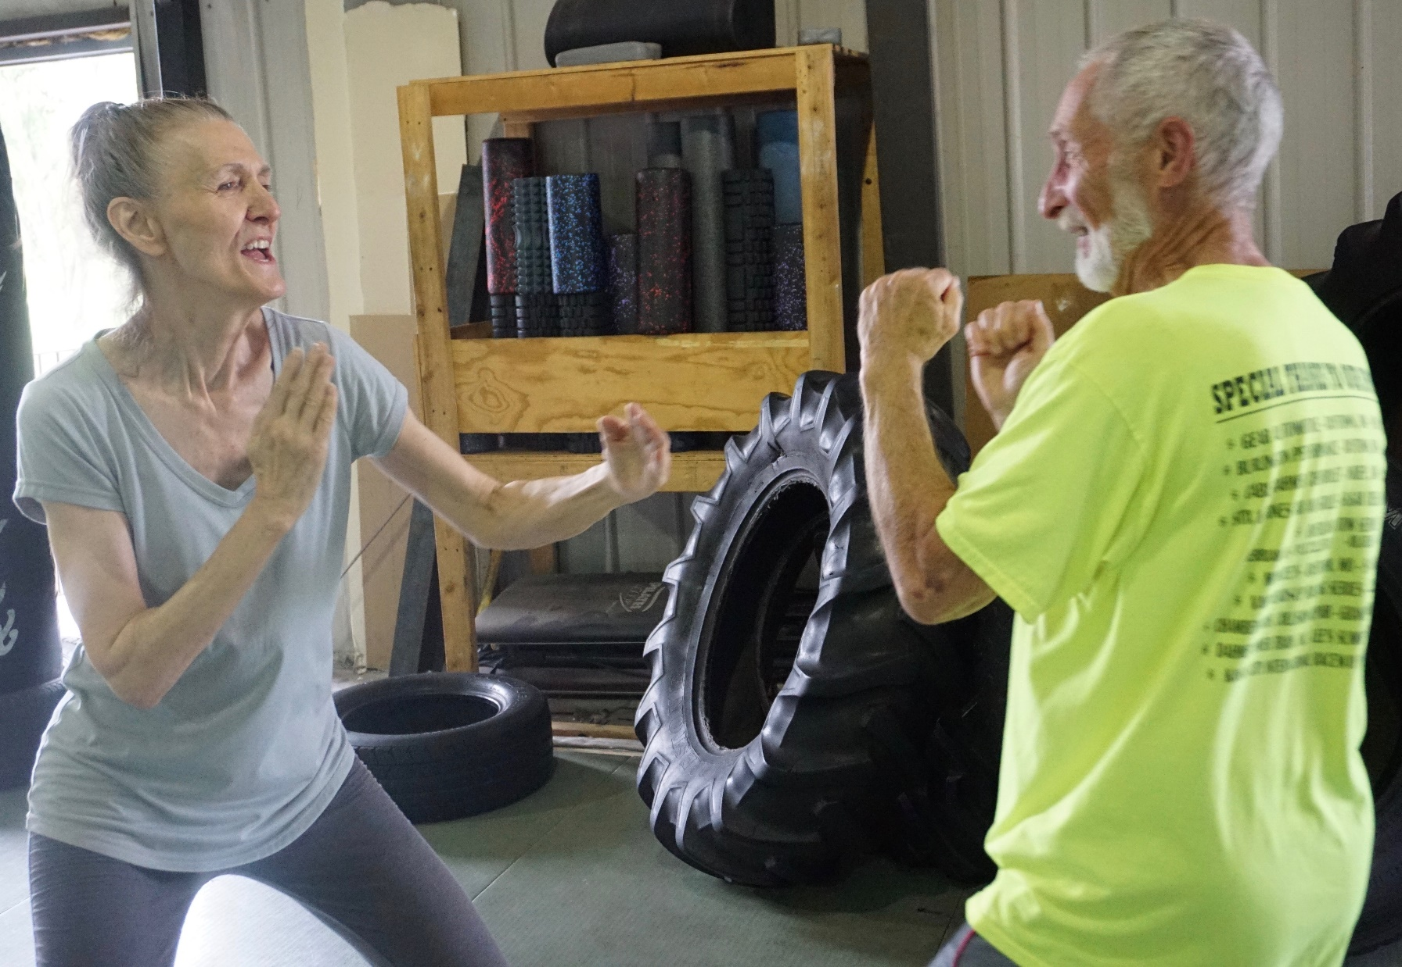
Notes:
Husband and wife

Slide 16
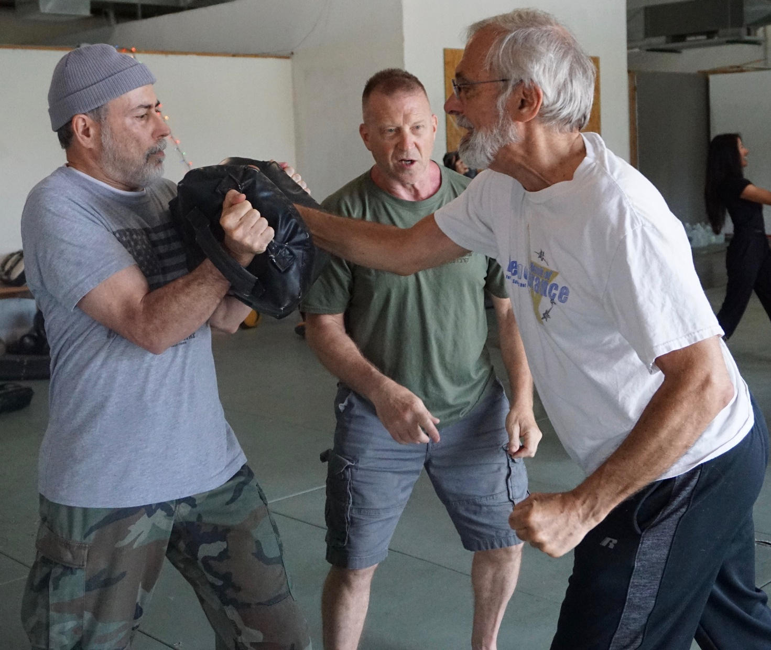
Notes:
Z’kenim, Elders

Slide 17
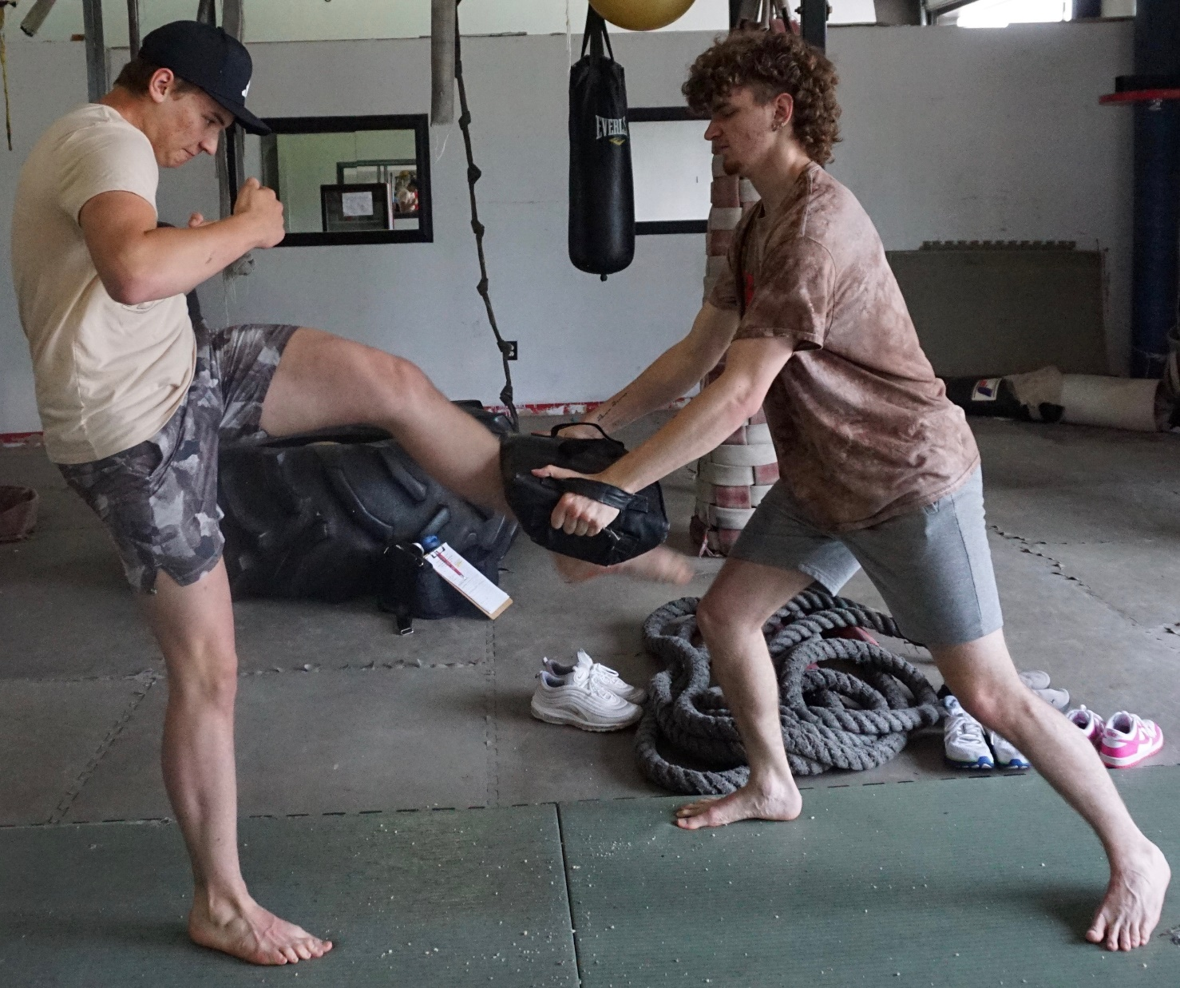
Notes:
Brothers

Slide 18
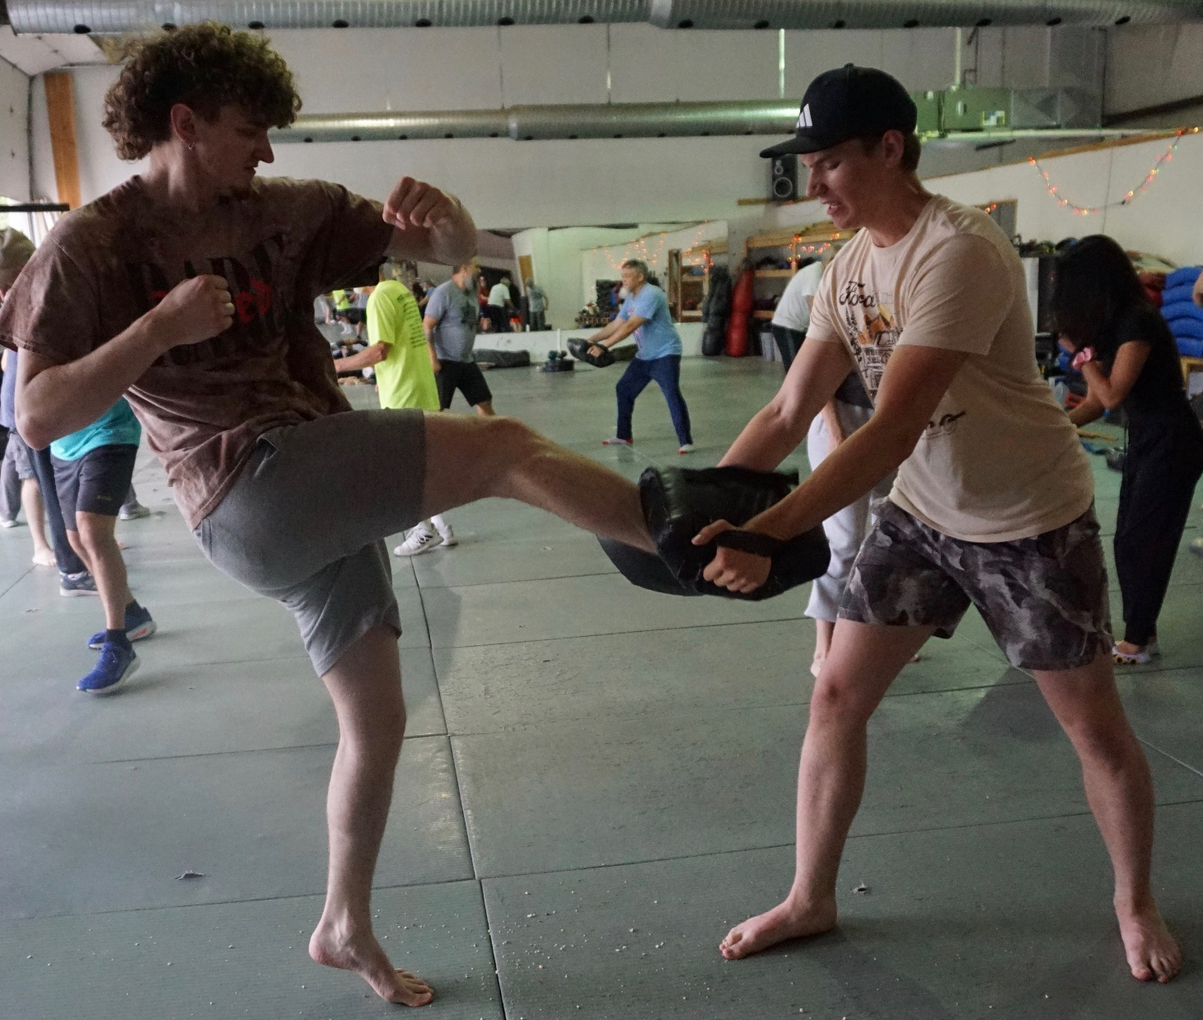
Notes:
brothers

Slide 19
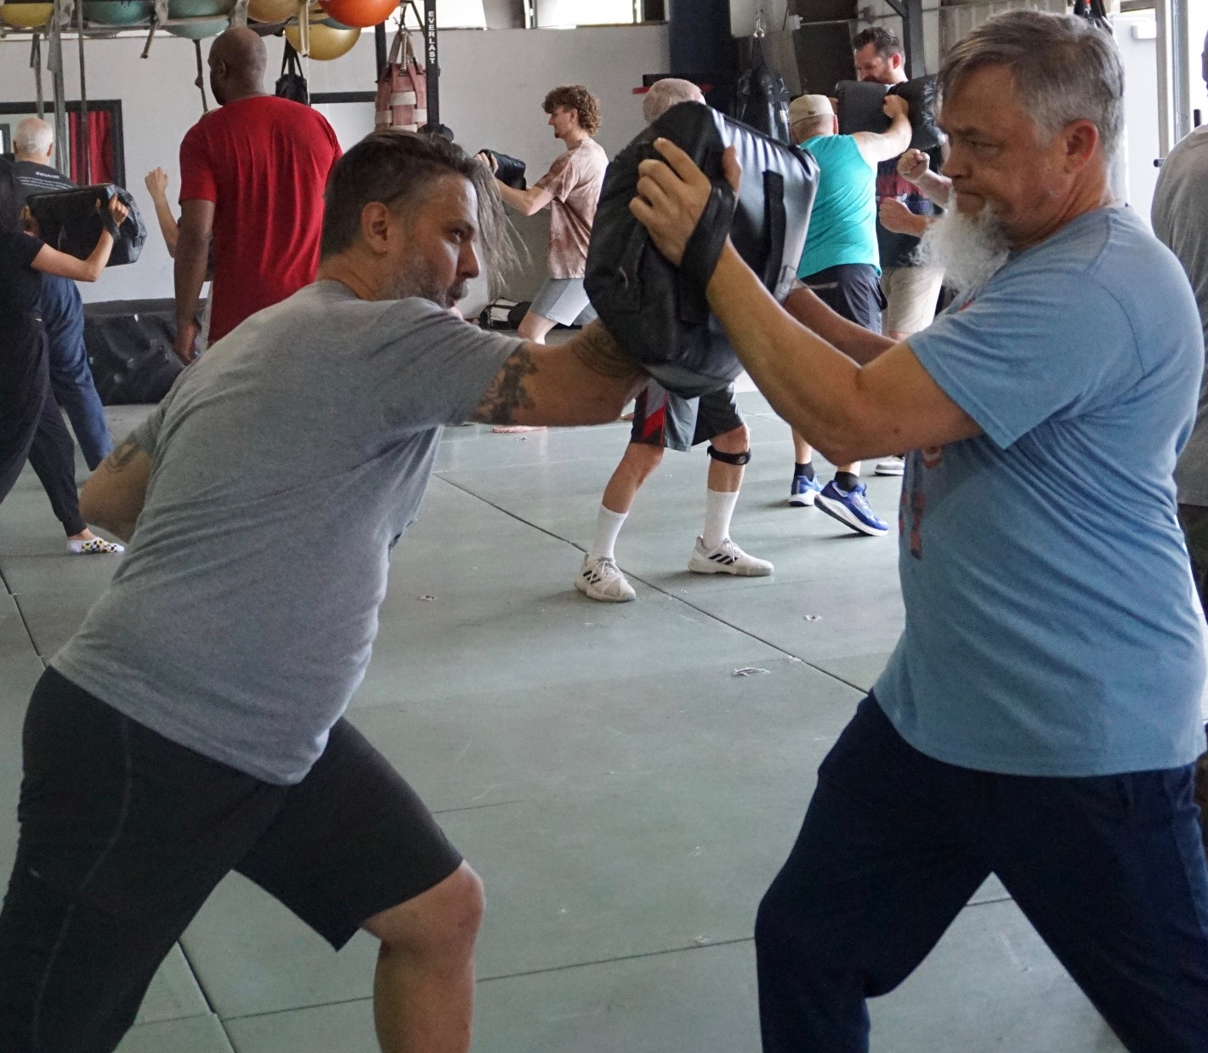
Notes:
Exemplary Leaders

Slide 20
Seriously…
^{Matt. 11.12} From the days of John the Immerser until now, the kingdom of heaven is treated with violence, and the violent grasp hold of it.
Notes:
One of my favorite scriptures, when life in Messiah gets difficult.

Slide 21
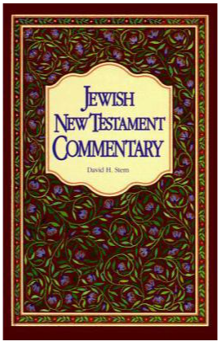
David Stern: The Greek is difficult.
As rendered, it means that violent ones (demons and their human vehicles) are trying to keep God from carrying out his plan through Yeshua,
Notes:
Block G-d’s purposes..

Slide 22
An alternative understanding, "...the Kingdom of Heaven has been advancing forcefully; and forceful people are seizing hold of it.”

Slide 23
^{Matt. 11.12} From the days of John the Immerser until now, the kingdom of heaven is treated with violence, and the violent grasp hold of it.
Notes:
We have to be sort of “spiritually violent” to persevere in the Kingdom of Messiah.

Slide 24
^{Eph 6.11-12} Use all the armor and weaponry that God provides, so that you will be able to stand against the deceptive tactics of the Adversary.

Slide 25
^{Eph 6.11-12} For we are not struggling against human beings, but against the rulers, authorities and cosmic powers governing this darkness, against the spiritual forces of evil in the heavenly realm.
Notes:
We ARE struggling.

Slide 27
Fight the good fight of the faith
The scripturality of the fight
What are the fights, the attacks?

Slide 28
^{2 Cor 7.5} When we came into Macedonia, our body had no rest. But we were hard pressed on every side — conflicts outside, fears within.
Notes:
External conflicts, internal turmoil

Slide 29
Most attacks are the work of HaSatan, the Adversary, accuser:
^{Rev 12.10} The accuser of our brothers and sisters—the one who accuses them before our God day and night.
Notes:
Fighting = dealing with accusations

Slide 30
Accusations of HaSatan:
Accuses G-d to us
Accuses us to G-d
Accuses other people to us
Accuses us to other people
Accuses us to ourselves

Slide 31
Accusations of HaSatan:
Accuses G-d to us
Accuses us to G-d
Accuses other people to us
Accuses us to other people
Accuses us to ourselves

Slide 32
Accuses G-d to us
^{Beresheet/Gen. 3.1-6} “Did God really say, ‘You must not eat from any tree in the garden’?”…“For God knows that when you eat from it your eyes will be opened,
Notes:
G-d accused of denying Hava and Adam insight, understanding

Slide 33
^{Beresheet/Gen. 3.1-6} “and you will be like God, knowing good and evil.”…the woman saw that the fruit of the tree was good for food and pleasing to the eye, and also desirable for gaining wisdom.”
Notes:
Accusation of denial of pleasure of taste and eye appeal, sensuality and ownership. Entitlement.

Slide 34
Do you ever feel G-d is unfair?
Not giving you what you are entitled to?
Notes:
Entitlement is a loaded word. We’re really not entitled to anything but the bread we get by the sweat of our face. Plus mercy if we’re not able to sweat.
But, easy to hear the accusation, “Not enough quantity or quality of bread, housing, car, medical care…”

Slide 35
Response:
Meditate on attributes of G-d in Messiah. High Holiday theme of Thirteen Attributes of Mercy.

Slide 36
^{Shmot/Ex 34.5-7} Adoni descended in the cloud, stood with him there and pronounced the name of Adoni. Adoni passed before him and proclaimed: “Adoni!!! Adoni is God,

Slide 37
^{Shmot/Ex 34.5-7} merciful and compassionate, slow to anger, rich in grace and truth; showing grace to the thousandth generation, forgiving offenses, crimes and sins; yet not exonerating the guilty.
Notes:
Zipporah Bennett has this set to music.
Again, HaSatan accuses G-d to us, in this case, to Yeshua.

Slide 38
^{Mtt 4.8-11} The Adversary took him up to the summit of a very high mountain, showed him all the kingdoms of the world in all their glory, and said to him, “All this I will give you [which you deserve] if you will bow down and worship me.”
Notes:
Here is an easy way to gain the Kingship you have coming to you. Much better than Your Father’s plan…of the execution torture stake. Sort of entitlement for Yeshua.

Slide 39
Response:
^{Mtt 4.8-11} “Away with you, Satan!” Yeshua told him, “For the Tanakh says, ‘Worship Adoni your God, and serve only him.’”
Notes:
Praise and worship are the greatest response to spiritual accusations of G-d, that your life is tooooo hard.

Slide 40
Peace be unto you, ministering angels, angels of the Most High, From the King, the King of Kings, the Holy One, Blessed be He.
May your arrival be to peace, angels of peace...

Slide 41
שָׁלוֹם עֲלֵיכֶם, מַלְאֲכֵי הַשָּׁרֵת,
Shalom a-lay-khem, mal-a-khay ha-sha-rayt
מַלְאֲכֵי עֶלְיוֹן, מִמֶּֽלֶךְ מַלְכֵי הַמְּלָכִים,
Mal-a-khay El-yon, Mee-meh-lekh mal-khay ha-m'la-kheem
הַקָּדוֹשׁ בָּרוּךְ הוּא
Ha-Kadosh ba-rookh hoo.

Slide 42
^{T’hillim / Ps 8.3} You established strength because of your foes, in order that you might silence the enemy and the avenger.
You are safe and secure from all your enemies; you stop anyone who opposes you.
Notes:
We want to enter into the silencing of the voice of accusation. The accuser is rebuked by Adoni! We enter that by praising G-d, loving Him.

Slide 43
Accusations of HaSatan:
Accuses G-d to us
Accuses us to G-d
Accuses other people to us
Accuses us to other people
Accuses us to ourselves

Slide 44
Satan as accuser before God
Already in Tanakh (Zech 3:1; Job 1:6; 2:1)
Jewish tradition amplified this: he accused Israel day and night except on Day of Atonement
But here Yeshua’s victory silences him
Ancient system of accusers vs. advocates (1 Jn 2:1)
Notes:
By Craig Keener Messiah Conf lecture

Slide 45
^{Eyov 1.6-11} It happened one day that the sons of God came to serve Adoni, and among them came the Adversary…The Adversary answered Adoni, “Is it for nothing that Iyov fears God? You’ve put a protective hedge around him,

Slide 46
^{Eyov 1.6-11} his house and everything he has. You’ve prospered his work, and his livestock are spread out all over the land. But if you reach out your hand and touch whatever he has, without doubt he’ll curse you to your face!”

Slide 47
Response: Commit to Him --
Eyov/Job 13.15 Even if He kills me, I will hope in Him.
הֵן יִקְטְלֵנִי, לוֹ אֲיַחֵל;
קָטַלto kill, to exterminate, to destroy ; to criticize
יִחֵל to hope for, to await, to look forward to

Slide 48
Our lives are a saga of great warfare, glorifying G-d.
^{Eyov/Job 19.23} I wish my words were written down, that they were inscribed in a scroll, that, engraved with iron and filled with lead, they were cut into rock forever.
Notes:
They were, that’s why we’re reading them!

Slide 49
^{Eph 2.6-7} God raised us up with the Messiah Yeshua and seated us with him in heaven, in order to exhibit in the ages to come how infinitely rich is his grace, how great is his kindness toward us who are united with the Messiah Yeshua.
Notes:
Response to accusation, feeling abandoned by G-d?
Thank Him for your adverse circumstances. You are a hero to G-d

Slide 50
^{T’hillim / Ps 8.3} You established strength because of your foes, in order that you might silence the enemy and the avenger.

Slide 51
Accusations of HaSatan:
Accuses G-d to us
Accuses us to G-d
Accuses other people to us
Accuses us to other people
Accuses us to ourselves

Slide 52
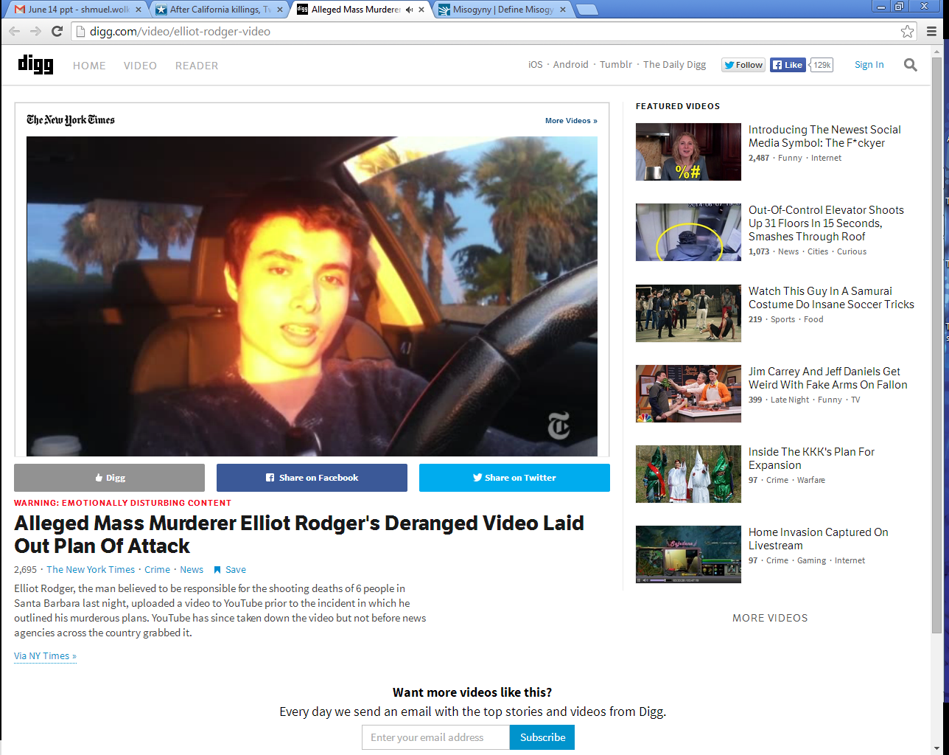
Elliot Roger in his BMW and
designer clothes, recording his
Plan of Retribution

Slide 53
His 144-page manifesto proclaimed, “I am going to enter the hottest sorority house of UCSB and I will slaughter every single spoiled,
Notes:
Univ CA Santa Barbara
Read more here: http://www.kansascity.com/news/local/article438881/After-California-killings-
Twitter%E2%80%99s-YesAllWomen-reveals-the-vast-extent-of-misogyny.html#storylink=cpy

Slide 54
stuck-up, blonde [chick] I see inside there, all those girls I’ve desired so much. They would have all rejected me.”
Notes:
Univ CA Santa Barbara
Read more here: http://www.kansascity.com/news/local/article438881/After-California-killings-
Twitter%E2%80%99s-YesAllWomen-reveals-the-vast-extent-of-misogyny.html#storylink=cpy

Slide 55
Elliot Rodger was the 22-year-old who on May 23, 2014, killed six University of California, Santa Barbara students and wounded 13 others before killing himself in a rampage ignited, at least in part, by his misogyny — an all-consuming hatred of women.
Notes:
That’s how the media describes it.
So superficial, and PC. Rather, believed a lie.
Read more here: http://www.kansascity.com/news/local/article438881/After-California-killings-
Twitter%E2%80%99s-YesAllWomen-reveals-the-vast-extent-of-misogyny.html#storylink=cpy

Slide 56
Misogyny noun hatred, dislike, mistrust of women
Rodger grew up in wealth. His father, Peter Rodger, is a photographer and director who worked on one of “The Hunger Games” movies. Some posit that Elliot Rodger’s belief that he was sexually overlooked emanates from an inflated sense of entitlement.
Notes:
Read more here: http://www.kansascity.com/news/local/article438881/After-California-killings-
Twitter%E2%80%99s-YesAllWomen-reveals-the-vast-extent-of-misogyny.html#storylink=cpy

Slide 57
Others point to a history of mental illness. They speak of his overt narcissism, laid bare on a foundation of feeling weak, like nothing, diminished and overlooked.
Notes:
“They would have all rejected me.” He believed
a lie.
Read more here: http://www.kansascity.com/news/local/article438881/After-California-killings-
Twitter%E2%80%99s-YesAllWomen-reveals-the-vast-extent-of-misogyny.html#storylink=cpy

Slide 58
Rodger, referring to himself as the “supreme gentleman,” said in his video, “I will take great pleasure in slaughtering all of you. You will finally see that I am, in truth, the superior one, the true alpha male.”
Notes:
“They would have all rejected me.” He believed
a lie.
Read more here: http://www.kansascity.com/news/local/article438881/After-California-killings-
Twitter%E2%80%99s-YesAllWomen-reveals-the-vast-extent-of-misogyny.html#storylink=cpy

Slide 59
I believe there is a guaranteed way to win in every conflict.
The winner is the first one to see and say:
“I was wrong in xxxx. Will you forgive me?”
No “you” statements. Only “I”
Notes:
Always works in marriage.
Most conflictive situation of my life, some of you were involved, I won one confrontation because I found a way to do this.
Fighting = dealing with accusations

Slide 60
^{T’hillim/Ps 141.5-8} Let the righteous strike me, let him correct me; it will be an act of love. Let my head not refuse such choice oil.
Notes:
for I will keep on praying about their wickedness.
Righteous don’t always correct with love. But take it as one from G-d.

Slide 61
Accusations of HaSatan:
Accuses G-d to us
Accuses us to G-d
Accuses other people to us
Accuses us to other people
Accuses us to ourselves

Slide 62
^{Mishlei/Prov 16.28} A whisperer separates close friends.
וְנִרְגָּן מַפְרִיד אַלּוּף
נִרְגָּן complaining, grumbling
Notes:
This is almost inevitable in our community, since we are working for the redemption of Yisrael, which is the key to the redemption of the world!

Slide 63
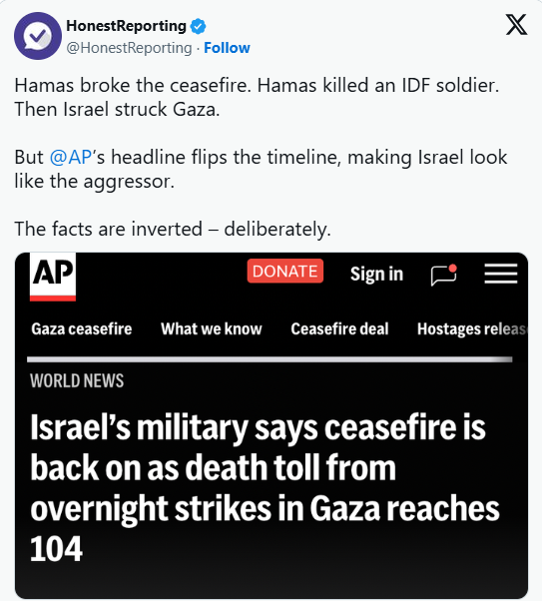
Notes:
https://unitedwithisrael.org/media-bias-on-full-display-hamas-violates-israel-blamed/

Slide 64
Notes:
https://unitedwithisrael.org/media-bias-on-full-display-hamas-violates-israel-blamed/
Israel is blamed. Nigerian true genocide ignored by the media, Jews didn’t do it.

Slide 65
Moshe accused
Ch 12, accused in regard to whom he married
Ch 14: giving them an impossible task: Giants
Ch 16: promoting himself to cohanut / priesthood

Slide 66
^{Bamidbar/Nu 16.1-3} Now [three groups]
Korach the son of Yitz'har, the son of K'hat, the son of Levi,
along with Datan and Aviram, the sons of Eli'av, and
On, the son of Pelet, descendants of Re'uven, took men and rebelled against Moshe.
Notes:
Analysis three groups
Proposed trial by ordeal of Leviim, with censers
With Datan and Aviram Moshe wanted to talk
On? Sages say his wise and righteous wife persuaded him to withdraw. Men: listen to the wise counsel of your wife. Almost always, she’s right. Almost.

Slide 67
^{Bamidbar/Nu 16.1-3} You take too much on yourselves! After all, the entire community is holy, every one of them. After all, the entire community is holy, every one of them and ADONI is among them. So why do you lift yourselves up above ADONI’s assembly?"
Notes:
This option is NOT usually available to us in our situations of accusation.

Slide 68
^{BaMidbar/Nu 16.28-31} Moshe said, "Here is how you will know that ADONI has sent me to do all these things and that I haven't done them out of my own ambition:

Slide 69
^{BaMidbar/Nu 16.28-31} if these men die a natural death like other people, only sharing the fate common to all humanity, then ADONI has not sent me. But if ADONI does something new -

Slide 70
^{BaMidbar/Nu 16.28-31} - if the ground opens up and swallows them with everything they own, and they go down alive to Sh'ol - then you will understand that these men have had contempt for ADONI ." The moment he finished speaking, the ground under them split apart -

Slide 71
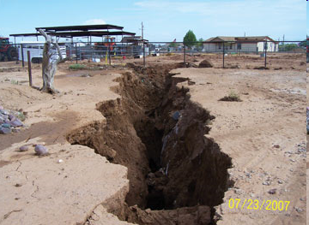

Slide 72
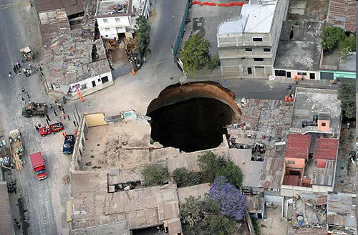
Notes:
Guatemala, also Florida sinkholes
It seems that this should address the issue of authority and justice. ~300 people died
This option is not usually available to us in situations of accusation.

Slide 73
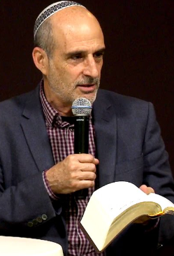
Asher Intrater:
The Haredim are saying that for the sake of the Torah, the government is doing them wrong to require them to serve in the army.
Notes:
https://www.tikkunglobal.org/post/torah-on-war

Slide 74
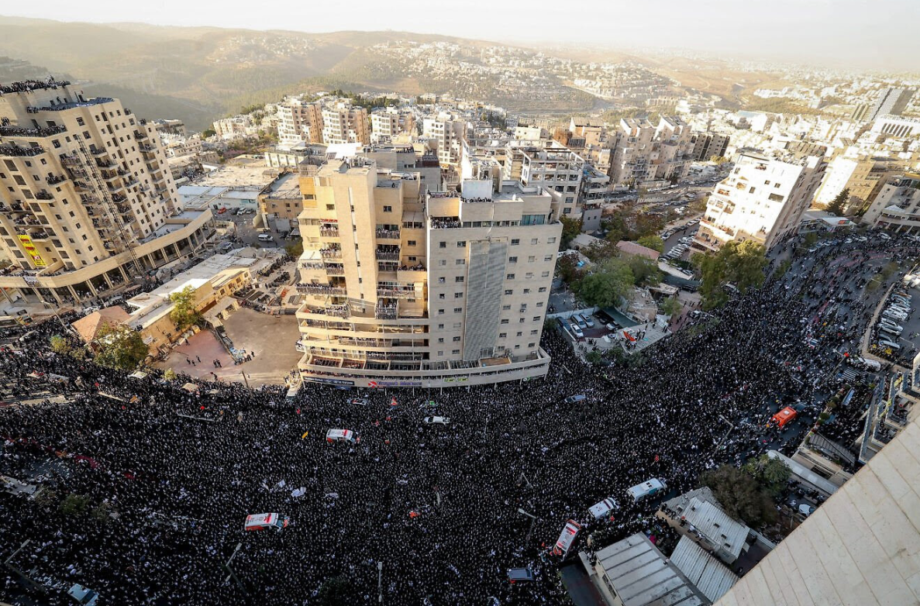
Notes:
Ultra-Orthodox Jewish men block a road during a protest Thursday, Oct. 30, 2025 against the jailing of Jewish seminary students who failed to comply with an army recruitment order in Jerusalem, August 7, 2025. (Photo: Yonatan Sindel/Flash90)
https://res.cloudinary.com/hb0stl6qx/image/upload/w_900,c_scale,q_auto,f_auto,dpr_auto/v1761811040/F250807YS10_x4rumx.jpg

Slide 75
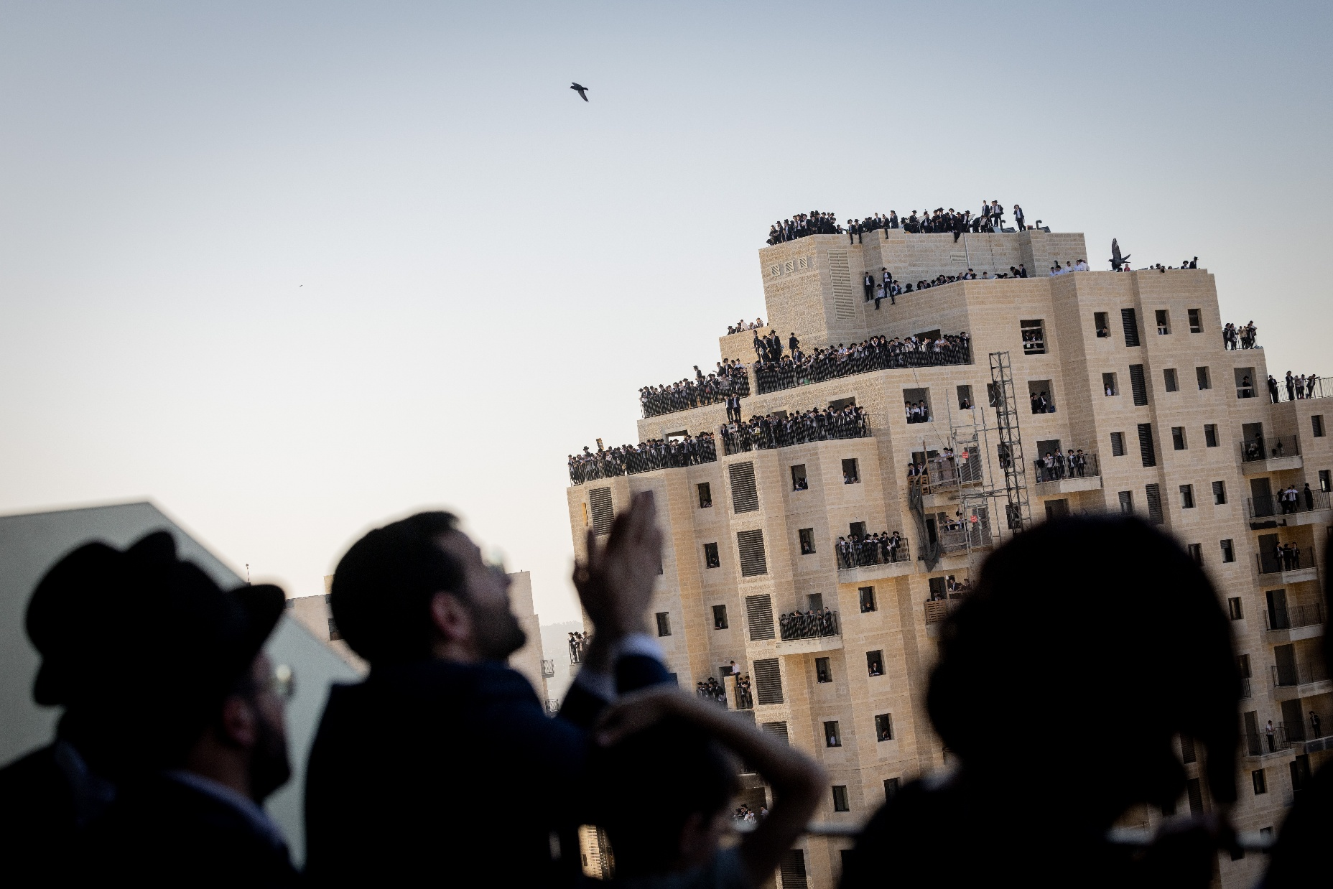
Notes:
Not without danger: ultra-Orthodox Jews on rooftops in Jerusalem during the “million-man demonstration” against compulsory military service. Photo: Chaim Goldberg/Flash90.
While the event began peacefully, a tragic accident occurred on the sidelines. A 15-year-old participant fell from a construction site near the protest area and succumbed to his injuries. Police and rescue forces worked nonstop, and the main entrances to Jerusalem were closed to manage the enormous influx of people.

Slide 76
^{Ber Gen 14:14} And Abram heard that his brother had been taken captive, he enlisted all of his trained men, 318, born of his household, and pursued unto Dan.
Notes:
Abram, later called Avraham, had an army and fought to rescue is nephew Lot.

Slide 77
^{Ex 17:9} And Moshe said to Joshua, choose for us men and go out to fight against Amalek.

Slide 78
Moshe angrily challenges the two and a half tribes east of the Jordan that they must fight together with the other tribes in the land of Canaan.
^{Nu 32:6} Will your brothers go out to war, and you will sit here?
Notes:
Literally applies to the current situation with the Haredim, Ultra Orthodox

Slide 79
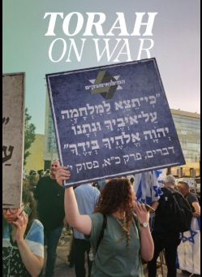
^{Dt 21:10} When you go out to war against your enemies, and YHVH your God gives them into your hand, and you take captives…
Notes:
https://www.tikkunglobal.org/post/torah-on-war

Slide 80
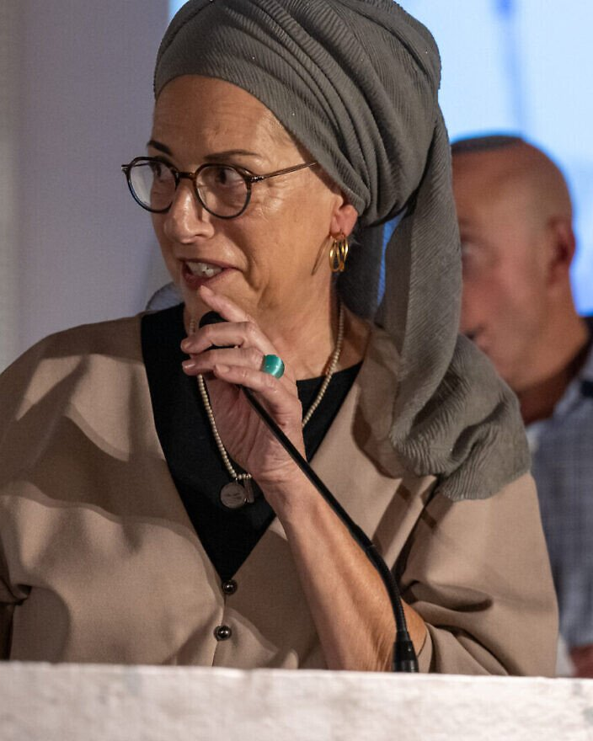
Ditza Or, whose son Avinatan Or was released in the last ceasefire deal,
Notes:
speaks at "The Future of Judea and Samaria" conference at the Inbal Hotel in Jerusalem on Oct. 29, 2025. Photo by Matt Kaminisky/JNS.

Slide 81

Former captives Noa Argamani and Avinatan Or are reunited, Oct. 13, 2025. Credit: IDF.
Notes:
https://www.israeltoday.co.il/read/mother-of-freed-hostage-now-is-time-to-fulfill-israels-divine-destiny/?mc_cid=f0410d2344&mc_eid=9f06d9f262

Slide 82
(JNS) Ditza Or, mother of Avinatan Or, who survived 738 days in Hamas captivity, said on Wednesday that the Jewish people stands at a historic crossroads.
Notes:
https://www.israeltoday.co.il/read/mother-of-freed-hostage-now-is-time-to-fulfill-israels-divine-destiny/?mc_cid=f0410d2344&mc_eid=9f06d9f262

Slide 83
Ditza Or belonged to the Tikva Forum, an alternative group to the Hostages and Missing Persons Families Forum. Unlike the latter, which demanded a deal to free the hostages immediately, the Tikva Forum argued that the nation’s interest took precedence over their own or those of their family members.
Notes:
https://www.israeltoday.co.il/read/mother-of-freed-hostage-now-is-time-to-fulfill-israels-divine-destiny/?mc_cid=f0410d2344&mc_eid=9f06d9f262
In other words, defeating Hamas is MUCH more important than the hostages. Unless Hamas is totally destroy, there will be more Oct. 7. That is what Hamas says.
60% of tunnels still intact!
20,000 Hamas fighters still! Israel took out 22,000

Slide 85
Accusations of HaSatan:
Accuses G-d to us
Accuses us to G-d
Accuses other people to us
Accuses us to other people
Accuses us to ourselves

Slide 86
Fight for our synagogue priorities
Our relationship with Messiah
Sharing that with people: Jews and the Nations
The survival and blessing of Jewish people and Israel
Context of Keeping of Torah
Notes:
Our personal salvation, forgiveness
Sharing salvation, peace with G-d, knowing that people are in the Book of Life
Loving Jewish people and Israel
Torah is our functional grid, how we live, not our end.

Slide 87
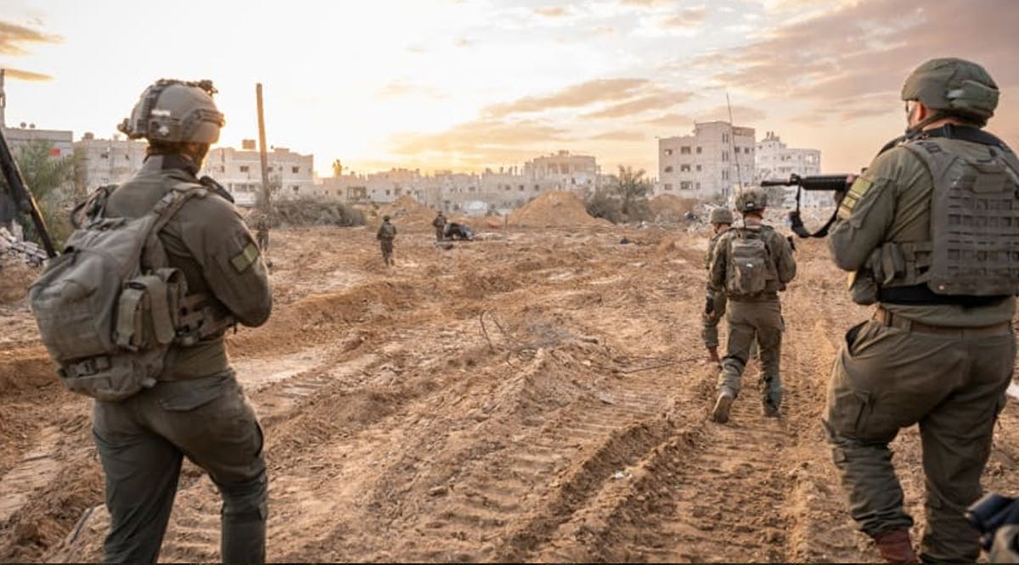
Notes:
https://vfinews.com/news/red-cross-rebukes-hamas-over-staged-hostage-body-h/279-idf-soldiers-attempted-suicide-since-start-of-

Slide 88
A report published on Tuesday, October 28, 2025, by the Knesset Research and Information Center found that from January 2024 through July 2025, 279 Israel Defense Forces soldiers attempted to take their own lives. 39 did take their own lives, which illuminates the scale of distress within the ranks nearly two years into the war.
Notes:
https://vfinews.com/news/red-cross-rebukes-hamas-over-staged-hostage-body-h/279-idf-soldiers-attempted-suicide-since-start-of-

Slide 89
^{Roman 8} Therefore, there is no longer any condemnation awaiting those who are in union with the Messiah Yeshua. Why? Because the Torah of the Spirit, which produces this life in union with Messiah Yeshua, has set me free from the "Torah" of sin and death…

Slide 90
^{Roman 8} For I am convinced that neither death nor life, neither angels nor other heavenly rulers, neither what exists nor what is coming, neither powers above nor powers below, nor any other created thing will be able to separate us from the love of God which comes to us through the Messiah Yeshua, our Lord.

Slide 91
Accusations are usually half truths because we all always could do better.

Slide 92
Accusations that are patently absurd don’t hurt at all. Usually laughable.

Slide 93
^{Mishlei/Prov 26.2 CEB} Like a darting sparrow, like a flying swallow, so an undeserved curse never arrives.
^{ESV} Like a sparrow in its flitting, like a swallow in its flying, a curse that is causeless does not alight.
כַּצִּפּוֹר לָנוּד, כַּדְּרוֹר לָעוּף --כֵּן קִלְלַת חִנָּם לא תָבֹא.
Notes:
sparrow, as the word is sometimes rendered, leaves its nest and wanders from it; and flies here and there, and settles nowhere;
like Shimei's cursing David;
The Septuagint takes in both,
``so a vain curse shall not come upon any;''
דְּרוֹר dror
liberty

Slide 94
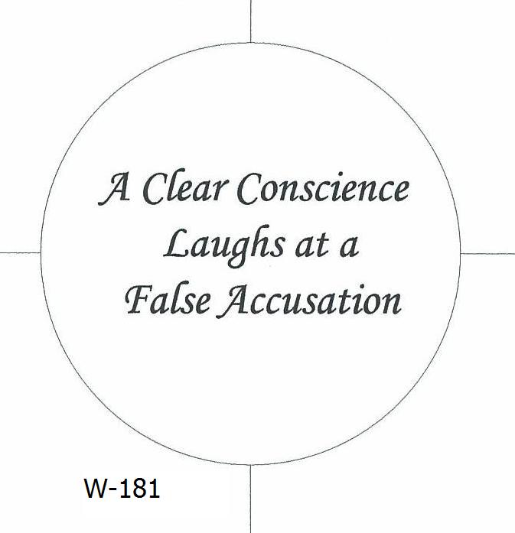

Slide 95
^{1 Cor. 4.3-5} And it matters very little to me how I am evaluated by you or by any human court; in fact, I don't even evaluate myself. I am not aware of anything against me, but this does not make me innocent. The one who is evaluating me is the Lord. So don't pronounce judgment prematurely, before the Lord comes;
Notes:
In this case, he deferred judgment to G-d

Slide 96
^{T’hillim / Ps 8.3} You established strength because of your foes, in order that you might silence the enemy and the avenger.

Slide 97

You are guilty!

Slide 98
^{Rev. 129-10} "Now have come God's victory, power and kingship, and the authority of his Messiah; because the Accuser of our brothers, who accuses them day and night before God, has been thrown out!
Notes:
Satan doesn’t care if accusations are true. Just loves to accuse, condemn. Difference between conviction of the Ruakh, gentle, intreatable, and accusations. But they sound and feel very similar, since HaSatan can transform himself into an angel of light.
Satan can imitate the light of G-d’s truth, but he cannot imitate the warmth of G-d’s love.

Slide 100
Accusations of HaSatan:
Accuses G-d to us
Accuses us to G-d
Accuses other people to us
Accuses us to other people
Accuses us to ourselves
Notes:
Fighting = dealing with accusations

