Slide 1
Three news items

Slide 2


Slide 3
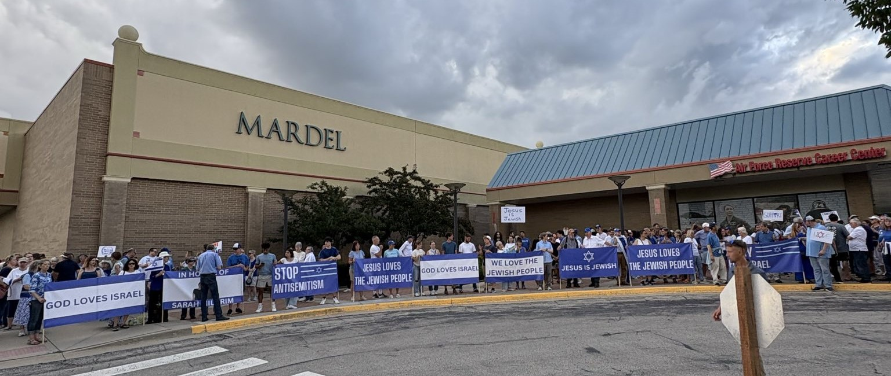

Slide 4
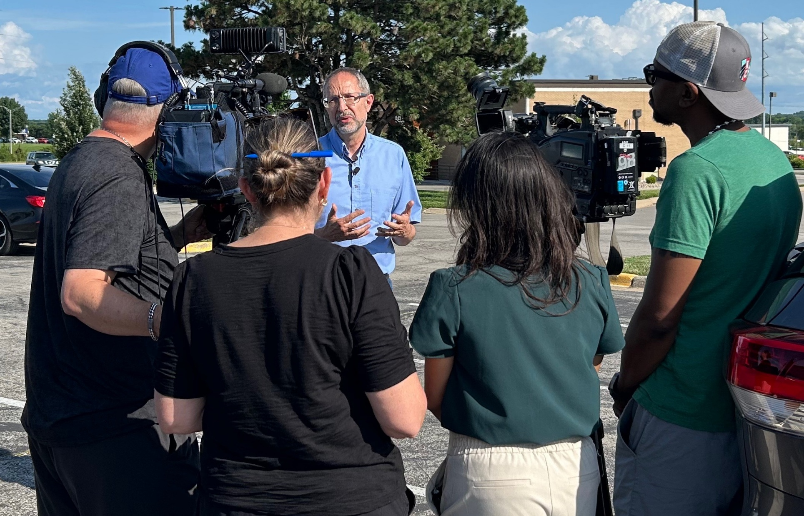

Slide 5
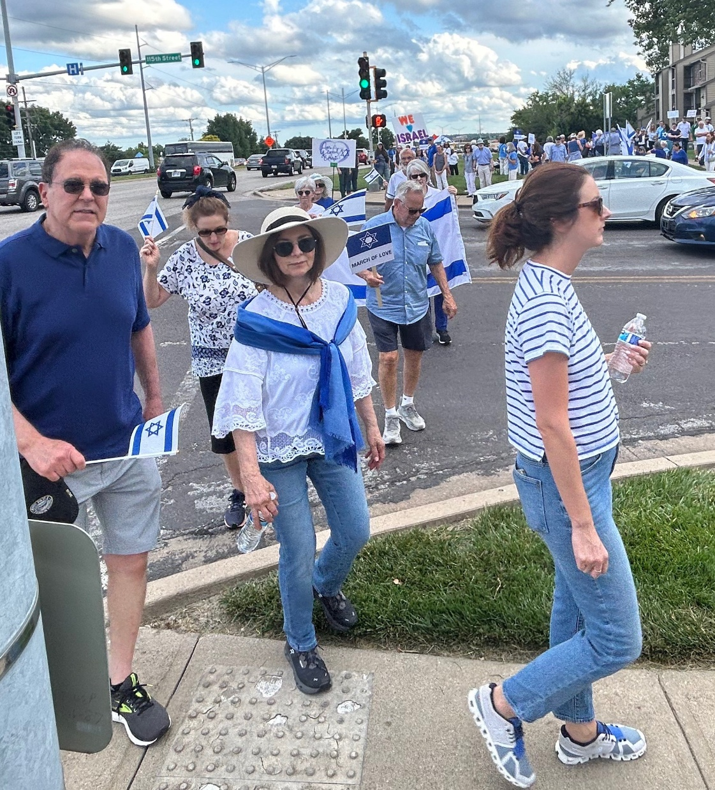

Slide 6
March of Love video

Slide 8

Israel Mossad secret services used a fake phone call to trick the top commanders of Iran’s air force into gathering at a single location before taking them out in a targeted strike, an Israeli Channel 12 commentator has said.
Notes:
https://www.thejc.com/news/israel/israeli-secret-services-used-fake-phone-call-to-lure-irans-air-force-elite-to-their-deaths-ejqk7guy

Slide 9
In a statement confirmed to the JC by Israeli sources, Amit Segal told the Call Me Back podcast on Monday: “What Israel did was create a fake phone call for 20 members of the air force senior staff calling them to a specific bunker in Tehran.”
This meant there was no one to give the order to fire the initial salvo of 1,000 ballistic missiles as Iran had previously threatened to do, he added.
Notes:
https://www.thejc.com/news/israel/israeli-secret-services-used-fake-phone-call-to-lure-irans-air-force-elite-to-their-deaths-ejqk7guy

Slide 10
According to sources familiar with the operation, Mossad initiated a targeted disinformation effort days before the strike. Using falsified communications through Iranian channels, they triggered what appeared to be an emergency meeting. The ruse successfully drew the entire senior leadership of Iran’s Islamic Revolutionary Guard Corps (IRGC) Aerospace Force,

Slide 11
including Commander General Amir Ali Hajizadeh, his deputies, and key technical personnel, into a fortified bunker outside Tehran.
Moments before the strike began, that bunker was hit in a precision airstrike, eliminating Iran’s top missile command.
Notes:
Now I have a bit more understanding why the Israeli brass underestimated and missed the Hamas attack. They were consumed with spending years and years planning the beeper attack on Hezbollah, and years planning this Mossad op in Iran. Relative to Hezbollah and Iran, Hamas seemed trivial and pacified.

Slide 13
The most idiotic comment by a newscaster I’ve heard in my life.
Sunday, June 8, ABC-7 Los Angeles anchor Jory Rand…
Notes:
Legacy media…

Slide 14
Rioters are just “having fun watching cars burn.” On Sunday, June 8, ABC-7 Los Angeles anchor Jory Rand warned, if President Trump moved law enforcement to stop the violence, he could “turn what is just a bunch of people having fun watching cars burn into a massive confrontation.”
Notes:
Until I read this, I would have thought that burning a car is a MAJOR felony act of arson and vandalism
https://washingtonstand.com/commentary/trump-is-americas-hitler-the-10-most-outrageous-comments-about-the-la-riots

Slide 15
Protesters set at least six Waymo electric taxis on fire during the riots. “Burning lithium-ion batteries release toxic gases, including hydrogen fluoride, posing risks to responders and those nearby,” warned the L.A. Police Department.
Notes:
Trump is “America’s Hitler.” Rep. Eric Swalwell (D-Calif.) doubled down on the 2024 campaign’s losing message, telling Saturday’s “No Kings” rally, “Donald Trump is America’s Hitler.”
https://washingtonstand.com/commentary/trump-is-americas-hitler-the-10-most-outrageous-comments-about-the-la-riots

Slide 17
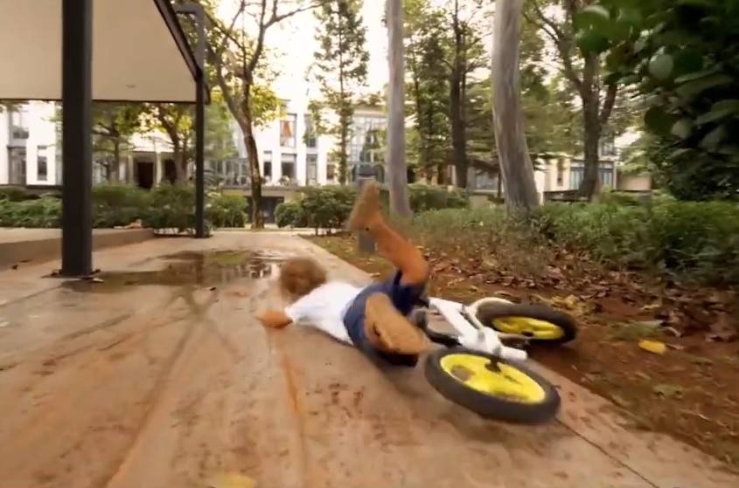
Resilience
Notes:
https://www.dailywire.com/episode/resilience?elementPosition=0&row=0&rowHeadline=More+Episodes&rowType=Horizontal+Show+Episodes+Carousel
0.05 to 0.59

Slide 18

Notes:
Not a scriptural word, but certainly scriptural meaning

Slide 19
Resilience
/rəˈzilēəns/ noun
1.the capacity to recover quickly from difficulties; toughness:
Notes:
https://search.yahoo.com/yhs/search?p=resilience%20definition&hspart=fc&hsimp=yhs-90&type=fc_AC22890F0FA_s69_g_e_d_n1_c999&param1=7&param2=eJwtjstuwyAURH%2BFZSIBvhdsU8KqqesPqLoqYuE41EHGD%2FkhV%2F36iiqazWh0RjpduFvjPioEKKSUlrrRGoeWurRb6lprnNbaUhdma5xUHDUXABwhUZ2frHH7aqnbG2vcMP2GGJus4EBORxjv07GScSMIHAw5wljmhvyU%2BZk08xz94W992LJCKi5Lcuof2xApiaH3pPNtP51J%2B1imwWcoFYcUsjbfzRKel6S1hqfqvvrlv79UtQRVActVdWWINTAtyivTKF%2FzN5BK1e%2BJbxMsQBQMSobiU4iLwAsWXOb49Qd5RlEQ

Slide 20
Resilience
2.the ability of a substance or object to spring back into shape; elasticity:“ nylon is excellent in wearability and resilience"

Slide 21
^{Matt 24. 4-14} Yeshua replied: “Watch out! Don’t let anyone fool you! For many will come in my name, saying, ‘I am the Messiah!’ and they will lead many astray. You will hear the noise of wars nearby and the news of wars far off; see to it that you don’t become frightened. Such things must happen,

Slide 22
^{Matt 24. 4-14} but the end is yet to come. For peoples will fight each other, nations will fight each other, and there will be famines and earthquakes in various parts of the world; all this is but the beginning of the ‘birth-pains.’ At that time you will be arrested and handed over to be punished and put to death, and all peoples will hate you because of me.

Slide 23
^{Matt 24. 4-14} At that time many will be trapped into betraying and hating each other, many false prophets will appear and fool many people; and many people’s love will grow cold because of increased distance from Torah.

Slide 24
^{Matt 24. 4-14} But whoever holds out till the end will be delivered. And this Good News about the Kingdom will be announced throughout the whole world as a witness to all the Goyim. It is then that the end will come.
Notes:
Pause & Pray

Slide 25

Resilience Phil 4.11-13
Not automatic
Life can crush us
Jordan B. Peterson
James Dobson
Israeli Jewish response
Eitan Shishkoff

Slide 26
Resilience Phil 4.11-13
Not automatic
Life can crush us
Jordan B. Peterson
James Dobson
Israeli Jewish response
Eitan Shishkoff

Slide 27
^{Phil 4.11-13} Not that I am saying this to call attention to any need of mine; since, as far as I am concerned, I have learned to be content regardless of circumstances. I know what it is to be in want,

Slide 28
^{Phil 4.11-13} and I know what it is to have more than enough — in everything and in every way I have learned the secret of being full and being hungry, of having abundance and being in need. I can do all things through him who gives me power.

Slide 29
“I have learned”
Resilience to tragedy does NOT come instantly with salvation, new birth, life in Messiah.
Two Greek words for
“I have learned.”
Notes:
I’m not minimizing these. I well remember my April 13,1969 experience of forgiveness, G-d’s love in Yeshua, new LIFE.
This message is so that all of us can soon say, or say better, “I have learned.”

Slide 30
^{Phil 4.11} I have learned to be content regardless of circumstances.

Slide 31

manthánō (akin tomathētḗs, "a disciple") – properly, learning key facts; gaining "fact-knowledge as someone learns from experience, often with the implication of reflection – 'come to realize' "
Notes:
Part of talmidut, discipleship, military drill, playing an instrument.

Slide 32
^{Phil 4.12} in everything and in every way I have learned the secret of being full

Slide 33

myéō (akin to mystḗrion, "mystery") – properly, shutting the eyes and mouth to experience mystery; (figuratively) initiated into the wonderful "mystery revelation" of learning to be content in Messiah in every scene of life – no exceptions!
Notes:
https://biblehub.com/interlinear/philippians/4-12.htm
The metaphor was also used of "the initiatory rites of the pagan mysteries. 'I have been initiated’ “
So, a sort of “Aha” moment. Revelation, insight.
I have learned…to bounce back.

Slide 35
Resilience Phil 4.11-13
Not automatic
Life can crush us
Jordan B. Peterson
James Dobson
Israeli Jewish response
Eitan Shishkoff

Slide 36
^{2 Cor 1.8-9} For, brothers, we want you to know about the trials we have undergone in the province of Asia. The burden laid on us was so far beyond what we could bear that we even despaired of living through it. In our hearts we felt we were under sentence of death.

Slide 37
^{T’hillim/Ps 13.2-4} For the leader. A psalm of David: How long, Adoni? Will you forget me forever? How long will you hide your face from me? How long must I keep asking myself what to do, with sorrow in my heart every day?

Slide 38
^{T’hillim/Ps 13.2-4} How long must my enemy dominate me? Look, and answer me, Adoni my God! Give light to my eyes, or I will sleep the sleep of death.
Notes:
David is writing about how he was overwhelmed. No bounce back, resilience.
You ever feel that way?

Slide 39
Jews and other ethnicities have an exaggerated “gevalt” response to tragedy.

Slide 40
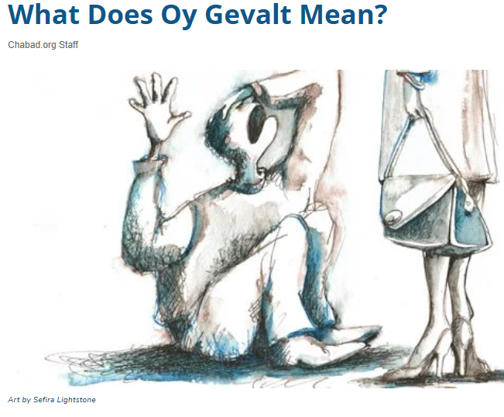
Oy, Gevalt!
Notes:
(used to express dismay, pain, shock, grief, etc., or as a cry for help).
Gevaltism

Slide 42
Resilience Phil 4.11-13
Not automatic
Life can crush us
Jordan B. Peterson
James Dobson
Israeli Jewish response
Eitan Shishkoff

Slide 43
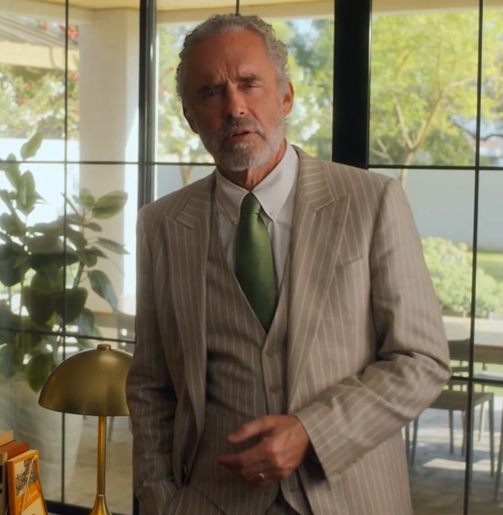
Jordan B. Peterson teaches resilience to parents of a debilitated child, applies to all of us.
Notes:
Learn to face tragedy

Slide 44
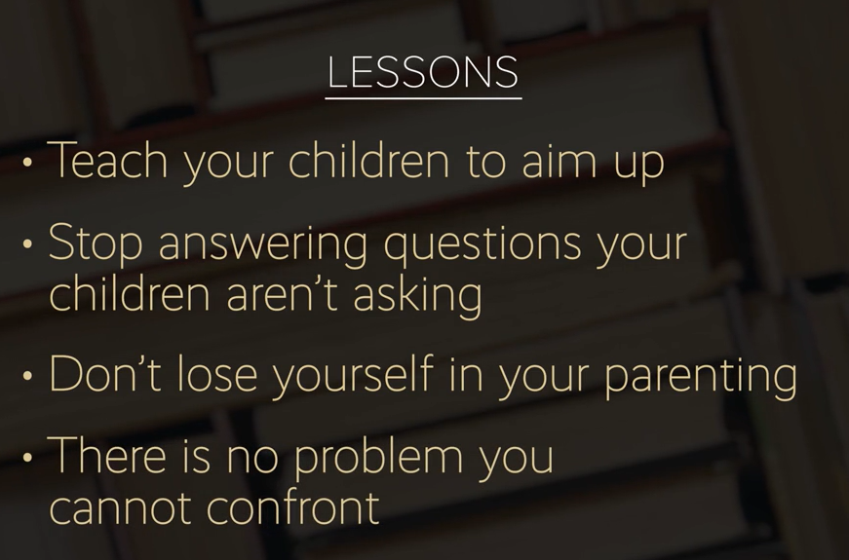

Slide 45
aim up: the more lofty the goal, the more rewarding to achieve it or come close
JP has daughter with degenerative condition. He and his wife set aside time, condition off the table.
Compartmentalize, you have other children, each other.

Slide 46
Model that the parents are NOT in despair.
Don’t assume that the thing that you’re most terrified is the thing that is going to happen. Practice being grateful for the things you do have.
Notes:
Gevaltism.

Slide 47
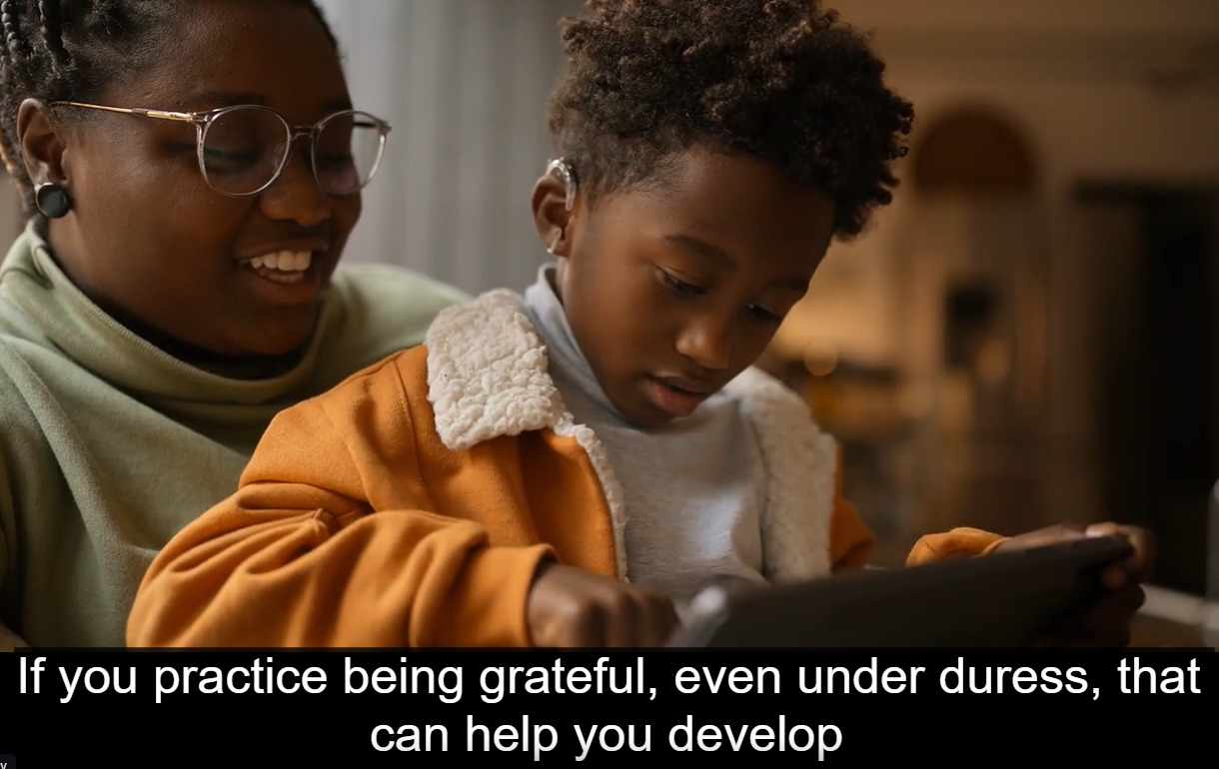
an attitude that makes you resilient.
Celebrate small victories

Slide 48
No one has an answer why innocent suffer. It’s really more how you cope.
Notes:
The child is likely not yet asking grand cosmic theological questions

Slide 49
Don’t lose yourself in parenting. [Or in your problem.] Peter Pan’s problem was he wanted to stay a child.
Peter Pan’s adult role model was the cruel Capt. Hook.
Common marriage dilemma: a child dies → parents divorce
Notes:
They won’t stay children forever.
In swimming rescue, it’s not uncommon for the rescuer to drown with the original victim.

Slide 50
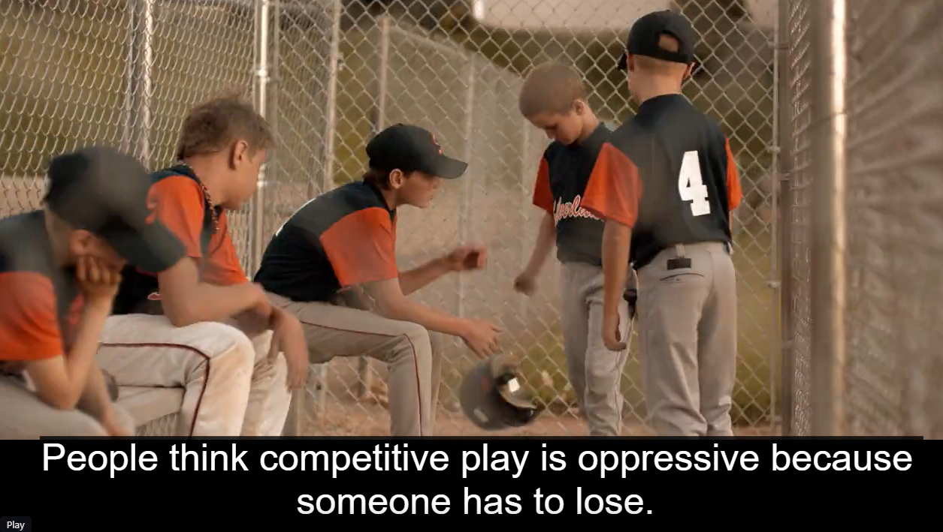
Practice losing well.

Slide 51

great
the opponent graciously. They haven’t lost.
Notes:
overcame

Slide 52
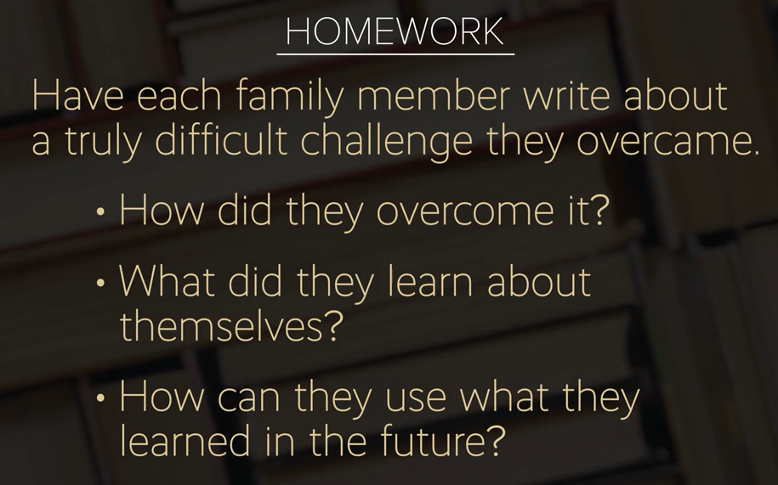

Slide 54
Resilience Phil 4.11-13
Not automatic
Life can crush us
Jordan B. Peterson
James Dobson
Israeli Jewish response
Eitan Shishkoff

Slide 55
Things aren’t always as they seem.

Slide 56
A story that Harry Truman told a number of years ago: A man was very ill, and the doctors thought he died. They shipped him off to a mortuary, and they put him in a casket. The fellow woke up about 3:00 in the morning in this silky thing,

Slide 57
and he sat up and he looked around, and he said, “If I'm alive, what am I doing in this thing, and if I'm dead, how come I have to go to the bathroom?”

Slide 58
Things aren’t always as they seem.

Slide 59
Resilience of Steven Hawking

Slide 60
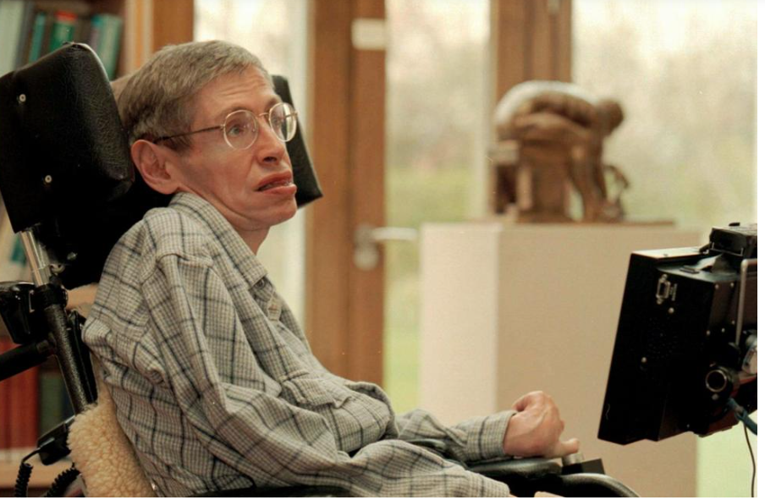
Physicist Steven
Hawking
Notes:
Physicist Stephen Hawking is seen in the library of The Issac Newton Institute of Mathematics in Cambridge University on March 20, 1997, with a new custom-built computer designed especially for him. (AP Photo/Findlay Kember)

Slide 61
Dr. Stephen Hawking is the man that has done most of the mathematical computations on which the understanding of space, and especially the black hole in space and other astronomical phenomenon is based.

Slide 62
Very interesting man, but he has what's called ALS syndrome or Lou Gehrig’s disease. Dr. Hawking is afflicted with this terminal disorder that totally debilitates the nervous system and leaves one unable to move,

Slide 63
and eventually, asphyxiation occurs because the body can't even carry on its functions and you can't breathe. He is in the latter stages of that disease, and the man sits in a wheelchair now with his head hanging to one side.

Slide 64
He cannot comb his hair, he can't feed himself, he can't move, he can't write, and he can only speak with the most labored effort. People that listen to him think that he's said an entire paragraph, and they don't understand him. Those that do comprehend him know that he's only uttered one sentence.

Slide 65
He has to work so hard to get his ideas across. Yet, that man sits in a wheelchair all day and thinks, and he works out mathematical equations in his mind. At the end of the day, he dictates formulas to his secretary, and that's how he does his work, which I'm told is tantamount to Beethoven, composing an entire symphony in his head.
Notes:
That is, equally magnificent and influential.

Slide 66
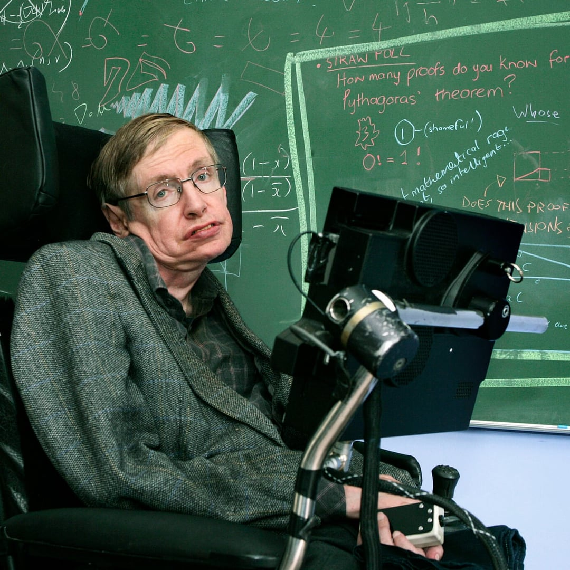
But I saw an interview of Dr. Stephen Hawking not too long ago about his disorder and his disease, and he made some incredible statements. He said,
Notes:
https://preview.redd.it/hello-fellow-mewbros-ive-got-an-idea-i-thought-about-v0-1ovuumyobdjb1.jpg?width=1080&crop=smart&auto=webp&s=0dc4c6277ba067faabf9e0cb46a50ab1ca8c72c1

Slide 67
"Before I became ill, I was bored with life, disinterested in my work." He said, "I drank too much, I smoked too much," but he said, "Then, it was suddenly taken from me, and I saw I was going to lose it," and he said, "Everything became new." Then, he uttered this quote. He said,

Slide 68
"When your expectations for life are reduced to zero, everything becomes meaningful." Everything takes on new meaning.

Slide 69
“Looking at a tree, or a sunset, or getting up in the morning and taking a walk, or a friendship, all those things that we take for granted before become meaningful when your expectations are reduced to zero.”
Notes:
Challenge: what has made you discontent? Release, repent of the sourness of the expectation. Be thankful for the things you have. Learn contentment.

Slide 70
We feel almost entitled by some kind of divine decree to 80+ years of bliss with very few frustrations and very few inconveniences, and very little stress, and very little difficulty.

Slide 71
You can plant a tree in a rainforest, which has plenty of water, doesn't have to go looking for it, and its roots stay on the surface. It doesn't have to send them down in order to find water. As a result, it can be blown over by the first windstorm that comes along.

Slide 72
It's not strong. You plant a mesquite tree in the arid desert, and it has to send its roots down 30 feet or more to find water, and that thing is so strong, nothing can blow it over, because it grows in a hostile environment.

Slide 73
What's the first thing that a person says when he gets depressed? He says, "Where's God? Why would he do this to me?" What's the first thing that a person says when he's hit with a catastrophic disease? "Why would God do this? Where is He? Why doesn't He heal me?"

Slide 74
Spiritual problems develop out of emotional and physical weakness, and if you do not have stability over here, emotionally, if you are soft, if you're weak, if you're blown over by the circumstances of life,

Slide 75
it will affect you spiritually as well. This is why God wants strength from us.
Nothing impresses me more than to see someone claw their way out of tragedy with their faith intact.

Slide 76
Philippians 4:11. Let me read it to you. Boy, this is my favorite Scripture. He said, "For I have learned... He didn't say, "This is my temperament. I was born this way. This is my genetics." He said, "I've learned." He had to adapt to it. He had to learn this attitude. "For I have learned in whatsoever state I am therewith to be content.“

Slide 77
Folks, do you realize where Paul was when he wrote that? He was sitting in a Roman jail, which was probably damp. I wouldn't be surprised if there were rats and spiders and bugs and cockroaches running back and forth. He's in there surrounded by criminals for an act that he did not commit. He, in order to write this, probably had to lift a chain that was on his arm. His feet were chained.
Notes:
Dobson speaking.

Slide 78
Who knows what kind of food they served in a Roman jail at this time. The water supply, who knows what that was? Can you imagine what kind of bathroom facilities were in a Roman jail at that time? What kind of misery that man must've been in, in addition to his physical difficulties. He was an older man by this time sitting in this jail writing,

Slide 79
"For I've learned that whatsoever state I am therewith to be content." He says, "I know how to be abased," boy does he ever, "And I know how to abound everywhere and in all things I am instructed.“ It's a commandment.

Slide 80
See, it's not just his conclusion. He's instructed. And if he is, you are. And if you are, I am. He said, "I am instructed both to be full and to be hungry, both to abound and to suffer need." It really doesn't matter positive or negative. I can cope. Whatever comes, full, hungry, it's all right. "For I can do all things through Messiah, which strengthens me."
Notes:
Let’s pause right now and be instructed.

Slide 81
Had a young lady, 22 years of age, come to see me at the hospital, leaning on a cane, sat down and wept. Beautiful girl or had been. She'd been in a car wreck. She was a stewardess until this wreck and had scarred her face and left her a cripple. And she came in on a cane. Her husband took one look at her and said, "No way, José. Not for me." And he left. That's cowardice.

Slide 82
Let me give the opposite. Dr. Richard Seltzer wrote a book called Mortal Lessons. It's got some heroes in it. Here's one of them. Contrast this with what I just said. He said, "I stand by the bed where a young woman lies, her face postoperative, her mouth twisted in palsy, clownish. The tiny twig of the facial nerve, the one to the muscles of her mouth had been severed.

Slide 83
She will be thus from now on. Speaking of himself, the surgeon had followed with religious fervor, the curve of her flesh. I promise you that. Nevertheless, to remove the tumor in her cheek, I had to cut the little nerve. Her young husband is in the room. He stands on the opposite side of the bed, and together they seem to dwell in the evening lamplight isolated from me in private.

Slide 84
Who are they, I ask myself, he and this wry mouth that I have made who gaze out and touch each other so generously, so greedily? The young woman speaks, "Will my mouth always be like this, she asks. "Yes, I say, "it will. It’s because the little nerve was cut." She nods and is silent. But the young man smiles. "I like it," he says. "I think it's kind of cute.”

Slide 85
All at once, I know who he is. I understand, and I lower my gaze. Unmindful, he bends to kiss her crooked mouth, and I so close, I can see how he twists his own lips to accommodate to hers, to show her that their kiss still works.

Slide 86
Faith is knowing that God is in control, even when events swirl out of control. Or as Reuben Welch said when he stood right here, "Faith is knowing that with God, even when nothing is happening, something is happening. God is there. And He wants us to be tough because He's with us.
Notes:
How can you and I be tougher??

Slide 88
Resilience Phil 4.11-13
Not automatic
Life can crush us
Jordan B. Peterson
James Dobson
Israeli Jewish response
Eitan Shishkoff

Slide 89
One of the mysteries of the Jewish people’s existence is found in the words of the prophet Jeremiah (30):
“Alas! For that day is great, none is like it. It is a time of distress for Jacob—yet he shall be saved from it.”

Slide 91
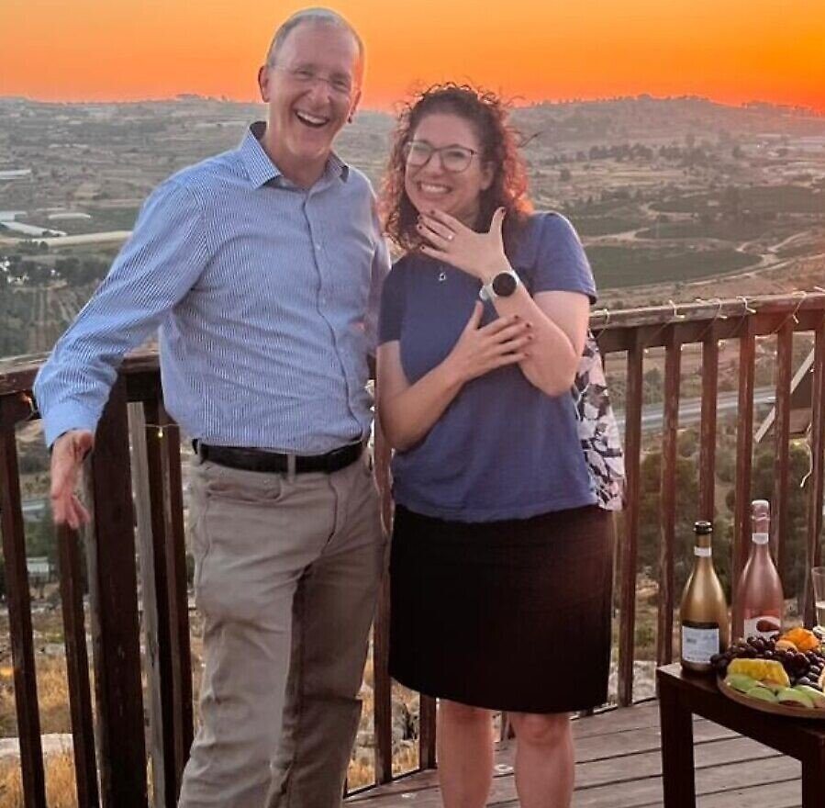
(June 20, 2025 / JNS)
Rabbi Leo Dee, whose wife and two daughters were murdered in a Palestinian terrorist attack in April 2023, announced on Thursday his engagement to Aliza Teplitsky
Notes:
https://www.jns.org/rabbi-who-lost-spouse-daughters-to-terror-announces-engagement/

Slide 92
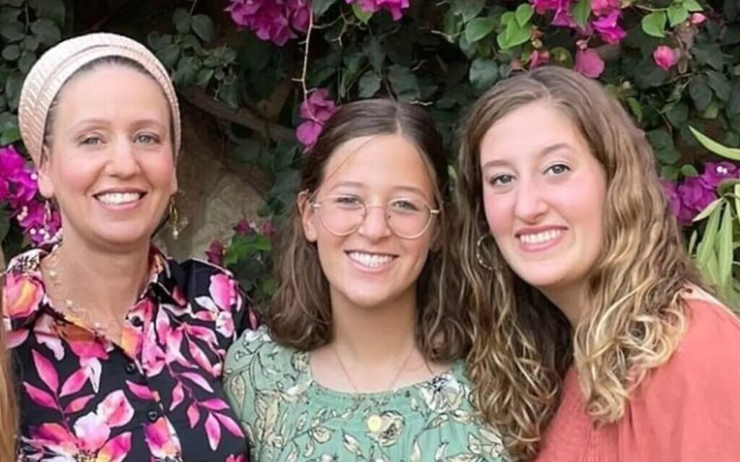
Notes:
7 April 2023. His daughters, Maia, 20, and Rina, 15, were shot dead at the scene. His wife, Lucy, 48, critically wounded, died in hospital three days later.

Slide 93
“With praise and gratitude, we are excited to share the joyful news: we are engaged—Aliza and Leo,” the rabbi, a resident of Efrat in Judea, wrote on Facebook.
“And for all of it, Lord our God, we thank You,” he added.
Notes:
https://www.jns.org/rabbi-who-lost-spouse-daughters-to-terror-announces-engagement/

Slide 94
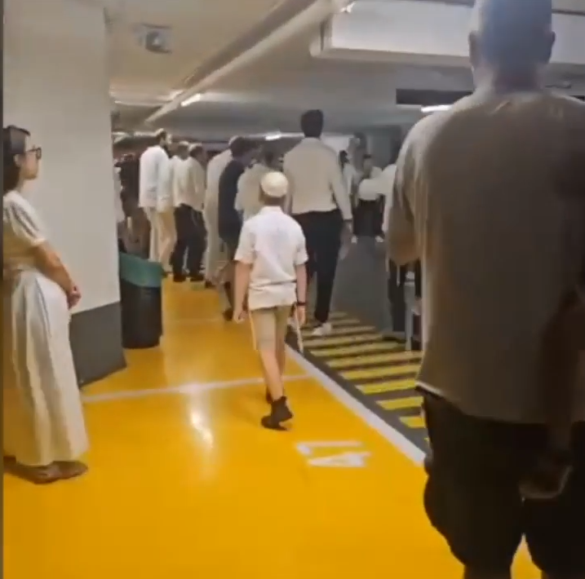
Israelis dancing in the garage/bomb shelter, response to Houthi rockets,
June 14, 2025
Notes:
video

Slide 96
Resilience Phil 4.11-13
Not automatic
Life can crush us
Jordan B. Peterson
James Dobson
Israeli Jewish response
Eitan Shishkoff

Slide 97
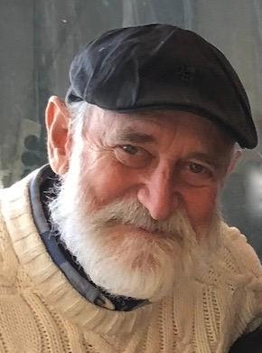
Are you being stretched beyond comfort?
I know this is not one of our normal updates. I just couldn't write as if none of this was happening. What is on my heart is to ask you a personal question.
Eitan
Shishkoff

Slide 98
Where are you being stretched, during these intense times? And how are you managing to respond? Are you being stretched beyond comfort?

Slide 99
I know this is not one of our normal updates. I just couldn't write as if none of this was happening. What is on my heart is to ask you a personal question. Where are you being stretched, during these intense times? And how are you managing to respond?

Slide 100
For me, it helps greatly to look to the “heroes” of the Bible. Fact is, I can’t think of a single one who was not stretched to the limit in following God’s path for their life. Abraham was told to sacrifice his son. Joseph endured family rejection and years of unjust imprisonment.

Slide 101
Moshe, after fleeing for his life from Egypt, returned to confront Pharaoh, only to spend 40 years with a complaining, ungrateful multitude. Hannah was barren and mocked. David became a fugitive, though King of all Israel. I could go on and on.

Slide 102
David himself wrote “When my heart is overwhelmed, lead me to the rock that is higher than I” (Psalm 61:2).
For a child to be born, a woman’s body must undergo stretching and more stretching for ¾ of a year. I look at an expecting mother and I’m dumbfounded.
Notes:
Are you being stretched beyond comfort?
I know this is not one of our normal updates. I just couldn't write as if none of this was happening. What is on my heart is to ask you a personal question. Where are you being stretched, during these intense times? And how are you managing to respond?
For me, it helps greatly to look to the “heroes” of the Bible. Fact is, I can’t think of a single one who was not stretched to the limit in following God’s path for their life. Abraham was told to sacrifice his son. Joseph endured family rejection and years of unjust imprisonment. Moses, after fleeing for his life from Egypt, returned to confront Pharaoh, only to spend 40 years with a complaining, ungrateful multitude. Hannah was barren and mocked. David became a fugitive, though King of all Israel. I could go on and on.
David himself wrote “When my heart is overwhelmed, lead me to the rock that is higher than I” (Psalm 61:2).
For a child to be born, a woman’s body must undergo stretching and more stretching for ¾ of a year. I look at an expecting mother and I’m dumbfounded. How can her belly keep expanding sufficiently to contain an entire infant?? She must give herself over to the process of being stretched. If it’s her first child, she’s never experienced it before.
We are now being stretched. The people of Israel are being stretched. The body of Messiah around the world is being stretched—in ways that we’ve never gone through. Why?
For the same purpose as a pregnant woman. We are pregnant with the kingdom of God, with the revival that must be birthed before Yeshua returns (see Joel 2:28-32, Isaiah 60:1-3 , Ezekiel 36-37, Hosea 3:4-5).
As we are being stretched together, may the purposes of God be born in your life. And may we see our modest efforts to equip the youth and young adults of Israel fulfill the harvest that is even now beginning.
With love and awareness that you and I have been called to the Kingdom for such a time as this,

Slide 103
How can her belly keep expanding sufficiently to contain an entire infant?? She must give herself over to the process of being stretched. If it’s her first child, she’s never experienced it before. We are now being stretched. The people of Israel are being stretched. The body of Messiah around the world is being stretched—in ways that we’ve never gone through. Why?
Notes:
Are you being stretched beyond comfort?
I know this is not one of our normal updates. I just couldn't write as if none of this was happening. What is on my heart is to ask you a personal question. Where are you being stretched, during these intense times? And how are you managing to respond?
For me, it helps greatly to look to the “heroes” of the Bible. Fact is, I can’t think of a single one who was not stretched to the limit in following God’s path for their life. Abraham was told to sacrifice his son. Joseph endured family rejection and years of unjust imprisonment. Moses, after fleeing for his life from Egypt, returned to confront Pharaoh, only to spend 40 years with a complaining, ungrateful multitude. Hannah was barren and mocked. David became a fugitive, though King of all Israel. I could go on and on.
David himself wrote “When my heart is overwhelmed, lead me to the rock that is higher than I” (Psalm 61:2).
For a child to be born, a woman’s body must undergo stretching and more stretching for ¾ of a year. I look at an expecting mother and I’m dumbfounded. How can her belly keep expanding sufficiently to contain an entire infant?? She must give herself over to the process of being stretched. If it’s her first child, she’s never experienced it before.
We are now being stretched. The people of Israel are being stretched. The body of Messiah around the world is being stretched—in ways that we’ve never gone through. Why?
For the same purpose as a pregnant woman. We are pregnant with the kingdom of God, with the revival that must be birthed before Yeshua returns (see Joel 2:28-32, Isaiah 60:1-3 , Ezekiel 36-37, Hosea 3:4-5).
As we are being stretched together, may the purposes of God be born in your life. And may we see our modest efforts to equip the youth and young adults of Israel fulfill the harvest that is even now beginning.
With love and awareness that you and I have been called to the Kingdom for such a time as this,

Slide 104
For the same purpose as a pregnant woman. We are pregnant with the kingdom of God, with the revival that must be birthed before Yeshua returns (see Joel 2:28-32, Isaiah 60:1-3 , Ezekiel 36-37, Hosea 3:4-5).
Notes:
Are you being stretched beyond comfort?
I know this is not one of our normal updates. I just couldn't write as if none of this was happening. What is on my heart is to ask you a personal question. Where are you being stretched, during these intense times? And how are you managing to respond?
For me, it helps greatly to look to the “heroes” of the Bible. Fact is, I can’t think of a single one who was not stretched to the limit in following God’s path for their life. Abraham was told to sacrifice his son. Joseph endured family rejection and years of unjust imprisonment. Moses, after fleeing for his life from Egypt, returned to confront Pharaoh, only to spend 40 years with a complaining, ungrateful multitude. Hannah was barren and mocked. David became a fugitive, though King of all Israel. I could go on and on.
David himself wrote “When my heart is overwhelmed, lead me to the rock that is higher than I” (Psalm 61:2).
For a child to be born, a woman’s body must undergo stretching and more stretching for ¾ of a year. I look at an expecting mother and I’m dumbfounded. How can her belly keep expanding sufficiently to contain an entire infant?? She must give herself over to the process of being stretched. If it’s her first child, she’s never experienced it before.
We are now being stretched. The people of Israel are being stretched. The body of Messiah around the world is being stretched—in ways that we’ve never gone through. Why?
For the same purpose as a pregnant woman. We are pregnant with the kingdom of God, with the revival that must be birthed before Yeshua returns (see Joel 2:28-32, Isaiah 60:1-3 , Ezekiel 36-37, Hosea 3:4-5).
As we are being stretched together, may the purposes of God be born in your life. And may we see our modest efforts to equip the youth and young adults of Israel fulfill the harvest that is even now beginning.
With love and awareness that you and I have been called to the Kingdom for such a time as this,

Slide 105
As we are being stretched together, may the purposes of God be born in your life. And may we see our modest efforts to equip the youth and young adults of Israel fulfill the harvest that is even now beginning.
With love and awareness that you and I have been called to the Kingdom for such a time as this,
Notes:
Are you being stretched beyond comfort?
I know this is not one of our normal updates. I just couldn't write as if none of this was happening. What is on my heart is to ask you a personal question. Where are you being stretched, during these intense times? And how are you managing to respond?
For me, it helps greatly to look to the “heroes” of the Bible. Fact is, I can’t think of a single one who was not stretched to the limit in following God’s path for their life. Abraham was told to sacrifice his son. Joseph endured family rejection and years of unjust imprisonment. Moses, after fleeing for his life from Egypt, returned to confront Pharaoh, only to spend 40 years with a complaining, ungrateful multitude. Hannah was barren and mocked. David became a fugitive, though King of all Israel. I could go on and on.
David himself wrote “When my heart is overwhelmed, lead me to the rock that is higher than I” (Psalm 61:2).
For a child to be born, a woman’s body must undergo stretching and more stretching for ¾ of a year. I look at an expecting mother and I’m dumbfounded. How can her belly keep expanding sufficiently to contain an entire infant?? She must give herself over to the process of being stretched. If it’s her first child, she’s never experienced it before.
We are now being stretched. The people of Israel are being stretched. The body of Messiah around the world is being stretched—in ways that we’ve never gone through. Why?
For the same purpose as a pregnant woman. We are pregnant with the kingdom of God, with the revival that must be birthed before Yeshua returns (see Joel 2:28-32, Isaiah 60:1-3 , Ezekiel 36-37, Hosea 3:4-5).
As we are being stretched together, may the purposes of God be born in your life. And may we see our modest efforts to equip the youth and young adults of Israel fulfill the harvest that is even now beginning.
With love and awareness that you and I have been called to the Kingdom for such a time as this,

Slide 107
Resilience Phil 4.11-13
Not automatic
Life can crush us
Jordan B. Peterson
James Dobson
Israeli Jewish response
Eitan Shishkoff

Slide 108
^{Phil 4.11-13} Not that I am saying this to call attention to any need of mine; since, as far as I am concerned, I have learned to be content regardless of circumstances. I know what it is to be in want,

Slide 109
^{Phil 4.11-13} and I know what it is to have more than enough — in everything and in every way I have learned the secret of being full and being hungry, of having abundance and being in need. I can do all things through him who gives me power.

