Slide 1
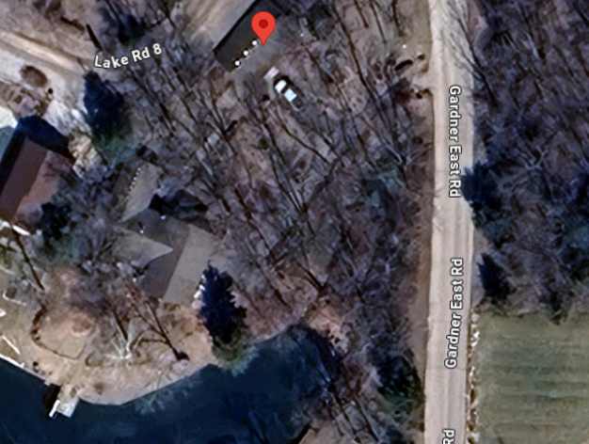
News
15628 Lake Rd 8, Gardner, KS 66030
Available for immersion
Notes:
Newly rebuilt dock wear water shoes.
Lake is MUCH less muddy, clear water
Any Sunday afternoon

Slide 2
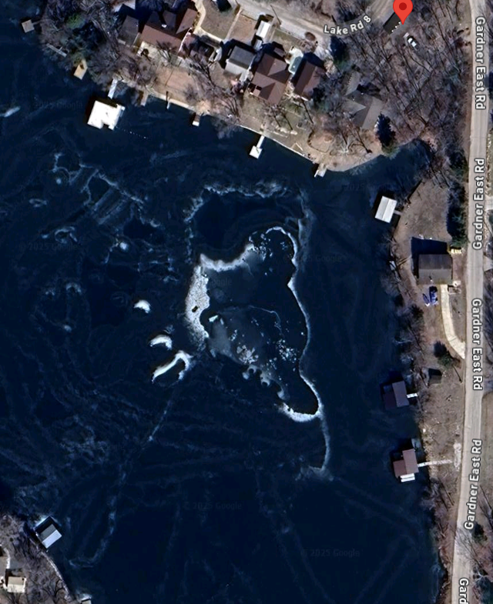
Afterward,
Swim and boat across the lake.

Slide 3
During the van ride home from the Messiah Conference, I watched and listened to the Shabbat service at Or HaOlam, here, from June 5.
I have to thank MANY people for GREAT service to the kingdom.

Slide 4
Rukhel Fields
Hedmon Mejia
Suzanne Alongi
Gary Anderson
Wes Blackburn
Kati Glenn
Victoria Egeland
Camron Miranda
Ulises Acosta
Dawn Acosta
Bonnie Anderson
Charlotte Miranda
Joelle Rutledge
Ann Sneary
Smartest lawyer in KC
Notes:
Google says.

Slide 5
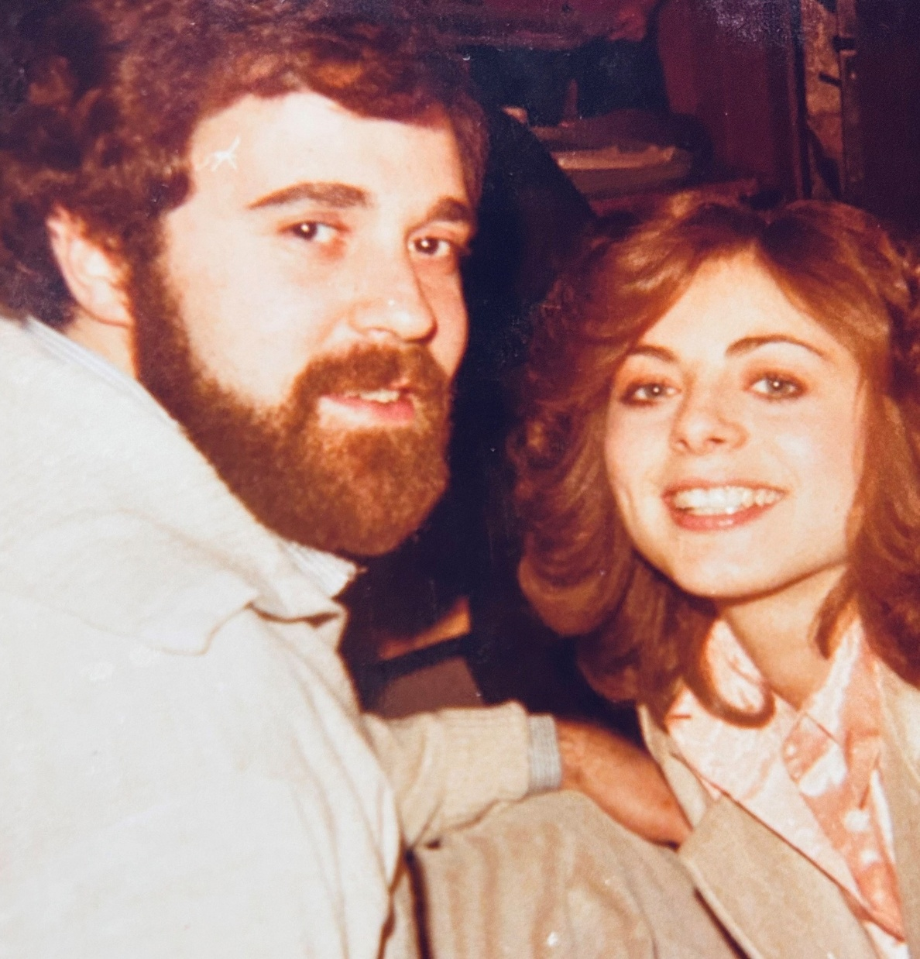
Notes:
This was likely his smartest deal ever.

Slide 6
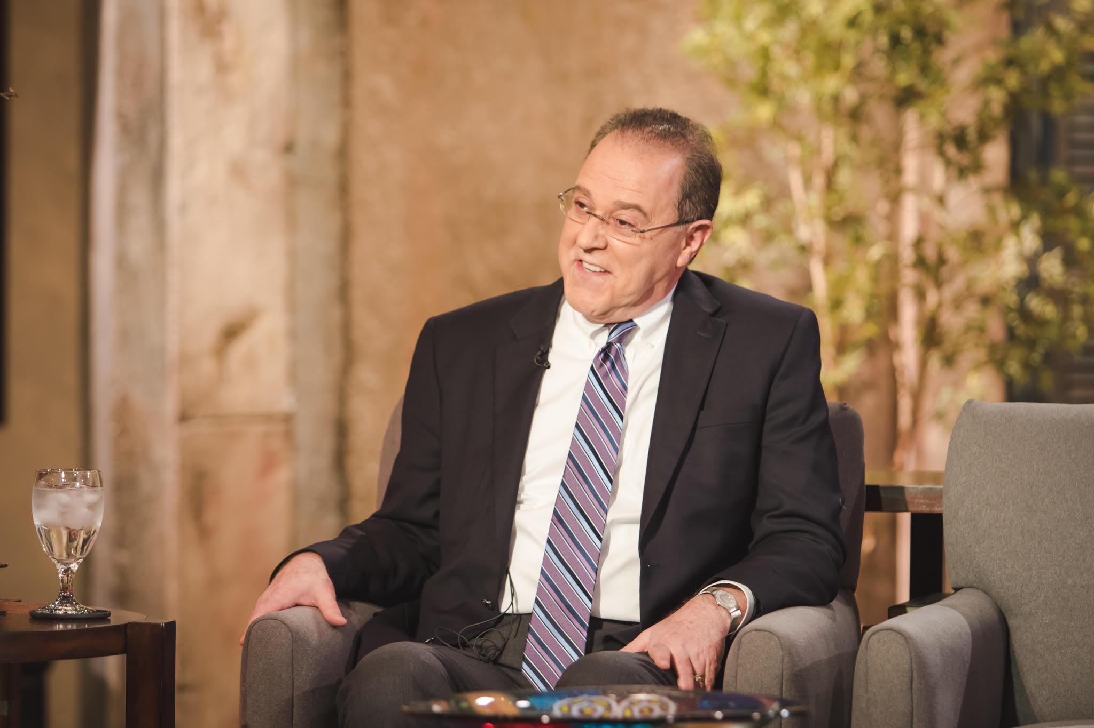

Slide 7
We are a blessed community.

Slide 8
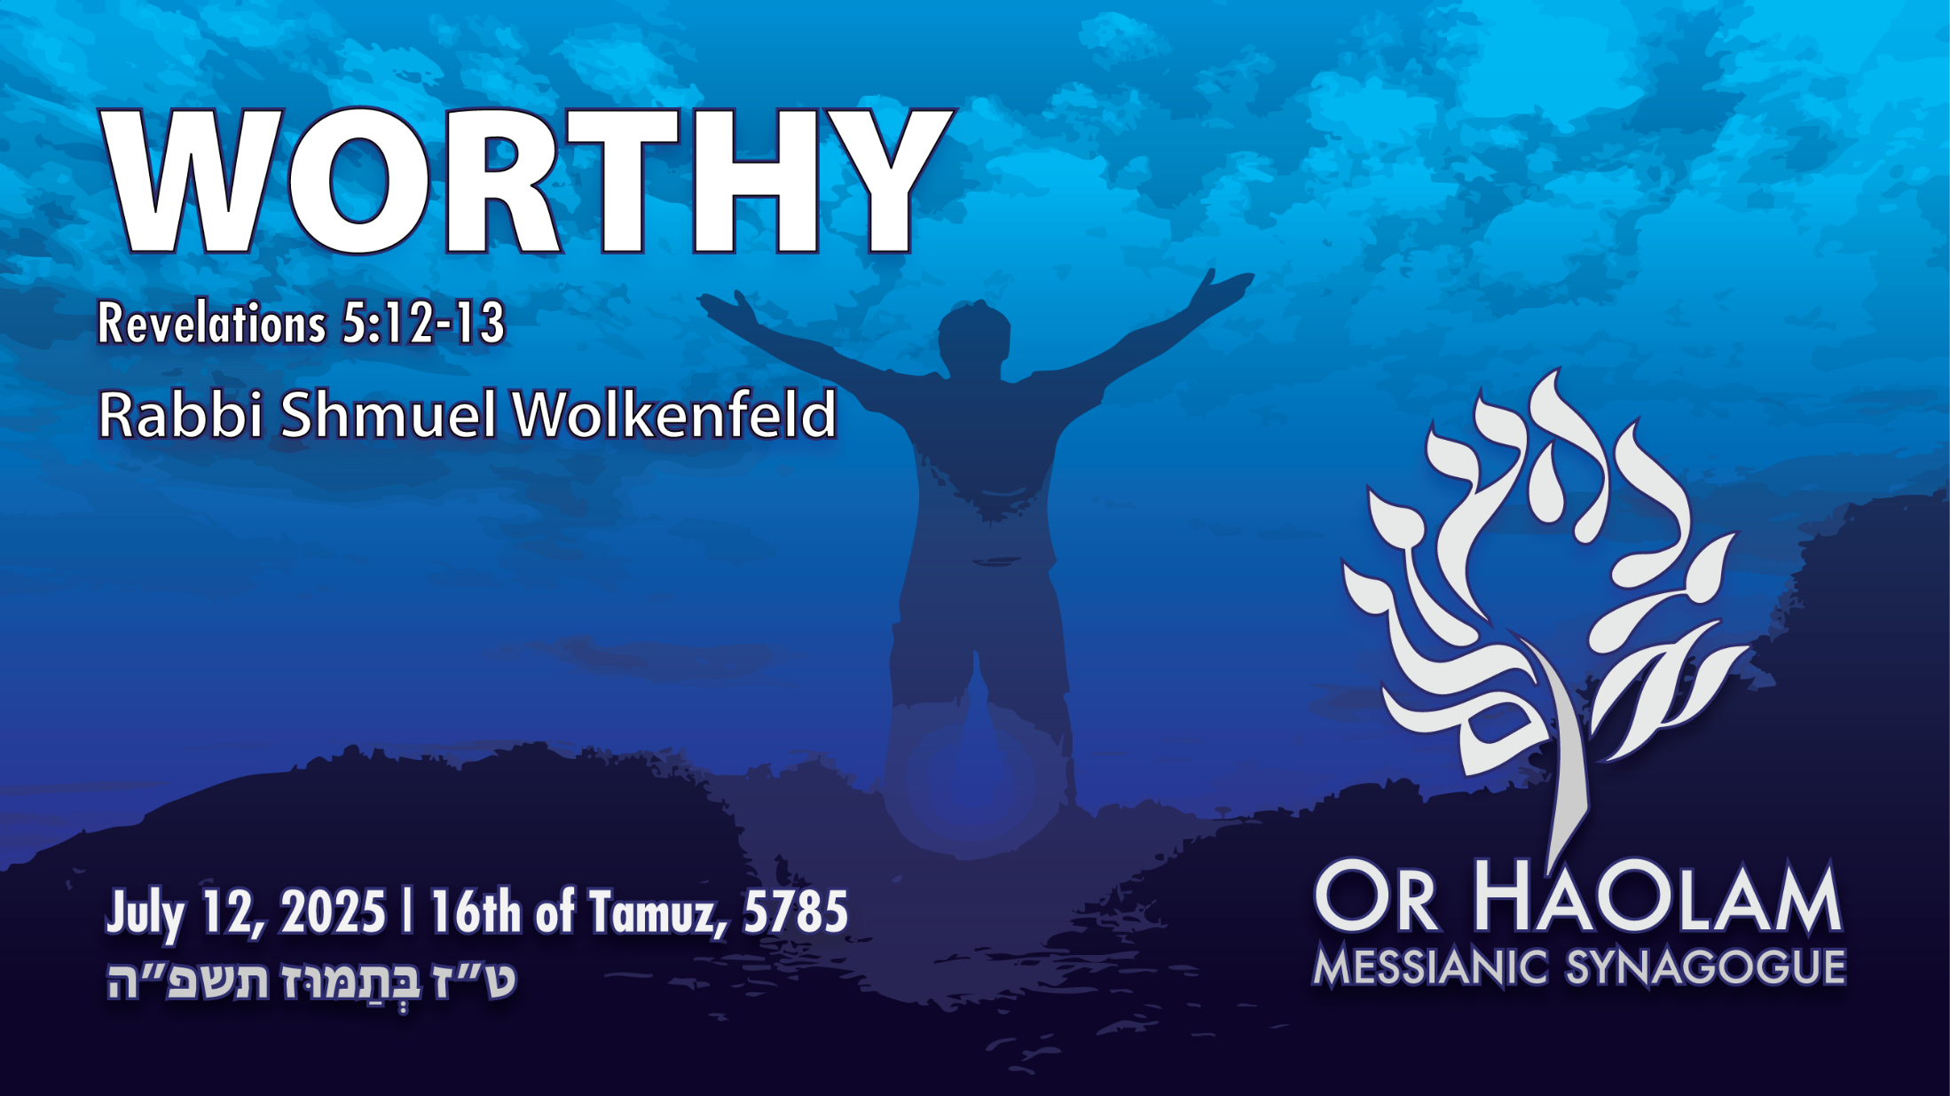

Slide 9

Worthy Rev. 5.12-13
Download story
Heavenly context
Scriptural and liturgy precedent
Praises

Slide 10
Worthy Rev. 5.12-13
Download story
Heavenly context
Scriptural and liturgy precedent
Praises

Slide 11
My daily devotions consist of
Music -- Uplifting, convicting Hebrew worship: Solu, Miqedem, etc.

Slide 12
My daily devotions consist of
Music -- Uplifting, convicting Hebrew worship: Solu, Miqedem, etc.
Confession before G-d in Messiah

Slide 13
My daily devotions consist of
Music -- Uplifting, convicting Hebrew worship: Solu, Miqedem, etc.
Confession before G-d in Messiah
2 chapters each Tanakh and Mes Scriptures, or equivalent study.
Notes:
Parasha of the week on Monday

Slide 14
My daily devotions consist of
Music -- Uplifting, convicting Hebrew worship: Solu, Miqedem, etc.
Confession before G-d in Messiah
2 chapters each Tanakh and Mes Scriptures, or equivalent study.
A prayer list.

Slide 15
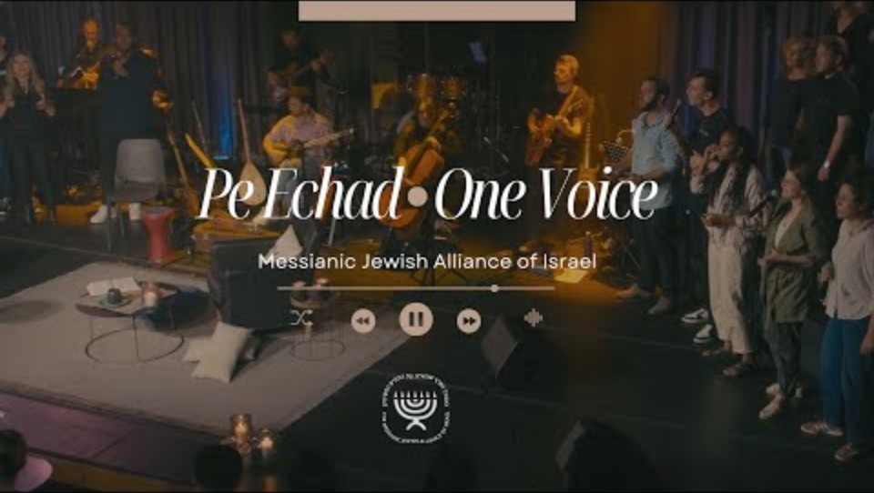
Lately I have been enamored with
Notes:
Which I’m sure I’ve mentioned.
https://www.youtube.com/watch?v=hBPl2214-jE&list=PL7pfgkokJgSLJjDzjoL1RI9BQ-VfX8Xpd
concert PE ECHAD - ONE VOICE that took place in June 2023 in Jerusalem.
And out of my devotion time has come at least one previous message:
Habitu alav, הביטו עליו Look to Him

Slide 16
from 8:40 to the end became a “download” to a message:
Words from Revelation 5: 12,13,
Rau’i רָאוּי (Worthy)
music by Thais Shucman

Slide 17
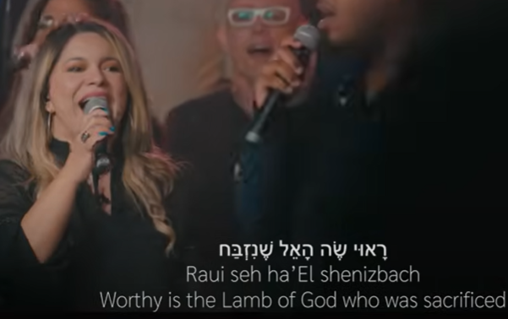
Notes:
Facebook: Worshiper in Jerusalem, Wife, Mom, singer, dentist!
Vocalist: ‪@schucman‬

Slide 19
Worthy Rev. 5.12-13
Download story
Heavenly context
Scriptural and liturgy precedent
Praises

Slide 20
^{Rev 5.12-13} “Worthy is the Lamb who was slain, to receive power and riches and wisdom and might and honor and glory and blessing!”
Notes:
What I feel the Ruakh highlighted was:
How can we do that?
Why these particular items?

Slide 21
^{Rev 5.12-13} And I heard every creature in heaven and on the earth and under the earth and on the sea and everything in them, responding, “To the One seated on the throne and to the Lamb be blessing and honor and glory and power forever and ever!”
Notes:
One additional item

Slide 22
Context

Slide 23
Revelation Ch 1: Vision of Yeshua amidst the 7 Golden menorot

Slide 24
Revelation Ch 1: Vision of Yeshua amidst the 7 Golden menorot
Revelation Ch 2-3: Letters to the 7 congregations.

Slide 25
Revelation Ch 1: Vision of Yeshua amidst the 7 Golden menorot
Revelation Ch 2-3: Letters to the 7 congregations.
Revelation Ch 4-5: Heavenly Throne room
Notes:
Keep this in mind. Heavenly throne room. Many interpretations when this will take place. Beginning of Great Tribulation, during it, end? Continuously forever?

Slide 26
^{Rev 4.2-3} Instantly I was in the Spirit, and there before me in heaven stood a throne, and on the throne Someone was sitting. The One sitting there gleamed like diamonds and rubies, and a rainbow shining like emerald encircled the throne.
Notes:
Who was this?? G-d the Father seated on the throne. Keep in mind.

Slide 27
^{Rev 4.4-6} Surrounding the throne were twenty-four other thrones, and on the thrones sat twenty-four elders dressed in white clothing and wearing gold crowns on their heads.
Notes:
Usually understood to be the redeemed. 12 tribes of Israel, doubled to 12 of the Nations, twelve talmidim /disciples /sent forth ones.

Slide 28
^{Rev 4.4-6} From the throne came forth lightnings, voices and thundering; and before the throne were seven flaming torches, which are the sevenfold Spirit of God. In front of the throne was what looked like a sea of glass, clear as crystal.
Notes:
So, we saw the Father on the throne, then the sevenfold = seven x perfect Ruakh. More than one entity in G-d. Ekhad is compound unity. Shma…
Then creatures combined from Ezek and Is 6.

Slide 29
^{Rev 5.1-5} Next I saw in the right hand of the One sitting on the throne a scroll with writing on both sides and sealed with seven seals; and I saw a mighty angel proclaiming in a loud voice, “Who is worthy to open the scroll and break its seals?”
Notes:
Title deed to the universe, forfeited by sin to the enemy. Sealed ~ foreclosed.

Slide 30
^{Rev 5.1-5} But no one in heaven, on earth or under the earth was able to open the scroll or look inside it. I cried and cried, because no one was found worthy to open the scroll or look inside it.
Notes:
Lost state of humanity. Cried and cried, lostness.

Slide 31
^{Rev 5.1-5} One of the elders said to me, “Don’t cry. Look, the Lion of the tribe of Y’hudah, the Root of David, has won the right to open the scroll and its seven seals.”
Notes:
Derek Prince: Yeshua was and still IS the Lion of the tribe of Yhudah, Judah

Slide 32
^{Rev 5.6-12} And in the midst of the throne and the four living creatures, and in the midst of the elders, I saw a Lamb standing, as having been slain — having seven horns and seven eyes, which are the seven spirits of God sent out into all the earth.
Notes:
Again, Yeshua as differentiated from the Ruakh, differentiated from the Father on the throne
^{Yn 16.7-8} But I tell you the truth, it is to your advantage that I go away; for if I don’t go away, the comforting Counselor will not come to you. However, if I do go, I will send him to you. “When he comes, he will show that the world is wrong about sin, about righteousness and about judgment.

Slide 33
^{Rev 5.6-12} He came and took the scroll from the right hand of the One seated on the throne.
Notes:
He = the Lamb
Seated on the throne = the Father
Note: Two different divine beings.
There is more than one being in the nature of G-d.

Slide 34
^{Rev 5.6-12} When He had taken the scroll, the four living creatures and the twenty-four elders fell down before the Lamb, each holding a harp and golden bowls full of incense—which are the prayers of the kedoshim / holy people.
Notes:
Fell down = worship
Harp = music
Bowl = incense of prayer.
Hence “Harp and Bowl” to which we added dance to make the Hebrew acronym Prayer + Dance + Song = Teerosh.

Slide 35
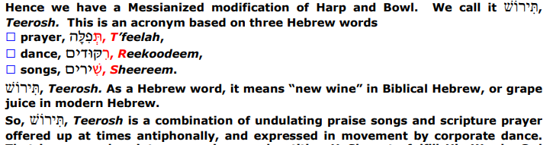

Slide 36
^{Rev 5.6-12} And they are singing a new song, saying, “You are worthy to take the scroll and to open its seals. For You were slain, and by Your blood You redeemed for God those from every tribe and tongue and people and nation. You have made them for our God a kingdom and kohanim, and they shall reign upon the earth.”

Slide 37
^{Rev 5.6-12} Then I looked, and I heard the voice of many angels around the throne and the living creatures and the elders—their number was myriads of myriads and thousands of thousands. They were chanting with a loud voice,

Slide 38
^{Rev 5.12-13} “Worthy is the Lamb who was slain, to receive power and riches and wisdom and might and honor and glory and blessing!”
Notes:
Heavenly, premier song of praise.
How can we do that?
Why these particular items?

Slide 39
^{Rev 5.12-13} And I heard every creature in heaven and on the earth and under the earth and on the sea and everything in them, responding, “To the One seated on the throne and to the Lamb be blessing and honor and glory and power forever and ever!”
Notes:
One additional item

Slide 41
Worthy Rev. 5.12-13
Download story
Heavenly context
Scriptural and liturgy precedent
Praises

Slide 42
Anything like this ever happen in scripture history?
Anything like this pean of praise in Jewish liturgy?

Slide 43
^{Daniel 7.13-14} “I kept watching the night visions, when I saw, coming with the clouds of heaven, someone like a son of man. He approached the Ancient One and was led into his presence. To him was given rulership, glory and a kingdom, so that all peoples,
Notes:
Two divine beings.

Slide 44
^{Daniel 7.13-14} nations and languages should serve him. His rulership is an eternal rulership that will not pass away; and his kingdom is one that will never be destroyed.

Slide 45
Let His great name be blessed forever and to all eternity.
[Ee-yov [Job] 1:21, Dan 2:20, Tehillim 113:2]
Blessed, praised, and glorified, exalted, extolled, and honored, magnified, and lauded
be the name of the Holy One,
blessed be He;

Slide 46
though He be high above all the blessings and hymns,
praises and consolations,
which are uttered in the world;
and all say, "A-mayn."

Slide 48
Worthy Rev. 5.12-13
Download story
Heavenly context
Scriptural and liturgy precedent
Praises

Slide 49
^{Rev 5.12-13} “Worthy is the Lamb who was slain, to receive power and riches and wisdom and might and honor and glory and blessing!”
Notes:
Heavenly, premier song of praise.
How can we do that?
Why these particular items?

Slide 50
^{Rev 5.12-13} And I heard every creature in heaven and on the earth and under the earth and on the sea and everything in them, responding, “To the One seated on the throne and to the Lamb be blessing and honor and glory and power forever and ever!”

Slide 51
Why shout loudly these things?
Should we do the same, or prepare in our spirits to do the same?

Slide 52
^{Phil 2.9-11} God raised him to the highest place and gave him the name above every name; that in honor of the name given Yeshua, every knee will bow — in heaven, on earth and under the earth — and every tongue will acknowledge that Yeshua the Messiah is Adonai — to the glory of God the Father.

Slide 53
Worthy
power
riches
wisdom
might
honor
glory
blessing
blessing
honor
glory
power

Slide 54
Worthy ἄξιος axios
(áksios) is the root of the English term, "axis." This also refers to a balance-scale, operating by off-setting weights.]
Notes:
Earth spins on its axis.
By Messiah’s atoning execution and attributes all the world spins, hangs, is suspended. We just acknowledge it, as we will see it in His throne room soon enough!!

Slide 55
is the Lamb who was slain 5x
Sphazó σφάζω : To slay, to slaughter, to kill
While the verb denotes violent killing, its New Covenant range spans deliberate murder, judicial execution, ritual sacrifice, and symbolic imagery.

Slide 56
Sphazó σφάζω : To slay, to slaughter, to kill
The contexts determine whether the act is wicked (Cain, Babylon, the Beast) or redemptive (the Lamb, martyr-witnesses). In every occurrence the death is purposeful, not accidental, and carries theological weight.
Notes:
On the reality of His death the whole spiritual world spins!

Slide 57
power δύναμις dunamis: Power, strength, ability, might, miracle
for חַיִל, גְּבוּרָה, עֹז, כֹּחַ, צָבָא ( an army, a host); strength, ability, power;
universally, "inherent power, power residing in a thing by virtue of its nature, or which a person or thing exerts and puts forth"
Notes:
He HAS power. We need to rest in it.

Slide 58
specifically, the power of performing miracles
moral power and excellence of soul
δύναμις foremost reveals the limitless ability of God,divine omnipotence

Slide 59
1. Proclamation—Confidence rests not in human eloquence but in the inherent power of the gospel.
2. Personal Holiness—Weakness becomes the arena for Messiah’s empowering grace.
3. Corporate Worship—Songs and prayers rightly ascribe power to God, nurturing reverent dependence.

Slide 60
4. Mission—Evangelism and mercy ministry advance by the same power that raised Yeshua, ensuring hope amid opposition.
5. Eschatology—Future expectations of resurrection and consummation flow from God’s proven power in history.

Slide 61
riches πλοῦτος ploutos: Riches, wealth, abundance From the base of pletho; wealth (as fulness), i.e. (literally) money, possessions, or (figuratively) abundance, richness, (specially), valuable bestowment -- riches.
Notes:
Plethora
We are GREATLY blessed already.
Yet, do more for Israel and the Nations. We saw a presentation by the Joseph Project of th the bombed out homes in the north, Kiryat Shmonah. Even if home not bombed, abandoned property and the rats ate the mattresses. Gave $1000
We elders, mostly me, are guilty of some overindulgence: next week Jason Rose, then Katy Bolls of One for Israel, then Greg Silverman. Great stuff!
Pickle ball, b-ball court,

Slide 62
Wisdom sophia: σοφία חָכְמָה, wisdom, broad and full intelligence
^{Ro 11.33-35} O the depth of the riches, both of the wisdom and knowledge of God! How unsearchable are His judgments and how incomprehensible His ways! For “who has known the mind of Adonai, or who has been His counselor?” Or “who has first given to Him, that it shall be repaid to him?”
Notes:
He HAS wisdom for us. Acknowledge it. Enjoy it.

Slide 63
Heavenly wisdom, in contrast, “is first pure, then peace-loving, gentle, accommodating, full of mercy and good fruit, impartial, and sincere” ^{(Yaakov 3:17)}. The way to obtain it remains simple: “If any of you lacks wisdom, he should ask God” ^{(Yaakov 1:5).}

Slide 64
Paul distinguishes two kinds of sophia: the passing wisdom of this age and the “hidden wisdom of God” ^{(1 Corinthians 2:6-7).} Preaching must therefore rest “not on man’s wisdom but on the power of God” ^{(1 Corinthians 2:5)}. Yet mature believers do speak wisdom—illumined by the Spirit, not philosophy.

Slide 65
^{1 Cor 1.25-27} For the foolishness of God is wiser than men, and the weakness of God is stronger than men. For you see your calling, brothers and sisters, that not many are wise according to human standards, not many are powerful, and not many are born well.

Slide 66
^{1 Cor 1.25-27} Yet God chose the foolish things of the world so He might put to shame the wise; and God chose the weak things of the world so He might put to shame the strong;
Notes:
Gary Selden founder of Jonathan Cahn’s congregation. Prosperous Jewish businessman came to faith. Unusual. No trauma rescue.

Slide 67
might ἰσχύς ischus:
Strength, might, power,
from the Gk root is, "force"
and /exō, "have") – properly, force to overcoming immediate resistance. inherent strength, It is not merely the exercise of power (as with δύναμις) but the capacity or resource that makes such action possible.
Notes:
Like David to overcome Golyat Goliath

Slide 68
Shaul/Paul prays that believers would know “the surpassing greatness of His power toward us who believe… the might of His strength” ^{(Ephesians 1:19).} The resurrection and exaltation of Messiah prove that God’s ἰσχύς is operative on behalf of the believers.

Slide 69
Honor τιμή timé:
value, price, respect
In the Greco-Roman world, honor was a limited good fought over in public competition. Scripture reorients that culture: honor is received from God and shared in self-sacrificing love.

Slide 70
Be devoted to one another in brotherly love. Outdo yourselves in honoring one another” ^{(Romans 12:10)}. Self-forgetting esteem imitates the Triune pattern of deferential love.

Slide 71
glory δόξα doxa:
Glory, honor, splendor, majesty, good opinion, judgment, view:
(from dokeō, "exercising personal opinion which determines value")
As a translation of the Hebrew כָּבוד in a use foreign to Greek: splendor, brightness;

Slide 72
^{2 Cor 3.18} So, all of us, with faces unveiled, see as in a mirror the glory of the Lord; and we are being changed into his very image, from one degree of glory to the next, by Adonai the Spirit.

Slide 73
^{2 Cor 4.6} For God, who said, “Let light shine out of darkness,” is the One who has shone in our hearts, to give the light of the knowledge of the glory of God in the face of Messiah.

Slide 74
Blessing εὐλογία eulogia:
praise, benefit
the full biblical idea of a verbal or enacted bestowal of good that comes ultimately from God.
God’s favor, once pledged in promise to Abraham, now overflows through Messiah Yeshua and returns to God in praise.

Slide 75
Power κράτος kratos:
Power, might, dominion, strength
krátos (from a root meaning "to perfect, complete," dominion, exerted power.

Slide 76
Worthy
power
riches
wisdom
might
honor
glory
blessing
blessing
honor
glory
power

Slide 78
Worthy Rev. 5.12-13
Download story
Heavenly context
Scriptural and liturgy precedent
Praises

Slide 79
^{Rev 5.12-13} “Worthy is the Lamb who was slain, to receive power and riches and wisdom and might and honor and glory and blessing!”

Slide 80
^{Rev 5.12-13} And I heard every creature in heaven and on the earth and under the earth and on the sea and everything in them, responding, “To the One seated on the throne and to the Lamb be blessing and honor and glory and power forever and ever!”

Slide 81
Thirty of us attended the Messiah Conference for a week, and some have praise to report:
Jason, Zeke, Jaedyn, Kathi

