Slide 1
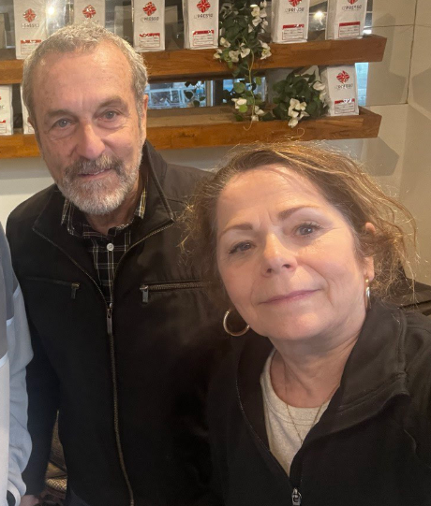
Stewart and Chantal Winograd. Stewart will be our guest speaker from Jerusalem by Zoom next Shabbat.
Notes:
I failed to promote this. My lame excuse is the plethora of special events this summer, since conference. I am grateful for all, especially Amy and Angela and the Youth Camp.

Slide 2
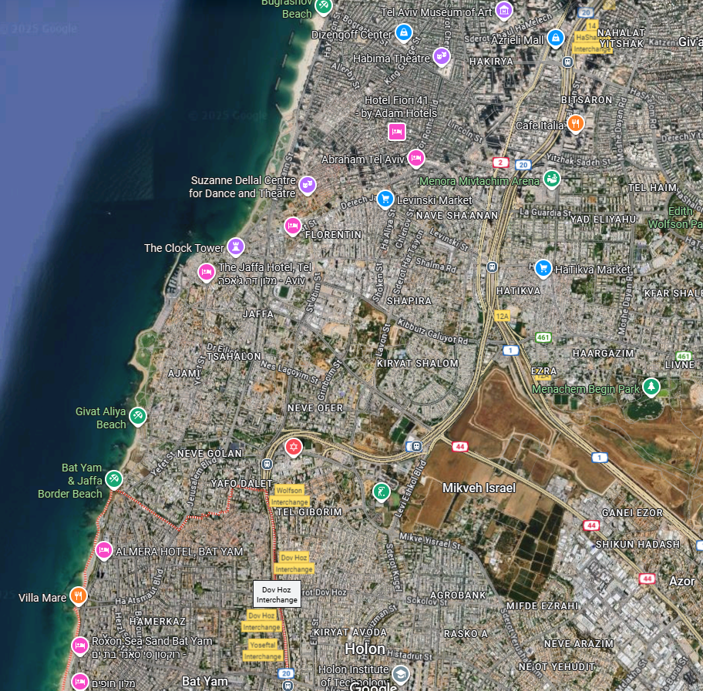
Bat Yam [daughter of the sea]
South of Tel Aviv
Notes:
Oxana’s mom lives here

Slide 3
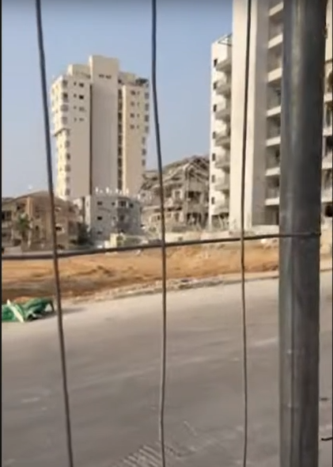
You can be a part of reaching thousands of hurting and traumatized Israelis like these, bringing them Yeshua's comfort and love.
The city of Bat Yam

Slide 4
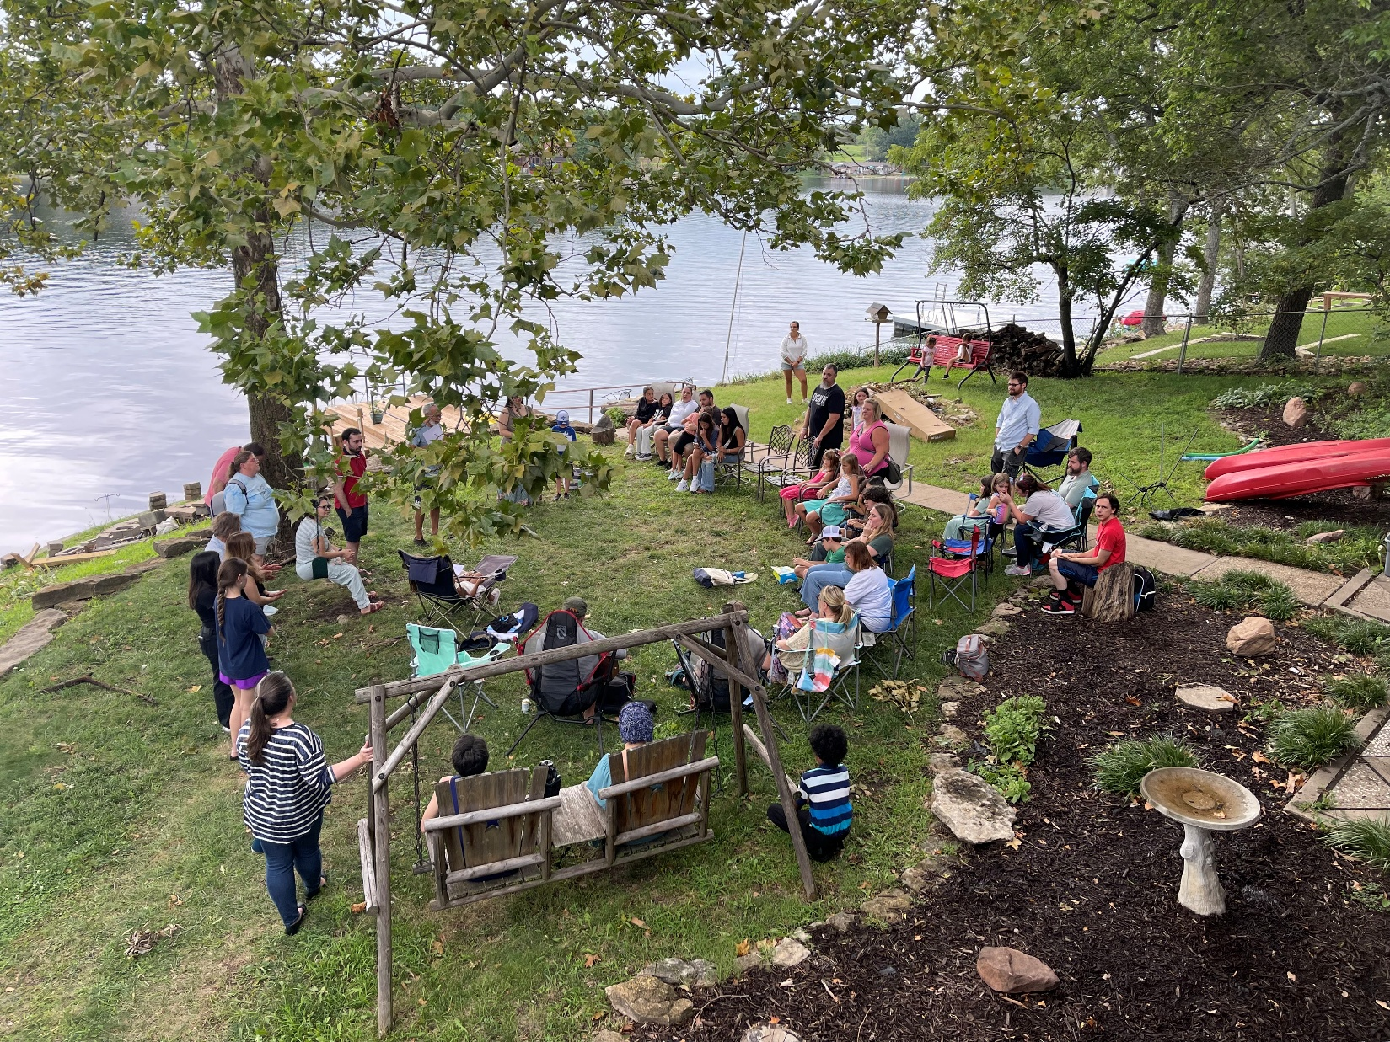
Our immer-sion service Sunday Aug. 10
Notes:
Sent by Glenn and Tamela Stockton

Slide 5
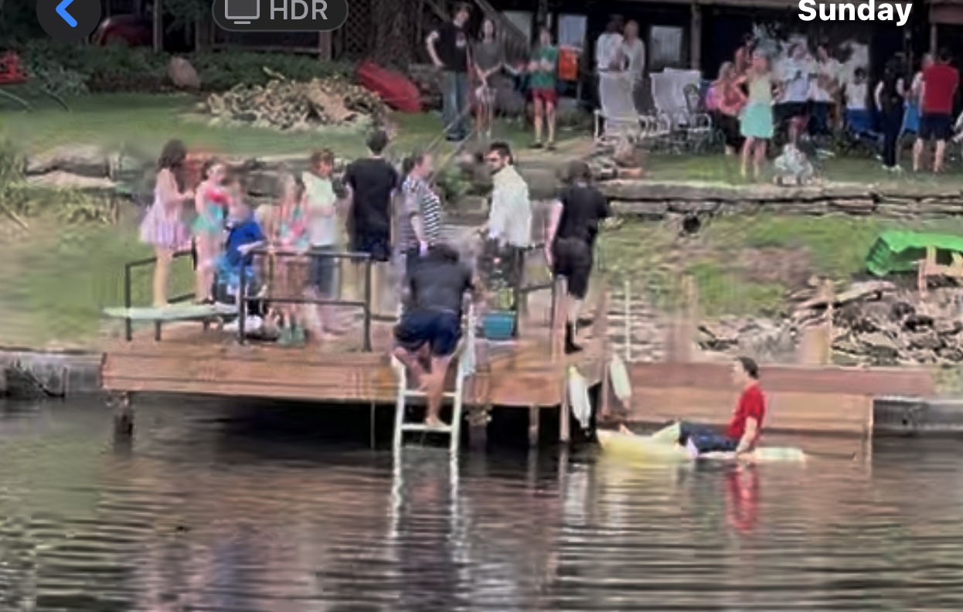
Swim party afterward

Slide 6
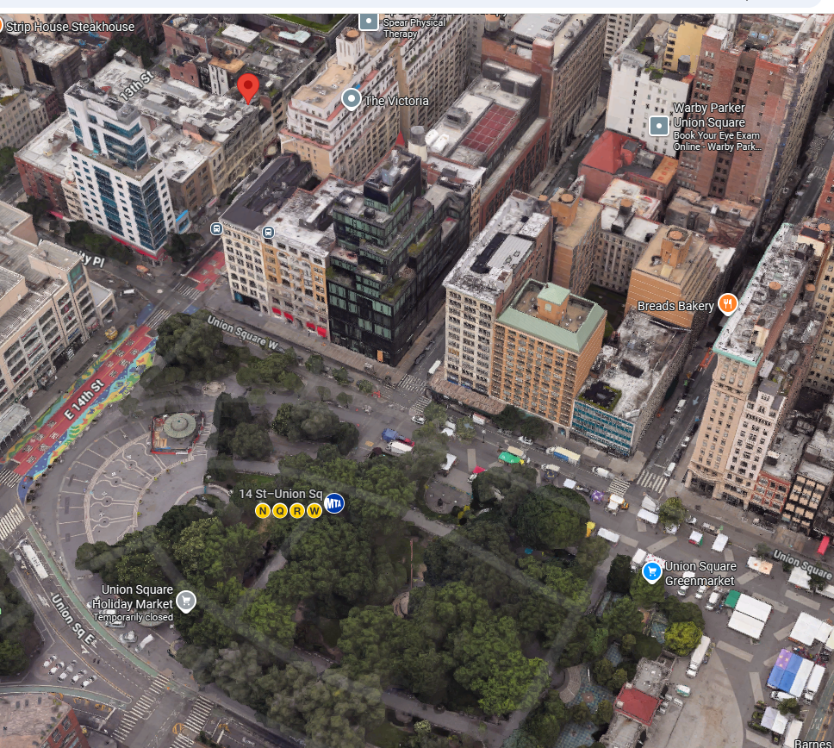
Free University of NY, near Union Square Park
Notes:
Greenwich Village to the southwest, East Village to the southeast near the square are several dormitories of New York University where Baron Trump is attending.

Slide 7
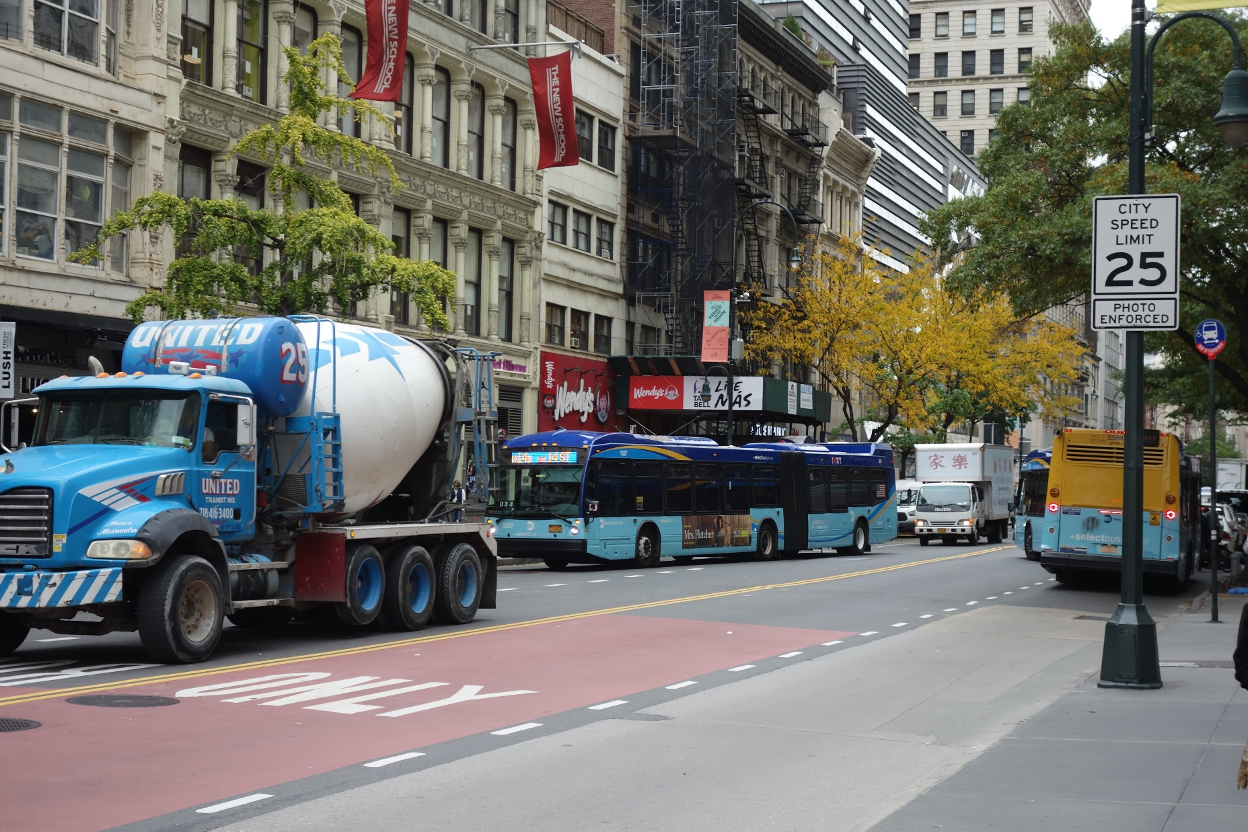
Free University of NY
Notes:
https://en.wikipedia.org/wiki/Free_University_of_New_York
14th St., near Union Park, NYU.

Slide 8
Free University of NY From summer catalogue, 1966: "The Free
University of New York has been forged in response to the intellectual bankruptcy and spiritual emptiness of the American educational establishment. It seeks ... to promote the social integrity and commitment.
Notes:
https://www.cia.gov/readingroom/docs/CIA-RDP73-00475R000201460001-4.pdf
So, I attended at about age 18, 1967

Slide 9
FUNY began as a home for professors dismissed from local universities for protesting the Vietnam War, or for holding socialist views. The FUNY opened on East 14th Street, above a storefront now occupied by a Wendy's
Notes:
https://en.wikipedia.org/wiki/Free_University_of_New_York

Slide 10
MAO FOR BEGINNERS: Charles Johnson, black Marxist-Leninist, visited Cuba, 1964.
MARXISM AND AMERICAN DECADENCE HISTORY OF THE LEFT IN THE U.S.: George Kruger, editor, The Internationalist.
Notes:
https://www.cia.gov/readingroom/docs/CIA-RDP73-00475R000201460001-4.pdf

Slide 11
ELEMENTARY COURSE IN MARXIST ECONOMICS: L. Marcus, professional economist and Marxist.
PERSPECTIVES FOR REVOLUTIONARY CHANGE: "This course will attempt to define a political orientation for Revolutionary Socialism.
Notes:
https://www.cia.gov/readingroom/docs/CIA-RDP73-00475R000201460001-4.pdf
This may have been the class I took.

Slide 12
In my undergraduate years, age 18, I bought into Marxism

Slide 13

Notes:
Great ideal. No greedy property ownership. Sounds nice. Doesn’t work. I didn’t know that then.

Slide 14
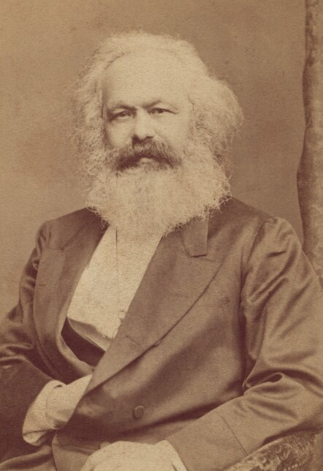
is a slogan popularized by Karl Marx In his 1875 Critique of the Gotha Programme.
Notes:
https://en.wikipedia.org/wiki/From_each_according_to_his_ability,_to_each_according_to_his_needs
https://upload.wikimedia.org/wikipedia/commons/2/2d/Karl-Marx_%28cropped%29.jpg

Slide 15
I studied and followed this utopian ideal, until one meeting in which I heard a communist leader express his contempt of the socialists.
To me, a hair’s breadth of difference, but a blast of vitriol. If there could such hostility and lovelessness, then Marxism was no utopia and answer.
So, I continued to search…

Slide 16
I found a community of supernatural love and joy and hope in Messiah in the Spring of 1969.

Slide 17


Slide 18
Community T'hillim / Ps 133.1
Oh, how good, how pleasant it is
for brothers to live together in harmony.
הִנֵּה מַה־טּוֹב, וּמַה־נָּעִים,שֶׁבֶת אַחִים גַּם־יָחַד.
Hinay mah tov, umah naim, shevet akhim gam yadad.

Slide 19
Community T'hillim / Ps 133.1
It is like fragrant oil on the head that runs down over the beard, over the beard of Aharon, and flows down on the collar of his robes.

Slide 20
Community T'hillim / Ps 133.1
It is like the dew of Hermon
that settles on the mountains of Tziyon. For it was there that Adoni ordained the blessing of everlasting life.

Slide 22

Community T'hillim / Ps 133.1
Community is normative
What if there are problems
People are our treasure
Jew and Gentile

Slide 23
What empowers our
community identity

Slide 24
When we say Welcome Immanuel בָּרוּךְ הַבָּא עִמָּנוּאֵל Immanuel, Barukh Haba
We are in one word acknowledging the whole plan of salvation: His coming to earth, living among us, G-d with us. Coming to earth of G-d! to be with us, walk with us, suffer with us, then for us, then in us!
Notes:
If you have a saving relationship with Yeshua, this invites him into your life.
If you don’t have a saving relationship with Yeshua, this concept should draw you to such!!

Slide 25
When we say Welcome Immanuel בָּרוּךְ הַבָּא עִמָּנוּאֵל Immanuel, Barukh Haba
We are welcoming Him to rule in our lives, our emotions, our relationships as G-d/ man with us.
We are giving Him authority over our response to life, to difficulties, to needs.

Slide 26
Community T'hillim / Ps 133.1
Community is normative
What if there are problems
People are our treasure
Jew and Gentile

Slide 27
^{Yn 17.17-23} “Make them holy in the truth. Your word is truth. Just as You sent Me into the world, so I have sent them into the world. And for their sakes I make Myself holy, so that they also may be made holy in truth. I pray not on behalf of these only,
Notes:
Holy, Messiah like in character, relationships.

Slide 28
^{Yn 17.17-23} but also for those who believe in Me through their message, that they all may be one. Just as You, Father, are in Me and I am in You, so also may they be one in Us, so the world may believe that You sent Me.
Notes:
Essence of holiness of character is deep unity.
This is the primary evidence of the divine mission, the deity of Yeshua the Messiah!

Slide 29
^{Yn 17.17-23} The glory that You have given to Me I have given to them, that they may be one just as We are one— I in them and You in Me—that they may be perfected in unity, so that the world may know that You sent Me and loved them as You loved Me.
Notes:
Liquid love, Presence
Repeat: Essence of holiness of character is deep unity.
This is the primary evidence of the divine mission, the deity of Yeshua the Messiah!

Slide 30
^{Eph 4.29-32} Let no harmful word come out of your mouth, but only what is beneficial for building others up according to the need, so that it gives grace to those who hear it. Do not grieve the Ruach ha-Kodesh of God,

Slide 31
^{Eph 4.29-32} by whom you were sealed for the day of redemption. Get rid of all bitterness and rage and anger and quarreling and slander, along with all malice. Instead, be kind to one another, compassionate, forgiving each other just as God in Messiah also forgave you.

Slide 32
^{Eph 1.4-6} He chose us in the Messiah before the foundation of the world, to be holy and blameless before Him in love. He predestined us for adoption as sons through Messiah Yeshua, in keeping with the good pleasure of His will— to the glorious praise of His grace, with which He has accepted us through the One He loves!
Notes:
Rejection is a BIG issue. According to RTF founders, Jim Keelstra, abandonment underlies all other wounds.
Disputes are NOT, ≠ personal rejection.

Slide 33
An illustration of community
from nature.

Slide 34
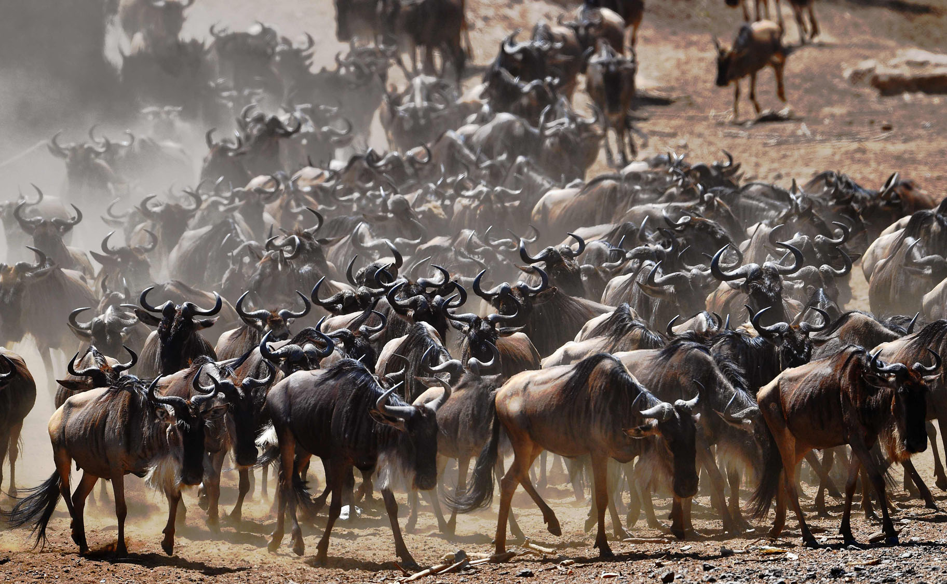
Wildebeest migration
Notes:
https://darkroom.baltimoresun.com/2016/09/annual-great-wildebeest-migration-in-kenya/#1
More than two million animals migrate from the Serengeti National Park in Tanzania to the Maasai Mara National Reserve in Kenya from July to October annually, according to Maasai Mara.

Slide 35
A program by National Geographic gives a powerful illustration for us. In the great annual wildebeest migration in Serengeti National Park in Africa a giant herd, thousands of wildebeest, slowly move in groups across the plain. They are invariably followed by stalking lions.
Notes:
George Whitten WIL-dib-eest

Slide 36
But the lions never attack the herd - they simply watch carefully for the stray wildebeest, either careless or seeking greener grass, who separates himself from the larger groups of animals. The isolated wildebeest will become the sudden prey of the lions who attack with lightening speed and ferocity.
Notes:
George Whitten

Slide 37
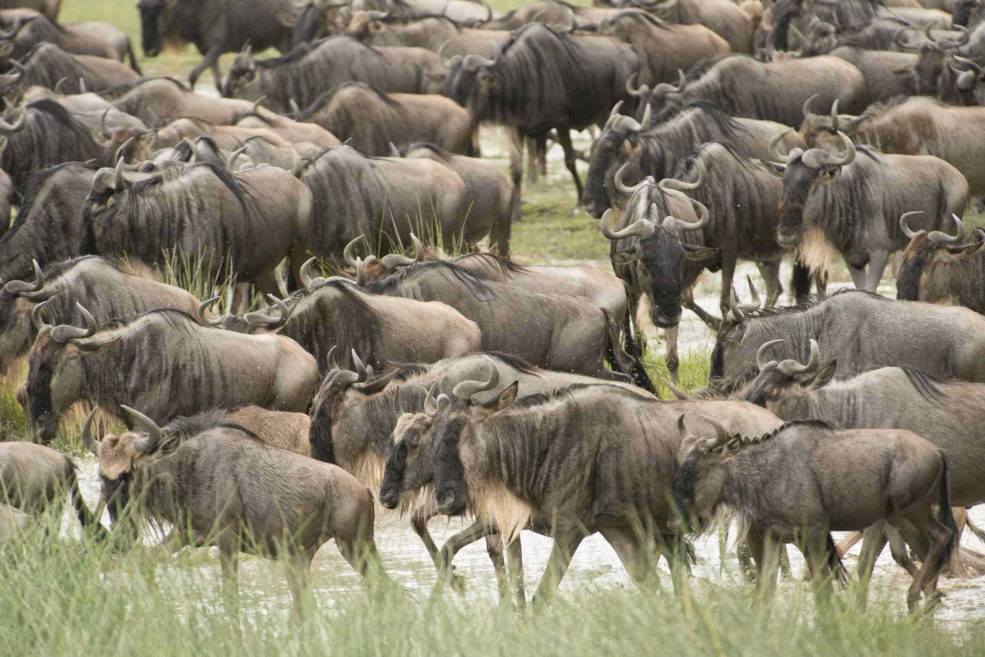
Notes:
https://africansermonsafaris.com/blog/wp-content/uploads/2018/05/serengeti-migration.jpeg

Slide 38
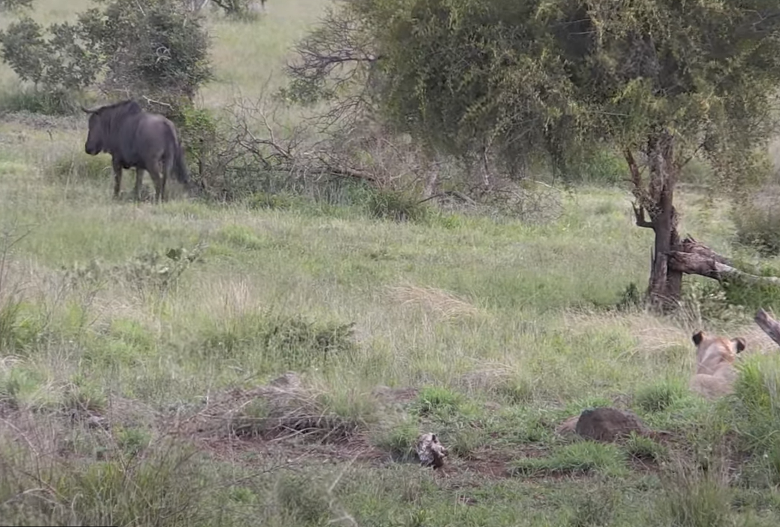
Notes:
https://youtu.be/3syRvlIzCmI

Slide 39
In spiritual warfare isolation is equally dangerous, as our enemy roams like a roaring lion looking for separated brethren to prey upon. We all need real relationship and spiritual community for protection against our enemy who is constantly stalking vulnerable prey.
Notes:
George Whitten

Slide 40
It's not enough to simply "go to service". We need to be the community of believers, actively participating in loving, serving, praying, counseling, giving/ tithing, encouraging, admonishing, eating, rejoicing, weeping, and forgiving as the family of God.
Notes:
George Whitten
Note in reports, Some not tithing?
Hoping to do outreach/ Ingathering as follow up to camp.

Slide 41
Living in His inheritance of forgiving, execution stake love also means trusting Him in apparently bad things.

Slide 42

The power of a modest hug
Notes:
Side hugs, neck hugs with opposite gender.

Slide 43

Always appropriate

Slide 44
In a carefully controlled laboratory at Carnegie Mellon University, researchers exposed more than 400 healthy volunteers to the common cold virus…Participants who were hugged on most days had about 60 percent lower odds of becoming infected than those who were rarely hugged.
Notes:
https://www.theepochtimes.com/health/the-perfect-hug-length-to-improve-immunity-and-reduce-stress-5879735?utm_source=Health_well&utm_medium=email&utm_campaign=well-2025-07-19&src_src=Health_well&src_cmp=well-2025-07-19&est=BPnHHSFbE39UP1S4tbQyv5%2BV4zkXdpj%2F8Bxht8CsdrCpJ7zqVlZKMwaWc7qReykx0Q%3D%3D

Slide 45
Additionally, those who did get sick recovered more quickly and had stronger immune responses than those who received fewer hugs.
Notes:
https://www.theepochtimes.com/health/the-perfect-hug-length-to-improve-immunity-and-reduce-stress-5879735?utm_source=Health_well&utm_medium=email&utm_campaign=well-2025-07-19&src_src=Health_well&src_cmp=well-2025-07-19&est=BPnHHSFbE39UP1S4tbQyv5%2BV4zkXdpj%2F8Bxht8CsdrCpJ7zqVlZKMwaWc7qReykx0Q%3D%3D

Slide 46
On a neurochemical level, hugging triggers the release of several “feel-good” chemicals. Chief among these is oxytocin, endorphins, dopamine. One-second hugs felt unsatisfying and provided minimal benefit. At the same time, five to 10 seconds proved optimal before longer contact became uncomfortable.
Notes:
https://www.theepochtimes.com/health/the-perfect-hug-length-to-improve-immunity-and-reduce-stress-5879735?utm_source=Health_well&utm_medium=email&utm_campaign=well-2025-07-19&src_src=Health_well&src_cmp=well-2025-07-19&est=BPnHHSFbE39UP1S4tbQyv5%2BV4zkXdpj%2F8Bxht8CsdrCpJ7zqVlZKMwaWc7qReykx0Q%3D%3D

Slide 48
Community T'hillim / Ps 133.1
Community is normative
What if there are problems
People are our treasure
Jew and Gentile

Slide 49
But what if we have an argument?
What if he or she offends me, does me wrong, hurts me?

Slide 50

Notes:
https://thumbs.dreamstime.com/b/offended-upset-young-woman-arms-crossed-feeling-mad-someone-teen-maximalism-facial-expressions-emotions-feelings-body-280872195.jpg

Slide 51

Notes:
https://thumbs.dreamstime.com/z/offended-upset-young-guy-arms-crossed-feeling-mad-someone-teen-maximalism-facial-expressions-emotions-feelings-body-278018304.jpg

Slide 52
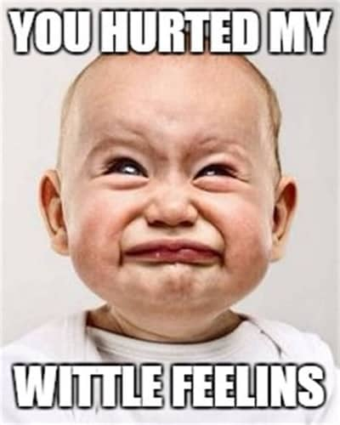
Notes:
https://tse1.mm.bing.net/th/id/OIP.KlfHL4wTDZwKYHxDdSho2wAAAA?pid=Api&P=0&h=180

Slide 53
^{Mtt 18.15-17} “Now if your brother sins against you, go and show him his fault while you’re with him alone.
Disputes are NOT, ≠ personal rejection.
Notes:
Rabbi, fix this…

Slide 54
^{Gal 6.1-2} Brothers and sisters, if someone is caught doing something wrong, you who are directed by the Ruach, restore such a person in a spirit of gentleness —.
Notes:
Cf complaint, denunciation, and tell him or her off. Give him a piece of my mind [assuming you have a piece to spare!]

Slide 55
^{Gal 6.1-2} looking closely at yourself so you are not tempted also. Bear one another’s burdens, and in this way you fulfill the Torah of Messiah.

Slide 56
^{Mtt 18.15-17} If he listens to you, you have won your brother. But if he does not listen, take with you one or two more, so that ‘by the mouth of two or three witnesses every word may stand.’
Notes:
That’s where me or Jeremy or Ulises or our wives come in, or a professional counselor.

Slide 57
^{Mtt 18.15-17} But if he refuses to listen to them, tell it to Messiah’s community. And if he refuses to listen even to Messiah’s community, let him be to you as a pagan and a tax collector.
Notes:
But how do we feel about outsiders, not-yet-believers? Compassion, grief, solicitousness!!

Slide 58
In 30 years of Or HaOlam we have seen a lot of
Conflict resolution
Notes:
When there is resolution, usually repentance and humbling and tears and hugs. The Ruakh is wonderfully present!!

Slide 59
In 30 years of Or HaOlam we have seen a lot of
Conflict resolution
Conflict unresolved → dissolution [separation and alienation]
Notes:
We have lost some. Never a split, but not everyone who was part of our community is still here. Some are!

Slide 60
In 30 years of Or HaOlam we have seen a lot of
Conflict resolution
Conflict unresolved → dissolution [separation and alienation]
Conflict suppression → isolation emotionally
Notes:
This is a half measure that is sometimes the best we can do.

Slide 61

from Joel Chernoff’s Daily Nosh
Notes:
Copyright © 2025 Messianic Publishing Company. Use by permission only. All rights reserved.

Slide 62
^{(TLV) Hebrews 12:15} See to it that no one falls short of the grace of God; and see to it that no bitter root springs up and causes trouble, and by it many be defiled.
Notes:
Copyright © 2025 Messianic Publishing Company. Use by permission only. All rights reserved.

Slide 63
Nosh: Unresolved bitterness towards others is like a contagious disease. The longer one has it the more it makes sick the embittered person as well as infecting and defiling those around them with a divisive and negative spirit.
Notes:
Copyright © 2025 Messianic Publishing Company. Use by permission only. All rights reserved.

Slide 64
It is essential that we quickly resolve held bitterness towards others and also choose to minimize or, if possible, avoid those who are carrying such a spiritual infection.
Notes:
Copyright © 2025 Messianic Publishing Company. Use by permission only. All rights reserved.

Slide 66
Community T'hillim / Ps 133.1
Community is normative
What if there are problems
People are our treasure
Jew and Gentile

Slide 67

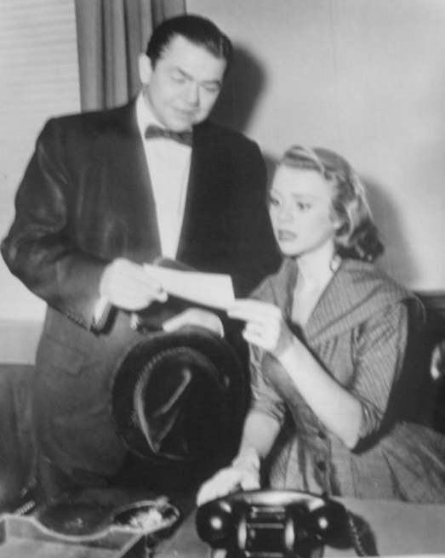
Notes:
https://upload.wikimedia.org/wikipedia/commons/5/58/Millionaire_1956.JPG
The Millionaire is an American anthology series that aired on CBS from 1955 to 1960. It told the stories of people who were given one million dollars ($10.9 million in 2022 dollars) from a benefactor who insisted they must never know his identity.

Slide 68
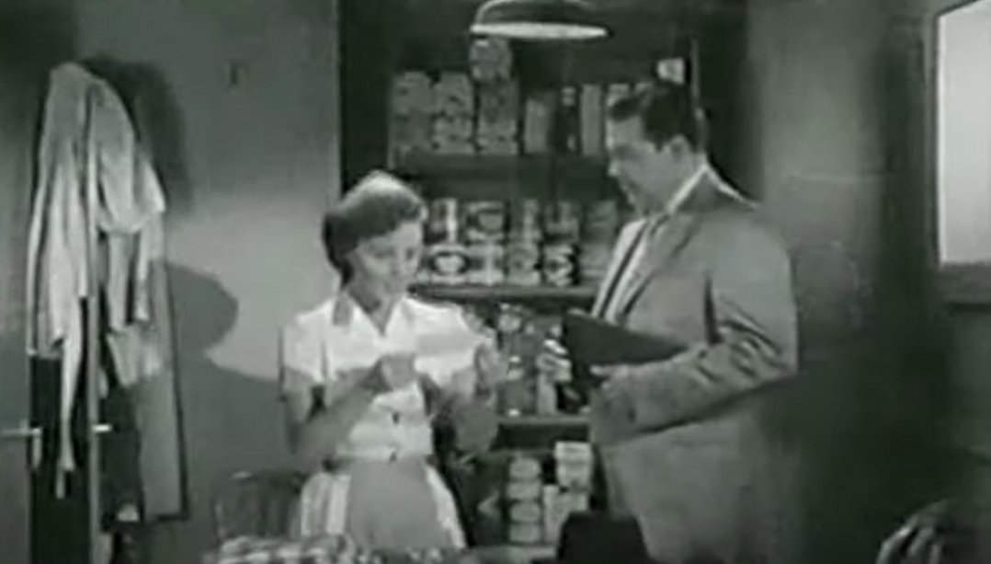
Notes:
https://youtu.be/rjdHrB5YOeA?t=146

Slide 69
^{Eph 1.18} I pray that he will give light to the eyes of your hearts,
What?

Slide 70
^{Eph 1.18} I pray that he will give light to the eyes of your hearts,
What?
^{Yeshayahu/Isaiah 9.2} The people living in darkness have seen a great light;
upon those living in the land that lies
in the shadow of death, light has dawned.

Slide 71
^{Eph 1.18} I pray that he will give light to the eyes of your hearts,
What?
^{Yeshayahu/ Is 35.5-6} Then the eyes of the blind will be opened, and the ears of the deaf will be unstopped; then the lame man will leap like a deer, and the mute person’s tongue will sing.

Slide 72
^{Eph 1.18} I pray that he will give light to the eyes of your hearts,
What?
^{Yeshayahu/Isaiah 60.2} For although darkness covers the earth and thick darkness the peoples; on you Adoni will rise; over you will be seen his glory.
Notes:
Maybe uses this mixed metaphor because the next revelation is shocking…

Slide 73
^{Eph 1.18} I pray that he will give light to the eyes of your hearts, so that you will understand the hope to which he has called you, what is the richness of His glorious inheritance in the holy people kedoshim קדושים
Notes:
I have good news and bad news. The inheritance is in love direct from G-d in Messiah, but it’s ALSO in the people. The people around you. $10 meg.
These people? The ones with the faults? The wrong opinions, annoy me, rude, wrong Siddur/prayer book, too charismatic, not charismatic, old Earth, young Earth, pre-trib, Sunday Shabbat, Saturday Shabbat, holidays. These that are [at times, in your opinion] inconsiderate, impolite, abrasive, difficult.
Look at someone. “You are my glorious inheritance.”
Community. Support. Revolving door?

Slide 74


Slide 75
^{T’hillim/Ps 2.7-8} “I will proclaim the decree: Adoni said to me, ‘You are my son; today I became your father. Ask of me, and I will make the nations your inheritance; the whole wide world will be your possession.

Slide 76
The person next to you is your
$10 million treasure!!
Notes:
Francis Chan: can only understand the love of G-d through the community of believers.
Cf: expect rejection ki guilt, hurts.

Slide 77
^{Iyov/Job 1. 20-21} Iyov [Job] got up, tore his coat, shaved his head, fell down on the ground and worshipped; he said, “Naked I came from my mother’s womb, [into the world] and naked I will return there [from the world]. Adoni gave; Adoni took; blessed be the name of Adoni.”
Notes:
There is one thing/possession that we WILL have in eternity.

Slide 78
^{1 Thes 2.19-20} For when our Lord Yeshua returns, what will be our hope, our joy, our crown to boast about? Won’t it be you? Yes, you are our glory and our joy!

Slide 80
Community T'hillim / Ps 133.1
Community is normative
What if there are problems
People are our treasure
Jew and Gentile

Slide 81

Notes:
P 55

Slide 82
From the Or HaOlam statement of faith:
7. I believe we are in unity with all believers, Gentile or Jewish.
Notes:
We NEVER bad mouth other groups.

Slide 83
^{Mtt 23.11-12} The greatest among you must be your servant, for whoever promotes himself will be humbled, and whoever humbles himself will be promoted.

Slide 84
^{Yermiyahu 31.9-13} Nations, hear the word of Adoni! Proclaim it in the coastlands far away. Say: “He who scattered Isra’el is gathering him, guarding him like a shepherd his flock.” For Adoni has ransomed Ya‘akov, redeemed him from hands too strong for him.

Slide 85
^{Yermiyahu 31.9-13} They will come and sing on the heights of Tziyon, streaming to the goodness of Adoni…“Then the virgin will dance for joy, young men and old men together; for I will turn their mourning into joy, comfort and gladden them after their sorrow.
Notes:
Easy for the girls to dance well.
Here is the commissioning and call of the old men.

Slide 86
^{Yermiyahu 31.9-13} I will give the cohanim their fill of rich food, and my people will be satisfied with my bounty,” says Adoni.

Slide 87
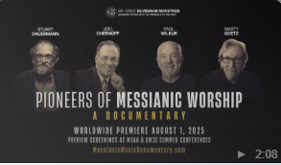
Wonderful movie on Messianic Music

Slide 88
I believe on key identifier of Messianic music and identity omitted: The Covenant
Maintaining Israel’s covenant identity is what distinguishes us from the body of believers around us.
Notes:
I shared my thought with Greg, who received it graciously

Slide 89
Rabbi Michael Wolf at Messiah Conference:
It’s more important to love Jewish people than to love Jewish things.

Slide 91
Community T'hillim / Ps 133.1
Community is normative
What if there are problems
People are our treasure
Jew and Gentile

Slide 96
Prayer points

Slide 97

Notes:
https://youtu.be/YYl-CPyQDrs

Slide 98
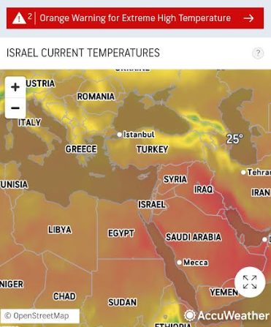

Slide 99
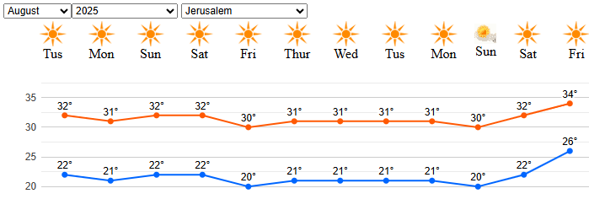
34 deg C = 93.2 deg F
Chart reads right to left

Slide 100
https://youtu.be/Yp9ErZimcgU
From Sally Shiff
The Ministry of Health has sent its latest findings on the condition of Israeli hostages in Gaza to the ICRC (Red Cross), and the details are horrific:
• FOOD & WATER: Fed expired, rotting food crawling with worms. Forced to drink contaminated water such as sewerage and sea water.

Slide 101
https://youtu.be/Yp9ErZimcgU
From Sally Shiff
• HEALTH: Suffering from constant diarrhea, high fevers, severe metabolic issues, lice, parasites, skin infections, and dangerous external and internal inflammation.
• ABUSE: Enduring daily beatings, relentless psychological torture, chronic sexual assault, and sustained trauma.
As a result of ongoing neglecting and the ICRC not providing them with medicines, The hostages lost 40% of their body weight and are on the verge of death due to untreated injuries and other medical conditions.

Slide 102
Pray for the Hostages by Name
Alon (24)
Ariel (27)
Avitnatan (32)
Bar (22)
David (34)
Eitan H. (37)
Eitan M. (24)
Elkana (35)

Slide 103
Pray for the Hostages by Name
Evyatar (24)
Gali (27)
Guy (23)
Matan A. (22)
Matan Z. (24)
Maxim 36)
Nimrod (20)
Omri (47)

Slide 104

Pray for the Hostages by Name
Rom (21)
Segev 27)
Yosef-Haim (24)
Ziv (27)
Bipin (24)
Tamir (20)
Chaim Malespin חיים מלספין
新生活- 生命
Executive Director/Chairman:
A.R.C.
*Infinite Blessings* ברכות נצחיות*

Slide 105
We declare Isaiah 61:1:
"The Spirit of the Lord is upon us to proclaim liberty to the captives and the opening of the prison to those who are bound.“ Lord, stretch out Your mighty arm over them. Send deliverance. Reveal hidden places. Expose the darkness. Confuse the plans of the wicked. Surround the hostages with Your shield. Give them strength in their bodies and peace in their minds. Let them feel hope—supernatural hope—rising within them. We pray for supernatural intelligence and wisdom for the Israeli leadership, the IDF, and all those working for their release. Guide them with clarity, protect them from error, and direct their steps as You did for David in battle. We declare Psalm 107:14 over every hostage: ”He brought them out of darkness, the utter darkness, and broke away their chains.” Lord, bring these captives home soon, we pray! We believe that nothing is impossible for You. No situation is too hard for You. You are the God who shuts the mouths of lions, opens prison doors, parts the Red Sea, and pushes back the enemy. We look to You to deliver all the remaining hostages from the hand of their captors. We ask this in the name of Yeshua, the Deliverer of Israel.

