Slide 1
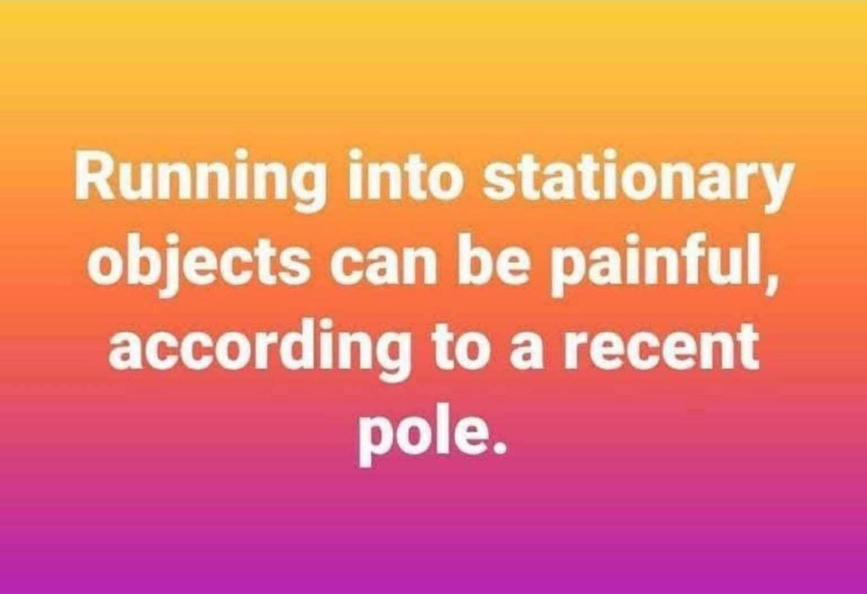

Slide 2
Notes:
From Brian Kaufman, the 737 SW pilot

Slide 3
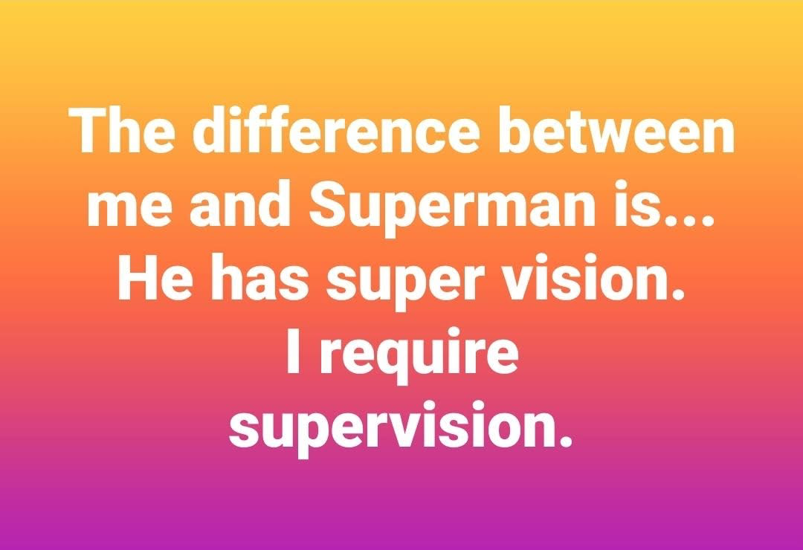
Notes:
From Brian Kaufman, the 737 SW pilot

Slide 4
Notes:
From Brian Kaufman, the 737 SW pilot

Slide 5
Another Jewish Holiday

Slide 7

Sunset, Friday, Aug. 8 till sunset Aug. 9
Extensions allowed and encouraged

Slide 8


Slide 9
The backstory

Slide 10
Low point in Israeli history. Shoftim/Judges ch 19-21
Levite / Levi from Ephraim, northern hills, whose concubine ran away to her father and home in Beit Lekhem [Bethlehem].
The Levi went “to persuade her to return.” ^{Shoftim/Ju 19.3}
Notes:
Ephraim north of Jerusalem, Beit Lekhem south.
None of the commentators LXX, Vulgate, Targum, nor Josephus see this as sexual infidelity, but rather a disagreement. Argument.

Slide 11
She was restored, but on the return trip north they were attacked in Givah /Gibeah, of the tribe of Benyamin, like Sdom.
The Levi was not protective, and the woman was molested and murdered.
Notes:
Like Lot.
Low point: bigamy, community desire for homosexual attack, non protection of the woman, molestation till death.

Slide 12
All the tribes sought to bring the rapists /murderers to justice, but instead there was great war between Benyamin and the other tribes.
Benyamin was reduced to 600 men, 100 men without wives.

Slide 13
^{Shoftim/Ju. 21.19-21} “Behold, there is the feast of Adoni from year to year at Shiloh” (which is to the north of Bethel, on the east side of the highway that goes up from Bethel to Shechem, and to the south of Lebonah).
Notes:
Not known what feast this is

Slide 14
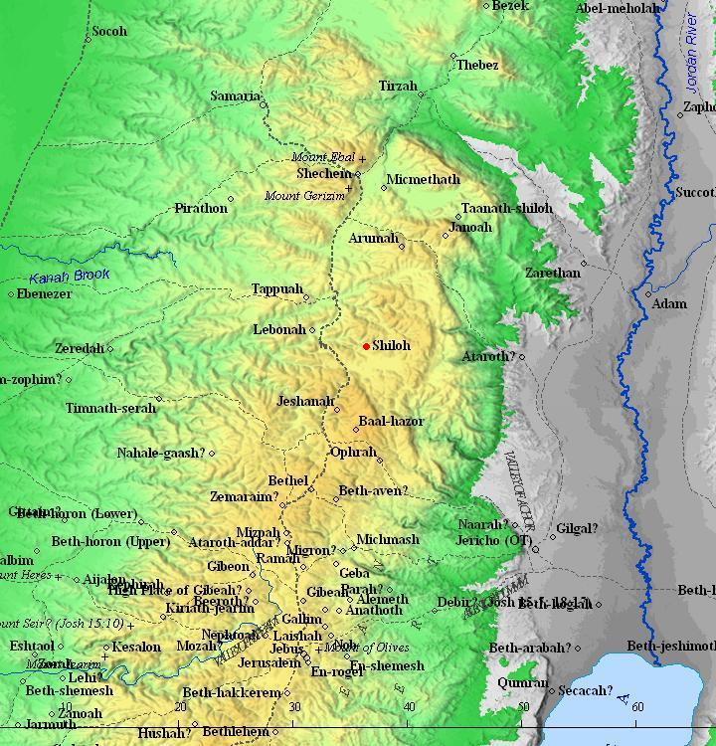
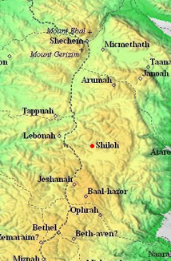

Slide 15
^{Shoftim/Ju. 21.19-21} So they commanded the children of Benyamin saying “Go and hide in the vineyards, and watch, and behold, if the daughters of Shiloh should come out to join in the dances, then come out of the vineyards, and let each of you catch his wife from among the daughters of Shiloh.
Notes:
Clarke: vines were in full leaf

Slide 16
Talmudic tradition ^{Taanit 30b} places this mysterious feast and dance and abduction of wives on 15 of Av.
Tu B’Av ט״ו באב‎ [9+6]
This has morphed into a minor holiday of love.

Slide 17
According to the Mishna, Tu B'Av was a joyous holiday in the days of the Temple in Jerusalem, marking the beginning of the grape harvest. Yom Kippur marked the end of the grape harvest.
Notes:
https://en.wikipedia.org/wiki/Tu_B%27Av#cite_note-9

Slide 18
On both dates the unmarried young women and girls of Jerusalem dressed in white garments, and went out to dance in the vineyards.
Notes:
https://en.wikipedia.org/wiki/Tu_B%27Av#cite_note-9
You didn’t know that Yom Kippur was an outdoor dance holiday? Mysterious bit of Jewish history. Like that guy in Mark who went out at Yeshua’s arrest, and fled naked?

Slide 19
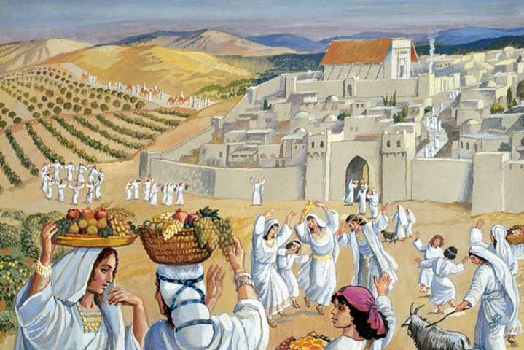
Notes:
https://external-content.duckduckgo.com/iu/?u=https%3A%2F%2Fwww.ou.org%2Fholidays%2Ffiles%2FTu-BAv-e1470913449272.jpg&f=1&nofb=1

Slide 20
In modern times, it has become a romantic Jewish holiday, and has been said to be a "great day for weddings, commitment ceremonies, renewal of vows, or proposing". Celebrated as a holiday of love
(חַג הָאַהֲבָה‎ Ḥag HaAhava).

Slide 21
It is a regular workday; music and dance festivals are typically held to celebrate the day. Israelis give cards and flowers to their loved ones on Tu b’Av.

Slide 22
These customs are observed by all segments of Israeli society, whether they consider themselves religious or non-religious.

Slide 23
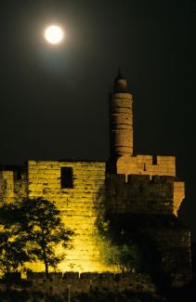
As the Hebrew calendar is lunar,
15 = טו [9+6] Tu b’Av occurs in the middle of the lunar month on a full moon.
Notes:
Linking the full moon, Tu b’Av is characterized by love, fertility, and romance.

Slide 24
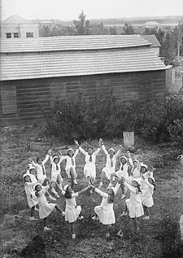
It is a day for romance, explored through singing, dancing, giving flowers, and studying. The rabbis teach that on Tu B’Av one begins to set more time for studying as the High Holidays approach.
Notes:
To Jewish people, study is romantic.
https://israelforever.org/interact/blog/Israel_forever_Dancing_Girls_Tu_BAv.jpg
https://www.myjewishlearning.com/article/celebrating-romantic-love/

Slide 25
2025: Sunset, Aug. 8–
nightfall, Aug.9
Notes:
So, we partially missed it this year, except…

Slide 26
2025: Sunset, Aug. 8–
nightfall, Aug.9
Extensions allowed
and encouraged.
Notes:
So, we missed it this year, except…

Slide 27
Two applications
All you married, dating men get your wives/girlfriends flowers, or a gift, or take care of her in some special way.
A day of love: I want to examine our MOST important love relationship, to the Heavenly Bridegroom.
Notes:
Singles NOT excluded!!
The above story and holiday teaching was just an intro…

Slide 28

Notes:
Let’s all say it: Immanuel, Barukh Haba

Slide 29

Welcome Immanuel בָּרוּךְ הַבָּא עִמָּנוּאֵל
History of the term Immanuel עִמָּנוּאֵל
Healing use of the term
Future of the term

Slide 30
Welcome Immanuel בָּרוּךְ הַבָּא עִמָּנוּאֵל
History of the term Immanuel עִמָּנוּאֵל
Healing use of the term
Future of the term

Slide 31
735-734 BCE, ^{Yeshayahu / Is 7.2} it was told to the house of David [Kingdom of Y’hudah / Judah] that Aram and Efrayim had become allies. Akhaz’s heart began to tremble, as did the hearts of his people, like forest trees shaken by the wind.
Notes:
Does that sound like a good mindset of security and victory?
Invader. Have you ever been in full panic mode?

Slide 32
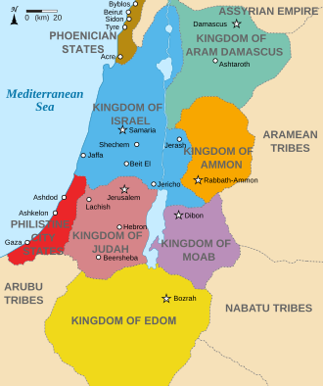
Ephraim
Notes:
Note Ephraim = Israel, largest of the 10 northern tribes
Aram Damascus = Syria
North of them is Assyria = modern Iraq
Syria is NOT Assyria

Slide 33
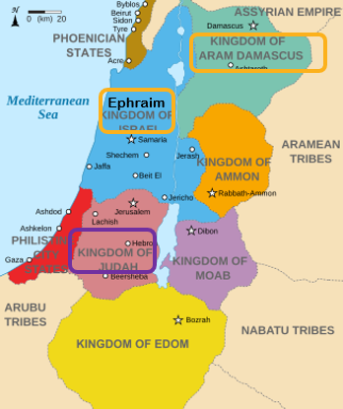
^{Yeshayahu / Is 7.3} Adoni said to Yesha‘yahu, “Go out now to meet Akhaz, you and your son…at the end of the aqueduct from the Upper Pool, on the road to the Launderers’ Field; and say to him,
Ephraim
Notes:
Note Ephraim = Israel Aram Damascus = Syria

Slide 34
^{Yeshayahu / Is 7.5-6} ‘Stay calm and unafraid; don’t be demoralized… Aram, Efrayim…have been plotting against you, thinking, “We will invade Y’hudah, tear it apart, divide it among ourselves and appoint the son of Tav’el as king there.”
Notes:
“Stay calm” !!
Full panic → stay calm.

Slide 35
^{Yeshayahu / Is 7.7} “‘This is what Adoni Elohim says: “It won’t occur; it won’t happen.
Notes:
Definitive.
G say anything like that to you?
You are forgiven of that disastrous offense.
You won’t starve.
Your business won’t fail.
Your marriage will succeed.
Your depression will lift.
Your fears will turn to joy and love.
Your disease isn’t fatal or lifelong.
Your kids will come back….
Basis of promises??

Slide 36
^{Yeshayahu / Is 7.10-12} Adoni spoke again to Achaz; he said, “Ask Adoni your God to give you a sign. Ask it anywhere, from the depths of Sh’ol to the heights above.” But Achaz answered, “I won’t ask, I won’t test Adoni.”

Slide 37
^{Yeshayahu / Is 7.14} Adoni himself will give you people a sign: the virgin young woman will become pregnant, bear a son and name him ‘Immanu El [God is with us] עִמָּנוּאֵל.
Notes:
Here is the warrantee. Immanuel. G-d with us.
In the immediate military threat, a general promise. To us now: Coming to earth of G-d! to be with us, walk with us, suffer with us, then for us, then in us!
Do we have the conscious sense that G-d is with us, not emotionally, but deeper, in your spirit.
^{Ro 8.16} The Spirit himself bears witness with our own spirits that we are children of God.
Immanuel reality.

Slide 38
^{Yeshayahu / Is 8.6-8}“Because these people have refused the softly flowing waters of Shiloah, and rejoice with Rezin and Remaliah’s son, therefore behold, Adoni is bringing on them the waters of the River—mighty and massive—Assyria’s king with all his glory!

Slide 39
^{Yeshayahu / Is 8.6-8} It will rise over all its channels and spill over all its banks. Then it will sweep through Judah, overflow as it passes through, reaching even to the neck! So the spread of its wings will be the full breadth of your land! Immanuel!
Notes:
That is, the enemies [Ephraim-Israel & Aram-Syria] will face the wrath and conquest of Assyria, but Judah will be protected.
Immanuel = G-d with us, is the battle cry, heart cry, affirmation cry of VICTORY, when apparently impossible!!

Slide 40
Ephraim
Notes:
Note Ephraim = Israel Aram Damascus = Syria
Assyria = modern Iraq further north, will invade and conquer, but Judah will be safe. Why? Immanuel!

Slide 41
^{Yeshayahu / Is 8.1} Let them plot
and let them plan.
Let them plot; they shall not stand.
Let them plot and let them plan,
For they shall not, they shall not stand,
For our G-d is with us.

Slide 42
עֻצוּ עֵצָה וְתֻפָר
Oo-tsoo ay-tsa v'too-far
דַּבְּרוּ דָבָר וְלֹא יָקוּם
Dab-roo da-var v'lo ya-koom
כִּי עִמָּנוּ אֵֽל:
Kee ee-ma-noo El.
Tanakh - Isaiah Chapter 8: 10

Slide 43
This became a general understanding principle in Israel:
^{Yeshayahu / Is 7.14} Adoni himself will give you people a sign: the virgin young woman will become pregnant, bear a son and name him ‘Immanu El [God is with us] עִמָּנוּאֵל.

Slide 44
^{Matt 1.20-23} An angel of Adoni appeared to him in a dream and said, “Yosef, “Yoseph son of David, do not be afraid to take Miriam as your wife, for the Child conceived in her is from the Ruach ha-Kodesh. She will give birth to a son; and you shall call His name Yeshua, for He will save His people from their sins.”

Slide 45
^{Matt 1.20-23} Now all this took place to fulfill what was spoken by Adoni through the prophet, saying, “Behold, the virgin shall conceive and give birth to a son, and they shall call His name Immanuel,” which means “God with us.”
Notes:
You may object and say that Yeshua was NEVER called Immanuel. However, this is so important to Hebrew understanding of names. Those called Sacred Namers fixate on the hyper-literal meaning of having a name. It means having an identity.

Slide 46
^{2 Shmuel 2.24-25} David comforted his wife Bat-Sheva, came to her and went to bed with her; she gave birth to a son and named him Shlomo. Adoni loved him and sent through Natan the prophet to have him named Y’didyah [loved by God], for Adoni’s sake.
Notes:
But Solomon was NEVER actually called that. It was his identity in G-d.

Slide 47
So when Yeshua teaches us to pray, ‘Our Father in heaven! May your Name be kept holy.’
It means Your identity. Your reputation. Not your pronunciation.
Notes:
Moshe prayed, don’t destroy the people. Nations will say Adoni wasn’t able…

Slide 48
^{Matt 1.20-23} You shall call His name Yeshua, for He will save His people from their sins…and they shall call His name Immanuel,” which means “God with us.”
Notes:
Yeshua’s identity is Immanuel.

Slide 50
Welcome Immanuel בָּרוּךְ הַבָּא עִמָּנוּאֵל
History of the term Immanuel עִמָּנוּאֵל
Healing use of the term
Future of the term

Slide 51
When we say Welcome Immanuel בָּרוּךְ הַבָּא עִמָּנוּאֵל Immanuel, Barukh Haba
We are in one word acknowledging the whole plan of salvation: His coming to earth, living among us, G-d with us. Coming to earth of G-d! to be with us, walk with us, suffer with us, then for us, then in us!
Notes:
I hope you don’t mind. I just get buzzed off of saying it in Hebrew. It seems to me to have more power, more authority, more authenticity.
If you have a saving relationship with Yeshua, this invites him into your life.
If you don’t have a saving relationship with Yeshua, this concept should draw you to such!!

Slide 52
When we say Welcome Immanuel בָּרוּךְ הַבָּא עִמָּנוּאֵל Immanuel, Barukh Haba
We are welcoming Him to rule in our lives, our emotions, our relationships as G-d/ man with us.
We are giving Him authority over our response to life, to difficulties, to needs.

Slide 53
He should be recognized moment by moment as Immanuel, G-d with us. “בָּרוּךְ הַבָּא עִמָּנוּאֵל Immanuel, Barukh Haba”
^{Col 1.15-17} He is the visible image of the invisible God. He is supreme over all creation, because in connection with him were created all things —

Slide 54
^{Col 1.15-17} in heaven and on earth, visible and invisible, whether thrones, lordships, rulers or authorities — they have all been created through him and for him. He existed before all things, and he holds everything together.

Slide 55
He is with us, if we let Him/ invite Him. Our dance leader.
He’s our coach to lead us to victory.
Notes:
Love when Javier leads. Me and Dawn.
I’ve seen a number of actors as Yeshua. Best one, most believable one was David Haddy, at a dance ministry called David’s House in the old NE corner of the city, earliest Jewish neighborhood of KC. He was Yeshua in a hora scene set in the Galil, Galilee. It just seemed a real Immanuel moment.
Ice cream sodas

Slide 56
Easy to go into panic mode:

Slide 57
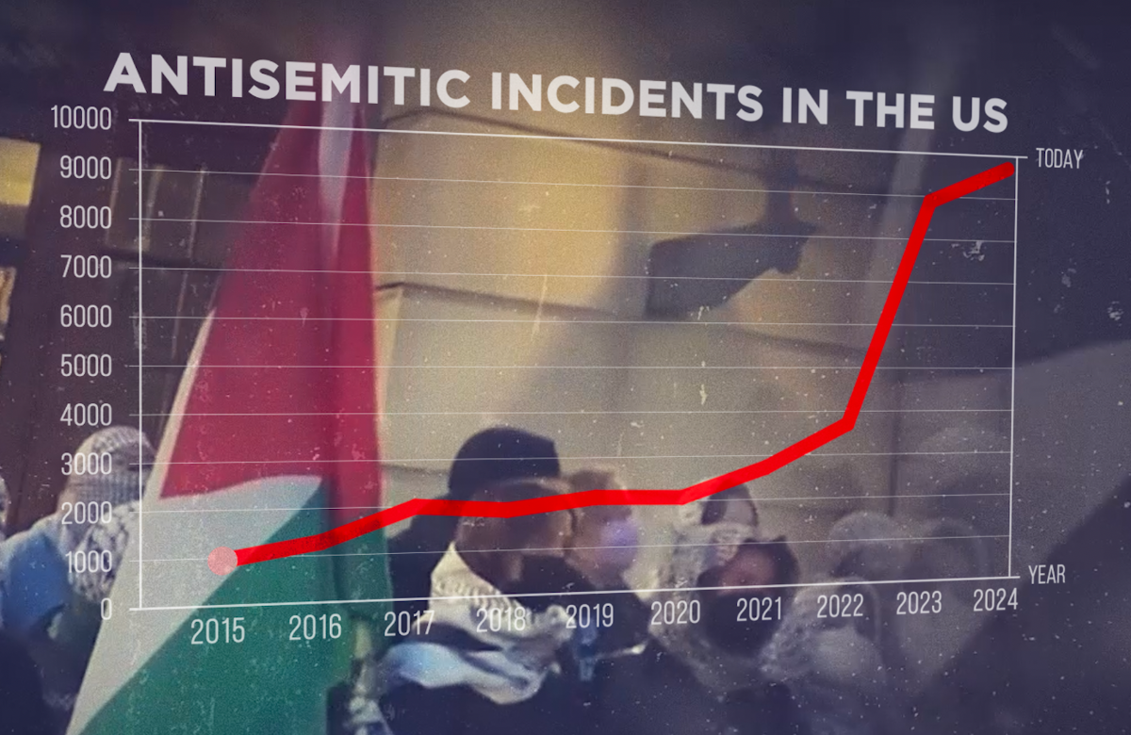
Notes:
https://jij.us5.list-manage.com/track/click?u=f90156f81e0ff7c8864d78183&id=918c353e61&e=5b00c6e90f

Slide 58
The statistics are staggering
United States: 9,354 antisemitic incidents in 2024—a 344% increase in five years.
Europe: In just two months, Paris saw more attacks than France did in all of 2022.
Notes:
He won’t let Israel or the Jews or those allied with the Jews perish, even when it looks gruesome.

Slide 59
UK: Over 4,000 incidents in 2023, doubling the year before.
Germany: Cases nearly doubled from 2022 to 2023.
Canada: From 2,000 incidents in 2022 to nearly 6,000 in 2024.

Slide 60
(Aug. 8, 2025 / JNS)
A Chabad rabbi and his family escaped a fire that destroyed a synagogue in the New York City suburbs on Friday, NJ.com reported.
No one was injured, but the Torah scrolls were burned in the blaze, according to the outlet.
Notes:
https://www.jns.org/nj-chabad-rabbi-family-escape-fire-that-destroys-synagogue-and-torahs/

Slide 61
(Aug. 8, 2025 / JNS)
A Chabad rabbi and his family escaped a fire that destroyed a synagogue in the New York City suburbs on Friday, NJ.com reported.
No one was injured, but the Torah scrolls were burned in the blaze, according to the outlet.
Notes:
https://www.jns.org/nj-chabad-rabbi-family-escape-fire-that-destroys-synagogue-and-torahs/

Slide 62
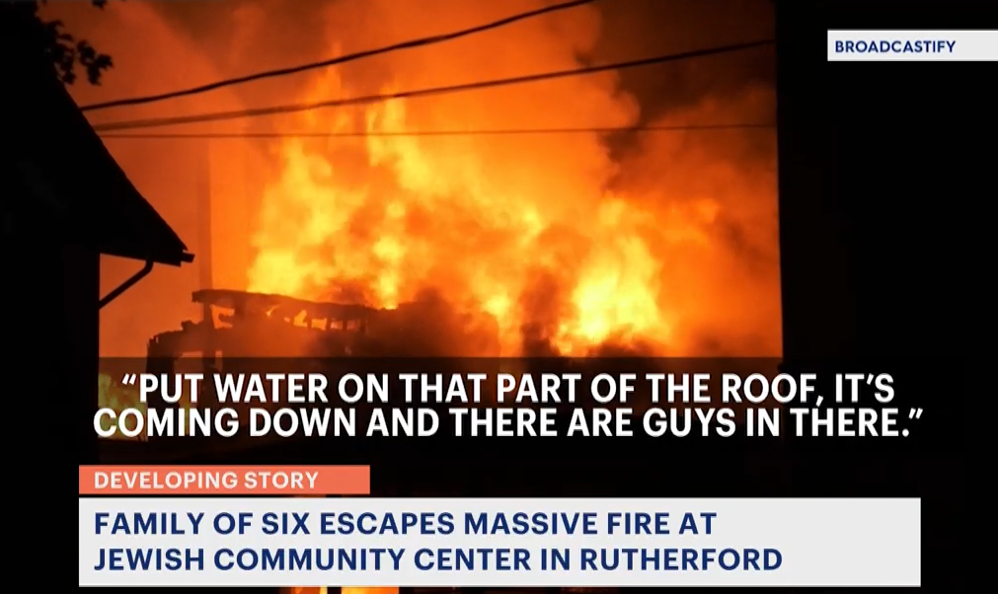
Notes:
https://newjersey.news12.com/massive-overnight-fire-engulfs-jewish-community-center-in-rutherford

Slide 63
Welcome Immanuel
בָּרוּךְ הַבָּא עִמָּנוּאֵל
Immanuel, Barukh Haba

Slide 65
^{2 Cor 4.6} For it is the God who once said, “Let light shine out of darkness,” who has made his light shine in our hearts, the light of the knowledge of God’s glory shining in the face of the Messiah Yeshua.

Slide 66
^{Yeshayahu/Is 60.1} “Arise, shine for your light has come, the glory of Adoni has risen over you.

Slide 67
^{Mes Jews/Heb 1.3} This Son is the radiance of the Sh’khinah, the very expression of God’s essence, upholding all that exists by his powerful word; and after he had, through himself, made purification for sins, he sat down at the right hand of HaG’dulah BaM’romim, the majesty above.

Slide 68
Welcome Immanuel
בָּרוּךְ הַבָּא עִמָּנוּאֵל
Immanuel, Barukh Haba

Slide 69
Sozo application
PRESENTING YESHUA
A. Presenting Yeshua is a tool used to bring healing in individuals' lives when they have been triggered by a familiar spirit or event, and then experience harmful situations from the past. When that occurs, wounds or lies can be implanted.

Slide 70
A. This tool helps them see that Yeshua was present during that situation and /or issue. The Godhead exchanges lies for truths and heals the wounds.

Slide 71
B. To use the Presenting Yeshua tool the leading Team member should ask Yeshua, the Holy Spirit, or Father God, to take the person back to the harmful situation in their mind. To make sure individuals are ‘there’, have them describe the situation or picture.

Slide 72
B. Ask Yeshua to show them the lie they learned through this situation (there can be more than one lie). Have them renounce the lie. Ask Yeshua what the truth is.

Slide 73
B. Ask the individuals if this information feels true or if they believe what Yeshua is saying.
Notes:
Say Barukh Haba even about past hurtful situations.

Slide 74
Daily application
Present any fears, insecurities, points of rage or depression and say Immanuel, Barukh Haba.
Visualize Him walking in the situation.

Slide 75
Welcome Immanuel
בָּרוּךְ הַבָּא עִמָּנוּאֵל
Immanuel, Barukh Haba

Slide 76
“If you want to change the world, go home and love your family.”
Isabel Brown on Ben Shapiro’s Daily Wire quoting Mother Teresa.

Slide 77
“It is easy to love the people far away. It is not always easy to love those close to us. Bring love into your home, for this is where our love for each other must start.”
Notes:
https://www.coraevans.com/blog/article/10-most-beautiful-mother-teresa-quotes-on-the-family

Slide 79
Welcome Immanuel בָּרוּךְ הַבָּא עִמָּנוּאֵל
History of the term Immanuel עִמָּנוּאֵל
Healing use of the term
Future of the term

Slide 80
^{Rev 21.1-4} Then I saw a new heaven and a new earth, for the old heaven and the old earth had passed away, and the sea was no longer there. Also I saw the holy city, New Yerushalayim, coming down out of heaven from God, prepared like a bride beautifully dressed for her husband.

Slide 81
^{Rev 21.1-4} I heard a loud voice from the throne say, “See! God’s Sh’khinah is with mankind, and he will live with them. They will be his people, and he himself, God-with-them, will be their God.He will wipe away every tear from their eyes. There will no longer be any death; and there will no longer be any mourning, crying or pain; because the old order has passed away.”
Notes:
https://youtu.be/hBPl2214-jE?t=154
Immanuel Barukh HaBa

Slide 82
Conclusion:
Present any fears, insecurities, points of rage or depression, temptation, pride, and say Immanuel, Barukh Haba.
Visualize Him walking in the situation.

Slide 83
Welcome Immanuel
בָּרוּךְ הַבָּא עִמָּנוּאֵל
Immanuel, Barukh Haba

