Slide 1

Notes:
https://youtu.be/WoPoM1JUbL0
https://youtu.be/iCaPVyw2g74
https://allisraelnews.com/videos/worlds-first-laser-shield-israels-defense-breakthrough-kan-11?utm_source=convertkit&utm_medium=email&utm_campaign=EDITORIAL%3A%20The%20UN%20fuels%20antisemitism%20with%20false%20genocide%20claims%20that%20collapse%20under%20genuine%20scrutiny%20-%2019030265

Slide 2
Israel's high-powered laser interception system, dubbed "Iron Beam," has been declared operational after completing development and final tests, and is set to be delivered to the military by the end of the year, the Defense Ministry and manufacturer Rafael said on Wednesday.
Notes:
4 or 5 different newsfeeds announced this.
Those were tests you saw of rockets and a drone being destroyed by Or Eitan

Slide 3
The Iron Beam is not meant to replace the Iron Dome or Israel's other air defense systems, but to supplement and complement them, shooting down smaller projectiles and leaving larger ones for the more robust missile-based batteries such as the David's Sling and Arrow systems.

Slide 4
In a symbolic move, the ministry renamed the system in Hebrew from Magen Orמָגֵן אוֹר (light shield) to Or Eitan אוֹר אֵיתָן (Eitan’s light), after Cpt. Eitan Oster, 22, a commander in the Egoz Commando Unit,

Slide 5
who was killed fighting Hezbollah in southern Lebanon in October 2024. Eitan Oster’s father… was among the "initiators and developers" of the Iron Beam project, the ministry said.

Slide 6
Moreover, unlike Israel's current interception systems, which cost tens of thousands of dollars per missile, the laser system costs one to two dollars per shot.
And there is no limit to ammunition, as long as there is electric power.

Slide 7
Although Raytheon in the US, as well as England, Russia, China, Germany, and Japan, are all at various stages of developing laser defense systems, the ministry said on Wednesday that Iron Beam is the only one that has moved beyond test firings to actual use in the field.
Notes:
https://www.jpost.com/israel-news/defense-news/article-867735?utm_source=ActiveCampaign&utm_medium=email&utm_content=Israel%20and%20Syria%20look%20to%20sign%20security%20pact%20%2A%20REPORT%20%7C%20Israel%20tells%20families%20it%20lacks%20precise%20Gaza%20hostage%20locations%20as%20IDF%20advances%20in%20Gaza%20City%20%2A%20Egypt%20s%20Sisi%20refers%20to%20Israel%20as%20%20enemy&utm_campaign=September%2018%2C%202025&vgo_ee=4QG72mkW24hxpXUbxNTB7vjbrOC5A5A%2BNgqBLaAF84FpIQlQ%3A0VlyMxEiBkPR0KhQYpcRJkr9d5LR%2B6vM

Slide 8


Slide 9

A fruitful grain of wheat Yn 8.34-35
We are at war: scriptures
War casualties and conquest
Erika Kirk

Slide 10
A fruitful grain of wheat Yn 8.34-35
We are at war: scriptures
War casualties and conquest
Erika Kirk

Slide 12
^{Yn 8 24-26} Yes, indeed! I tell you that unless a grain of wheat that falls to the ground dies, it stays just a grain; but if it dies, it produces a big harvest. He who loves his life loses it,

Slide 13
^{Yn 8 24-26} but he who hates his life in this world will keep it safe right on into eternal life! If someone is serving me, let him follow me; wherever I am, my servant will be there too. My Father will honor anyone who serves me.

Slide 14
^{Mtt 5. 10-11} “How blessed are those who are persecuted because they pursue righteousness! for the Kingdom of Heaven is theirs. “How blessed you are when people insult you and persecute you and tell all kinds of vicious lies about you because you follow me!

Slide 15
^{Mtt 5. 10-11} Rejoice, be glad, because your reward in heaven is great — they persecuted the prophets before you in the same way.

Slide 16
^{Mt 24.8-10} All these things are only the beginning of birth pains. Then they will hand you over to persecution and will kill you. You will be hated by all the nations because of My name. And then many will fall away and will betray one another and hate one other.

Slide 17
^{Yn 16.2} Yes, an hour is coming when whoever kills you will think he is offering service to God.
^{Rev 6.9} When the Lamb broke the fifth seal, I saw underneath the altar the souls of those who had been put to death for proclaiming the Word of God, that is, for bearing witness.
Notes:
Or in secular terms, doing a good thing for the world.

Slide 18
^{1 Cor 10.4-5} The weapons we use to wage war are not worldly. On the contrary, they have God’s power for demolishing strongholds. We demolish arguments and every arrogance that raises itself up against the knowledge of God;

Slide 19
we take every thought captive and make it obey the Messiah.
NOT, demolish the people.
Notes:
Charlie to one student who said, “I hate America.”
“Are you going to leave and go somewhere else.”
“No.”
Charlie: This is the only country where people who hate it want to stay.

Slide 20
^{Lk 6.22-23} “How blessed you are whenever people hate you and ostracize you and insult you and denounce you as a criminal on account of the Son of Man. Be glad when that happens; yes, dance for joy! because in heaven your reward is great. For that is just how their fathers treated the prophets.

Slide 21


Slide 22

Notes:
https://img.fotocommunity.com/dance-of-joy-36d481b3-e813-4bd6-a7d1-60941959d27b.jpg?height=1080

Slide 23
^{Acts 7.59-60} As they were stoning him, Stephen called out to God, “Lord Yeshua! Receive my spirit!” Then he kneeled down and shouted out, “Lord! Don’t hold this sin against them!” With that, he fell asleep.

Slide 24
^{Acts 4.23-31} Upon being released, they went back to their friends and reported what the head cohanim and elders had said to them. When they heard it, they raised their voices to God with singleness of heart. “Master,” they prayed,

Slide 25
^{Acts 4.23-31} “You made heaven, earth, the sea and everything in them. By the Ruakh HaKodesh, through the mouth of our father David, your servant, you said,

Slide 26
^{Acts 4.23-31} ‘Why did the nations rage and the peoples devise useless plans? The kings of the earth took their stand; and the rulers assembled together against Adoni and against his Messiah.’ “This has come true in this city, since Herod and Pontius Pilate, with Goyim and the peoples of Isra’el,

Slide 27
^{Acts 4.23-31} all assembled against your holy servant Yeshua, whom you made Messiah, to do what your power and plan had already determined beforehand should happen. “So now, Lord, take note of their threats; and enable your slaves to speak your message with boldness!

Slide 28
^{Acts 4.23-31} Stretch out your hand to heal and to do signs and miracles through the name of your holy servant Yeshua!” While they were still praying, the place where they were gathered was shaken. They were all filled with the Ruach HaKodesh, and they spoke God’s message with boldness.
Notes:
Boldness. Essence of Charlie Kirk. Gentleness and boldness mixed!!

Slide 29
^{Rev 6.9-11} When the Lamb broke the fifth seal, I saw underneath the altar the souls of those who had been put to death for proclaiming the Word of God, that is, for bearing witness. They cried out in a loud voice, “Sovereign Ruler, HaKadosh, the True One,

Slide 30
^{Rev 6.9-11} how long will it be before you judge the people living on earth and avenge our blood?” Each of them was given a white robe; and they were told to wait a little longer, until the full number of their fellow-servants should be reached, of their brothers who would be killed, just as they had been.

Slide 31
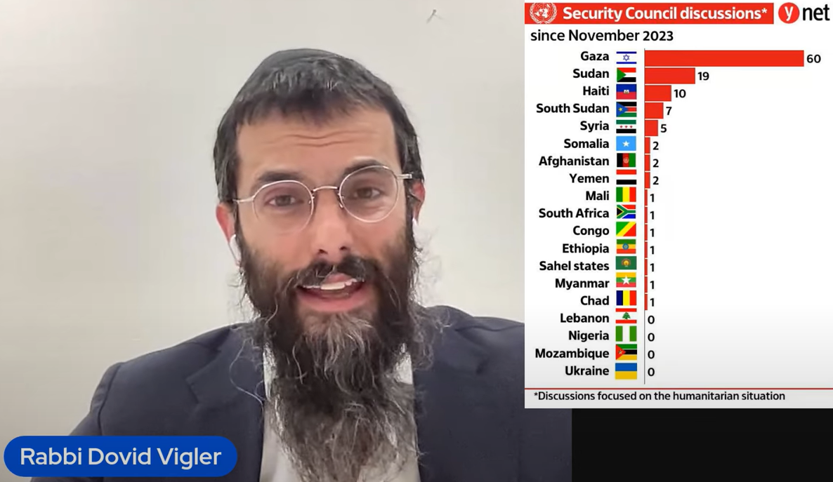
Notes:
https://www.youtube.com/watch?v=P7kIKefFWSo

Slide 33
A fruitful grain of wheat Yn 8.34-35
We are at war: scriptures
War casualties and conquest
Erika Kirk

Slide 35
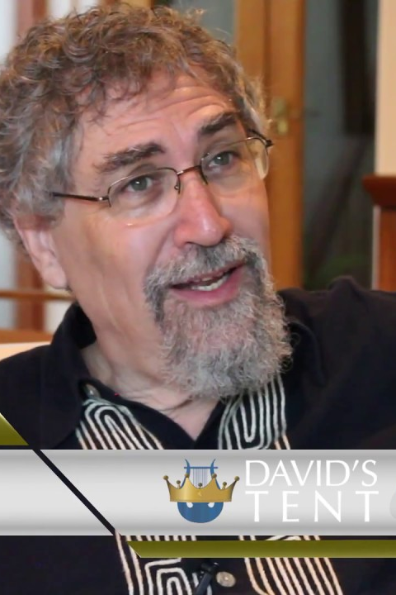
From Avner Boskey, senior Messianic scholar and musician, living near Beersheva, Israel: “Herod wanted to kill John, but he was afraid of the people, because they considered John a prophet” ^{(Matthew 14:5)}

Slide 36
Those who hated Charlie, hated him with a passion. John the Baptist confronted Herod over his unlawful taking of his brother’s wife. Kirk spoke against sexual sin just like John the Baptist did. They both paid with their lives.
Notes:
Avner Boskey

Slide 37
Herod eventually had John beheaded. I saw a report about Charlie Kirk’s death, about whether he suffered pain or was aware of what happened to him when he was shot in the neck. The severing of the jugular vein and carotid artery leads to nearly instantaneous death. The brain doesn’t have the chance to register the pain.
Notes:
Avner Boskey

Slide 38
Charlie Kirk took it in the neck, in a way very similar to John the Baptist.
John the Baptist was a beacon of truth in the midst of a faithless and twisted generation. So too was Charlie Kirk. The ‘love grown cold’ of our times is seen in the perversity of some of the depraved and mocking responses to Kirk’s death. This too is a sign.
Notes:
Avner Boskey

Slide 39
“And because lawlessness will be increased, the love of many will grow cold” (Matthew 24:12)
Notes:
Avner Boskey

Slide 40
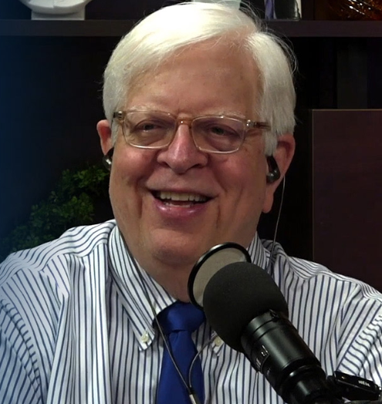
From Dennis Prager:
America’s youth in particular have lost a moral and intellectual leader, one who would, perhaps, have one day become their president.

Slide 41
As a committed Jew, I thank God regularly that a non-Jew, a committed Christian, became one of the few great public spokesmen on behalf of Israel and the Jewish communities outside of Israel. Few Jews could match Charlie’s knowledge and eloquent arguments on behalf of those two entities.
Notes:
https://www.prageru.com/remembering-our-dear-friend-charlie-kirk?utm_source=Iterable&utm_medium=email&utm_campaign=campaign_14963361

Slide 42
For one of the first times in my 20 years with my wife, Sue, I have seen her sob uncontrollably. The Prager home is in deep mourning
Notes:
https://www.prageru.com/remembering-our-dear-friend-charlie-kirk?utm_source=Iterable&utm_medium=email&utm_campaign=campaign_14963361

Slide 43
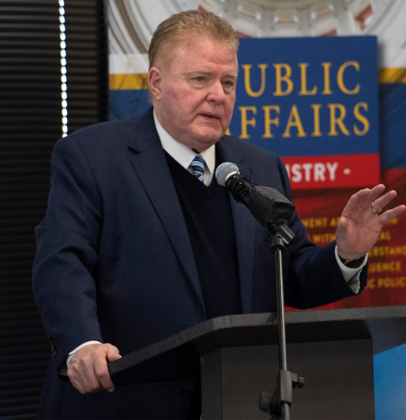
Jim Garlow, adviser to presidents and Knesset members, retired Wesleyan pastor

Slide 44
His last name is Kirk. That is “church”, or “ekklesia.” A new form of the ekklesia might be breaking out now.
His first name means “free man” or “warrior.” That word terrifies the weak. They don’t comprehend what real SPIRITUAL warriors look like.
Notes:
Jim Garlow

Slide 45
They like being “Mr. Nice Guy.” They like to be liked. They want the accolades of other humans more than they fear God.
Charlie did not seek popularity. But he was popular because he was bold for truth.
Notes:
Jim Garlow
Me: I like to be liked. Probably too much.

Slide 46

Beni Harmony, an ABC new anchor, paid an impassioned tribute to Kirk, whom she knew personally, during a Sept.12 segment on ABC20’s Marketplace program.
Notes:
https://tse1.mm.bing.net/th/id/OIF.S17D79pg0KFA4qHx1e5UlQ?pid=Api&P=0&h=180
https://www.theepochtimes.com/us/news-anchor-resigns-after-being-suspended-over-on-air-charlie-kirk-tribute-5915658?utm_source=RTNews&src_src=RTNews&utm_campaign=rtbreaking-2025-09-16-1&src_cmp=rtbreaking-2025-09-16-1&utm_medium=email&est=EnD8yCMqf2NhV5QWszXAFB01G%2F6rYqimLYbyJGq7IsdA4vky2ey9DPeSLG1WTzKDug%3D%3D

Slide 47
“I want you to know that it’s OK if you feel sadness, it’s OK if you’re grieving,” the host told her TV audience. “I want to share with you one of my favourite sayings that Charlie would always tell us at the office, he would yell it from the mountain-tops, so please listen:
Notes:
https://tse1.mm.bing.net/th/id/OIF.S17D79pg0KFA4qHx1e5UlQ?pid=Api&P=0&h=180
https://www.theepochtimes.com/us/news-anchor-resigns-after-being-suspended-over-on-air-charlie-kirk-tribute-5915658?utm_source=RTNews&src_src=RTNews&utm_campaign=rtbreaking-2025-09-16-1&src_cmp=rtbreaking-2025-09-16-1&utm_medium=email&est=EnD8yCMqf2NhV5QWszXAFB01G%2F6rYqimLYbyJGq7IsdA4vky2ey9DPeSLG1WTzKDug%3D%3D

Slide 48
When conversations stop happening, when individuals become wordless, that’s when violence begins. So, if you do one thing today, make it be with passion, with conviction. Stand up for your friends, stand up for your beliefs, and speak loudly, even if your voice shakes. Your words have meaning, your values have purpose. Never forget that.
Notes:
https://www.theepochtimes.com/us/news-anchor-resigns-after-being-suspended-over-on-air-charlie-kirk-tribute-5915658?utm_source=RTNews&src_src=RTNews&utm_campaign=rtbreaking-2025-09-16-1&src_cmp=rtbreaking-2025-09-16-1&utm_medium=email&est=EnD8yCMqf2NhV5QWszXAFB01G%2F6rYqimLYbyJGq7IsdA4vky2ey9DPeSLG1WTzKDug%3D%3D

Slide 49
According to a post Harmony made three days later, she was suspended by her network [ABC] for the tribute to her former employer, whose assassination on a Utah college campus on Sept. 10 made national headlines.
Notes:
https://www.theepochtimes.com/us/news-anchor-resigns-after-being-suspended-over-on-air-charlie-kirk-tribute-5915658?utm_source=RTNews&src_src=RTNews&utm_campaign=rtbreaking-2025-09-16-1&src_cmp=rtbreaking-2025-09-16-1&utm_medium=email&est=EnD8yCMqf2NhV5QWszXAFB01G%2F6rYqimLYbyJGq7IsdA4vky2ey9DPeSLG1WTzKDug%3D%3D

Slide 50
“Many in the mainstream media have been fired or punished for mocking his assassination,” Harmony wrote in a Sept. 15 post on X.
“I believe I am the first to be targeted for honoring him on air.
Notes:
https://www.theepochtimes.com/us/news-anchor-resigns-after-being-suspended-over-on-air-charlie-kirk-tribute-5915658?utm_source=RTNews&src_src=RTNews&utm_campaign=rtbreaking-2025-09-16-1&src_cmp=rtbreaking-2025-09-16-1&utm_medium=email&est=EnD8yCMqf2NhV5QWszXAFB01G%2F6rYqimLYbyJGq7IsdA4vky2ey9DPeSLG1WTzKDug%3D%3D

Slide 52
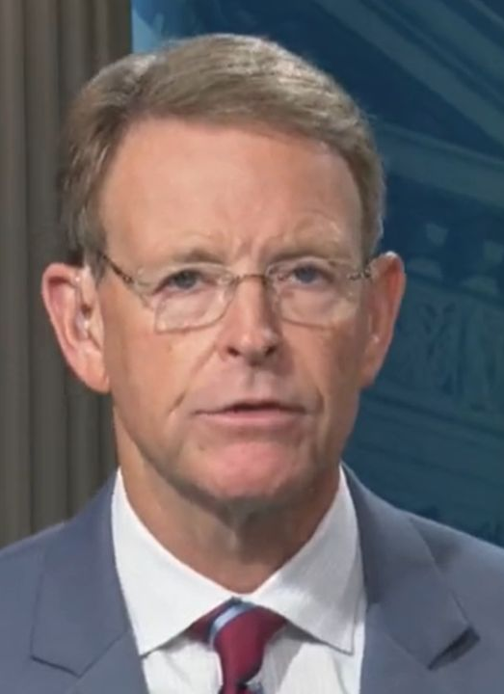
Tony Perkins, Southern Baptist pastor, who has served as president of the Family Research Council since 2003. Previously, he was a police officer and television reporter. From 1996 to 2004, he served as a member of the Louisiana House of Representatives.

Slide 53
In London, thousands flooded the streets, draped in British and American flags, holding signs that read, “We are all Charlie.” In South Korea, videos capture crowds chanting, “We are Charlie Kirk!” In Canada, Fox News reported massive gatherings singing the U.S. national anthem. Comments from Japan, New Zealand, elsewhere in the U.K., and beyond echo the same sentiment: “We’re hurting here, too.”
Notes:
https://washingtonstand.com/article/god-is-using-charlie-kirks-life-and-death-to-point-people-to-christ

Slide 54
Let us remember one of Charlie's mottos and a quote, "Be courageous and live fearlessly," and, “Yeshua defeated death so that you can live.'"

Slide 55
God Is Using Charlie Kirk’s Life and Death to Point People to Messiah!

Slide 56

Reporter for the Washington Stand
For many, the wound remains raw, as they try to make sense of a senseless tragedy. This isn’t just America’s grief — the world is waking up to it.
Notes:
Sarah Holliday is a reporter at The Washington Stand. Tony Perkins.

Slide 57
Yet, my encouragement is this: stand firm. Not in your own strength or fleeting resolve, but in Messiah — His unshakable character, His eternal purposes.
The Lord is weaving something profound through this tragedy, in ways we could scarcely have imagined or predicted

Slide 58
Across social media and news outlets, a groundswell is emerging. People are confessing, “I’ve never been to church, but I’m feeling a pull to attend a Sunday service.” Friends and family have shared with me that their churches were overflowing this past Sunday, a phenomenon echoed nationwide.
Notes:
https://washingtonstand.com/article/god-is-using-charlie-kirks-life-and-death-to-point-people-to-christ

Slide 59
Alongside this, lifelong atheists and skeptics are turning to prayer and seeking out Bibles. Even those once aligned with the Democratic Party or liberal ideologies are declaring, “No more.” Christians who shared Charlie’s convictions are emerging from the shadows,
Notes:
https://washingtonstand.com/article/god-is-using-charlie-kirks-life-and-death-to-point-people-to-christ

Slide 60
no longer content to hide behind safe reputations or social media metrics. They’re proclaiming, “I don’t care if people reject me. This is the truth, and it must be heard.”
Notes:
https://washingtonstand.com/article/god-is-using-charlie-kirks-life-and-death-to-point-people-to-christ

Slide 61
It’s encouraging to see this among everyday Americans as well as those with platforms. Forrest Frank, for example, is a fairly well-known Christian singer and songwriter – especially popular among Gen Z. He posted grieving about Charlie Kirk, and later revealed he lost 30,000 followers for it.
Notes:
https://washingtonstand.com/article/god-is-using-charlie-kirks-life-and-death-to-point-people-to-christ

Slide 62
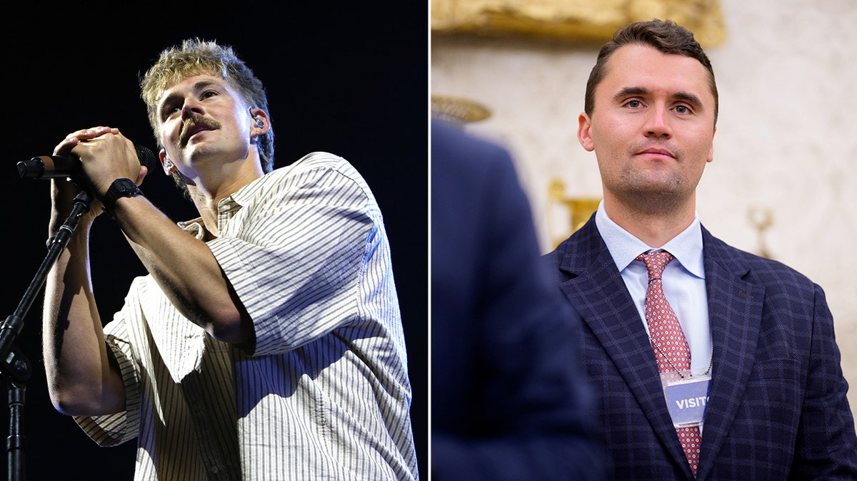
Notes:
https://a57.foxnews.com/static.foxnews.com/foxnews.com/content/uploads/2025/09/1200/675/forrest-frank-charlie-kirk.jpg?ve=1&tl=1
https://youtu.be/o3ETVqqSXTc

Slide 63
His response? A resolute “Good.” With unwavering conviction, he declared that he cares not for followers but for being a follower — of Messiah — spreading the good news and standing for truth.
Notes:
https://washingtonstand.com/article/god-is-using-charlie-kirks-life-and-death-to-point-people-to-christ

Slide 64
In London, thousands flooded the streets, draped in British and American flags, holding signs that read, “We are all Charlie.” In South Korea, videos capture crowds chanting, “We are Charlie Kirk!”
Notes:
https://washingtonstand.com/article/god-is-using-charlie-kirks-life-and-death-to-point-people-to-christ

Slide 65
In Canada, Fox News reported massive gatherings singing the U.S. national anthem. Comments from Japan, New Zealand, elsewhere in the U.K., and beyond echo the same sentiment: “We’re hurting here, too.”
Notes:
https://washingtonstand.com/article/god-is-using-charlie-kirks-life-and-death-to-point-people-to-christ
My in-laws, Dawn’s parents, were very adept at “Yankee bashing” when I was there.

Slide 66
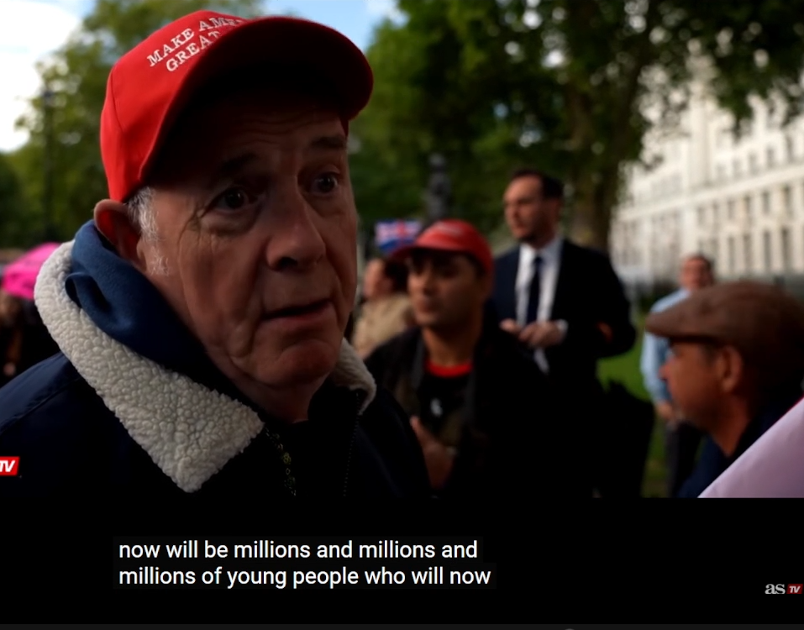
see the light
Notes:
https://washingtonstand.com/article/god-is-using-charlie-kirks-life-and-death-to-point-people-to-christ

Slide 67
I condemn the violence and hatred that stole him from us. Yet, I praise the God who redeems even the darkest evil for good. As Pastor Joe McTarsney of Calvary Chapel University said on Monday’s “Washington Watch” with guest host Jody Hice,
Notes:
https://washingtonstand.com/article/god-is-using-charlie-kirks-life-and-death-to-point-people-to-christ

Slide 68
Charlie Kirk’s death is stirring a lion in the hearts of believers. “I was deeply internally impacted because of Charlie Kirk,” McTarsney shared. “It was because of his life that I was infused with courage.”
Notes:
https://washingtonstand.com/article/god-is-using-charlie-kirks-life-and-death-to-point-people-to-christ

Slide 69
McTarsney went on to explain how, on behalf of him and his wife, “It was through Charlie and his ministry that we were awakened to the call to go to the public square and speak biblical truth in a world that’s filled with confusion and darkness.”
Notes:
https://washingtonstand.com/article/god-is-using-charlie-kirks-life-and-death-to-point-people-to-christ

Slide 70
Charlie inspired them to act, to get involved by attending school board meetings and speak biblical truth at their state capitol in California.
Notes:
https://washingtonstand.com/article/god-is-using-charlie-kirks-life-and-death-to-point-people-to-christ

Slide 71
Now, “there’s thousands upon thousands of young Charlie Kirk’s. They’re going to rise up to their call and take the message of Messiah forward. I see they’re not going to be ashamed of the good news of King Messiah Yeshua.
Will you be one? Gentle + bold?
Notes:
https://washingtonstand.com/article/god-is-using-charlie-kirks-life-and-death-to-point-people-to-christ

Slide 72
It’s what we were made to do. Ambassadors for Messiah is who we were made to be. Speak the truth.
Notes:
https://washingtonstand.com/article/god-is-using-charlie-kirks-life-and-death-to-point-people-to-christ

Slide 73

Notes:
https://x.com/Uncensorednewsw/status/1966858787018731796?ref_src=twsrc%5Etfw%7Ctwcamp%5Etweetembed%7Ctwterm%5E1966858787018731796%7Ctwgr%5E42bb3b69a3b0167458e7e2e4e8c3521a8fc7c0ed%7Ctwcon%5Es1_&ref_url=https%3A%2F%2Fm.economictimes.com%2Fnews%2Finternational%2Fus%2Ffrom-london-to-seoul-movement-goes-worldwide-as-thousands-march-chanting-we-are-charlie-kirk%2Farticleshow%2F123872933.cms

Slide 74
#London flooded with crowds ahead of Tommy Robinson’s Unite the Kingdom rally #CharlieKirk Streets packed 2.5 hours before start — police preparing for up to 1 million attendees. Could be Europe’s largest demonstration ever British patriots are chanting the name of Charlie Kirk in his memory.
Notes:
https://x.com/Uncensorednewsw/status/1966858787018731796?ref_src=twsrc%5Etfw%7Ctwcamp%5Etweetembed%7Ctwterm%5E1966858787018731796%7Ctwgr%5E42bb3b69a3b0167458e7e2e4e8c3521a8fc7c0ed%7Ctwcon%5Es1_&ref_url=https%3A%2F%2Fm.economictimes.com%2Fnews%2Finternational%2Fus%2Ffrom-london-to-seoul-movement-goes-worldwide-as-thousands-march-chanting-we-are-charlie-kirk%2Farticleshow%2F123872933.cms

Slide 75
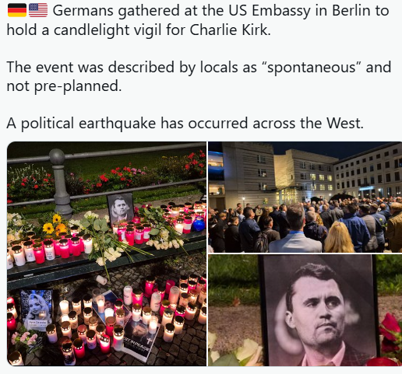
Notes:
https://x.com/VinceDaoTV/status/1966298918796583085/photo/1

Slide 76

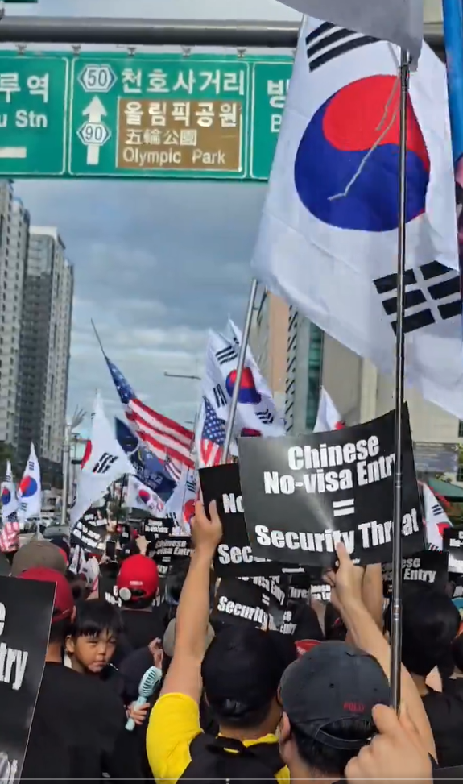
Seoul, Korea
Notes:
https://twitter.com/i/status/1966882781570703744

Slide 77
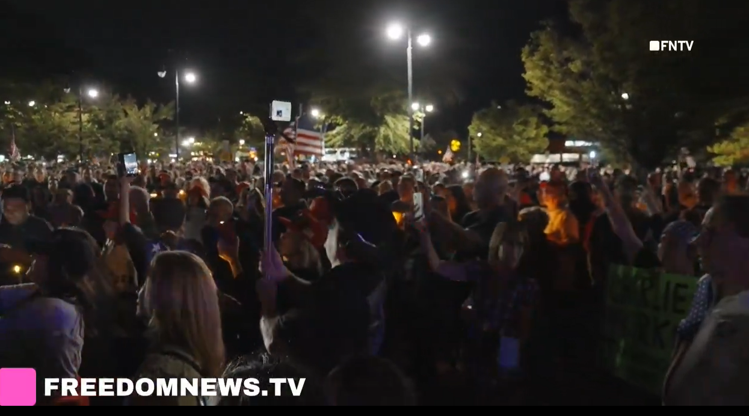
Seaford, NY (Long Island)

Slide 78
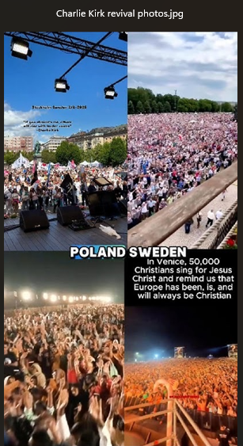

Slide 79
Martyrs: a person who sacrifices something of great value and especially life itself for the sake of principle

Slide 80
Kefa Peter – Crucified upside down in Rome under Nero because he felt unworthy to die in the same manner as Messiah.
Andrew – Crucified on an X-shaped cross in Greece, preaching the gospel until his last breath.
Yaakov James (son of Zebedee) – Beheaded in Jerusalem, the first apostle martyred (Acts 12:2).
John – The only apostle believed to have died a natural death, though he suffered exile and persecution on Patmos.
Notes:
https://thrivenews.co/christian-news-the-blood-of-the-martyrs-the-seed-of-the-church/

Slide 81
Thomas – Tradition says he was speared to death in India while preaching the gospel. [Jonathan Cahn went to that mountain to blow shofar and break the curse.]
Philip – Martyred in Asia Minor, possibly by crucifixion.
Bartholomew (Nathanael) – Reportedly flayed alive and then beheaded for his faith.
Notes:
https://thrivenews.co/christian-news-the-blood-of-the-martyrs-the-seed-of-the-church/

Slide 82
Matthew – Tradition says he was killed in Ethiopia while ministering.
Yaakov James (son of Alphaeus) – Thrown from the temple pinnacle and then beaten to death.
Thaddeus (Jude) – Martyred in Persia.
Simon the Zealot – Tradition says he was sawn in half.
Matthias (who replaced Judas) – Stoned and beheaded for preaching Messiah.
Notes:
https://thrivenews.co/christian-news-the-blood-of-the-martyrs-the-seed-of-the-church/

Slide 83
Stephen (Acts 7) –, stoned for proclaiming Messiah. His prayer for his persecutors echoed Yeshua’s own words from the cross.
Polycarp (c. 69–155 AD) – Bishop of Smyrna, burned at the stake at age 86, declaring, “Eighty and six years have I served Him, and He has done me no wrong.”
Notes:
https://thrivenews.co/christian-news-the-blood-of-the-martyrs-the-seed-of-the-church/

Slide 84
William Tyndale (1494–1536) – Burned at the stake for translating the Bible into English so ordinary people could read God’s Word.
David Brainerd (1718–1747) – Though not killed violently, his early death at 29 from illness after missionary labors among Native Americans inspired countless to go to the mission field.
Notes:
https://thrivenews.co/christian-news-the-blood-of-the-martyrs-the-seed-of-the-church/

Slide 85
Jim Elliot & Nate Saint (1956) – Martyred while taking the gospel to the Waodani [Auca] people of Ecuador. Elliot’s words still ring: “He is no fool who gives what he cannot keep to gain that which he cannot lose.”
Notes:
https://thrivenews.co/christian-news-the-blood-of-the-martyrs-the-seed-of-the-church/

Slide 86
Martin Luther King Jr. (1968) – On April 4, 1968, King was assassinated in Memphis, Tennessee, at just 39 years old. His death echoed the truth that standing for righteousness often comes with a price. Like the prophets of old, he lifted his voice against injustice, and like so many martyrs before him, he paid for it with his life.
Notes:
https://thrivenews.co/christian-news-the-blood-of-the-martyrs-the-seed-of-the-church/

Slide 87
Rachel Joy Scott & Cassie Bernall (1999) – Teenagers killed in the Columbine school shooting, remembered for boldly confessing Messiah in their final moments.
Notes:
https://thrivenews.co/christian-news-the-blood-of-the-martyrs-the-seed-of-the-church/

Slide 88
Charlie Kirk (2025) -Charlie Kirk’s murder makes him a modern-day martyr. His stance for Christ and Christian values and debating in the public square, standing against the tide of liberalism.
Notes:
https://thrivenews.co/christian-news-the-blood-of-the-martyrs-the-seed-of-the-church/

Slide 89
Turning Point USA (TPUSA), Charlie’s organization, has been inundated with over 37,000 new chapter requests since his assassination. The New York Post reported this “would increase TPUSA’s presence on campuses by nearly twentyfold.”
Notes:
https://washingtonstand.com/article/god-is-using-charlie-kirks-life-and-death-to-point-people-to-christ
About 50k as of this Shabbat morning.
Or HaOlam is one of them. Turning Point / Faith.

Slide 90
From London to Seoul: Movement goes worldwide as thousands march chanting ‘We Are Charlie Kirk’
The assassination of Charlie Kirk sent shockwaves through conservative circles worldwide. Vigils and rallies followed almost immediately in cities from London to Seoul and Canberra, with supporters chanting “We Are Charlie Kirk.”
Notes:
https://economictimes.indiatimes.com/topic/charlie-kirk-memorial-marches-we-are-charlie-kirk

Slide 91
Google searches for TPUSA spiked dramatically — first after the tragedy, then surging 455% following Erika Kirk’s first public remarks. Viral videos of Charlie sharing the gospel on college campuses are spreading, and vigils honoring his legacy are being held worldwide.
Notes:
https://washingtonstand.com/article/god-is-using-charlie-kirks-life-and-death-to-point-people-to-christ

Slide 92
1 Peter 3:15 states, “But in your hearts honor Messiah the Lord as holy, always being prepared to make a defense to anyone who asks you for a reason for the hope that is in you; yet do it with gentleness and respect.
Notes:
https://washingtonstand.com/article/god-is-using-charlie-kirks-life-and-death-to-point-people-to-christ

Slide 93
A 16-year-old Australian

Slide 94
As a 16-year-old, I loved Charlie Kirk. I loved what he stood for, the way he debated students with both firmness and respect, but most of all, how he always put his Christian faith before anything else. I spent hours watching his three-hour-long videos of campus debates, wishing he would one day come to Australia.
Notes:
https://thrivenews.co/charlie-kirks-lasting-impact-on-the-next-generation/

Slide 95
The morning my parents walked into my room to tell me that my hero had died—because someone couldn’t handle the truth he was speaking—I broke down in tears.
Notes:
https://thrivenews.co/charlie-kirks-lasting-impact-on-the-next-generation/

Slide 96
Going to school that day was one of the hardest things I’ve ever done. The first conversation I overheard was students mocking him, openly saying they weren’t sad about his death. It took every ounce of self-control not to react in anger. I knew my emotions were too raw.
Notes:
https://thrivenews.co/charlie-kirks-lasting-impact-on-the-next-generation/

Slide 97
Later that day, after I had time to process, grief gave way to courage. I wanted to be more like him—to speak truth boldly, to stand for my faith no matter the cost.
That very day I had political discussions. For the first time in a long time, I spoke with my teacher and peers about abortion. They disagreed with me, but I carried the conversation with civility and conviction, drawing strength from Mr. Kirk’s example.
Notes:
https://thrivenews.co/charlie-kirks-lasting-impact-on-the-next-generation/

Slide 98
Never again will I stay silent. Never again will I back down. Never again will I cower when it comes to speaking truth and standing for my faith.
To the young people reading this: be bold. The Bible calls us to boldness, to proclaim Christ, and to lead others to Him. Don’t be afraid to speak the truth, and speak it well—that is what God has called us to do
Notes:
https://thrivenews.co/charlie-kirks-lasting-impact-on-the-next-generation/

Slide 99
He tirelessly went from campus to campus, from Oxford to Utah, dialoging with any student who wished to debate him. Using his vast reservoir of facts and his exceptionally speedy and articulate mind,

Slide 100
He gave them what seemed to be unlimited amounts of time, and then calmy eviscerated all their anti-American, anti-Western, and anti-Judeo-Christian positions.

Slide 103
A fruitful grain of wheat Yn 8.34-35
We are at war: scriptures
War casualties and conquest
Erika Kirk

Slide 104
Turning Point USA announced on Sept. 18 it has named Erika Kirk as the new CEO and board chair of Turning Point USA, which her late husband, Charlie Kirk, co-founded.
Erika Kirk was elected unanimously as the new leader of the organization, which was founded in 2012.
Notes:
https://www.theepochtimes.com/us/charlie-kirks-widow-erika-named-new-ceo-of-turning-point-usa-5916994?utm_source=RTNews&src_src=RTNews&utm_campaign=rtbreaking-2025-09-18-4&src_cmp=rtbreaking-2025-09-18-4&utm_medium=email&est=y3kI79HCCop7xf1m5YWLFhb1lxfsKEowPo2ka0e5RZmEu39U833xzxco05uPMcfSWQ%3D%3D

Slide 105
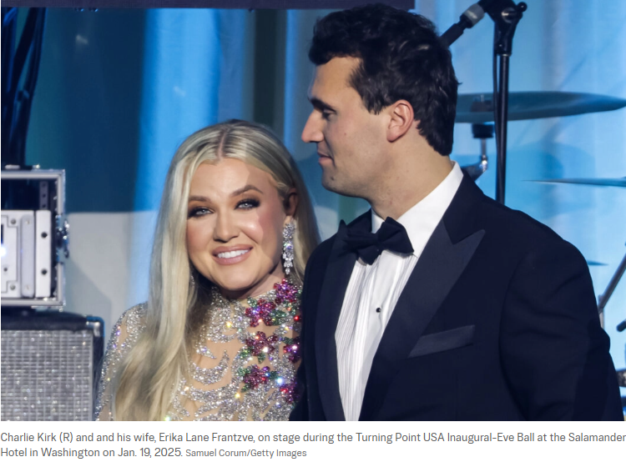
Notes:
https://www.theepochtimes.com/us/charlie-kirks-widow-erika-named-new-ceo-of-turning-point-usa-5916994?utm_source=RTNews&src_src=RTNews&utm_campaign=rtbreaking-2025-09-18-4&src_cmp=rtbreaking-2025-09-18-4&utm_medium=email&est=y3kI79HCCop7xf1m5YWLFhb1lxfsKEowPo2ka0e5RZmEu39U833xzxco05uPMcfSWQ%3D%3D

Slide 106
Before her connection to Charlie Kirk and TPUSA, Erika Kirk, a 36-year-old mother of two, Erika won the Miss Arizona pageant in 2012, and before that was an NCAA Women’s Basketball athlete, and also worked as a model and actress in New York City and China.

Slide 107
She launched Everyday Heroes Like You, a 501(c)(3) organization, in 2006, when she was just 17 years old. The group’s mission is to promote “everyday heroes” in communities around the nation.
Erika Kirk’s group went global with its “Romanian Angels” project, where it teamed up with the U.S. Marine Corps to sponsor an orphanage in Constanta, Romania.

Slide 108
The new TPUSA CEO earned a double major in political science and international relations from Arizona State University, and later received her Juris Master’s Degree in American Legal Studies from Liberty University. She’s currently pursuing a Doctorate in Biblical Studies from the same university.

Slide 109
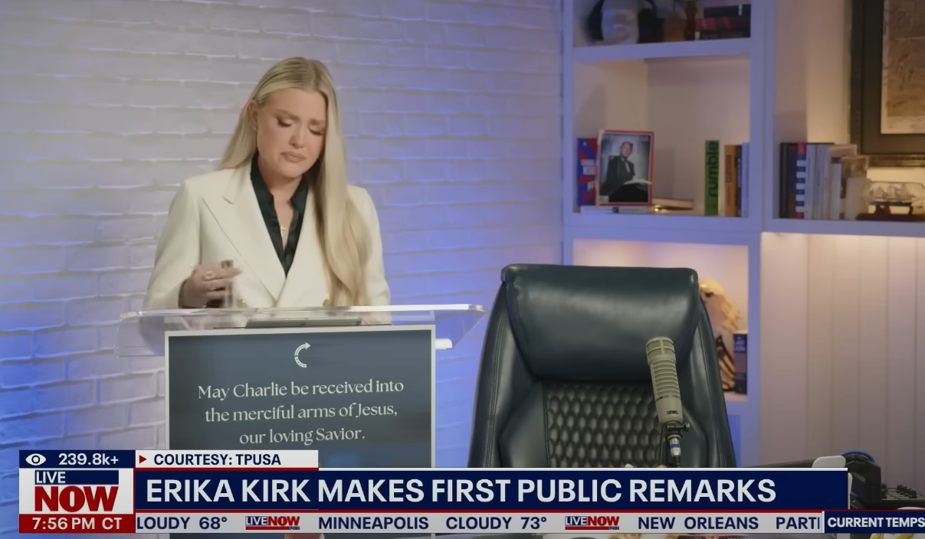
Notes:
https://tse1.mm.bing.net/th/id/OIF.S17D79pg0KFA4qHx1e5UlQ?pid=Api&P=0&h=180

Slide 110
“As Charlie always said, ‘We have a country to save.’ We will not surrender or kneel before evil. We will carry on. The attempt to destroy Charlie’s work will become our chance to make it more powerful and enduring than ever before.”

Slide 111
Prayer time this Shabbat immediately following.
Afternoon Witness Walk in the Plaza Art Festival.

