Slide 1
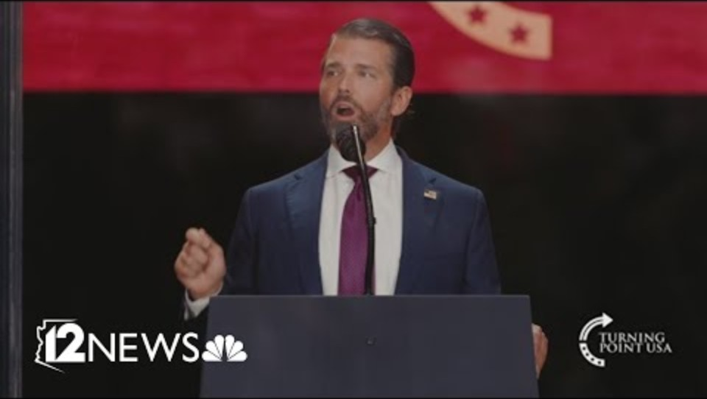
Notes:
https://www.youtube.com/watch?v=ietMH04_JZ8
0 to 1.00

Slide 2

Today is Shabbat Shuva.

Slide 3
We are in the High Holidays, also known as Days of Awe
Yamim Noraim יָמִים נוֹרָאִים‎
consist of the period of ten days known also as the
Ten Days of Repentance
עשרת ימי תשובה
Why: bookends RH & YK
Notes:
Biblical basis

Slide 4
Rosh Hashanah’s complex calling
No work
Gathering
Remember, implying giving account!
Loud sounds, implying trumpet of judgement!
Sweet foods →G-d’s mercy
Notes:
http://www.ulpanor.com/

Slide 5
Yom Kippur
Remembering the Temple atonement: visualizing Messiah!
Afflicting one’s soul: Fasting
Forgiveness: visualizing Messiah!
Confession
Intercession
Notes:
http://www.ulpanor.com/

Slide 6
This Shabbat, today, in the midst of the Ten Days of Repentance
עשרת ימי תשובה
today, is called Shabbat Shuvah. So the ancient rabbis picked the Haftarah that begins:
^{Hos 14:2} שׁוּבָה יִשְׂרָאֵל עַד ה' אֱלֹוהֶיךָ
Return, O Israel, to Adoni your God”
Notes:
http://www.ulpanor.com/

Slide 7
שוב Shuv: The root of שובה (return) and תשובה (repentance). It means not only to return back, but also to return upward — to our Source.
Notes:
http://www.ulpanor.com/

Slide 8
Traditionally, on this day every step of teshuvah — every whisper, every prayer, every thought of return — is received in heaven with joy.
We’ve heard the blast of the shofar, calling us to repentance!
Notes:
http://www.ulpanor.com/
Called me!

Slide 9
Rabbi Levi Yitzchak of Berditchev taught: On Shabbat Shuvah, even the smallest movement toward G-d is magnified a thousandfold. The gates of return are wide open, and Hashem’s love is especially close.
It is a Shabbat of beginnings, of returning, of courage, and of prayer.
Notes:
http://www.ulpanor.com/

Slide 10
What is repentance?
Turning to a right relationship with G-d and with people.
Changing our ways to serve G-d.
Changing our ways to be in right standing with people
  Forgiving and
  Being forgiven
Notes:
Today’s focus…

Slide 11
What is repentance?
Turning to a right relationship with G-d and with people.
Changing our ways to serve G-d.
Changing our ways to be in right standing with people
  Forgiving and
  Being forgiven

Slide 12


Slide 13
Total Forgiveness
Today is Shabbat Shuva.
What is the measure?

Slide 14
How long is an inch?
In 1324, the legal definition of the inch was set out in a statute of Edward II of England, defining it as "three grains of barley, dry and round, placed end to end, lengthwise"
Notes:
http://en.wikipedia.org/wiki/Inch
Inaccurate standard leads to discrepancies and confusion and arguments

Slide 15
How long is a second?
Before 1956, 1/86,400 of the time the earth takes to spin around on its own axis and see the sun again each day.
But because the moon's gravity and the tides are slowing down the earth's spin, this is not a stable quantity.

Slide 16
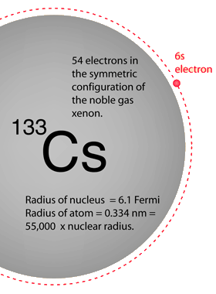
In 1967 the official definition of the second became 9,192,631,770 vibrations of a Cesium-133 atom.

Slide 17
How long is a meter?
The basic unit of length in the metric system; it was originally planned so that the circumference of the Earth would be measured at about forty million meters.
Today, the meter is defined to be the distance light travels in
¹ / _{299,792,458} seconds.
Notes:
Measured by the Cesium clock.

Slide 18
How do we measure repentance of forgiveness?
Here is the measuring standard.

Slide 19
^{Matit 6.12,14-45} Forgive us what we have done wrong, as we too have forgiven those who have wronged us…For if you forgive others their offenses, your heavenly Father will also forgive you; but if you do not forgive others their offenses, your heavenly Father will not forgive yours.
Notes:
[pause to pray]

Slide 21
Total Forgiveness
Today is Shabbat Shuva.
What is the measure?
First things

Slide 22
A few weeks ago I spoke on problem solving: Mt 18 resolving wounds
Then I did a related message on an unoffendable spirit: immunity (too strong) resistance to wounds.
Today: dealing with unresolved wounds

Slide 23
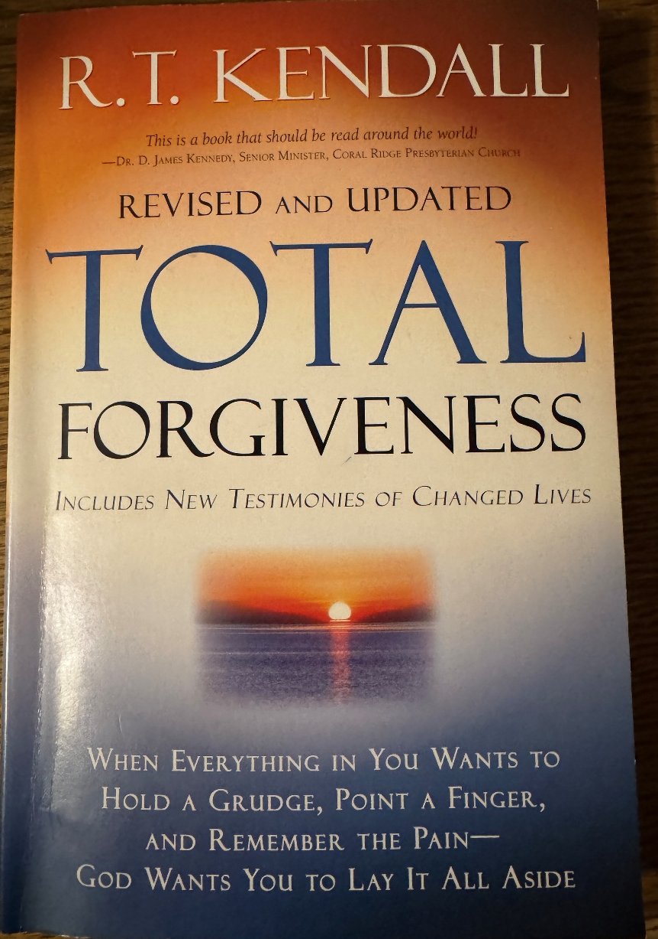

Slide 24
According to the author there has been a real dearth on this subject matter till 1984 Lewis Smedes!
Notes:
Similar for Wesley’s Standard Teaching. John Wesley was my personal mentor, sort of.

Slide 25
How to forgive

Slide 26
Two types of forgiveness, according to the Messiah
Unconditional / volitional
^{Mark 11.25} And when you stand praying, if you have anything against anyone, forgive him; so that your Father in heaven may also forgive your offenses.
Notes:
Simple, direct, just do it. No conditions. No exceptions. Otherwise, prayer can be a vendetta.
Easter prayers about the Jews who caused the death of Yeshua ישוע → violence. Easter was a dangerous time for European Jews.
Islamic prayers.

Slide 27
Two types of forgiveness, according to the Messiah
2. Conditional / Reconciliation
^{Lk 17.3-4} If your brother sins, rebuke him; and if he repents, forgive him. Also, if seven times in one day he sins against you, and seven times he comes to you and says, `I repent,' you are to forgive him."

Slide 28
Unconditional / volitional
Detached forgiveness: reduction in negative feeling
Limited forgiveness: decrease in emotional intensity
Total forgiveness: true inner release

Slide 29
Remember, revisit, situations of wounding.
Like to rewind it and correct it.
Like to redo it and WIN, hurt back, destroy, say the right response.
If only I hadn’t let him do that, say that…

Slide 30
A sin against you is a sort of debt.
Emotionally impossible to release because there’s a balance owed.
Only way to release is to know that Yeshua ישוע was there to pay it, to restore the comfort, the outrage, the indignity. He paid the debt. Receive the satisfaction from Him and release the party.
He’s your Father, Comforter, Mentor, Coach, Counselor
Notes:
Pause, allow
This is a sermon in and of itself. Take this home and apply. But there’s more to cover.

Slide 31
2. Conditional / Reconciliation
/ Relational

Slide 32
^{Mtt 18.15} "Moreover, if your brother commits a sin against you, go and show him his fault -- but privately, just between the two of you. If he listens to you, you have won back your brother.
Notes:
Reconciliation, peace, party time, joy, shalom

Slide 33
Impossible situations
Unfaithful spouse
Abusive parent
Absent parent
Clergy abuse
Rapists
Murderers
Former friends
Abusers of family members
Notes:
Kendall p 12

Slide 34
Yeshua ^{Lk 23.33-34} When they came to the place called The Skull, they nailed him to a stake; and they nailed the criminals to stakes, one on the right and one on the left. Yeshua said, “Father, forgive them; they don’t understand what they are doing.”
Notes:
He could have said, “I forgive you.” Asking Father is grander gesture. Asked Father not to take revenge or punish. Also, beyond His own [human] strength.
Was He praying about soldiers, or Sanhedrin?
Likely some of these present on Shavuot following, Act 2, outpouring of the Ruakh in Jerusalem!

Slide 35
RT Kendall [RT] fierce contention in congregation. He prayed certain people be forgiven.
G “Do you mean that I should bless and prosper them?” “What if I should bless you in proportion to how you want me to bless and forgive them?”
Notes:
RT yielded, but motive partially self protection.
Story p 17 TV series depicting believers who had forgiven. Producer: “I can take or leave a sermon, but can’t ignore this. Something happening in their lives.” Ro 5.8
P 18 Muslim MBB
Semi-natural explanation p 19

Slide 36
Mandate to forgive.
^{Eph 4.32} Instead, be kind to each other, tenderhearted; and forgive each other, just as in the Messiah God has also forgiven you.

Slide 37
Mandate to forgive.
^{Col 3.13} Bear with one another; if anyone has a complaint against someone else, forgive him. Indeed, just as the Lord has forgiven you, so you must forgive.

Slide 38
How has Adoni Yeshua forgiven you?
^{T’hillim/Ps 103.10-12} He has not treated us as our sins deserve or paid us back for our offenses, because his mercy toward those who fear him is as far above earth as heaven. He has removed our sins from us as far as the east is from the west.
Notes:
Know one will ever know, unless you feel the need to tell. If you can’t contain the pain, choose someone who really won’t repeat it, and will guide you to real forgiveness.

Slide 39
Can a person forgive and also report a crime?
Absolutely yes!
Total forgiveness ≠ closing our eyes to those who will continue to harm others.
Not easy for a victim to be both a courtroom witness and a forgiver.

Slide 41
Total Forgiveness
Today is Shabbat Shuva.
What is the measure?
First things
What total forgiveness is NOT

Slide 42
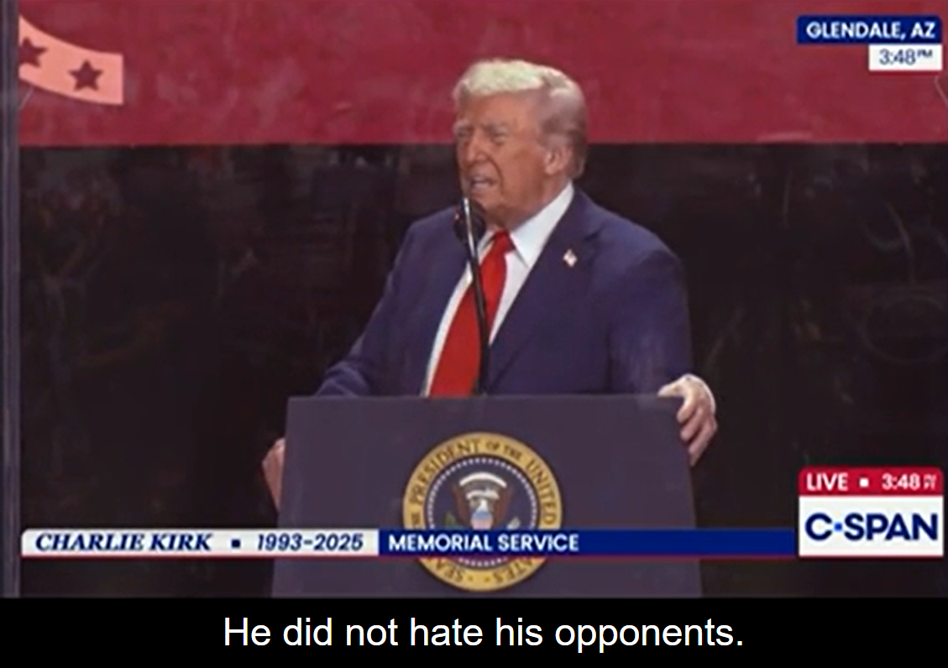
Notes:
https://www.msn.com/en-us/news/politics/donald-trump-where-i-disagree-with-charlie-kirk-is-i-hate-my-opponents-i-dont-want-the-best-for-them/vi-AA1N11TI

Slide 43
What total forgiveness is not
Not approval of sin. ^{Yn 8.9-11} [Her accusers] began to leave, one by one, the older ones first, until he was left alone, with the woman still there. Standing up, Yeshua said to her, “Where are they? Has no one condemned you?” She said, “No one, sir.” Yeshua said, “Neither do I condemn you. Now go, and don’t sin any more.”

Slide 44
2. Forgiveness is NOT excusing what they did.
^{Nu 14.19} Forgive now the guiltiness of this people in accordance with the greatness of Your lovingkindness, just as You have pardoned this people from Egypt until now!”
Notes:
Moshe doesn’t minimize, but appeals to G-d’s Khesed.

Slide 45
3. Forgiveness is NOT justifying: never minimize wrong, make it look right.
4. Forgiveness is not pardoning. Pardoning is judicial by the courts. Forgiveness is internal.
Notes:
P 25 ME man raped. She asked to testify. Forgiven, but did. He sent back.

Slide 46
5. Forgiveness is NOT reconciliation. That takes two parties. ^{2 Cor 5.20} We are ambassadors of the Messiah; in effect, God is making his appeal through us. What we do is appeal on behalf of the Messiah, “Be reconciled to God!

Slide 47
6 Forgiveness is NOT denying what they did.
Psychological repression or denial → dissociated personality.
7. Forgiveness is NOT blindness to what happened. Pretend it didn’t happen.

Slide 48
8. Forgiveness is NOT forgetting. G-d chooses NOT to remember.
We may not be able to forget, we can choose to not remember.
9. Forgiveness is NOT refusing to take the wrong seriously. “What’s wrong?” “Nothing!” Sin is serious.
Notes:
Homer Simpson cartoon I could have shown.

Slide 49
10. Pretending we are not hurt.
^{Yn 18.23} Yeshua answered him, “If I said something wrong, state publicly what was wrong; but if I was right, why are you hitting me?” Yet could forgive.

Slide 51
Total Forgiveness
Today is Shabbat Shuva.
What is the measure?
First things
What total forgiveness is NOT
What total forgiveness IS

Slide 52
Total forgiveness IS
1 Being aware of what someone has done, and releasing it. We kiss revenge goodbye. Justice still done.
2. Keeping no record of wrongs. Total forgiveness is a choice.

Slide 53
3. Refusal to punish. ^{1 Yn 4.8} Perfect love drives out fear. For fear has to do with punishment, and the one who fears has not been made perfect in love. Supernatural. Corrie ten Boom

Slide 54
^{Ro 12.19-20} Never seeks revenge, instead, leave that to God’s anger; for in the Tanakh it is written,“ Adoni says, “Vengeance is my responsibility; I will repay.’” On the contrary, “If your enemy is hungry, feed him; if he is thirsty,

Slide 55
^{Ro 12.19-20} give him something to drink. For by doing this, you will heap fiery coals [of shame] on his head.”
Notes:
Wesley: Melting coals of fiery love.

Slide 56
4 Forgiveness is not telling what they did, more than those involved with the problem and the solution. Or therapy. Not broadcast.
5. Forgiveness is being merciful. ^{Mt 5.7“}Blessed are the merciful, for they shall be shown mercy.

Slide 57
^{Ps 130.3-4} If You, Adoni, kept a record of iniquities— my Lord, who could stand? For with You there is forgiveness, so You may be feared.
Notes:
Forgiveness gives hope

Slide 58
Grace is getting what we don’t deserve. Mercy is NOT getting what we do deserve.
6. Graciousness = forbearance, tolerance, not severe judging. In politics to win is not enough, you have to make your opponent look bad. NOT so forgiving.

Slide 59
7. Forgiveness IS a condition of the heart. ^{Mt 12.34-35} For the mouth speaks what overflows from the heart. The good person brings forth good things from his store of good, and the evil person brings forth evil things from his store of evil.

Slide 60
Confidence toward G-d is key. Most of the people we need to forgive do not believe they did anything wrong. “90%”
8 Absence of bitterness. Relinquishing bitterness is an open invitation to the Holy Spirit.
Does NOT mean coffee weekly.
Notes:
P41 Henry Wright

Slide 61
9. Forgiving G-d. Allowing G-d to be G-d. Sovereign of our lives. His judgement with evil and suffering. Choice of your parents.
10. Forgiving ourselves. Lasting joy.

Slide 63
Total Forgiveness
Today is Shabbat Shuva.
What is the measure?
First things
What total forgiveness is NOT
What total forgiveness IS
Standard of completion

Slide 64
How to know if we’ve totally forgiven
Joseph paradigm
Wounded by brothers
Wounded by Potiphar’s wife.
Wounded by Potiphar’s simplicity.
Wounded by jail mate.
Notes:
Time p 55:
Finally in a government position of almost absolute authority. Tested brothers’ current integrity. At his total mercy…

Slide 65
^{Ber/Gen 45.1-5} At last Yosef could no longer control his feelings in front of his attendants and cried, “Get everybody away from me!” So, no one else was with him when Yosef revealed to his brothers who he was. He wept aloud, and the Egyptians heard, and Pharaoh’s household heard.
Notes:
One of greatest, most dramatic scenes in the Bible. Movie stuff.
Privacy for honor.
Not rage, but weeping

Slide 66
^{Ber/Gen 45.1-5} Yosef said to his brothers, “I am Yosef! Is it true that my father is still alive?”
His brothers couldn’t answer him, they were so dumbfounded at seeing him. Yosef said to his brothers,
Notes:
Not berate them. Not punish them. Not humiliate them in front of Egyptians or Pharoah.

Slide 67
^{Ber/Gen 45.1-5} “Please! Come closer.” And they came closer. He said, “I am Yosef, your brother, whom you sold into Egypt. But don’t be sad that you sold me into slavery here or angry at yourselves, because it was God who sent me ahead of you to preserve life.
Notes:
Come close. Not denial, yet not vindictive. Saw G-d’s hand. Told them what to say to Yaakov Jacob Dad
No rage, not punishment, no berating, no denial, blessing and future hope.
That is the pattern of forgiveness!!

Slide 69
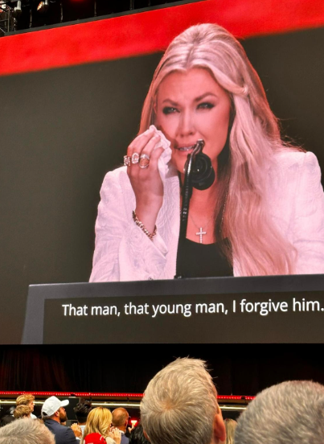
Notes:
https://mail.google.com/mail/u/0/?ui=2&ik=9f4a945fb9&view=lg&permmsgid=msg-f:1844060246288444032
That man, that young man, I forgive him.

Slide 70
The crowning moment of the entire five-hour event was when she uttered the words that will remain immortal across the centuries. After citing the words of Yeshua on the cross about forgiving those who executed Him, for they know not what they do,
Notes:
Jim Garlow
https://mail.google.com/mail/u/0/?ui=2&ik=9f4a945fb9&view=lg&permmsgid=msg-f:1844060246288444032

Slide 71
Erika whispered those words that touched the entire cosmos: “That man, that young man, I forgive him.”
You could see the indescribable pain in her words. It was not easy to proclaim. Yet there was resolve. She was going to say them. Rather, she declared them.
Notes:
Jim Garlow
https://mail.google.com/mail/u/0/?ui=2&ik=9f4a945fb9&view=lg&permmsgid=msg-f:1844060246288444032

Slide 72
Spiritually minded people know what happened in that moment. She broke the power of Satan. Forgiveness does that. It blocks Satan and releases the blessings of God.
Notes:
Jim Garlow
https://mail.google.com/mail/u/0/?ui=2&ik=9f4a945fb9&view=lg&permmsgid=msg-f:1844060246288444032

Slide 73
Spiritually dull persons or spiritually immature people may not understand this. But biblically grounded persons can “see into the heavenlies, where the spiritual battle is taking place for our nation, and our families.” With those words, she crippled the demonic forces. She was not going to participate in a life of bitterness.
Notes:
Jim Garlow
https://mail.google.com/mail/u/0/?ui=2&ik=9f4a945fb9&view=lg&permmsgid=msg-f:1844060246288444032

Slide 74
By her act of forgiveness, Erika broke free from the devil’s bait: to be offended. She was free! And by declaring it, she helped set millions of others free as well.
Notes:
https://mail.google.com/mail/u/0/?ui=2&ik=9f4a945fb9&view=lg&permmsgid=msg-f:1844060246288444032

Slide 75
That one sentence will be remembered 100 years from now. And beyond. Every news report carried this as a headline. Historians will tell and retell this moment. And well they should. She majestically lived out the gospel, in the most difficult times imaginable.
Notes:
https://mail.google.com/mail/u/0/?ui=2&ik=9f4a945fb9&view=lg&permmsgid=msg-f:1844060246288444032

Slide 76
And in the years to come, we will see that freedom of forgiveness envelope her children, as they are raised with her biblically-grounded maturity.
Notes:
https://mail.google.com/mail/u/0/?ui=2&ik=9f4a945fb9&view=lg&permmsgid=msg-f:1844060246288444032

Slide 77
“When you say, ‘Here I am, Lord, use me,’ God will take you up on that, and he did with Charlie,” Kirk said. His life, cut short at 31, was one of spiritual devotion, she said. “While Charlie died far too early, he was also ready to die,” Erika Kirk explained. “There was nothing he was putting off. He left this world without regrets.”

Slide 78
The crowd responded with a standing ovation. “I forgive him because it was what Christ did and is what Charlie would do,” she said. “The answer to hate is not hate. The answer, we know from the Gospel, is love and always love — love for our enemies and love for those who persecute us.”
Notes:
https://mycharisma.com/news/the-early-viewership-numbers-from-charlie-kirks-memorial-are-in-likely-the-most-viewed-gospel-presentation-ever/

Slide 80
Total Forgiveness
Today is Shabbat Shuva.
What is the measure?
First things
What total forgiveness is NOT
What total forgiveness IS
Standard of completion

Slide 81
Do you know that you are forgiven by G-d?
Is there anyone whom you need to totally, fully forgive?

