Slide 1
I have finally discerned my retirement and succession
time table.
Notes:
I have a prototype.

Slide 2
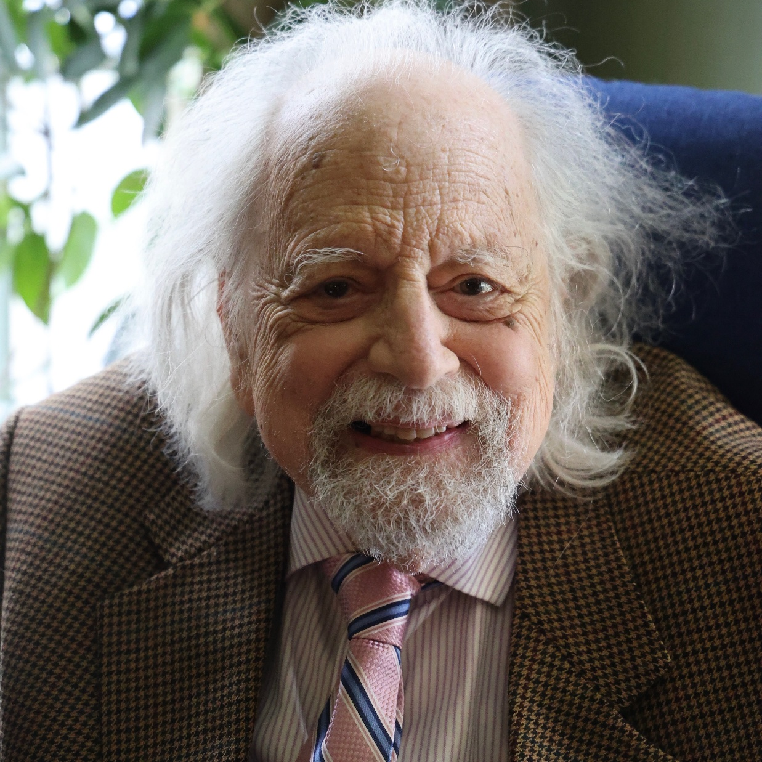
Judge Howard Sachs to retire at age 100
Notes:
https://www.kcjc.com/current-news/top-stories/10318-judge-howard-sachs-to-retire

Slide 3
Sachs, who is 99 years old, is planning to retire shortly after his centennial birthday on Sept. 13.
It’s a deserved retirement, as Sachs has served as a federal judge for more than four-and-a-half decades and as an attorney for 28 years before that.
Notes:
>45 years as a judge
28 years attorney

Slide 4
Sachs made history as the first Jewish judge since the 1800s when President Jimmy Carter appointed him in 1979.

Slide 5
Sachs is a lifelong member of The Temple, Congregation B’nai Jehudah. His family joined the synagogue in the 1880s, not long after its founding. Sachs would have become a bar mitzvah in the fall of 1938, but he said B’nai Jehudah didn’t offer it at the time.
Notes:
Reform Judaism was trying to imitate the church, and did confirmations at age 16, I believe.

Slide 6
His civil rights work included tackling antisemitism and discrimination in the social clubs of Kansas City. That work resulted in the Kansas City Club accepting Jewish members.
Notes:
Jews were not allowed in country clubs.

Slide 7
In 1951, Sachs was completing a clerkship for Judge Albert A. Ridge when a case arose where three Black individuals were denied the opportunity to attend the Swope Park swimming pool.
Notes:
Black people were not allowed in public swimming pools.

Slide 8
Sachs assisted Judge Ridge’s decision, which determined that the Swope Park pool must be integrated.
Three years later and just 64 miles away, the Swope Park ruling that Sachs helped with was integral to the result in Brown v. Board of Education, one of the biggest victories of the Civil Rights Movement.

Slide 9
“I am stopping at age 100, partly because parties and lawyers may question anyone being competent that long, and partly because I am somewhat frail,” Sachs said.
Notes:
So, Jeremy, you are a great blessing, with your heart for Messiah and for people, and skills in music, the Word, electronics, art.
You will have full responsibility for everything that goes wrong [the main definition of leadership] in just 24 years.
Pause….

Slide 10
I feel the Ruakh calling me to preach the most difficult message in my 30 years at Or HaOlam.
One that I don’t fully live up to.
It might be the hardest message imaginable.
Notes:
You can often tell a preacher's sins by his sermon topics. Preaching to himself first of all. Lead the flock by example…wounded healer. His own wounds, then attends to others.
I received this “download” about 3 weeks ago, so it’s gotten a bit lengthy...

Slide 11
Unoffendable spirit
^{T’hillim 119.165} Those who love Your Torah have great peace, and nothing will cause them to be hurt in their spirit.
^{KJV} Great peace have they which love Your Torah: and nothing shall offend them.
Notes:
How to escape from, heal from, avoid being hurt → angry, depressed.

Slide 12


Slide 13
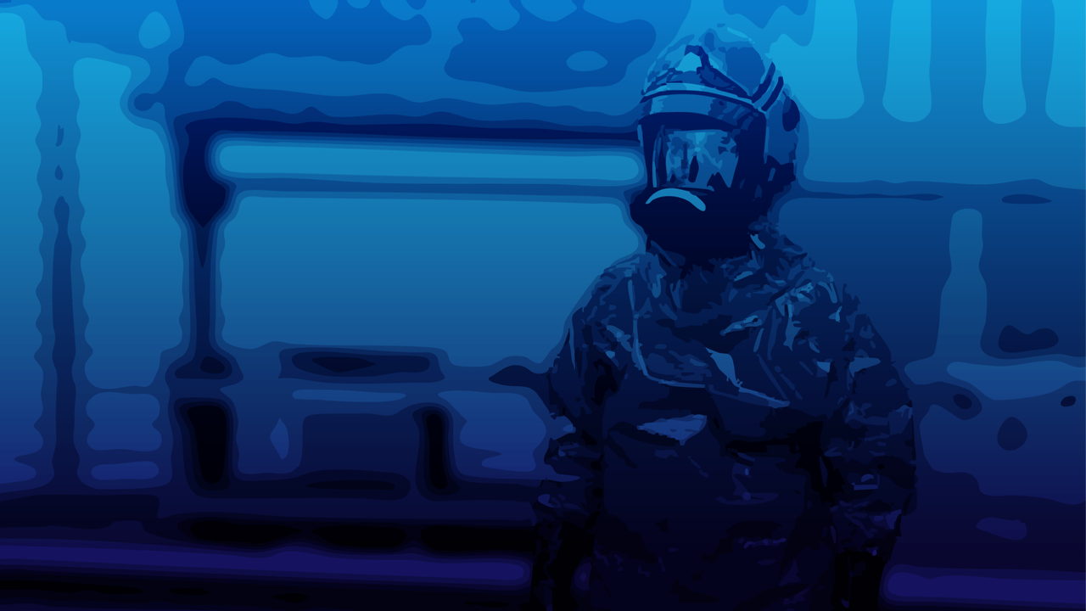
Notes:
In a football uniform, fully padded and protected. No hurts, no vulnerability, never offended.
One way to avoid hurts is walls and padding, untouchable.

Slide 14
Unoffendable Spirit Ps 119.165
What does it mean objectively to
be offended?
What does it mean subjectively to be offended? How does it feel?
How can we deal with offense internally?
How can we deal with offense
externally?

Slide 15
Unoffendable Spirit Ps 119.165
What does it mean objectively to
be offended?
What does it mean subjectively to be offended? How does it feel?
How can we deal with offense internally?
How can we deal with offense
externally?

Slide 16


Slide 18
מִכְשׁוֹל mikhshol or offended
denotes any hindrance that trips a person physically or morally. Its fourteen appearances trace a movement from literal obstruction to profound spiritual metaphor, showing how stumbling can arise from human malice in word or action,

Slide 19
מִכְשׁוֹל mikhshol
inner idolatry, or divine judgment, and how God calls His people to remove every impediment to covenant faithfulness.

Slide 21
Being offended often relates to feeling hurt or wronged by someone's words or actions.
Offenses can arise from misunderstandings or differing beliefs.
Offenses can lead to sin if they cause anger or resentment (Ephesians 4:26).
Notes:
https://search.yahoo.com/yhs/search?p=what%20does%20it%20mean%20to%20be%20offended%20in%20the%20bible&hspart=fc&hsimp=yhs-90&type=fc_AC22890F0FA_s69_g_e_d_n1_c999&param1=7&param2=eJwtj9uKgzAYhF8lly1E%2B%2F%2FGRJPcSfUBlr3akItoUxs84gGXffrFUuZmGL6BmTY8jLZfdwTgjDFD7Wi0RUPtmRtqG6OtlNJQG2ajbSKAKycAlXvWtaozACUwVVKIXHn0uRIZ94ba1k9G23011O7OaDtMf6Hv3Y3HQC5HGB%2FTsZJxIwgxaHKEUaSa%2FIr0Stw89%2F7wdRe2G2dZzAS5dK9t6CnpQ%2BdJ65tuupLmtUyDv2EK8VtkdU%2B3hE%2Fl3LuGz4d99cvbl2lW5gVCJGQhI8QKooJhFTGEIpFlJbm4n3xzwgkkPIIsSsQ3gEq54lmMOf%2F5B5%2FFWDI%3D

Slide 23
Unoffendable Spirit Ps 119.165
What does it mean objectively to
be offended?
What does it mean subjectively to be offended? How does it feel?
How can we deal with offense internally?
How can we deal with offense
externally?

Slide 24
The ultimate and absolutely offended Person

Slide 25
^{Yeshayahu Is 53.3} He was despised and rejected by men, a man of sorrows, acquainted with grief, One from whom people hide their faces. He was despised, and we did not esteem Him.
Notes:
Feeling offended means…
Do you ever feel despised, unimportant, rejected, cast out, grieved by how you’ve been treated, excluded??

Slide 26
^{T’hillim Ps 22.2-3} My God! My God! Why have you abandoned me? Why so far from helping me, so far from my anguished cries? My God, by day I call to you, but you don’t answer; likewise at night, but I get no relief.
Notes:
Abandonment is the key to all other woundings, according to the founders of RTF, Chester Kylstra.

Slide 27
^{T’hillim Ps 22.7} But I am a worm, not a man, scorned by everyone, despised by the people. All who see me jeer at me; they sneer and shake their heads:
Notes:
Scorned, despised, jeered and sneered. Excluded.

Slide 28
A person is offended if the wound is identity dependent, defiled.
“I am offended.” They are defending their personhood, defending their dignity, their rights.
Defense
Department of Defense protects.
Notes:
Do you ever feel disrespected, your rights and dignity violated?
I realize that I’m I precarious territory, easy to be misunderstood and offend!

Slide 29
Trump wants to rename the Department of Defense as the Department of War.
That was the name until 1947.
Offended people, wounded people, can be
hot and hostile to deal with. “A bear robbed of her cubs…”

Slide 30
Or offended people can be depressed and withdrawn. Crushed. Suicidal.
Or offended people can be in alarm mode.

Slide 31
Another form of offense, defilement, inner turmoil, similar to offense, is PTSD.
Notes:
I’m a bit out of my depth here, but just speaking tentatively and subjectively.

Slide 32
Post-traumatic stress disorder (PTSD)is a mental disorder that develops from experiencing a traumatic event,
Notes:
https://en.wikipedia.org/wiki/Post-traumatic_stress_disorder

Slide 33
such as sexual assault, domestic violence, child abuse, warfare and its associated traumas, natural disaster, bereavement, traffic collision, or other threats on a person's life or well-being.
Notes:
https://en.wikipedia.org/wiki/Post-traumatic_stress_disorder
DEEP wounds, offenses.

Slide 34
Symptoms may include disturbing thoughts, feelings, or dreams related to the events, mental or physical distress to trauma-related cues, attempts to avoid trauma-related cues, alterations in the way a person thinks and feels,
Notes:
https://en.wikipedia.org/wiki/Post-traumatic_stress_disorder

Slide 35
and an increase in the fight-or-flight response. These symptoms last for more than a month after the event and can include triggers.
Notes:
https://en.wikipedia.org/wiki/Post-traumatic_stress_disorder
Many of us here, from toxic homes, have something akin to PTSD, maybe in a very reduced, yet painful form.

Slide 36
Many of us may feel offended by someone, something.

Slide 38
Unoffendable Spirit Ps 119.165
What does it mean objectively to
be offended?
What does it mean subjectively to be offended? How does it feel?
How can we deal with offense internally?
How can we deal with offense
externally?

Slide 39
Unoffendable spirit
^{T’hillim 119.165} Those who love Your Torah have great peace, and nothing will cause them to be hurt in their spirit.
^{KJV} Great peace have they which love Your Torah: and nothing shall offend them.
Notes:
Here is the answer. You might say this is glib, and superficial. Let’s examine.

Slide 40
Notes:
Shalom Rav…song
Love Torah, all scripture, the Living Word, Messiah

Slide 41
Love and immersion in the Torah and all the Word, in the words of the Word, and in the Word made flesh in the Messiah, is what can keep us from being offended, and help us disengage when we are offended.

Slide 42
Nothing causes them [lovers of the Torah, the Word, the Messiah] to stumble: be offended, sidetracked, seduced, irritated, outraged out of control, defiled, rejected.
Nothing.
They see EVERYTHING as the redemptive love of King Messiah!
Notes:
Concepts following from Jerusalem Rabbi Shalom Arush, Breslov Hasid.

Slide 43
Levels of living faith.
אֱמוּנָה Emunah
faith, trust, confidence
Active faith.
Notes:
A word of disclaimer on Shalom Arush’s book. His concepts and interp of scripture is EXCELLENT. Some of his illustrations are from Kabbalah, some about reincarnation. I am NOT endorsing those illustrations. Men’s group remember we had to filter some things.
Why use? Marriage book that we did in Men’s Group called men to a deeper level of the crucified life than Dobson, Trent, Smalley, etc. Not use that terminology.
This book calls us to an amazing level of faith. Those who remember David Dreiling, highly endorsed.

Slide 44
Basic level Emuna: firm belief that EVERYTHING comes from Adoni by way of perfect Divine providence. No secondary causes.
Notes:
Like holiness. We accept G-d goodness, and praise. We fall before His Holiness. We praise ALL His works. ALL. Gan Emuna 21, 22

Slide 45
Intermediate level: belief that everything that comes from Adoni is for the very best. All troubles have their purpose. Therefore PRAISE. Without understanding the purpose.
Notes:
We talk about Sozo ministry, which involves finding the lies about life and G-d that we’ve received, renouncing, and asking G-d for revelation of truth.
This is generalized Sozo, כי the basic lie is that life/G-d is mean, against us.
We commit to praise in everything. Even the consequences of our and others failures. Still in His hands.

Slide 46
Upper level: Belief that our joyful task is to discern the message to us in EVERY trouble.
Notes:
Message NOT = punishment. Iyov/Job was not punished, but called to go higher. Tho He slay me, yet will I trust Him.

Slide 47
^{T’hillim/Ps 32.9-11} Don't be like a horse or mule that has no understanding, that has to be curbed with bit and bridle, or else it won't come near you. Many are the torments of the wicked, but grace surrounds those who trust in ADONI. Be glad in ADONI; rejoice, you righteous! Shout for joy, all you upright in heart!
Notes:
Some of us have bit and bridle religion. Horseback riding is really fun.
What about when we fail, and don’t rejoice, and get angry and depressed, and blow it?
We can still come before Him, repent, trust Yeshua’s blood and sacrifice for forgiveness, and praise Him that He will work even our failure for good. Trust Him in all.

Slide 48
^{Phil. 3.8-10} Because of Him…I gave up everything and regard it all as garbage, in order to gain the Messiah, and be found in union with Him, not having any righteousness of my own based on legalism, but having that righteousness which comes through the Messiah's faithfulness, the righteousness from God based on trust.
Notes:
Here’s where Messianic depart from others that keep Torah. We keep Torah as an expression of our faith and joy, and the power of the Blood of Yeshua, and if we’re Jewish, of our covenant with G.
Torah earns us NOTHING.

Slide 49
^{Phil. 3.8-10} Yes, I gave it all up in order to know him, that is, to know the power of his resurrection and the fellowship of his sufferings as I am being conformed to his death,
Notes:
I can handle sufferings that I understand the purpose. I can praise in that…

Slide 50
^{1 Thes. 5. 16-22} Always be joyful. Pray regularly. In everything give thanks, for this is what God wants from you who are united with the Messiah Yeshua. Don't quench the Spirit...

Slide 51
^{1 Thes. 5. 16-22} May the God of shalom make you completely holy - may your entire spirit, soul and body be kept blameless for the coming of our Lord Yeshua the Messiah.
Notes:
Weird idea. Always be happy. Only if have active faith, Emuna about life.
NOT talking about Alfred E Newman. What, me worry?

Slide 52
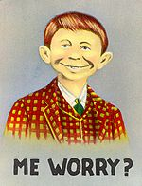

Slide 53
Right attitude toward offenders
^{T’hillim Ps 126.5-6} Those who sow in tears will reap with cries of joy.
He who goes out weeping
as he carries his sack of seed
will come home with cries of joy
as he carries his sheaves of grain.
Notes:
ps 126 Sishkoff p 65
Tshuvah → Immanuel

Slide 54
^{1 Cor 13 4-7} Love suffers long and kind, not jealous, not boastful, not proud, rude or selfish, not [easily] angered, and it keeps no record of wrongs. Love does not gloat over other people’s sins but takes its delight in the truth. Love always bears up, always trusts, always hopes, always endures.
Notes:
Offenses NOT unexpected.
Double negative: Offenses are to be expected.

Slide 55
Not every negative statement by people equals rejection, defilement, offense.
Some accusations, insults, curses, are the result of the offender’s inner turmoil, confusion.

Slide 56
^{Mishlei/Prov 26.2} Like a fluttering sparrow or a flying swallow, so an undeserved curse does not land.

Slide 57
Many curses in the Bible are undeserved, causeless, and will NOT land.
Will not sting. Need not sting. Can be brushed aside.
Maybe your offense?

Slide 58
^{Bamidbar Nu 23.8} “Balak, the king of Mo’av, brings me from Aram, from the eastern hills, saying, ‘Come, curse Ya‘akov for me; come and denounce Isra’el.’ “How am I to curse those whom God has not cursed? How am I to denounce those whom Adoni has not denounced?

Slide 59
^{Bamidbar Nu 23.8} “From the top of the rocks I see them, from the hills I behold them — yes, a people that will dwell alone and not think itself one of the nations. “Who has counted the dust of Ya‘akov or numbered the ashes of Isra’el? May I die as the righteous die! May my end be like theirs!”

Slide 60
^{Dvarim Dt 23.5} “No ‘Amoni or Mo’avi may enter the assembly of Adoni, nor may any of his descendants down to the tenth generation ever enter the assembly of Adonai, because they did not supply you with food and water when you were on the road after leaving Egypt,

Slide 61
^{Dvarim Dt 23.5} and because they hired Bil‘am the son of B‘or from P’tor in Aram-Naharayim to put a curse on you. But Adoni your God would not listen to Bil‘am; rather, Adoni your God turned the curse into a blessing for you; because Adoni your God loved you.

Slide 62
^{1 Shmuel 14.28-29} But one of the people said [to Yonathan] in response, “Your father [Shaul] strictly charged the people with an oath, ‘A curse on any man who eats any food today’; even though the people are fainting with hunger.” Y’honatan answered,

Slide 63
^{1 Shmuel 14.28-29} “My father has brought trouble to the land. Just look how my eyes have lit up because I tasted a little of this honey.
Notes:
King Shaul’s curse didn’t affect Yonatan/ Jonathan.

Slide 64
^{1 Sam 17.43} Then the Philistine said to David, “Am I a dog, that you come to me with sticks?” Then the Philistine cursed David by his gods.
Notes:
Golyat, Goliath

Slide 65
^{2 Shmuel 16.5,12} When King David arrived at Bachurim, there came out from there a man from Sha’ul’s family named Shim‘i the son of Gera; and he came out pronouncing curses…

Slide 66
^{2 Shmuel 16.11-12} David then said to Avishai and all his servants, “Look, my own son, who came from my own body, seeks my life. So how much more now this Binyamini! Let him alone; and let him curse, if Adoni told him to.

Slide 67
^{2 Shmuel 16.11-12} Maybe Adoni will notice how I’m treating him, and Adoni will reward me with good instead of his curses.

Slide 68
So, many offensive statements, curses, are without substance. Can be ignored. NOT suppressed, just not significant.
All offenses are subject to thanking G-d for His purpose.
^{T’hillim 119.165} Those who love Your Torah have great peace, and nothing will cause them to be hurt in their spirit.

Slide 70
Unoffendable Spirit Ps 119.165
What does it mean objectively to
be offended?
What does it mean subjectively to be offended? How does it feel?
How can we deal with offense internally?
How can we deal with offense
externally?

Slide 71
^{T’hillim Ps 141.3-5} Set a guard, Adonai, over my mouth; keep watch at the door of my lips. Don’t let my heart turn to anything evil or allow me to act wickedly…Let the righteous strike me, let him correct me; it will be an act of love. Let my head not refuse such choice oil, for I will keep on praying.

Slide 72
^{Mishlai Prov 9. 7-10} “He who corrects a scoffer only gets insulted; reproving a wicked man becomes his blemish. If you reprove a scoffer, he will hate you; if you reprove a wise man, he will love you. Give to a wise man, and he grows still wiser; teach a righteous man, and he will learn still more.
Notes:
It’s risky to try to address your offender. Last message about that. This mostly about internal processing.

Slide 73
^{Luke 4.18-19} The Spirit of Adoni is upon me; therefore, he has anointed me to announce Good News to the poor; he has sent me to proclaim freedom for the imprisoned and renewed sight for the blind, to release those who have been crushed, to proclaim a year of the favor of Adoni.

Slide 74
How did Yeshua deal with people who denounced, cursed, offended Him?

Slide 75
^{Yn 8.47-51} Whoever belongs to God listens to what God says; the reason you don’t listen is that you don’t belong to God.” The Judeans answered him, “Aren’t we right in saying you are from Shomron and have a demon?”
Notes:
Is that an insult?

Slide 76
^{Yn 8.47-51} Yeshua replied, “Me? I have no demon. I am honoring my Father. But you dishonor me. I am not seeking praise for myself. There is One who is seeking it, and he is the judge. Yes, indeed! I tell you that whoever obeys my teaching will never see death.”
Notes:
Here is the key issue. Dishonor, disrespect, devalued, contempt, rejection.
Yeshua clearly, kindly, articulately corrected them. No rancor.
Bottom line strategy…

Slide 77
^{Vayikra Lev 19. 16-17} ‘Do not go around spreading slander among your people, but also don’t stand idly by when your neighbor’s life is at stake; I am Adoni. “‘Do not hate your brother in your heart,
Notes:
Don’t malign your neighbor, but don’t ignore his sins. Both are forms of hate: malice and ignoring.

Slide 78
^{Vayikra Lev 19. 16-17} but rebuke your neighbor frankly, so that you won’t carry sin because of him. Don’t take vengeance on or bear a grudge against any of your people; rather, love your neighbor as yourself; I am Adoni.
Notes:
The Matthew 18 mode comes out of this. Previous message. This mostly about internal processing.

Slide 79
Build community. ^{T’hillim Ps 133}
Oh, how good, how pleasant it is for brothers to live together in harmony. It is like fragrant oil on the head that runs down over the beard, over the beard of Aharon, and flows down on the collar of his robes.

Slide 80
Build community. ^{T’hillim Ps 133}
It is like the dew of Hermon that settles on the mountains of Tziyon. For it was there that Adoni ordained the blessing of everlasting life.

Slide 81
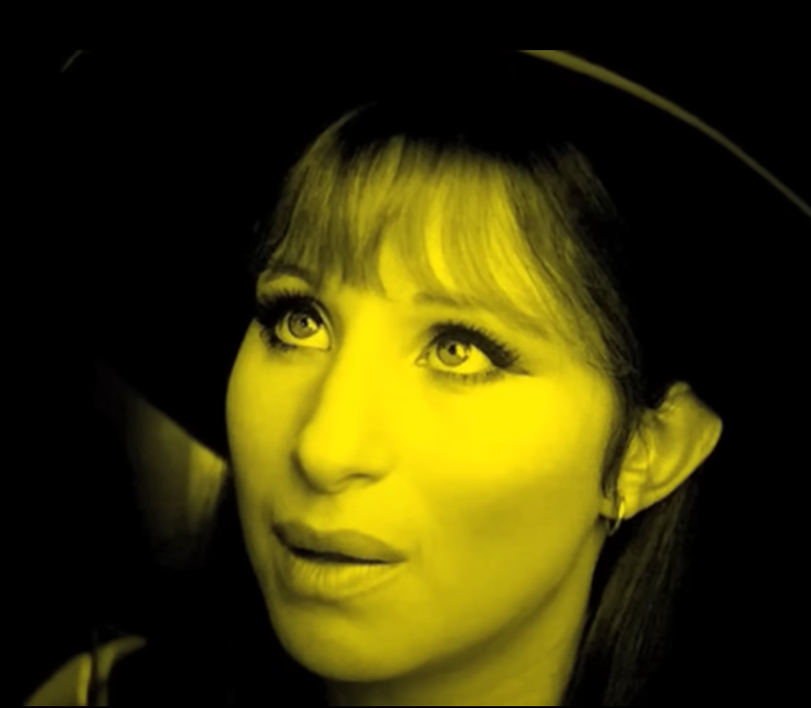
Barbara Streisand
People
Her signature song.
Half true.
Notes:
https://www.youtube.com/watch?v=fPlQ6EtArSc
community vs neediness NEED is to give

Slide 82
Barbara Streisand got it half right in her signature song, “People.”
We need community, but NOT as our ultimate source. We need community so we can pour in AND draw out affirmation, affection, validation.
We ultimately get this from Yeshua!

Slide 83
People
People who need people
Are the luckiest people in the world
Notes:
https://genius.com/Barbra-streisand-people-lyrics

Slide 84
We're children, Needing other children
And yet letting our grown-up pride
Hide all the need inside
Acting more like children than children
Notes:
https://genius.com/Barbra-streisand-people-lyrics

Slide 85
Lovers, Are very special people
They're the luckiest people in the world
With one person, One very special person
A feeling deep in your soul
Says you were half, now you're whole
Notes:
https://genius.com/Barbra-streisand-people-lyrics

Slide 86
No more hunger and thirst
But first be a person who needs people
People who need people
Are the luckiest people in the world.
Half true…love people with Immanuel, Barukh HaBa
Notes:
https://genius.com/Barbra-streisand-people-lyrics

Slide 87
Are we a psalm 133 community?
Are we a safe place or a condemning, critical place?
Are we an offending place?
Big Tent. Jews, Gentiles, full spectrum.
Love people with Immanuel, Barukh HaBa עמנואל ברוך הבא

Slide 88
Empathy: A Trait 3 Generations Will Inherit
New research shows parents pass down qualities that safeguard their children and grandchildren from loneliness in our increasingly disconnected world.

Slide 89

A 25-year study published in 2024 followed families across 3 generations and found that empathy is a trait that endures over time and across relationships.
Notes:
https://www.theepochtimes.com/health/three-generations-will-inherit-this-trait-and-its-not-genetic-5799665?utm_source=Bright&src_src=Bright&utm_campaign=bright-2025-08-20&src_cmp=bright-2025-08-20&utm_medium=email&est=bpsMuKxG9u%2BJ3rdgK6C%2BK7DyiBCAO2r%2BdJpkkl0S%2F1fh2eeyz%2BPLdt1CkXgNHHcM%2Fw%3D%3D

Slide 90
The “empathy blueprints” we receive from our parents are paid forward, shaping how we connect with our friends and, later, how we nurture our children.
Notes:
https://www.theepochtimes.com/health/three-generations-will-inherit-this-trait-and-its-not-genetic-5799665?utm_source=Bright&src_src=Bright&utm_campaign=bright-2025-08-20&src_cmp=bright-2025-08-20&utm_medium=email&est=bpsMuKxG9u%2BJ3rdgK6C%2BK7DyiBCAO2r%2BdJpkkl0S%2F1fh2eeyz%2BPLdt1CkXgNHHcM%2Fw%3D%3D

Slide 91
“Good parents teach their children important life skills, and empathy—particularly the ability to accurately ‘read’ other people—is among the most important of those skills,” William Ickes, social and personality psychologist and distinguished professor of psychology, told The Epoch Times in an interview.
Notes:
https://www.theepochtimes.com/health/three-generations-will-inherit-this-trait-and-its-not-genetic-5799665?utm_source=Bright&src_src=Bright&utm_campaign=bright-2025-08-20&src_cmp=bright-2025-08-20&utm_medium=email&est=bpsMuKxG9u%2BJ3rdgK6C%2BK7DyiBCAO2r%2BdJpkkl0S%2F1fh2eeyz%2BPLdt1CkXgNHHcM%2Fw%3D%3D

Slide 92
Empathy arises in infancy, nurtured through intimate face-to-face interactions. “The seeds of empathy are planted in our parent-child relationships, where our babies first learn trust, attachment, empathy, and love,” Borba stated.
Notes:
https://www.theepochtimes.com/health/three-generations-will-inherit-this-trait-and-its-not-genetic-5799665?utm_source=Bright&src_src=Bright&utm_campaign=bright-2025-08-20&src_cmp=bright-2025-08-20&utm_medium=email&est=bpsMuKxG9u%2BJ3rdgK6C%2BK7DyiBCAO2r%2BdJpkkl0S%2F1fh2eeyz%2BPLdt1CkXgNHHcM%2Fw%3D%3D

Slide 93
However, the digital age disrupts these essential interactions. In a world mediated by screens, the conditions needed for empathy to flourish are eroding.
Notes:
When someone wants to talk to you, put down your phone, look them in the eye, and smile. Otherwise you build, maybe ever so slightly, rejection and offense.

Slide 94
While we often hear about trauma being passed down through the generations, research such as this sheds light on the opposite phenomenon—the transmission of empathy—an essential psychological sustenance. By modeling active listening and nurturing our children’s emotional resilience, we shape not only our children’s futures but the emotional legacy of generations to come.
Notes:
Last illustration…

Slide 95

Dogs are the most unoffendable lovers imaginable.
Consider and learn…
Notes:
https://discover.hubpages.com/animals/Ways-Dogs-Show-Their-Love

Slide 96

1. Dogs Say "I Love You" By Gazing Into Your Eyes
Notes:
https://discover.hubpages.com/animals/Ways-Dogs-Show-Their-Love

Slide 97
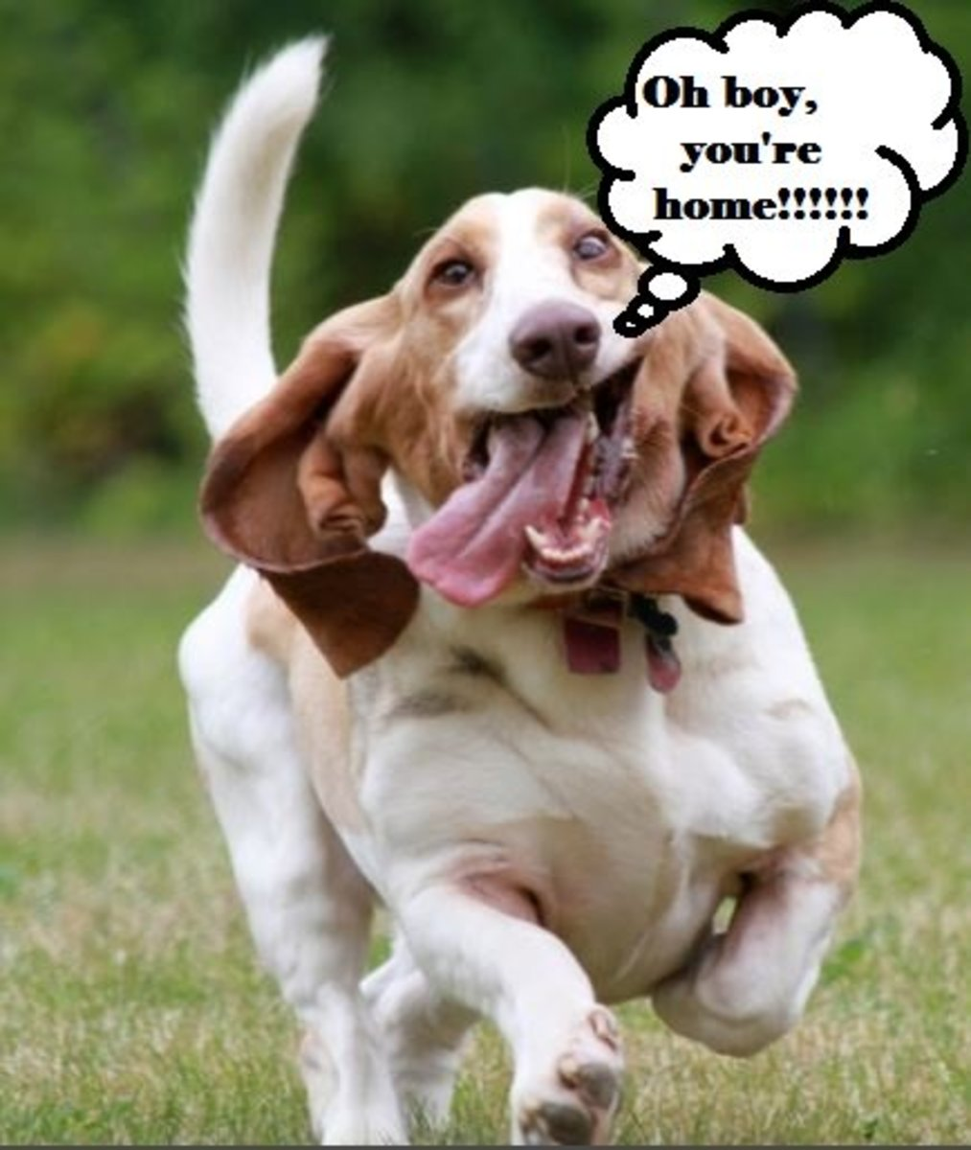
2. They Happily Greet You When You Come Home
Notes:
https://discover.hubpages.com/animals/Ways-Dogs-Show-Their-Love

Slide 98
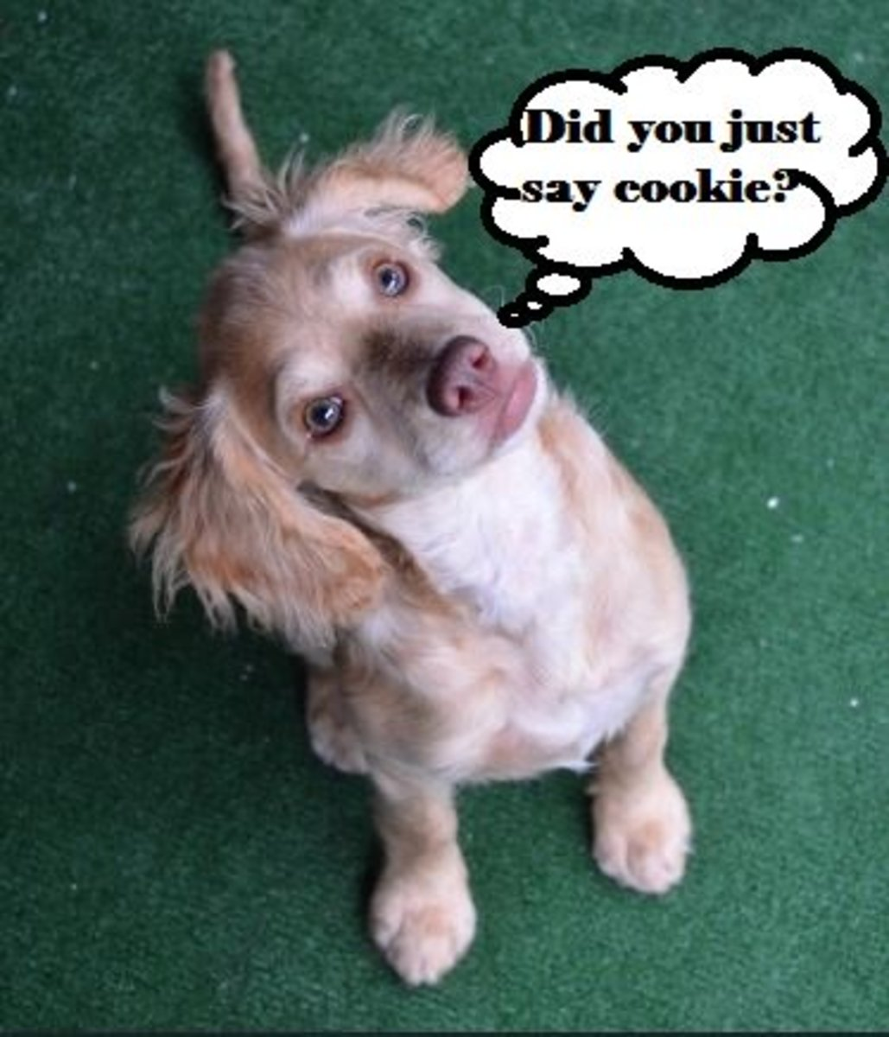
3. Dogs Love Us by Listening to Our Voices
Notes:
https://discover.hubpages.com/animals/Ways-Dogs-Show-Their-Love

Slide 99
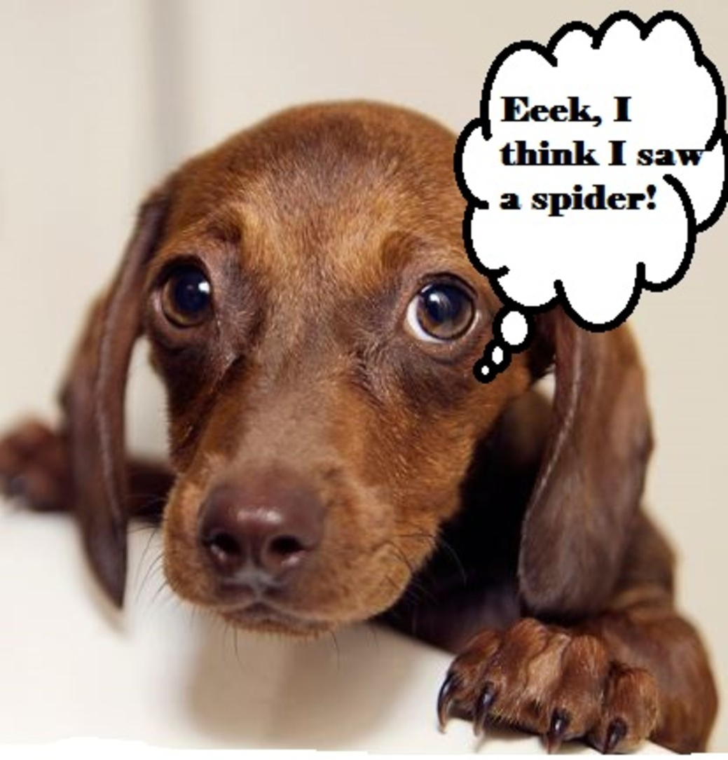
4. Dogs Seek Emotional Comfort From Their Owners as a Sign of Love
Notes:
https://discover.hubpages.com/animals/Ways-Dogs-Show-Their-Love

Slide 101
Unoffendable Spirit Ps 119.165
What does it mean objectively to
be offended?
What does it mean subjectively to be offended? How does it feel?
How can we deal with offense internally? Immanuel, Barukh Haba
How can we deal with offense
externally?

Slide 102
Have you been offended?
Seek Yeshua for your inner response.
^{KJV} Great peace have they which love Your Torah: and nothing shall offend them.
Go to the offender

