Slide 1
^{Mt 24.8-10} All these things are only the beginning of birth pains. Then they will hand you over to persecution and will kill you. You will be hated by all the nations because of My name. And then many will fall away and will betray one another and hate one other.
Notes:
From Torben Sondergaard

Slide 2
^{Yn 16.2} Yes, an hour is coming when whoever kills you will think he is offering service to God.
^{Rev 6.9} When the Lamb broke the fifth seal, I saw underneath the altar the souls of those who had been put to death for proclaiming the Word of God, that is, for bearing witness.
Notes:
Or in secular terms, doing a good thing for the world.

Slide 3
Why did Donald Trump live, and Charlie Kirk die?
Why in Acts 7 did Stephen die, but in Acts 12 Kefa / Peter was delivered?
We are facing a time of wrath.
^{Rev 12.12} Ha-Satan has come down to you, and he is very angry, because he knows that his time is short!”
Notes:
From Torben Sondergaard

Slide 4
We don’t know how it will play out in each life.
A baby chick has to be in the egg 28 days. No more, no less.
We will be in persecution exactly as long as G-d needs to refine us.
The thing that offends you is the source of your sanctification.
Notes:
Heavenly man in China, they don’t pray for release from prison, but G-d’s will for refinement time.

Slide 5
Charlie Kirk was not the last, nor the first martyr. We will honor his memory by living well and holy, suffering well, for Yeshua.

Slide 6
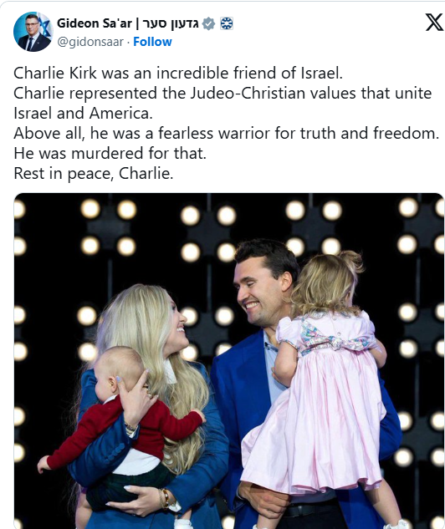
Gideon Sa'ar | גדעון סער
Minister of Foreign Affairs of the State of Israel
שר החוץ של מדינת ישראל
Notes:
Gideon Saar says RIP. We don’t say that prayer, because we, including Charlie, HAVE the assurance in our innermost spirits of resting in the Prince of Peace.
Charlie was a supporter of scripture, and therefore of Israel and Torah. Here is a clip of him saying something maybe surprising…

Slide 7
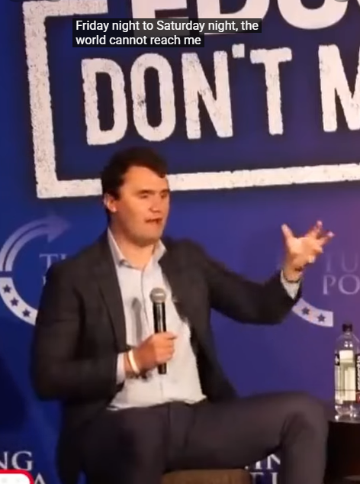
Notes:
https://youtube.com/shorts/WxB4_Q55dNM?si=eVrdk4Im9R1Lk0B-

Slide 8
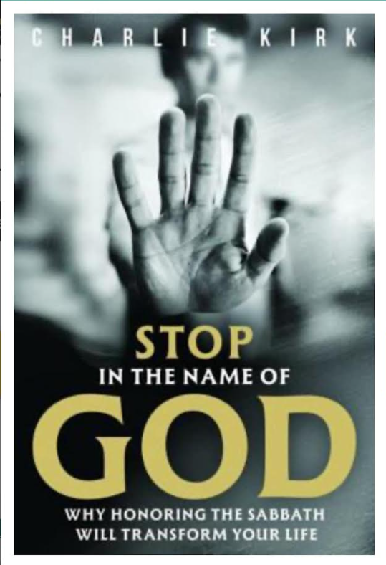
Publication date: ‎
Dec. 9, 2025
Notes:
So maybe in honor of Charlie, we could make a special point to honor Shabbat.
Powering down cell phones? Gaming
Making it a no commercial transaction day
No shopping Shabbat shopping → shaboping
No restaurants
Have to? Get to!! Honor G-d and Shabbat

