Slide 1


Slide 2
Notes:
Scott Hahn

Slide 3
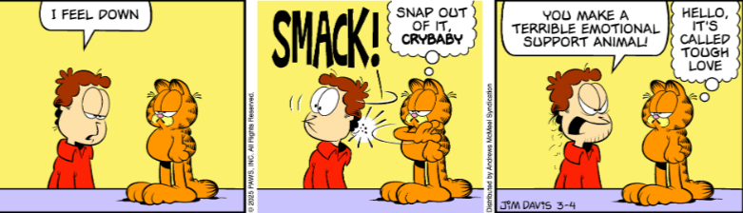
Notes:
This message is about emotional distress!
Garfield

Slide 6

Anxiety
Anxiety
Notes:
https://static.billygraham.org/sites/forgive.me/uploads/prod/2025/08/The-Cure-for-Anxiety-Pamphlet.pdf

Slide 7
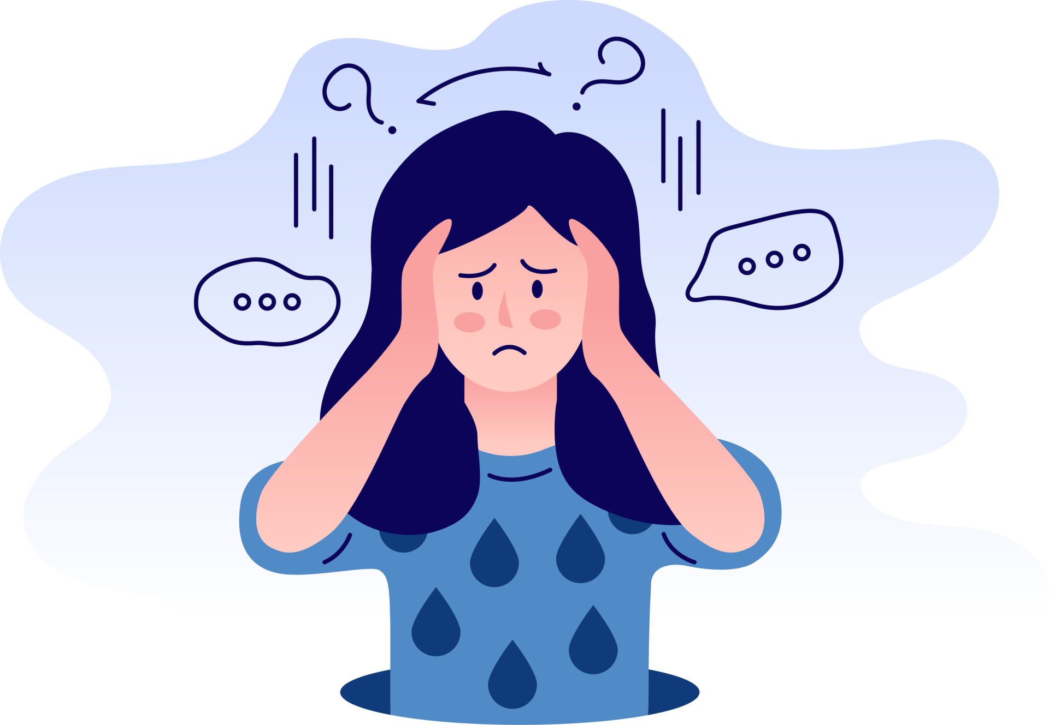
Anxiety
Anxiety
Anxiety
Anxiety
Notes:
https://static.vecteezy.com/system/resources/previews/024/659/353/original/anxiety-disorder-illustration-png.png

Slide 8


Slide 9

Making Anxiety Worse or Better
Phil 4.6
Epidemic of Anxiety
Anxiety rejected
Making anxiety worse
Relief from anxiety: Yeshua,
friends, physical exercise,
service in Israel

Slide 10
Making Anxiety Worse or Better
Phil 4.6
Epidemic of Anxiety
Anxiety rejected
Making anxiety worse
Relief from anxiety: Yeshua,
friends, physical exercise,
service in Israel

Slide 11
^{(Phil. 4:6 NIV).} The Bible app YouVersion has revealed its most popular verse of the year for 2024: “Do not be anxious about anything, but in every situation, by prayer and petition, with thanksgiving, present your requests to God”
Notes:
https://www.gbs.edu/wp-content/uploads/2025/02/Gods-Revivalist-2025-MARCH-web.pdf

Slide 12
According to YouVersion, that verse had “higher engagement than any other verse this year.”
Notes:
https://www.gbs.edu/wp-content/uploads/2025/02/Gods-Revivalist-2025-MARCH-web.pdf

Slide 13
^{Isaiah 41:10} was the most engaged verse on the app for 2023, 2022, 2020, and 2018. That verse reads, “So do not fear, for I am with you; do not be dismayed, for I am your God. I will strengthen you and help you; I will uphold you with my righteous right hand” (NIV).
Notes:
https://www.gbs.edu/wp-content/uploads/2025/02/Gods-Revivalist-2025-MARCH-web.pdf

Slide 14
Most considered issues.
Anxiety in 2024
Fear in 2023, 2022, 2020, 2018

Slide 15
Anxiety and depression are two of the most common mental health conditions experienced by adults in the United States . In 2019, about 6% of adults had experienced moderate or severe symptoms of anxiety in the past 2 weeks,
Notes:
https://www.cdc.gov/nchs/data/nhsr/nhsr213.pdf

Slide 16
and 7% had experienced moderate or severe symptoms of depression in the past 2 weeks
Notes:
https://www.cdc.gov/nchs/data/nhsr/nhsr213.pdf
Word study…

Slide 17

Phil. 4.6 word study:

Slide 18
merimnáō, "a part, as opposed to the whole") – properly, drawn in opposite directions; "divided into parts"; (figuratively) "to go to pieces" because pulled apart (in different directions), literally, to be divided, distracted, to be troubled with cares
Notes:
King Mashiakh Yeshua considers this an important issue…

Slide 19
^{Mat 6.25-34} “Therefore, I tell you, don’t worry about your life — what you will eat or drink; or about your body — what you will wear. Isn’t life more than food and the body more than clothing? Look at the birds flying about! They neither plant nor harvest, nor do they gather food into barns; yet your heavenly Father feeds them.

Slide 20
^{Mat 6.25-34} Aren’t you worth more than they are? Can any of you by worrying add a single hour to his life? “And why be anxious about clothing? Think about the fields of wild irises, and how they grow. They neither work nor spin thread, yet I tell you that not even Shlomo in all his glory was clothed as beautifully as one of these.

Slide 21
^{Mat 6.25-34} If this is how God clothes grass in the field — which is here today and gone tomorrow, thrown in an oven — won’t he much more clothe you? What little trust you have! “So don’t be anxious, asking, ‘What will we eat?,’ ‘What will we drink?’ or ‘How will we be clothed?’

Slide 22
^{Mat 6.25-34} For it is the pagans who set their hearts on all these things. Your heavenly Father knows you need them all. But seek first his Kingdom and his righteousness, and all these things will be given to you as well. Don’t worry about tomorrow — tomorrow will worry about itself! Today has enough tsuris already!

Slide 23
^{1 Kefa / Peter 5.6-8} Therefore, humble yourselves under the mighty hand of God, so that at the right time he may lift you up. Throw all your anxieties upon him, because he cares about you. Stay sober, stay alert! Your enemy, the Adversary, stalks about like a roaring lion looking for someone to devour.

Slide 24
Anxiety is a physiological and psychological response that occurs when the mind and body encounter stressful, dangerous, or unfamiliar situations. It manifests as a feeling of discomfort, distress, or apprehension before a significant event.
Notes:
https://www.anxiety.org/what-is-anxiety

Slide 25
While a certain amount of anxiety can increase alertness and awareness, people with anxiety disorders experience a far from normal state that can render them completely incapacitated.
Notes:
https://www.anxiety.org/what-is-anxiety

Slide 27
Making Anxiety Worse or Better
Phil 4.6
Epidemic of Anxiety
Anxiety rejected
Making anxiety worse
Relief from anxiety: Yeshua,
friends, service in Israel,
physical exercise

Slide 28
Don’t feed depression
Don’t focus on the problem.

Slide 29
^{T’hillim / Ps 42.6-8} Why are you downcast, O my soul? Why are you murmuring within me? Hope in God, for I will yet praise Him, for the salvation of His presence. My God, my soul is downcast within me!
Notes:
Hamelekh king David was having an inner battle to NOT feed his anxiety.

Slide 30
^{T’hillim / Ps 42.6-8} Therefore I remember You from the land of Jordan and from the peaks of Hermon, from Mount Mitzar. Deep calls to deep in the roar of Your waterfalls. All Your waves and breakers have swept over me.
Notes:
Anxiety → depression

Slide 31
Don’t feed depression.
Don’t focus on the problem.
Don’t broadcast news of the problem or the problem makers.

Slide 32
^{Mislei /Prov 20.19} A talebearer goes around revealing secrets, so don’t get involved with a talkative person.

Slide 33
^{Mishlei/Prov 18.8} A slanderer’s words are tasty morsels; they slide right down into the belly.
Notes:
Solving problems with love and counsel is NOT the same as just discussing problems. More on that later.

Slide 34
Don’t feed depression
Don’t broadcast the problem or the problem makers
Don’t use intoxicants.

Slide 35

Notes:
https://ranchcreekrecovery.com/wp-content/uploads/2021/09/bigstock-Drunk-Alcoholic-Depressed-Woma-318923950-1.jpg

Slide 36
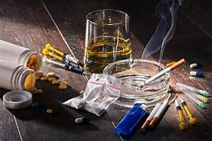
Notes:
https://tse3.mm.bing.net/th/id/OIP.u_ghzFIyr4LXWdlue0LLcgHaE8?pid=Api&P=0&h=180

Slide 37
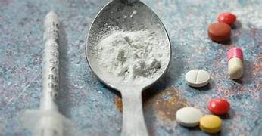
Notes:
https://images.search.yahoo.com/yhs/view;_ylt=Awrg4yvSR5lphlIBDns2nIlQ;_ylu=c2VjA3NyBHNsawNpbWcEb2lkAzYxY2ViMjk1Njc1ZTRkMGRiZjIyNjgzZjJmZWFlZjFhBGdwb3MDODIEaXQDYmluZw--?back=https%3A%2F%2Fimages.search.yahoo.com%2Fyhs%2Fsearch%3Fp%3Ddrugs%2Bas%2Bescape%2Bfrom%2Banxiety%26type%3Dfc_A2EFA035EF5_s69_g_e_d111225_n141297_c999%26fr%3Dyhs-fc-5918_1%26hsimp%3Dyhs-5918_1%26hspart%3Dfc%26param1%3D7%26param2%3DeJwtT8lqwzAU%252FBUdE5AUPW22olPA9geUnip0cB3FEV7xgku%252FvsiUuQyzwEwbn876jwIYUzITDvvRWQ8SuMkc9skEAM6Vw75x1htjHPZxTrrQVAgKRlLIuMO%252BDZOzfl8d9nvtrB%252Bm39j39U1Rhi5HHJ%252FTsaJxQ8Aos%252BiIo5YW%252FWh5RfU89%252BEI313cbkpkVGh06d7b0GPUxy6gNjTddEXNe5mGcAOpKEtAa%252F2ql%252FhfSbvW804asIbl5A%252BdV6bgjLCyzAhABSR%252FFIZo0GWV51yW56O9SWHOuCaMEw6fTN2FuQNQk%252BuvP2PAU7U%253D%26nost%3D1%26tab%3Dorganic%26ri%3D82&w=1250&h=650&imgurl=thepleasantdream.com%2Fwp-content%2Fuploads%2F2022%2F05%2FDream-of-Drugs-76-Scenarios-and-Their-Meaningful-Interpretations.jpg&rurl=https%3A%2F%2Fthepleasantdream.com%2Fdreams-of-drugs%2F&size=88KB&p=drugs+as+escape+from+anxiety&oid=61ceb295675e4d0dbf22683f2feaef1a&fr2=&fr=yhs-fc-5918_1&tt=Dreams+Of+Drugs+-+Does+It+Mean+a+Desire+to+Escape+from+Reality%3F&b=61&ni=150&no=82&ts=&tab=organic&sigr=pEJ59bGQyadR&sigb=L9LnRgZczR5j&sigi=am_3J65WzsIl&sigt=BhOgFTLa8UVJ&.crumb=C42LpB4Kedf&fr=yhs-fc-5918_1&hsimp=yhs-5918_1&hspart=fc&type=fc_A2EFA035EF5_s69_g_e_d111225_n141297_c999&param1=7&param2=eJwtT8lqwzAU%2FBUdE5AUPW22olPA9geUnip0cB3FEV7xgku%2FvsiUuQyzwEwbn876jwIYUzITDvvRWQ8SuMkc9skEAM6Vw75x1htjHPZxTrrQVAgKRlLIuMO%2BDZOzfl8d9nvtrB%2Bm39j39U1Rhi5HHJ%2FTsaJxQ8Aos%2BiIo5YW%2FWh5RfU89%2BEI313cbkpkVGh06d7b0GPUxy6gNjTddEXNe5mGcAOpKEtAa%2F2ql%2FhfSbvW804asIbl5A%2BdV6bgjLCyzAhABSR%2FFIZo0GWV51yW56O9SWHOuCaMEw6fTN2FuQNQk%2BuvP2PAU7U%3D

Slide 38
Don’t feed depression
Don’t broadcast the problem or the problem makers
Don’t use intoxicants.
Don’t rely first of all on pre-scription or OTC meds.

Slide 39
I’m not a doctor, so this is only my opinion, but for anxiety, take NONE of these as a first remedy. If really needed, and with a credible doctor’s advice, do what is best. Anxiety is NOT autism, bi-polar disorder, schizophrenia.
DO what is medically advised and wise!
Notes:
Lori Ginson manic depression story. DON’T go off legitimate meds.

Slide 40


Slide 41
Modern anxiety is not directed toward the real, valid, justified fears such as eternity, death, and the judgment of God. It passes these off as “old hat” and manufactures fears of its own to match its synthetic brand of anxiety. This generation is dying, not from external pressure, but from internal combustion.
Notes:
https://static.billygraham.org/sites/forgive.me/uploads/prod/2025/08/The-Cure-for-Anxiety-Pamphlet.pdf

Slide 42
I asked a man, “Are you afraid to die?” The man replied, “No, but I am afraid to live!”
It is the demons within us we fear—not the demons of the other world. It is the hell within us we fear—not the Hell hereafter.
Notes:
https://static.billygraham.org/sites/forgive.me/uploads/prod/2025/08/The-Cure-for-Anxiety-Pamphlet.pdf
Billy Graham

Slide 43
Anxiety is the natural result when
our hopes are centered in anything short of God and His
will for us.
Notes:
https://static.billygraham.org/sites/forgive.me/uploads/prod/2025/08/The-Cure-for-Anxiety-Pamphlet.pdf

Slide 45
Making Anxiety Worse or Better
Phil 4.6
Epidemic of Anxiety
Anxiety rejected
Making anxiety worse
Relief from anxiety: Yeshua,
friends, service in Israel,
physical exercise

Slide 46
^{Phil 4.4-9} Rejoice in the Lord always—again I will say, rejoice! Let your gentleness be known to all people. The Lord is near. Do not be anxious about anything—but in everything, by prayer and petition with thanksgiving, let your requests be made known to God.
Notes:
I have a loooong prayer list. But thanksgiving is the key.

Slide 47
Choose to Praise G-d
Notes:
G-d could turn my kids around. But if it brings more glory for him for me to walk joyfully in Him without their hearts yet turned, than for Him to turn them now, I will accept.
^{Yeshayahu Is 60.4} Lift up your eyes and look all around: they all gather—they come to you— your sons will come from far away, your daughters carried on the hip.
^{Yeshayahu Is 60.26} I, Adoni, will hasten it in its time.

Slide 48
Choose to Praise G-d
G-d is near!
Notes:
Valley of the shadow of death…You are with me. Third person in the opening.

Slide 49
^{Phil 4.4-9} And the shalom of God, which surpasses all understanding, will guard your hearts and your minds in Messiah Yeshua. Finally, brothers and sisters, whatever is true, whatever is honorable, whatever is just, whatever is pure,
Notes:
~1973 janitor job Cinti Public schools. Nov vote for tax defeated…eventually lay off notice. Studies, city mission, street evang, no time to job search except did find an opening as a dishwasher. Already school janitor.
Entered into this verse and testified.
Thursday before final Friday went to AAA office for sales position telephone marketing. Go it and successful. From school janitor to AC office talking.

Slide 50
Choose to Praise G-d
G-d is near!
Pray with thanksgiving!
Think about praiseworthy things!

Slide 51
^{Phil 4.4-9} whatever is lovely, whatever is commendable—if there is any virtue and if there is anything worthy of praise—dwell on these things. What you have learned and received and heard and seen in me—put these things into practice, and the God of shalom will be with you.

Slide 52
^{Yeshahyu Is 26.3} You keep in perfect peace one whose mind is stayed on You, because he trusts in You.

Slide 53
^{Mt 11.28-30} “Come to me, all of you who are struggling and burdened, and I will give you rest. Take my yoke upon you and learn from me, because I am gentle and humble in heart, and you will find rest for your souls. For my yoke is easy, and my burden is light.”
Notes:
Let’s look at Mt 6 again…

Slide 54
^{Mat 6.25-34} “Therefore, I tell you, don’t worry about your life — what you will eat or drink; or about your body — what you will wear. Isn’t life more than food and the body more than clothing? Look at the birds flying about! They neither plant nor harvest, nor do they gather food into barns; yet your heavenly Father feeds them.

Slide 55
^{Mat 6.25-34} Aren’t you worth more than they are? Can any of you by worrying add a single hour to his life? “And why be anxious about clothing? Think about the fields of wild irises, and how they grow. They neither work nor spin thread, yet I tell you that not even Shlomo in all his glory was clothed as beautifully as one of these.

Slide 56
^{Mat 6.25-34} If this is how God clothes grass in the field — which is here today and gone tomorrow, thrown in an oven — won’t he much more clothe you? What little trust you have! “So don’t be anxious, asking, ‘What will we eat?,’ ‘What will we drink?’ or ‘How will we be clothed?’

Slide 57
^{Mat 6.25-34} For it is the pagans who set their hearts on all these things. Your heavenly Father knows you need them all. But seek first his Kingdom and his righteousness, and all these things will be given to you as well. Don’t worry about tomorrow — tomorrow will worry about itself! Today has enough tsuris already!
Notes:
Yiddish word. Like gevalt…gevaltism.

Slide 58
^{1 Kefa / Peter 5.6-8} Therefore, humble yourselves under the mighty hand of God, so that at the right time he may lift you up. Throw all your anxieties upon him, because he cares about you. Stay sober, stay alert! Your enemy, the Adversary, stalks about like a roaring lion looking for someone to devour.
Notes:
Roaring lion is the toothless lion who roars to drivet he panicked prey to the opposite direction, where the young lions are waiting.

Slide 59
^{T’hillim / Ps 18.29} “For you, Adoni, light my lamp; Adoni, my God, lights up my darkness.
Notes:
He comes in the darkness!

Slide 60
^{2 Cor 12.9} He told me, “My grace is enough for you, for my power is brought to perfection in weakness.” Therefore, I am very happy to boast about my weaknesses, in order that the Messiah’s power will rest upon me.

Slide 61

Notes:
This past Wednesday, we welcomed the month of Adar (אֲדָר — Adar)
Our sages teach: “When Adar enters, we increase joy” (Mishenichnas Adar marbim b’simchah).
Why? Because embedded within Adar is the festival of Purim (פּוּרִים — Purim), the day when Jewish history experienced one of its most dramatic reversals

Slide 63
Making Anxiety Worse or Better
Phil 4.6
Epidemic of Anxiety
Anxiety rejected
Making anxiety worse
Relief from anxiety: Yeshua,
friends, service in Israel,
physical exercise

Slide 64
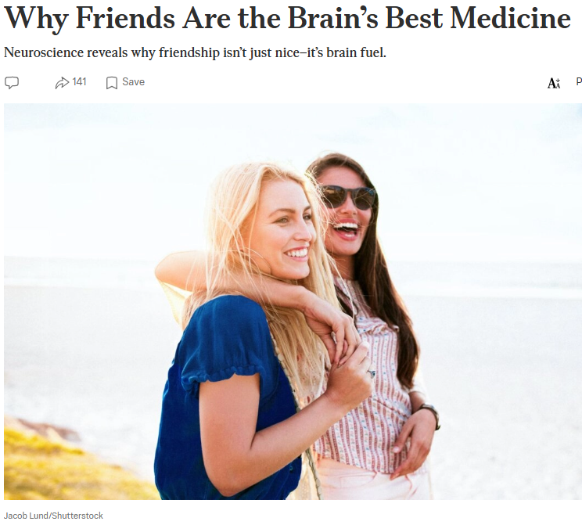
Notes:
https://www.theepochtimes.com/health/friends-the-brains-best-medicine-5960550?utm_source=Health&src_src=Health&utm_campaign=health-2026-0

Slide 65
Picture your brain lighting up like a pinball machine—“feel good” hormones dopamine, oxytocin, and serotonin all firing at once. That’s what happens when you sit across from a friend and talk. Now picture those same circuits going dark and stress hormones flooding in. That’s isolation. Your brain knows the difference, even when you don’t.
Notes:
https://www.theepochtimes.com/health/friends-the-brains-best-medicine-5960550?utm_source=Health&src_src=Health&utm_campaign=health-2026-0

Slide 66
a growing field of social neuroscience, shows that the presence of friends—or even brief, kind interactions with strangers—helps the brain feel safe, stimulated, and primed to heal.
[So, help with Misloakh manot distribution next week!]
Notes:
https://www.theepochtimes.com/health/friends-the-brains-best-medicine-5960550?utm_source=Health&src_src=Health&utm_campaign=health-2026-0

Slide 67
“Those social cues—eye contact, expressions, tone—are what tell our brains, ‘You are with another human being,’ and they’re what fire up the oxytocin, dopamine, and serotonin systems that make social interaction feel good,” Rein told The Epoch Times.​
Notes:
https://www.theepochtimes.com/health/friends-the-brains-best-medicine-5960550?utm_source=Health&src_src=Health&utm_campaign=health-2026-0

Slide 68
A longitudinal study of more than 12,000 older adults found that people who report persistent loneliness have a 40 percent higher risk of developing dementia,
Notes:
https://www.theepochtimes.com/health/friends-the-brains-best-medicine-5960550?utm_source=Health&src_src=Health&utm_campaign=health-2026-0

Slide 69
The flip side shows up in our stress hormones. When connection fades, the chemistry turns—long stretches of loneliness drive up cortisol, disrupt sleep, and trap the mind in spirals of worry. In isolation, the brain flips into threat mode, bracing the body for danger.
Notes:
https://www.theepochtimes.com/health/friends-the-brains-best-medicine-5960550?utm_source=Health&src_src=Health&utm_campaign=health-2026-0

Slide 70
instead of allowing it to rest and grow. “When we’re isolated, our cortisol levels start to go up. Humans experience stress when we are alone because our brains are trying to push us back toward other people, where we’ve always survived best,” Rein noted.
Notes:
https://www.theepochtimes.com/health/friends-the-brains-best-medicine-5960550?utm_source=Health&src_src=Health&utm_campaign=health-2026-0

Slide 71
Do find a trusted friend to share the anxiety with. First of all, the Chief Friend.
Do find aspects for praising G-d in Yeshua for the anxiety. He will work it for good!!
Do: Purim Ester anxiety 3 days fasting and prayer

Slide 72
Rebuking, face to face,
is love and stress relief.

Slide 73
^{Vayikra/Lev 19.16-18} “‘Do not go around spreading slander among your people, but also don’t stand idly by when your neighbor’s life is at stake; I am Adoni. “‘Do not hate your brother in your heart, but rebuke your neighbor frankly,
Notes:
If you have negative information about anyone, and you tell anyone, except a trusted counselor to help you GO the person in the negative, you are hating.

Slide 74
^{Vayikra/Lev 19.16-18} so that you won’t carry sin because of him. Don’t take vengeance on or bear a grudge against any of your people; rather, love your neighbor as yourself; I am Adoni.
Notes:
Rebuking someone frankly is a high form of love. Is it easy? Will you do it wrong?
It must be a first person witnessed offense.

Slide 75
^{Yaakov/Jas 5.19-20} My brothers, if one of you wanders from the truth, and someone causes him to return, you should know that whoever turns a sinner from his wandering path will save him from death and cover many sins.
Notes:
Rebuking in love is a high form of friendship.

Slide 77
Making Anxiety Worse or Better
Phil 4.6
Epidemic of Anxiety
Anxiety rejected
Making anxiety worse
Relief from anxiety: Yeshua,
friends, physical exercise,
service in Israel,

Slide 78
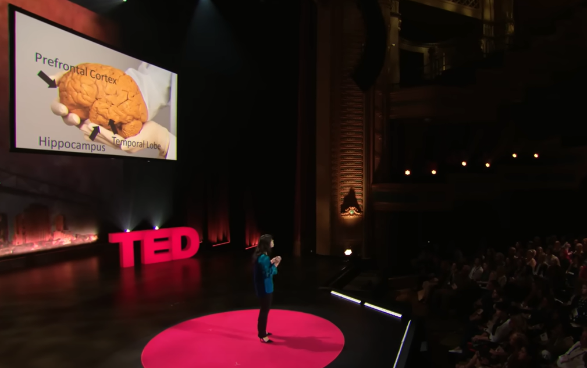
Exercise
Notes:
https://youtu.be/BHY0FxzoKZE

Slide 79
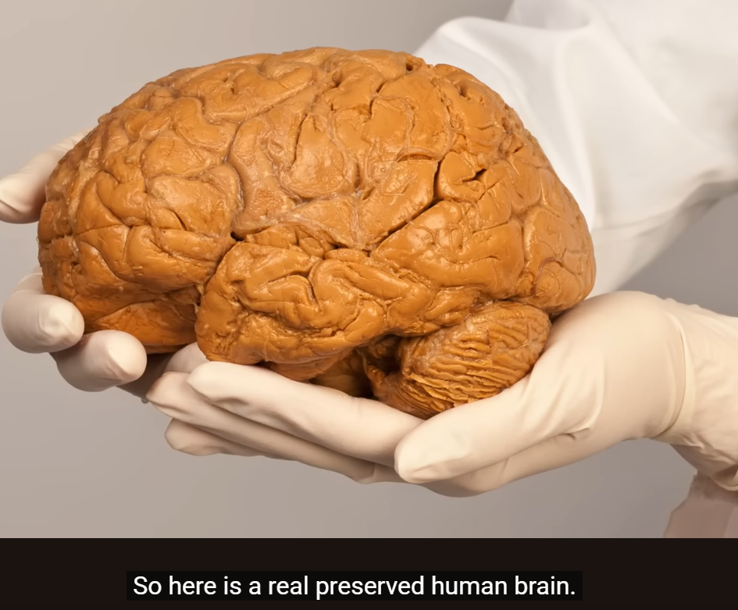

Slide 80
Physical activity sets off a cascade of internal changes that begins with muscle contractions. This triggers the production of proteins called myokines, chemical messengers
Notes:
https://join1440.com/t/exercise?utm_source=1440-dd&utm_medium=email&utm_campaign=view-content-top&user_id=68ab968ed7432303610d4faf

Slide 81
released into the bloodstream that travel to distant organs to reduce inflammation, improve insulin sensitivity, and promote brain development.
Notes:
https://join1440.com/t/exercise?utm_source=1440-dd&utm_medium=email&utm_campaign=view-content-top&user_id=68ab968ed7432303610d4faf

Slide 82
Downstream, cardiovascular function improves as the heart becomes more efficient and blood vessels more elastic, thus increasing oxygen delivery to working tissues. In the brain, exercise stimulates the release of neurotransmitters like dopamine, serotonin, and norepinephrine,
Notes:
https://join1440.com/t/exercise?utm_source=1440-dd&utm_medium=email&utm_campaign=view-content-top&user_id=68ab968ed7432303610d4faf

Slide 83
improving mood and focus. It also increases levels of BDNF (brain-derived neurotrophic factor), a growth factor that enhances memory, learning, and resilience to stress.
Notes:
https://join1440.com/t/exercise?utm_source=1440-dd&utm_medium=email&utm_campaign=view-content-top&user_id=68ab968ed7432303610d4faf

Slide 84
Public health guidelines recommend 150 minutes of moderate aerobic activity per week, plus at least two days of strength training. However, emerging evidence suggests that even 10 minutes of walking can reduce stress, improve one's mood, and begin to reverse some of the physiologic harm caused by sitting.
Notes:
https://join1440.com/t/exercise?utm_source=1440-dd&utm_medium=email&utm_campaign=view-content-top&user_id=68ab968ed7432303610d4faf

Slide 86
Making Anxiety Worse or Better
Phil 4.6
Epidemic of Anxiety
Anxiety rejected
Making anxiety worse
Relief from anxiety: Yeshua,
friends, physical exercise,
service in Israel

Slide 87
Serve others in Israel:
Jews and Arabs!

Slide 88

Khader and Stevie Ghanim
Notes:
https://vimeo.com/482672090?fl=pl&fe=cm
He is from a local Jericho family, led to Yeshua in his youth. She is a Scandinavian Christian. They can’t overtly evangelize, but, live the life of service and joy, and people ask questions. They are Arab believers in Messiah, friends of Israel, run the best restaurant of the tour, according to John Stewart.

Slide 89

Seeds of
Notes:
https://vimeo.com/996685473?fl=pl&fe=cm

Slide 91
Making Anxiety Worse or Better
Phil 4.6
Epidemic of Anxiety
Anxiety rejected
Making anxiety worse
Relief from anxiety: Yeshua,
friends, physical exercise,
service in Israel

