Slide 1
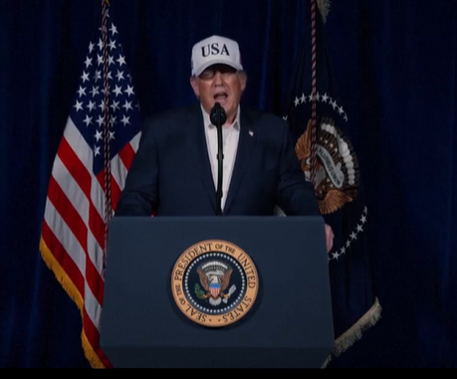
Notes:
https://www.theepochtimes.com/us/trumps-full-statement-on-iran-5992099?utm_source=RTNews&src_src=RTNews&utm_campaign=rtbreaking-2026-02-28-1&src_cmp=rtbreaking-2026-02-28-1&utm_medium=email&est=PeCCG3HEA5OSpqsU81iXkRC6Txro2Enef5DMovskoza0G4fsd5SZC9Ma60cV%2FcqPjA%3D%3D

Slide 2
President Donald Trump announced in a video on Feb. 28 that the United States had begun “major combat operations” in Iran with the goal of eliminating threats from the Iranian regime.
Here’s Trump’s address in full:
Notes:
https://www.theepochtimes.com/us/trumps-full-statement-on-iran-5992099?utm_source=RTNews&src_src=RTNews&utm_campaign=rtbreaking-2026-02-28-1&src_cmp=rtbreaking-2026-02-28-1&utm_medium=email&est=PeCCG3HEA5OSpqsU81iXkRC6Txro2Enef5DMovskoza0G4fsd5SZC9Ma60cV%2FcqPjA%3D%3D

Slide 3
A short time ago, the United States military began major combat operations in Iran. Our objective is to defend the American people by eliminating imminent threats from the Iranian regime. A vicious group of very hard, terrible people. Its menacing activities directly endanger the United States, our troops, our bases overseas, and our allies throughout the world…
Notes:
https://www.theepochtimes.com/us/trumps-full-statement-on-iran-5992099?utm_source=RTNews&src_src=RTNews&utm_campaign=rtbreaking-2026-02-28-1&src_cmp=rtbreaking-2026-02-28-1&utm_medium=email&est=PeCCG3HEA5OSpqsU81iXkRC6Txro2Enef5DMovskoza0G4fsd5SZC9Ma60cV%2FcqPjA%3D%3D

Slide 4
To the members of the Islamic Revolutionary Guard, the armed forces, and all of the police, I say tonight that you must lay down your weapons and have complete immunity. Or in the alternative, face certain death. So, lay down your arms. You will be treated fairly with total immunity, or you will face certain death.
Notes:
https://www.theepochtimes.com/us/trumps-full-statement-on-iran-5992099?utm_source=RTNews&src_src=RTNews&utm_campaign=rtbreaking-2026-02-28-1&src_cmp=rtbreaking-2026-02-28-1&utm_medium=email&est=PeCCG3HEA5OSpqsU81iXkRC6Txro2Enef5DMovskoza0G4fsd5SZC9Ma60cV%2FcqPjA%3D%3D

Slide 5
Finally, to the great proud people of Iran, I say tonight that the hour of your freedom is at hand. Stay sheltered. Don’t leave your home. It’s very dangerous outside. Bombs will be dropping everywhere. When we are finished, take over your government. It will be yours to take. This will be probably your only chance for generations.
Notes:
https://www.theepochtimes.com/us/trumps-full-statement-on-iran-5992099?utm_source=RTNews&src_src=RTNews&utm_campaign=rtbreaking-2026-02-28-1&src_cmp=rtbreaking-2026-02-28-1&utm_medium=email&est=PeCCG3HEA5OSpqsU81iXkRC6Txro2Enef5DMovskoza0G4fsd5SZC9Ma60cV%2FcqPjA%3D%3D

Slide 6
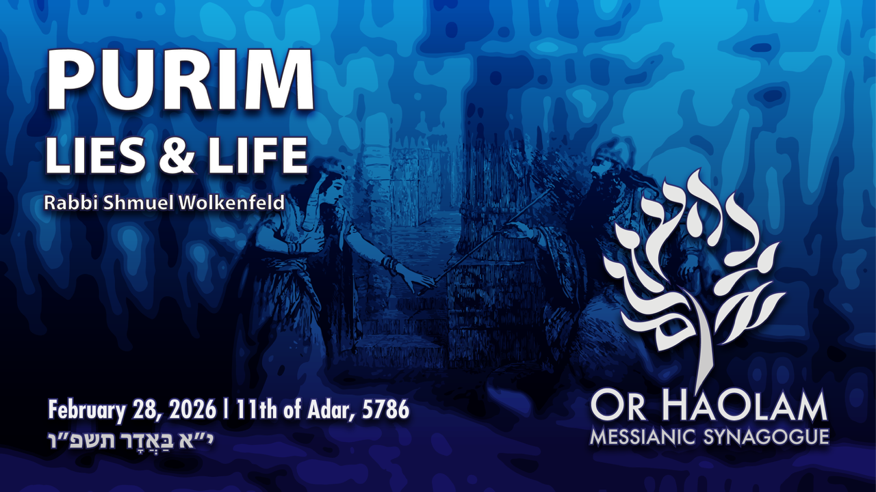

Slide 7
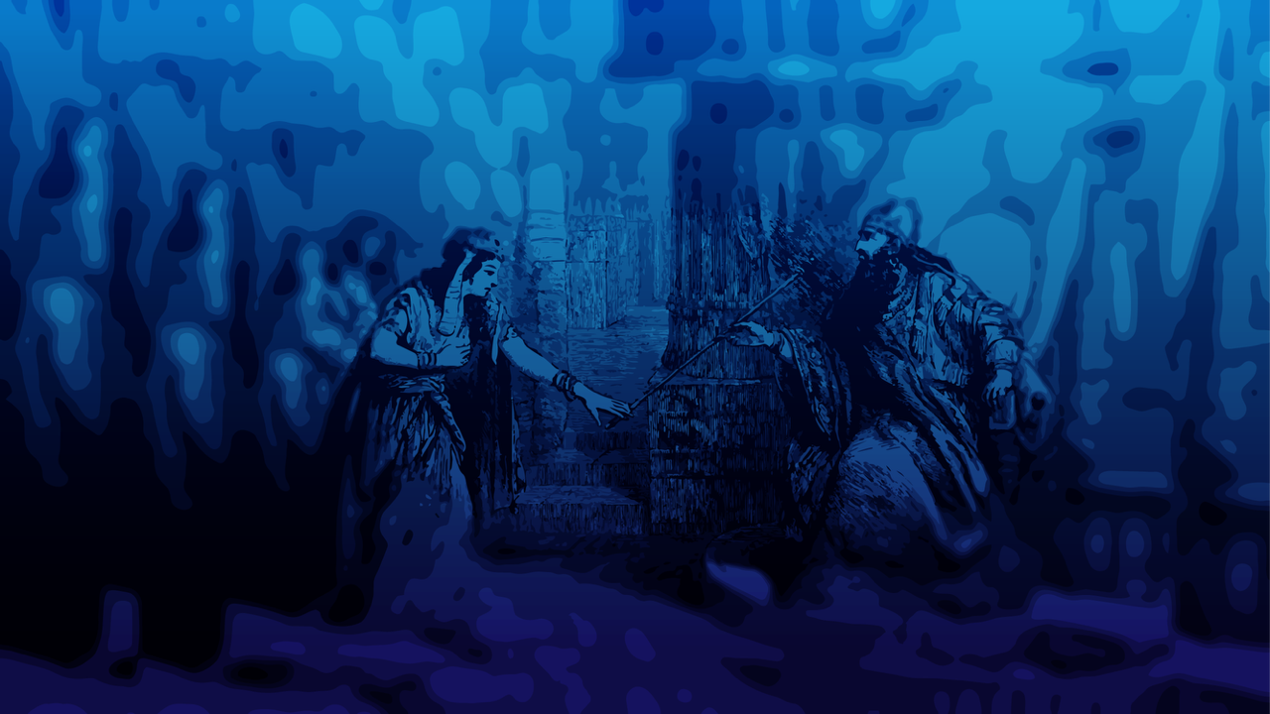
Purim: Lies and Life Ester 3.8-11
Haman’s slander of the Jewish
people is the book plot basis.
2. Other slanders of the Jews
3. Reversal on Haman
4. Reversals the Norm

Slide 8
Purim: Lies and Life Ester 3.8-11
Haman’s slander of the Jewish
people is the book plot basis.
2. Other slanders of the Jews
3. Reversal on Haman
4. Reversals the Norm

Slide 9
slander
1: the utterance of false charges or misrepresentations which defame and damage another's reputation
2: a false and defamatory oral statement about a person
Notes:
https://www.merriam-webster.com/dictionary/slander?src=search-dict-box

Slide 10
^{T’hillim/Ps 31.13} All I hear is whispering, terror is all around me; they plot together against me,
scheming to take my life.
^{T’hillim/Ps 31.13} ^{KJV} For I have heard the slander of many: fear was on every side: while they took counsel together against me, they devised to take away my life.

Slide 11
^{T’hilim 15.1,3} ADONI, who can rest in your tent? Who can live on your holy mountain? Those who…keep their tongues from slander; who never do harm to others or seek to discredit neighbors;

Slide 12
^{Ester 3.8-11} Then Haman said to Akhashverosh, “There is a particular people scattered and dispersed among the peoples in all the provinces of your kingdom. Their laws are different from those of every other people; moreover, they don’t observe the king’s laws.
Notes:
Examples of different laws and disobeying

Slide 13
^{Ester 3.8-11} It doesn’t befit the king to tolerate them. If it please the king, have a decree written for their destruction…The king took his signet ring from his hand

Slide 14
^{Ester 3.8-11} and gave it to Haman the son of Hamdata the Agagi, the enemy of the Jews. The king said to Haman, “The money is given to you, and the people too, to do with as seems good to you.”

Slide 15
^{Ester 3.13} Letters were sent by courier to all the royal provinces “to destroy, kill and exterminate all Jews, from young to old, including small children and women, on a specific day, the thirteenth day of the twelfth month, the month of Adar, and to seize their goods as plunder.”

Slide 16
What was the crime
that justified genocide?
Their laws are different from those of every other people; moreover, they don’t observe the king’s laws.
Example? Evidence?

Slide 18
Purim: Lies and Life Ester 3.8-11
Haman’s slander of the Jewish
people is the book plot basis.
2. Other slanders of the Jews
3. Reversal on Haman
4. Reversals the Norm

Slide 19
^{Vayikra /Lev 3.17} It is to be a permanent regulation through all your generations wherever you live that you will eat neither fat nor blood.’”

Slide 20
^{Vayikra /Lev 7.22-27} Adoni said to Moshe, “Say to the people of Isra’el, ‘You are not to eat the fat of bulls, sheep or goats. The fat of animals that die of themselves or are killed by wild animals may be used for any other purpose, but under no circumstances are you to eat it.

Slide 21
^{Vayikra /Lev 7.22-27} For whoever eats the fat of animals of the kind used in presenting an offering made by fire to Adoni will be cut off from his people. You are not to eat any kind of blood, whether from birds or animals, in any of your homes. Whoever eats any blood will be cut off from his people.’”
Notes:
No blood, no fat. Kosher Subway pastrami sandwich…”facon” to enhance. Soak meat in kefir or kosher salt to get out blood.

Slide 22
Chicken is NOT a Temple sacrificial animal. So chicken fat is permissible to eat, and it became a whole form of cuisine.

Slide 23
Schmaltz (also spelled schmalz or shmalz) is rendered (clarified) chicken or goose fat. It is an integral part of traditional Ashkenazi Jewish cuisine, where it has been used for centuries in a wide array of dishes, such as
Notes:
https://en.wikipedia.org/wiki/Schmaltz

Slide 24
chicken soup, latkes, matzah brei, chopped liver, matzah balls, fried chicken, and many others, as a cooking fat, spread, or flavor enhancer.
Notes:
https://en.wikipedia.org/wiki/Schmaltz

Slide 25
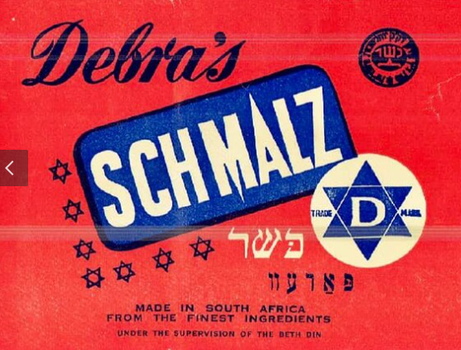

Slide 26
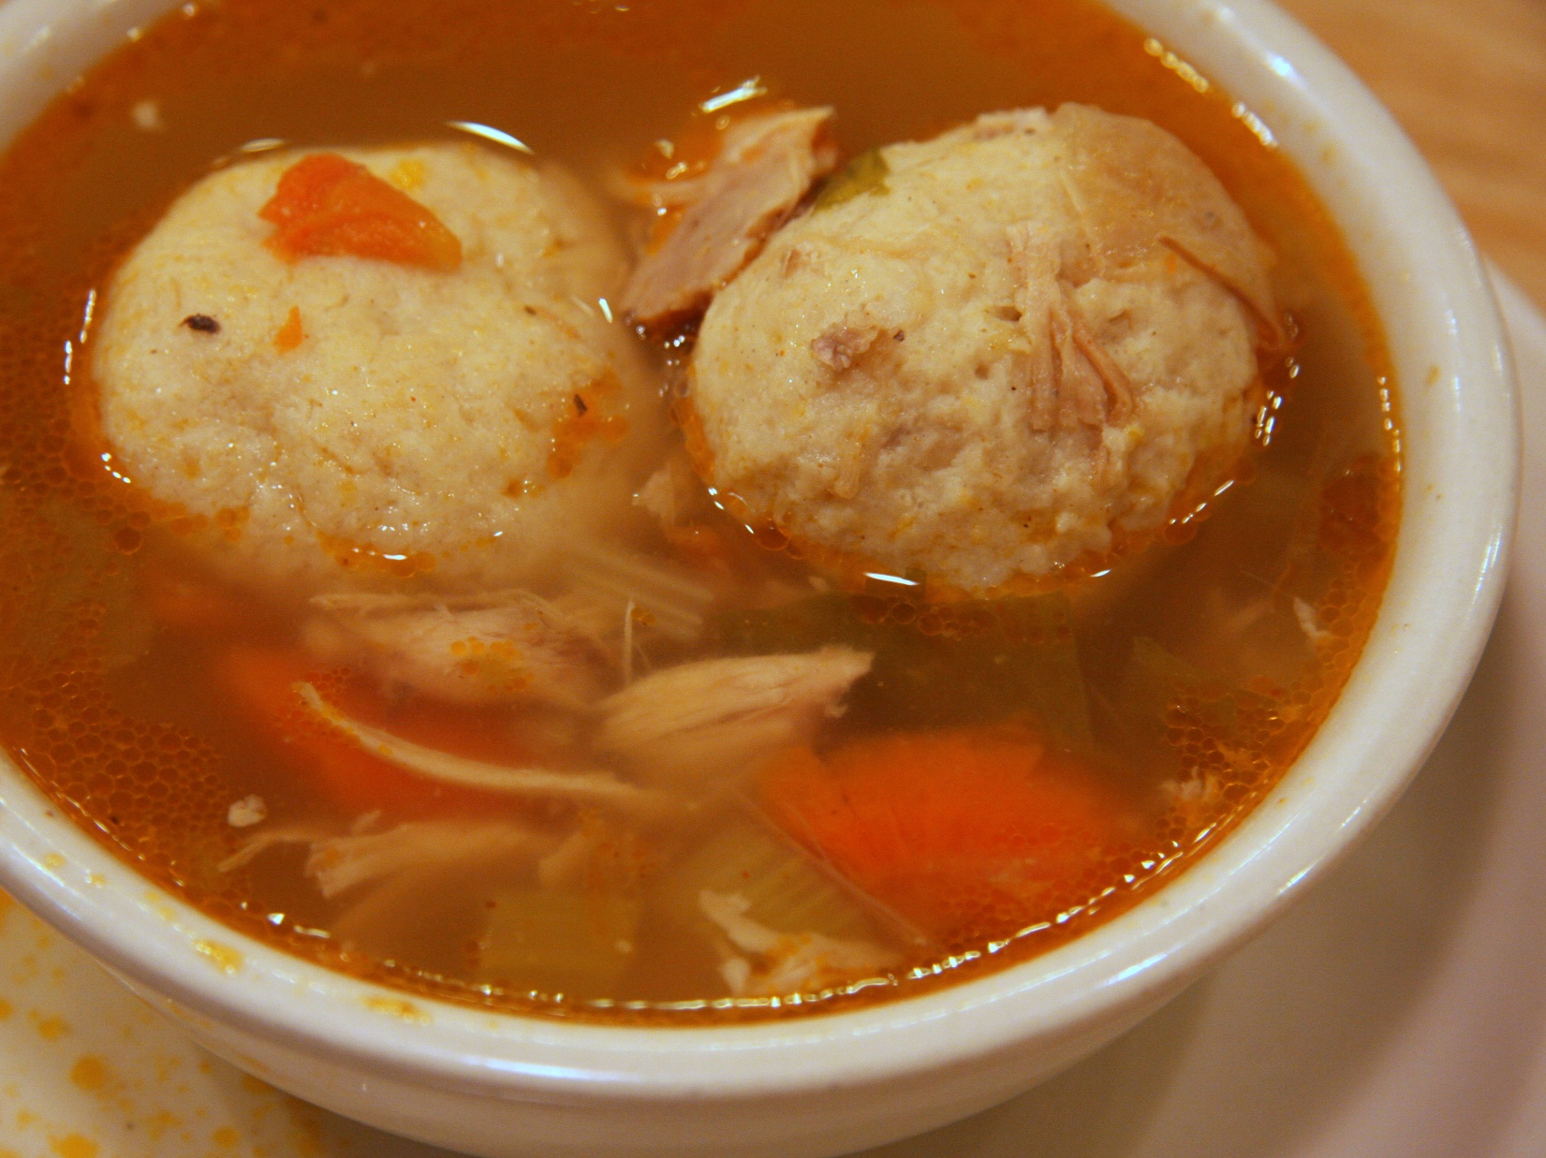
Notes:
https://upload.wikimedia.org/wikipedia/commons/d/d3/MatzahBalls.jpg
See globules?

Slide 27
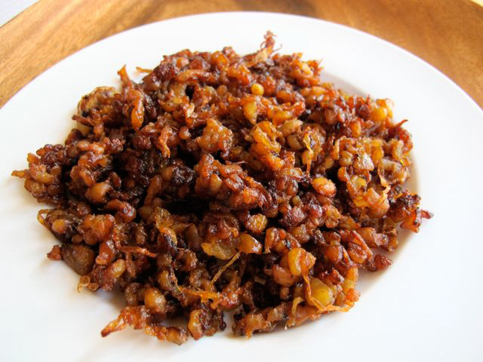
Gribenes: onions & chicken skin
fried in schmaltz
Notes:
Schmaltz is basically rendered chicken fat. It is collected by slowly sautéing chicken skin and fat, then collecting the liquid fat that melts as it cooks. It’s easy to make and adds an authentic flavor to many Jewish recipes, including matzo balls and chopped liver.
See the full post:http://toriavey.com/toris-kitchen/2010/06/schmaltz-and-gribenes/#IHUf8YrK2c8VTBDE.99

Slide 28
Gribenes (rough pronunciation "GRIB-bin-iss"), or "scraps," are crispy chicken skin and onion remnants, ‎somewhat similar to bacon, preserved from the preparation of schmaltz. Gribenes is a favored food among ‎
Ashkenazi Jews. This dish is often associated

Slide 29
with the Jewish holidays Hannukah and Shabbat. The food ‎is frequently mentioned in Jewish stories and parables. Many Jews believe "that there is no flavor ‎comparable with the tawny and well-watched scraps." Gribenes have been fabled to attract potential ‎dinner guests.‎

Slide 30
So, no blood, no fat in Jewish food, to a cultural motif!
Nevertheless..

Slide 31
Alexandria, first century AD The first recorded blood libel against Jews was by the classical Greek ‎author Apion, who claimed that Jews sacrificed Greek victims in their temple. This blood libel from ‎ancient Greek times pre-dates Christianity This resulted in an attack on Jews in Alexandria in 38 CE in ‎which thousands of Jews died.

Slide 32
Constantinople, 415 Socrates Scholasticus reported that some Jews in a drunken frolic bound a Christian ‎child on a cross in mockery of the death of Messiah and scourged him until he died.‎

Slide 33
Norwich, East Anglia, 1144 March 20 (Passover), the first blood libel in Europe against Jews. Jews of ‎Norwich were accused of both ritual murder and blood libel after a boy (William of Norwich) was found ‎dead with stab wounds. The legend was turned into a cult, with William acquiring the status of martyr and ‎crowds of pilgrims bringing wealth to the local
Notes:
You saw Braveheart

Slide 34
church. In 1189, the Jewish deputation attending the ‎coronation of Richard the Lionheart was attacked by the crowd. Massacres of Jews at London and York ‎soon followed.

Slide 35
On Feb 6 1190, all the Norwich Jews were found slaughtered in their houses, except a few ‎who found refuge in the castle. Jews would later be expelled from all of England in 1290 and not allowed ‎to return until 1655.‎

Slide 36
County of Flanders, c. 1250 An early blood libel against Jews appears in Bonum Universale de Apibus ii. ‎‎29, § 23, by Thomas of Cantimpré (a monastery near Cambray).

Slide 37
Thomas wrote "It is quite certain that the ‎Jews of every province annually decide by lot which congregation or city is to send Christian blood to the ‎other congregations."‎

Slide 38
Lincolnshire, 1255 The case of Little Saint Hugh of Lincoln is mentioned by Chaucer, and thus has ‎become well known. A child of eight years, named Hugh, son of a woman named Beatrice,

Slide 39
disappeared at ‎Lincoln on the 31st of July. His body was discovered on the 29th of August, covered with filth, in a pit or ‎well belonging to a Jewish man named Copin.‎

Slide 40
Alsace, 1270 At Weissenburg, a miracle alone decided the charge against the Jews. According to the ‎accusation, the Jews had suspended a child (whose body was found in the Lauter river)

Slide 41
by the feet, and ‎had opened every artery in its body in order to obtain all the blood. Again, supernatural claims were ‎made: the child's wounds were said to have bled for

Slide 42
five days afterward, despite its treatment.‎ Tyrol, Austria 1462 At Rinn, near Innsbruck, a boy named Andreas Oxner (also known as Anderl von ‎Rinn) was said to have been bought

Slide 43
by Jewish merchants and cruelly murdered by them in a forest near ‎the city, his blood being carefully collected in vessels. The accusation of drawing off the blood (without ‎

Slide 44
murder) was not made until the beginning of the seventeenth century, when the cult was founded. The ‎cult continued until it was officially prohibited in 1994 by the Bishop of Innsbruck. ‎

Slide 45
Trentino, 1475 Simon of Trent, aged two, disappeared, and his father alleged that he had been kidnapped ‎and murdered by the local Jewish community. Fifteen local Jews were sentenced to death and burned. ‎Simon was regarded as a saint, and was canonized by Pope Sixtus V in 1588.

Slide 46
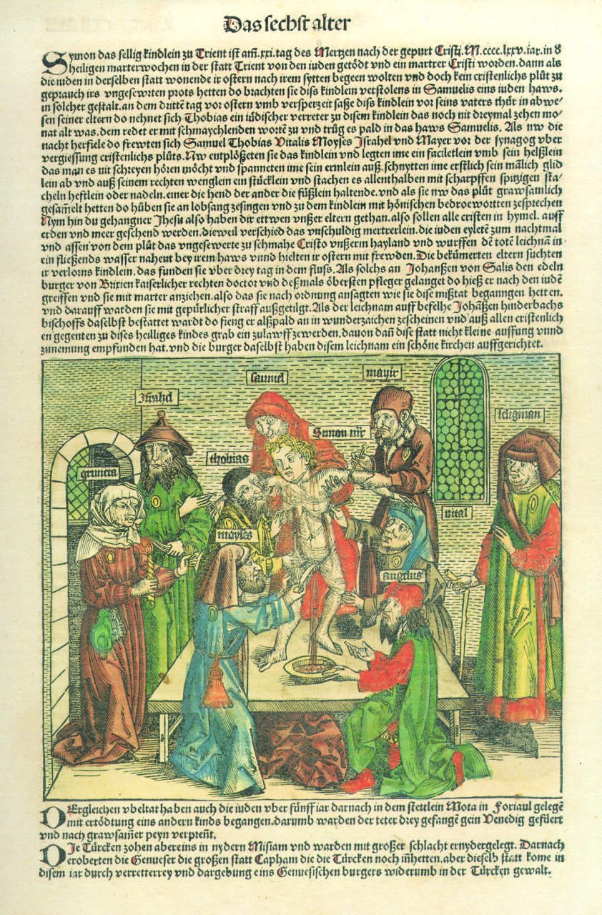
The story of Simon of Trent (1475)

Slide 47
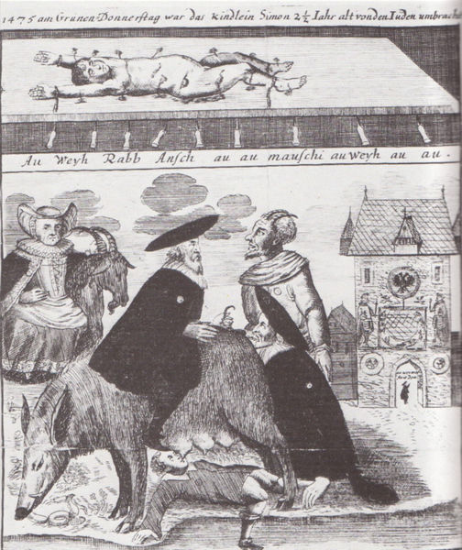
Above: The murdered body
of Simon of Trent.
Below: The "Judensau."

Slide 48
His status as a saint was ‎removed in 1965 by Pope Paul VI, though his murder is still promoted as a fact by a handful of ‎extremists.‎

Slide 49
Castile, 1491 Christopher of Toledo, was a four-year-old Christian boy supposedly murdered by two Jews ‎and three Conversos (converts to Christianity). In total, eight men were executed. It is now believed that ‎this case was constructed by the Spanish Inquisition to facilitate the expulsion of Jews from Spain.

Slide 50
He ‎was canonized by Pope Pius VII in 1805. Christopher has since been removed from the canon, though ‎once again, a handful of individuals still claim the validity of this case.

Slide 51
Vom Schem Hamphoras was a book written by German Reformation leader Martin Luther in 1543 in ‎which he equated Jews with the Devil. Shem Hamphoras
שם המפורשis the Hebrew rabbinic name for the ineffable ‎name of God, the tetragrammaton. The use of the term is in itself a taunt and insult to Jewish sensitivities.‎

Slide 52
It was written several months after Luther published On the Jews and Their Lies.‎ In the book he wrote:‎ Here in Wittenburg, in our parish church, there is a sow carved into the stone under which lie ‎young pigs and Jews who are sucking; behind the sow stands a rabbi who is lifting up the right leg ‎of the sow, raises behind the sow, bows down and looks with great effort into the

Slide 53
Talmud under ‎the sow, as if he wanted to read and see something most difficult and exceptional; no doubt they ‎gained their Shem Hamphoras from that place...‎

Slide 54
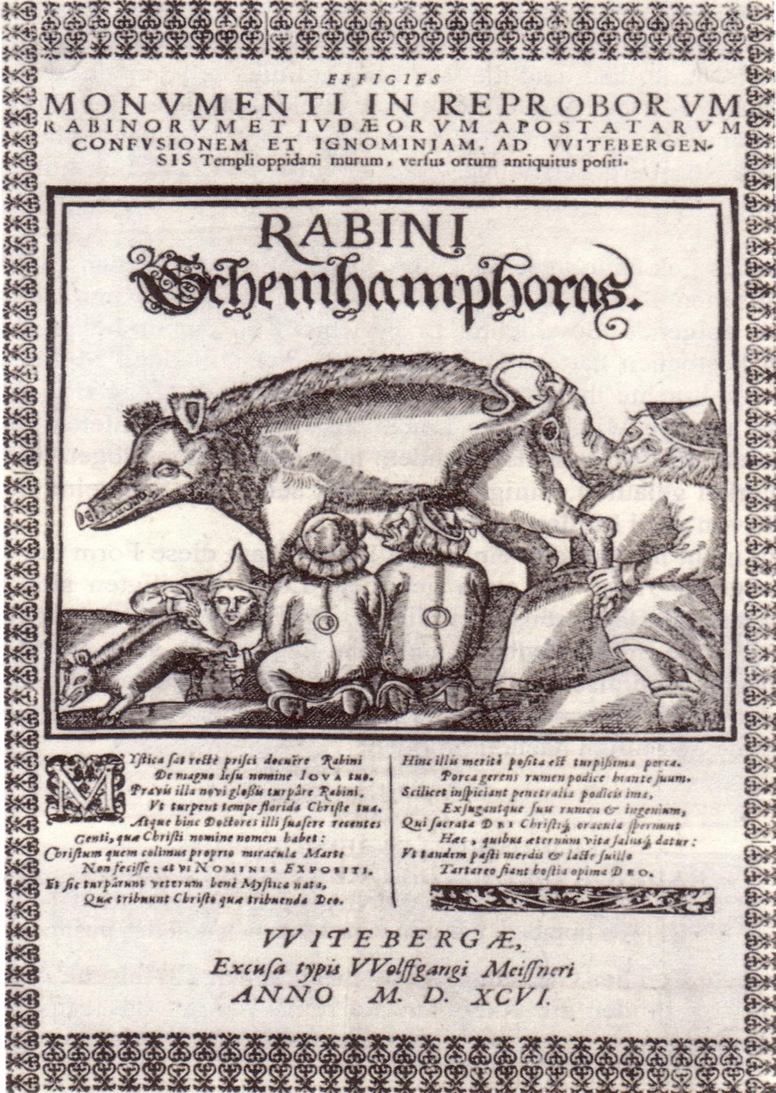

Slide 55
When Judas hanged himself and his bowels gushed forth, and, as happens in such cases, his ‎bladder also burst, the Jews were ready to catch the Judas-water and the other precious things, and ‎then they gorged and swilled on the merd among themselves, and were thereby endowed with ‎such a keenness of sight

Slide 56
Hungary, 1529 At Pezinok, Slovakia, it was charged that a nine-year-old boy had been bled to death, ‎suffering cruel torture; thirty Jews confessed to the crime and were publicly burned. The true facts of the ‎case were disclosed later, when the child was found alive in Vienna. He had been stolen by the accuser, ‎Count Wolf of

Slide 57
Bazin, as an easy but fiendish means of ridding himself of his Jewish creditors at Bazin.‎
Kiev, Ukraine, Russia 1911 In Kiev, a Jewish factory manager, Mendel Beilis, was accused of murdering ‎a Christian child and using his blood in matzos. He was acquitted by an all-Christian jury after a ‎sensational trial in 1913.‎

Slide 58
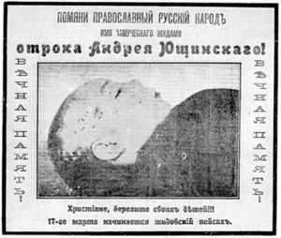
Antisemitic flier in Kiev, 1910:
"Christians, take care of your
children!!! It will be Jewish Passover
on ‎March 17.‎

Slide 59
Kielce, Poland July 4, 1946, The Kielce pogrom against Holocaust survivors in Poland was sparked by ‎an accusation of blood libel. resulted in 37 Polish Jews being murdered out of about 200 Holocaust ‎survivors who had returned home after World War II, fourteen months after the end of World War II, ‎shocking the Jews in Poland and the international community. ‎

Slide 60
Six months prior to the Kielce pogrom, during the Hanukkah celebration, a hand grenade had been thrown ‎into the local Jewish community headquarters. The Jewish Community Council had approached the ‎Bishop of Kielce, Czesław Kaczmarek, requesting him to admonish the Polish population to refrain from ‎attacking the Jews. The Bishop refused this request, replying

Slide 61
that "as long as the Jews concentrated upon ‎their private business Poland was interested in them, but at the point when Jews began to interfere in ‎Polish politics and public life they insulted the Poles’ national sensibilities." ‎

Slide 62
On July 1, 1946, an eight-year old Polish boy, Henryk Błaszczyk, was reported missing by his father ‎Walenty. Two days later, the boy, his father and one of their neighbors went to a local police station ‎where Henryk falsely claimed that he had been kidnapped by Jews (years later, shortly before his death in ‎‎1990s, he said

Slide 63
he was told to lie by his father and the men from the secret police). Henryk accused the ‎Jews of killing children for their blood and keeping the bodies in the cellar of the Kibbutz (Jewish ‎socialist collective community) on Planty Street, among other alleged horrors.‎

Slide 64
Multiple branches of the Syrian government, including the Damascus Police Command and the Department of Antiquities and Museums, the security ministry, the culture ministry, created an anti-Semitic television TV series called Ash-Shatat ("The Diaspora".) This series originally aired in Syria and in Lebanon late

Slide 65
2003, and was broadcast by Al-Manar, a satellite television network owned by Hezbollah. This TV series is based on the anti-Semitic forgery The Protocols of the Learned Elders of Zion, shows the Jewish people as engaging in a conspiracy to rule the world, and presents Jews as people who murder Christian children, drain their blood, and use this blood to bake matzah.

Slide 66
In a twist on the libel of Jews using blood in matzah, a Passover food, in 2002, a Saudi newspaper claimed that Jews use blood in homentashn, triangular cookies eaten on the Jewish holiday of Purim.

Slide 67
A 2004 story from Iran speaks of Jewish doctors stealing organs of Palestinian children in Israeli hospitals.

Slide 68
At the end of April 2005, five boys, ages 9 to 12, in Krasnoyarsk (Russia) disappeared. In May 2005, their burnt bodies were found in the city sewage. Some Russian nationalist groups claimed that the children were murdered by a Jewish sect with a ritual purpose.

Slide 69
Nationalist M. Nazarov, one of the authors of "The Letter of Five Hundred" alleges "the existence of a 'Hasidic sect', whose members kill children before Passover to collect their blood."

Slide 70
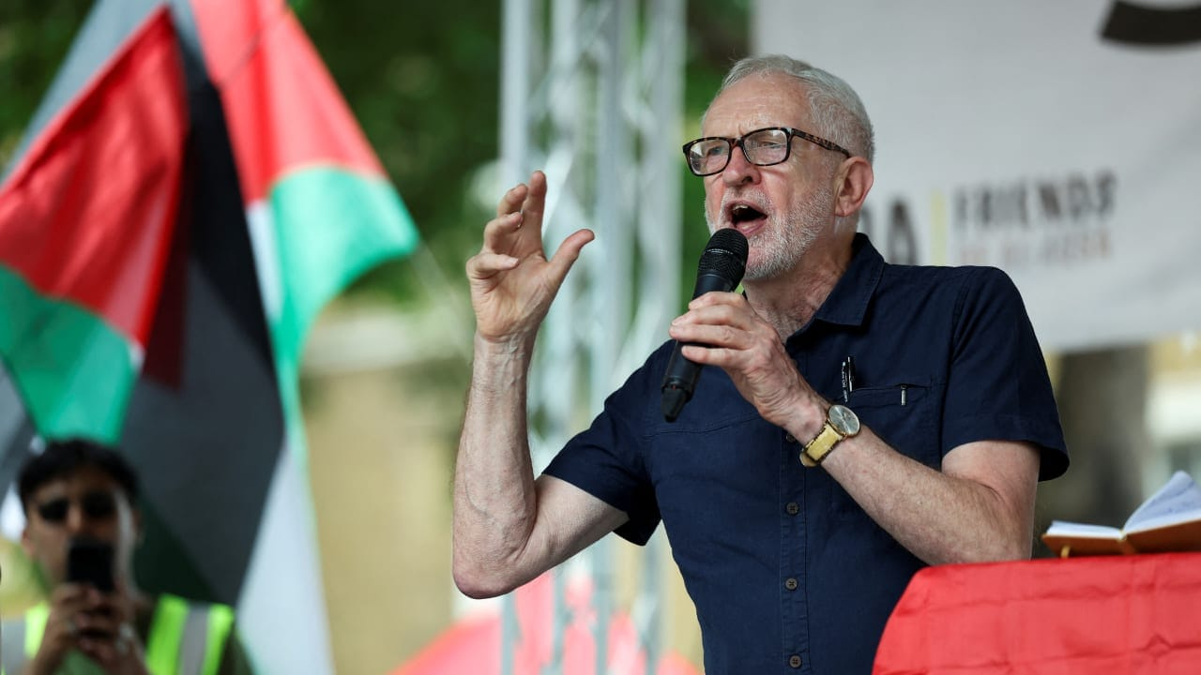
Former UK
Labour leader
Jeremy Corbyn
Notes:
FORMER UK Labour leader Jeremy Corbyn speaks at a pro-Palestinian rally in London last month. He has congratulated Zohran Mamdani on his New York City mayoral primary win.(photo credit: ISABEL INFANTES/REUTERS)

Slide 71
Jeremy Corbyn repeats claim Israel 'harvested organs' of Gazans. The Israeli Embassy in London rejected the allegations by the former British Labour Party leader, describing them as recycled smears and blood libels.
Notes:
https://www.jpost.com/diaspora/antisemitism/article-888080?utm_source=activetrail&utm_medium=email&utm_campaign=February262026

Slide 72
Carlson claimed that Trump is operating under the direction of Israel. He is being terribly insulting to the president of the United States, the vice president of the United States, and this administration to the American people and he’s being downright antisemitic to the Jews of this country,” Michael Leiter, Israeli Ambassador to the U.S continued.
Notes:
https://nypost.com/2026/02/27/world-news/tucker-carlsons-antisemtic-ramblings-bordering-on-pornography-says-israel-ambassador/

Slide 73
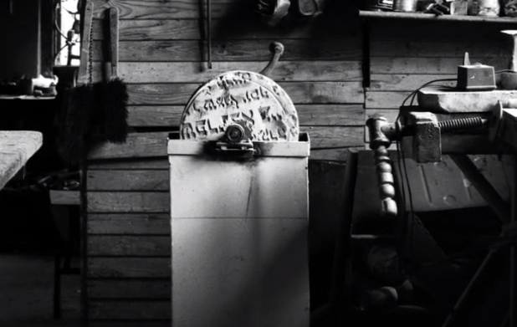
Notes:
From the movie Among Neighbors: The Story of Pelagia Radecka and Yoav Potash's Exploration of Polish-Jewish Relations During the Holocaust

Slide 76
Purim: Lies and Life Ester 3.8-11
Haman’s slander of the Jewish
people is the book plot basis.
2. Other slanders of the Jews
3. Reversal on Haman
4. Reversals the Norm

Slide 77
^{Ester 4.15-17} Ester had them return this answer to Mordekhi: “Go, assemble all the Jews to be found in Shushan, and have them fast for me, neither eating nor drinking for three days, night and day; also, I and the girls attending me will fast the same way.

Slide 78
^{Ester 4.15-17} Then I will go in to the king, which is against the law; and if I perish, I perish.” Then Mordekhi went his way and did everything Ester had ordered him to do.

Slide 79
Relief from slanderers comes through prayer and fasting, and truth.

Slide 80
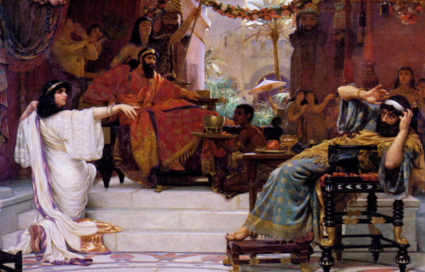

Slide 81
^{Yn 8.31-32} So Yeshua said to the Judeans who had trusted him, “If you obey what I say, then you are really my talmidim, you will know the truth, and the truth will set you free.

Slide 82
^{Eph 4.15-16} speaking the truth in love, we will in every respect grow up into him who is the head, the Messiah. Under his control, the whole body is being fitted and held together by the support of every joint, with each part working to fulfill its function; this is how the body grows and builds itself up in love.

Slide 85
Purim: Lies and Life Ester 3.8-11
Haman’s slander of the Jewish
people is the book plot basis.
2. Other slanders of the Jews
3. Reversal on Haman
4. Reversals the Norm

Slide 86
^{Ro 7.22-25} For in my inner self I completely agree with God’s Torah; but in my various parts, I see a different “torah,” one that battles with the Torah in my mind and makes me a prisoner of sin’s “torah,”

Slide 87
^{Ro 7.22-25} which is operating in my various parts. What a miserable creature I am! Who will rescue me from this body bound for death? Thanks be to God [He will]! — through Yeshua the Messiah, our Lord!

Slide 88
^{Vayikra 18.5} You are to observe my laws and rulings; if a person does them, he will have life through them; I am Adoni.
Notes:
Good. Commandments for LIFE. Therefore health exemption, Pikuakh Nefesh. UltraOrthodox take their shift in hospitals. Firemen similarly.
Difficult…no one CAN observe the Torah perfectly.

Slide 89
^{Ro 10.5-9} For Moshe writes about the righteousness grounded in the Torah that “The person who does these things will attain life through them.”
Moreover, the righteousness grounded in trusting says
Notes:
No one can.

Slide 90
^{Ro 10.5-9} “Do not say in your heart, ‘Who will ascend to heaven?’” — that is, to bring the Messiah down — or, “‘Who will descend into Sh’ol?’” that is, to bring the Messiah up from the dead. What, then, does it say?“ The word is near you, in your mouth and in your heart.” —

Slide 91
^{Ro 10.5-9} “that is, the word about trust which we proclaim, namely, that if you acknowledge publicly with your mouth that Yeshua is Lord and trust in your heart that God raised him from the dead, you will be delivered.

Slide 92
Story of righteousness by faith in Israel…

Slide 93
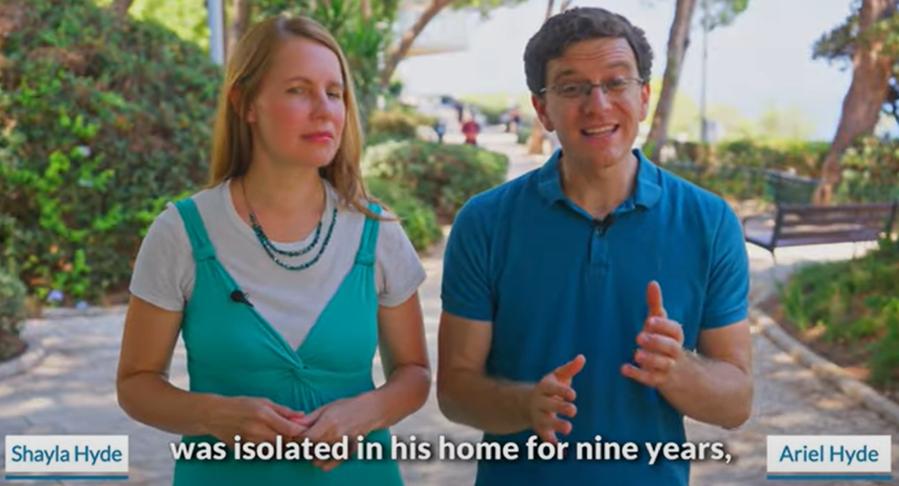
Notes:
We have hosted his mom, Carolyn Hyde, for a concert in our old building. We ALL ate in their home on a tour about 10 years ago.
https://youtu.be/hZAPuOThXpw
https://youtu.be/oIbGl5GwNvw

Slide 94
^{Ester 9.20-22} Mordekhi recorded these events and sent letters to all the Jews in all the provinces of King Akhashverosh, both near and far, instructing them to observe the fourteenth day of the month of Adar and the fifteenth day, every year, [to commemorate]

Slide 95
^{Ester 9.20-22} the days on which the Jews obtained rest from their enemies and the month which for them was turned from sorrow into gladness and from mourning into a holiday; they were to make them days of celebrating and rejoicing, sending portions [of food] to each other and giving gifts to the poor.

Slide 96
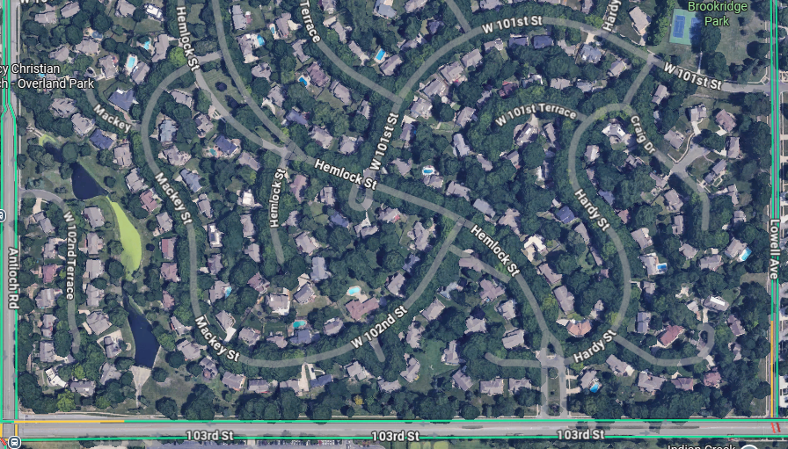
Mishloakh Manot
Notes:
If you go this afternoon and are condemned that it is a day or two early, note…

Slide 97



Slide 98
Another reversal…

Slide 99
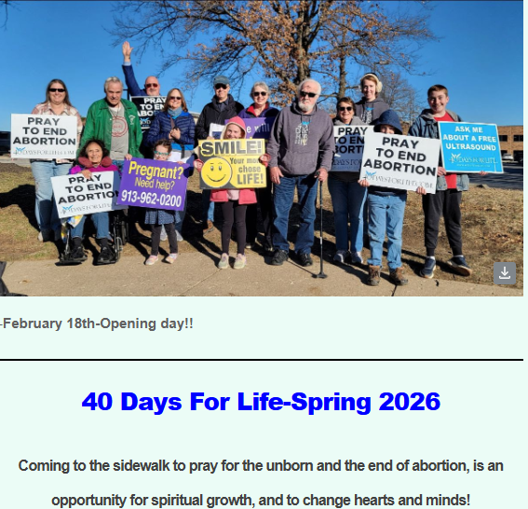
Tuesday, Mar 10

Slide 100
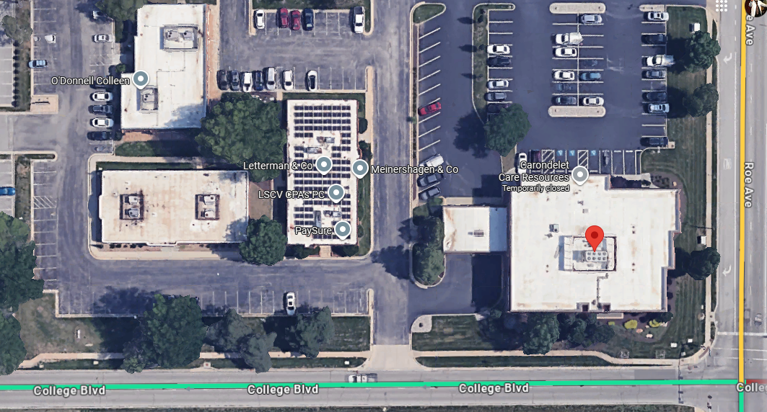
Tuesday, Mar 10

Slide 101
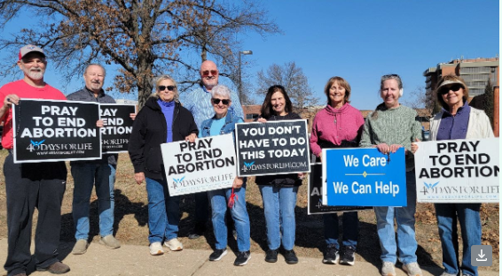
Tuesday, Mar 10
Notes:
February 19th- So many churches represented on this day!!
Left to right: Rob Stickney - Holy Spirit Catholic Church. Ron/Cathy Anielak - St Robert Bellarmine Catholic. Allen McLain - Kingdom Living Messianic Congregation. Judy Newkirk - St. Robert Bellarmine, Linda Linder - St. Robert Bellarmine, Terri Bryant - St. Robert Bellarmine.
Annie Bang - St. John La Lande, Donna Harris - St. John La Lande

Slide 102
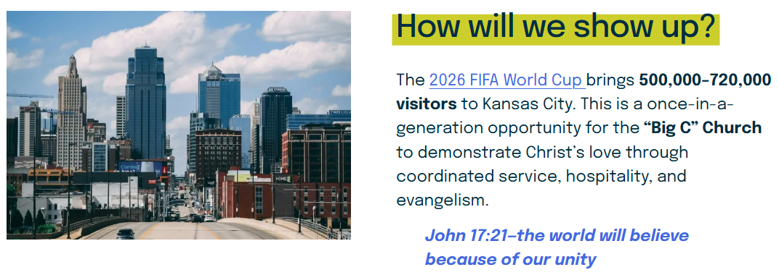
June 16- July 4
Yeshua

Slide 103
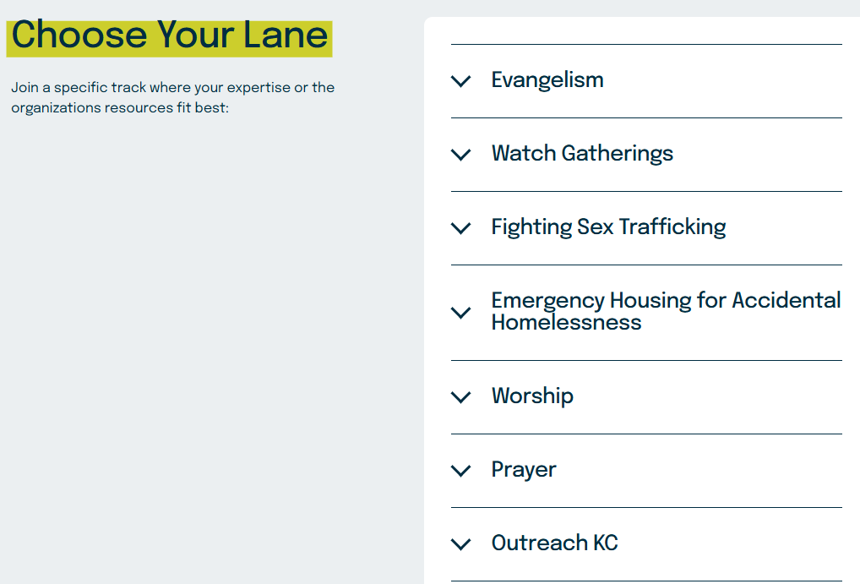
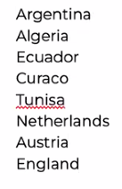
Tunisia
Notes:
https://www.unitekc.org/world-cup
https://victorybeyondthecup.com/

Slide 104
The best reversal…

Slide 105
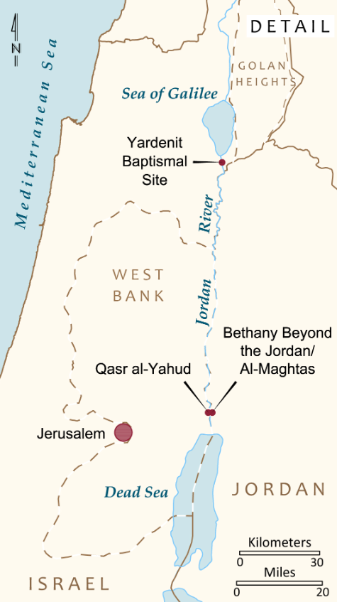
November 15 - Covenant and Renewal in the Jordan Valley
Today, we get an early start! After breakfast, visit Beit She'an, a major Roman city. Continue to Qasr al-Yahud, the traditional site of Yeshua's immersion by John

Slide 106
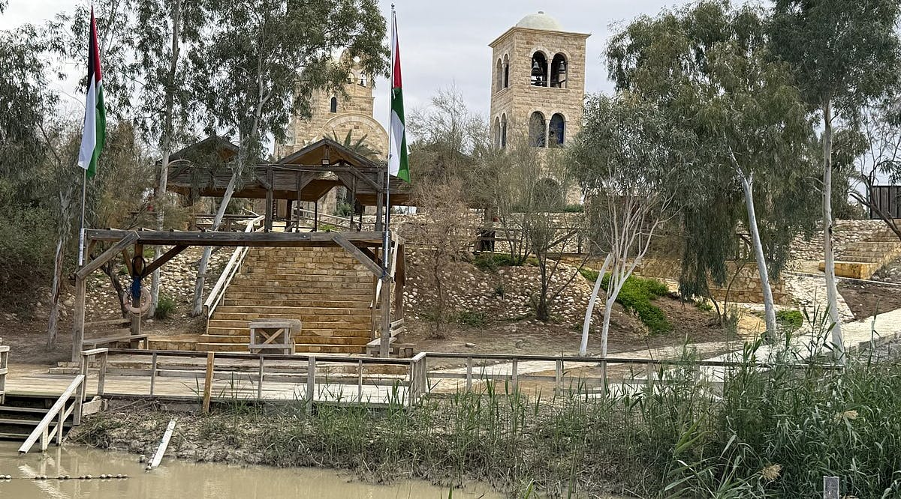
Qasr-al-Yahud immersion
site reopens after
nis 25 million facelift
Notes:
https://vfinews.com/news/us-evacuates-embassy-staff-from-lebanon-as-iran-tensions-intensify-hamas-refuses-to-disarm/qasr-al-yahud-baptismal-site-reopens-after-nis-25-million-facelift?utm_source=VFI+News+-+English&utm_campaign=f96c05737a-EMAIL_CAMPAIGN_2026_02_27_06_10&utm_medium=email&utm_term=0_c414809724-f96c05737a-148559991&mc_cid=f96c05737a&mc_eid=UNIQID

Slide 108
Purim: Lies and Life Ester 3.8-11
Haman’s slander of the Jewish
people is the book plot basis.
2. Other slanders of the Jews
3. Reversal on Haman
4. Reversals the Norm

