Slide 1
Happy π pi Day
3/14 March 14
mathematical constant, approximately equal to 3.14159, the ratio of a circle's circumference to its diameter.

Slide 2
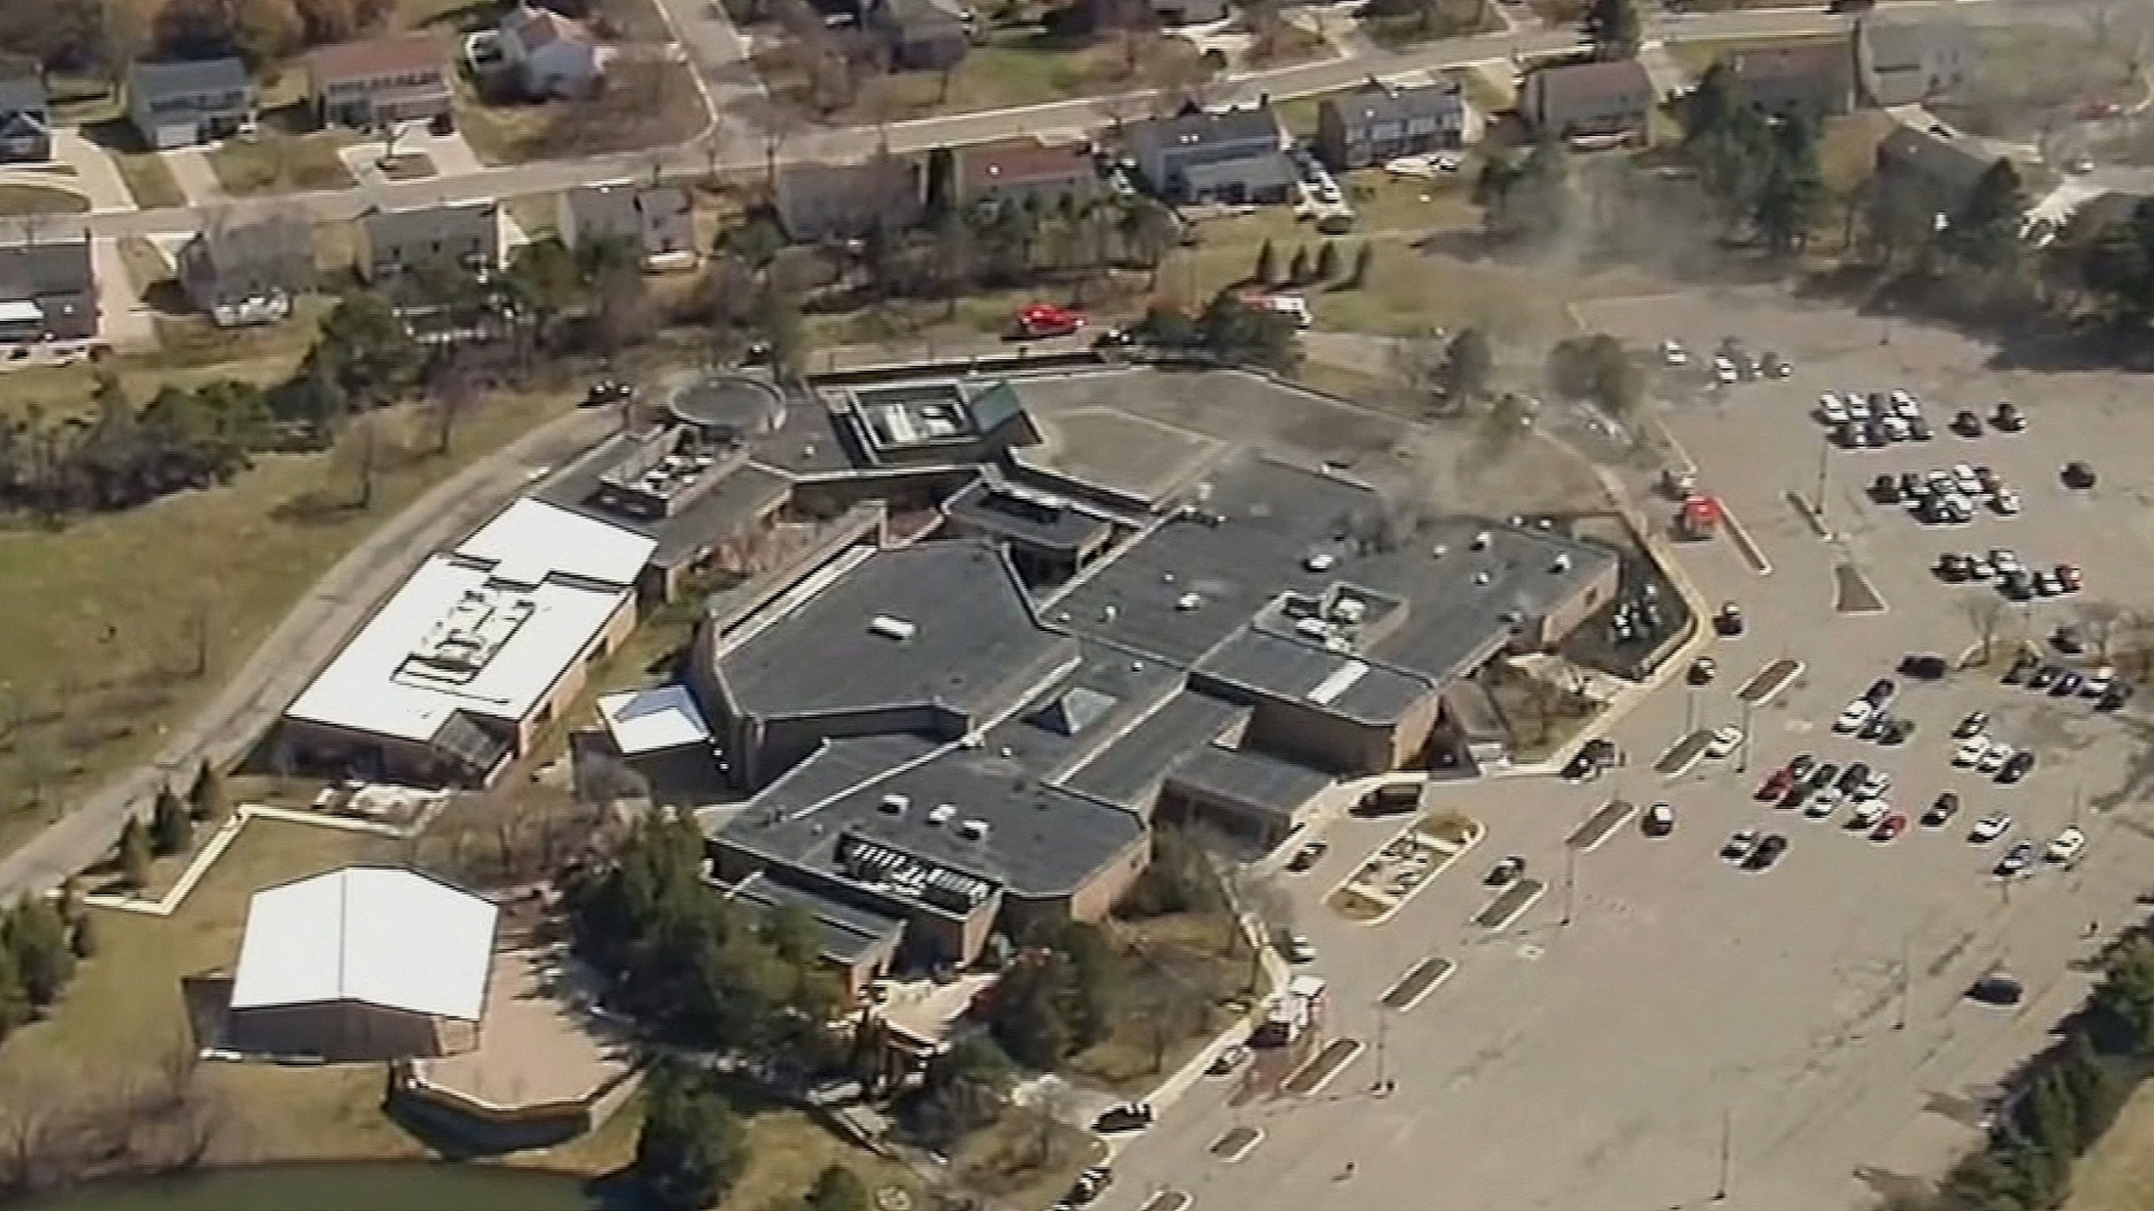
Active Shooter Reported at
Temple Israel in West Bloomfield
After Vehicle Crashes Into Building
Notes:
My cousin Judy lived in MI and attended there for many simkhas, she just told me.
Smoke apparently from the vehicle on fire.

Slide 3
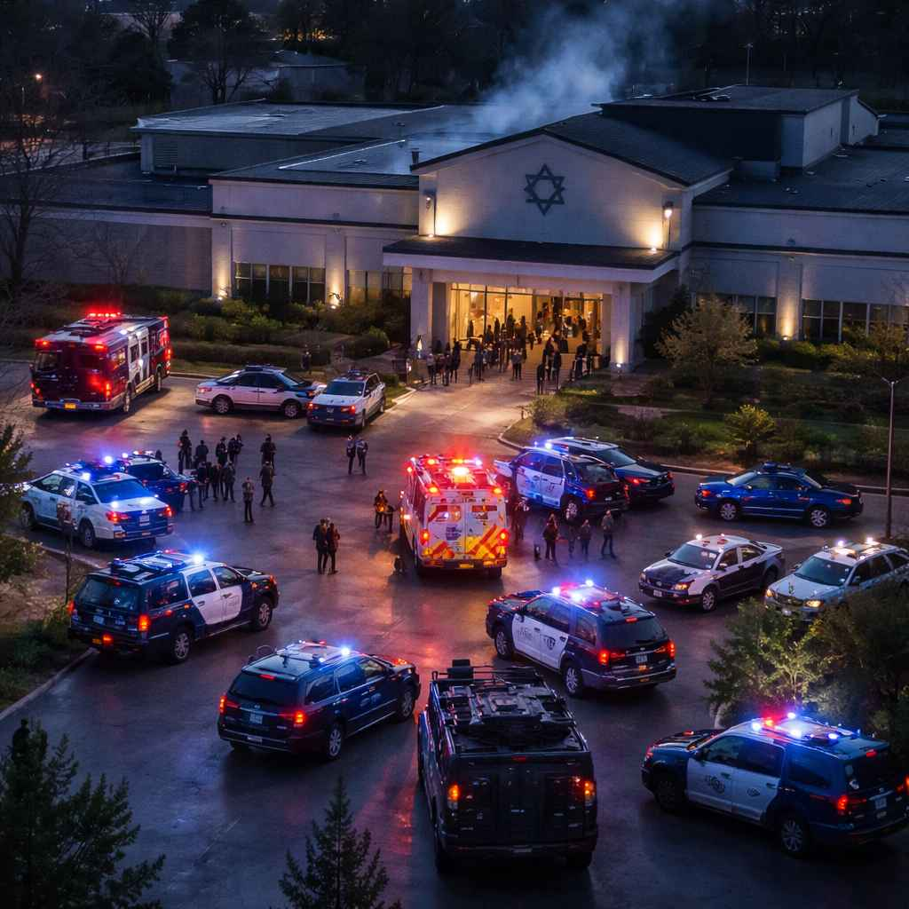
Temple Israel, Bloomfield, MI
Notes:
https://swikblog.com/wp-content/uploads/2026/03/temple_israel_detroit_incident_compressed.jpg
I’m not sure if the invader crashed through the doors that you see. We have bollards protecting our glass doors, but may get more.

Slide 4
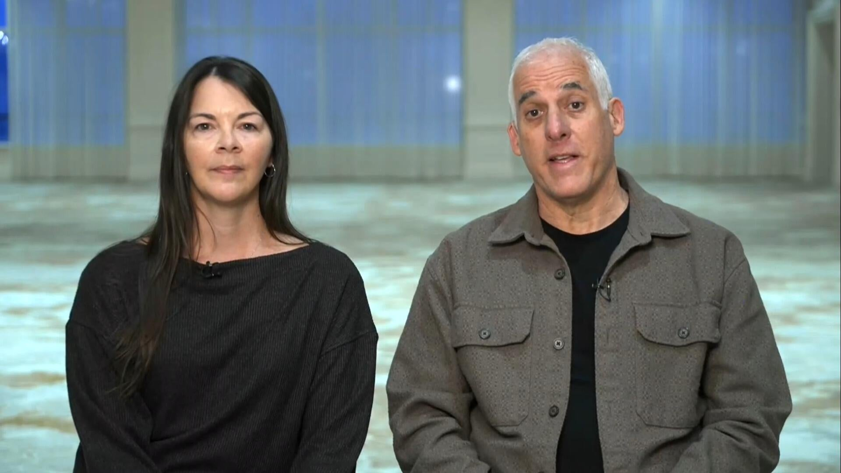
Rabbi Josh Bennett of Temple Israel
and Cassi Cohen, a staff member
Notes:
https://assets3.cbsnewsstatic.com/hub/i/2026/03/13/eada9ab0-470c-4f45-814d-963bad062377/cbsn-fusion-temple-israel-rabbi-staff-say-they-immediately-knew-that-something-was-wrong-credit-training-thumbnail.jpg

Slide 5
who were inside at the time, speak to "CBS Mornings" about the attack at the Michigan synagogue. The two credit the security training of the staff, saying "we know that these moments can happen to us, but we will always be prepared."
Notes:
https://assets3.cbsnewsstatic.com/hub/i/2026/03/13/eada9ab0-470c-4f45-814d-963bad062377/cbsn-fusion-temple-israel-rabbi-staff-say-they-immediately-knew-that-something-was-wrong-credit-training-thumbnail.jpg

Slide 6
In a moment that could have ended in tragedy, two rabbis from Temple Israel said that preparation and training helped ensure that “everything went right” during the March 12 attack on the Reform congregation in the western suburbs of Detroit.
Notes:
https://www.jns.org/everyone-knew-what-to-do-michigan-synagogues-rabbis-credit-training-security-after-attack/?utm_campaign=Daily%20Syndicate%20Emails&utm_medium=email&_hsenc=p2ANqtz-81yhD19wBiwSZ-LIekXqsbHGxg7btyfhPByunl6TVTE7IL4Ta4tWXypb1kruEl9_qiphWYP17C1Oz-UQ3Ken4Ndk2AZw&_hsmi=130970825&utm_content=130970825&utm_source=hs_email

Slide 7
Rabbi Josh Bennett, who has been a member of the congregation’s clergy since 1994, told JNS he felt “grateful and a little bit overwhelmed,” adding that “because of our preparedness and because of the heroic actions of our team, we are on the good side of this story.”
Notes:
https://www.jns.org/everyone-knew-what-to-do-michigan-synagogues-rabbis-credit-training-security-after-attack/?utm_campaign=Daily%20Syndicate%20Emails&utm_medium=email&_hsenc=p2ANqtz-81yhD19wBiwSZ-LIekXqsbHGxg7btyfhPByunl6TVTE7IL4Ta4tWXypb1kruEl9_qiphWYP17C1Oz-UQ3Ken4Ndk2AZw&_hsmi=130970825&utm_content=130970825&utm_source=hs_email

Slide 8
“When you are prepared, and you have relationships, and you have the program in place, the outcome does not have to be tragic,” he said. “We’re never going to remove evil from the world, but we are going to stand strong against it.”

Slide 9
Rabbi Jennifer Kaluzny, who has served on Temple Israel’s clergy since 2004, told JNS it was “a terrifying experience and also a miracle.”
Notes:
https://www.jns.org/everyone-knew-what-to-do-michigan-synagogues-rabbis-credit-training-security-after-attack/?utm_campaign=Daily%20Syndicate%20Emails&utm_medium=email&_hsenc=p2ANqtz-81yhD19wBiwSZ-LIekXqsbHGxg7btyfhPByunl6TVTE7IL4Ta4tWXypb1kruEl9_qiphWYP17C1Oz-UQ3Ken4Ndk2AZw&_hsmi=130970825&utm_content=130970825&utm_source=hs_email

Slide 10
“Everyone who was trained to do what they were supposed to do did what they were supposed to do, but it was still a miracle that everyone came out alive today,” she said.
Notes:
https://www.jns.org/everyone-knew-what-to-do-michigan-synagogues-rabbis-credit-training-security-after-attack/?utm_campaign=Daily%20Syndicate%20Emails&utm_medium=email&_hsenc=p2ANqtz-81yhD19wBiwSZ-LIekXqsbHGxg7btyfhPByunl6TVTE7IL4Ta4tWXypb1kruEl9_qiphWYP17C1Oz-UQ3Ken4Ndk2AZw&_hsmi=130970825&utm_content=130970825&utm_source=hs_email

Slide 11
Kaluzny said she soon learned that security personnel had confronted and neutralized the attacker while staff followed emergency procedures practiced many times before.

Slide 12
“Everything went right,” she said. “Our teachers remained calm. They followed exactly what their training was. Our security guards knew exactly what to do.”

Slide 13
“The security people ran towards the problem. They ran towards what everyone else runs away from,” she added. “And because everyone was trained and vigilant and everyone knew what to do, it went right.”

Slide 14
So, what about us?

Slide 15

Notes:
Wednesday, Mar 11, I was in a local clergy meeting with Clint Hall of City Wide Prayer, and he hosted the Regional Security Advisor of SCN.

Slide 16
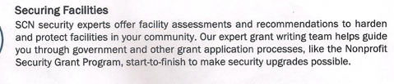
Notes:
So, I contacted him and we have their Regional Security Advisor coming to our building in mid to late April.
Also, we need to practice our security alarm. You are about to hear it, and if you can, just drop in place, except for the armed security people who will move toward the [this time] imaginary invader who is at the lobby door.
So, no one panic, but 1, 2, 3…

Slide 17


Slide 18

Radiant Righteousness
and Accusations
Radiant believers
Wrecking the radiance
Applications

Slide 19
Radiant Righteousness
and Accusations
Radiant believers
Wrecking the radiance
Applications

Slide 20
^{Yeshayahu /Isaiah 62.1-4} For Tziyon’s sake I will not be silent, for Yerushalayim’s sake I will not rest,
until her vindication shines out brightly and her salvation like a blazing torch.

Slide 21
^{Yeshayahu /Isaiah 62.1-4} The nations will see your vindication and all kings your glory. Then you will be called by a new name which Adoni himself will pronounce. You will be a glorious crown in the hand of Adoni, a royal diadem held by your God.

Slide 22
^{Yeshayahu /Isaiah 62.1-4} You will no longer be spoken of as ‘Azuvah [Abandoned] or your land be spoken of as ‘Sh’mamah [Desolate]; rather, you will be called Heftzi-Vah [My-Delight-Is-In-Her]
Notes:
Set to music in Hebrew at
https://www.youtube.com/watch?v=-NqbtkM4hTs
So, I was listening to this YouTube from Jerusalem, and felt the download that THIS is what the congregation should be like. Are we?

Slide 23
Expounded reading
Notes:
These are intoxicating words.
I am still the liquid love effect.

Slide 24

^{Yeshayahu /Isaiah 62.1-4} For Tziyon’s sake I will not be silent, for Yerushalayim’s sake I will not rest,
until her vindication shines out brightly
נֹגַהּ nogah: Brightness, radiance, light, splendor
Notes:
Silent: command Sheket!!
Continual, unending, passionate prayer for THIS.
Say “Nogah” Next few slides word study on this word, Nogah.

Slide 25
Across the Hebrew scriptures, נֹגַהּ marks the effulgence that surrounds the Lord when He manifests Himself. David sings, “Out of the brightness before Him coals of fire flamed forth” (2 Sam 22:13; Psalm 18:12), identifying the blinding radiance that envelops the Divine Warrior.
Notes:
https://biblehub.com/hebrew/5051.htm

Slide 26
Ezekiel’s inaugural vision multiplies the image: the storm-cloud, the wheels, and the cherubim are all “like the appearance of glowing metal, as the appearance of fire, and there was brightness נֹגַהּ nogah all around” (Ezekiel 1:4, 13, 27-28; 10:4).
Notes:
https://biblehub.com/hebrew/5051.htm

Slide 27
In these versesנֹגַהּ accents transcendence—an otherworldly splendor that both reveals and conceals, assuring the seer that the One encountered is the holy, covenant-keeping God of Israel.
Notes:
https://biblehub.com/hebrew/5051.htm
Review:

Slide 28
^{Yeshayahu /Isaiah 62.1-4} For Tziyon’s sake I will not be silent, for Yerushalayim’s sake I will not rest,
until her vindication shines out brightly
נֹגַהּ nogah: Brightness, radiance, light, splendor

Slide 29

^{Yeshayahu /Isaiah 62.1-4} …and her salvation like a blazing torch.
לַפִּיד torches, torch, burning torches, lightning flashes

Slide 30
^{Yeshayahu /Isaiah 62.1-4} The nations will see your vindication and all kings your glory.
כָּבוֹד kavowd: Glory, honor, splendor, wealth

Slide 31

^{Yeshayahu /Isaiah 62.1-4} Then you will be called by a new name which Adoni himself will pronounce.
נָקַב nakav to puncture, literally (to perforate, with more or less violence) or figuratively (to specify, designate, libel)
Notes:
[The letter nun נ is a weak letter and drops out in certain conjunctions, grammar forms.]
There is an implication that to have this new name and glorious ramifications, there is a piercing, puncturing, perforate, with more or less violence.
It was costly painful for G-d to get Israel to this place. I’m talking, of course, about the piercing of Messiah to bring Israel, and those grafted in, to glory.

Slide 32

^{Yeshayahu /Isaiah 62.1-4}
You will be a glorious crown in the hand of Adoni,
a royal diadem held by your God.
diadem, hood, mitre, turban,

Slide 33
^{Yeshayahu /Isaiah 62.1-4} You will no longer be spoken of as ‘Azuvah [Abandoned] or your land be spoken of as ‘Sh’mamah [Desolate]; rather, you will be called Heftzi-Vah [My-Delight-Is-In-Her]
Notes:
These very words were in the mouth of Mark Twain about Israel, then Ottoman Turkish Palestine, in 1867.

Slide 34
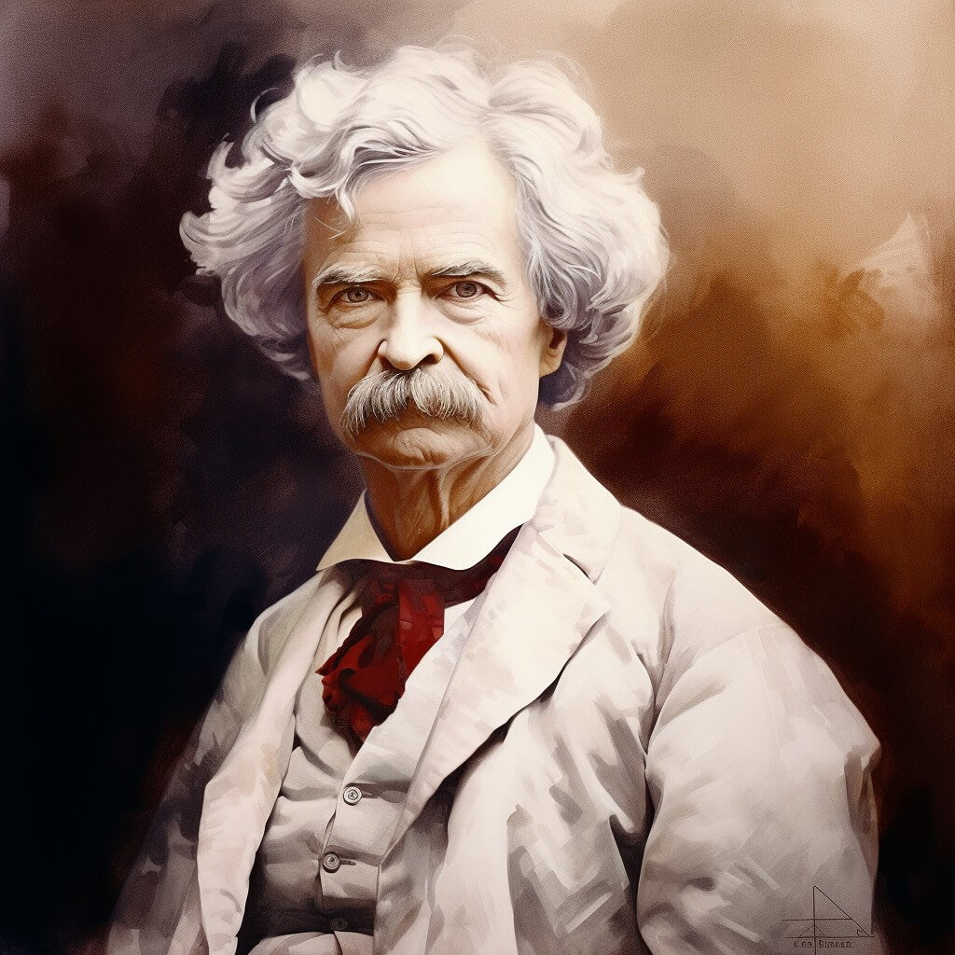
Mark Twain, American author and humorist
1835-1910
Notes:
https://www.uhashtag.com/wp-content/uploads/2024/06/Mark-Twai.jpg

Slide 35
Upon arriving in Ottoman Turkish Palestine in 1867, Twain was stunned by the barrenness of the land. His descriptions portray an abandoned landscape, devoid of agriculture and people, a sharp contrast to later claims of a once-thriving Arab society.
Notes:
https://zionist.org/history-of-zionism/mark-twains-travels-to-palestine/

Slide 36
Quotes from “The Innocents Abroad” (1869):
👉 “A desolate country whose soil is rich enough, but is given over wholly to weeds… a silent mournful expanse… a desolation… we never saw a human being on the whole route.” (p. 361-362)
Notes:
https://zionist.org/history-of-zionism/mark-twains-travels-to-palestine/

Slide 37
Quotes from “The Innocents Abroad” (1869):
👉 “No landscape exists that is more tiresome to the eye than that which bounds the approaches to Jerusalem.”
Notes:
https://zionist.org/history-of-zionism/mark-twains-travels-to-palestine/

Slide 38
👉 “There is not a solitary village throughout its whole extent – not for thirty miles in either direction. There are two or three small clusters of Bedouin tents, but not a single permanent habitation. One may ride ten miles, hereabouts, and not see ten human beings.”
Notes:
https://zionist.org/history-of-zionism/mark-twains-travels-to-palestine/

Slide 39
👉 “Palestine sits in sackcloth and ashes… The spell of a curse that has withered its fields and fettered its energies… Palestine is desolate and unlovely.”
Notes:
https://zionist.org/history-of-zionism/mark-twains-travels-to-palestine/

Slide 40
Summary: Israel, land [and people] will change from
Desolation
Abandonment
Transformed by piercing to:

Slide 41
Radiant splendor of integrity
Blazing lightning flash salvation
Nations will see GLORY
Role as a royal turban, tiara
Notes:
Glorious role for Israel and those grafter in.
Are we as a congregation desolate and barren and abandoned by G-d? Or the above?
Analogous to Yeshua’s prayer

Slide 42
^{Yn 17.22-23} The glory which you have given to me, I have given to them; so that they may be one, just as we are one — I united with them and you with me, so that they may be completely one, and the world thus realize that you sent me, and that you have loved them just as you have loved me.
Notes:
Do we, as a community, always live up to this, to convict the world.
How do receive from G-d, and how do we treat each other?
What is the main killer of glory in our community?

Slide 44
Radiant Rigteousness
and Accusations
Radiant believers
Wrecking the radiance
Applications

Slide 45
^{Gal 5.14-15} For the whole of the Torah is summed up in this one sentence: “Love your neighbor as yourself”; but if you go on snapping at each other and tearing each other to pieces, watch out, or you will be destroyed by each other!

Slide 46
Most attacks are the work of HaSatan, the Adversary, accuser:
^{Rev 12.10} The accuser of our brothers and sisters—the one who accuses them before our God day and night.
Notes:
It’s easy, if we have wounds, to live in an environment of accusations.

Slide 47

Accusations of HaSatan:
Accuses G-d to us
Accuses us to G-d
Accuses other people to us
Accuses us to other people
Accuses us to ourselves

Slide 48
Accusations of HaSatan:
Accuses G-d to us
Accuses us to G-d
Accuses other people to us
Accuses us to other people
Accuses us to ourselves

Slide 49
Accuses G-d to us
^{Beresheet/Gen. 3.1-6} “Did God really say, ‘You must not eat from any tree in the garden’?”…“For God knows that when you eat from it your eyes will be opened,
Notes:
G-d accused of denying Hava and Adam insight, understanding

Slide 50
^{Beresheet/Gen. 3.1-6} “and you will be like God, knowing good and evil.”…the woman saw that the fruit of the tree was good for food and pleasing to the eye, and also desirable for gaining wisdom.”
Notes:
Accusation of denial of pleasure of taste and eye appeal, sensuality and ownership. Entitlement.

Slide 51
Do you ever feel G-d is unfair?
Not giving you what you are entitled to?
Notes:
Entitlement is a loaded word. We’re really not entitled to anything but the bread we get by the sweat of our face. Plus mercy if we’re not able to sweat.
But, easy to hear the accusation, “Not enough quantity or quality of bread, housing, car, medical care…”

Slide 52
Response:
Meditate on attributes of G-d in Messiah. High Holiday theme of Thirteen Attributes of Mercy.

Slide 53
^{Shmot/Ex 34.5-7} Adoni descended in the cloud, stood with him there and pronounced the name of Adoni. Adoni passed before him and proclaimed: “Adoni!!! Adoni is God,

Slide 54
^{Shmot/Ex 34.5-7} merciful and compassionate, slow to anger, rich in grace and truth; showing grace to the thousandth generation, forgiving offenses, crimes and sins; yet not exonerating the guilty.
Notes:
Zipporah Bennett has this set to music.
Again, HaSatan accuses G-d to us, in this case, to Yeshua.

Slide 55
^{Mtt 4.8-11} The Adversary took him up to the summit of a very high mountain, showed him all the kingdoms of the world in all their glory, and said to him, “All this I will give you [which you deserve] if you will bow down and worship me.”
Notes:
Here is an easy way to gain the Kingship you have coming to you. Much better than Your Father’s plan…of the execution torture stake. Sort of entitlement for Yeshua.

Slide 56
Response:
^{Mtt 4.8-11} “Away with you, Satan!” Yeshua told him, “For the Tanakh says, ‘Worship Adoni your God, and serve only him.’”
Notes:
Praise and worship are the greatest response to spiritual accusations of G-d, that your life is tooooo hard.

Slide 57
Accusations of HaSatan:
Accuses G-d to us
Accuses us to G-d
Accuses other people to us
Accuses us to other people
Accuses us to ourselves

Slide 58
Satan as accuser before God
Already in Tanakh (Zech 3:1; Job 1:6; 2:1)
Jewish tradition amplified this: he accused Israel day and night except on Day of Atonement
But here Yeshua’s victory silences him
Ancient system of accusers vs. advocates (1 Jn 2:1)
Notes:
By Craig Keener Messiah Conf lecture

Slide 59
^{Eyov 1.6-11} It happened one day that the sons of God came to serve Adoni, and among them came the Adversary…The Adversary answered Adoni, “Is it for nothing that Iyov fears God? You’ve put a protective hedge around him,

Slide 60
^{Eyov 1.6-11} his house and everything he has. You’ve prospered his work, and his livestock are spread out all over the land. But if you reach out your hand and touch whatever he has, without doubt he’ll curse you to your face!”

Slide 61
Response: Commit to Him --
^{Eyov/Job 13.15} Even if He kills me, I will hope in Him.
הֵן יִקְטְלֵנִי, לוֹ אֲיַחֵל;
קָטַלto kill, to exterminate, to destroy ; to criticize
יִחֵל to hope for, to await, to look forward to

Slide 62
Our lives are a saga of great warfare, glorifying G-d.
^{Eyov/Job 19.23} I wish my words were written down, that they were inscribed in a scroll, that, engraved with iron and filled with lead, they were cut into rock forever.
Notes:
They were, that’s why we’re reading them!

Slide 63
^{Eph 2.6-7} God raised us up with the Messiah Yeshua and seated us with him in heaven, in order to exhibit in the ages to come how infinitely rich is his grace, how great is his kindness toward us who are united with the Messiah Yeshua.
Notes:
Response to accusation, feeling abandoned by G-d?
Thank Him for your adverse circumstances. You are a hero to G-d

Slide 64
^{T’hillim / Ps 8.3} You established strength because of your foes, in order that you might silence the enemy and the avenger.

Slide 65
Accusations of HaSatan:
Accuses G-d to us
Accuses us to G-d
Accuses other people to us
Accuses us to other people
Accuses us to ourselves

Slide 66
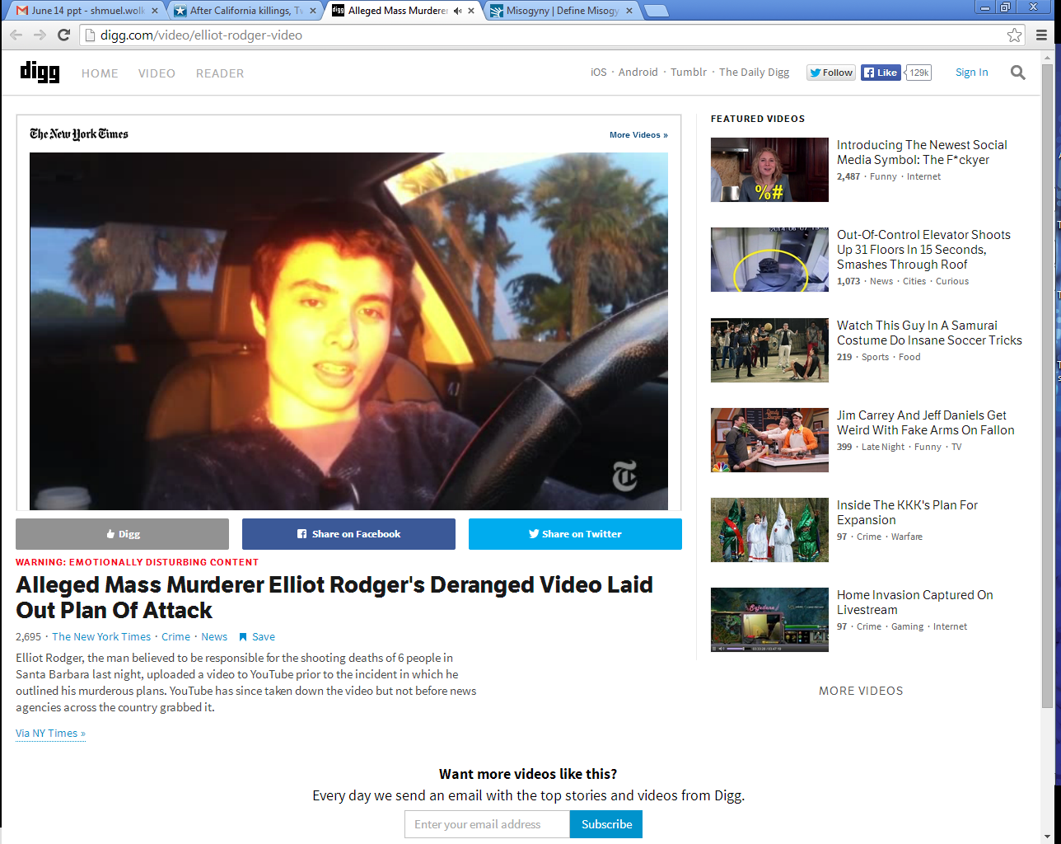
Elliot Roger in his BMW and
designer clothes, recording his
Plan of Retribution

Slide 67
His 144-page manifesto proclaimed, “I am going to enter the hottest sorority house of UCSB and I will slaughter every single spoiled,
Notes:
Univ CA Santa Barbara
Read more here: http://www.kansascity.com/news/local/article438881/After-California-killings-
Twitter%E2%80%99s-YesAllWomen-reveals-the-vast-extent-of-misogyny.html#storylink=cpy

Slide 68
stuck-up, blonde [chick] I see inside there, all those girls I’ve desired so much. They would have all rejected me.”
Notes:
Univ CA Santa Barbara
Read more here: http://www.kansascity.com/news/local/article438881/After-California-killings-
Twitter%E2%80%99s-YesAllWomen-reveals-the-vast-extent-of-misogyny.html#storylink=cpy

Slide 69
Elliot Rodger was the 22-year-old who on May 23, 2014, killed six University of California, Santa Barbara students and wounded 13 others before killing himself in a rampage ignited, at least in part, by his misogyny — an all-consuming hatred of women.
Notes:
That’s how the media describes it.
So superficial, and PC. Rather, believed a lie.
Read more here: http://www.kansascity.com/news/local/article438881/After-California-killings-
Twitter%E2%80%99s-YesAllWomen-reveals-the-vast-extent-of-misogyny.html#storylink=cpy

Slide 70
Misogyny noun hatred, dislike, mistrust of women
Rodger grew up in wealth. His father, Peter Rodger, is a photographer and director who worked on one of “The Hunger Games” movies. Some posit that Elliot Rodger’s belief that he was sexually overlooked emanates from an inflated sense of entitlement.
Notes:
Read more here: http://www.kansascity.com/news/local/article438881/After-California-killings-
Twitter%E2%80%99s-YesAllWomen-reveals-the-vast-extent-of-misogyny.html#storylink=cpy

Slide 71
Others point to a history of mental illness. They speak of his overt narcissism, laid bare on a foundation of feeling weak, like nothing, diminished and overlooked.
Notes:
“They would have all rejected me.” He believed
a lie.
Read more here: http://www.kansascity.com/news/local/article438881/After-California-killings-
Twitter%E2%80%99s-YesAllWomen-reveals-the-vast-extent-of-misogyny.html#storylink=cpy

Slide 72
Rodger, referring to himself as the “supreme gentleman,” said in his video, “I will take great pleasure in slaughtering all of you. You will finally see that I am, in truth, the superior one, the true alpha male.”
Notes:
“They would have all rejected me.” He believed
a lie.
Read more here: http://www.kansascity.com/news/local/article438881/After-California-killings-
Twitter%E2%80%99s-YesAllWomen-reveals-the-vast-extent-of-misogyny.html#storylink=cpy

Slide 73
I believe there is a guaranteed way to win in every conflict.
The winner is the first one to see and say:
“I was wrong in xxxx. Will you forgive me?”
No “you” statements. Only “I”
Notes:
Always works in marriage.
The most conflictive situation of my life, some of you were involved, I won one confrontation because I found a way to do this.

Slide 74
^{T’hillim/Ps 141.5-8} Let the righteous strike me, let him correct me; it will be an act of love. Let my head not refuse such choice oil.
Notes:
for I will keep on praying about their wickedness.
Righteous don’t always correct with love. But take it as one from G-d.

Slide 75
Accusations of HaSatan:
Accuses G-d to us
Accuses us to G-d
Accuses other people to us
Accuses us to other people
Accuses us to ourselves

Slide 76
^{Mishlei/Prov 16.28} A whisperer separates close friends.
וְנִרְגָּן מַפְרִיד אַלּוּף
נִרְגָּן complaining, grumbling
Notes:
This is almost inevitable in our community, since we are working for the redemption of Yisrael, which is the key to the redemption of the world!

Slide 77
Moshe accused
Ch 12, accused in regard to whom he married
Ch 14: giving them an impossible task: Giants
Ch 16: promoting himself to cohanut / priesthood

Slide 78
^{Bamidbar/Nu 16.1-3} Now [three groups]
Korach the son of Yitz'har, the son of K'hat, the son of Levi,
along with Datan and Aviram, the sons of Eli'av, and
On, the son of Pelet, descendants of Re'uven, took men and rebelled against Moshe.
Notes:
Analysis three groups
Proposed trial by ordeal of Leviim, with censers
With Datan and Aviram Moshe wanted to talk
On? Sages say his wise and righteous wife persuaded him to withdraw. Men: listen to the wise counsel of your wife. Almost always, she’s right. Almost.

Slide 79
^{Bamidbar/Nu 16.1-3} You take too much on yourselves! After all, the entire community is holy, every one of them. After all, the entire community is holy, every one of them and ADONI is among them. So why do you lift yourselves up above ADONI’s assembly?"
Notes:
This option is NOT usually available to us in our situations of accusation.

Slide 80
^{BaMidbar/Nu 16.28-31} Moshe said, "Here is how you will know that ADONI has sent me to do all these things and that I haven't done them out of my own ambition:

Slide 81
^{BaMidbar/Nu 16.28-31} if these men die a natural death like other people, only sharing the fate common to all humanity, then ADONI has not sent me. But if ADONI does something new -

Slide 82
^{BaMidbar/Nu 16.28-31} - if the ground opens up and swallows them with everything they own, and they go down alive to Sh'ol - then you will understand that these men have had contempt for ADONI ." The moment he finished speaking, the ground under them split apart -

Slide 83
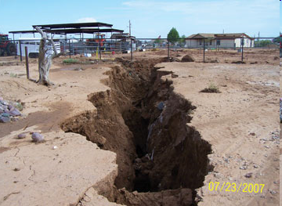

Slide 84
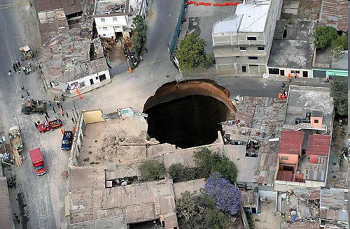
Notes:
Guatemala, also Florida sinkholes
It seems that this should address the issue of authority and justice. ~300 people died
This option is not usually available to us in situations of accusation.

Slide 85
Accusations of HaSatan:
Accuses G-d to us
Accuses us to G-d
Accuses other people to us
Accuses us to other people
Accuses us to ourselves

Slide 86
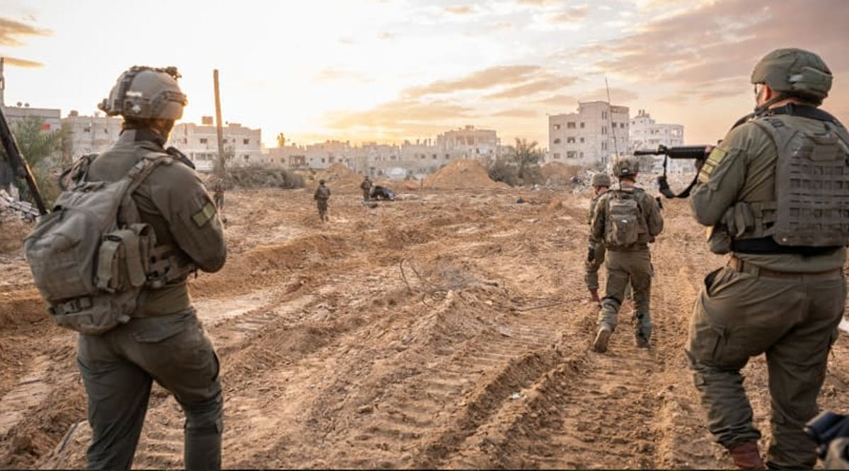
Notes:
https://vfinews.com/news/red-cross-rebukes-hamas-over-staged-hostage-body-h/279-idf-soldiers-attempted-suicide-since-start-of-

Slide 87
A report published on Tuesday, October 28, 2025, by the Knesset Research and Information Center found that from January 2024 through July 2025, 279 Israel Defense Forces soldiers attempted to take their own lives. 39 did take their own lives, which illuminates the scale of distress within the ranks nearly two years into the war.
Notes:
https://vfinews.com/news/red-cross-rebukes-hamas-over-staged-hostage-body-h/279-idf-soldiers-attempted-suicide-since-start-of-

Slide 88
^{Roman 8} Therefore, there is no longer any condemnation awaiting those who are in union with the Messiah Yeshua. Why? Because the Torah of the Spirit, which produces this life in union with Messiah Yeshua, has set me free from the "Torah" of sin and death…

Slide 89
^{Roman 8} For I am convinced that neither death nor life, neither angels nor other heavenly rulers, neither what exists nor what is coming, neither powers above nor powers below, nor any other created thing will be able to separate us from the love of God which comes to us through the Messiah Yeshua, our Lord.

Slide 90
Accusations are usually half truths because we all always could do better.

Slide 91
Accusations that are patently absurd don’t hurt at all. Usually laughable.

Slide 92
^{Mishlei/Prov 26.2 CEB} Like a darting sparrow, like a flying swallow, so an undeserved curse never arrives.
ESV Like a sparrow in its flitting, like a swallow in its flying, a curse that is causeless does not alight.
כַּצִּפּוֹר לָנוּד, כַּדְּרוֹר לָעוּף --כֵּן קִלְלַת חִנָּם לא תָבֹא.
Notes:
sparrow, as the word is sometimes rendered, leaves its nest and wanders from it; and flies here and there, and settles nowhere;
like Shimei's cursing David;
The Septuagint takes in both,
``so a vain curse shall not come upon any;''

Slide 93
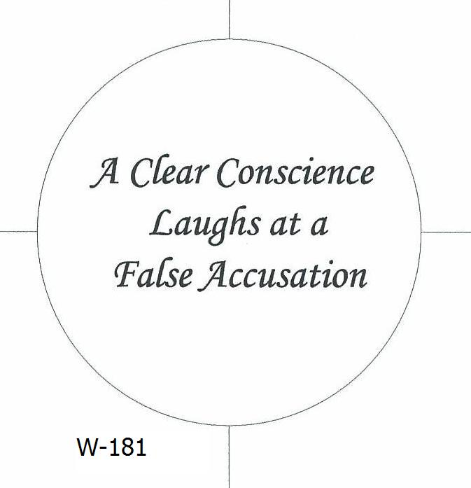

Slide 94
^{1 Cor. 4.3-5} And it matters very little to me how I am evaluated by you or by any human court; in fact, I don't even evaluate myself. I am not aware of anything against me, but this does not make me innocent. The one who is evaluating me is the Lord. So don't pronounce judgment prematurely, before the Lord comes;
Notes:
In this case, he deferred judgment to G-d

Slide 95
^{T’hillim / Ps 8.3} You established strength because of your foes, in order that you might silence the enemy and the avenger.

Slide 96
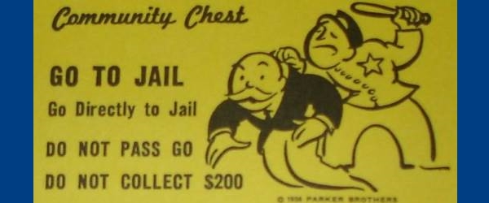
You are guilty!

Slide 97
^{Rev. 12.9-10} "Now have come God's victory, power and kingship, and the authority of his Messiah; because the Accuser of our brothers, who accuses them day and night before God, has been thrown out!
Notes:
Satan doesn’t care if accusations are true. Just loves to accuse, condemn. Difference between conviction of the Ruakh, gentle, intreatable, and accusations. But they sound and feel very similar, since HaSatan can transform himself into an angel of light.
Satan can imitate the light of G-d’s truth, but he cannot imitate the warmth of G-d’s love.

Slide 98
Accusations of HaSatan:
Accuses G-d to us
Accuses us to G-d
Accuses other people to us
Accuses us to other people
Accuses us to ourselves

Slide 100
Radiant Rigteousness
and Accusations
Radiant believers
Wrecking the radiance
Applications

Slide 101
Renounce accusations:
Accuses G-d to us
Accuses us to G-d
Accuses other people to us
Accuses us to other people
Accuses us to ourselves
Notes:
G-d is NOT unfair
We are NOT condemned before G-d in Messiah.
Other people are NOT against us. Find the charitable interpretation.
Love suffers long and is kind…thinks no evil; keeps no accounts of evil does not rejoice in iniquity, but rejoices in the truth; bears all things, believes all things, hopes all things, endures all things.;
4. What other people think of us is their problem
5.No condemnation now I dread, Yeshua and all in Him is mine.

Slide 102
No condemnation now I dread;
Yeshua, and all in Him, is mine!
Alive in him, my living Head,
and clothed in righteousness divine,
bold I approach th’eternal throne,
Notes:
https://www.trinitypsalterhymnal.org/hymns/and-can-it-be-that-i-should-gain/

Slide 103
and claim the crown, through Messiah, my own.
Amazing love! How can it be
that thou, my God, shouldst die for me?
Notes:
https://www.trinitypsalterhymnal.org/hymns/and-can-it-be-that-i-should-gain/

Slide 104
Renounce accusations:
Accuses G-d to us
Accuses us to G-d
Accuses other people to us
Accuses us to other people
Accuses us to ourselves
Notes:
G-d is NOT unfair
We are NOT condemned before G-d in Messiah.
Other people are NOT against us. Find the charitable interpretation.
Love suffers long and is kind…thinks no evil; keeps no accounts of evil does not rejoice in iniquity, but rejoices in the truth; bears all things, believes all things, hopes all things, endures all things.;
4. What other people think of us is their problem
5.No condemnation now I dread, Yeshua and all in Him is mine.

Slide 105
Israel is the place of His glory.

Slide 106
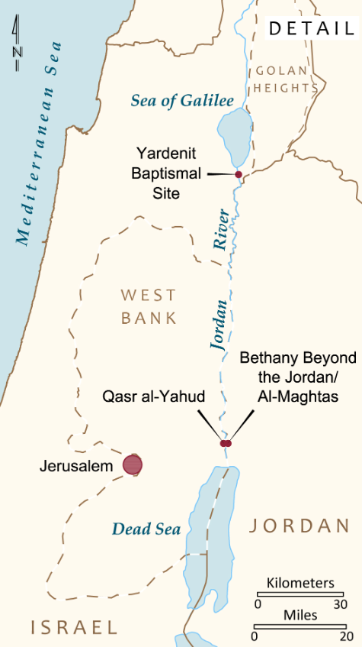
November 15 - Covenant and Renewal in the Jordan Valley
Today, we get an early start! After breakfast, visit Beit She'an, a major Roman city. Continue to Qasr al-Yahud, the traditional site of Yeshua's immersion by John

Slide 107
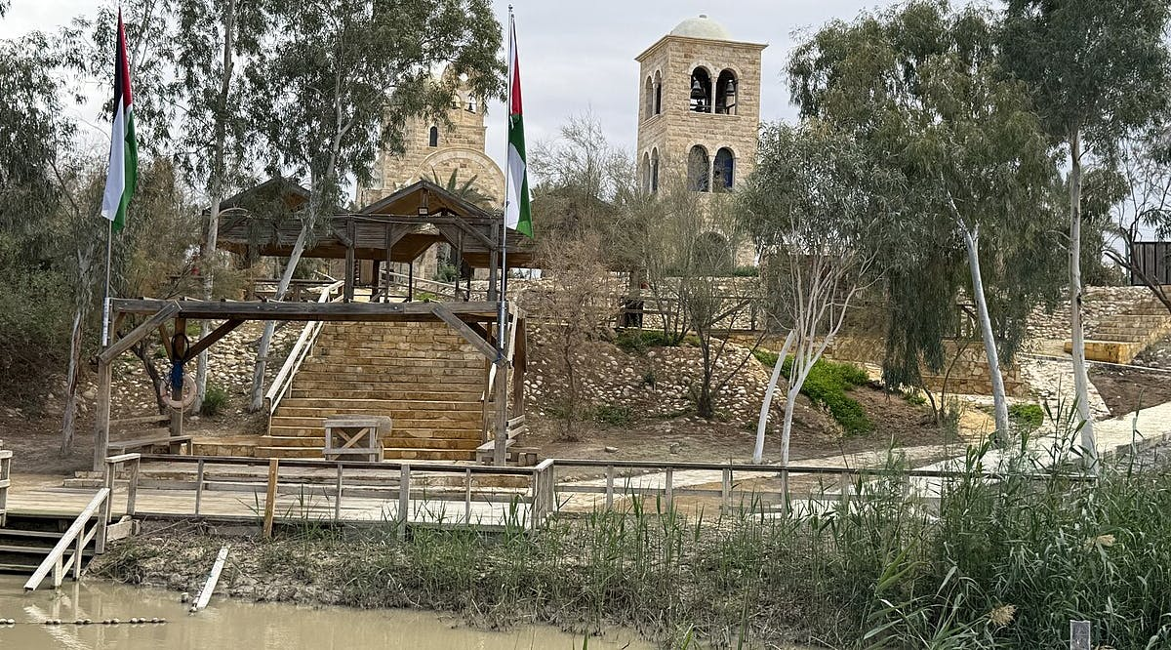
Qasr-al-Yahud immersion
site reopens after
nis 25 million facelift
Notes:
https://vfinews.com/news/us-evacuates-embassy-staff-from-lebanon-as-iran-tensions-intensify-hamas-refuses-to-disarm/qasr-al-yahud-baptismal-site-reopens-after-nis-25-million-facelift?utm_source=VFI+News+-+English&utm_campaign=f96c05737a-EMAIL_CAMPAIGN_2026_02_27_06_10&utm_medium=email&utm_term=0_c414809724-f96c05737a-148559991&mc_cid=f96c05737a&mc_eid=UNIQID

Slide 108
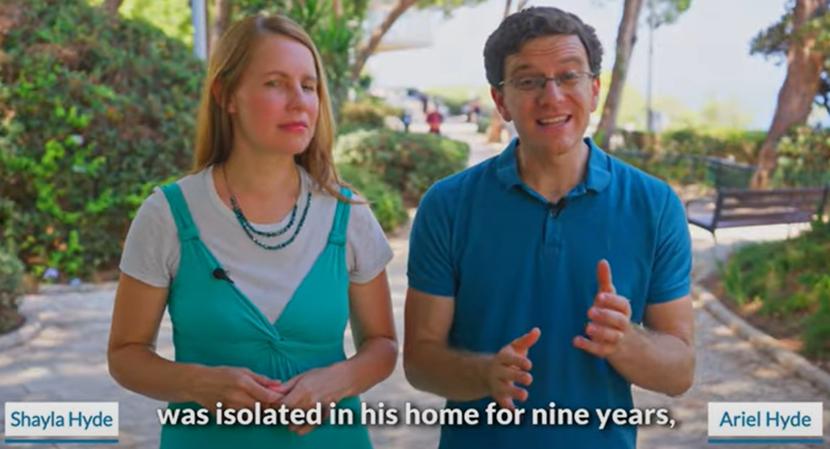
Notes:
We have hosted his mom, Carolyn Hyde, for a concert in our old building. We ALL ate in their home on a tour about 10 years ago.
https://youtu.be/hZAPuOThXpw
https://youtu.be/oIbGl5GwNvw

Slide 109
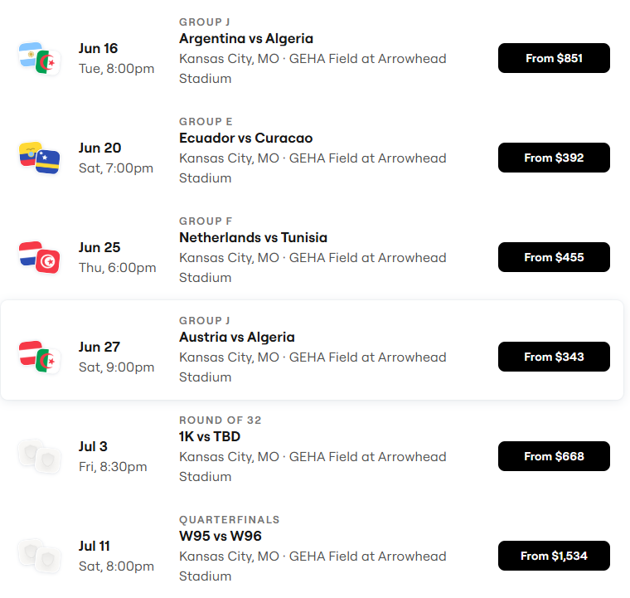
World Cup Schedule
~700,000 visitors to KC!

Slide 110
Distribute water bottles with our QR code AND
Distribute Bibles in Arabic to the Algerian and Tunisian fans.
There will be a place we can set up our prayer station as well.

Slide 111
2. A watch party. Messiah Conference is June 28-July 4. But, Sat eve, June 20 or Sat eve July 11, we could invite the neighborhood via social media and our marquee sign to a food and fun time. We tried to do this for the super bowl, but people were watching at home. We may or may not be more successful with this, but we could try.
Notes:
A new sin to preach against…

Slide 112
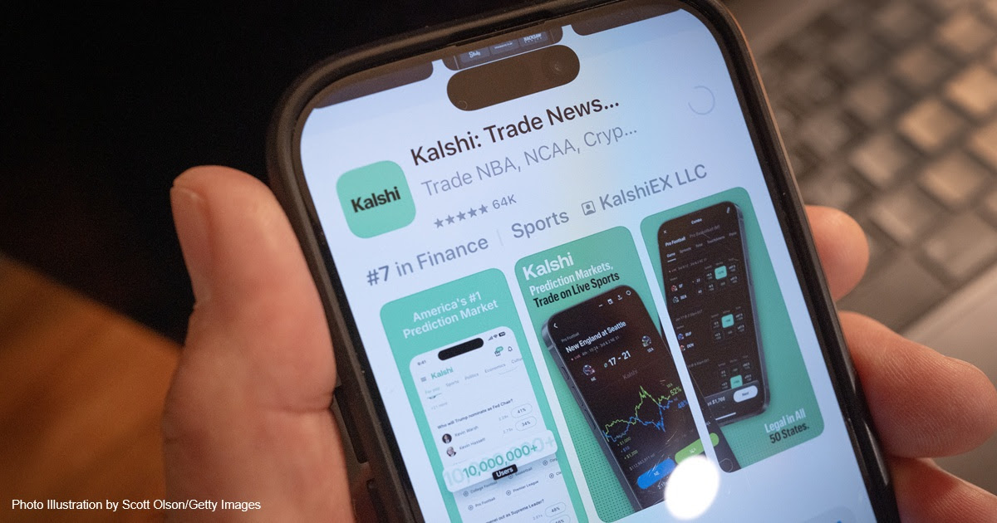
Notes:
https://washingtonstand.com/article/concerns-grow-over-prediction-market-online-betting-platforms

Slide 113
An Ohio federal court ruled Monday that a "prediction market" online betting platform is required to abide by the same state gambling laws that regulate casinos. The ruling highlights the enormous spread of the prediction market gambling industry, which allows users to gamble on almost any "event contract,"
Notes:
https://washingtonstand.com/article/concerns-grow-over-prediction-market-online-betting-platforms

Slide 114
including sporting events, election races, or even when the return of Messiah will occur. Experts say that prediction market gambling presents a host of dangers to society, including high rates of addiction, the corruption of athletes and others with insider knowledge surrounding bets, and even threats to national security.
Notes:
https://washingtonstand.com/article/concerns-grow-over-prediction-market-online-betting-platforms

Slide 116
Radiant Rigteousness
and Accusations
Radiant believers
Wrecking the radiance
Applications

