Slide 1
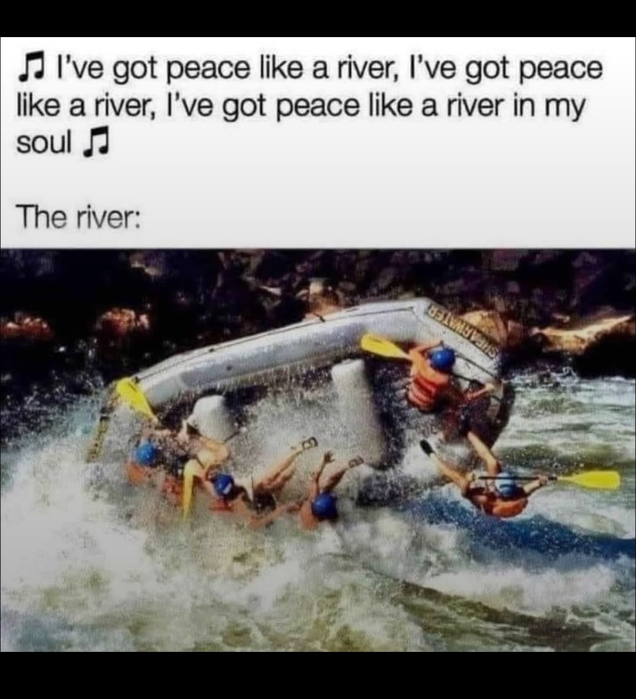

Slide 2
Notes:
Ben Troyer

Slide 3
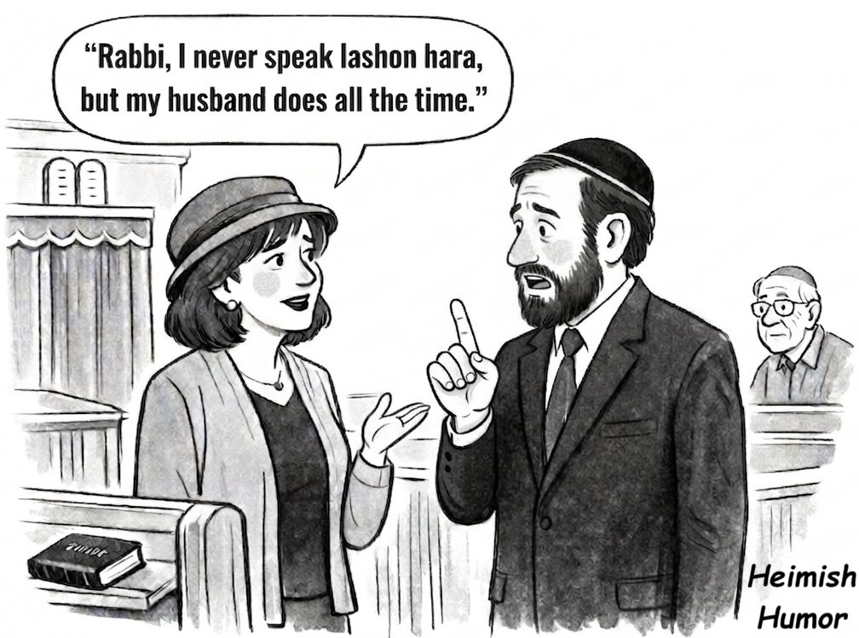

Slide 4
Notes:
Rukhel Fields

Slide 5
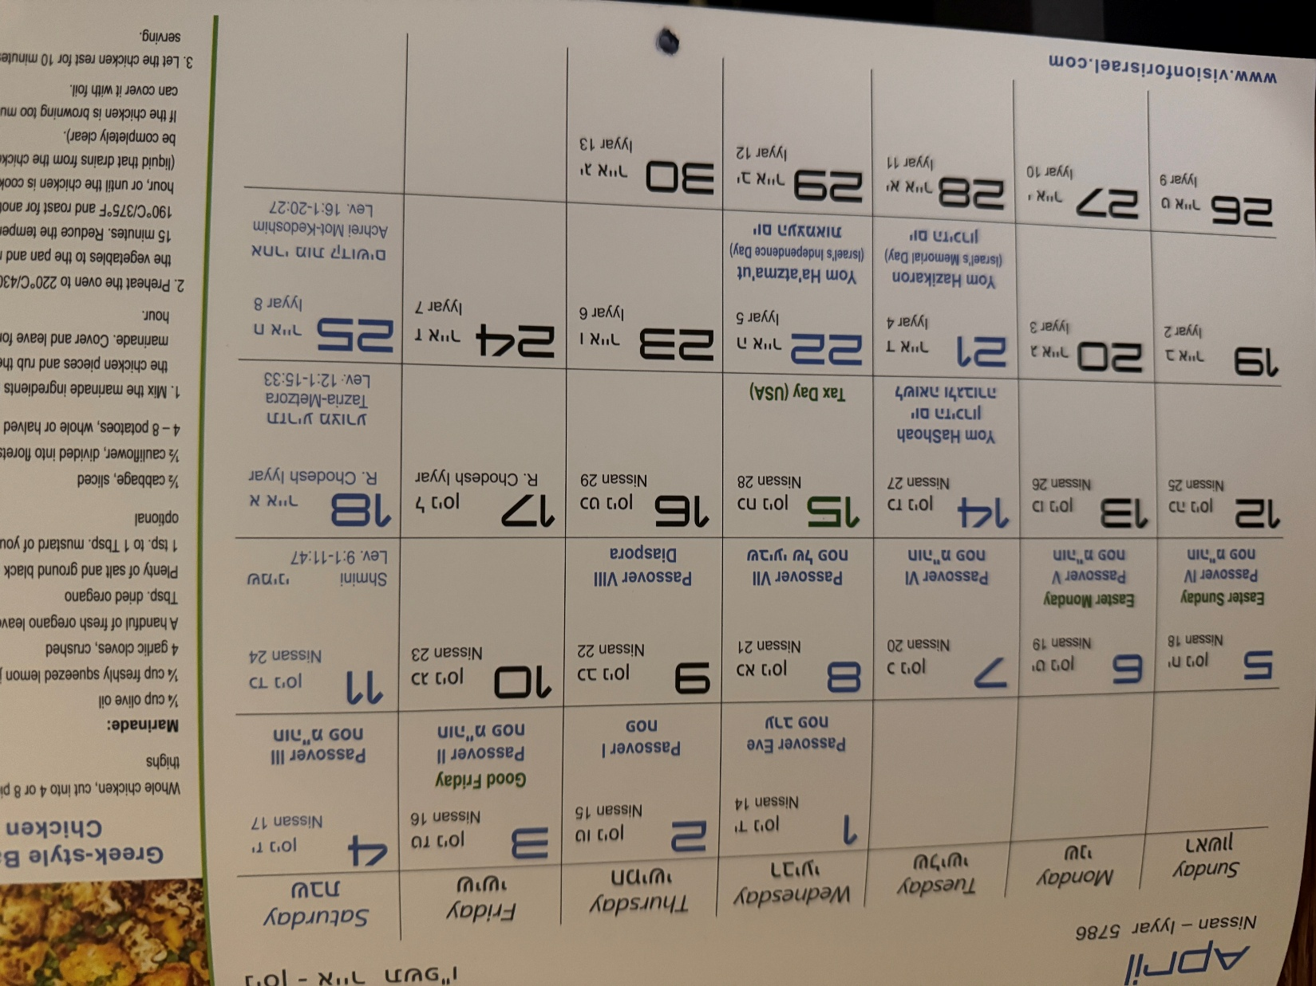
My Hebrew wall calendar for April, 2026
Notes:
Note this Tuesday and Wednesday

Slide 6


Slide 7
Why these extra holidays?
And why should we care?
Notes:
What are they exactly?

Slide 8
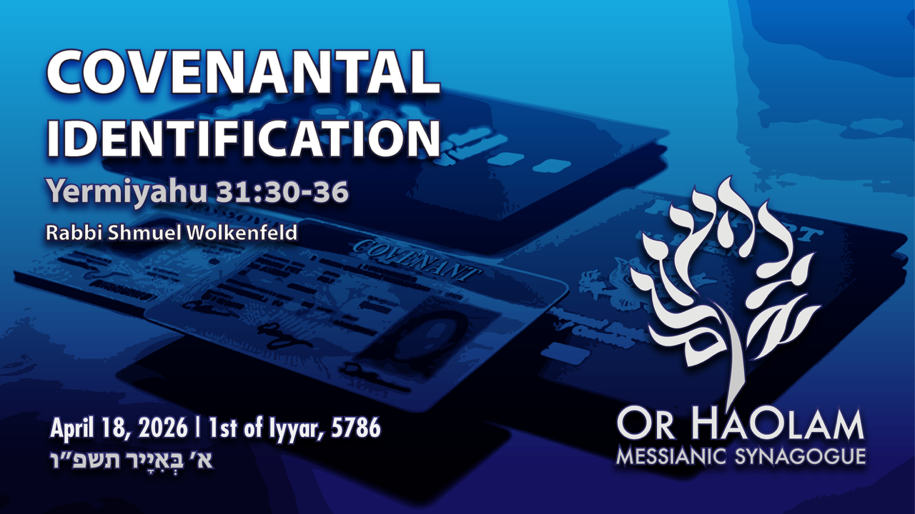

Slide 9

Covenantal Identification Yer 31.
30-36
Israel’s history (–) and (+)
Covenant and contract
Covenantal restoration and help?
Covenants in our lives

Slide 10

Monday, April 20
6-7 pm
The White Theatre at The J
5801 W 115 Street Overland Park, KS 66211
הַזִּכָּרוֹן יום

Slide 11
Yom HaZikaron [Israeli Memorial Day] honoring fallen soldiers and victims of terror.
The program will include prayers and personal stories shared by members of our community, as we come together in reflection and remembrance.
For context:
Notes:
Register for free at:
https://www.thejkc.org/events/2026/04/jewish-experiences/20/yom-hazikaron-commemoration-2026/#registerNow

Slide 12
Korean War 36,500 U.S. deaths.
Vietnam War 58,000 U.S. deaths.
War in Afghan 2,400 U.S. deaths.
Iraq War 4,500 U.S. deaths.
Total 101,400 U.S. military deaths since WW II

Slide 13
The U.S. population is ~367 million
The Israeli population is ~10 million, 7 million Jews
367 million ÷ 7 million = 52
Casualty figures in Israel need to by multiplied by 52 to feel the impact.

Slide 14
Total Israeli military casualties since 1948 are estimated at around 24,000.
24,000 x 52 = 1,248,000 proportionally
Total 101,400 U.S. military deaths since WW II
10x as many.
Notes:
https://search.yahoo.com/yhs/search?p=total%20Israeli%20casualties%20of%20war&hspart=fc&hsimp=yhs-5918_1&type=fc_A2EFA035EF5_s69_g_e_d111225_n141297_c999&param1=7&param2=eJwtT8lqwzAU%2FBUdE5AVPT1Z9otOXZwPKD1V6OA4qiO8Yju49OuLQpnLMAvMtPHmrP94BylzXaDjfnTWgwZFheM%2BmQCgVO64b5z1ROS4j3PS0QhEAaQFFMpx34bJWf9YHfeP2lk%2FTL%2Bx7%2BtTLiQ77HG8TfvKxo2BFNKyPY5GW%2FZj9JHV89yHPVy7uJ1yLAQaduju29Bz1scusDY03XRkzX2ZhnACXQiZwNb6u17ifyXtWp930oA1LE%2Beo8ESLzJDqigDuEBWUolZia%2B6IiorentJ%2BSaFlVQmkzoD86nwLOmMIDTS1x9ZdFOP

Slide 15
Yom HaZikaron יום הזכרון Israeli Memorial Day 5786, Monday,
April 20, 6-7 pm. For details or to register, go to:
thejkc.org/events/2026/04/hide-from-website/20/yom-hazikaroncommemoration-2026/

Slide 16
The Yom Kippur War (1973) resulted in approximately 2,500 Israeli military deaths.
[equivalent to 130,000 U.S. deaths, twice Vietnam]
But two days later…
Notes:
https://search.yahoo.com/yhs/search?p=total%20Israeli%20casualties%20of%20war&hspart=fc&hsimp=yhs-5918_1&type=fc_A2EFA035EF5_s69_g_e_d111225_n141297_c999&param1=7&param2=eJwtT8lqwzAU%2FBUdE5AVPT1Z9otOXZwPKD1V6OA4qiO8Yju49OuLQpnLMAvMtPHmrP94BylzXaDjfnTWgwZFheM%2BmQCgVO64b5z1ROS4j3PS0QhEAaQFFMpx34bJWf9YHfeP2lk%2FTL%2Bx7%2BtTLiQ77HG8TfvKxo2BFNKyPY5GW%2FZj9JHV89yHPVy7uJ1yLAQaduju29Bz1scusDY03XRkzX2ZhnACXQiZwNb6u17ifyXtWp930oA1LE%2Beo8ESLzJDqigDuEBWUolZia%2B6IiorentJ%2BSaFlVQmkzoD86nwLOmMIDTS1x9ZdFOP

Slide 17
But two days later…
Notes:
https://search.yahoo.com/yhs/search?p=total%20Israeli%20casualties%20of%20war&hspart=fc&hsimp=yhs-5918_1&type=fc_A2EFA035EF5_s69_g_e_d111225_n141297_c999&param1=7&param2=eJwtT8lqwzAU%2FBUdE5AVPT1Z9otOXZwPKD1V6OA4qiO8Yju49OuLQpnLMAvMtPHmrP94BylzXaDjfnTWgwZFheM%2BmQCgVO64b5z1ROS4j3PS0QhEAaQFFMpx34bJWf9YHfeP2lk%2FTL%2Bx7%2BtTLiQ77HG8TfvKxo2BFNKyPY5GW%2FZj9JHV89yHPVy7uJ1yLAQaduju29Bz1scusDY03XRkzX2ZhnACXQiZwNb6u17ifyXtWp930oA1LE%2Beo8ESLzJDqigDuEBWUolZia%2B6IiorentJ%2BSaFlVQmkzoD86nwLOmMIDTS1x9ZdFOP

Slide 18

יום העצמאות
Wed., April 22
5 - 7 pm
The Jewish Community Campus
5801 W. 115th St.
OP KS 66211

Slide 19
Israel’s Independence Day: a vibrant and engaging experience for all ages.
Explore Israel through
interactive games, crafts, and activity stations that highlight Israeli culture, spirit, and creativity.
Guests are encouraged to wear white in honor of the holiday!
https://www.thejkc.org/events/2026/04/jewish-experiences/26/yom-ha-atzmaut-community-celebration-2026/#registerNow
Notes:
https://www.thejkc.org/events/2026/04/jewish-experiences/26/yom-ha-atzmaut-community-celebration-2026/#registerNow

Slide 20
Food available for purchase:
Hummus & Pita Plate with Israeli Salad - $8
Falafel with Israeli Salad - $12
Chicken Shawarma - $14
Food available for purchase until Monday, April 20, at 10 p.m. Food must be purchased in advance and is not available on-site.

Slide 21
Why should we care about Israel’s huge number of war deaths,
and amazing national renewal?
There are 195 countries recognized globally, including 193 UN member states and 2 observer states.

Slide 23
Covenantal Identification Yer 31.
30-36
Israel’s history (–) and (+)
Covenant and contract
Covenantal restoration and help?
Covenants in our lives

Slide 24
All past history
and prophetic future
hinges on
covenants G-d made.

Slide 25
^{Yermiyahu 31.30-36} “Here, the days are coming,” says Adoni, “when I will make a new covenant with the house of Isra’el and with the house of Y’hudah. It will not be like the covenant I made with their fathers on the day I took them by their hand and brought them out of the land of Egypt;

Slide 26
^{Yermiyahu 31.30-36} because they, for their part, violated my covenant, even though I, for my part, was a husband to them,” says Adoni. “For this is the covenant I will make with the house of Isra’el after those days,” says Adoni : “I will put my Torah within them and write it on their hearts; I will be their God, and they will be my people.

Slide 27
^{Yermiyahu 31.30-36} No longer will any of them teach his fellow community member or his brother, ‘Know Adoni’; for all will know me, from the least of them to the greatest; because I will forgive their wickednesses and remember their sins no more.”
Notes:
Actualizing and enabling ALL blessings and promises.

Slide 28
^{Yermiyahu 31.30-36} This is what Adoni says, who gives the sun as light for the day, who ordained the laws for the moon and stars to provide light for the night, who stirs up the sea until its waves roar — Adoni-Tzva’ot is his name:) “If these laws leave my presence,” says Adoni,

Slide 29
^{Yermiyahu 31.30-36} “then the offspring of Isra’el will stop being a nation in my presence forever.” This is what Adoni says: “If the sky above can be measured and the foundations of the earth be fathomed, then I will reject all the offspring of Isra’el for all that they have done,” says Adoni.

Slide 30
This covenant,
that we just read,
is the key to understanding
current human history.

Slide 31

What Is the Difference Between a Contract and
a Covenant?
A contract is an entire agreement between parties, built on mutual promises and an exchange of value. A covenant is a specific promise or restriction.
Notes:
https://legalclarity.org/what-is-the-difference-between-a-contract-and-a-covenant/

Slide 32
What a Covenant Is
A covenant is a formal promise to do something or to refrain from doing something. Unlike a contract, which encompasses the entire deal between parties, a covenant is a single obligation or restriction.
Notes:
https://legalclarity.org/what-is-the-difference-between-a-contract-and-a-covenant/

Slide 33
A contract is contingent on the other party’s compliance.
A covenant is a commitment, regardless of the other party.

Slide 34
In scripture, G-d made many relational promises to people.
Termed conditional covenants, or really contracts.
Eden, Adam, Moshe, David
The covenants with Noakh, Avraham and the renewed were unconditional.
Notes:
Eden conditional on eating of the fruit
Adam, conditional on faith in the virtue of an animal sacrifice.
Moshe blessings conditional on obedience to Torah.
David dynasty conditional on obedience, no idolatry.
Renewed…”I will”
Noakh, Noah, no more flood.
Avraham the Land is Israel’s forever.

Slide 35
Name: | Noakhic [Noah]
Verses | Ber / Gen 8.20-9.13
Provisions | Seasons, no flood
Type | Unconditional
Response | Capital punishment
Sign | rainbow
Participants | all humanity
Notes:
Physical salvation

Slide 36
Name: | Avrahamic
Verses | Ber / Gen 12, 15, 17
Provisions | Blessings and curses, Land
Type | Unconditional
Response | Avraham’s obedience
Sign | Circumcision
Participants | Avraham’s descendents
Notes:
Abrahamic covenant is NOT salvation. It’s blessings and the LAND.
Abe saved by faith in Gen 15
Abe covenant in Gen 12
Occupying the Land is NOT the same as owning it. 2000 years expelled.
Just recently, 1900’s reoccupied the land,

Slide 37
Name: | Renewed
Verses | Yermiyahu/Jer 31.31-34
Provisions | Torah in our hearts
Type | Unconditional for the nation, but not necessarily EVERY Jew
Response
Sign | Seder of Messiah [communion]
Participants | Israel & Judah, grafted
Notes:
God made two UNCONDITIONAL choices: salvation information through Jews, salvation fact through Yeshua.

Slide 39
Covenantal Identification Yer 31.
30-36
Israel’s history (–) and (+)
Covenant and contract
Covenantal restoration and help?
Covenants in our lives

Slide 40
Current Covenantal history in process before our eyes

Slide 41
The Yermiyahu New Covenant restores all the previous.
Consider the context of Ch. 31

Slide 42
^{Yer 31.1} “The people escaping the sword found favor in the desert —
I have brought Isra’el to its rest.”
Notes:
Holocaust survivors…desert of DP camps to amazing national renewal May 15, 1948
Help from Jews and non-Jews? Truman, Orde Wingate
Truman you’ve likely heard of, first to recognized the Jewish state ~15 minutes after declaration,
Orde Wingate no so much.

Slide 43
^{Yer 31.2-3a} From a distance Adonai appeared to me, [saying,] “I love you with an everlasting love; this is why in my grace I draw you to me. Once again, I will build you; you will be rebuilt, virgin of Isra’el.
Notes:
Rebuilt the waste lands, swamps and deserts. New cities. Tel Aviv was founded in 1909 on the sand dunes north of Jaffa

Slide 44
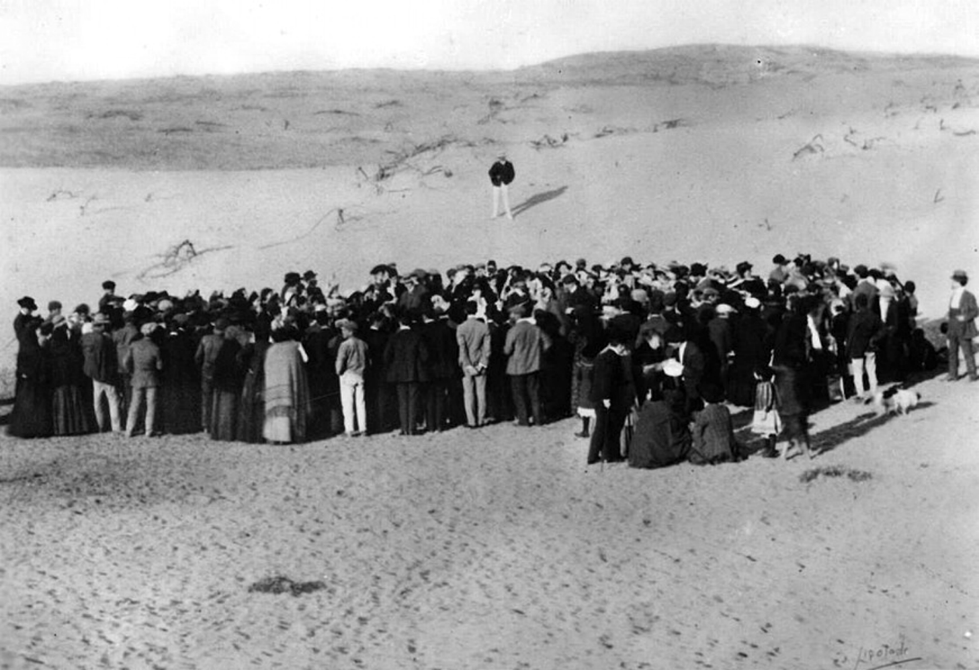
Lottery for the first Tel Aviv
lots, April 1909
Notes:
https://upload.wikimedia.org/wikipedia/commons/e/e2/TelAviv-Founding.jpg

Slide 45
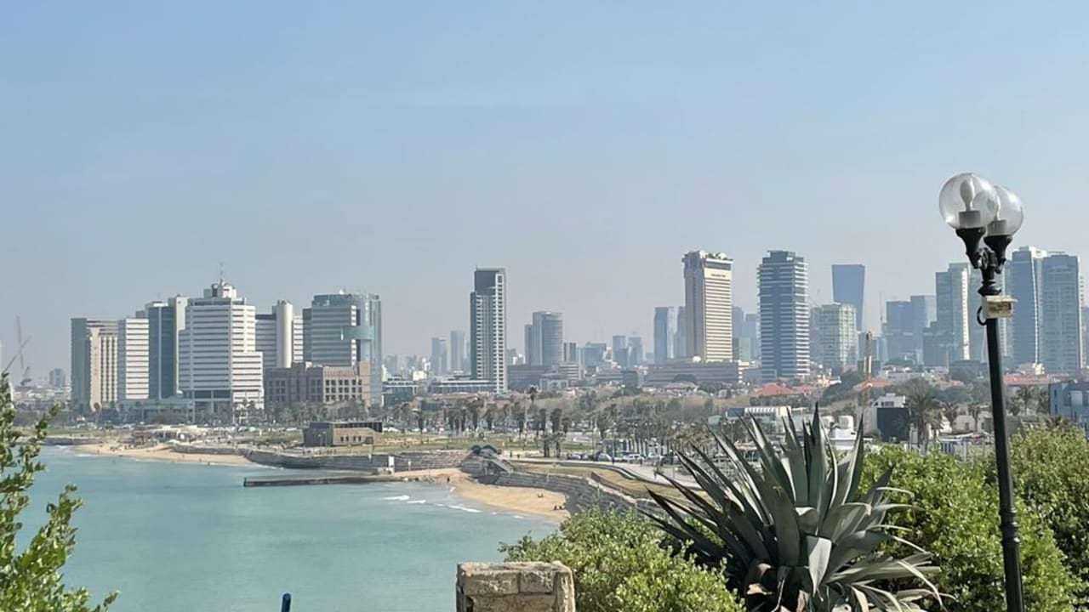
Tel Aviv today
Notes:
https://images.jpost.com/image/upload/f_auto,fl_lossy/q_auto/c_fill,g_faces:center,h_720,w_1280/533858

Slide 46
^{Yer 31.3b} Once again, equipped with your tambourines, you will go out and dance with the merrymakers.
There was and is NO dance or instruments in Orthodox or Traditional Jewish worship.
Notes:
Rose Price, a Messianic Holocaust survivor and speaker in our midst for years, said to a questioning rabbi about the dancing, “It’s OK. Maskhiakh has come. We are no longer a dispersed, rejected people.” Something similar.

Slide 47
^{Yer 31.4} Once again, you will plant vineyards on the hills of Shomron = Samaria.

Slide 48
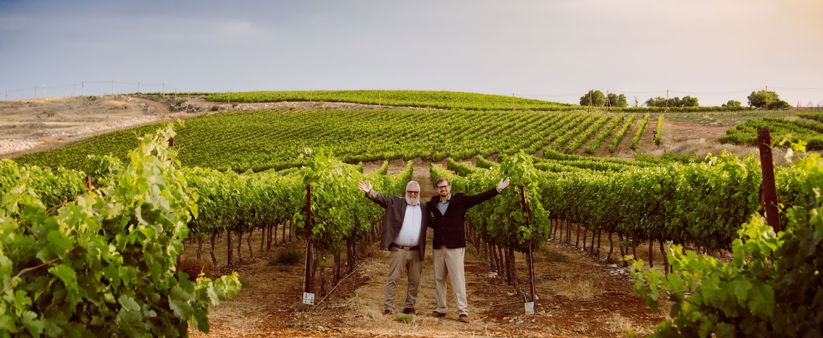
Tommy & Zac Waller in the vineyards of Har Bracha, Samaria

Slide 49
About 20 years ago, some young Jewish men, fresh out of their mandatory army service, recognized that no one was living on a portion of the Mount Gerizim. They believed that it was the time and season to revive it. They wanted to resettle the land of their forefathers on the empty hillside near the top of the mountain.
Notes:
https://firmisrael.org/learn/vineyards-in-samaria/

Slide 50
Looking for ways to bring in some income, they considered planting vineyards. Experts were brought in to evaluate the land, the soil, and topography to give their opinions on planting vineyards. Their conclusion was that the soil was terrible, the land had wrong elevation, and a host of other reasons why the vineyard idea would never work.
Notes:
https://firmisrael.org/learn/vineyards-in-samaria/

Slide 51
Yet, as God fearing men, they prayed proclaiming this scripture: “Again you will plant vineyards, on the hills of Samaria; The planters will plant and will enjoy them.” ^{Yer. 31:5} With faith in God, a biblical promise about vineyards in Samaria and a healthy dose of Israeli chutzpa (Yiddish slang term for “hardheaded nerve”) they refused to give up.
Notes:
https://firmisrael.org/learn/vineyards-in-samaria/
Nir Lavi, an Orthodox Jew

Slide 52
They randomly chose some grape varieties and planted vineyards in Samaria. For the first time in almost 2000 years there was now a vineyard on the Mount of Blessing. And within just a few years the vineyards exploded, producing an abundance of fruit that was in high demand.
Notes:
https://firmisrael.org/learn/vineyards-in-samaria/
Rashi, said, “When Palestine becomes so very fertile, Messiah's advent is near, and there can be no clearer sign than this.”

Slide 53
With such great success with growth on the Mount of Blessing, they decided to begin making their own wine. Soon, it also became wildly successful under the label Har Bracha or the Mount of Blessing vineyards. After some local success,
Notes:
https://firmisrael.org/learn/vineyards-in-samaria/

Slide 54
Har Bracha decided to enter a few of their wines into a 14,500 blind bottle taste test in Europe. To everyone’s surprise, Har Bracha won #2 in one category, landed #3 in another, beating out famed and established wineries from France and Italy.
Notes:
https://firmisrael.org/learn/vineyards-in-samaria/
Europe was all excited UNTIL they found out that the vineyard was in Samaria = “occupied territories.”

Slide 55
A Christian organization called HaYovel reached out to the vineyards after seeing a prophetic connection in the Scriptures, found in Isaiah 61:5:
“Strangers will stand and pasture your flocks and foreigners will be your farmers and your vinedressers.”

Slide 56
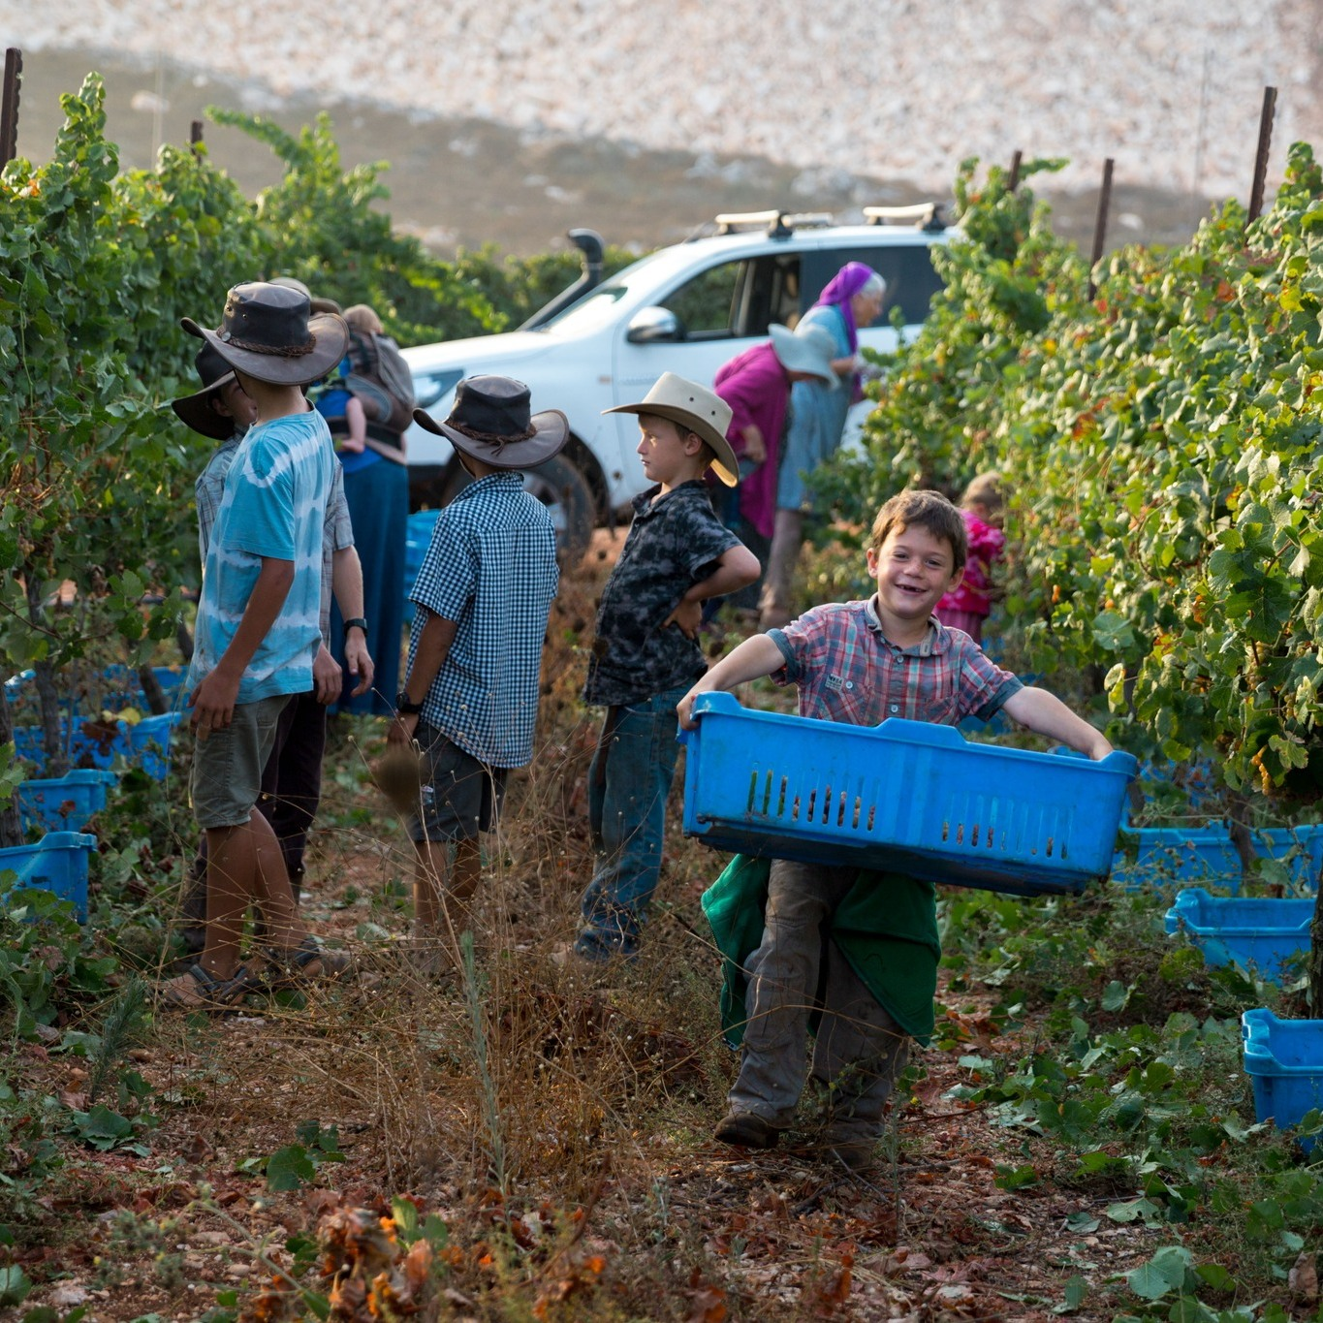


Slide 57
^{Yer 31.7} Look! I am bringing them from the land in the north, gathering them from the far ends of the earth; among them are the blind and lame, women with children, women in labor, all together, a vast throng returning here.

Slide 58
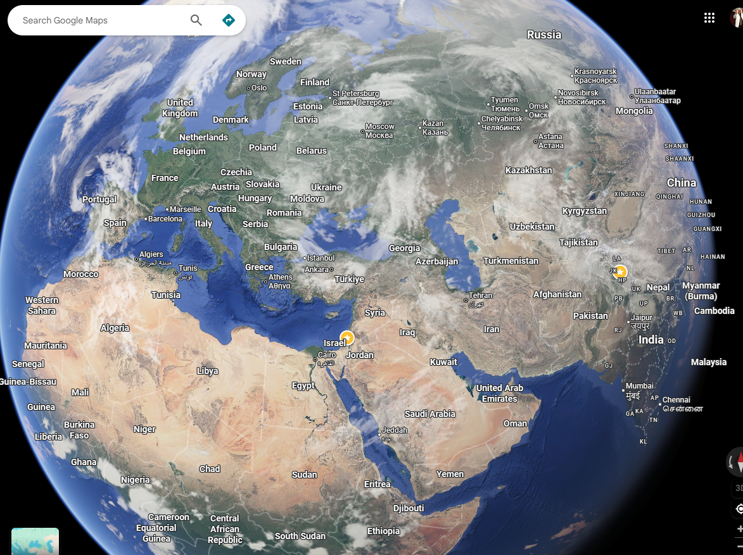
Notes:
https://www.google.com/maps/@37.3959524,36.5096485,7104004m/data=!3m1!1e3!5m1!1e1?entry=ttu&g_ep=EgoyMDI2MDQxNC4wIKXMDSoASAFQAw%3D%3D

Slide 59
Post-Soviet Russian citizens immigrated to Israel and their descendants, as of 2022, Russian-speakers number around 1,300,000 people, or 15% of the Israeli population.
Notes:
Israel has Hebrew, English, Arabic, and Russian and Spanish as their languages.
At a Bar Mitzvah and the Western Wall in ~2005, the rabbi turned to the Bar Mitzvah crowd and shouted “Canta con mas fuerza!” I thought I had fallen into a worm hole space time lapse.

Slide 60
Nearly 20,000 new immigrants are reported to have made Aliyah since last Passover. According to the data, a total of 19,386 people, including 11,216 families, have immigrated to Israel since April 20, 2025. While the largest number—over 6,000—came from Russia, more than 3,000 came from the U.S., and another 3,000 from France.
Notes:
The Israel Guys HaYovel P.O. Box 736919 Chicago, IL 60673
Pumpkin Aliyah bc complaints no pumpkin latte Starbucks in Israel.

Slide 61
^{Yer 31.9-10} Nations, hear the word of Adoni! Proclaim it in the coastlands far away. Say: “He who scattered Isra’el is gathering him, guarding him like a shepherd his flock.” For Adoni has ransomed Ya‘akov, redeemed him from hands too strong for him.

Slide 62
The Nazis, then British, then Arab resistance to Jewish survival was too strong for the survivors.
Notes:
https://en.wikipedia.org/wiki/Tower_and_Stockade#

Slide 63
Tower and Stockadeחוֹמָה וּמִגְדָּל
was a defensive, pessimistic settlement method used by Zionist settlers in Mandatory Palestine during the 1936–39 Arab Revolt
Notes:
https://en.wikipedia.org/wiki/Tower_and_Stockade#

Slide 64
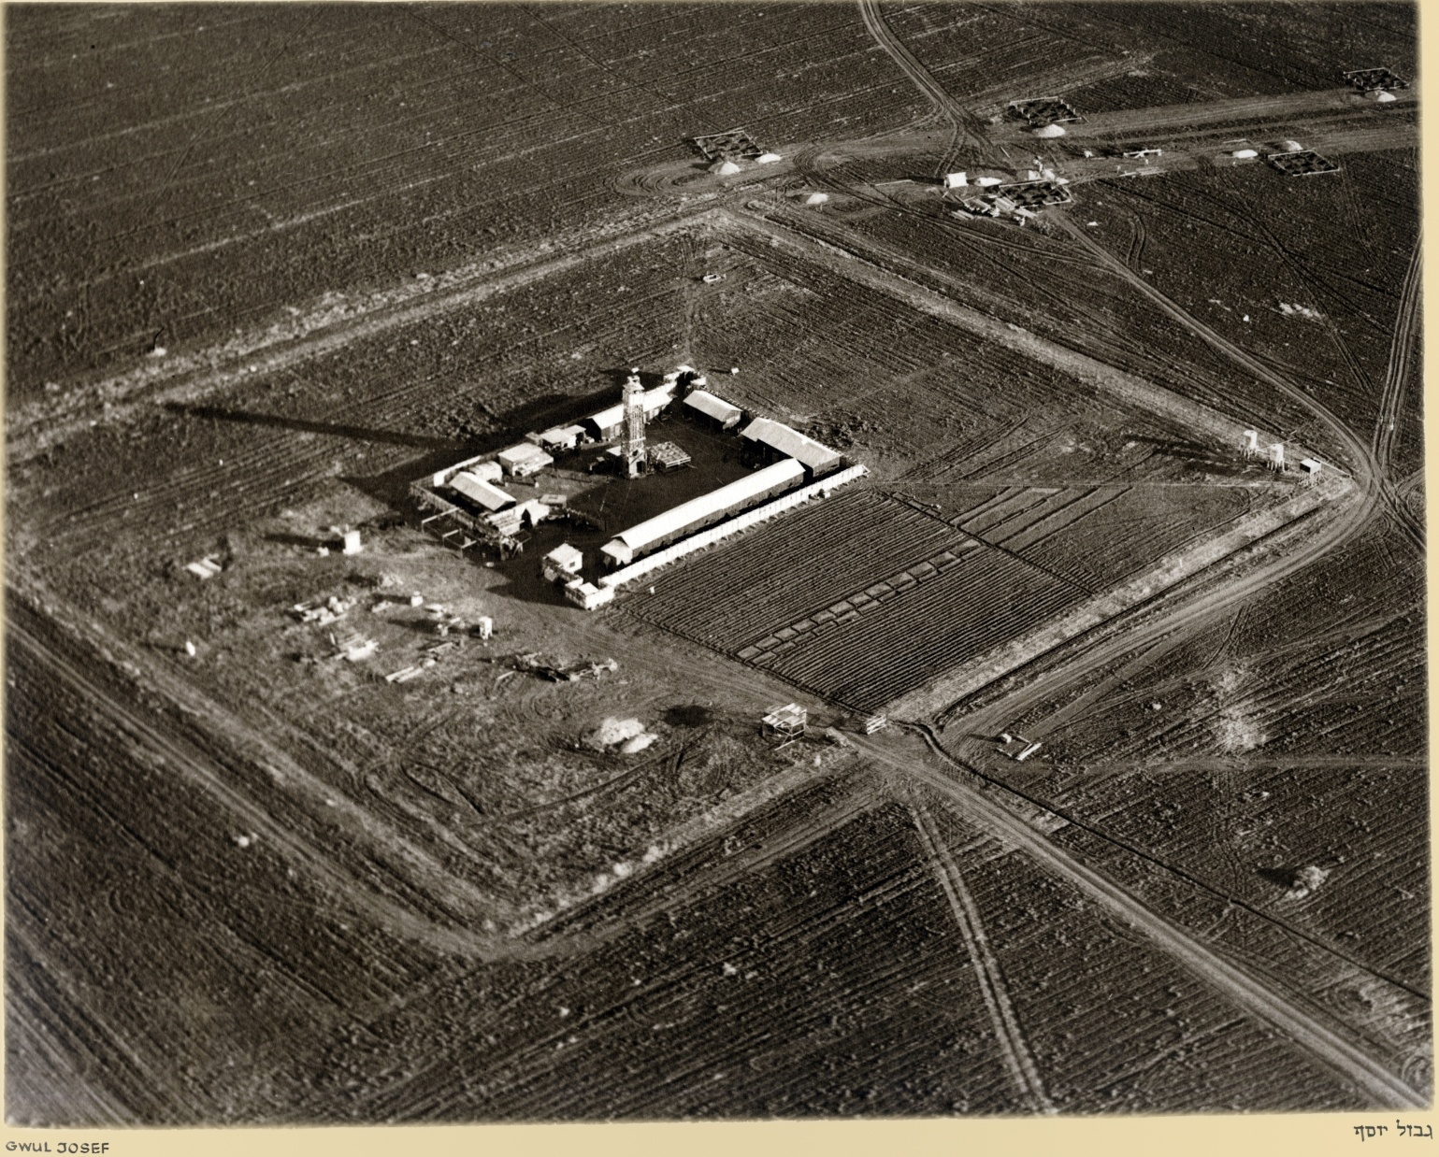
Notes:
https://en.wikipedia.org/wiki/Tower_and_Stockade#

Slide 65
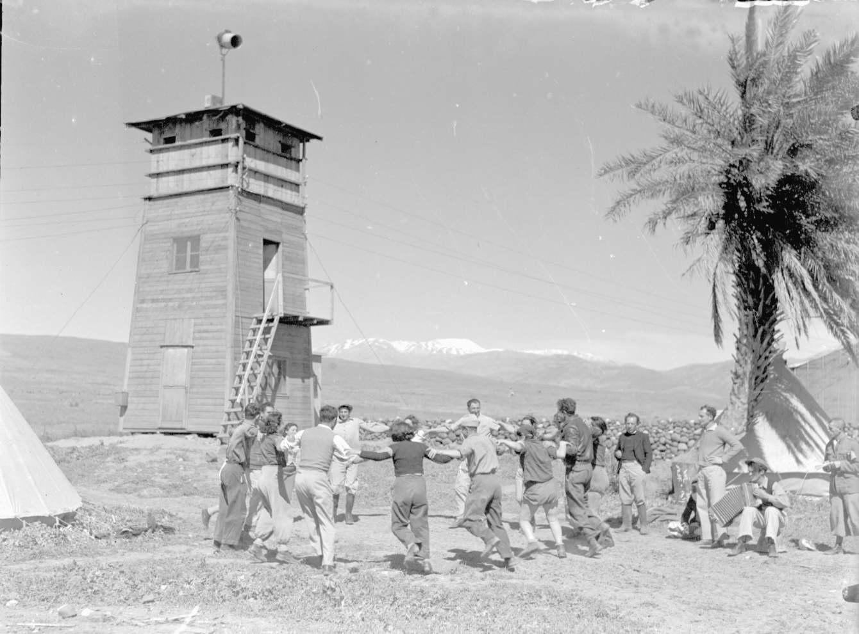
Notes:
https://en.wikipedia.org/wiki/Tower_and_Stockade#

Slide 66
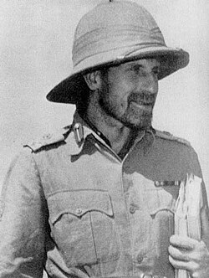
1903 - 1944 British Army officer known for his creation of the Special Ops deep-penetration missions in Japanese -held Burma Campaign
Notes:
Bible reading Pilgrim Brethren Christian, believed in G-d’s covenantal purpose of Jewish return.

Slide 67
Until Wingate arrived in Palestine, the Jewish attitude towards Arab marauders and Arab terror was one of self-defense only. The establishment of the Special Night squads in 1936 marked a change

Slide 68
in this attitude from a purely defensive to a more offensive ethos. After Wingate the night, which had previously belonged to the Arabs alone, no longer did so.
Notes:
Moshe Dayan: Everything we know, we learned from Orde Wingate. He taught the Jews to fight.

Slide 69
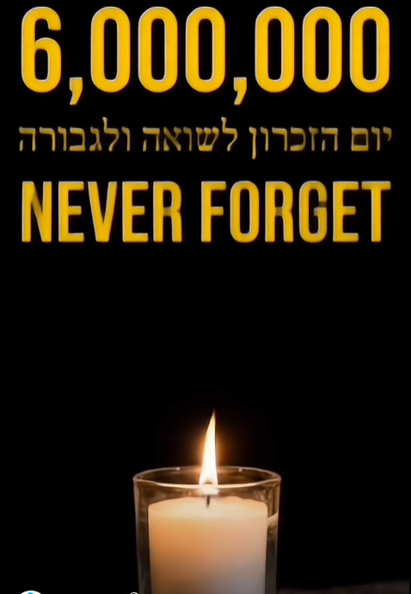
Notes:
https://www.facebook.com/reel/1579466239793203

Slide 70
^{Yer 31.26-27} “Here, the days are coming,” says Adoni, when I will sow the house of Isra’el and the house of Y’hudah with the seed of humans and the seed of animals. At that time, just as I used to watch over them with the intent to uproot, break down, overthrow, destroy and do harm; so then I will watch over them to build and plant,” says Adoni.

Slide 71
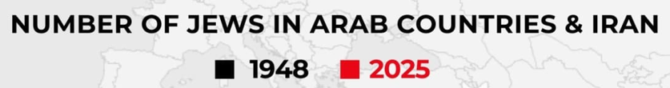
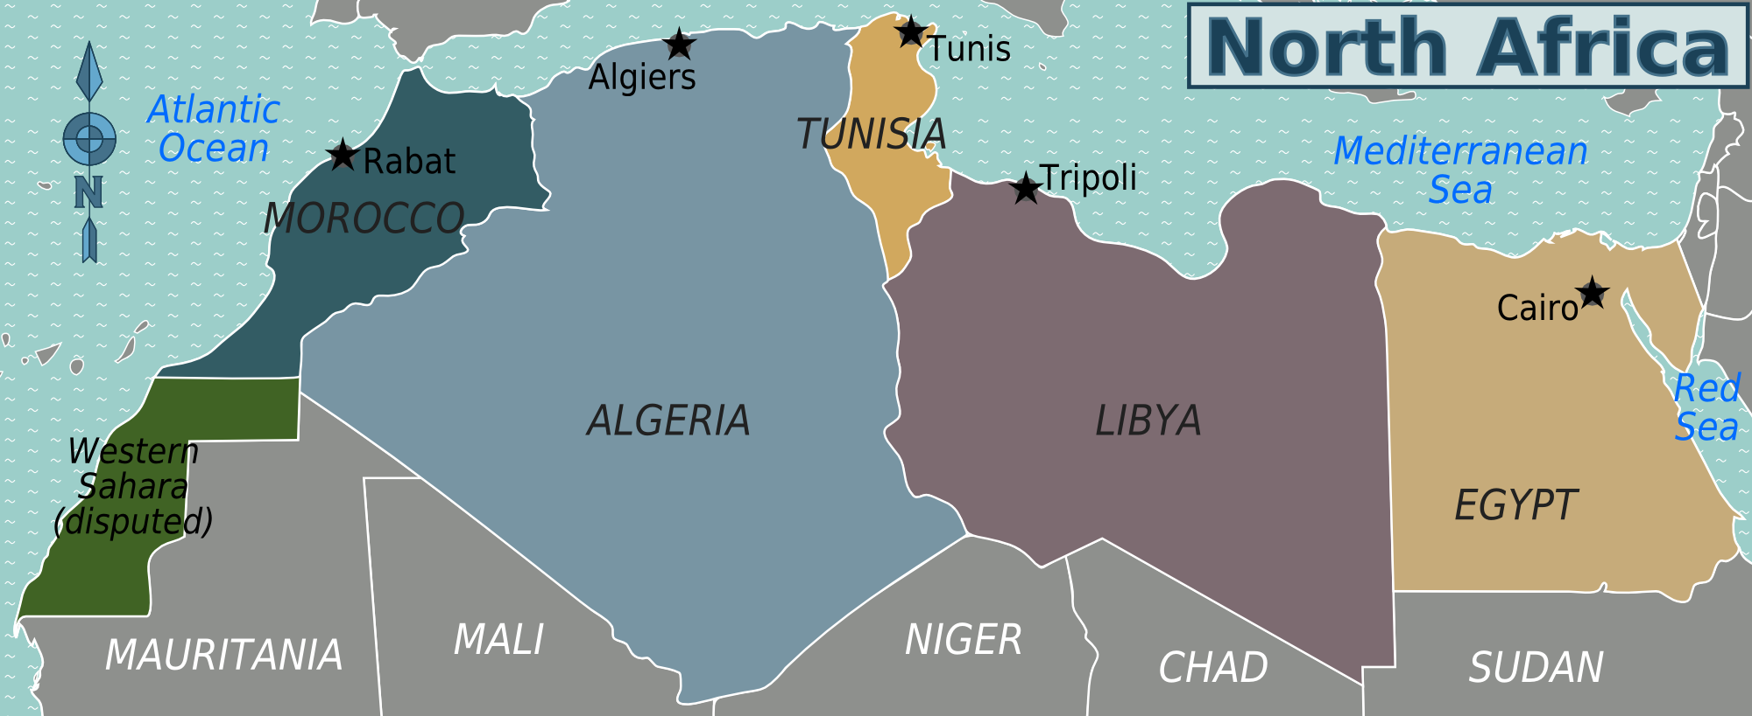
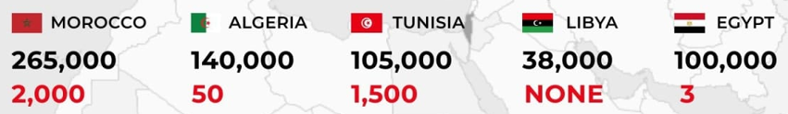
Notes:
https://upload.wikimedia.org/wikipedia/commons/1/14/North_Africa_regions_map.png
https://allisraelnews.com/israel-commemorates-mass-expulsion-of-nearly-one-million-jews-from-arab-and-muslim-lands-after-1948?utm_source=convertkit&utm_medium=email&utm_campaign=Netanyahu%20submits%20to%20President%20Herzog%20%27extraordinary%27%20pardon%20request%20which%20does%20not%20apologize%20or%20admit%20guilt%20-%2019907102

Slide 72
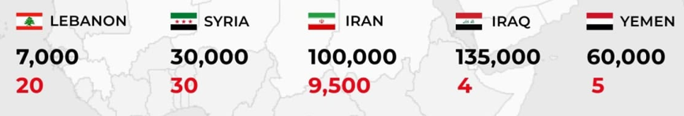
Notes:
https://upload.wikimedia.org/wikipedia/commons/1/14/North_Africa_regions_map.png
https://allisraelnews.com/israel-commemorates-mass-expulsion-of-nearly-one-million-jews-from-arab-and-muslim-lands-after-1948?utm_source=convertkit&utm_medium=email&utm_campaign=Netanyahu%20submits%20to%20President%20Herzog%20%27extraordinary%27%20pardon%20request%20which%20does%20not%20apologize%20or%20admit%20guilt%20-%2019907102

Slide 73
^{Yer 31.12} Then the virgin will dance for joy, young men and old men together; for I will turn their mourning into joy, comfort and gladden them after their sorrow.
Notes:
I already referred to this in vs 31.3, but since scripture repeats and amplifies it, it will too. Not the additional word “together.” Messianic Jewish dance is not just spiritual expression of joy, it is spiritual expression of joy IN COMMUNITY. Individual salvation in Messiah, AND community expression of joy TOGETHER!! That’s why we do circles, lines.

Slide 74
Conclusion: G-d is working covenantal restoration in our days in Israel and the Jewish people!

Slide 76
Covenantal Identification Yer 31.
30-36
Israel’s history (–) and (+)
Covenant and contract
Covenantal restoration and help?
Covenants in our lives: Israel,
Shabbat, marriage,
Outreach/Ingathering

Slide 77
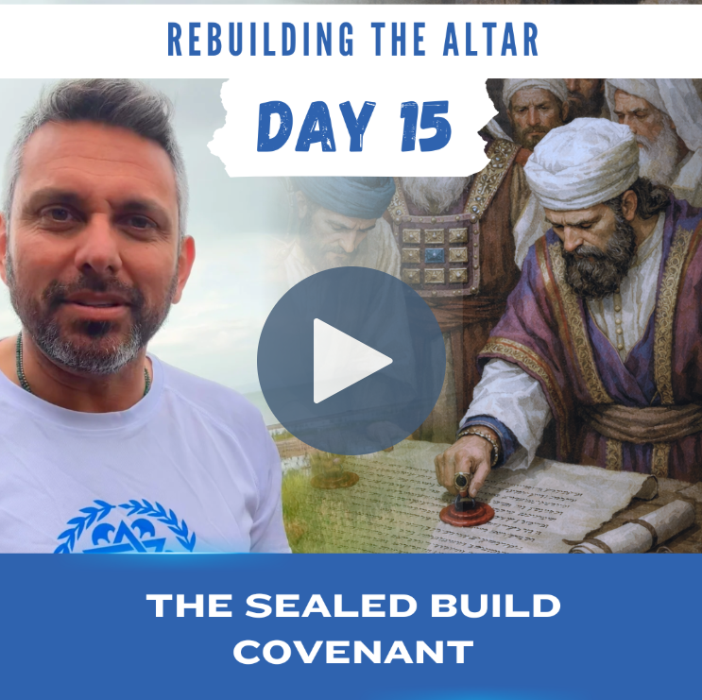
Notes:
https://il.faithfulgalileans.com/share/hubspotvideo/392034811119?utm_campaign=377245915-Passover%20_%20Pentecost&utm_medium=email&_hsenc=p2ANqtz-_ZjgpmVKhX3YgxUbf-A4DfqwAcChw0DoZSidjVBF72ZrvxjuiTzlrQGyrCx-InSXfnnuszgpajvh0bmu3zeu4su9sByA&_hsmi=133445248&utm_content=133445248&utm_source=hs_email

Slide 78
Help Israel
Support Yom Zikaron יום הזיכרון Israel Memorial Day Monday
Support Yom HaAtzmaut
יום העצמאות Israel Ind Day Wed.
Pray, attend Teerosh Tuesday
Go to the Land, with me.

Slide 79
Speaking at a Holocaust Remembrance Day ceremony, Mossad Director David Barnea said operatives worked “in the heart of Tehran,” providing precise intelligence that enabled Israeli airstrikes against missile systems threatening civilians.
Notes:
https://www.worthynews.com/113660-mossad-chief-vows-mission-continues-until-iranian-regime-falls

Slide 80
In one of his strongest public statements to date, Barnea declared that Mossad’s responsibility will end “only when this radical regime is replaced,” framing regime change in Iran as a central objective.
“That regime, which seeks our destruction, must pass from the world. This is our mission,” he said. “We will not stand by in the face of another existential threat.”
Notes:
https://www.worthynews.com/113660-mossad-chief-vows-mission-continues-until-iranian-regime-falls

Slide 81
The Institute for Intelligence and Special Operations
המוסד למודיעין ולתפקידים מיוחדים
Mosád le-Modi-ín u-le-Tafkidím Meyuḥadím

Slide 82
Remember Shabbat as a covenantal joy, a choreography of worship, NOT just an obligation.

Slide 83
^{Shmot Ex 31.15-17} On six days work will get done; but the seventh day is Shabbat, for complete rest, set apart for Adoni... The people of Isra’el are to keep the Shabbat, to observe Shabbat through all their generations as a perpetual covenant.

Slide 84
^{Shmot Ex 31.15-17} It is a sign between me and the people of Isra’el forever; for in six days Adoni made heaven and earth, but on the seventh day he stopped working and rested.’”

Slide 85
Our marriages are an expression of covenantal joy.

Slide 86
^{Mal 3.14-16} Adoni bears witness between you and the wife of your youth, whom you have treated deceitfully. Yet she had been your companion and your wife by covenant. Did the One not make her with a remnant of Ruach? Then what is the One seeking? Offspring of God!
Notes:
How did Dawn and I make it for 50 years?
Walking in covenant: worship and joyful intimacy.

Slide 87
^{Mal 3.14-16} So protect your spirit— do not betray the wife of your youth. “For I hate divorce,” —says Adoni the God of Israel— “and the one who covers his garment with injustice,” says Adoni -Tzva’ot. So protect your spirit—do not act treacherously.

Slide 88
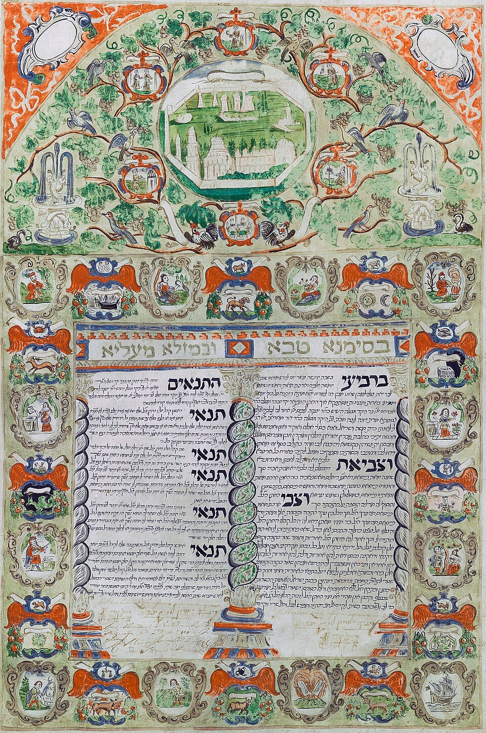
An illuminated
ketubah
Notes:
https://upload.wikimedia.org/wikipedia/commons/thumb/3/37/Decorated_Ketubbah%2C_Livorno%2C_1698.jpg/960px-Decorated_Ketubbah%2C_Livorno%2C_1698.jpg

Slide 89
A ketubah כְּתוּבָּהis a Jewish marriage contract. It is considered an integral part of a traditional Jewish marriage, and outlines the rights and responsibilities of the groom, in relation to the bride.

Slide 90
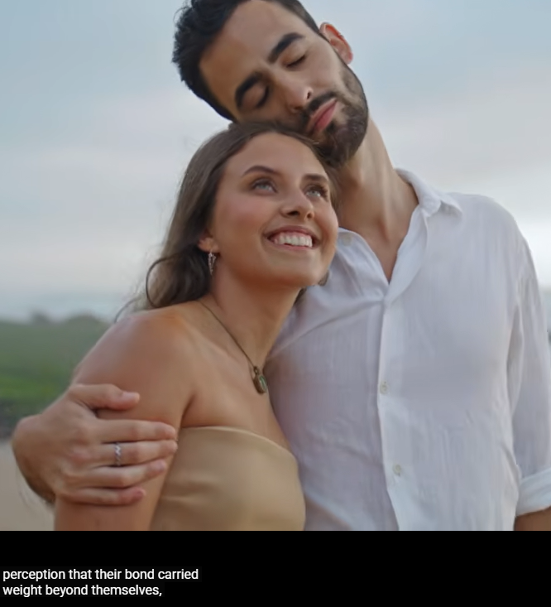

Slide 91
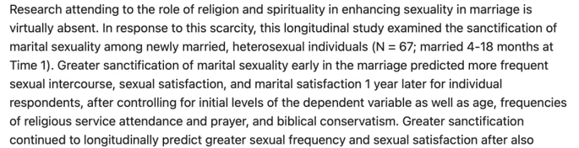
Notes:
https://youtu.be/mUNeJr3zbHc?t=309

Slide 92
Stand for truth in our nation.

Slide 93

Greensboro, North Carolina abortion business announced it has killed its last baby...and will shut down completely by the end of the month of April!
Notes:
https://www.youtube.com/watch?v=YbKzQw5cOi8
https://myemail.constantcontact.com/BREAKING--Abortion-Facility-Announces-Closure.html?soid=1140924987582&aid=0ZKHph-fQfc

Slide 94
It's the 185th abortion facility closed following YOUR prayers at a 40 Days for Life vigil! The expected flood of abortion-bound women from pro-life states that border North Carolina never materialized.
Notes:
https://www.youtube.com/watch?v=YbKzQw5cOi8
https://myemail.constantcontact.com/BREAKING--Abortion-Facility-Announces-Closure.html?soid=1140924987582&aid=0ZKHph-fQfc

Slide 95


Slide 96
Outreach / Ingathering
to extend the covenant
From our website home page

Slide 97
The Vision of Or HaOlam: Working to bring Jewish people, and those grafted in, to their covenantal identity in Messiah.

Slide 98
Implies:
Salvation through the Atonement of the Messiah; personal faith in the atoning death and resurrection of Yeshua; it's all about the King.
Covenantal identity of Jewish people, not replacement

Slide 99
Restoration to Torah lifestyle
Restoration/survival of the nation of Israel.
(Covenantal identity, so Jewish believers don't assimilate. Romans 11:15 "For if their casting Yeshua aside means reconciliation for the world, what will their accepting him mean? It will be life from the dead!)

Slide 101
Covenantal Identification Yer 31.
30-36
Israel’s history (–) and (+)
Covenant and contract
Covenantal restoration and help?
Covenants in our lives: Israel,
Shabbat, marriage,
Outreach/Ingathering

Slide 103
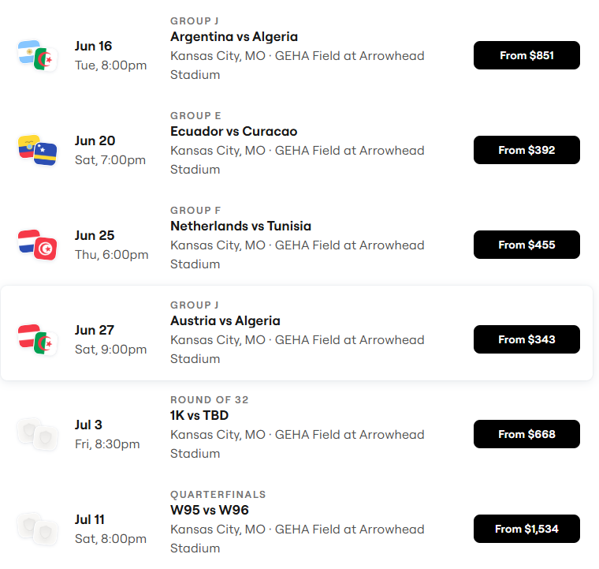
World Cup Schedule
~700,000 visitors to KC!

Slide 104
