Slide 2
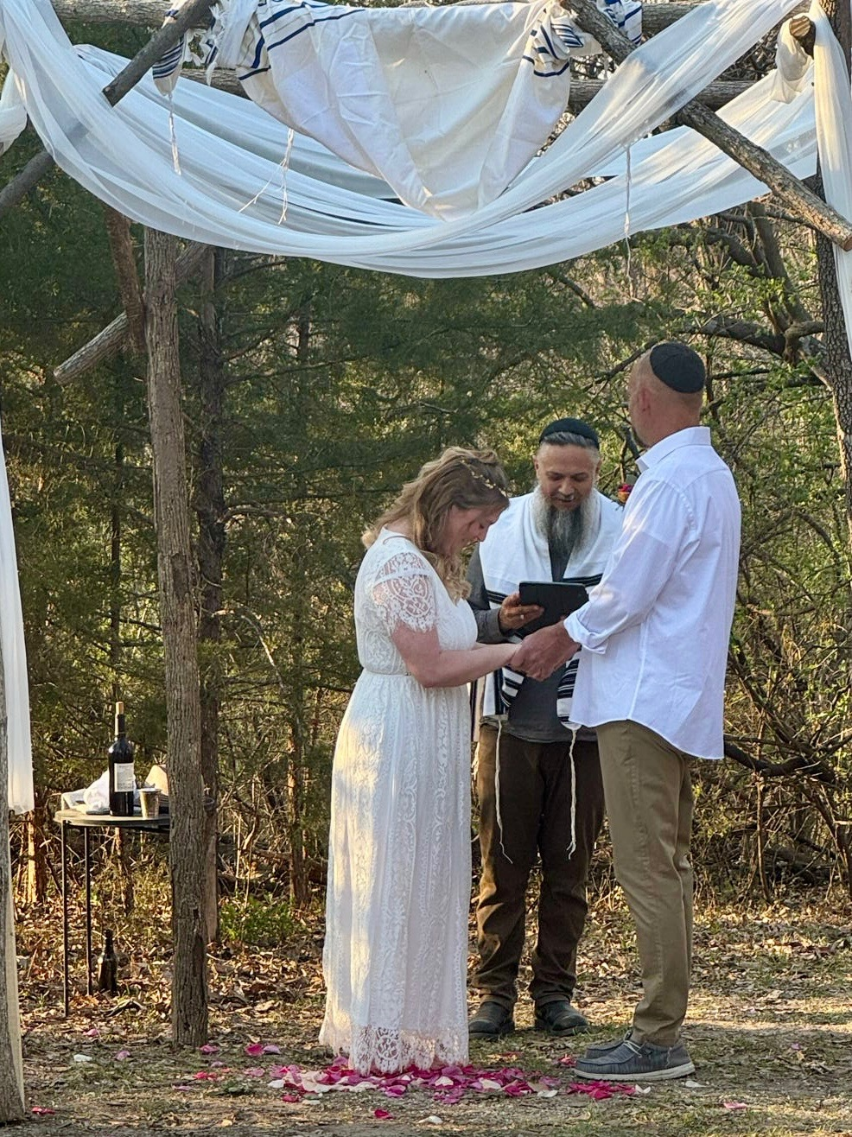
I introduce to you Mr. & Mrs. Grady and Rachel Merritt, married Sunday evening,
Mar. 29, 2026 by Rabbi Jeremy Walla.

Slide 3
7th Wedding Blessing:
Blessed are You, Adoni, our G-d, King of the universe, Who has created joy and gladness, bridegroom and bride, mirth and exultation, pleasure and delight, love, brotherhood, peace and fellowship. Adoni our G-d, soon may there be heard in the cities of Judah,
Notes:
Some say this was part of the original blessing by G-d of Adam and Hava in the Garden.

Slide 4
and in the streets of Jerusalem, and throughout Your kingdom among the nations, the voice of joy and gladness, the voice of the bridegroom and the voice of the bride, the jubilant voices of bridegrooms from their canopies, and of youths from their feasts of song.

Slide 5
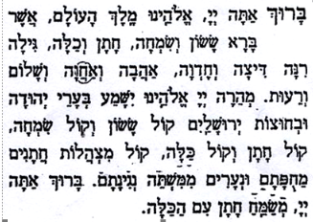

Slide 6
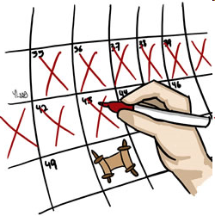
Counting the Omer
S'fee-raht
Ha-oh-mehr
סְפִירַת הַעֹמֶר

Slide 7
^{Lev 23.9-10} Adoni said to Moshe, "Tell the people of Isra'el, 'After you enter the land I am giving you and harvest its ripe crops, you are to bring a sheaf of the firstfruits of your harvest to the cohen.

Slide 8
Lev 23.11-12 He is to wave the sheaf before Adoni, so that you will be accepted; the cohen is to wave it on the day after the Shabbat. On the day that you wave the sheaf, you are to offer a male lamb without defect, in its first year, as a burnt offering for Adoni.

Slide 9
Lev 23.15-16 From the day after the day of rest — that is, from the day you bring the sheaf for waving — you are to count seven full weeks, until the day after the seventh week; you are to count fifty days; and then you are to present a new grain offering to Adonai .' "

Slide 10
The Counting of the Omer begins on the second day of Passover (the 16th of Nisan) for Rabbinic Jews (Orthodox, Conservative, Reform), April 2 in the evening or all day, April 3.
Notes:
https://en.wikipedia.org/wiki/Counting_of_the_Omer

Slide 11
and after the weekly Shabbat during Passover for Karaite, Samaritan, Sadducean Jews. [April 5]
Notes:
https://en.wikipedia.org/wiki/Counting_of_the_Omer
And Michael Rood.

Slide 12
The counting is preferably done at night, at the beginning of the Jewish day. If one realizes the next morning or afternoon that they have not yet counted, the count may still be made, but [Rabbinic law] without a blessing.
Notes:
https://en.wikipedia.org/wiki/Counting_of_the_Omer

Slide 13
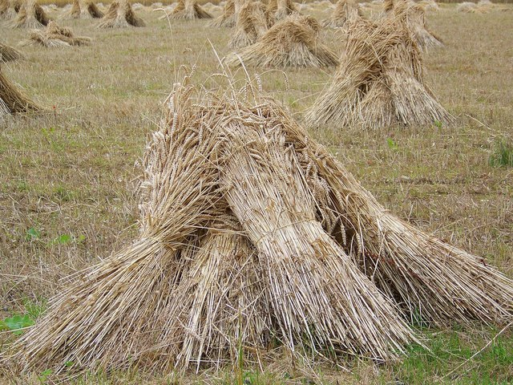
Modern day wheat sheaves.
Counting during the Omer gathering
Notes:
Not actually counting the Omer, although this is the terminology. Most of us don’t have any wheat to bundle into sheaves and count!

Slide 14


Omer counting app, available at the Google play store,
iPhone App Store.
Notes:
Some screenshots from my phone…

Slide 15
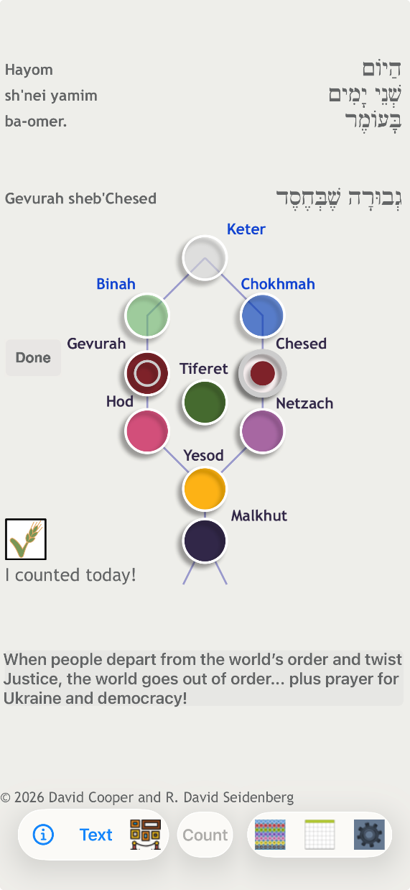
Notes:
Then you check off that you’ve counted to day, which reports to the Mossad that you are counted kosher.

Slide 16
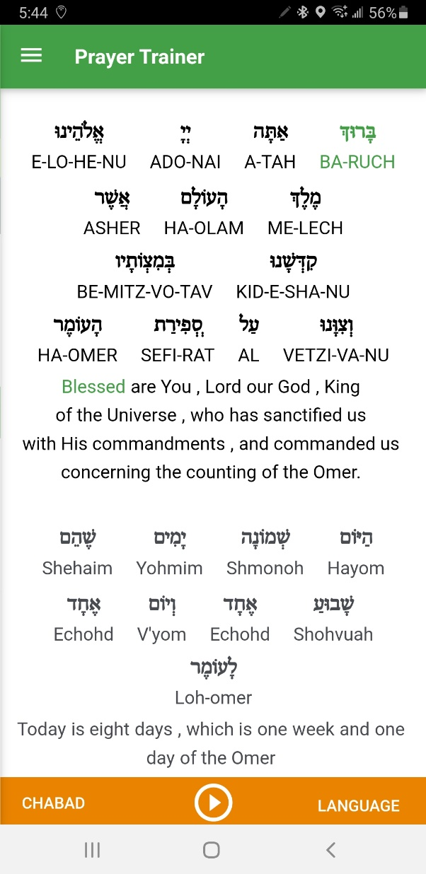
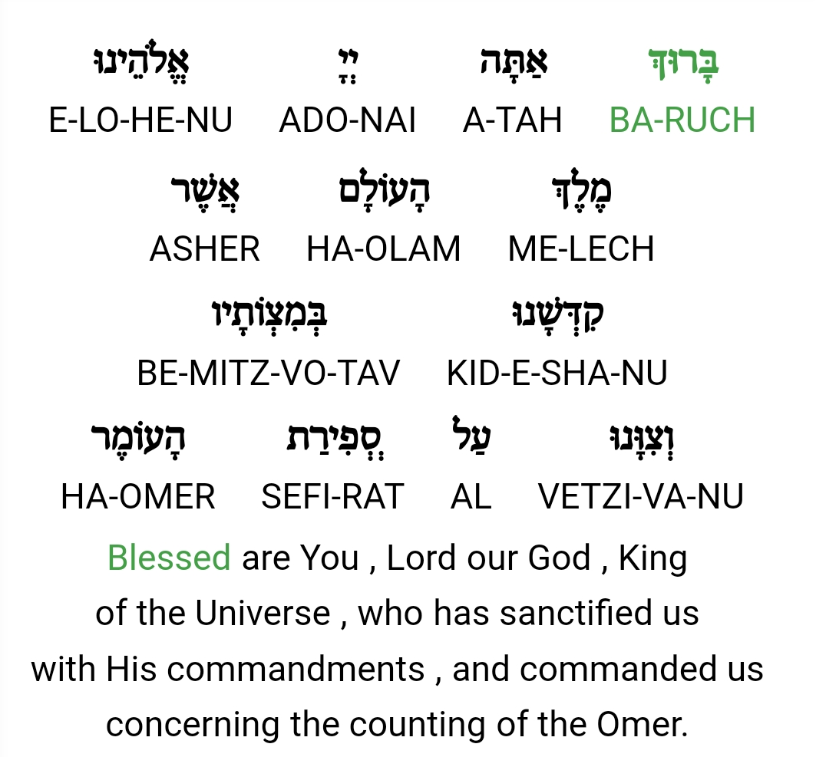
Notes:
Say with me, if it’s large enough to read.

Slide 17
This is the second day
of the Omer count.
הַיוֹם שִׁנֵי יָמִים לָעֹמֶר: 2.
Ha-yom shnay ya-meem la-Omer.

Slide 18
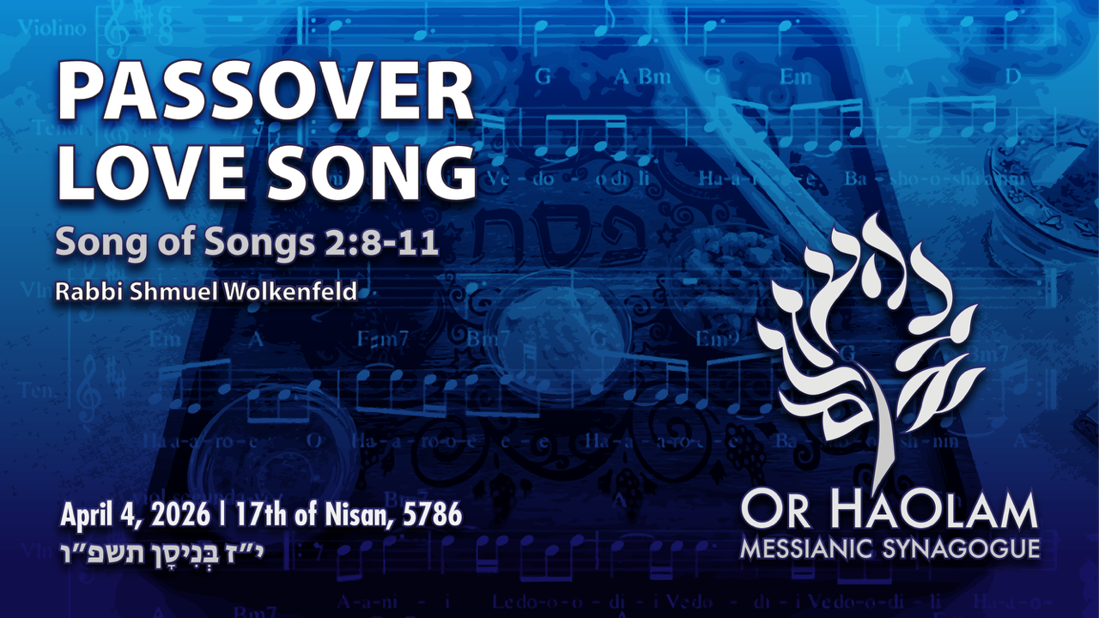
Notes:
As I was contemplating the message, I checked the parasha, the weekly reading, and I found something to my surprise that the Ruakh seemed to breathe on…

Slide 19
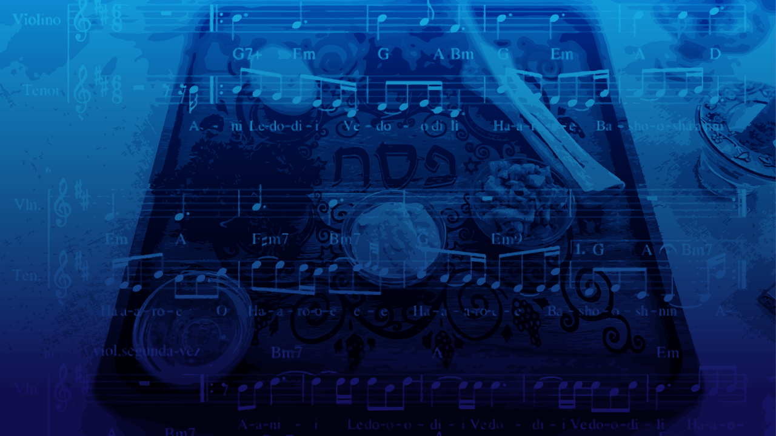
Passover Love Song
Hebrew organization of scripture
Song and Pesakh in the Spring
G-d has passionate love for Israel
Song, Pesakh, Yeshua Abduction
and Rescue
5. Apple analogy
6. Current Rescue
Notes:
Like the Song of Songs is about passionate love

Slide 20
Passover Love Song
Hebrew organization of scripture
Song and Pesakh in the Spring
G-d has passionate love for Israel
Song, Pesakh, Yeshua Abduction
and Rescue
5. Apple analogy
6. Current Rescue
Notes:
Like the Song of Songs is about passionate love

Slide 21
From Hebcal.com
Pesach III Saturday, April 4
Passover, the Feast of Unleavened Bread. Also called Hag HaMatzot (the Festival of Matzah), it commemorates the Exodus and freedom of the Israelites from ancient Egypt
Torah: Exodus 33:12-34:26; Numbers 28:19-25; Song of Songs 1:1-8:14
Notes:
Hebcal.com
Note:
Passover = Unleavened bread 14th & 15th Nisan, because usually people will slaughter a lamb Nisan 14, before eating it Nisan 15.
2nd day of the Omer = 3rd day of Passover
Almost NOTHING that all Jews agree on, except the weekly readings. Any synagogue around the world. Reading Song of Songs
Passover is about FREEDOM
The ancient rabbis associated that Passover freedom with the Song of Songs !!??

Slide 22
Context:
The Hebrew Bible or Jewish Bible or Tanakhתַּנַ״ךְ, [acronymn]:
the canonical collection of Hebrew scriptures, comprising
the Torah (the five Books of Moses)
the Nevi'im (the Books of the Prophets), and
the Ketuvim ('Writings', eleven books).
Notes:
https://en.wikipedia.org/wiki/Hebrew_Bible
Note T, N, K

Slide 23
Yeshua understood and used this organization of the scriptures
^{Lk 24.27} Then beginning with [Torah] Moshe and all the Prophets, He explained to them the things written about Himself in all the Scriptures.

Slide 24
The third and final section of the Hebrew Bible, Writings (Ketuvim), contains five scrolls called megillahs [megillot] that are read in synagogues on different Jewish holidays.
Esther is read on Purim — it tells the Purim story
Notes:
https://www.myjewishlearning.com/article/why-jews-read-the-song-of-songs-on-passover/

Slide 25
Lamentations, is read on Tisha B’Av because describes the prophets Yermiyahu / Jeremiah’s lament over the destruction of the Temple.
Ruth is read on Shavuot and
Ecclesiastes is read by some communities on Sukkot.
Notes:
https://www.myjewishlearning.com/article/why-jews-read-the-song-of-songs-on-passover/

Slide 26
Perhaps the most elusive connection of all is the one between Song of Songs (Shir Hashirim in Hebrew) and Passover.
Notes:
Why is this megillah/scroll read on Passover week, and how can we apply this to our lives?

Slide 27
Song of Songs is an erotic poem, Passover is a celebration of the freeing of the Israelites from Egyptian bondage. So, what’s the deep connection between the two, between passionate love, and Passover freedom?

Slide 29
Passover Love Song
Hebrew organization of scripture
Song and Pesakh in the Spring
G-d has passionate love for Israel
Song, Pesakh, Yeshua Abduction
and Rescue
5. Current Rescue

Slide 30
Song of Songs is set in springtime, just as Passover is.

Slide 31
Shir HaShirim (Song of Songs) 2:8
ק֣וֹל דּוֹדִ֔י הִנֵּה־זֶ֖ה בָּ֑א מְדַלֵּג֙ עַל־הֶ֣הָרִ֔ים מְקַפֵּ֖ץ עַל־הַגְּבָעֽוֹת׃
The voice of the man I love!
Here he comes, bounding over the mountains, skipping over the hills!

Slide 32
Shir HaShirim (Song of Songs) 2:9
דּוֹמֶ֤ה דוֹדִי֙ לִצְבִ֔י א֖וֹ לְעֹ֣פֶר הָאַיָּלִ֑ים הִנֵּה־זֶ֤ה עוֹמֵד֙ אַחַ֣ר כׇּתְלֵ֔נוּ מַשְׁגִּ֙יחַ֙ מִן־הַֽחַלֹּנ֔וֹת מֵצִ֖יץ מִן־הַחֲרַכִּֽים׃
My darling is like a gazelle or young stag. There he is, standing outside our wall, looking in through the windows, peering in through the lattice.

Slide 33
Shir HaShirim (Song of Songs) 2:10
עָנָ֥ה דוֹדִ֖י וְאָ֣מַר לִ֑י ק֥וּמִי לָ֛ךְ רַעְיָתִ֥י יָפָתִ֖י וּלְכִי־לָֽךְ׃
My darling speaks; he is saying to me, “Get up, my love! My beauty! Come away!
Notes:
Some say that this is a picture of the rapture of believers.

Slide 34
Shir HaShirim (Song of Songs) 2:11
כִּֽי־הִנֵּ֥ה הַסְּתָ֖ו עָבָ֑ר הַגֶּ֕שֶׁם חָלַ֖ף הָלַ֥ךְ לֽוֹ׃
“For you see that the winter has passed, the rain is finished and gone … ”

Slide 35
^{Song of Songs 2.12-15} Blossoms appear in the land, the time of singing has come, and the voice of the turtle-dove is heard in our land. The fig tree ripens its early figs. The blossoming vines give off their fragrance. Arise, come, my darling, my pretty one, and come, come!
Notes:
https://en.wikipedia.org/wiki/Hebrew_Bible

Slide 36
^{Song of Songs 2.12-15} My dove, in the clefts of the rock, in a secret place along the steep path, let me see your form, let me hear your voice. For your voice is sweet and your form is lovely.” Catch the foxes for us— the little foxes that ruin the vineyards, for our vineyards are in blossom.

Slide 37
So, Song of Songs is set in the Springtime:
Winter has passed
Doves are singing
Early figs ripening
Vines blossoming 2x

Slide 38
Passover is set in the Spring, the time of the barley harvest.
^{Shmot/Ex 9.31-33} The flax and barley were ruined, because the barley was ripe and the flax in bud. But the wheat and buckwheat were not ruined, because they come up later.
Notes:
Winter grains, come up in the Spring.
I’m a city boy, surprised to hear this, but grain harvest can be twice,
Fall planting → Spring harvest [biggest]
Spring planting → Fall harvest

Slide 39
^{Shmot/Ex 9.31-33} Moshe went out of the city, away from Pharaoh, and spread out his hands to Adoni. The thunder and hail ended, and the rain stopped pouring down on the earth.

Slide 40
Passover is set in the Spring, the time new life and freedom from confinement and cabin fever.
Think of your seder and week of matzah as
Z’man herutenu זמן חרותינו
Time of our freedom
Notes:
Freedom in company of those you love. Rescue!

Slide 42
Passover Love Song
Hebrew organization of scripture
Song and Pesakh in the Spring
G-d has passionate love for Israel
Song, Pesakh, Yeshua Abduction
and Rescue
5. Apple analogy
6. Current Rescue
Notes:
Like the Song of Songs is about passionate love

Slide 43
Jews have never read Song of Songs simply as a love story. Rather, since ancient times it has been understood in religious terms as an expression of the ardent covenantal love between God and the Jewish people.
Notes:
https://www.myjewishlearning.com/article/why-jews-read-the-song-of-songs-on-passover/

Slide 44
The marriage metaphor is found repeatedly in the Hebrew Bible, for example in Hosea (chapters 1–3), Ezekiel (chapter 16) and Jeremiah (especially chapter 2).
Notes:
https://www.myjewishlearning.com/article/why-jews-read-the-song-of-songs-on-passover/

Slide 45
^{Hoshea 2.10, 15} I Myself gave her the grain, the wine and the fresh oil. I lavished on her silver, also gold…adorning herself with her rings and jewelry, going after her lovers — However, Me she forgot.” It is a declaration of Adoni.

Slide 46
^{Hoshea 2.16-18} “So then, I Myself will entice her, I will bring her into the wilderness and speak to her heart. I will give her back her vineyards from there and make the valley of Achor a door of hope. She will respond there—
Notes:
Love of G-d for Israel and all of us,
Hoshea for his errant wife Gomer, and all husbands

Slide 47
^{Hoshea 2.16-18} as in the days of her youth, as in the day she came up out of the land of Egypt. In that day—it is a declaration of Adoni— you will proclaim, ‘My husband,’ and never again call Me, ‘My Baal.’

Slide 48
^{Y’khezkael/Ezek 16.8} “‘Again I passed by you, looked at you and saw that your time had come, the time for love. So, I spread my cloak over you to cover your private parts and entered into a covenant with you,’ says Adoni Elohim, ‘and you became mine.

Slide 49
^{Y’khezkael/Ezek 16.10-11} I also clothed you with an embroidered gown, gave you fine leather sandals to wear, put a fine linen headband on your head and covered you with silk. I gave you jewelry to wear, bracelets for your hands, a necklace for your neck,

Slide 50
^{Y’khezkael/Ezek 16.13-4} Thus you were decked out in gold and silver; your clothing was of fine linen, silk and richly embroidered cloth; you ate the finest flour, honey and olive oil. You grew increasingly beautiful — you were fit to be queen.

Slide 51
^{Y’khezkael/Ezek 16.13-4} Your fame spread among the nations because of your beauty, because it was perfect, due to my having bestowed my own splendor on you’ says Adoni Elohim.

Slide 52
^{Yermiyahu/Jer 2.1-3} Again, the word of Adoni came to me, saying: “Go, and cry in the ears of Jerusalem, saying, thus says Adoni: I remember the devotion of your youth, your love as a bride, and the way you followed Me in the wilderness, in a land not sown. Israel was kadosh to Adoni, the firstfruits of the harvest.

Slide 53
The saga of the Exodus from Egypt and the subsequent revelation at Mount Sinai is reminiscent of a larger-than-life love affair, G-d and His people, complete with
Notes:
https://www.myjewishlearning.com/article/why-jews-read-the-song-of-songs-on-passover/

Slide 54
forced separation at the hands of a villain (Pharaoh),
gallant rescue (the Exodus) and
eventual marriage [Sinai covenant]
Notes:
https://www.myjewishlearning.com/article/why-jews-read-the-song-of-songs-on-passover/

Slide 55
There is one place in the Song of Songs where there is a possible word picture of a abduction / seduction of the bride, and a rescue.

Slide 56
[He]
^{Song 6.10-12} “Who is this, shining forth like the dawn, fair as the moon, bright as the sun” — but formidable as an army marching under banners?

Slide 57
^{Song 6.10-12} [She]
I had gone down to the nut orchard to see the fresh green plants in the valley, to see if the vine had budded, or if the pomegranate trees were in bloom. Before I knew it, I found myself in a chariot, and with me was a prince.

Slide 58
^{Song 7.1} Come back, come back, girl from Shulam! Come back, come back to where we can see you!
[He, after rescue]
^{Song 7.7} How beautiful you are, my love, how charming, how delightful!

Slide 59
forced separation at the hands of a villain (Pharaoh),
gallant rescue (the Exodus) and
eventual marriage [Sinai covenant]
Notes:
https://www.myjewishlearning.com/article/why-jews-read-the-song-of-songs-on-passover/

Slide 60
These three aspects are certainly evident in the Messiah Yeshua’s rescue of us.

Slide 61
forced separation at the hands of a villain (Pharaoh),
gallant rescue (the Exodus) and
eventual marriage [Sinai covenant]
Notes:
https://www.myjewishlearning.com/article/why-jews-read-the-song-of-songs-on-passover/

Slide 63
^{1 Kefa /Peter 5.8} Stay alert! Watch out! Your adversary the devil prowls around like a roaring lion, searching for someone to devour.

Slide 64
^{2 Tim 2.24-26} The Lord’s slave must not be quarrelsome, but be kind to all, able to teach, tolerant. Let him give guidance with humility to those who are in opposition—perhaps God may grant them a change of mind, leading to the knowledge of truth.

Slide 65
^{2 Tim 2.24-26} Then they may regain their senses and escape the devil’s snare, in which they had been held captive by him to do his will.

Slide 66
forced separation at the hands of a villain (Pharaoh),
gallant rescue (the Exodus) and
eventual marriage [Sinai covenant]
Notes:
https://www.myjewishlearning.com/article/why-jews-read-the-song-of-songs-on-passover/
G-d rescued us with the plagues that convinced Pharaoh, then the splitting of the Sea of Reed.

Slide 67
^{Ro 5.6-11} For while we were still helpless, at the right time, the Messiah died on behalf of ungodly people. Now it is a rare event when someone gives up his life even for the sake of somebody righteous, although possibly for a truly good person one might have the courage to die.

Slide 68
^{Ro 5.6-11} But God demonstrates his own love for us in that the Messiah died on our behalf while we were still sinners. Therefore, since we have now come to be considered righteous by means of his bloody sacrificial death, how much more will we be delivered through him from the anger of God’s judgment!

Slide 69
^{Ro 5.6-11} For if we were reconciled with God through his Son’s death when we were enemies, how much more will we be delivered by his life, now that we are reconciled! And not only will we be delivered in the future,

Slide 70
^{Ro 5.6-11} but we are boasting about God right now, because he has acted through our Lord Yeshua the Messiah, through whom we have already received that reconciliation.

Slide 71
forced separation at the hands of a villain (Pharaoh),
gallant rescue (the Exodus) and
eventual marriage [Sinai covenant]
Notes:
https://www.myjewishlearning.com/article/why-jews-read-the-song-of-songs-on-passover/

Slide 72
^{Shmot/Ex 19.4-6}‘You have seen what I did to the Egyptians, and how I carried you on eagles’ wings and brought you to myself. Now if you will pay careful attention to what I say and keep my covenant,

Slide 73
^{Shmot/Ex 19.4-6} then you will be my own treasure from among all the peoples, for all the earth is mine; and you will be a kingdom of cohanim for me, a nation set apart.’ These are the words you are to speak to the people of Isra’el.”
Notes:
Israel’s covenantal marriage with G-d at Mt Sinai

Slide 74
^{Yn 14.19-21} In just a little while, the world will no longer see me; but you will see me. Because I live, you too will live. When that day comes, you will know that I am united with my Father, and you with me, and I with you.

Slide 75
^{Yn 14.19-21} Whoever has my commands and keeps them is the one who loves me, and the one who loves me will be loved by my Father, and I will love him and reveal myself to him.”

Slide 76
^{Yn 14.26} Yeshua answered him, “If someone loves me, he will keep my word; and my Father will love him, and we will come to him and make our home with him.

Slide 77
^{Lk 22.14-15} When the hour came, Yeshua reclined at table, and the emissaries with Him. And He said to them, “I have eagerly desired to eat this Passover with you before I suffer.
^{KJV} “With desire I have desired to eat this Passover with you
Notes:
Passover is a love fest of family and friends. Exodus is like a Song of Songs betrothal

Slide 78
Said at the close of Yeshua’s Last Seder
^{Yn 17.22-23} The glory that You have given to Me I have given to them, that they may be one just as We are one — I in them and You in Me—that they may be perfected in unity, so that the world may know that You sent Me and loved them as You loved Me.

Slide 80
Passover Love Song
Hebrew organization of scripture
Song and Pesakh in the Spring
G-d has passionate love for Israel
Song, Pesakh, Yeshua Abduction
and Rescue
5. Apple analogy
6. Current Rescue
Notes:
Like the Song of Songs is about passionate love

Slide 81
^{Song 2.3-6} Like an apple tree among the other trees in the forest is my darling among the other men. I love to sit in his shadow; his fruit is sweet to my taste. He brings me to the banquet hall; his banner over me is love.

Slide 82
^{Song 2.3-6} Sustain me with raisins, refresh me with apples, for I am sick with love.[I wish] his left arm [were] under my head, and his right arm around me.

Slide 83
Just as an apple produces blossoms before leaves, so the Israelites at Mount Sinai undertook to do even before they had heard what they were supposed to do:

Slide 84
^{Shmot/Ex 19.7-8} Moshe came, summoned the leaders of the people and presented them with all these words which Adoni had ordered him to say. All the people answered as one, “Everything Adoni has said, we will do.”
[Hadn’t heard yet.]

Slide 85
^{1 Kefa 1.6-9} You rejoice in this greatly, even though now for a little while, if necessary, you have been distressed by various trials. These trials are so that the true metal of your faith (far more valuable than gold, which perishes though refined by fire) may come to light

Slide 86
^{1 Kefa 1.6-9} in praise and glory and honor at the revelation of Messiah Yeshua. Though you have not seen Him, you love Him. And even though you don’t see Him now, you trust Him and are filled with a joy that is glorious beyond words, receiving the outcome of your faith—the salvation of your souls.

Slide 87
An apple tree takes 50 days to ripen — just as the Israelites received the Torah 50 days after they left Egypt.
Notes:
https://www.myjewishlearning.com/article/why-jews-read-the-song-of-songs-on-passover/

Slide 89
Passover Love Song
Hebrew organization of scripture
Song and Pesakh in the Spring
G-d has passionate love for Israel
Song, Pesakh, Yeshua Abduction
and Rescue
5. Apple analogy
6. Current Rescue
Notes:
Like the Song of Songs is about passionate love

Slide 90
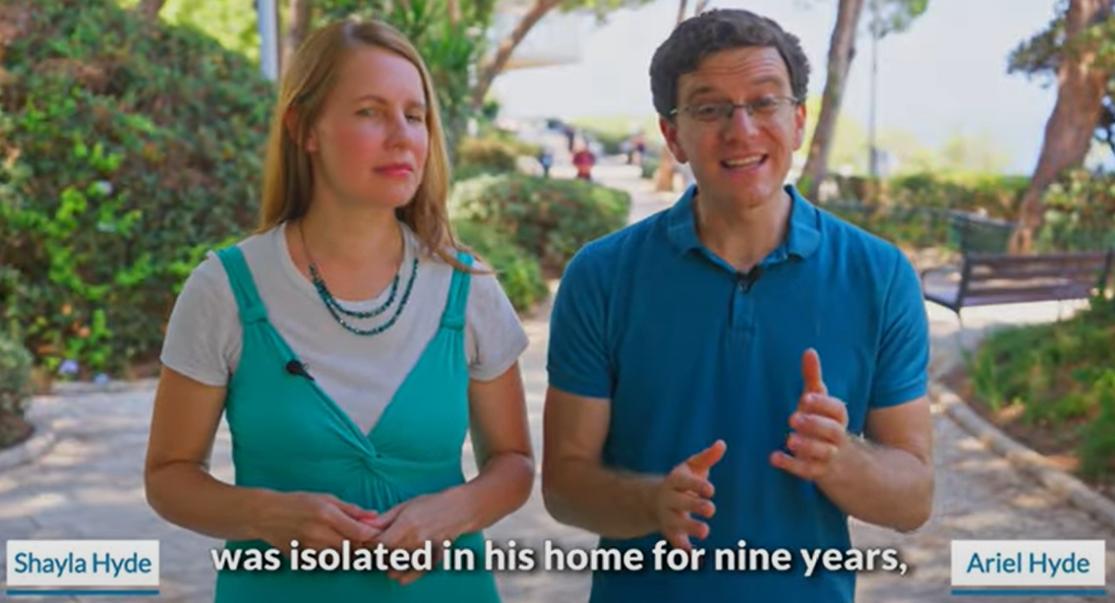
Notes:
We have hosted his mom, Carolyn Hyde, for a concert in our old building. We ALL ate in their home on a tour about 10 years ago.
https://youtu.be/hZAPuOThXpw
https://youtu.be/oIbGl5GwNvw

Slide 91
World Cup Spiritual Rescue
104 games will take place in the 2026 World Cup across the USA, Mexico, and Canada with 16 different host cities selected and the schedule confirmed.

Slide 92
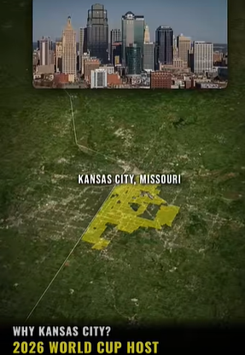

Slide 93
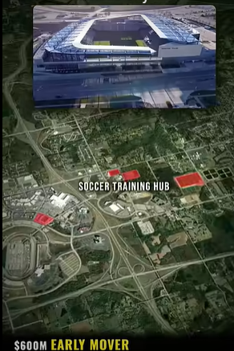

Slide 94
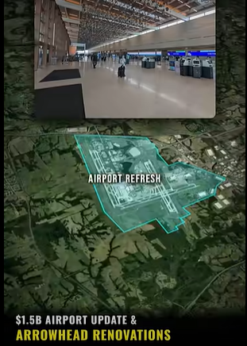

Slide 95
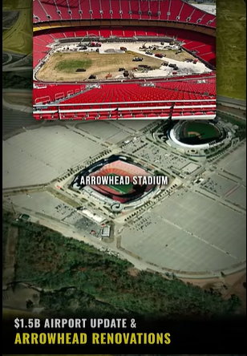

Slide 96
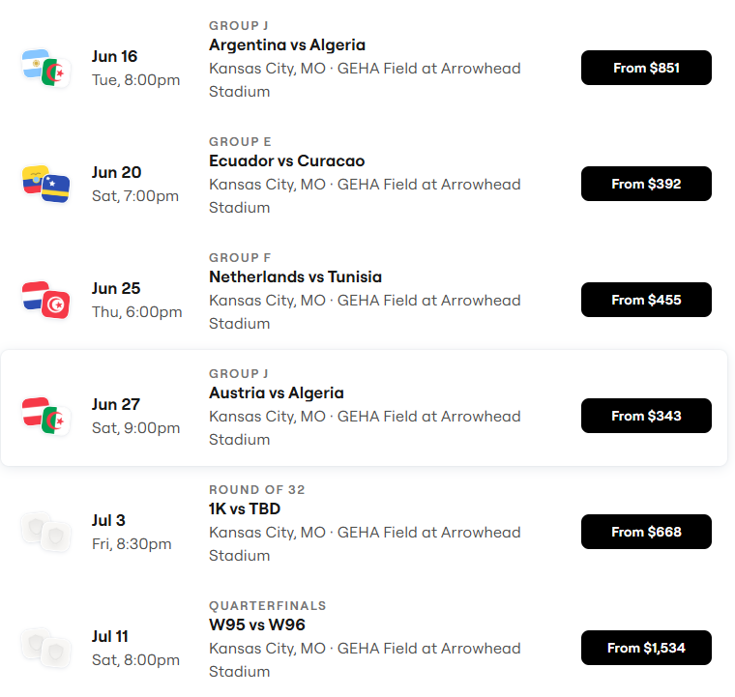
World Cup Schedule
~700,000 visitors to KC!

Slide 97
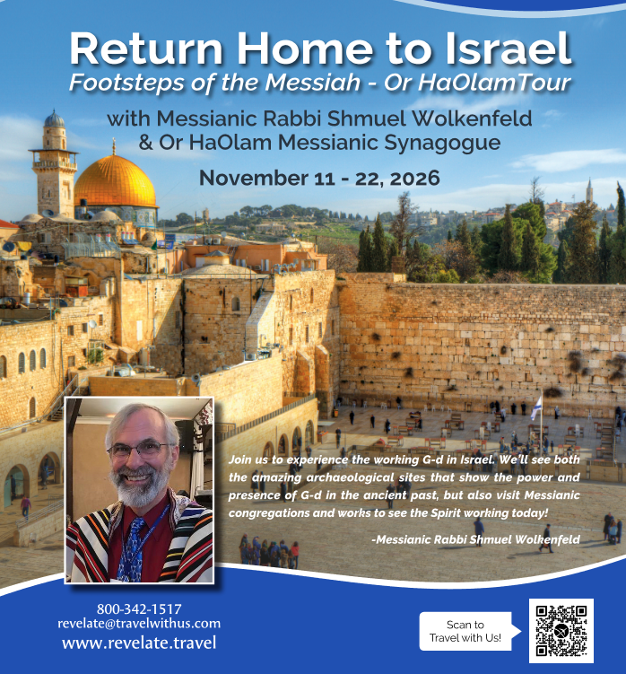

Slide 99
Passover Love Song
Hebrew organization of scripture
Song and Pesakh in the Spring
G-d has passionate love for Israel
Song, Pesakh, Yeshua Abduction
and Rescue
5. Apple analogy
6. Current Rescue
Notes:
Like the Song of Songs is about passionate love

