Slide 1
Engineers' Conversion Table
2000 mockingbirds =
2 kilomockingbirds

Slide 2
Engineers' Conversion Table
52 cards =
1 decacards

Slide 3
Engineers' Conversion Table
1 kilogram of falling figs =
1 figNewton
Notes:
OK for 12/6
I don’t play cards hardly at all, but learned a few games as a kid. In poker there is a royal flush. New interp

Slide 4
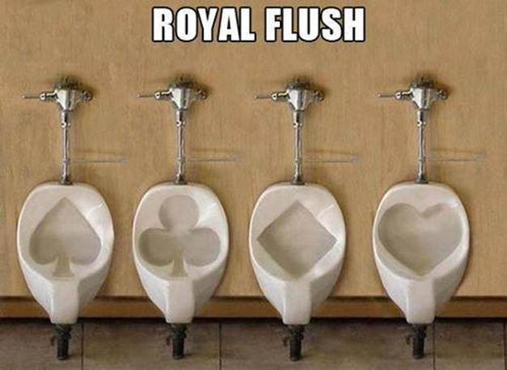

Slide 5
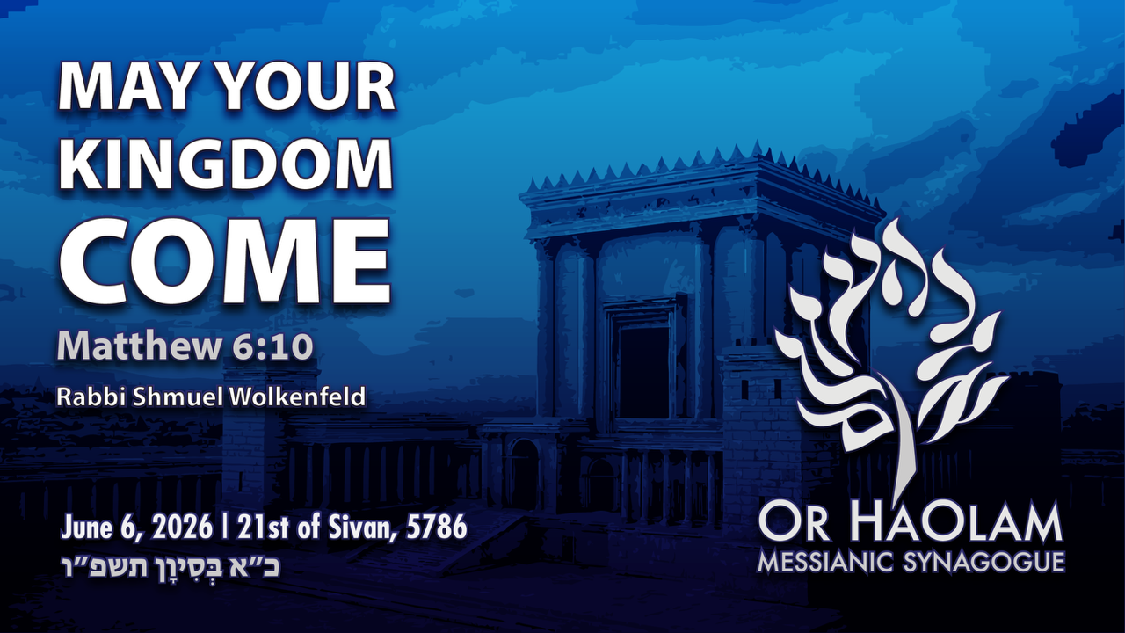
Notes:
54x “kingdom” in Mtt

Slide 6

May Your Kingdom Come Mtt 6.10
Tenakh on G-ds kingship
Matityahu on the Kingdom
Applications

Slide 7
Mattityahu (Matthew) 6.10
10תָּבוֹא מַלְכוּתְךָ יֵעָשֶׂה רְצוֹנְךָ כְּבַשָּׁמַיִם כֵּן בָּאָרֶץ.
10 May your Kingdom come, your will be done on earth as in heaven.
the realm in which a king sovereignly rules
Notes:
Now Kingdom.
None of these new concepts to Jewish ears.
Kingdom of G-d? = Kingdom of Heaven, avoiding saying divine names/titles.

Slide 8
^{Shmot/Ex 20.2} I am ADONI your God
^{Dvarim/Dt. 6.4-5} שמע ישראל
Shma Yisrael. Hear, Isra'el! ADONI our God, ADONI is one. You are to love ADONI your God with all your heart, all your being and all your resources.
Notes:
Shmot 20.2 Kingship claimed over Israel
Invisible Kingdom, Universal Kingdom, National Kingdom

Slide 9
The ancient commentators and rabbis viewed reciting this as taking on the yoke of the Kingdom of Heaven,
ol malkut HaShamayim,
עול מלכות השמים

Slide 10
^{T’hillim/Ps 93.1-2} ADONI is king, robed in majesty; ADONI is robed, girded with strength; The world is well established; it cannot be moved. Your throne was established long ago; you have existed forever.
Notes:
Universal kingdom

Slide 11
^{T’hillim/Ps 2.6-7} "I myself have installed my king on Tziyon, my holy mountain. I will proclaim the decree: ADONI said to me, 'You are my son; today I became your father.’
Notes:
Picture of Adoni as King, and the arm of the wicked broken. National Kingdom

Slide 12
^{T’hillim/Ps 10.15-16} Break the arm of the wicked! As for the evil man, search out his wickedness until there is none left. ADONI is king forever and ever!
Notes:
Picture of Adoni as King, and the arm of the wicked broken. National Kingdom

Slide 13
The rulership of the KING
^{Yeshayahu/Is 2.2-3} In the אחרית הימים akharit-hayamim end of days the mountain of ADONI’s house will be established as the most important mountain…Many peoples will go and say, “Come, let's go up to the mountain of of ADONI…
Notes:
A kingdom reigning, His laws obeyed, no challenging wars

Slide 14
The rulership of the KING
^{Yeshayahu/Is 2.2-3} Many peoples will go and say, “Come, let's go up to the mountain …He will teach us about his ways, and we will walk in his paths.” For out of Tziyon will go forth Torah, the word of ADONI from Yerushalayim.
Notes:
In the end of days…A kingdom reigning, His laws obeyed, no challenging wars

Slide 15
The rulership of the KING
^{Yeshayahu/Is 2.4} He will judge between the nations and arbitrate for many peoples. Then they will hammer their swords into plow-blades and their spears into pruning-knives; nations will not raise swords at each other, and they will no longer learn war.

Slide 16
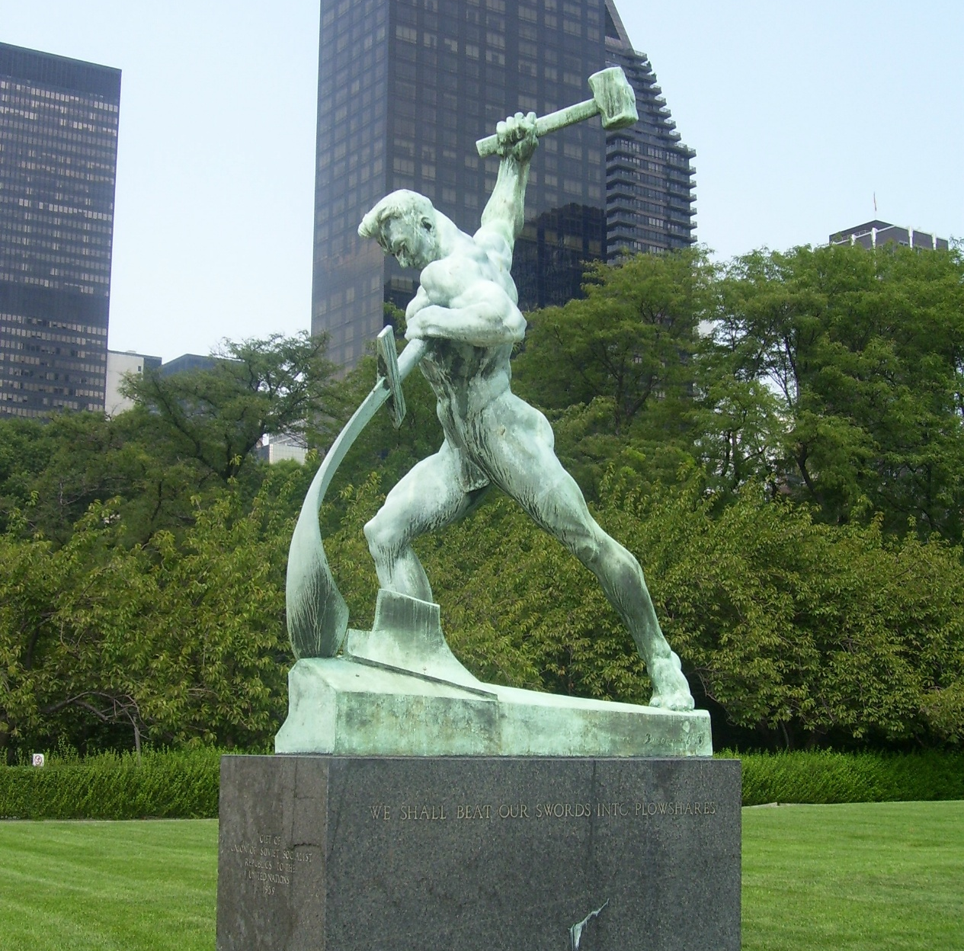
Notes:
Outside the United Nations headquarters in NYC, on the East River. Beating sword into a plow.

Slide 17
Even nature would be transformed by the King
^{Yeshayahu/Is 11.5-6} Justice will be the belt around his waist, faithfulness the sash around his hips. The wolf will live with the lamb; the leopard lie down with the kid; calf, young lion and fattened lamb together, with a little child to lead them.

Slide 18
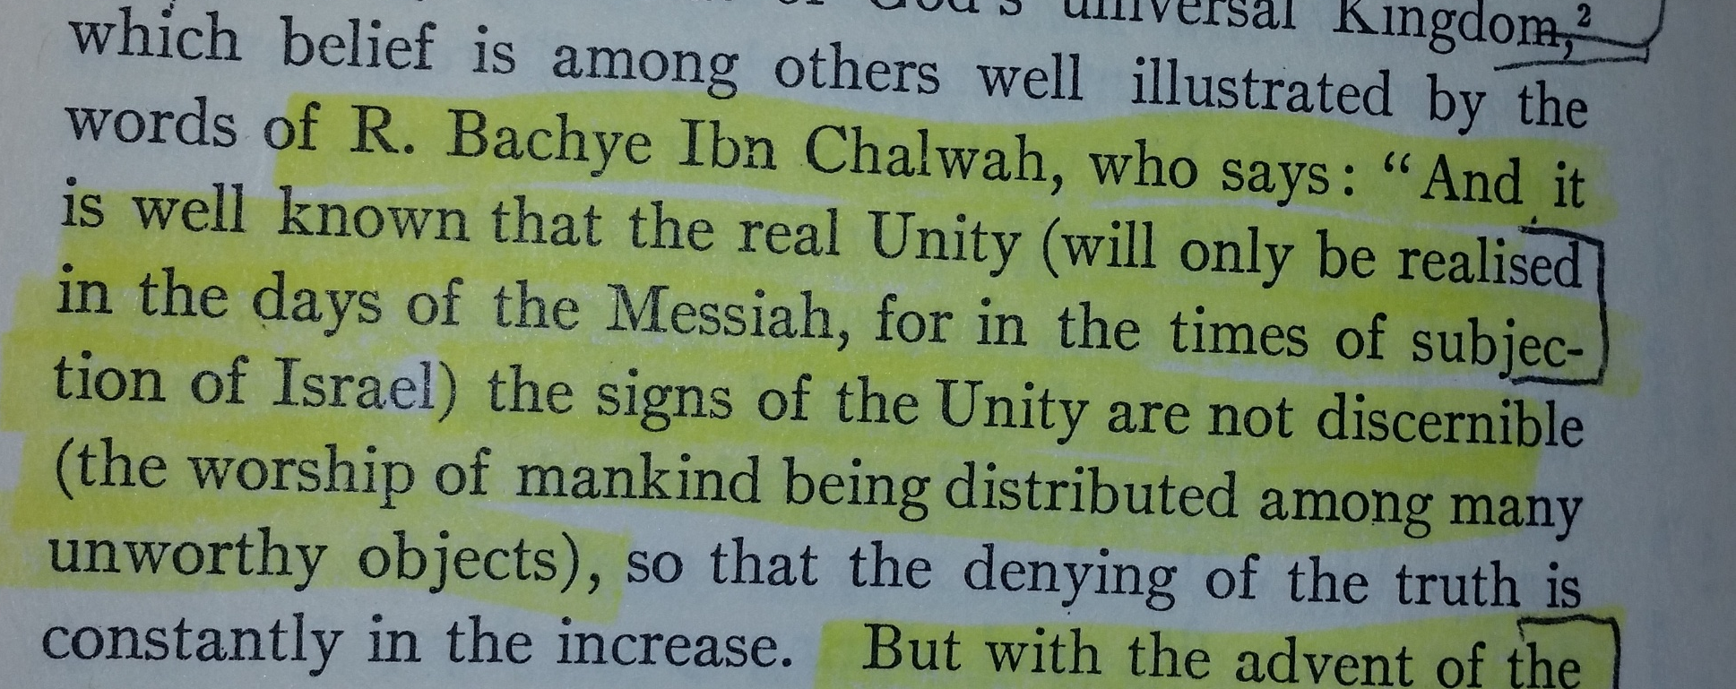
Notes:
Solomon Schechter, Aspects of Rabbinic Theology p 96, 1969 printing

Slide 19

Notes:
Solomon Schechter, Aspects of Rabbinic Theology p 96, 1969 printing

Slide 20
^{Zekh 14.9} Then ADONI will be king over the whole world. On that day ADONI will be the only one, and his name will be the only name.
Notes:
Expectation of Israel: Invisible Kingdom of loving G-d, Universal Kingdom over nature, National Kingdom to come. Yeshua ישוע entered this understanding.

Slide 21
^{T’hillim/Ps 45.1-8} A lovesong: My heart is stirred by a noble theme; I address my verses to the king;…You are the most handsome of men; gracious speech flows from your lips. For God has blessed you forever.
Notes:
Kingdom of G-d is a romance. Daveed HaMelekh, King David, knew this in Ps 23, but richer, universal, King has come to us.
May your kingdom come: may you dance with the King, admire His beauty. He delights in you!! Yeshua ישוע thinks you are delightful, fascinating.
^{Yer 2.2-3} "Go and shout in the ears of Yerushalayim that this is what ADONI says: 'I remember your devotion when you were young; how, as a bride, you loved me; how you followed me through the desert, through a land not sown. "'Isra'el is set aside for ADONI, the firstfruits of his harvest;

Slide 22
^{T’hillim/Ps 45.1-8} Warrior, strap your sword at your thigh; [gird on] your splendor and majesty. In your majesty, succeed, ride on in the cause of truth, meekness and righteousness…

Slide 23
^{T’hillim/Ps 45.1-8} Your throne, God, will last forever and ever; you rule your kingdom with a scepter of equity. You have loved righteousness and hated wickedness.
Notes:
Enter into time with the King. The King who is G-d. One of the key deity of Messiah texts. Daily He wants to hear your voice, your heart. You to hear Him.
King is filled with JOY of heaven.
Note: addressed to G-d

Slide 24
^{T’hillim/Ps 45.1-8} Therefore God, your God, has anointed you with the oil of joy in preference to your companions. Your robes are all fragrant with myrrh, aloes and cassia; from ivory palaces stringed instruments bring you joy.
Notes:
Note the duality of Divine persons, addressed to
G-d, yet the G-d of G-d!

Slide 25
Notes:
54x “kingdom” in Mtt

Slide 26
May Your Kingdom Come Mtt 6.10
Tenakh on G-ds kingship
Matityahu on the Kingdom
Applications

Slide 27


Slide 28
especially refers to the rule of Messiah in believers' hearts – which is a rule that “one day will be universal on the physical earth in the Millennium.”

Slide 29
By Yokhanan the immerser:
^{Mtt 3.2} “Turn from your sins to God, for the Kingdom of Heaven is near!”
Later in Mt 4.17 same words by Yeshua himself
Notes:
Much of Israel under the P’rushim/ Pharisees and believed in Ro 10.2-3 For I testify about them that they have zeal for God—but not based on knowledge. ³ For being ignorant of God’s righteousness and seeking to establish their own, they did not submit themselves to the righteousness of God.
Others following Tsdukim / Sadducees denied the resurrection of the dead
Zealots: resisting Rome will set up the Kingdom
K/H For Messiah is the goal^{[a]} of the Torah as a means to righteousness for everyone who keeps trusting.
If Israel do not repent, they will never be redeemed; but as soon as they repent, they will be redeemed; yea, if they repent but one day, immediately the son of David will come.’ ^{Bab. Sanhed. fol. 97. 2.}

Slide 30
^{Mt 4.23} Yeshua went all over the Galil teaching in their synagogues, proclaiming the Good News of the Kingdom
Notes:
the good news of the kingdom of the Messiah being come, and which now took place; wherefore he exhorted them to repent of, and relinquish their former principles;

Slide 31
^{Mtt 5.3} How blessed are the poor in spirit! for the Kingdom of Heaven is theirs.
Notes:
The greater part of mankind are insensible of this their condition; but think themselves rich, and increased with goods: there are some who are sensible of it, who see their poverty and want, freely acknowledge it, bewail it.
The message not only reaches their ears, but their hearts; it enters into them, is applied unto them, they receive and embrace it with the utmost joy and gladness; but eternal glory, this is prepared for them, and given to them; they are born heirs of it, have a right unto it, are making meet for it, and shall enjoy it.

Slide 32
^{Matt 5.10} How blessed are those who are persecuted because they pursue righteousness! for the Kingdom of Heaven is theirs.
Notes:
How often we are persecuted only for our faults. Our dysfunction, toxicity: Too little devotion, too much time away.
Rarely truly only, usually mixed “Blessed are you when people revile you and persecute you and say all kinds of evil against you falsely, on account of Me.”

Slide 33
^{Mtt 5.19-20} So whoever disobeys the least of these mitzvot and teaches others to do so will be called the least in the Kingdom of Heaven. But whoever obeys them and so teaches will be called great in the Kingdom of Heaven.

Slide 34
^{Mtt 5.19-20} For I tell you that unless your righteousness is far greater than that of the Torah-teachers and P’rushim, you will certainly not enter the Kingdom of Heaven!

Slide 35
^{Mtt 6.33} But seek first his Kingdom and his righteousness, and all these things will be given to you as well.
Notes:
Healthy balance

Slide 36
^{Mtt 11.11} Yes! I tell you that among those born of women there has not arisen anyone greater than Yochanan the Immerser! Yet the one who is least in the Kingdom of Heaven is greater than he!
Notes:
^{1 Kefa/Peter 1.12} And these same things have now been proclaimed to you by those who communicated the Good News to you through the Ruach HaKodesh sent from heaven. Even angels long to look into these things!

Slide 37
^{Mtt 11.12} From the time of Yokhanan the Immerser until now, the Kingdom of Heaven has been suffering violence; yes, violent ones are trying to snatch it away.
Notes:
This is really the heart of the message [John Gill’s wording revised slightly]: We who were under violent apprehensions of wrath and vengeance, of our lost and undone state and condition by nature; are now “violently” in love with Messiah, and desperately desirous of salvation by Him, and communion with Him; and have our affections set upon the things of another world: these having the good news preached to us, which is a declaration of God's love to sinners, a proclamation of peace and pardon, and a publication of righteousness and life by the Messiah, we greedily sought it, and embraced it.
“I won’t be denied” “I will pray daily: self, family.”

Slide 38
^{Mtt 12.25} However, knowing what they were thinking, Yeshua said to them, “Every kingdom divided against itself will be ruined, and every city or household divided against itself will not survive.

Slide 39
^{Mtt 13.19,23} Whoever hears the message about the Kingdom, but doesn’t understand it, is like the seed sown along the path — the Evil One comes and seizes what was sown in his heart...

Slide 40
^{Mtt 13.19,23} However, what was sown on rich soil is the one who hears the message and understands it; such a person will surely bear fruit, a hundred or sixty or thirty times what was sown.”

Slide 41
^{Mtt 13.31-32} Yeshua put before them another parable. “The Kingdom of Heaven is like a mustard seed which a man takes and sows in his field. It is the smallest of all seeds, but when it grows up it is larger than any garden plant

Slide 42
^{Mtt 13.31-32} and becomes a tree, so that the birds flying about come and nest in its branches.”
Surprising exposition:

Slide 43
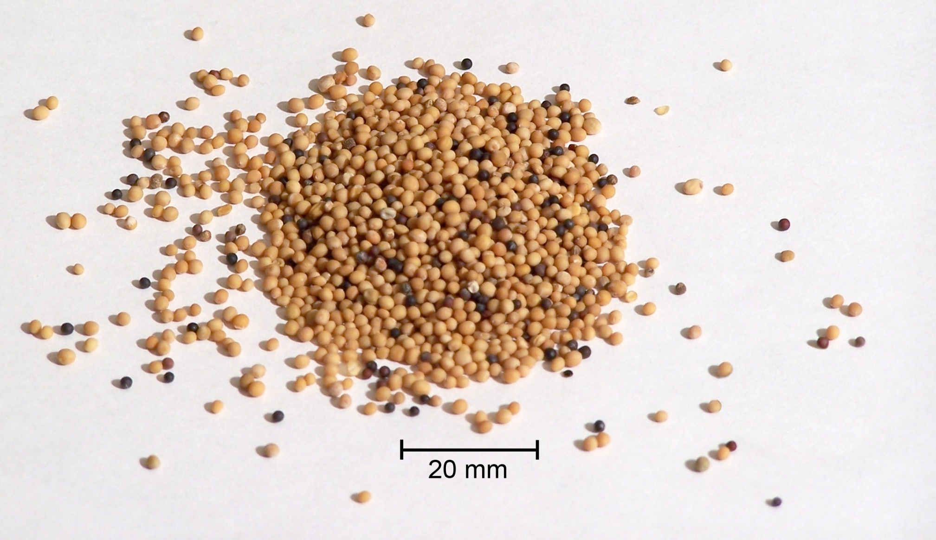
about 1/16 in each
Notes:
Not precise speech necessarily, but: very small. Phrase is often used, literature of the day, proverbially T. Bab. Beracot, fol. 31. 1. Megilla, fol. 23. 2. Nidda, fol. 66. 1., for the least thing, little, mean, and contemptible,
Kingdom of Yeshua: lead by executed Messiah, followers of varying socio-economic status, some broken defiled, uneducated, emotionally, all this Jewish affiliation [“You want to be associated with Jews?”]

Slide 44
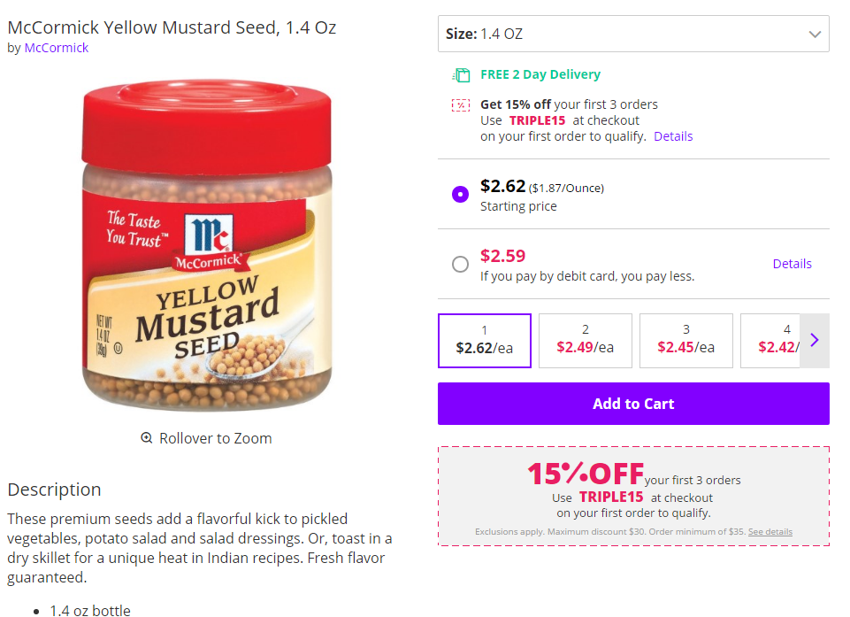
Notes:
$2.62 for 1.4 oz, not expensive

Slide 45
Mattityahu (Matthew) 13:32
אַךְ לְאַחַר צְמִיחָתוֹ גָּדוֹל הוּא מִן הַיְּרָקוֹת
But when it grows up it is larger
than any garden plant.“
lachanōn λαχάνων an herb, garden plant, vegetable: no woody tissue.
Notes:
Keep that in mind «No woody tissue» in a lachanon

Slide 46
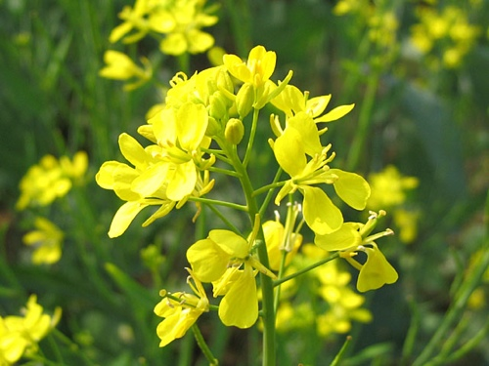

Slide 47
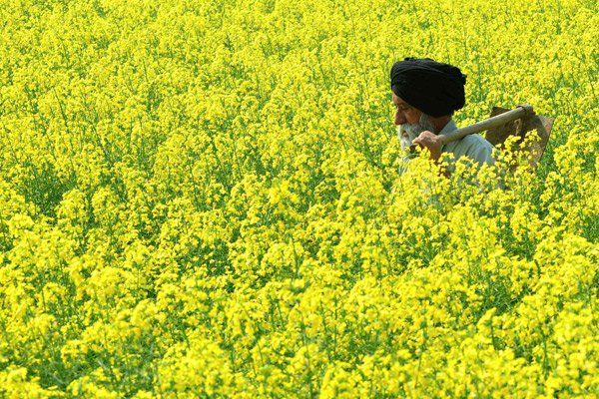
An Indian farmer walks through
a mustard field in Baran village
Notes:
It IS a tall herb, but still an herb, not woody.

Slide 48
lachanōn λαχάνων an herb, garden plant, vegetable
no woody tissue
Annual, not perenial. Needs replanting from seed annually.
Notes:
Not rigid or brittle, soft, succulent, with medicinal value. NOT: “My way or the highway” in non-essentials. ^{Eph 4.29-32} Let no harmful word come out of your mouth, but only what is beneficial for building others up according to the need, so that it gives grace to those who hear it. Do not grieve the Ruach ha-Kodesh of God, by whom you were sealed for the day of redemption. Get rid of all bitterness and rage and anger and quarreling and slander, along with all malice. Instead, be kind to one another, compassionate, forgiving each other just as God in Messiah also forgave you. Subtle
Annual: NOT permanent. Dependent on new LIFE in the Ruakh. Effort in prayer to keep life in an organization for many generations. Easy to rigidify.

Slide 49
Mattityahu (Matthew) 13:32
וְהוֹפֵךְ לְעֵץ, כָּךְ שֶׁעוֹפוֹת הַשָּׁמַיִם בָּאִים וּמְקַנְּנִים בֵּין עֲנָפָיו."
and becomes a tree, so that the birds flying about come and nest in its branches.
Birds are a metaphor for cursed desolation.
Notes:
Not supposed to be a tree. Mutation.

Slide 50
^{Rev 18.2} He cried out with a mighty voice, saying: “Fallen, fallen is Babylon the great! She has become a den for demons,
a haunt for every unclean spirit
and for every unclean bird
and for every unclean and detestable beast.
Notes:
Hebrew poetry style was parallelism, repeating phrases in slightly different wording.

Slide 51
^{Yeshayahu / Is 34} ADONI is angry at every nation… "For my sword has drunk its fill in heaven; now it descends on Edom to judge them, the people I have doomed to destruction. “Its smoke will rise forever. In all generations it will lie waste;
Notes:
Edom sometimes understood as Rome

Slide 52
no one will pass through it ever again. Horned owl and hawk will possess it, screech owl and raven will live there; he will stretch over it the measuring line of confusion and the plumbline of the empty void…

Slide 53
Thorns will overgrow its palaces… Lilit [the night monster] will lurk there and find herself a place to rest. There the hoot owl will nest, lay her eggs, hatch and gather her young in its shade. There the vultures will assemble, every one with its mate.

Slide 54
Yet, “The Kingdom of Heaven is like…”
Still the Kingdom of Heaven?
Tree: rigid, controls environment [good and bad O₂ ], permanent

Slide 55
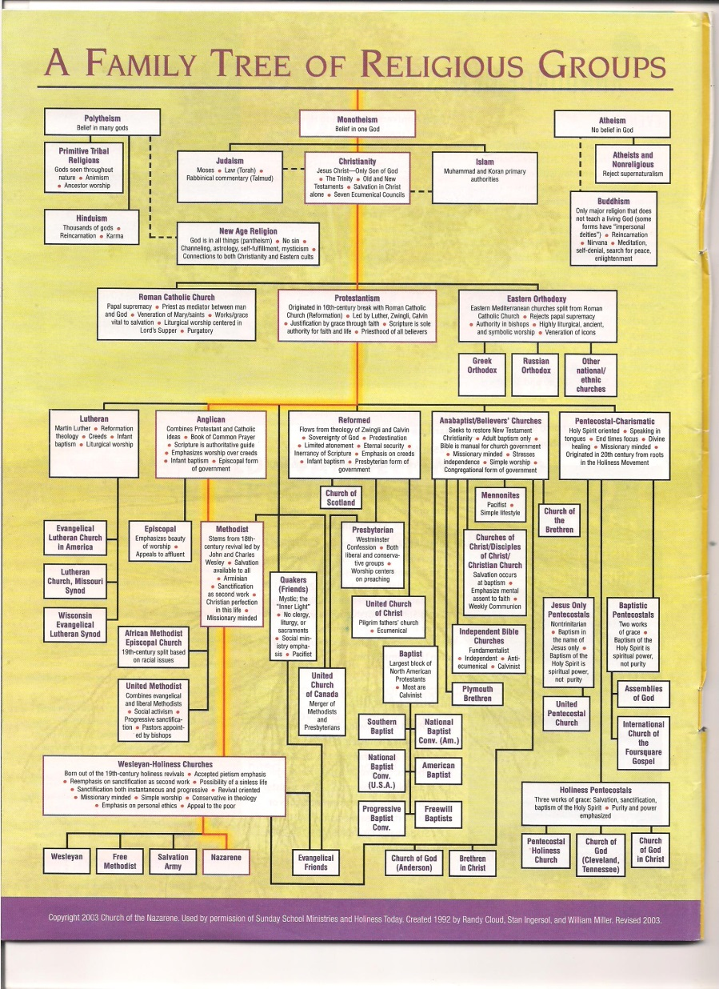
Notes:
Was a glorious spiritual awakening. Love, joy, peace. Living organism → many organizations
Need organization, but often fossilization.

Slide 56
Notes:
Composed by Daniel Ketchum, a Nazarene, so red line to them. I would have put the Pentecostal-Charismatics as under the Wesleyan Holiness box, which he says in the text.

Slide 57
^{Mt 13.47-50} “Once more, the Kingdom of Heaven is like a net thrown into the lake, that caught all kinds of fish. When it was full, the fishermen brought the net up onto the shore, sat down and collected the good fish in baskets, but threw the bad fish away.

Slide 58
^{Mt 13.47-50} So it will be at the close of the age — the angels will go forth and separate the evil people from among the righteous and throw them into the fiery furnace, where they will wail and grind their teeth.
Notes:
Why we have to be internally “violent.” Not all in the community are in the kingdom.

Slide 59
Statement of Yeshua’s Deity

Slide 60
^{Mt 16.18-20} “I also tell you this: you are Kefa,” [which means ‘Rock,’] “and on this rock ["solid or native rock, rising up through the earth] I will build my Community, and the gates of Sh’ol will not overcome it.
Notes:
He will build the community. We don’t have to stress over results…just faithfulness, internally violent faithfulness.

Slide 61
^{Mt 16.18-20} I will give you the keys of the Kingdom of Heaven. Whatever you prohibit on earth will be prohibited in heaven, and whatever you permit on earth will be permitted in heaven.”

Slide 62
^{Mtt 18.1-4} At that moment the talmidim came to Yeshua and asked, “Who is the greatest in the Kingdom of Heaven?” He called a child to him, stood him among them, and said, “Yes! I tell you that unless you change and become like little children,

Slide 63
^{Mtt 18.1-4} you won’t even enter the Kingdom of Heaven! So the greatest in the Kingdom is whoever makes himself as humble as this child.

Slide 64
^{Mtt.22.1-4} Yeshua again used parables in speaking to them: “The Kingdom of Heaven is like a king who prepared a wedding feast for his son, but when he sent his slaves to summon the invited guests to the wedding, they refused to come. So he sent some more slaves, instructing them to tell the guests,

Slide 65
^{Mtt.22.1-4} ‘Look, I’ve prepared my banquet, I’ve slaughtered my bulls and my fattened cattle, and everything is ready. Come to the wedding!’
Notes:
Desperate for outreach.

Slide 66
^{Matthew 23:13} “But woe to you hypocritical Torah-teachers and P’rushim! For you are shutting the Kingdom of Heaven in people’s faces, neither entering yourselves nor allowing those who wish to enter to do so.
Notes:
Violent about consistency.

Slide 67
^{Mtt 24.4-5,14} Yeshua replied: “Watch out! Don’t let anyone fool you! For many will come in my name, saying, ‘I am the Messiah!’ and they will lead many astray…And this Good News about the Kingdom will be announced throughout the whole world as a witness to all the Goyim. It is then that the end will come.

Slide 68
Notes:
54x “kingdom” in Mtt

Slide 69
May Your Kingdom Come Mtt 6.10
Tenakh on G-ds kingship
Matityahu on the Kingdom
Applications

Slide 70
^{Ro 14.17} The Kingdom of God is not eating and drinking, but righteousness, shalom and joy in the Ruakh HaKodesh.
^{1 Cor. 4.20} For the Kingdom of God is not a matter of words but of power.
Notes:
Yeshua ישוע came not to make bad people good, but to make dead people alive.
the powerful efficacy of the Spirit, attending the preaching of the Gospel to the quickening of dead sinners, the enlightening of blind eyes, and unstopping of deaf ears; the softening of hard hearts, the delivering of persons from the slavery of sin and Satan, the transforming and renewing of them both inwardly and outwardly; and to the comforting, enlivening, strengthening, and establishing of the saints; all which can never be ascribed to the persuasive language of men, but to the power of God;

Slide 71
^{John 15.11-13} I have said this to you so that my joy may be in you, and your joy be complete. This is my command: that you keep on loving each other just as I have loved you. No one has greater love than a person who lays down his life for his friends.
Notes:
Love Bob Weiner’s exhortation to exercise faith BEFORE getting out of bed.
Good morning Lord!
Good Lord, it’s morning!
Ask for FAITH to delight in Him all day.
May your Kingdom come, your will be done on earth as in heaven.
Parallelism, dance with the King.

Slide 72
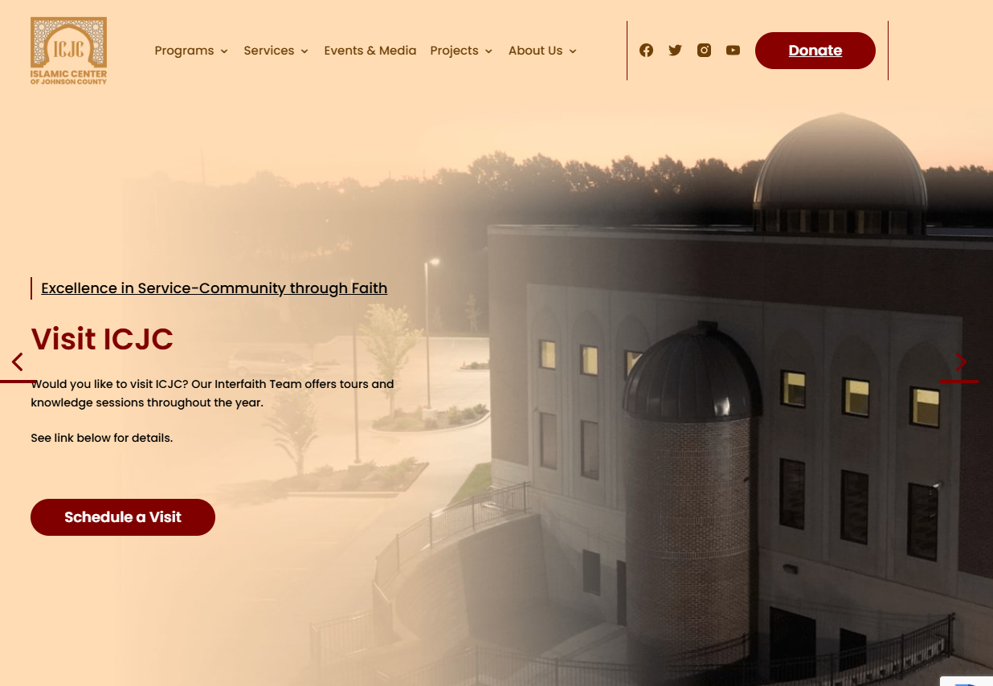
2nd largest mosque in the US
Roe. Ave.
Notes:
https://www.icjc.org/

Slide 73
To be a training center for Islamic outreach.
Some reports that there is a Hamas and Hezbullah training in the area.
According to Wycliffe translators, KC is the most linguistically diverse city in the US!

Slide 74
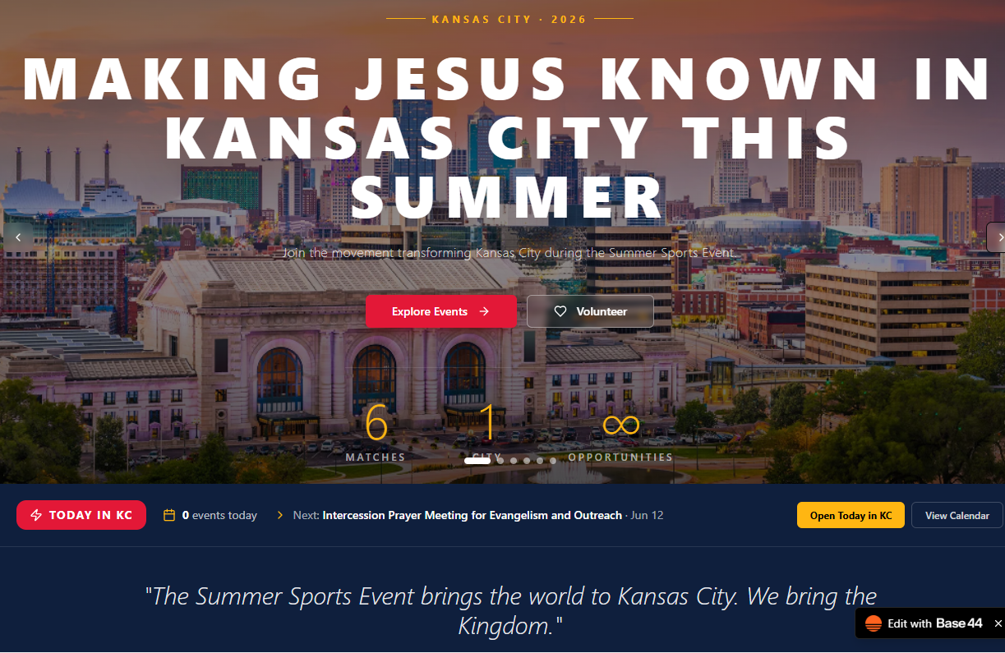
Notes:
https://kingdomcomekc.base44.app/

Slide 75

Revealing to Muslims the Biblical Yeshua.
Educating the World about Islam.
https://muslimworldoutreach.com/
Notes:
2nd largest mosque in the US is being build on Roe Ave

Slide 76


Slide 77
You’re Invited: World Cup Watch Party!
Come join us for a relaxed evening of soccer, food, and fellowship at a World Cup Watch Party on Tuesday, June 16, at Or HaOlam Messianic Synagogue.
The party will begin around 7:30 PM, and the game is expected to start at 8:00 PM.

Slide 78
Dress casually and comfortably — whatever you would normally wear to an indoor sporting event is just right.
If you’d like, bring a biblically kosher food item to share — no pork or shellfish, please. Foods inspired by the countries playing would be a fun addition, too. If you’re not able to bring anything, no problem at all. Just come and enjoy the game with us.

Slide 79
Bring your friends, wear your team colors, and join us for an unforgettable night as we gather around the global game together.
Everyone is welcome. We’d love to have you there!

Slide 80
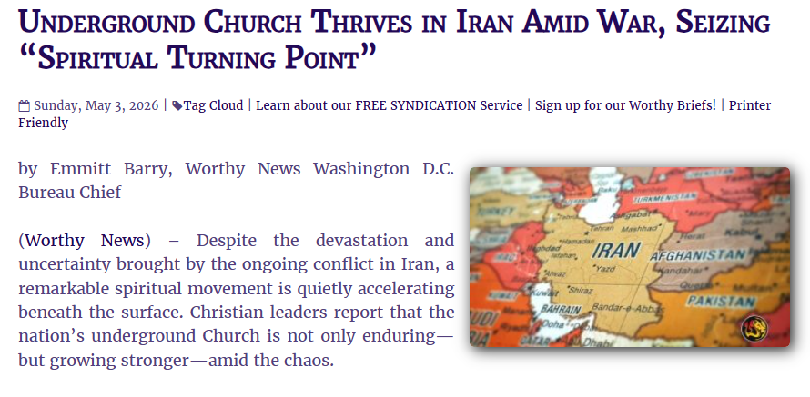
Notes:
https://www.worthynews.com/114071-underground-church-thrives-in-iran-amid-war-seizing-spiritual-turning-point

Slide 81
Recent estimates suggest that Iran is home to one of the fastest-growing believing populations in the world. Over the past 25 years, the number of believers has surged from a few hundred thousand to over 1 million,
Notes:
https://www.worthynews.com/114071-underground-church-thrives-in-iran-amid-war-seizing-spiritual-turning-point

Slide 82
with some ministry estimates placing the broader movement—including seekers and underground participants—at several million. This extraordinary growth has occurred almost entirely through house churches and personal evangelism.
Notes:
https://www.worthynews.com/114071-underground-church-thrives-in-iran-amid-war-seizing-spiritual-turning-point

Slide 83
Even more striking is the attitude of believers on the ground. Nettleton said no Christian connected with VOM has asked to flee the country. Instead, many view this moment as divinely appointed. “This is a turning point; this is a spiritual turning point for Iran,” believers told him. “We want to be here… to see the harvest.”
Notes:
https://www.worthynews.com/114071-underground-church-thrives-in-iran-amid-war-seizing-spiritual-turning-point

Slide 84
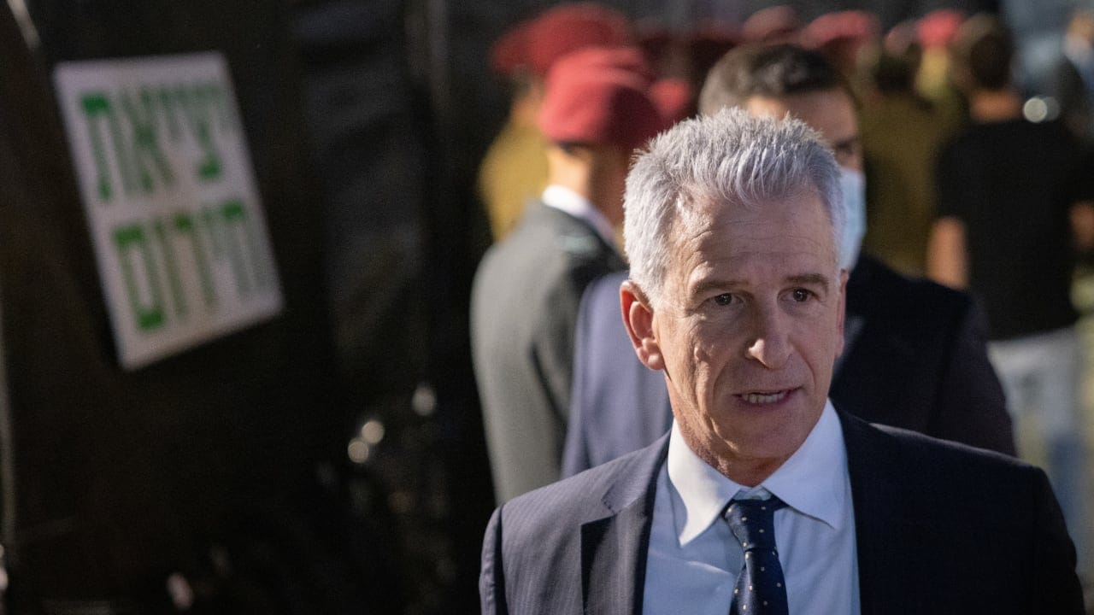
Mossad outgoing chief,
David Barnea

Slide 85
The Mossad announced on Tuesday morning that its outgoing chief, David Barnea, in a retirement ceremony late Monday night, called for Israel and the agency to remain committed to toppling the Islamic regime, which still runs Iran, following the recent 2026 war.
Notes:
https://www.jpost.com/israel-news/defense-news/article-898063?utm_source=activetrail&utm_medium=email&utm_campaign=June202026

Slide 86
"I promised that Iran would never get a nuclear weapon. Today, when the Iranian regime is at its weakest, most challenged, and most wounded, this is the time to complete the job, and to pay back the regime which engraved destroying us on its flag. We are at the height of a historic and important campaign," said Barnea.
Notes:
https://www.jpost.com/israel-news/defense-news/article-898063?utm_source=activetrail&utm_medium=email&utm_campaign=June202026

Slide 87
Will there be difficulties?

Slide 88
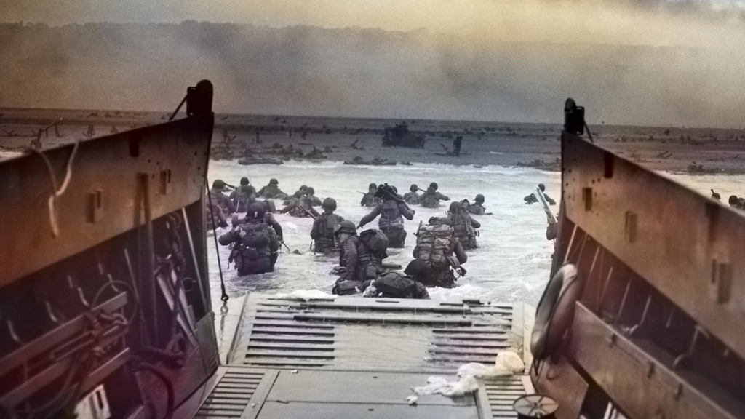
Normandy invasion June 6, 1944
Notes:
https://www.drjamesdobson.org/wp-content/uploads/2026/06/Family-Talk-Web-06_05.png

Slide 89
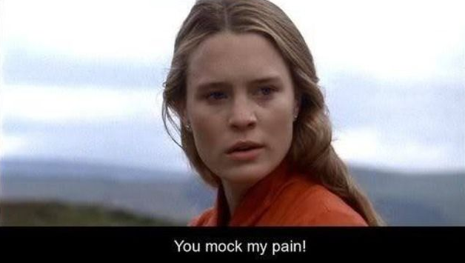
From
The
Princess
Bride
movie
Notes:
https://i.pinimg.com/736x/45/91/79/4591798a2b39a5d7a0cf65005bc7dbd2.jpg

Slide 90
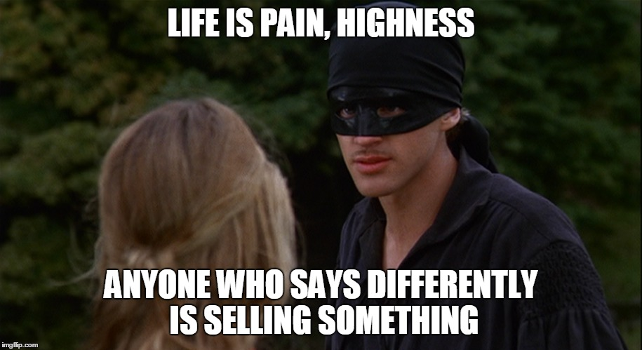
Notes:
“As you wish”

Slide 91
^{Mark 10.29-31} In the ‘olam haba, [world to come] eternal life. But many who are first will be last, and many who are last will be first!”

Slide 92
Said one candidate for the US Congress in Texas’s 35th Congressional District

Slide 93
“If you are a Zionist,” then “you are a danger to humanity and belong in prison.” “She’ll turn Karnes ICE Detention Center into a prison for American Zionists and former ICE officers for human trafficking,”
Notes:
https://www.jns.org/news/u-s-news/dems-distance-themselves-from-texas-candidate-calling-for-zionists-to-be-imprisoned-castrated?utm_campaign=Daily%20Syndicate%20Emails&utm_medium=email&_hsenc=p2ANqtz--d_wfrIgu_ElL90n3Jpa4UFvkHXR7Yjl4LkKzQFX-3l-lQ1Hv6iA8_Gu_aEjqr8Wh5PSUJ86FMeCdkqUyix71W2bZXcA&_hsmi=136346184&utm_content=136346184&utm_source=hs_email

Slide 94
a post from a campaign social media page states. “It will also be a castration processing center for pedophiles, which will probably be most of the Zionists,” it adds.
Notes:
https://www.jns.org/news/u-s-news/dems-distance-themselves-from-texas-candidate-calling-for-zionists-to-be-imprisoned-castrated?utm_campaign=Daily%20Syndicate%20Emails&utm_medium=email&_hsenc=p2ANqtz--d_wfrIgu_ElL90n3Jpa4UFvkHXR7Yjl4LkKzQFX-3l-lQ1Hv6iA8_Gu_aEjqr8Wh5PSUJ86FMeCdkqUyix71W2bZXcA&_hsmi=136346184&utm_content=136346184&utm_source=hs_email
How can someone talk like this. Rebuked by many, thankfully.

Slide 95

Notes:
https://www.israeltoday.co.il/read/israeli-embassy-in-washington-marks-year-since-murders-of-two-of-its-staffers/

Slide 96
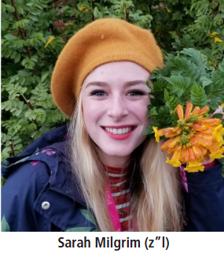
One year after tragedy, Sarah Milgrim’s legacy of peace and bridge-building lives on. Community mourns Sarah Milgrim, killed by gunman at AJC event in Washington
Notes:
https://www.kcjc.com/current-news/top-stories/10846-milgrim-legacy-one-year

Slide 97
One year since Milgrim, a 26-year old Israeli embassy staffer, and her boyfriend, fellow embassy staffer Yaron Lischinsky, 30, were ambushed and fatally shot on May 21, 2025, by an accused anti-Israel terrorist in Washington, D.C., Milgrim’s influence as a force for global good is being felt across Greater Kansas City and far beyond.
Notes:
https://www.kcjc.com/current-news/top-stories/10846-milgrim-legacy-one-year

Slide 98
^{1 Cor 13.4} Love suffers long and is kind
Longsuffering is a great and noble concept to honor…until
offense,

Slide 99
^{1 Cor 13.4} Love suffers long and is kind
Longsuffering is a great and noble concept to honor…until
offense,
depression,

Slide 100
^{1 Cor 13.4} Love suffers long and is kind
Longsuffering is a great and noble concept to honor…until
offense,
depression,
fight,

Slide 101
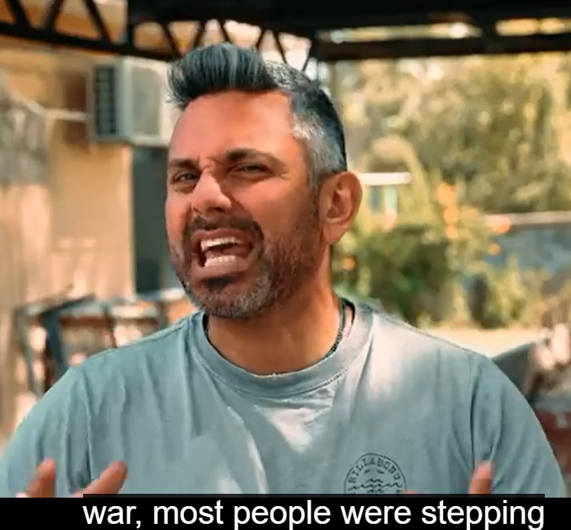

Slide 102
From the Tent of Meeting to the plains of Moab, from the prophets to the upper room, the promise never stopped moving: His face is still going. His rest is still waiting – both at the destination and along the road. And every spring, when the wheat ripens in the fields of Israel,

Slide 103
the church and the synagogue both hear, in their own way, the seven words that started it all: “My Presence will go with you. And I will give you rest.” – Exodus 33:14

Slide 105


Slide 106
We recently confirmed that the 187th abortion facility has closed its doors following a 40 Days for Life campaign.
But does closing abortion facilities even matter when women can order abortion pills online?

Slide 107
Absolutely. A large majority of abortions still take place through brick-and-mortar facilities. Plus, when Planned Parenthood centers close, the abortion giant's capacity to groom its next generation of customers is slashed.
﻿

Slide 108
﻿On this week's episode of The 40 Days for Life Podcast, we look at Planned Parenthood's latest annual report--which showed a startling collapse in many of the abortion chain's sex education programs:

Slide 109
Notes:
54x “kingdom” in Mtt

Slide 110
May Your Kingdom Come Mtt 6.10
Tenakh on G-ds kingship
Matityahu on the Kingdom
Applications

