Slide 1
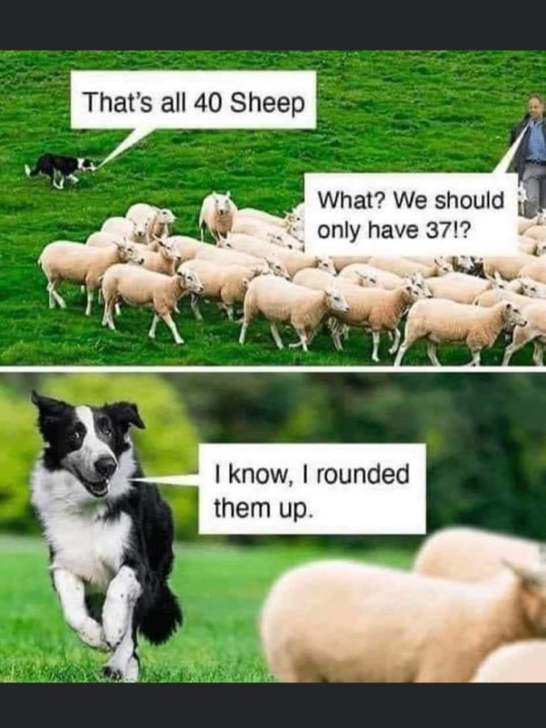

Slide 2
Notes:
I’m a math guy. Rounding?

Slide 3
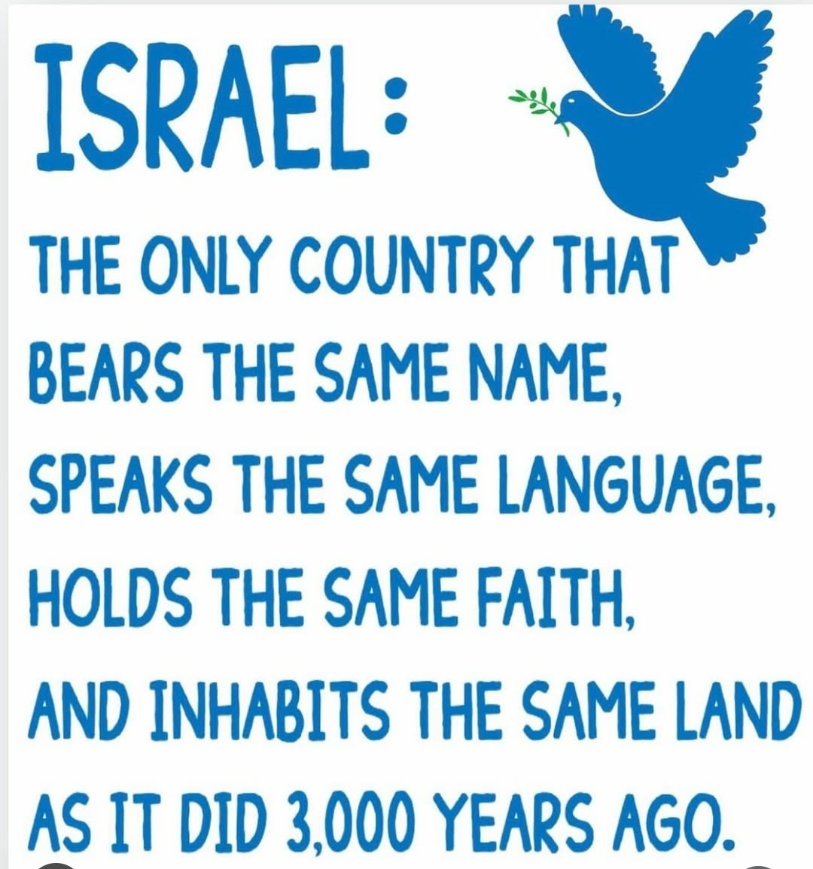
Notes:
Evidence…

Slide 4
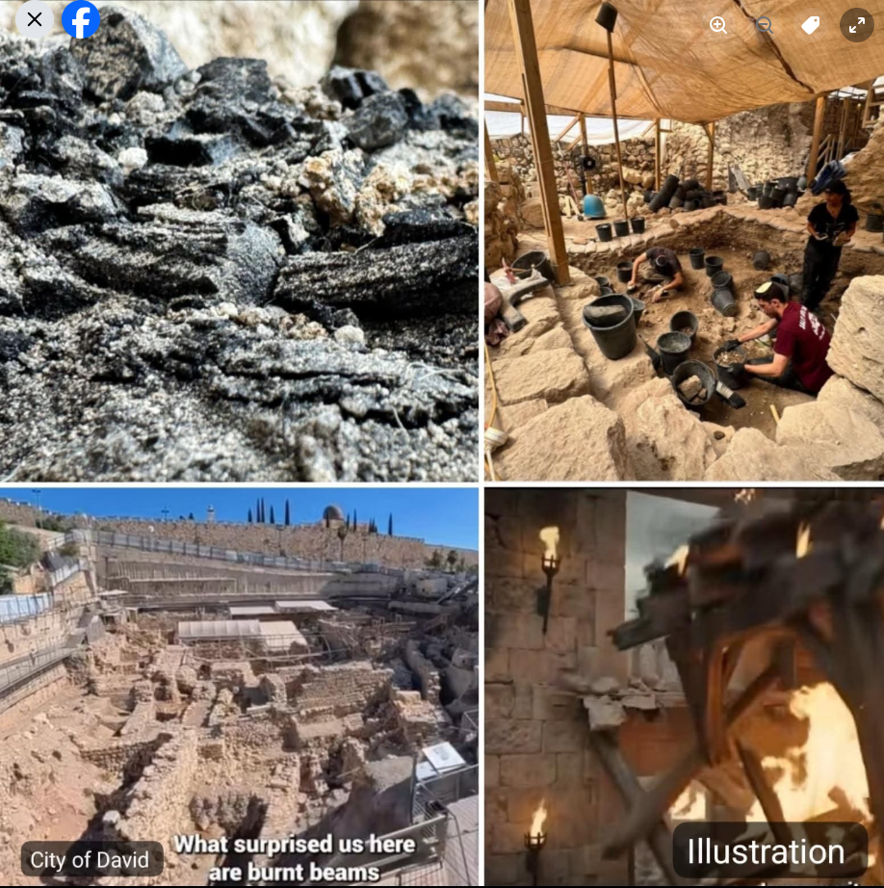
THIS WEEK, Israeli archaeologists discovered a 2,600-year-old charred wooden beam in the City of David,
Notes:
https://www.facebook.com/photo?fbid=1438062731491229&set=a.319778523319661

Slide 5
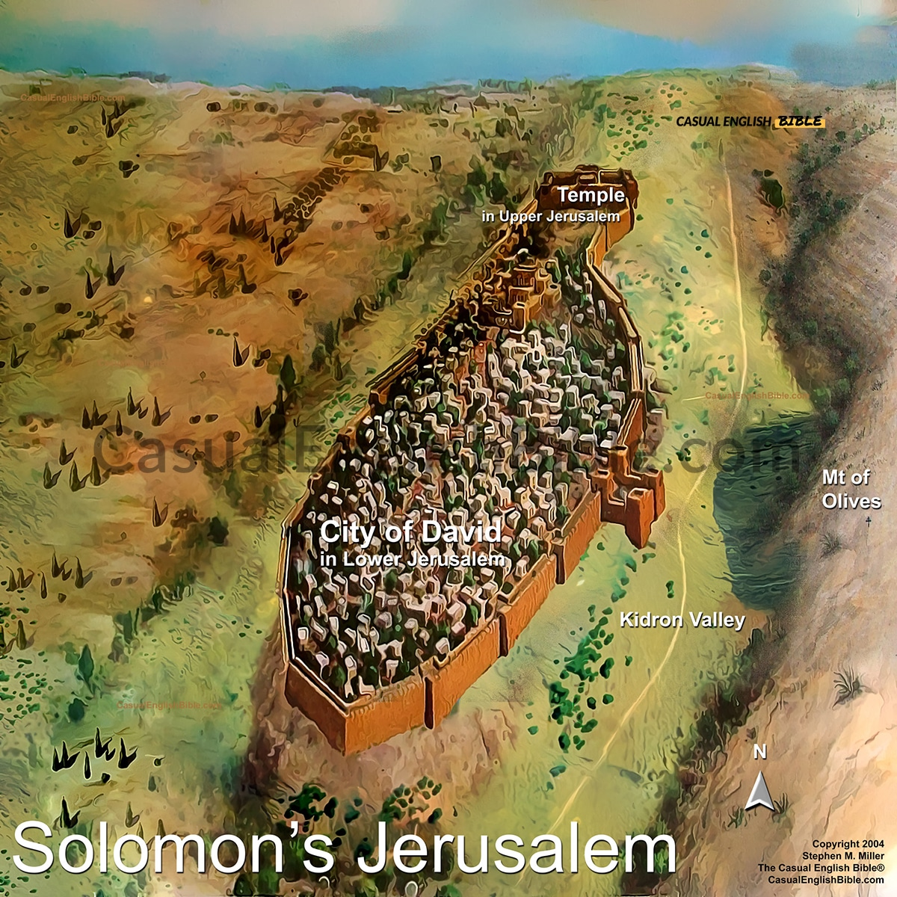
Notes:
https://www.casualenglishbible.com/resource/solomons-jerusalem-add-on

Slide 6
buried beneath a collapsed Byzantine house. Remarkably, the sycamore wood still preserves visible growth rings. According to carbon-14 dating, the beam dates to around 586 BC—the time of the destruction of the First Temple.

Slide 7
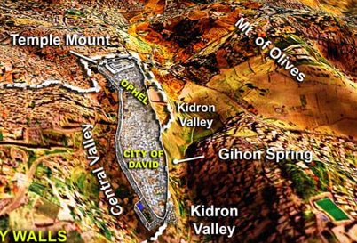
Notes:
https://www.casualenglishbible.com/resource/jerusalem-temple-walls-rebuilt

Slide 8
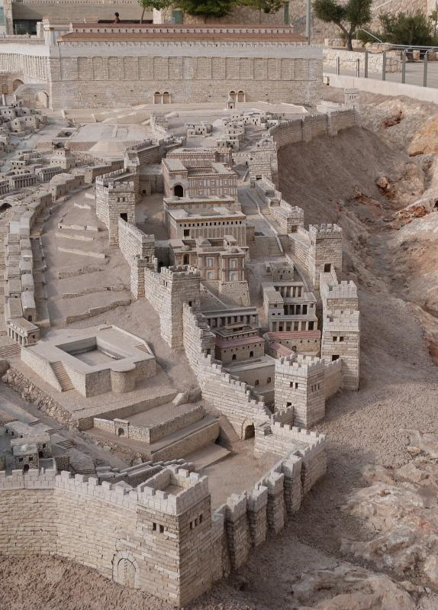
The City of David in Yeshua’s time, 2nd Temple

Slide 9
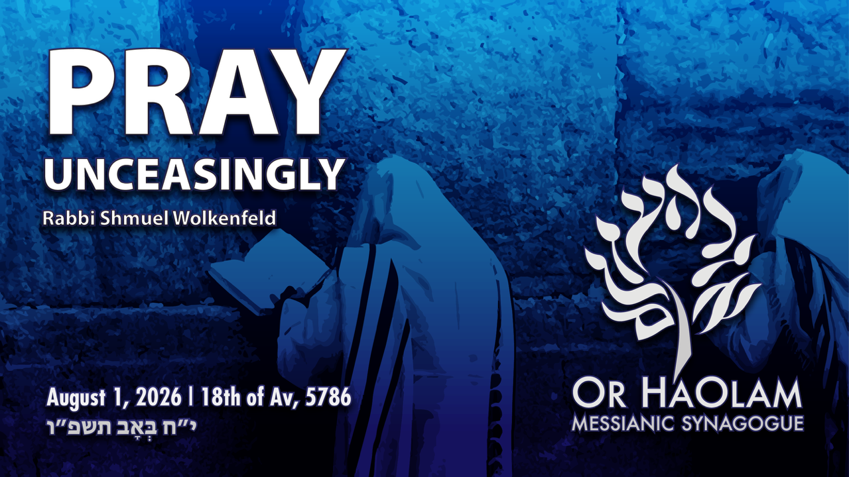

Slide 10
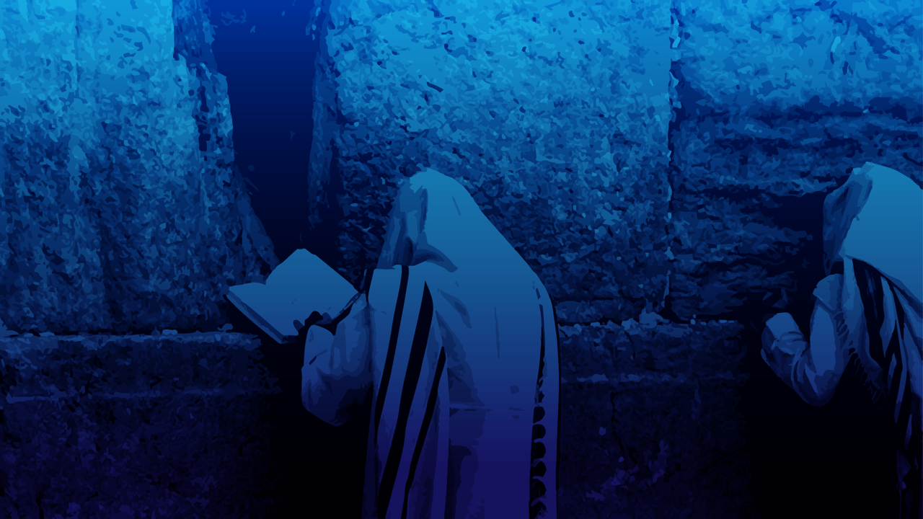
Pray unceasingly 1 Thes. 5.17
Word analysis
Types of private prayer
Types of group prayer
Some historic interpretations

Slide 11
Pray unceasingly 1 Thes. 5.17
Word analysis
Types of private prayer
Types of group prayer
Some historic interpretations
Notes:
What does this MEAN??

Slide 12

ἀδιαλείπτως, adverb, without intermission, incessantly, assiduously

Slide 13
This Pauline adverb expresses an activity that is marked by continual, uninterrupted regularity. It points to a pattern so steady and frequent that the breaks are negligible, conveying a life rhythm characterized by consistency rather than sporadic bursts.

Slide 14
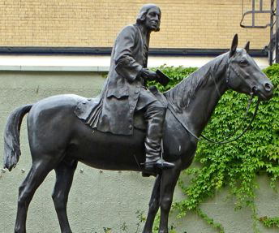
John Wesley on horseback. He travelled between four and five thousand miles a year.
Notes:
https://wesley.nnu.edu/?id=95
My personal lunchtime mentor in 1970

Slide 15
“He was a hard but unskillful rider; and his seat was as ungraceful as it appeared uneasy, with a book in his hand and his hands up to his head.” His habit of reading may have made him appear ungraceful. In June, 1750, he mentions he started at four o’clock that morning, and was not in bed till twelve. He had been nearly twenty hours in the saddle.
Notes:
https://wesley.nnu.edu/?id=95
I would read books driving the Interstate.

Slide 16
It is estimated that John Wesley traveled around 250,000 miles and preached over 40,000 sermons in a span of 66 years.
Wesley’s comments on “Pray unceasingly”
Notes:
A stuffy English scholar, but with a burning heart for Yeshua.
Analogy to David Ben Gurion…left behind little possession, but the nation of Israel.
Wesley left behind little estate, but the Methodist Movement.
My personal mentor in 1970 lunches

Slide 17
“Our Lord has purchased joy, as well as righteousness for us. It is the very design of the Good News that, being saved from guilt, we should be happy in the love of Messiah. Prayer may be said to be the breath of our spiritual life.

Slide 18
“He that lives cannot possibly cease breathing. So much as we really enjoy the presence of G-d, so much prayer and praise do we offer up without ceasing.

Slide 19
“or else our rejoicing is but delusion. Thanksgiving is inseparable from true prayer; it is almost essentially connected with it. He that always prays is ever giving praise, whether in ease or pain, both for prosperity and for the greatest adversity. He blesses G-d for all things,

Slide 20
“looks on them as coming from Him, and receives them only for His sake; not choosing nor refusing, liking nor disliking, anything, but only as is agreeable or disagreeable to His perfect will.”
Notes:
Pause for prayer…

Slide 21
^{Ro 1.9} For God is my witness, whom I serve with my spirit in the Good News of His Son. How unceasingly I make mention of you

Slide 22
^{1 Thes 1.2-4} We give thanks to God always for you all, making mention of you in our prayers, remembering without ceasing your work of faith, labor of love, and patience of hope in Adonenu, our Lord Yeshua HaMashiakh in the sight of our God and Father, knowing, beloved brethren, your election by God.

Slide 23
1 Thes 2.13 For this reason, we also thank God constantly that when you received the word of God which you heard from us, you accepted it not as the word of men, but as it truly is—the word of God, which does its work in you who believe

Slide 24
prayer as priestly ministry that never clocks out.
prayer as prophetic ministry charging the believers to remain alert for the Lord’s return by sustaining an open line of communion with Him.

Slide 25
^{Phil 4. 5-7} Rejoice in the Lord always—again I will say, rejoice! Let your gentleness be known to all people. The Lord is near. Do not be anxious about anything—but in everything, by prayer and petition with thanksgiving,
Notes:
Can you pray if you are a victim?

Slide 26
^{Phil 4. 5-7} let your requests be made known to God. And the shalom of God, which surpasses all understanding, will guard your hearts and your minds in Messiah Yeshua.

Slide 27
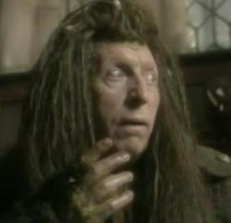
Puddleglum
the Marshwiggle
Notes:
Puddleglum my favorite CS Lewis Narnia Chronicles character
He is gloomy and pessimistic and described by other characters as a "wet blanket", although by his account other Marsh-wiggles are gloomier still.
He is a caricature of pessimism and a bastion of gloomy fortitude
I will carry on for Yeshua, although life is generally miserable.

Slide 28
Context
Prayer is part of a partnership of faith: pray, go, encourage, give, organizational support.
^{Phil 1.8} You are all sharing with me in this privileged work.
Moshe held up his hands, Aharon and Hur helped him, Yehoshua fought.

Slide 29
Context
^{1 Thes 5.16-20} Always be joyful. Pray constantly. In everything give thanks, for this is what God wants from you who are united with the Messiah Yeshua. Don’t quench the Spirit, don’t despise inspired messages.
Notes:
This is to be the tenor of our lives, our flavor, our “smell.” Not crisis and chaos.

Slide 31
Pray unceasingly 1 Thes. 5.17
Word analysis
Types of private prayer
Types of group prayer
Some historic interpretations

Slide 32
Personal prayer
^{T’hillim /Ps 63.1-2} O God, You are my God; early will I seek You; My soul thirsts for You; My flesh longs for You In a dry and thirsty land Where there is no water. So I have looked for You in the sanctuary, To see Your power and Your glory.

Slide 33

שַׁחַר Shakhar
dawn, daybreak, sunrise ,first light, first thing in the morning, early morning, sunup

Slide 34
properly, to dawn, i.e. (figuratively) be (up) early at any task (with the implication of earnestness); by extension, to search for (with painstaking) -- (do something) betimes, enquire early, rise (seek) betimes, seek diligently) early, in the morning).
Notes:
I’m always up before Dawn.
But I do my calisthenics first: pushups, etc. Before I can really think about the pain, it’s over.

Slide 35
Micheal Wolf at Messiah Conf:
“Marty Chernoff hammered us with the importance of a personal quiet time.” An hour/day?
David Chernoff challenged us with 3 hours / day!

Slide 36
^{Mtt 26.40} He returned to the talmidim and found them sleeping. He said to Kefa, “Were you so weak that you couldn’t stay awake with me for even an hour?

Slide 37
Do you spend one hour/ day?
How to spend an hour in prayer?
  Pray scripture and claim promises.
  ^{Yn 15.7-8} “If you remain united with me, and my words with you, then ask whatever you want, and it will happen for you.
Notes:
e

Slide 38
Do you spend one hour/ day?
How to spend an hour in prayer?
  Pray scripture and claim promises.
  This is how my Father is glorified — in your bearing much fruit; this is how you will prove to be my talmidim.”
Notes:
e

Slide 39
How to spend an hour in prayer?
Sing scriptures, particularly as Solu and Miqedem and others sing them. Easier to memorize.

Slide 40
How to spend an hour in prayer?
  Prayer list:
    Each name briefly envision
    Each issue briefly envision
Notes:
“At the Name of Yeshua every knee shall bow” It’s joy now to do so in love. It will be terror to do so mandated.”

Slide 41
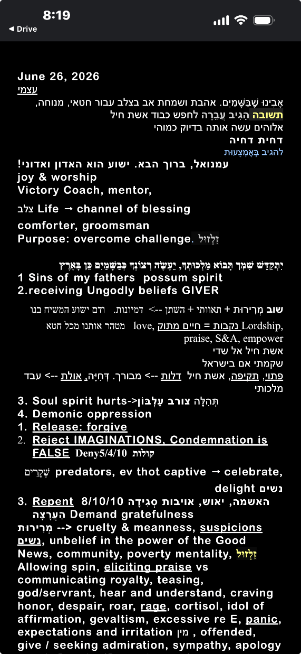
My personal prayer list, with 13 screens like this to scroll through.

Slide 42
How to spend an hour in prayer?
הִתְבּוֹדְדוּת Hitbodedut from boded lone, solitary
The term was popularized by Nachman of Breslov (1772–1810) to refer to an unstructured, spontaneous, and individualized form of prayer and meditation through which one would establish a close, personal relationship with God
Notes:
P 188 Garden of Emuna

Slide 43
How to spend an hour in prayer?
Siddur and Tefillin
It’s sort of feels like an embrace of Messiah!
8 a.m. Aug 13 here. Hebrew and English. Mostly sung.
Notes:
I was at a Jewish community pre RH event. Choir, singing, teaching. The person next to me at the end said, “It was a pleasure to pray with you.”

Slide 45
Pray unceasingly 1 Thes. 5.17
Word analysis
Types of private prayer
Types of group prayer
Some historic interpretations

Slide 46
Family prayer
^{Dt 6.4-7} “Sh’ma, Yisra’el! Adoni Eloheinu, Adoni ekhad [Hear, Isra’el! Adoni our God, Adoni is one]; and you are to love Adoni your God with all your heart, all your being and all your resources. These words, which I am ordering you today, are to be on your heart; and you are to teach them diligently to your children.

Slide 47
Many family devotional books to use. With kids…brief.

Slide 48

Teerosh
Tuesdays, 7:30 to 8:30

Slide 49
Teerosh is a combination of praise songs and scripture prayer, and expressed in movement by corporate dance. That is, we read scripture promises, and petition HaShem to fulfill His Word. G-d delights to establish His Word.

Slide 50
^{Psalm 138:1} “For You have magnified Your word above all Your Name.” Thus, the heart of Teerosh is the psalmic pattern of praying scripture promises, emphasized and entreated before the throne by antiphonal singing and dance.

Slide 51
Tuesdays 7:30 p.m.
Michael Wolf: Beth Messiah, Cincinnati, weekly prayer; 10% come
Some years ago, much youth prayer and worship leaders
“I go home knowing something was accomplished.”
Other Zoom or group times.
Notes:
Kipp Adler, Marina Kurban, Evan?. Heidi,

Slide 52
Dance
Dance, as intercessory prayer, is taught in Ps 149: “Let them praise his name with dancing, make melody to him with tambourine and lyre . . . Let the high praises of G-d be in their throats,

Slide 53
Dance
but a two-edged sword in their hands to carry out vengeance on the nations and punishment on the peoples, to bind their kings with chains and put their nobles in irons...”

Slide 54
Dance
As the dance circle is a place of praise, it is also an easy place to pray, and we have seen wonderful and effective healing prayers when offered in the middle of a prayer circle.

Slide 55
Dance
Dance actually seems to be a form of spiritual warfare, by the expression of praise and faith in movement, we fulfill the promise of Romans 16.20. “And God, the source of shalom, will soon crush the Adversary under your feet.”

Slide 56
Prayer lines
There is a subjectively sensed different anointing in various places in the sanctuary. The front, near the musicians and place of the Word, has certain warmth, intensity. ??
Prayer ministers can encourage, instruct, exhort, pray with you.
Notes:
David Dreiling’s insight.

Slide 57
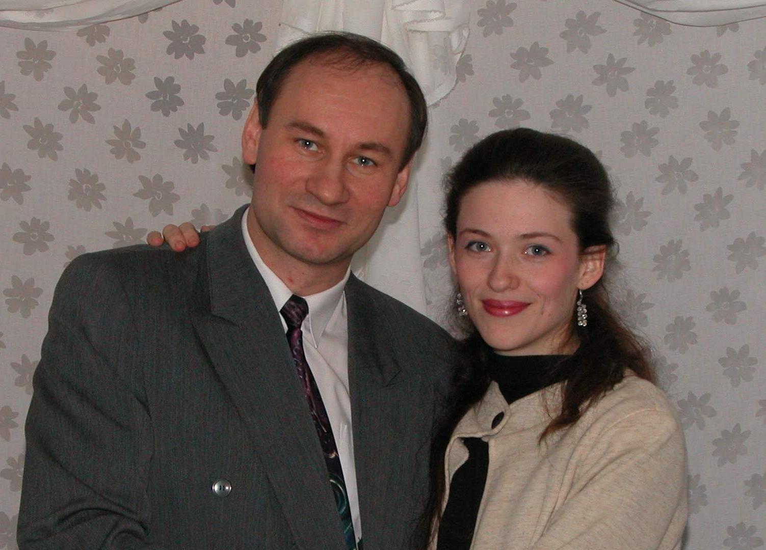
Retreats, all night intensives
Valodia &
Yulia Bouryi

Slide 58
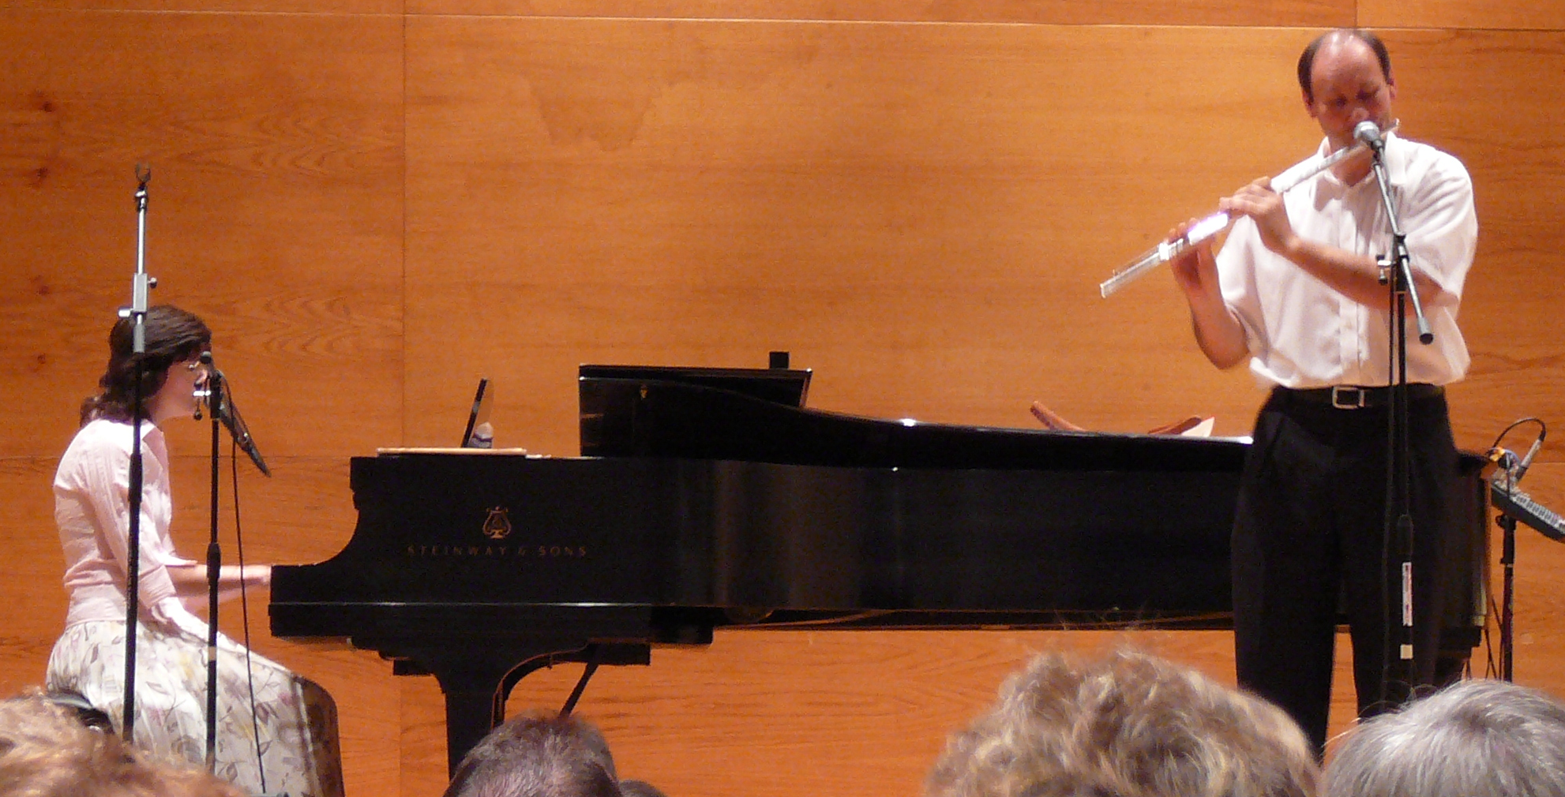
Pritsat Derekh פְּרִיצַת דֶּרֶךְ Prayer Retreat June 5-6, 2010

Slide 59
Or HaOlam has secured use of the Sanctuary Of Hope, 2601 Ridge Avenue, K.C., KS 66102 http://www.sanctuaryofhope.org/
We’ll be meeting there after our Shabbat service, at 4 p.m. Saturday, continuing until 6 p.m. Sunday, June 6, 2010.

Slide 60
We’ll have sessions of prayer, worship, testimonies, and insights, with breaks, fellowship, and relaxation. Valodia and Yulia will be our featured musicians, as well as our wonderful teams.

Slide 61
No meals provided, but there will be coffee and tea. You are free to bring your own food; fasting is encouraged, but of course not required. We are believing for G-d to give us a breakthrough time of prayer as well as bonding to each other; Pritsat Derekh! פְּרִיצַת דֶּרֶךְ

Slide 62
at 4 p.m. Saturday, continuing until 6 p.m. Sunday, June 6.
Notes:
Haven’t done this since we got this building in 2016. Need to.

Slide 64
Pray unceasingly 1 Thes. 5.17
Word analysis
Types of private prayer
Types of group prayer
Some historic interpretations

Slide 65
Early writers—from Chrysostom to Augustine—cited these verses to encourage rhythmic prayer amid ordinary labor.

Slide 66
Monastic traditions later translated the concept into fixed hours of prayer,

Slide 67
Reformers emphasized the priesthood of all believers, urging tradesmen and mothers to pray “without ceasing” in the workshop and the home.

Slide 68
Revival movements have repeatedly returned to these texts to call the believers to sustained intercession for awakening.

Slide 70
Pray unceasingly 1 Thes. 5.17
Word analysis
Types of private prayer
Types of group prayer
Some historic interpretations

Slide 71
Do you have a daily time of private prayer? הִתְבּוֹדְדוּת Hitbodedut, alone with Yeshua
Do you have a daily couple or family prayer?
Do you participate in corporate prayer?

Slide 72
^{Mtt 7.7-8} “Keep asking, and it will be given to you; keep seeking, and you will find; keep knocking, and the door will be opened to you. For everyone who keeps asking receives; he who keeps seeking finds; and to him who keeps knocking, the door will be opened.

Slide 73
Do you KNOW Yeshua and the assurance of sins forgiven?
Are you hearing daily from His Word?
How are you applying what you heard?
Are you asking this of another?
Notes:
Who are you discipling, building up?4

