Slide 1


Slide 2


Slide 3


Slide 4
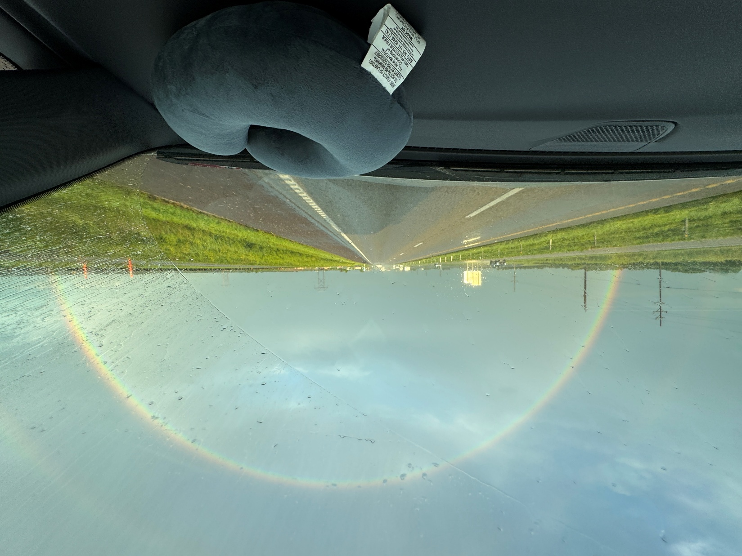

Slide 5
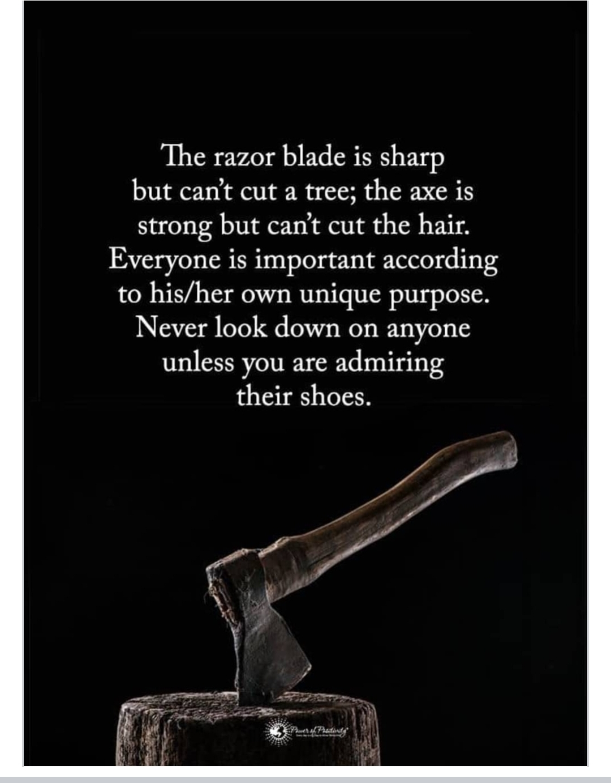

Slide 7
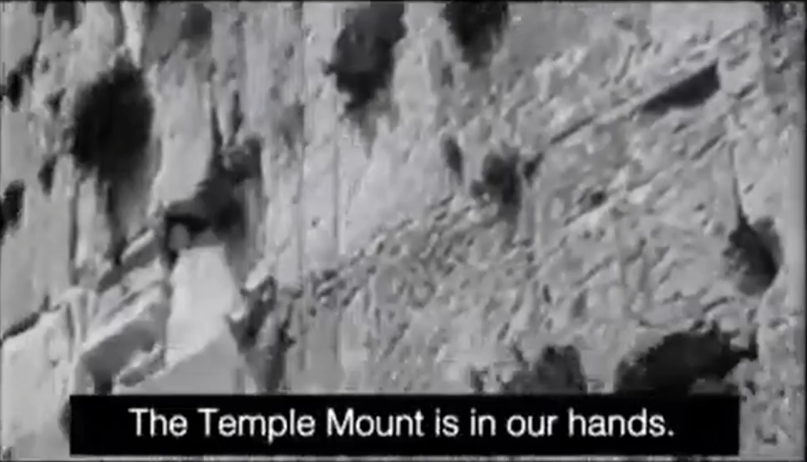
הר הבית בידינו
Har HaBiyit b’yadenu
Notes:
Electrifying words to the Jewish and Bible believing world in 1967

Slide 8
^{Lk 21.24} Yerushalayim will be trampled down by the Goyim until the age of the Goyim has run its course.
In 1967, in the Six-Day War, Israel liberated East Jerusalem from Jordan on June 7, 1967.

Slide 9
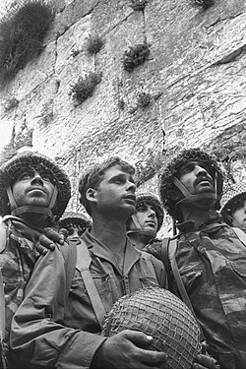
David Rubinger's iconic photograph of IDF paratroopers at Jerusalem's Western Wall shortly after its capture. The soldiers in the foreground are (from left) Zion Karasenti, Yitzhak Yifat, and Haim Oshri.
Notes:
https://upload.wikimedia.org/wikipedia/commons/thumb/6/62/%D7%A6%D7%A0%D7%97%D7%A0%D7%99%D7%9D_%D7%91%D7%9B%D7%95%D7%AA%D7%9C_%D7%94%D7%9E%D7%A2%D7%A8%D7%91%D7%99.jpg/960px-%D7%A6%D7%A0%D7%97%D7%A0%D7%99%D7%9D_%D7%91%D7%9B%D7%95%D7%AA%D7%9C_%D7%94%D7%9E%D7%A2%D7%A8%D7%91%D7%99.jpg?utm_source=en.wikipedia.org&utm_campaign=imageinfo&utm_content=thumbnail

Slide 10
All the believers then, in 1969, had their seat belts fastened and expected Yeshua’s return in the rapture any minute. I came to faith in April, 1969, and there was a LOT of preaching on prophecy and Messiah’s imminently expected return.
Notes:
Then after a while, not so much. Then after, after a while, sort of stopped. However…

Slide 11


Slide 12

Signs of the End Times Mt 24.3
Islamic deception
Moral corruption
Universal attack on Jews
and Israel
4. Application
C

Slide 13
^{Mtt 24.3} When he was sitting on the Mount of Olives, the talmidim came to him privately. “Tell us,” they said, “when will these things happen? And what will be the sign that you are coming, and that the ‘olam hazeh [this world] is ending?”

Slide 14
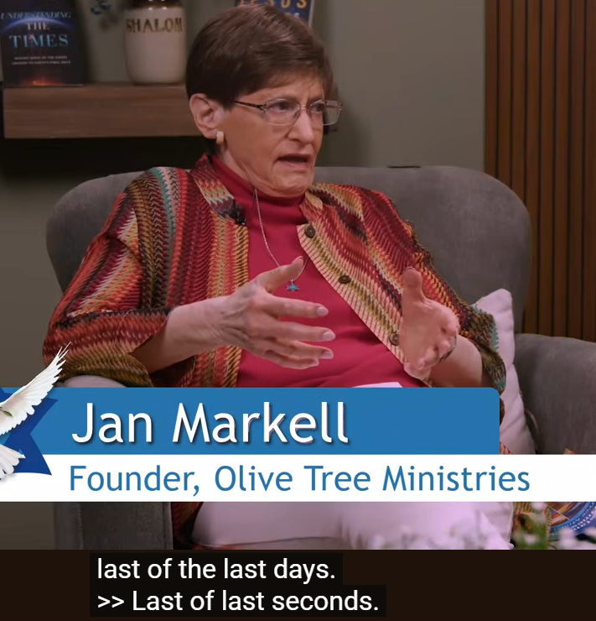
Notes:
https://www.youtube.com/watch?v=pb9W1YONjCM

Slide 15
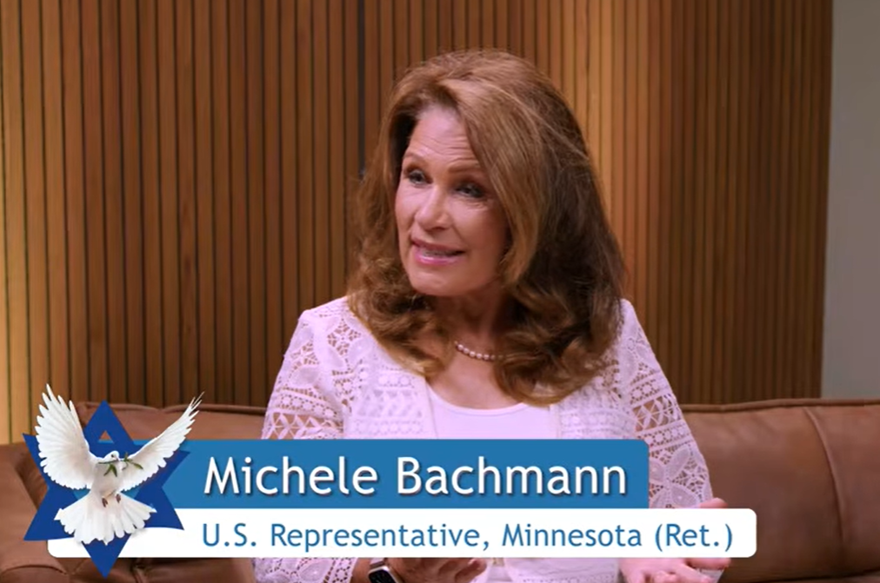
Notes:
https://www.youtube.com/watch?v=pb9W1YONjCM

Slide 16
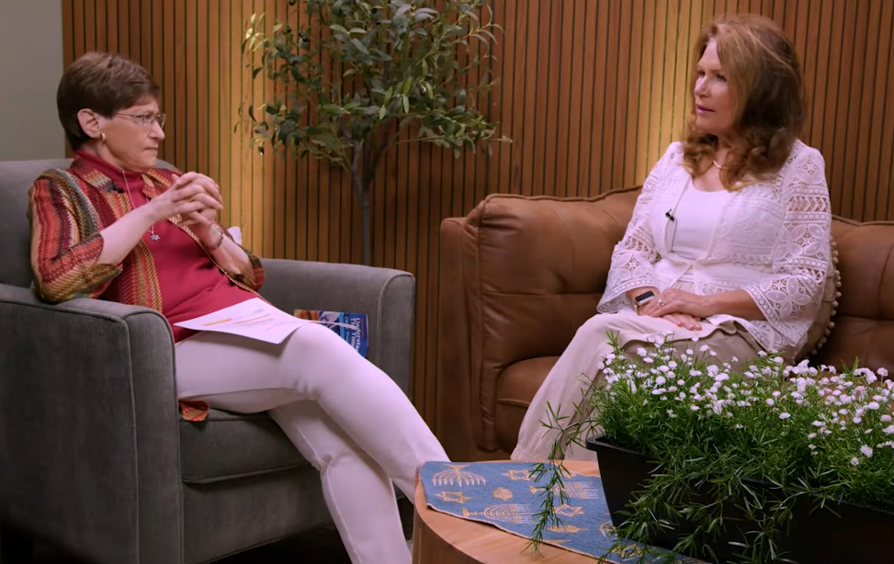
Notes:
https://www.youtube.com/watch?v=pb9W1YONjCM

Slide 17
Signs of the End Times Mt 24.3
Islamic deception
Moral corruption
Universal attack on Jews
and Israel
4. Application
C

Slide 18
^{Mtt 24.4-5, 11} Yeshua answered them, “Be careful that no one leads you astray! For many will come in My name, saying, ‘I am the Messiah,’ and will lead many astray…Many false prophets will arise and lead many astray.

Slide 19
When Prophet Muhammad immigrated from Makkah to Madinah, he did not just transfer his residence or take shelter in another city, but as soon as he arrived in Madinah he began the transformation of that city in every aspect:
Notes:
https://historyofislam.com/contents/the-age-of-faith/the-significance-of-the-hijrah-622-ce/

Slide 20
The Hijrah, also Hegira, was the journey the Islamic prophet Muhammad and his followers took from Mecca to Medina. The year in which the Hijrah took place is also identified as the epoch of the Lunar Hijri and Solar Hijri calendars; its date equates to 16 July 622 in the Julian calendar.
Notes:
https://en.wikipedia.org/wiki/Hijrah

Slide 21
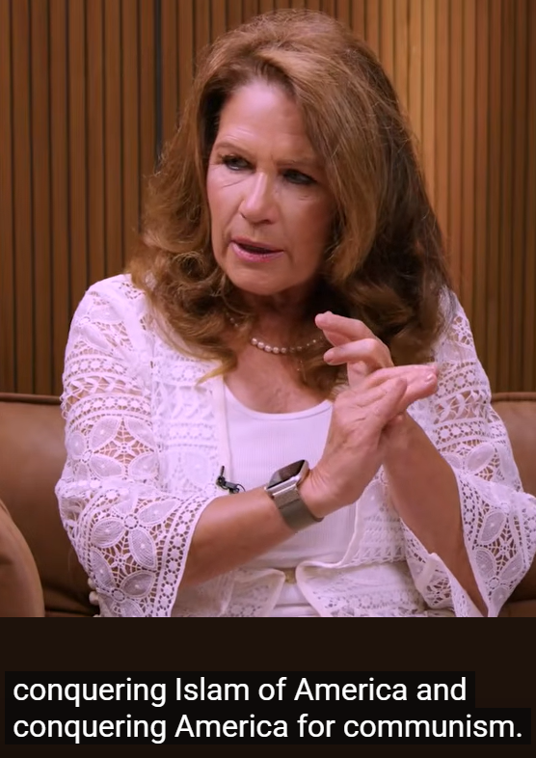

Slide 22
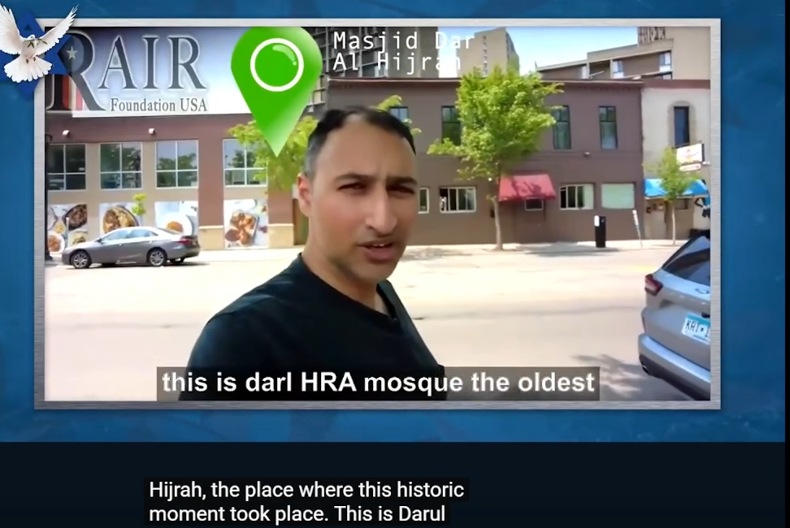

Slide 23
Immigration in Minnesota is not like historic American immigration. My Belarussian Jewish grandparents were immigrants. Jewish Americans!!
These will not assimilate, Wahabe and Salafi like our helping the Mujahideen in Afghan, but eventually became enemies.

Slide 24
We must ultimately submit to Islamic Dhimmi status. The term Dhimmi originates from the Arabic word Dhimma ذمة which means, “a contract,” “responsibility,” or “treaty.” Dhimmi is the person who has been given a pledge; but according to Islamic texts, a Dhimmi is a non-Muslim who resides in an Islamic state.
Notes:
https://myislam.org/dhimmi/

Slide 25
In exchange for “protection,” and freedom to practice his religion and religious ceremonies, a Dhimmi is required to pay a specific sum, called Jizya, to the Islamic government. According to majority of scholars, Muslims can impose Jizya on any non-Muslim including Jews, Christians, Magus, or polytheists.
Notes:
https://myislam.org/dhimmi/

Slide 26
According to Michelle Bachman, $20 billion has been stolen from Minnesota. That is half national budget Somalia.
When prayer call 5x/day instituted MB tried get support to stop. No help. Legal scholars, pastors People are afraid. Sept 11 WTC
Notes:
Jews in Arab Muslim lands, North Africa, had prohibitions on building new places of worship, repairing existing ones in areas where Muslims lived, preventing relatives from converting to Islam. Depending on specific areas and periods, Dhimmis were also restricted in the professions they could engage in, limited in travelling outside of specific areas, owning property and were periodically exposed to forced conversions and massacres. They were also required to wear a yellow badge or other distinctive clothing, refrain from carrying weapons, and avoid riding on saddles.
https://en.wikipedia.org/wiki/Dhimmi

Slide 27
According to Michelle Bachman, 20 billion has been stolen from Minnesota. That is half national budget Somalia.
When the prayer call 5x/day was instituted MB tried get support to stop. No help. Legal scholars, pastors People are afraid. Sept 11 WTC to instill fear.
Also TX, TN

Slide 28
Allah is not Elohim

Slide 29
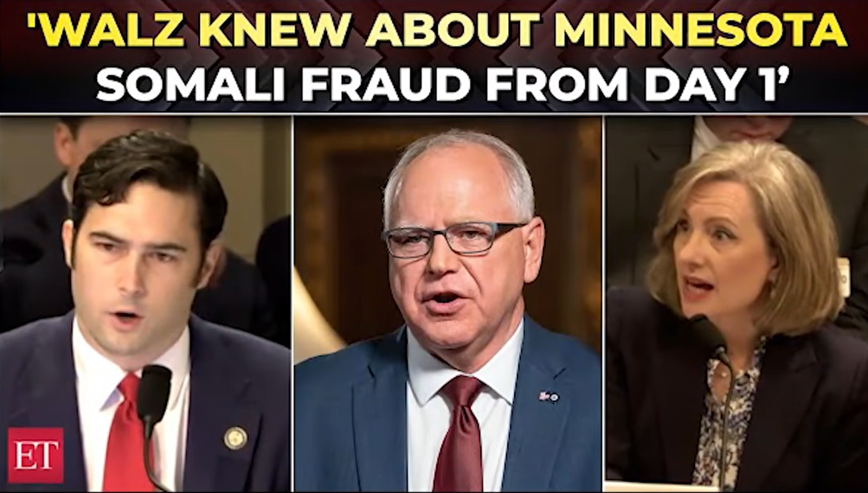
Notes:
https://youtu.be/pb9W1YONjCM?t=860

Slide 30
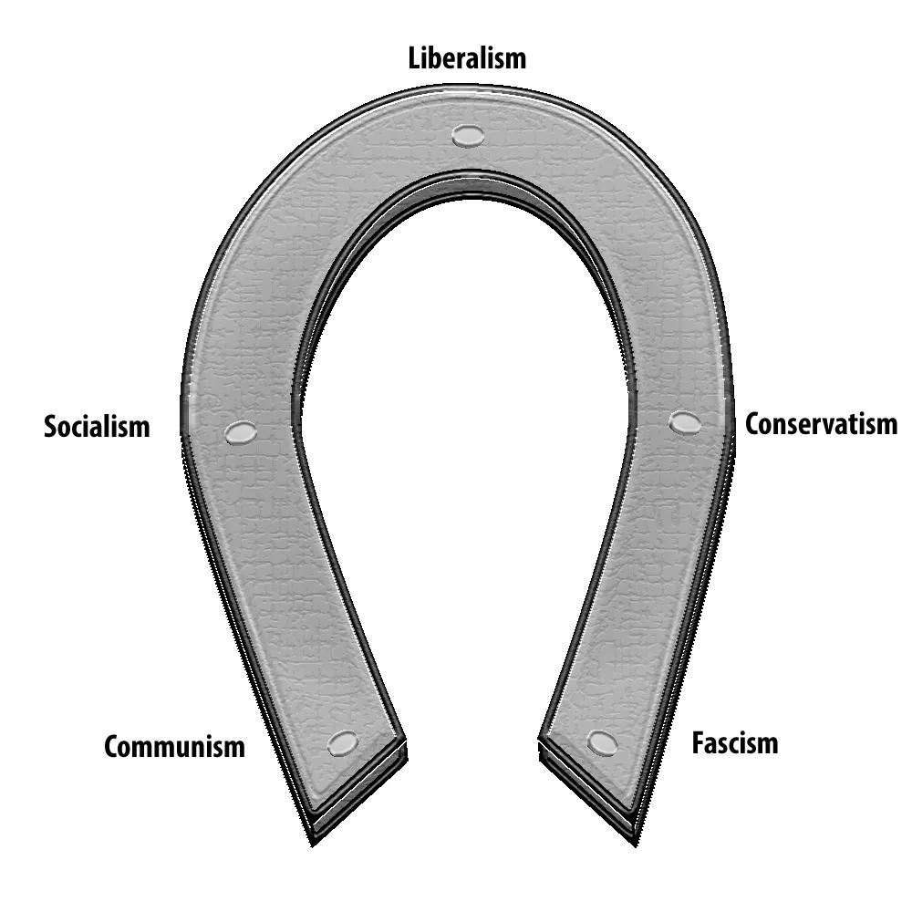
Notes:
https://miro.medium.com/v2/resize:fit:1000/1*XB0PLyu7HK2pPkJdP47ldQ.jpeg

Slide 31
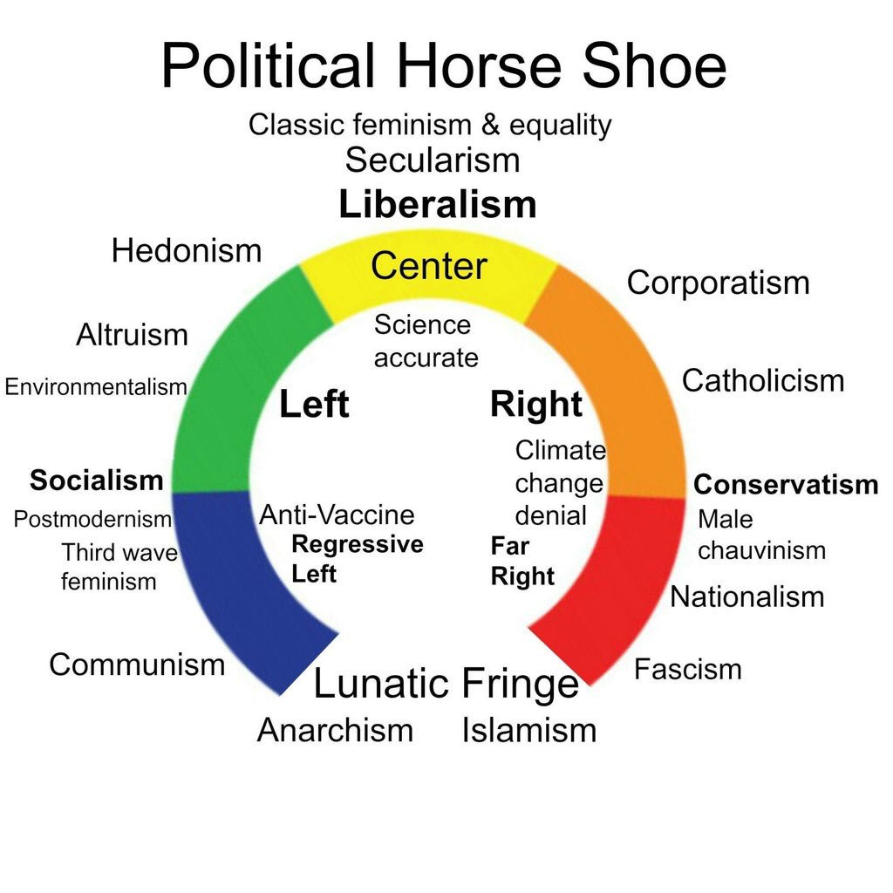
Notes:
https://pbs.twimg.com/media/CdtvkLGVIAAhu0f.jpg

Slide 32
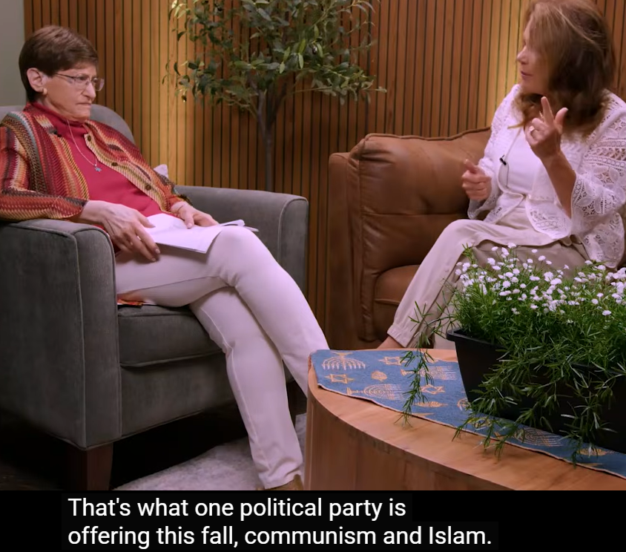
Notes:
So what to do?
Love your Muslim neighbors.
Share Yeshua with them.
VOTE!!

Slide 34
Signs of the End Times Mt 24.3
Islamic deception
Moral corruption
Universal attack on Jews
and Israel
4. Application
C

Slide 35
^{2 Tim 3.1-4} Moreover, understand this: in the אחרית הימים acharit-hayamim [end of days] will come trying times. People will be self-loving, money-loving, proud, arrogant, insulting, disobedient to parents, ungrateful, unholy,

Slide 36
^{2 Tim 3.1-4} heartless, unappeasable, slanderous, uncontrolled,

Slide 37

^{2 Tim 3.1-4} heartless, unappeasable, slanderous, uncontrolled,
astorgos: Without natural affection, unloving, hard-hearted towards kindred,

Slide 38
the frightening condition in which natural bonds of affection are severed. Scripture associates this loveless disposition with an advanced stage of moral collapse in individuals, families, societies, and the visible believers.

Slide 39
^{Ro 1.23-25} They have exchanged the glory of the immortal God for mere images, like a mortal human being, or like birds, animals or reptiles! This is why God has given them up to the vileness of their hearts’ lusts,

Slide 40
^{Ro 1.23-25} to the shameful misuse of each other’s bodies. They have exchanged the truth of God for falsehood, by worshipping and serving created things, rather than the Creator — praised be he for ever. Amen.

Slide 41
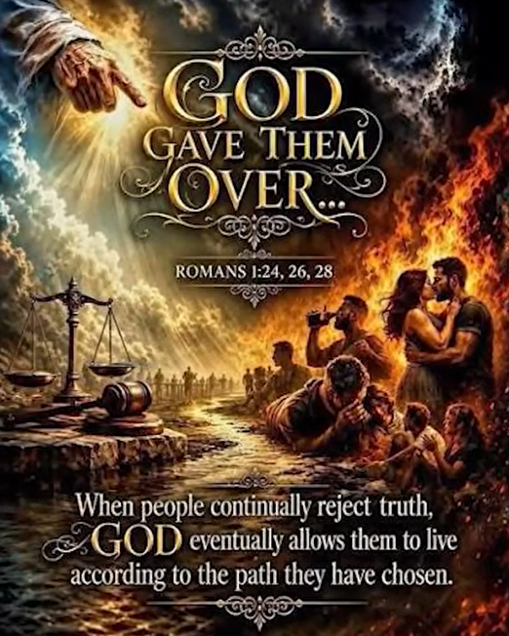
Notes:
The next video may be offensive to some.

Slide 42


Slide 43
^{Yeshayahu/ Is 5.20} Woe to those who call evil good and good evil, who change darkness into light and light into darkness, who change bitter into sweet and sweet into bitter!

Slide 44
Truth is called misinformation.
Biology is called hate speech.
The Bible is called Bible extremism.
Patriotism is called racism.
Biblical convictions are dangerous.

Slide 45
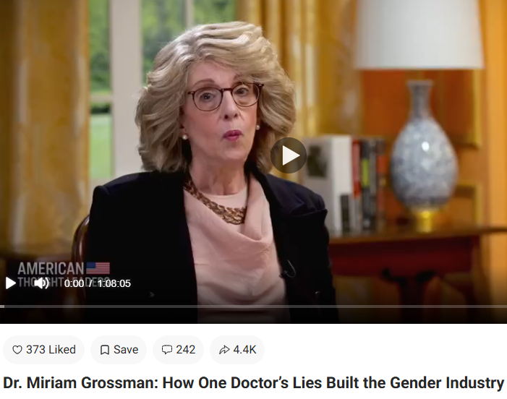
Notes:
https://www.theepochtimes.com/epochtv/dr-miriam-grossman-how-one-doctors-lies-built-the-gender-industry-part-1-post-4852600?est=UIEGFkCTabAWolSstTc3T7Iv07hWuuxrWmFfkHEVJJvn6wzUYRnnAL01Jdta9N7ZCQ%3D%3D

Slide 46
Dr John Money at Johns Hopkins had a theory and tried to validate it with identical twins; one with botched circumcision. He advised parents to transition him to girl, did surgery and trans clothes, but the kid NEVER acted like girl.

Slide 47
Plus Money sexually abused the boys at visits. XY prevailed. Y chromosome has many effects: organs, size. Finally told the truth and tried to de-transition but the de-transitioned boy had suicidal depression.

Slide 48
80% gender dyphoria self-resolve. Tavistock in UK largest clinic for tranisiton closed. Most of world recognizes that transitioning not sound.

Slide 49
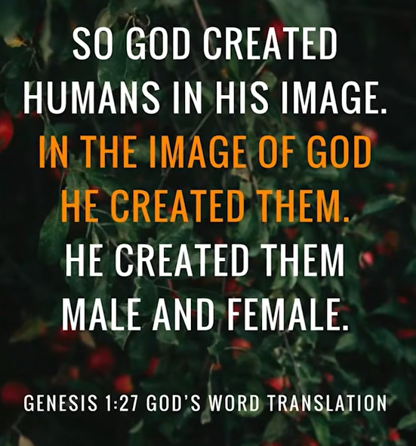
Notes:
https://www.youtube.com/watch?v=pb9W1YONjCM
What to do:
Strengthen your own purity, marriage.
Pray for revival!!

Slide 51
Signs of the End Times Mt 24.3
Islamic deception
Moral corruption
Universal attack on Jews
and Israel
4. Application
C

Slide 52
^{1 Thes 5.2-3} You yourselves well know that the Day of the Lord will come like a thief in the night. When people are saying, “Everything is so peaceful and secure,” then destruction will suddenly come upon them, the way labor pains come upon a pregnant woman, and there is no way they will escape.

Slide 53
Israel must be dwelling in apparent safety and security before the last battle, assembling at the Mountain of Megiddo = Har Megiddo = Armegeddon, and attacking Jerusalem.
The current hostility MUST have a good end.

Slide 54
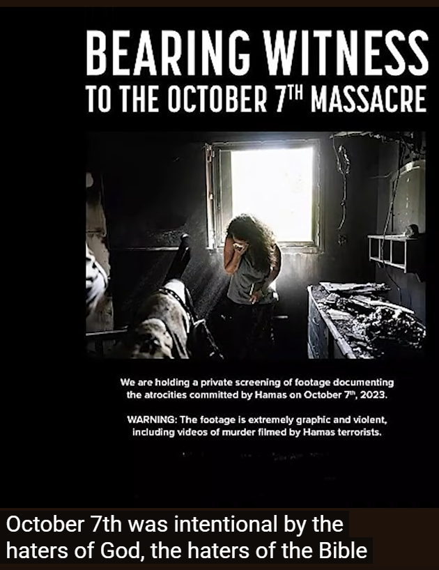

Slide 55
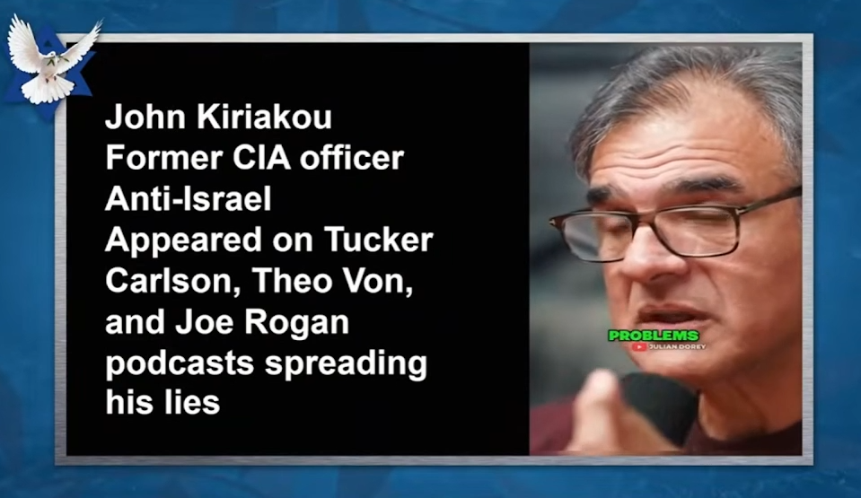

Slide 56
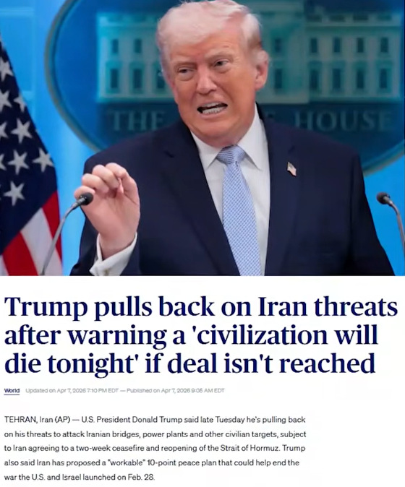
There MUST be a temporary cessation of war against Israel.
Notes:
The end times war…

Slide 57
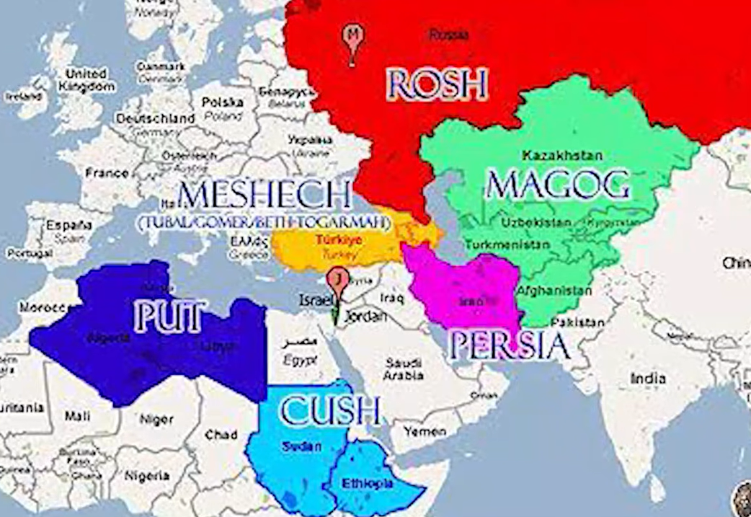

Slide 58
^{Y’khezkel/Ezek 38.2,5-6} “Human being, turn your face toward Gog (of the land of Magog), chief prince [Rosh] of Meshekh and Tuval; and prophesy against him…Paras, Ethiopia and Put are with them, all with breastplates and helmets;

Slide 59
^{Y’khezkel/Ezek 38.2,5-6} Gomer with all its troops; the house of Togarmah in the far reaches of the north, with all its troops

Slide 61
^{Y’khezkel/Ezek 38.8} After many days have passed, you will be mustered for service; in later years you will invade the land which has been brought back from the sword, gathered out of many peoples,

Slide 62
^{Y’khezkel/Ezek 38.8} the mountains of Isra’el. They had been lying in ruins for a long time, but now Isra’el has been extracted from the peoples and all of them are living there securely.
Notes:
This is 20th 21st C, except for the “living there securely.”:

Slide 63
^{Y’khezkel/Ezek 38.11} You will say, “I am going to invade this land of unwalled villages; I will take by surprise these people who are at peace, living securely, all in places without walls, bars or gates

Slide 64
^{Y’khezkel/Ezek 38.14-15} “Therefore, human being, prophesy! Tell Gog that Adonai Elohim says this: ‘Won’t you be aware of it when my people Isra’el are living in security? You will choose just that time to come from your place in the far reaches of the north, you and many peoples with you

Slide 65
In WW II, we didn’t think about making a deal with Hitler of Germany.
In WW II, we didn’t think about making a deal with Hirohito of Japan
We cannot think about making a deal, an MoU, with the IRGC.

Slide 66
All Israel will be saved

Slide 67
^{Zekh 12.9-11} It will happen in that day that I will seek to destroy all the nations that come against Jerusalem. “Then I will pour out on the house of David and the inhabitants of Jerusalem a spirit of grace and supplication, when they will look toward Me whom they pierced.

Slide 68
^{Zekh 12.9-11} They will mourn for him as one mourns for an only son and grieve bitterly for him, as one grieves for a firstborn. In that day there will be a great mourning in Jerusalem, mourning like Hadad-rimmon in the valley of Megiddo

Slide 69
^{Zekh 13.1} When that day comes, a spring will be opened up for the house of David and the people living in Yerushalayim to cleanse them from sin and impurity.

Slide 70
^{Zekh 14.8-9} On that day, fresh water will flow out from Yerushalayim, half toward the eastern sea and half toward the western sea, both summer and winter. Then Adoni will be king over the whole world. On that day Adoni will be the only one, and his name will be the only name.

Slide 72
Signs of the End Times Mt 24.3
Islamic deception
Moral corruption
Universal attack on Jews
and Israel
4. Application
C
Notes:
https://lcaction.org/detail/260813-sharia-invades-america

Slide 73
^{1 Thes 3.12-13} And as for you, may the Lord make you increase and overflow in love toward each other, indeed, toward everyone, just as we do toward you; so that he may give you the inner strength to be blameless, by reason of your holiness, when you stand before God our Father at the coming of our Lord Yeshua with all his angels.
Notes:
Born again, filled with the Spirit, given to prayer and praise!! Reconciliation!!

Slide 74

9 am CDT

