Slide 1
I was hunting big game deep in Kruger National Park in the wilds of South Africa. This was a one-in-a-million photo op.

Slide 2
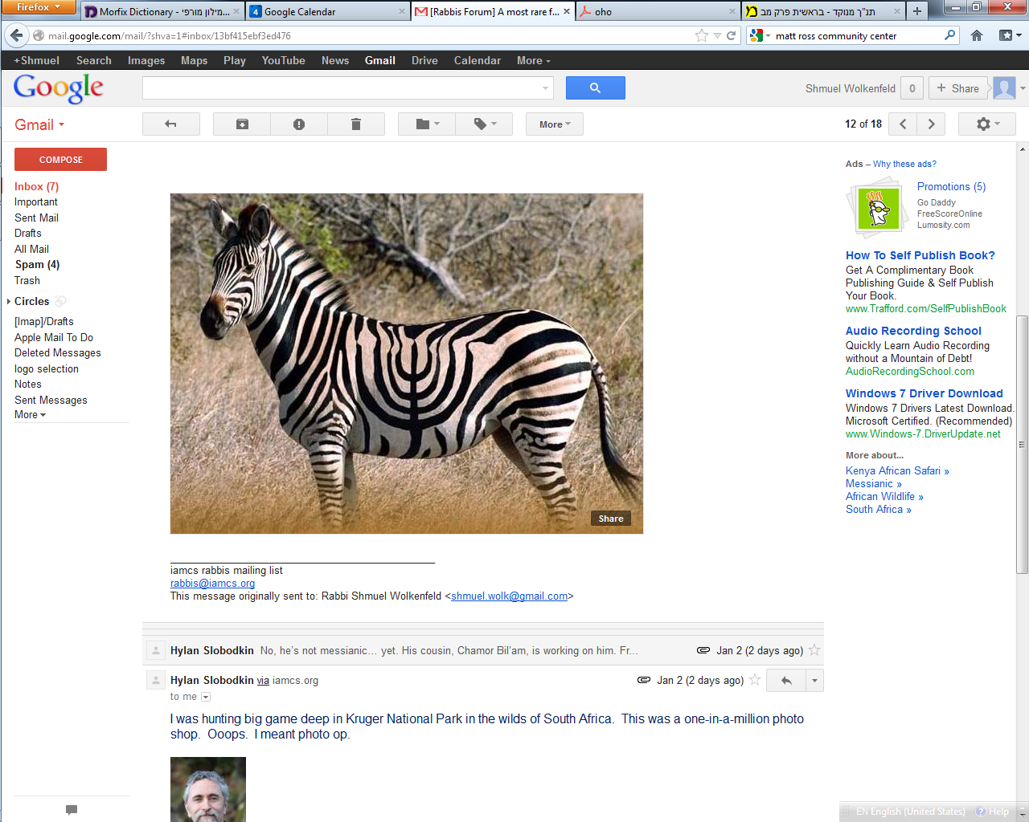

Slide 3
I was hunting big game deep in Kruger National Park in the wilds of South Africa. This was a one-in-a-million photo op.
Ooops. I meant photo shop.

Slide 4
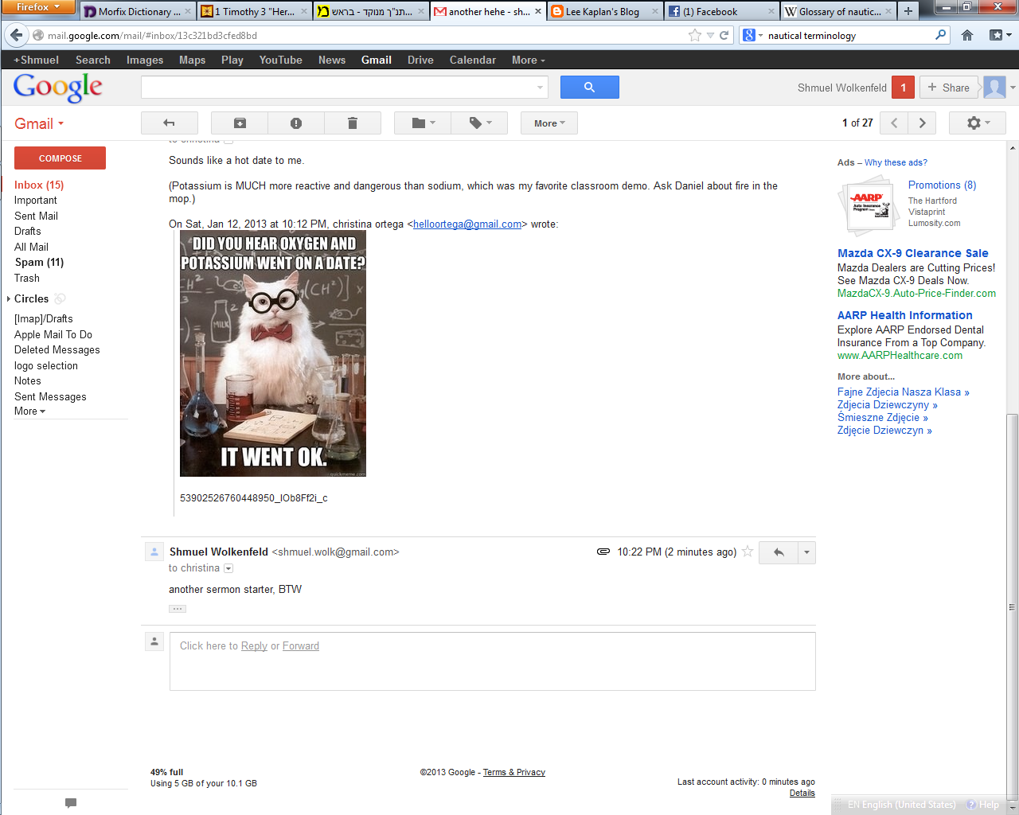
Notes:
Actually K₂O

Slide 5
Actually K₂O
Notes:
Actually K₂O

Slide 6


Slide 7
Eustace Scrubb, now a reformed character following the events of The Voyage of the Dawn Treader, encounters his classmate and new friend Jill Pole at their school.
Aslan charges Jill with helping Eustace find King Caspian X's son, Prince Rilian of Narnia, who disappeared ten years earlier.

Slide 8
Jill and Eustace are flown to the marshes on the northern edge of Narnia where they meet their guide, Puddleglum, a gloomy but stalwart Marsh-wiggle.

Slide 9
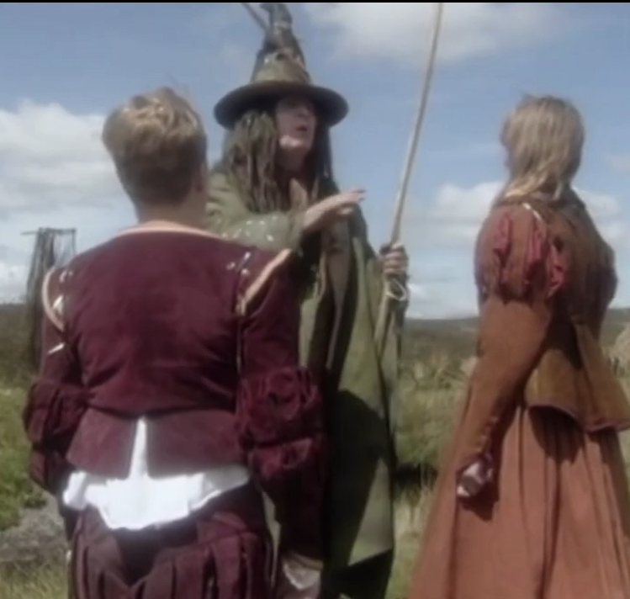
Eustace and Jill meet Puddleglum
Notes:
https://www.youtube.com/watch?v=nj7WkATQwwY

Slide 10
Eutace and Jill are captured by the Green Lady tries to bewitch them all into forgetting who they are.

Slide 11
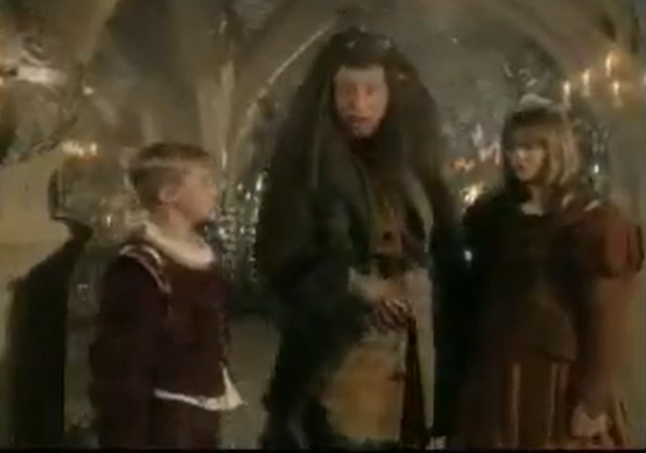
Notes:
https://www.youtube.com/watch?v=Wh55SzhLkmc

Slide 12
Puddleglum saves the mission
Puddleglum, gloomy but stalwart
Yeshua appreciates faithfulness, but it’s NOT the central theme.
Notes:
I identify with Puddleglum. Gevaltism. What will go wrong next, but keep trucking.

Slide 13
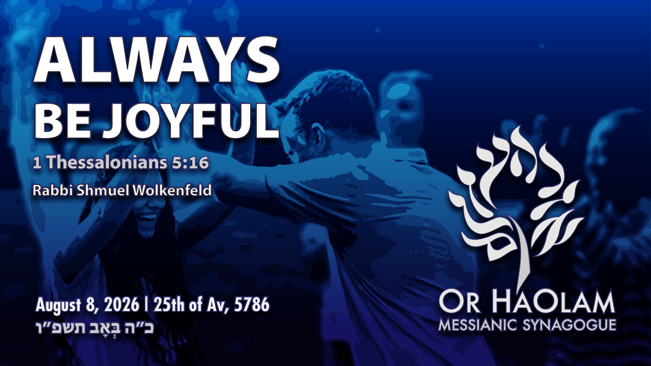

Slide 14

Always be joyful 1 Thes. 5.16
Word analysis
Reasons to Praise
Shalom Arush
Torah misuse

Slide 15
Always be joyful 1 Thes. 5.16
Word analysis
Reasons to Praise
Shalom Arush
Torah misuse

Slide 16
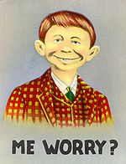
Mad Magazine Alfred E Neuman
Notes:
the image of the smiling, idiotic boy who would eventually be known as Alfred E. Neuman.
conveys simpleton-like obliviousness, embodies a satirical archetype of youthful idiocy.
Always be joyful is not this.

Slide 17
Context
^{1 Thes 5.16-20} Always be joyful. Pray constantly. In everything give thanks, for this is what God wants from you who are united with the Messiah Yeshua. Don’t quench the Spirit, don’t despise inspired messages.
Notes:
This is to be the tenor of our lives, our flavor, our “smell.” Not crisis and chaos.

Slide 18

always, evermore.
From pas and hote; every when, i.e. At all times -- alway(-s), ever(-more).

Slide 19
chairó: Rejoice, be glad, be joyful
properly, to delight in God's grace ("rejoice") – literally, to experience God's grace (favor), be conscious (glad) for His grace.

Slide 20
Joy is neither circumstantial nor seasonal; it is rooted in the unchanging character of God.

Slide 21
Wesley’s commentary:
In uninterrupted happiness in G-d.

Slide 23
Always be joyful 1 Thes. 5.16
Word analysis
Reasons to Praise
Shalom Arush
Torah misuse

Slide 24
הַלְלוּיָהּ Halleluyah
הַלֵּל Hallel noun praise, glorification
הִלֵּל Hillel vb to praise, to glorify, to exalt, commend, laud
יָה G-d, Adoni, the L-rd Yah

Slide 25
הַלְלוּ 2nd person imperative Hallelu
יָהּ Yah
So, when we say Halleluyah, we are really giving a command to a group. “You praise Yah.”

Slide 26
I praise Yah is Ani M’hallel Yah.
אני מהלל יה
Don’t sweat it:
The command and the personal expression are virtually, poetically synonymous

Slide 27
^{T’hillim/ Psalm 148} Halleluyah! Praise Adoni from the heavens! Praise him in the heights! Praise him, all his angels! Praise him, all his armies! Praise him, sun and moon! Praise him, all shining stars! Praise him, highest heaven, and waters above the heavens!
Notes:
Heavens G-d’s throne Holy Place Kadosh chant
Heights…mountains, scenery
Angels…armies: unseen warfare and protection
Sun… astronomy…breathtaking, sort of intoxicating Voyager I outside the solar system…heliopause. Found phenomena no physicist expected. Solar wind protons and electrons met by interstellar force.

Slide 28
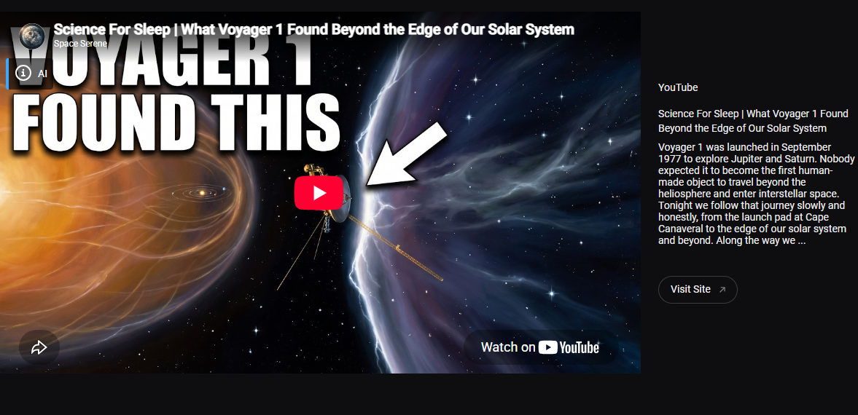
Notes:
We’ll travel to all this in eternity.
A bit similar scuba diving. G-d’s untouched creation
https://video.search.yahoo.com/yhs/search;_ylt=AwriqrLptHZqJwIArg8PxQt.;_ylu=Y29sbwNiZjEEcG9zAzEEdnRpZAMEc2VjA3Nj?hspart=fc&hsimp=yhs-6028_11&type=fc_AD78CC72F59_s69_g_e_d111225_n141297_c999&param1=7&param2=eJwtj8tqwzAURH9FywQkRVe2ZClaxZh8QOmqFy1cR3GEn%2FiBS7%2B%2BKJTZDMwcmGnjA53%2FqEAIZaRG6kd0HnKQtkDqUwgAUiqkvkHnrbVIfZzRecmV5mAsB5kh9W2Y0Pl9Rer3Gp0fpt%2FY9%2FVFcUFORxwf07GScSMguHDkiKPOHfnR%2BZnU89yHI3x3cbuorOCZJqfutQ09JX3sAmlD001n0ryWaQgXUMBFElnrZ73EfyStWt9n0oA1LG9f6rIA0IJZWZUM4A7sVtwEq6y2tpB3U9pE7k0qSyE1E4YJ8ymya66vYLiG%2FOsP4XhTMw%3D%3D&p=Voyager+1+beyond+the+heliosphere&fr=yhs-fc-6028_11&turl=https%3A%2F%2Ftse1.mm.bing.net%2Fth%2Fid%2FOVP.SFCcd0eb6lA7iv13nVPQwgEsDh%3Fpid%3DApi%26w%3D296%26h%3D156%26c%3D7%26p%3D0&rurl=https%3A%2F%2Fwww.youtube.com%2Fwatch%3Fv%3DVU2C7bnE3ZU&tit=NASA+Found+New+Evidence+Beyond+the+Heliopause+%E2%80%94+Voyager+1+Was+Right&pos=01&vid=9c8b849499653664d8b1d0199b56811e&sigr=Hvj9oufjsH2m&sigt=2eoXe3pUvPgC&sigi=ZTsbIFFqlMxG

Slide 29
^{T’hillim/ Psalm 148} Let them praise the name of Adoni; for he commanded, and they were created. He established them forever and ever; he has given a law to which they must conform. Praise Adoni from the earth, sea monsters and watery depths,.
Notes:
5. Name of Adoni…His character, attributes
6. Laws of physics, chemistry, biology. Elon Musk didn’t create anything, but exploits it well.
7. See monsters…Whales, zoo praise study. walruses

Slide 30
^{T’hillim/ Psalm 148} fire and hail, snow and mist, storm-winds that obey his word, mountains and very hill, fruit trees and all cedars, wild animals and all livestock, creeping reptiles, flying birds,
Notes:
8. Weather is amazing, narrow window and life impossible.
9. Scenery. Kansas no mountains or oceasn
10. Trees
Animals
Bugs, birds

Slide 31
^{T’hillim/ Psalm 148} kings of the earth and all peoples, princes and all rulers on earth,
What about when government is vile?
Notes:
13 Government. Our republic revolution of 1763, according to Eric Metaxis.

Slide 32
As the world looks away, Iran continues brutal hangings of protesters to crush the next uprising
IRAN AFFAIRS: Iran’s campaign of executions is part of a wider attempt to reverse the defiance of January, dismantle protest networks, and reassert control over society.
Notes:
https://www.jpost.com/middle-east/iran-news/article-904794

Slide 33
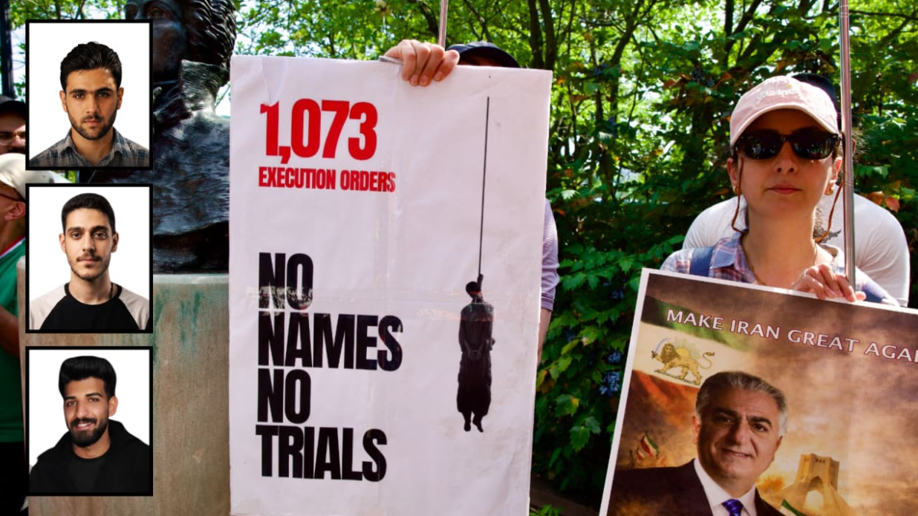
Notes:
https://www.jpost.com/middle-east/iran-news/article-904794

Slide 34
At dawn on July 28, the Islamic Republic of Iran publicly hanged Abolfazl Sepahi Badjani and Amirhossein Safari Hosseinabadi in Alikhani Square in Isfahan.
Notes:
https://www.jpost.com/middle-east/iran-news/article-904794

Slide 35
According to N12, the secret Mossad-CIA proposal called for Kurdish ground forces to enter Iran under extensive Israeli and American air cover. Iranian minorities would then help remove the Islamic Republic’s leadership, allowing alternative Iranian figures to take power.
Notes:
https://www.jpost.com/israel-news/article-904817

Slide 36
G-d is still working.
The Crusades precipitated the Renaissance
The Inquisition motivated Jews to flee to America
The Holocaust precipitated the formation of Israel.
Notes:
G-d is working His purposes.

Slide 37
^{T’hillim/ Psalm 148} Young men and women alike, old men and children.
Let them praise the name of Adoni, for his name alone is exalted; his glory is above both earth and heaven. He has increased the power of his people, granted praise to all his faithful, to the descendants of Isra’el, a people close to him.
Notes:
15. Youthful energy, strength and beauty
16. His Glory >> any of this amazing creation
17. Power to people to create.
18. Faithfulness to Israel to survive, and create. BC national culture of the Word.

Slide 38
happy, overjoyed Ashrei אַשְׁרֵי
אֶשֶׁר Asher describes the objective, God-given condition of blessedness enjoyed by those who walk in covenant faithfulness. It is not a fleeting emotion but a settled state of well-being grounded in the character and promises of the L-rd.

Slide 39
happy, overjoyed Ashrei אַשְׁרֵי
אֶשֶׁר Approximately forty-five occurrences, spread mainly through Psalms, Proverbs, and prophetic or covenant contexts, form a tapestry that reveals what a truly “blessed” life looks like in the sight of God.

Slide 40
T’hillim/Ps 32:1 quoted in Ro 4.7-8 Ashrei אַשְׁרֵי How blessed are those whose offense is forgiven,
those whose sin is covered!
How blessed those to whom Adonai imputes no guilt,
in whose spirit is no deceit!

Slide 41
Ashrei אַשְׁרֵי blessed is the one who has stopped counting offenses as though mercy were running out. Blessed is the one whose heart is being freed from the prison of ledgers, who remembers that the Father's mercy was not measured out with a calculator but poured out through the broken body and shed blood of Yeshua.
Notes:
George Whitten

Slide 42
^{Rev 4.11} “You are worthy, Adoni Eloheinu, to have glory, honor and power, because you created all things — yes, because of your will they were created and came into being!”
Notes:
Creator

Slide 43
^{Revelation 5.12} “Worthy is the slaughtered Lamb to receive
power, riches, wisdom, strength,
honor, glory and praise!”
Notes:
Redemption of Mashiakh

Slide 44
^{Rev 5.13} And I heard every creature in heaven, on earth, under the earth and on the sea — yes, everything in them — saying, “To the One sitting on the throne and to the Lamb belong praise, honor, glory and power forever and ever!”

Slide 46
Always be joyful 1 Thes. 5.16
Word analysis
Reasons to Praise
Shalom Arush
Torah misuse

Slide 47


Slide 48
^{Mtt 10.29-32} Aren't sparrows sold for next to nothing, two for an assarion? Yet not one of them will fall to the ground without your Father's consent.
Notes:
a very small coin; according to them it contained four grains of silver; was the ninety sixth part of a "sela", or shilling Maimon. in Misn. Peah, c. 8. sect. 1.
not one of them is taken in a snare, or killed with a stone, or shot flying, or sitting, but by the will of God: from whence it may be strongly concluded, that nothing comes by chance; that there is no such thing as contingency with respect to God, though there is to men, with respect to second causes; that all things are firmly ordained by the purpose of God, and are wisely ordered by his providence:
Just like we can’t grasp the HOLINESS of G, we can’t grasp his purposes in all things. But we can worship!! In ALL circumstances!!

Slide 49
^{Mtt 10.29-32} As for you, every hair on your head has been counted. So do not be afraid, you are worth more than many sparrows. Whoever acknowledges me in the presence of others I will also acknowledge in the presence of my Father in heaven.

Slide 50
^{Ro 8.28-29} Furthermore, we know that God causes everything to work together for the good of those who love God and are called in accordance with His purpose;
Notes:
The whole purpose of life is to Know G-d, revealed in Yeshua. If we ignore a message, He sends a louder one. Our task to discern Yeshua’s loving message to us, Not to sink into frustration, anger, depression!!
Hebrew term is Tikkun, soul correction, this is to correct ourselves!!

Slide 51
^{Ro 8.28-29} because those whom he knew in advance, he also determined in advance would be conformed to the pattern of his Son, so that he might be the firstborn among many brothers

Slide 52
^{Yn 16.33} "I have said these things to you so that, united with me, you may have shalom. In the world, you have tsuris. But be brave! I have conquered the world!"
Notes:
Tsuris: Trouble; aggravation. A Yiddish phrase for worries, stress, or hassle.
Does it look like it’s conquered?
Everyone has troubles.
Robin Hood is based on lack of understanding the ways of G-d. If we have faith, poor and rich are by the will of G-d. So is Marxism. Confiscatory taxes in UK.
How has He conquered? Joy IF we trust HIM!! Don’t like rejection, disputes, shortfalls, health problems.

Slide 53
^{T’hillim Ps 25.4-5} Make me know your ways, ADONI, teach me your paths. Guide me in your truth, and teach me; for you are the God who saves me, my hope is in you all day long.
Notes:
My truth is to have life easy. YOUR truth is to perfect me through all.

Slide 54
^{T’hillim Ps 73.21-25} When I had a sour attitude and felt stung by pained emotions, I was too stupid to understand; I was like a brute beast with you. Nevertheless, I am always with you; you hold my right hand.
Notes:
Moshe took off his sandals to worship the holy. We need to take off our self protection, defensiveness, justification, woundedness, revenge, accusation, anger, walls, and worship. Worship Him who does all things well. Thank him for the worst. Not that the worst is not so bad, but the HE is working through it. No second causes.
If someone sins, it’s wrong. But the effect on US is processed by Divine providence. Wrong to them, right to us!!
If we sin, it’s wrong. But consequences of our sin are processed by Divine providence. So we can repent and still praise!! Get irritable? Provoke reaction? Repent, and praise G for the reaction!

Slide 55
^{T’hillim Ps 73.21-25} You will guide me with your advice; and afterwards, you will receive me with honor. Whom do I have in heaven but you? And with you, I lack nothing on earth.

Slide 56
Forms of doubt
Doubt that the minutest details of our lives are the providence of a loving G-d and for our redemption.
Notes:
Joy Starts here, p 125

Slide 57
Forms of doubt
Doubt that we can speak effectively to G-d about every circumstance, in surrender → praise, and prayer.
Notes:
Joy Starts here, p 125

Slide 58
Forms of doubt
Doubt that He loves us, and desires to help us, especially when we talk to Him
Notes:
Joy Starts here, p 125

Slide 59
Forms of doubt
Doubt that G-d has power, mercy, and compassion that are limitless to work wonders.
Notes:
A midrash, a fanciful story to interpret scripture. Not necessarily true. Maybe, but illustrative. Moshe prayed 515 times to enter the promised land. Then G-d told him to stop. One more prayer and He’d have to reverse.
Don’t really think it happened, but it’s an illustration that shows the power of prayer.

Slide 60
^{T’hillim Ps 147.10-12} He takes no delight in the strength of a horse, no pleasure in a runner's speed. ADONI takes pleasure in those who fear him, in those who wait for his grace. Glorify ADONI, Yerushalayim! Praise your God, Tziyon!
Notes:
It’s NOT our abs, or figure, or impressive skills and knowledge, or financial resources that give G-d pleasure. It’s glorifying G-d in all. This is VERY liberating.

Slide 61
Levels of living faith.
אֱמוּנָה Emunah
faith, trust, confidence
Active faith.
Notes:
A word of disclaimer on Shalom Arush’s book. His concepts and interp of scripture is EXCELLENT. Some of his illustrations are from Kabbalah, some about reincarnation. I am NOT endorsing those illustrations. Men’s group remember we had to filter some things.
Why use? Marriage book that we did in Men’s Group called men to a deeper level of the crucified life than Dobson, Trent, Smalley, etc. Not use that terminology.
This book calls us to an amazing level of faith. Those who remember David Dreiling, highly endorsed.

Slide 62
Basic level Emuna: firm belief that EVERYTHING comes from Adoni by way of perfect Divine providence. No secondary causes.
Notes:
Like holiness. We accept G-d goodness, and praise. this MUCH more pro-active. Can change your life.
We fall before His Holiness. We praise ALL His works. ALL. Gan Emuna 21, 22
We talk about Sozo ministry, which involves finding the lies about life and G-d that we’ve received, renouncing, and asking G-d for revelation of truth.
This is generalized Sozo, כי the basic lie is that life/G-d is mean, against us.
We commit to praise in everything. Even the consequences of our and others failures. Still in His hands.

Slide 63
Intermediate level: belief that everything that comes from Adoni is for the very best. All troubles have their purpose. Therefore PRAISE. Without understanding the purpose.

Slide 64
Upper level: Belief that our joyful task is to discern the message to us in EVERY trouble.
Notes:
Message NOT = punishment. Iyov/Job was not punished, but called to go higher. Tho He slay me, yet will I trust Him.

Slide 65
^{Dvarim 28.45-46} "All these curses will come on you, pursuing you and overtaking you until you are destroyed, because you didn't pay attention to what ADONI your God said, observing his mitzvot and regulations that he gave you. These curses will be on you and your descendants as a sign and a wonder forever. WHY sooo intense??

Slide 66
^{Dvarim 28.47} Because you didn’t serve Adoni your God with joy and gladness in your heart when you had such an abundance of everything;

Slide 68
Always be joyful 1 Thes. 5.16
Word analysis
Reasons to Praise
Shalom Arush
Torah misuse

Slide 69
^{Ro 10.1-4} Brothers, my heart’s deepest desire and my prayer to God for Isra’el is for their salvation; for I can testify to their zeal for God. But it is not based on correct understanding; for, since they are unaware of God’s way of making people righteous

Slide 70
^{Ro 10.1-4} and instead seek to set up their own, they have not submitted themselves to God’s way of making people righteous. For the goal at which the Torah aims is the Messiah, who offers righteousness to everyone who trusts.

Slide 71
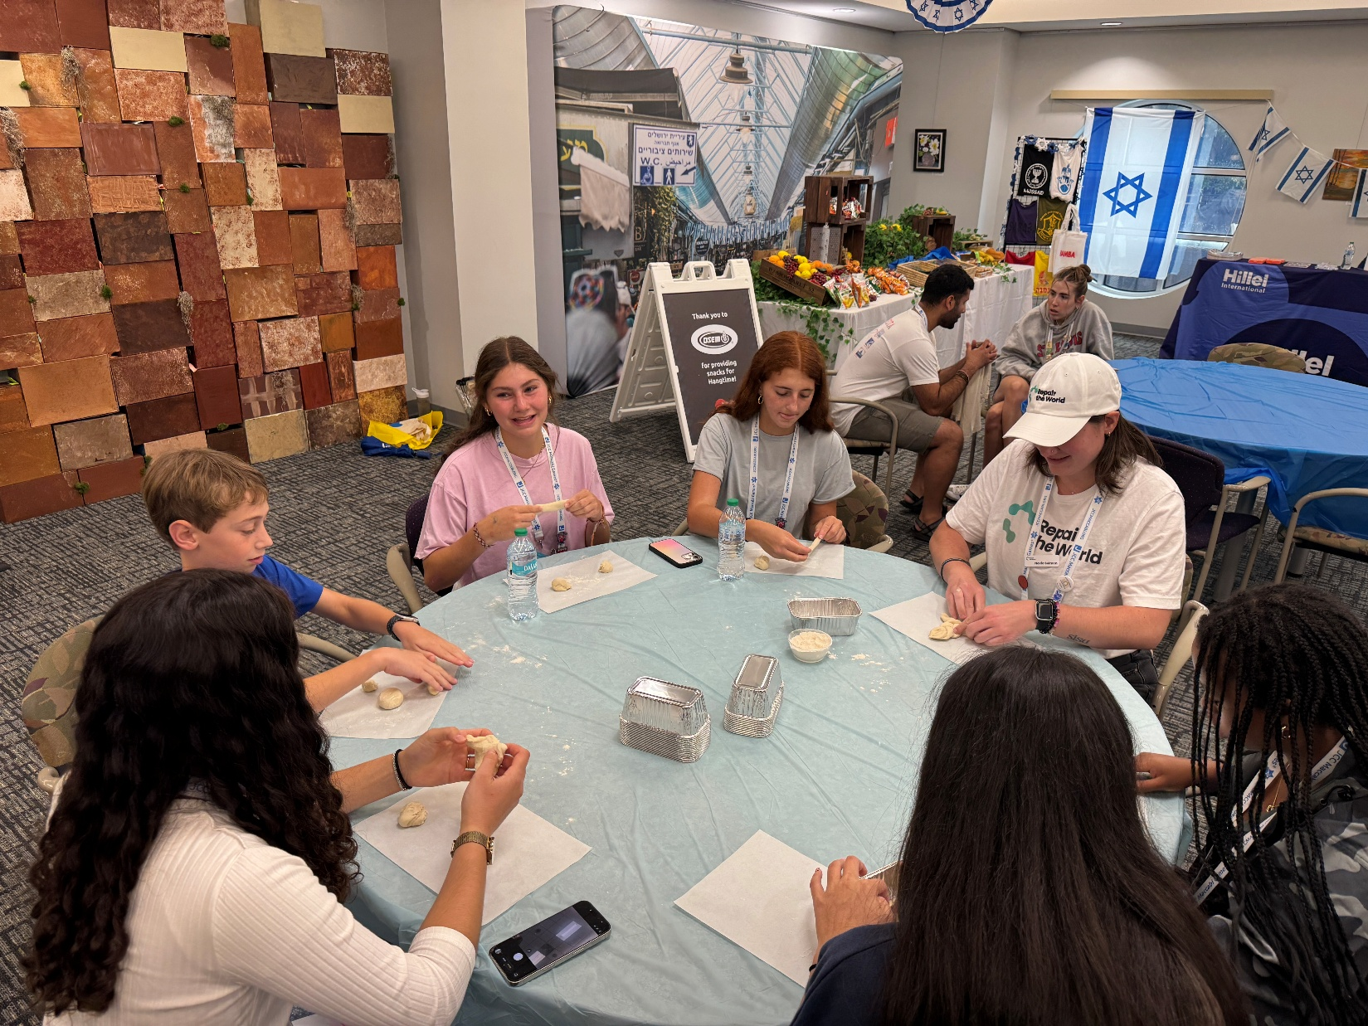
Notes:
I had the privilege of being a volunteer at the Maccabi Games. Hangtime room, between events. Visit, schmooze. Be an adult in the room. Teens made Hallah bread. I made one!

Slide 72
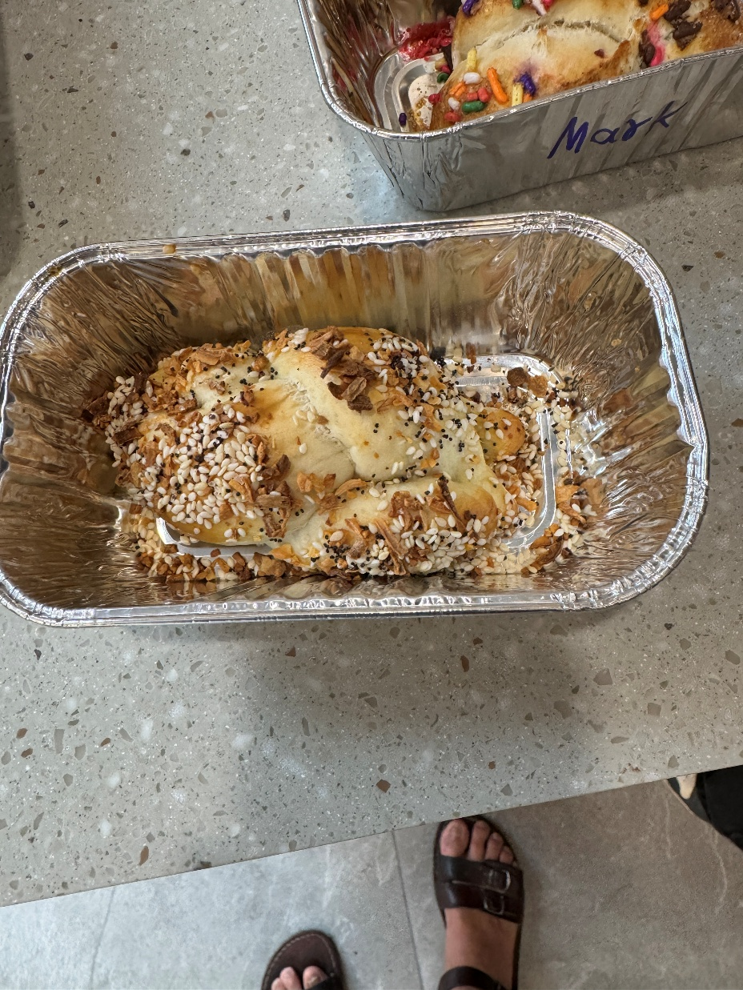
I made a hallah.
Notes:
The 30 something Hasidic rabbi was offering to lay tefillin, really wrap, but the colloquialism is “lay tefillin” on all takers. Lots of the teen athletes. One whole team, and then they won their competition by 30 points! Me as well. I commented later to him…”Lots of customers.” His response with joy was “Many mitzvot today!” He was exactly going about to set up his own earned righteousness. With joy and success! So, what do we Messianics have to offer to such Jewish people.

Slide 73
^{Ro 8.3-4} For what the Torah could not do by itself, because it lacked the power to make the old nature cooperate, God did by sending his own Son as a human being with a nature like our own sinful one [but without sin]. God did this in order to deal with sin,

Slide 74
^{Ro 8.3-4} and in so doing he executed the punishment against sin in human nature, so that the just requirement of the Torah might be fulfilled in us who do not run our lives according to what our old nature wants but according to what the Spirit wants

Slide 75
^{Ro 8.35,39} Who will separate us from the love of the Messiah? Trouble? Hardship? Persecution? Hunger? Poverty? Danger? War? … neither powers above nor powers below, nor any other created thing will be able to separate us from the love of God which comes to us through the Messiah Yeshua, our Lord.
Notes:
RTF abandonment key to all emo wounds

Slide 76
^{Matthew 5.20} For I tell you that unless your righteousness is far greater than that of the Torah-teachers and P’rushim, you will certainly not enter the Kingdom of Heaven!
Notes:
I had a guy attending here, in the old building, who said that he would out Orthodox the Orthodox. I told him, “You have no idea what you are saying.” We need to be Torah observant, but what we really have is…

Slide 77
^{Gal 5.22-25} But the fruit of the Spirit is love, joy, peace, patience, kindness, goodness, faithfulness, humility, self control. Nothing in the Torah stands against such things. Moreover, those who belong to the Messiah Yeshua

Slide 78
^{Gal 5.22-25} have put their old nature to death on the stake, along with its passions and desires. Since it is through the Spirit that we have Life, let it also be through the Spirit that we order our lives day by day.
Do we?

Slide 79
Why do we need Yeshua if the Chabad have it so together?
Objectively: the atoning Blood
Subjectively: the fruit of the Ruakh.
Do we? Or are we Puddleglum
Notes:
All Israel will be saved. Meaning

Slide 80
Notes:
https://www.youtube.com/watch?v=Wh55SzhLkmc

Slide 81
Puddleglum, gloomy but stalwart
Yeshua appreciates faithfulness, but it’s NOT the central theme.

Slide 83
Always be joyful 1 Thes. 5.16
Word analysis
Reasons to Praise
Shalom Arush
Torah misuse

