Slide 1
e-handout
To have these notes
without taking notes
Go to OrHaOlam.com
Click on Messages tab,
2026 Messages

Slide 2
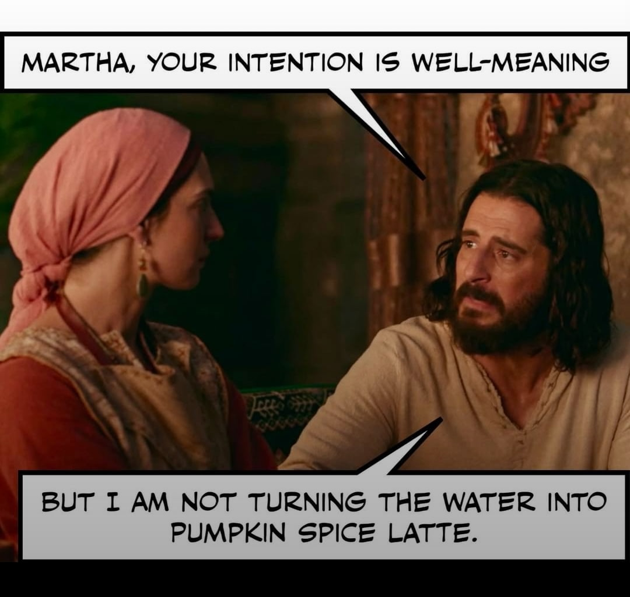

Slide 4
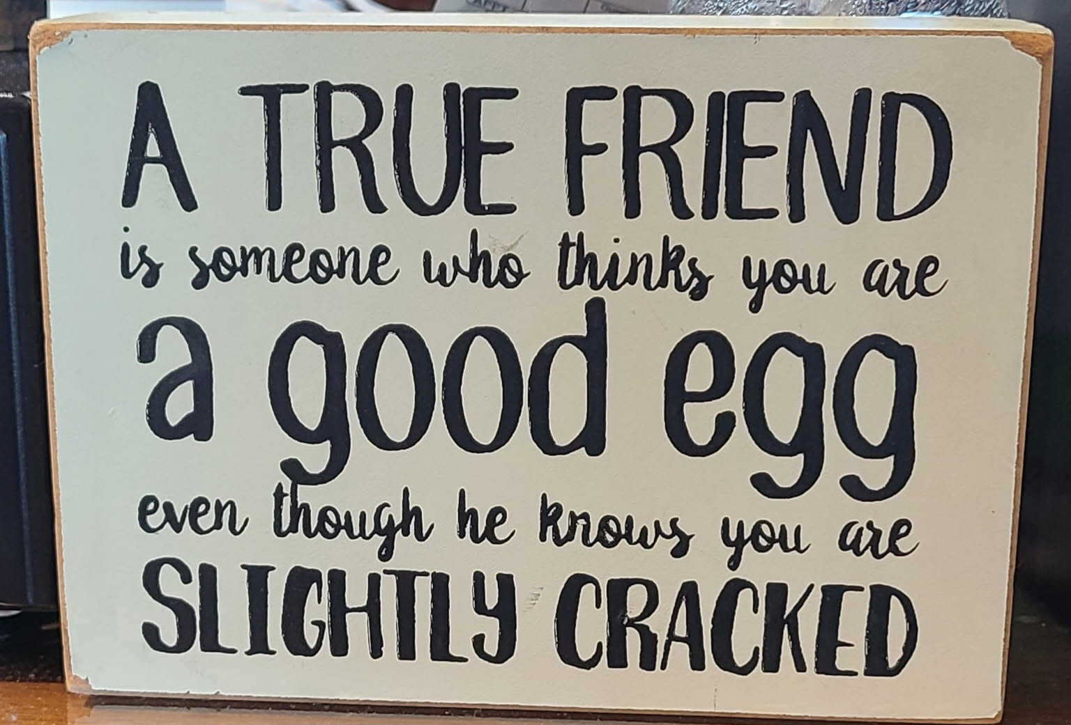

Slide 5
Notes:
Ben Troyer. Tree surgeon

Slide 6

^{Vayikra / Lev 23.23-24} Adoni said to Moshe, “Tell the people of Isra’el, ‘In the seventh month, the first of the month is to be for you a day of complete rest for remembering.
Notes:
With T’ruah = loud sounds, but that is not the focus this evening.

Slide 7
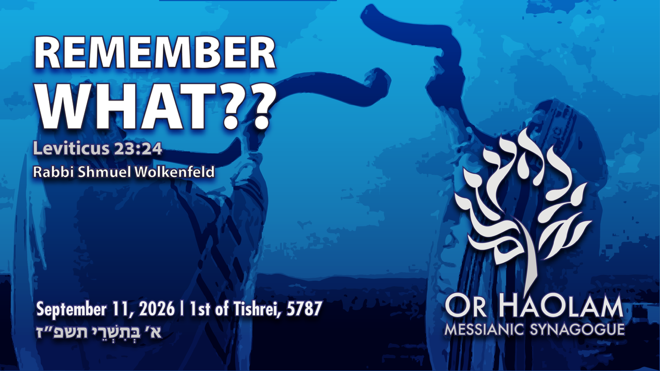

Slide 8
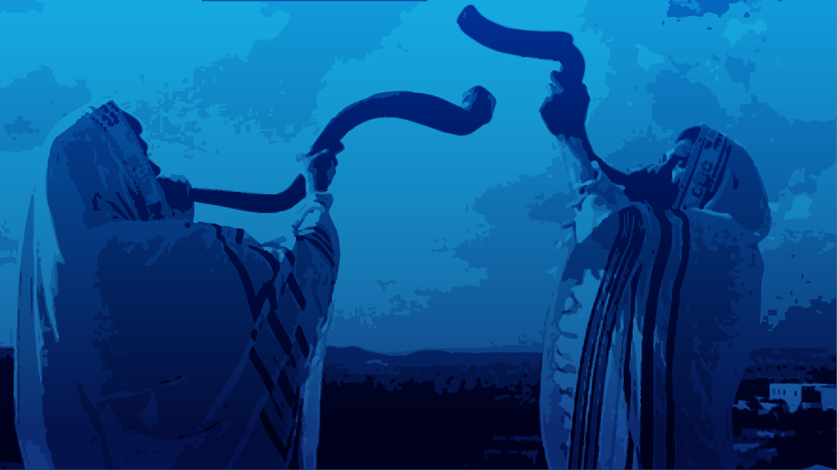
Remembering What?? Ex 23.24
Rosh Hashana miscellany
Who G-d is Messiah.
Who we are in Messiah.
The Needy

Slide 9
Remembering What?? Ex 23.24
Rosh Hashana miscellany
Who G-d is Messiah.
Who we are in Messiah.
The Needy

Slide 10
Some Rosh Hashanna greetings
L’Shana Tovah לְשָׁנָה טוֹבָה
[Have a] Good Year
שָׁנָה טוֹבָה וּמְתוּקָה
Shana Tova oo-m’tukah
[Have a] Good and sweet year
Notes:
10
These are entirely Biblical.
There is a variant of a good year be written unto you. Tikatevu mentioned in the wonderful talmidut/ discipleship class Tuesday..
More complex Hebrew. OK rabbinic tradition, and not Biblical.

Slide 11
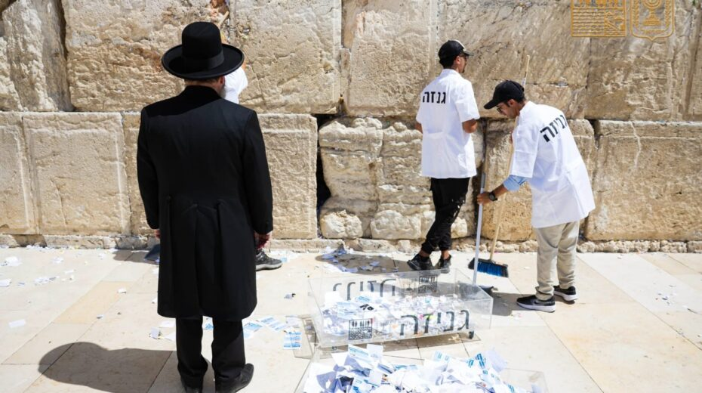
Notes:
A few days before Rosh Hashanah, the traditional clearing of prayer notes at the Western Wall. As every year, thousands of small notes that visitors have placed between the ancient stones over the past months were carefully removed and subsequently interred in a geniza, a special storage and burial site for sacred texts. There is a Geniza in KC, in one of the cemeteries.
https://www.israeltoday.co.il/read/western-wall-remains-a-place-of-hope-and-prayer/?mc_cid=50bf590dc9&mc_eid=9f06d9f262
We have genuine Jerusalem stone. You can put prayer requests.

Slide 12
Yom Kippur greeting:
צוֹם קַל tsom kal
Easy fast

Slide 13
Rosh Hashanah רֹאשׁ הַשָּׁנָה‎‎, literally "head [of] the year"
Why that name?

Slide 14
The historian Josephus, and the ancient Aramaic translation of the Bible, the Targum Jonathan, identify Rosh HaShanah as the New Year observed by the people of Israel before the holiday of Passover was instituted.
Notes:
Encyclopedia Judaica

Slide 15
The traditional Jewish concept is that the world, Adam and Khava/Eve, were created on Rosh HaShanah, so this day is indeed the beginning of the year chronologically.
Notes:
https://en.wikipedia.org/wiki/Rosh_Hashanah

Slide 16
The Babylonian name Tishri seems to derive from the root Ugaritic or Akkadian seru, which means "to begin." The ancient Semitic peoples thought of the year as beginning in the autumn, at the time of the late harvest. This was the beginning of the economic year, when crops began to be sold.
Notes:
School year too, based on agriculture

Slide 17
G-d made a spiritual cycle to start on Nisan near Pesakh, but the chronological year didn't change. So, Jews have four new years:
a chronological one,
a spiritual one,
one for trees,
one for livestock.
Notes:
https://www.bing.com/search?FORM=ARPACA&PC=3ACA&PTAG=1_2_1_339_I6&q=how%20many%20Jewish%20new%20years

Slide 18
^{Shmot/Ex. 12:1-2} Now Adoni said
to Moshe and Aharon in the land of Egypt, "This month shall be the beginning of months for you; it is to be the first month of the year to you."
So, it’s scripturally OK to call this holiday Rosh HaShanah!

Slide 20
^{Vayikra / Lev 23.23-24} Adoni said to Moshe, “Tell the people of Isra’el, ‘In the seventh month, the first of the month is to be for you a day of complete rest for remembering.
Notes:
With T’ruah = loud sounds

Slide 21
Remembering What?? Ex 23.24
Rosh Hashana miscellany
Who G-d is Messiah.
Who we are in Messiah.
The Needy

Slide 22
^{Kohelet/Eccles 12.1} So, remember your Creator in the days of your youth.
Notes:
Remember Who G-d is…

Slide 23
^{Shmot/ Ex 33.18-23} Moshe said, “I beg you to show me your glory!” He [Adoni] replied, “I will cause all my goodness to pass before you, and in your presence I will pronounce the name of Adoni. Moreover, I show favor to whomever I will, and I display mercy to whomever I will. But my face,” he continued,

Slide 24
^{Shmot/ Ex 33.18-23} “you cannot see, because a human being cannot look at me and remain alive. Here,” he said, “is a place near me; stand on the rock. When my glory passes by, I will put you inside a crevice in the rock and cover you with my hand, until I have passed by. Then I will remove my hand, and you will see my back, but my face is not to be seen.”

Slide 25
^{Shmot/ Ex 34. 5-7} Adoni descended in the cloud, stood with him there and pronounced the name of Adoni. Adoni passed before him and proclaimed:

Slide 26
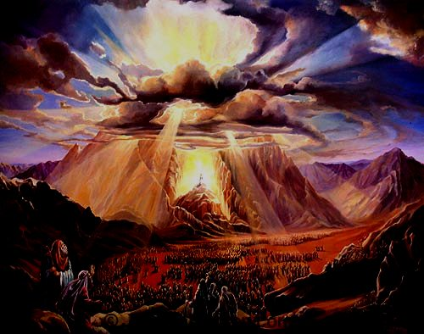
The Thirteen Attributes of ADONI
[Sh’mot (Exodus) 34: 6-7]

Slide 27
ADONI, ADONI is G-d, merciful and compassionate, slow to anger and rich in grace and truth, showing grace to the thousandth generation, forgiving offenses, crimes, and sins, yet not exonerating the guilty.

Slide 28
יְיָ יְיָ אֵל רַחוּם וְחַנּוּן
Adoni, Adoni, Ayl ra-khoom v'kha-noon
אֶֽרֶךְ אַפַּֽיִם, וְרַב חֶֽסֶד וְאֶמֶת
Eh-rekh a-pi-yeem, v'rav
khe-sed v'eh-met

Slide 29
נֹצֵר חֶֽסֶד לָאֲלָפִים נֹשֵׂא עָוֹן וָפֶֽשַׁע וְחַטָּאָה
No-tsayr khe-sed la-ah-la-feem, no-say ah-von v'feh-shah v'kha-ta-ah
וְנַקֵּה לֹא יְנַקֶּה
V'nah-kay lo y'nah-keh

Slide 30
^{Shmot/Ex 34.8} At once Moshe bowed his head to the ground, prostrated himself.
What is our response to hearing the nature of Adoni?
Notes:
Pause and meditate…Selah

Slide 31
^{2 Cor 4:6} For it is the God who once said, “Let light shine out of darkness,” who has made his light shine in our hearts, the light of the knowledge of God’s glory shining in the face of the Messiah Yeshua.

Slide 32
^{2 Cor 3:18} So all of us, with faces unveiled, see as in a mirror the glory of the Lord; and we are being changed into his very image, from one degree of glory to the next, by Adoni the Spirit.

Slide 33
Just one thing have I asked of Adoni; only this will I seek: to live in the house of Adoni all the days of my life, to see the beauty of Adoni and meditate in His temple.
Remember who G-d in Messiah is!

Slide 35
^{Vayikra / Lev 23.23-24} Adoni said to Moshe, “Tell the people of Isra’el, ‘In the seventh month, the first of the month is to be for you a day of complete rest for remembering.
Notes:
With T’ruah = loud sounds

Slide 36
Remembering what?

Slide 37
Remembering What?? Ex 23.24
Rosh Hashana miscellany
Who G-d is Messiah.
Who we are in Messiah.
The Needy

Slide 38
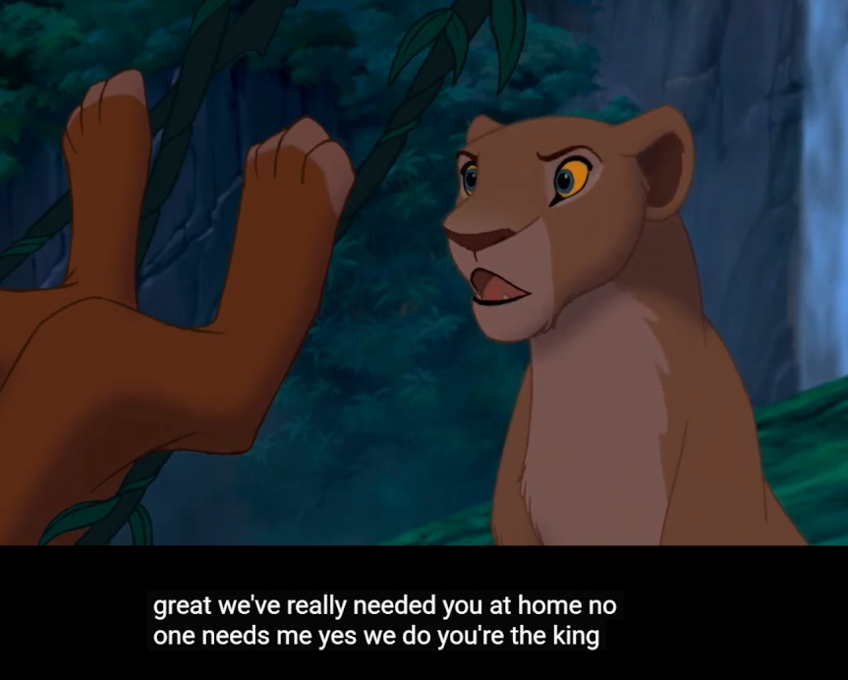
You have a calling.
You are the king!
Notes:
https://www.bing.com/videos/riverview/relatedvideo?q=nala+convinces+simba+to+return&&mid=C8914D1BA8213FA7ADF5C8914D1BA8213FA7ADF5&churl=https%3a%2f%2fwww.youtube.com%2fchannel%2fUC8IEkN72T6Xm5JAcYo-1ibA&FORM=VCGVRP
Play clip now

Slide 39
Lion King analogy
Mufasa is the father King.
Simba is the son, Prince.
Scar is the evil uncle.
Nala is the girlfriend / Queen.
Notes:
Idea of Mickey Simmons, the New Yorker.

Slide 40
Simba was deceived by Scar and ran away to a life of irresponsible pleasure, Hakuna Matata.
"Hakuna matata" is a Swahili language phrase. In English, it means "no trouble" or "no worries" and "take it easy."

Slide 41
Nala, the girlfriend, symbolizes grace, the Spirit, sent to call Simba out of despair / buried in pleasure, back to face the evil uncle, and reign as the righteous king!

Slide 42
Are we ever awash in hopeless guilt and despair, and resorting to diversion in mindless pleasure? Hakuna matata
Do our enemies seem too fierce to overcome?
The Spirit is calling you to rise up!
You ARE a King in Messiah!!
Notes:
The word Ruakh רוח is a female noun. All Hebrew nouns have gender. Like Spanish. La mesa.

Slide 43
You have a calling.
You are the king!
Notes:
https://www.bing.com/videos/riverview/relatedvideo?q=nala+convinces+simba+to+return&&mid=C8914D1BA8213FA7ADF5C8914D1BA8213FA7ADF5&churl=https%3a%2f%2fwww.youtube.com%2fchannel%2fUC8IEkN72T6Xm5JAcYo-1ibA&FORM=VCGVRP

Slide 44
^{Shmot/Ex 19.5-6} Now if you will pay careful attention to what I say and keep my covenant, then you will be my own treasure from among all the peoples, for all the earth is mine; You will be a kingdom of cohanim for me, a nation set apart.’ These are the words you are to speak to the people of Isra’el.”
Notes:
To Israel at Sinai

Slide 45
^{1 Kefa / Peter 2.9} But you are a chosen people, the King’s cohanim, a holy nation, a people for God to possess Why? In order for you to declare the praises of the One who called you out of darkness into his wonderful light.
Notes:
To all nations!!

Slide 46
Remember: YOU are royalty
in Messiah Yeshua!!
Are we living as servant leaders Kings and Queens?
Notes:
Pause…

Slide 47
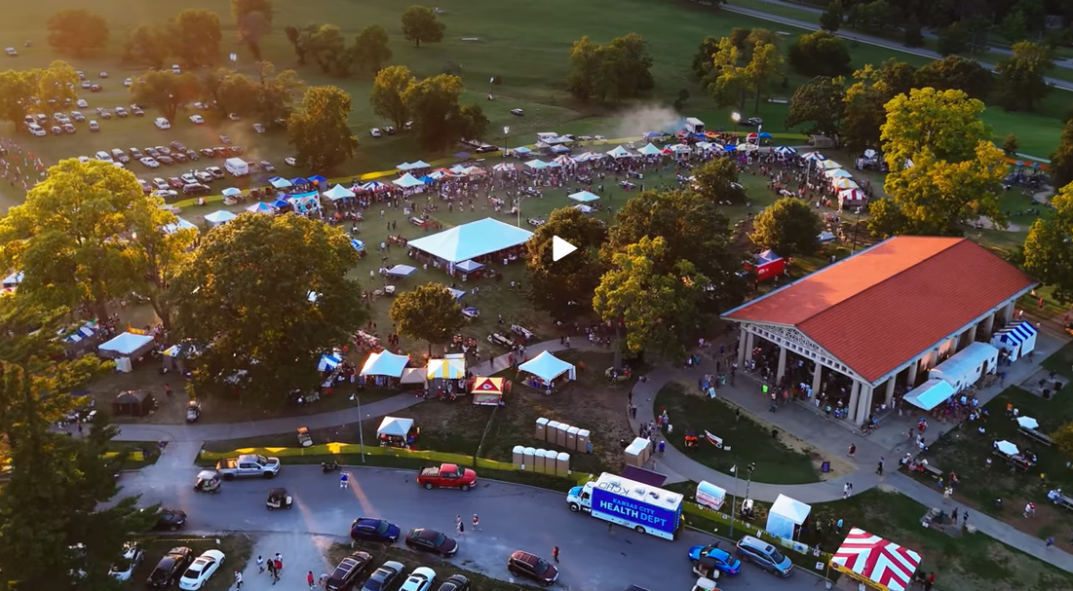
Ethnic Enrichment Festival
Notes:
In August I volunteered to help sell Israeli food: falafel, humus, olives, salads in the Israeli booth.

Slide 48

Parade of the Nations at the Kansas City Ethnic Enrichment Festival
Notes:
There was a surprising little sign by the sales window…

Slide 49
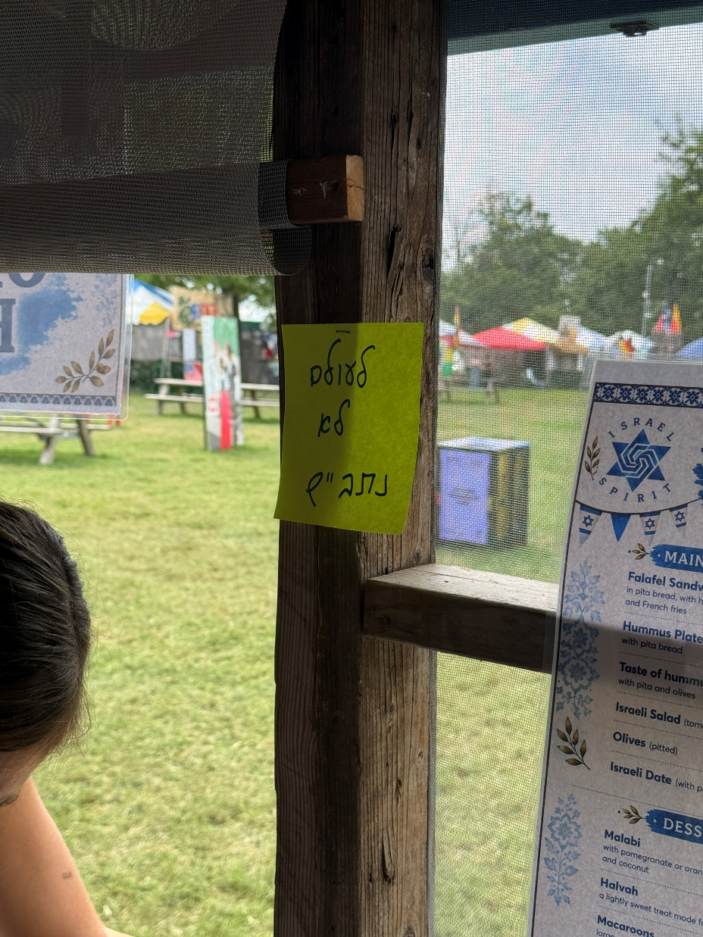
Note the yellow sign by the front of the Israel booth. In Hebrew script
לעולם לא נתבייש
L’Olam lo nitbayesh
Never be ashamed.

Slide 50

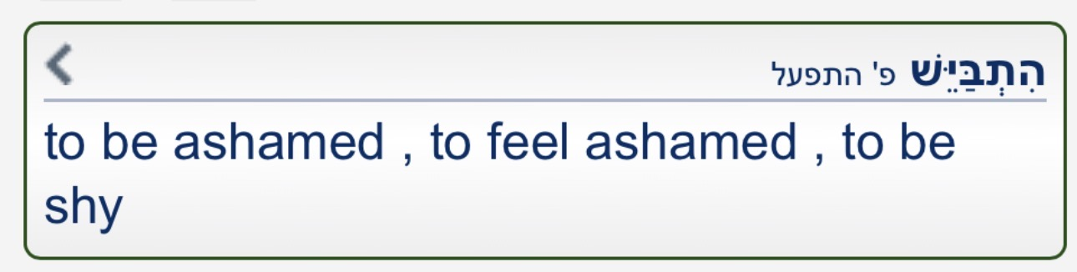
לעולם לא נתבייש
L’Olam lo nitbayesh
Never be ashamed.
Notes:
Why would the Israeli Jews be that concerned with the temptation to be ashamed??
The world, the spirit of the world, HATES Jews.
Hates ALL followers of Yeshua too, especially if you identify with the Jews and Israel. Hates you!
Part of the reason I feel impelled to almost always wear a kippah. I’m flying the flag of Israel. Supposed to be dangerous to do some places. Minnesota!!
I’m not ashamed to be Jewish, Am Yisrael. I want to remember who I am!

Slide 51
Remember your covenantal identity!

Slide 52
^{Dvarim/Dt 8.11,17-18} “Be careful not to forget Adoni your God…You will think to yourself, ‘My own power and the strength of my own hand have gotten me this wealth.’ No, you are to remember Adoni your God,

Slide 53
^{Dvarim/Dt 8.11,17-18} because it is he who is giving you the power to get wealth, in order to confirm his covenant, which he swore to your ancestors, as is happening even today.

Slide 54
We have three populations, demographics at Or HaOlam
Those brought up Jewish who came to faith in Messiah.
Those brought up Christian, then a hunger for Torah, AND found Jewish ancestry as adults
Those who want to bless Israel and be blessed. Gen. 12.1-3
Notes:
Usually not practicing. Jewish ID more important after Yeshua than before
Or brought up secular atheist with hunger. Largest group. Brought back to covenant ID
Affirm who you are, as the Ruakh leads. Some jewelry, pins, tsitist, kippah

Slide 55
Why is asserting Covenantal identity important?
^{Ro 11.15} For if their casting Yeshua aside means reconciliation for the world, what will their accepting him mean? It will be life from the dead!
That is, Jews accepting Him as Jews! Remember who you are!
Notes:
Dr. Michael Brown 50 Jews in a Messianic Cong >> 500 Jews in the churches.

Slide 56
Remember our heroes, prototypes:
That is why we say Kaddish. To remember those we love.
Today,
Sept. 11, 2001
Charlie Kirk

Slide 58
^{Vayikra / Lev 23.23-24} Adoni said to Moshe, “Tell the people of Isra’el, ‘In the seventh month, the first of the month is to be for you a day of complete rest for remembering.
Notes:
With T’ruah = loud sounds

Slide 59
Remembering what?
Notes:
Scripture doesn’t say, but over 3000 years Jewish people have come up with a LOT of answers. I’d like to give those, plus some more.

Slide 60
Remembering What?? Ex 23.24
Rosh Hashana miscellany
Who G-d is Messiah.
Who we are in Messiah.
The Needy

Slide 61
^{Mes Jews Heb 13:3} Remember those in prison and being mistreated, as if you were in prison with them and undergoing their torture yourselves.
Nigeria, Iran, Afghanistan, China
Those ill among us!

Slide 62
Remember that YOU
are a light to the world!
To Communicate Yeshua’s salvation to the World!

Slide 63
^{Eph 4.29-30} Let no harmful language come from your mouth, only good words that are helpful in meeting the need, words that will benefit those who hear them. Don’t cause grief to God’s Ruach HaKodesh, for he has stamped you as his property until the day of final redemption.
Notes:
Harmful language…Speaking in unknown tongues in the public gathering, without and interpretation.

Slide 64
^{2 Tim 2.24-26} The Lord’s slave must not be quarrelsome, but be kind to all, able to teach, tolerant. Let him give guidance with humility to those who are in opposition—perhaps God may grant them a change of mind,

Slide 65
^{2 Tim 2.24-26} leading to the knowledge of truth. Then they may regain their senses and escape the devil’s snare, in which they had been held captive by him to do his will.

Slide 66
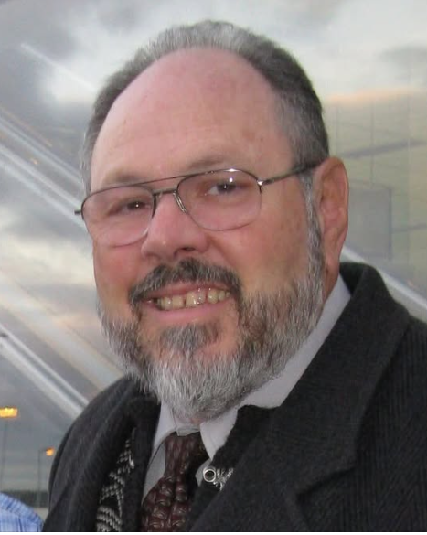
Dr. Dan Juster
Notes:
https://www.facebook.com/search/top?q=daniel%20juster

Slide 67
From Dan Juster’s Facebook account
SURPRISING ISRAELI RESPONSES. Some of you know about the radical racist Ben G'vir who, I believe, wants to see all Arabs leave. He is a disciple of Kahane who said, "They must go." He may even want only Halakhic Jews born of Jewish mother to stay. I am not sure.
Notes:
https://www.facebook.com/search/top?q=daniel%20juster

Slide 68
He was the defense lawyer who defended the man who bombed the Ortiz family (Messianic Jews in Samaria) and left their son, Ami Ortiz, debilitated, though he has mostly recovered.
Notes:
https://www.facebook.com/search/top?q=daniel%20juster

Slide 69
Yesterday I visited my barber. He has been doing my hair for over 20 years. He and his wife had a salon together. They divorced, and she moved to Chicago. His two sons have become religious and were in Uman at the grave observance of Rabbi Nachman. Wow! Then I asked his advice as to who to vote for. He said, Ben G'vair. He was not kidding.
Notes:
https://www.facebook.com/search/top?q=daniel%20juster

Slide 70
Today near the gym, I stopped by a table in the coffee house with some gym friends. I asked one woman who she thought I should vote for. She said she did not yet know. Her father said, "Ben G'vir." These are secular Jews, and Ben G'vir is a radical nationalist Orthodox Jew.
Notes:
https://www.facebook.com/search/top?q=daniel%20juster

Slide 71
Why is this happening? Because some Israelis are full of anger. The Palestinians were offered a state three times. They refused. Then there was the withdrawal from Gaza. Then came Oct. 7. They have had enough and want to get rid of them.
Notes:
https://www.facebook.com/search/top?q=daniel%20juster

Slide 72
But it is not a rational direction. Getting rid of them would bring the anger of the world at such a level that it would be very bad for Israel. I don't think it can be done.
Israeli Jews NOT remembering the founders vision of a righteous, albeit secular, nation. Ben Gurion
Notes:
https://www.facebook.com/search/top?q=daniel%20juster

Slide 74
^{Vayikra / Lev 23.23-24} Adoni said to Moshe, “Tell the people of Isra’el, ‘In the seventh month, the first of the month is to be for you a day of complete rest for remembering.
Notes:
With T’ruah = loud sounds

Slide 75
Remembering what?

Slide 76
Remembering What?? Ex 23.24
Rosh Hashana miscellany
Who G-d is Messiah.
Who we are in Messiah.
The Needy

Slide 77
Remember as we hear the sound of the Shofar.

