Slide 1
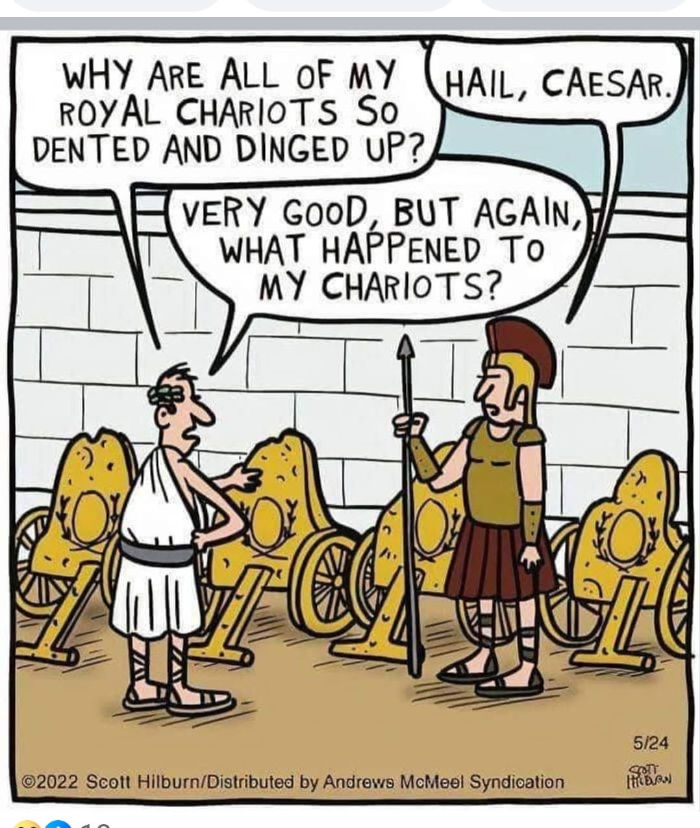
Notes:
We are finishing up a hail damage claim.

Slide 2

Aug 27,
2026
Partial lunar eclipse
Notes:
Thanks to Victoria Egeland for informing us.

Slide 3
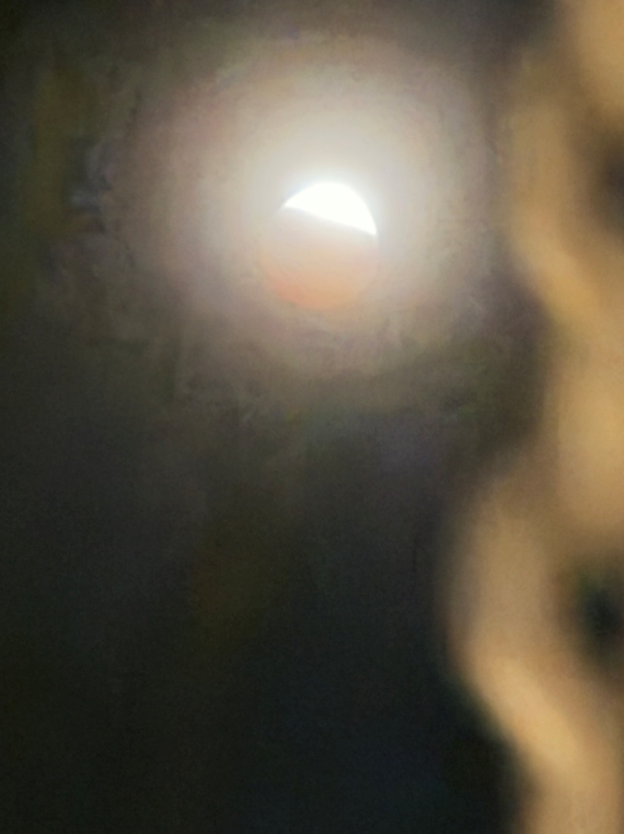
Taken with my iPhone 15.

Slide 4
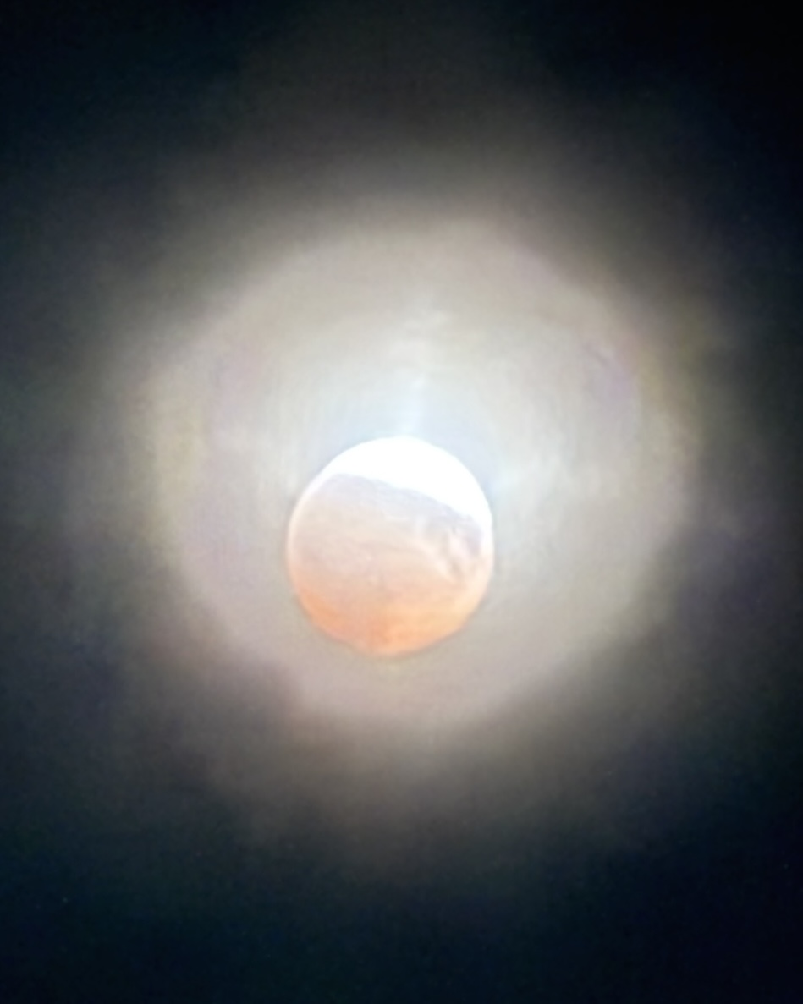

Slide 5
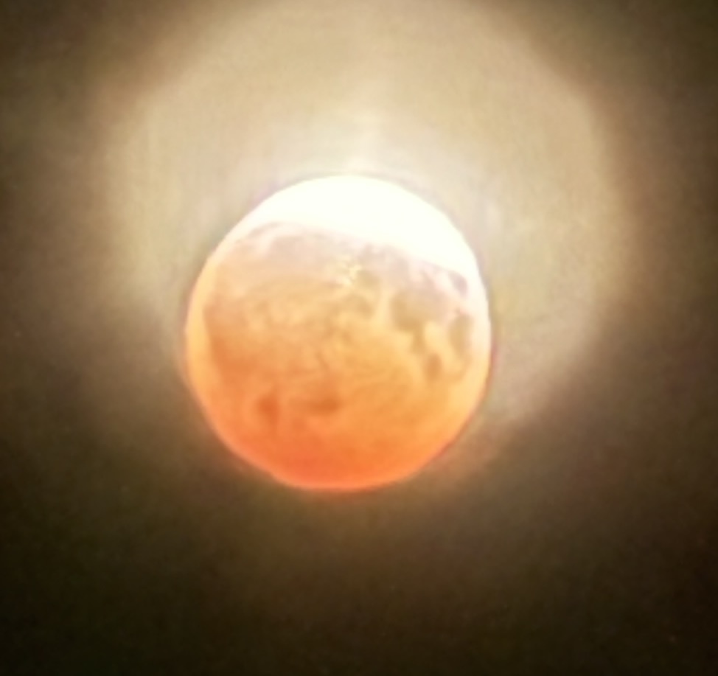

Slide 6
^{T’hillim/Ps 19.1} The heavens declare the glory of God, the dome of the sky speaks the work of his hands.

Slide 7

Notes:
Matt and Karen were married on Rosh Hashanna 26 years ago.

Slide 8


Slide 9

May Your Kingdom Come #2 Mt 6.10
תָּבוֹא מַלְכוּתְךָTavo malkutkah
Illustration of the Kingdom
What IS the Kingdom
Kingdom internal dangers
Kingdom external dangers
Notes:
Say with me…

Slide 10
May Your Kingdom Come #2 Mt 6.10
תָּבוֹא מַלְכוּתְךָTavo malkutkah
Illustration of the Kingdom
What IS the Kingdom
Kingdom internal dangers
Kingdom external dangers

Slide 11
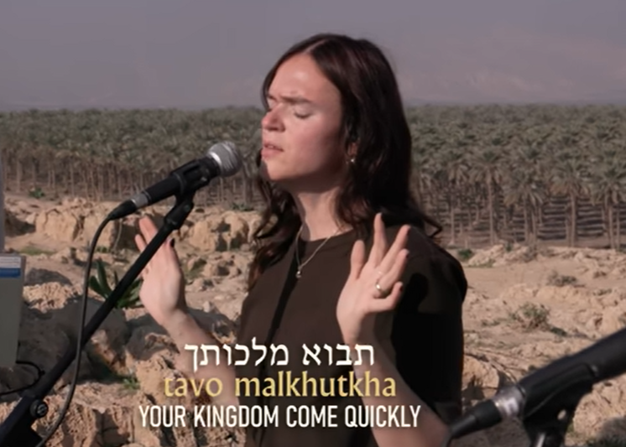
Notes:
https://youtu.be/Diq1e4Flp0Y

Slide 12
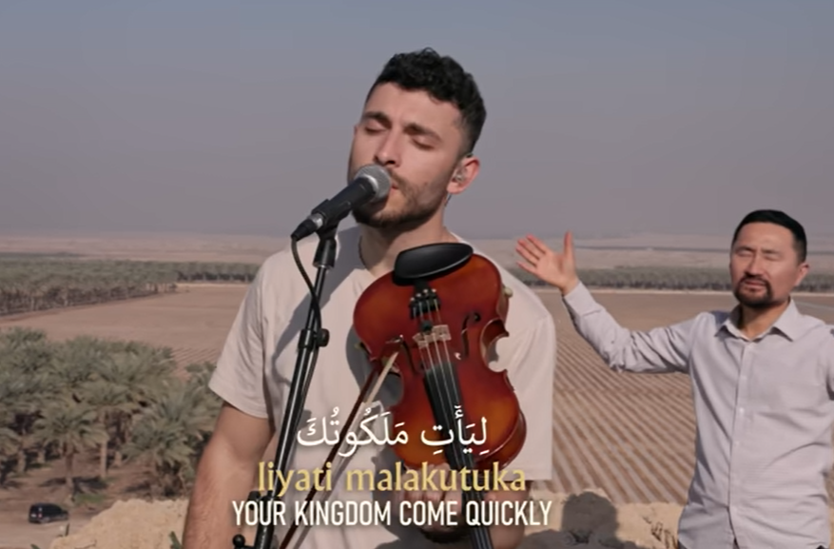
Notes:
https://youtu.be/Diq1e4Flp0Y
We don’t have an Arabic vocalist, so I had to play the recording. If Josie were here, she could’ve done it!

Slide 13
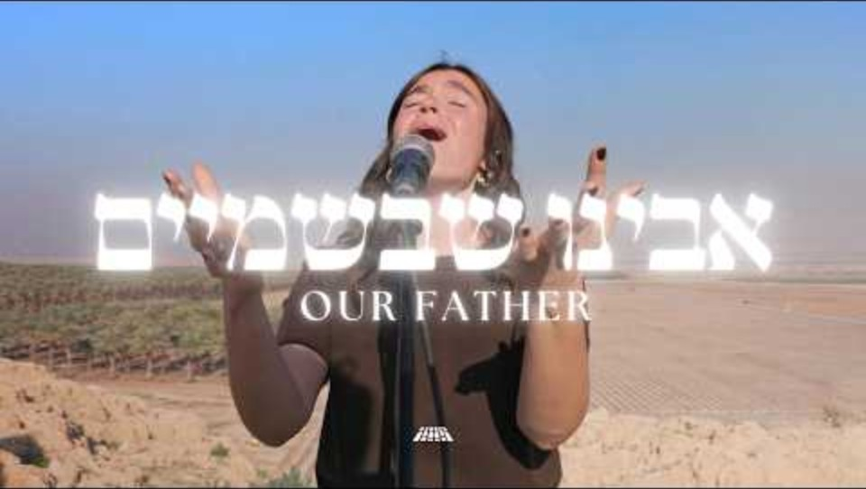
Notes:
Let that sink in. Hebrew speaking Israelis, IDF members, and an Arabic speaking man. Arab man is Temothaous Sakhnini. A Nazareth Christian Arab family. https://www.sakhninibrothers.com/
Arab Christians, Eastern Orthodox, can be some of the worst in replacement theology.
Sakhnini brothers are real evangelicals. Play again

Slide 15
May Your Kingdom Come #2 Mt 6.10
תָּבוֹא מַלְכוּתְךָTavo malkutkah
Illustration of the Kingdom
What IS the Kingdom?
Kingdom internal dangers
Kingdom external dangers

Slide 16
^{Ro 14.17-18} For the Kingdom of God is not eating and drinking, but righteousness, shalom and joy in the Ruakh HaKodesh. Anyone who serves the Messiah in this fashion both pleases God and wins the approval of other people.
Notes:
Subjective, but we experience Yeshua. ^{Yn 3.3} Yeshua answered him, “I tell you that unless a person is born again from above, he cannot see the Kingdom of God.”
The Joy of Adoni is our strength.

Slide 17
^{Ro 8.15-17} For you did not receive the spirit of slavery to fall again into fear; rather, you received the Spirit of adoption, by whom we cry, “Abba! Father!” The Ruach Himself bears witness with our spirit that we are children of God.

Slide 18
^{Ro 8.15-17} And if children, also heirs—heirs of God and joint-heirs with Messiah—if indeed we suffer with Him so that we may also be glorified with Him.
Notes:
This is a supernaturally endued faith.
And we suffer, with joy!

Slide 19
^{Ro 14.17-18} For the Kingdom of God is not eating and drinking, but righteousness, shalom and joy in the Ruakh HaKodesh. Anyone who serves the Messiah in this fashion both pleases God and wins the approval of other people.
Notes:
Subjective. Many Gen Z turning to Latin rite RC, E Ortho more structure and liturgy. BC touchy feely → sin.
Repeating for context to next verse

Slide 20
^{Ro 14.19-20} So then, let us pursue the things that make for shalom and mutual upbuilding. Don’t tear down God’s work for the sake of food. True enough, all things are clean; but it is wrong for anybody by his eating to cause someone to fall away.
Notes:
I have an email from Blaine Robison from about 2010, when we were in the old shul on 74th St., concerned that our attendance was pushing 200, and concerns about handling the crowd of 200+. Then we grew down, then up, then COVID, then up, then…

Slide 21
^{1 Cor 4.19-20} But I am coming to you soon, if the Lord wills; and I will take cognizance not of the talk of these arrogant people but of their power. For the Kingdom of God is not a matter of words but of power.
Notes:
We are describing things unseen, but experienced!!

Slide 22
^{Yn 18.36-37} Yeshua answered, “My kingdom is not of this world. If My kingdom were of this world, then My servants would be fighting so that I wouldn’t be handed over to the Judean leaders. But as it is, My kingdom is not from here.” So Pilate said to Him,

Slide 23
^{Yn 18.36-37} “Are you a king, then?” Yeshua answered, “You say [כן ken, as you have said.] that I am a king. For this reason I was born, and for this reason I came into the world, so that I might testify to the truth. Everyone who is of the truth hears My voice.”

Slide 24
^{Yn 12.3-8} Then Miriam took a pound of very expensive oil of pure nard and anointed Yeshua’s feet, and she wiped His feet dry with her hair. Now the house was filled with the fragrance of the oil. But Judah from Kriot, one of His disciples, the one who was about to betray Him, said,

Slide 25
^{Yn 12.3-8} “Why wasn’t this oil sold for three hundred denarii and the money given to the poor?” Now he said this not because he cared about the poor, but because he was a thief. Since he had the moneybox, he used to steal from what was put in it.

Slide 26
^{Yn 12.3-8} Therefore Yeshua said, “Leave her alone! She set it aside for the day of My burial. You will always have the poor among you, but you will not always have Me.”
Notes:
We are in a Kingdom of love. We LOVE Him, because He first loved us.

Slide 27
The Kingdom Wedding

Slide 28
^{T’hillim/Ps 45.7-8} Your throne, God, will last forever and ever; you rule your kingdom with a scepter of equity. You have loved righteousness and hated wickedness. Therefore God, your God, has anointed you with the oil of joy in preference to your companions.
Notes:
Note the G-d of G-d. Two of the three in the Trinity.

Slide 29
^{T’hillim/Ps 45.14-16} Inside [the palace], the king’s daughter looks splendid, attired in checker-work embroidered with gold. In brocade, she will be led to the king, to you, with the virgins in her retinue. They will be led in with gladness and joy, they will enter the king’s palace.

Slide 30
The Kingdom Future

Slide 31
^{Dan 2.44} “In the days of those kings the God of heaven will establish a kingdom that will never be destroyed, and that kingdom will not pass into the hands of another people. It will break to pieces and consume all those kingdoms; but it, itself, will stand forever

Slide 32
^{Rev 11:15} The seventh angel sounded his shofar; and there were loud voices in heaven, saying, “The kingdom of the world has become the Kingdom of our Lord and his Messiah, and he will rule forever and ever!”

Slide 34
May Your Kingdom Come #2 Mt 6.10
תָּבוֹא מַלְכוּתְךָTavo malkutkah
Illustration of the Kingdom
What IS the Kingdom
Kingdom internal dangers
Kingdom external dangers

Slide 35
^{1 Cor 6.9-11} Don’t you know that unrighteous people will have no share in the Kingdom of God? Don’t delude yourselves — people who engage in sex before marriage, who worship idols, who engage in sex after marriage with someone other than their spouse,

Slide 36
^{1 Cor 6.9-11} who engage in active or passive homosexuality, who steal, who are greedy, who get drunk, who assail people with contemptuous language, who rob — none of them will share in the Kingdom of God. Some of you used to do these things.
Notes:
Also, anyone in the Kingdom can fall into this. Ruakh joy → sexual joy.
I’m understanding “passive homosexuality” as porn and mental fixation. Anyone can have a weird thought, to be battled and rejected. If it’s dwelled on, contemplated, it becomes sin, passive homosexuality.

Slide 37
Great and powerful Kingdom ministries can be wrecked by a lapse into sin.
NEVER be alone in a car or building with non-family of the opposite gender.
Only touch the opposite gender WITH PERMISSION, on the shoulder. Side, neck hugs.
Notes:
#1 Oh, it doesn’t matter. We’ll of course behave. Famous Billy Graham practice.
One person’s email says, “Finish well.”

Slide 38
Be gentle and truthful with your speech. Kingdom words are “truth in love.”
Be scrupulous with your money. Accountable. Or HaOlam procedures.
Be humble.

Slide 39
^{1 Cor 6.9-11} But you have cleansed yourselves, you have been set apart for God, you have come to be counted righteous through the power of the Lord Yeshua the Messiah and the Spirit of our God.
Notes:
Relative to ALL the sins mentioned, repentance is possible.
But, complete repentance. I sent a letter to Mike Bickle to confess ALL. 51 Shades of Grey Confession. He might implicate others, might go to jail, but he would restore the honor of the Kingdom!

Slide 40
^{Mt 18.1-5} At that moment the talmidim came to Yeshua and asked, “Who is the greatest in the Kingdom of Heaven?” He called a child to him, stood him among them, and said, “Yes! I tell you that unless you change and become like little children,

Slide 41
^{Mt 18.1-5} you won’t even enter the Kingdom of Heaven! So, the greatest in the Kingdom is whoever makes himself as humble as this child. Whoever welcomes one such child in my name welcomes me.
Notes:
When we had Solu here for the concert in June, I was visiting with Sarah, Shiloh ben Hod’s wife. I asked how many people did they have travelling. Thirteen in a fifteen-passenger van. “An you get along?”
She didn’t even look stressed by the question. She said something like, “It’s part of the calling.” “You areחיילים Khiyilim [warriors].” That is why they have the anointing and joy!
I love taking out the garbage. Doing so establishes my authority as rabbi and leader.

Slide 43
May Your Kingdom Come #2 Mt 6.10
תָּבוֹא מַלְכוּתְךָTavo malkutkah
Illustration of the Kingdom
What IS the Kingdom
Kingdom internal dangers
Kingdom external dangers

Slide 44
September 4–7, 2026, at Huntington Place Convention Center in Detroit, Michigan, thousands are expected to gather in Detroit at the Islamic Society of North America (ISNA) annual convention.
Notes:
Liberty Counsel Action is a 501(c)(4) tax-exempt non-profit organization. Donations are not tax-deductible.

Slide 45
The chilling voices of violent radicals are among the featured speakers, and some have been very frank about their dangerous goals for America.
Notes:
Liberty Counsel Action is a 501(c)(4) tax-exempt non-profit organization. Donations are not tax-deductible.

Slide 46
Imam Zaid Shakir, a frequent ISNA speaker, previously spoke of building a nationwide Muslim “infrastructure,” saying that with enough organization and resources, “we’d take over this country in a very short time.”
Notes:
Liberty Counsel Action is a 501(c)(4) tax-exempt non-profit organization. Donations are not tax-deductible.

Slide 47
Imam Siraj Wahhaj, former ISNA vice president, told Muslims that political involvement should be “a weapon to use in the cause of Islam.” He also spoke openly about Muslims gaining enough political power to take control of America, saying: “Take my word, if eight million Muslims unite in America, the country will come to us.”
Notes:
Liberty Counsel Action is a 501(c)(4) tax-exempt non-profit organization. Donations are not tax-deductible.

Slide 48
Kingdom at war!

Slide 49
Communist China, a revanchist Russia, revolutionary Iran, and other totalitarian and authoritarian regimes are not simply geopolitical rivals, but civilizational. Each represents, in different ways, an alternative understanding of political legitimacy,
Notes:
https://www.theepochtimes.com/opinion/the-revolutions-enduring-mission-6061613?utm_source=opinionnoe&src_src=opinionnoe&utm_campaign=opinion-2026-08-03&src_cmp=opinion-2026-08-03&utm_medium=email&est=F6FpkSCLuPecSn2GF5ItQ0yVNW4hmMyQvxNfUOaSXgWqlqVhglv%2BBMfs3wPVR7PP4Q%3D%3D

Slide 50
where the state precedes the individual and rights originate with political authority rather than existing independently of it. Power is what defines justice rather than serving it.
Notes:
https://www.theepochtimes.com/opinion/the-revolutions-enduring-mission-6061613?utm_source=opinionnoe&src_src=opinionnoe&utm_campaign=opinion-2026-08-03&src_cmp=opinion-2026-08-03&utm_medium=email&est=F6FpkSCLuPecSn2GF5ItQ0yVNW4hmMyQvxNfUOaSXgWqlqVhglv%2BBMfs3wPVR7PP4Q%3D%3D

Slide 51
This is more than a contest over territory or military capability. It is ultimately a contest between competing conceptions of the human person and the political order; it is a true clash of civilizations.
Notes:
https://www.theepochtimes.com/opinion/the-revolutions-enduring-mission-6061613?utm_source=opinionnoe&src_src=opinionnoe&utm_campaign=opinion-2026-08-03&src_cmp=opinion-2026-08-03&utm_medium=email&est=F6FpkSCLuPecSn2GF5ItQ0yVNW4hmMyQvxNfUOaSXgWqlqVhglv%2BBMfs3wPVR7PP4Q%3D%3D

Slide 52
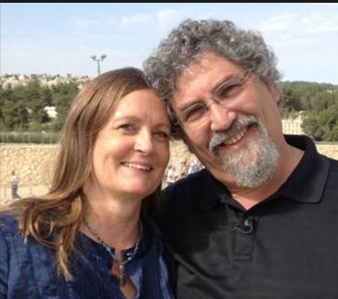
From Avner Boskey
Notes:
https://davidstent.org/making-the-crooked-plain-in-the-middle-east/

Slide 53
The 48th sura (chapter) of the Quran (Al-Fatḥ), describes in detail something called ‘the Treaty of Hudaybiyyah,’ a ten-year pact established in March 628 AD between Mohammad and the Arabian tribe of Quraysh.
Notes:
https://davidstent.org/making-the-crooked-plain-in-the-middle-east/

Slide 54
Mohammad broke that treaty two years later, in January 630 AD, when his jihadi forces – having re-armed and grown strong during the interim – subjugated the Quraysh tribe, and then moved on to conquer Mecca.
Notes:
https://davidstent.org/making-the-crooked-plain-in-the-middle-east/

Slide 55
PLO leader Yasir Arafat cited this Islamic precedent a number of times when signing the Oslo Accords with the Jewish state. It was his justification for ‘supposedly recognizing’ Israel and ‘supposedly renouncing’ terrorist activities.
Notes:
https://davidstent.org/making-the-crooked-plain-in-the-middle-east/

Slide 56
The following quote from the Arabic-language newspaper al-Quds, published in Jerusalem on May 10, 1998, illustrates Arafat’s strategy:
Notes:
https://davidstent.org/making-the-crooked-plain-in-the-middle-east/

Slide 57
Question: “Do you feel sometimes that you made a mistake in agreeing to Oslo?” Arafat: “No – no! Allah's messenger Mohammad accepted the al-Hudaybiyyah peace treaty
Notes:
https://davidstent.org/making-the-crooked-plain-in-the-middle-east/

Slide 58
and Salah a-Din accepted the peace agreement with Richard the Lion-Hearted” (n.b.: Salah a-Din was the Muslim leader who, after a cease-fire, declared a jihad against the Crusaders and captured Jerusalem).
Notes:
https://davidstent.org/making-the-crooked-plain-in-the-middle-east/

Slide 59
Western leaders who attempt to manipulate jihadi governments into signing and certifying ‘peace agreements’ are ignoring 1400 years of Islamist realpolitik. They are getting dragged into an Islamist desert illusion, a mirage, whose ultimate goal is to destroy the Christian West and Israel.
Notes:
https://davidstent.org/making-the-crooked-plain-in-the-middle-east/

Slide 60
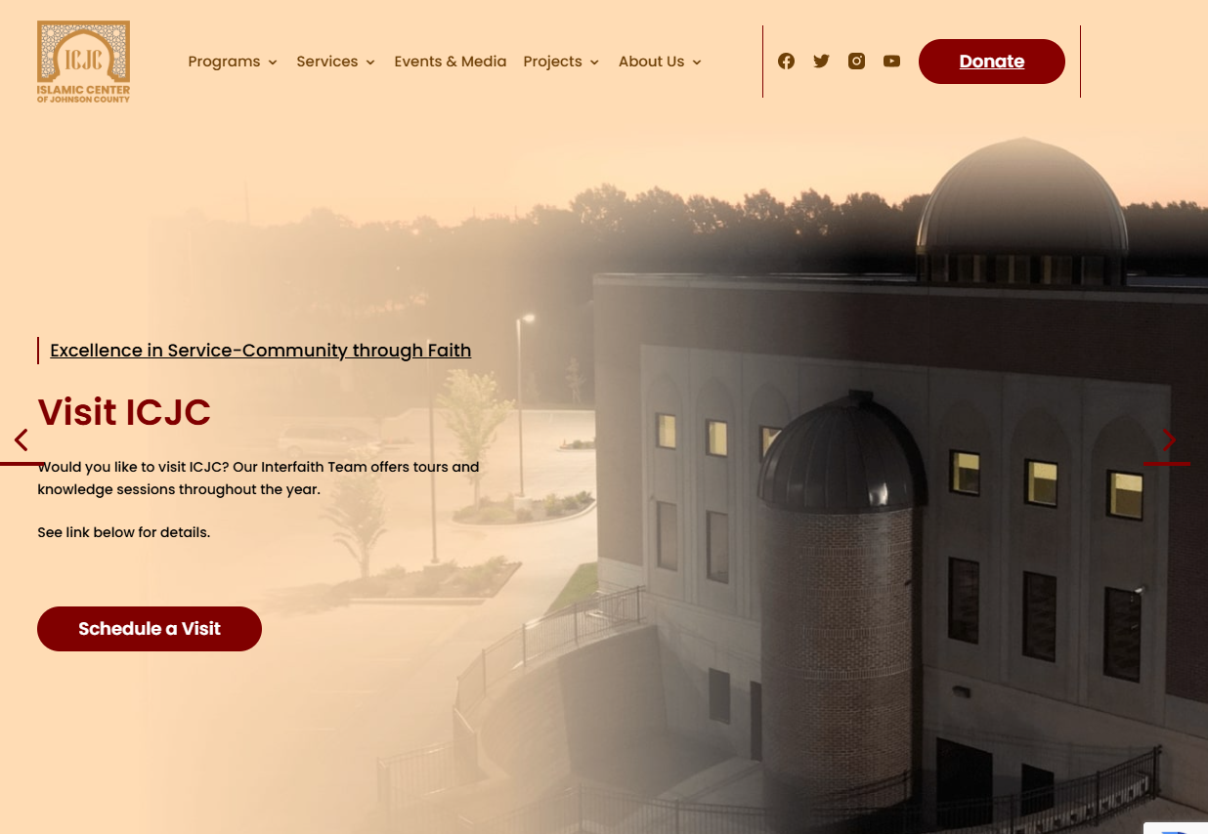
2nd largest mosque in the US
Roe. Ave.
Notes:
https://www.icjc.org/

Slide 61
To be a training center for Islamic outreach.
Some reports that there is a Hamas and Hezbullah training in the area.
According to Wycliffe translators, KC is the most linguistically diverse city in the US!
Notes:
Closer to home…

Slide 62
The U.S. Department of Justice (DOJ) is suing the public school district of Kansas City, Kans. (KCKPS) for guidelines that would facilitate student gender transitions without notifying parents, the DOJ announced Tuesday.
Notes:
https://washingtonstand.com/article/doj-sues-kansas-city-school-district-for-policy-to-hide-student-gender-transitions-from-parents

Slide 63
This is the first instance of the U.S. government suing a local school district for violating the Family Educational Rights and Privacy Act (FERPA) and the Protection of Pupil Rights Amendment (PPRA) for such a policy.
Notes:
https://washingtonstand.com/article/doj-sues-kansas-city-school-district-for-policy-to-hide-student-gender-transitions-from-parents

Slide 64
Daniel Grand is an Orthodox Jewish man. As a devout practitioner of his faith, he simply wanted to host a prayer gathering in his home with a small group of friends. But a neighbor learned about Daniel’s plans and reported him to the mayor, demanding that the city “put a stop to this.”
Shockingly, University Heights, Ohio did exactly that.

Slide 65
City officials ordered Daniel to obtain a permit to hold the prayer gathering with friends in his home and falsely accused him of starting an illegal synagogue.
Then things got worse.
The city began surveilling his house and even encouraged neighbors to spy on him and report any suspected violations.

Slide 66
Daniel attempted to comply with the town’s outrageous demand. But there was a catch. The permit process wasn’t designed for a family home—it was designed for churches, synagogues, and other dedicated houses of worship. If the city issued a permit, Daniel would have to stop using his house as a residence altogether.

Slide 68
May Your Kingdom Come #2 Mt 6.10
תָּבוֹא מַלְכוּתְךָTavo malkutkah
Illustration of the Kingdom
What IS the Kingdom
Kingdom internal dangers
Kingdom external dangers
What can we do?

Slide 69
Live in His joy! Sing, read, pray, love people!!
Walk in obvious integrity: sexual, financial, relational.
Work on the outsiders: pray, share Yeshua, VOTE!

Slide 70
^{Ro 14.17-18} For the Kingdom of God is not eating and drinking, but righteousness, shalom and joy in the Ruakh HaKodesh. Anyone who serves the Messiah in this fashion both pleases God and wins the approval of other people.

